Slide 1
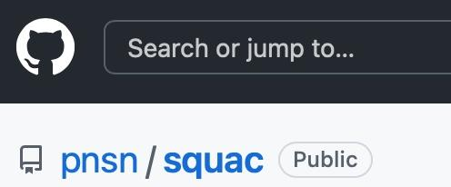
Seismic Quality Assurance Console
GUI
django backend API
simple python read/write scripts
PNSN All hands meeting Sep 2022
Notes:
SQUAC is our Metrics database effort.
We’ve been working on it for over 3 years with lots of lessons learned.
Well documented wiki pages with examples

Slide 2
What is SQUAC?
It’s a fancy metrics database & interface tuned for PNSN
Metrics: waveform- N big/small bumps, power, noise floor, peak Acc...
SOH- latency, gaps, completeness at datacenter
Variable granularity: 10 min/hourly/daily/monthly
Contributor source agnostic; currently 8 sources
Notes:
WavNot too dissimilar from MUSTANG but tuned for PNSN as an ANSS RSN (often SMAs) and ShakeAlert partner.
There are many overlapping needs, but still some differences.
Now that we’ve done it, appreciate how much effort goes behind MUSTANG/DQA.
eform based thing many are familiar with like power, but those don’t capture “bumps” well.
-16 full time CPUs @PNSN
-power from IRIS MUSTANG
-latency/gaps sniffed at 4 ShakeAlert centers on dev machines
-Caltech and Berkeley are contributing trigger counts for different algorithms

Slide 3
What is SQUAC?
It’s a fancy metrics database & interface tuned for PNSN
Metrics: waveform- N big/small bumps, power, noise floor, peak Acc...
SOH- latency, gaps, completeness at datacenter
Variable granularity: 10 min/hourly/daily/monthly
Contributor source agnostic; currently 8 sources
AWS EC2 w RDS db, 2-10 servers (autoscaled), S3 archive ~$500/mo
~2 Billion measurements (400 GB)
9 Million measurements/day (>100/sec)
Performance: Create_or_overwrite ~80 measurements/sec
Read ~500 measurements/sec

Slide 4
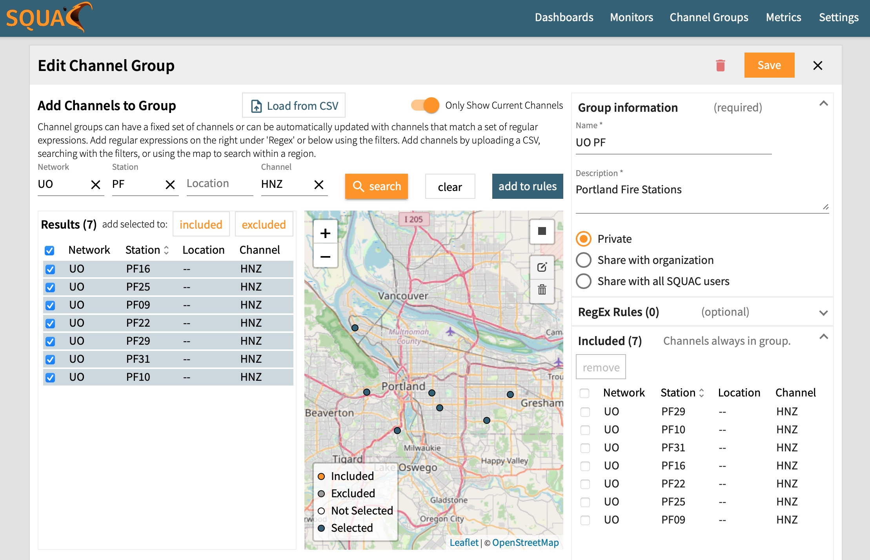
Automagical updating
Creating your channel group

Slide 5
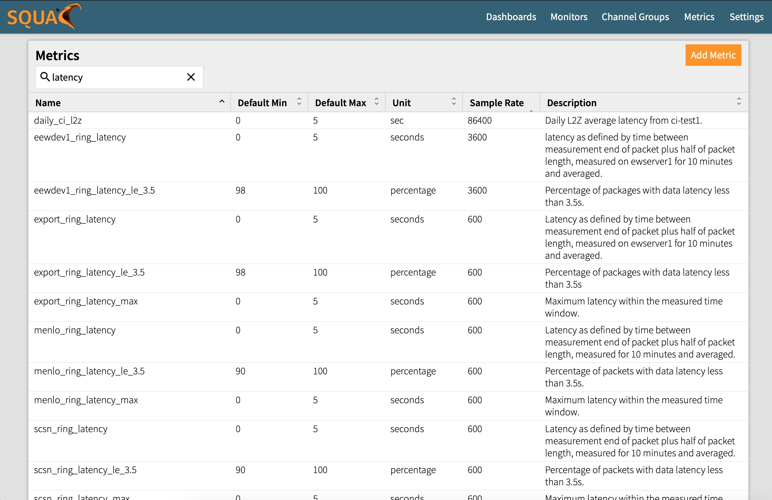
Dozens of metrics: latency, gaps, waveform quality, noise levels, N bumps, N triggers

Slide 6
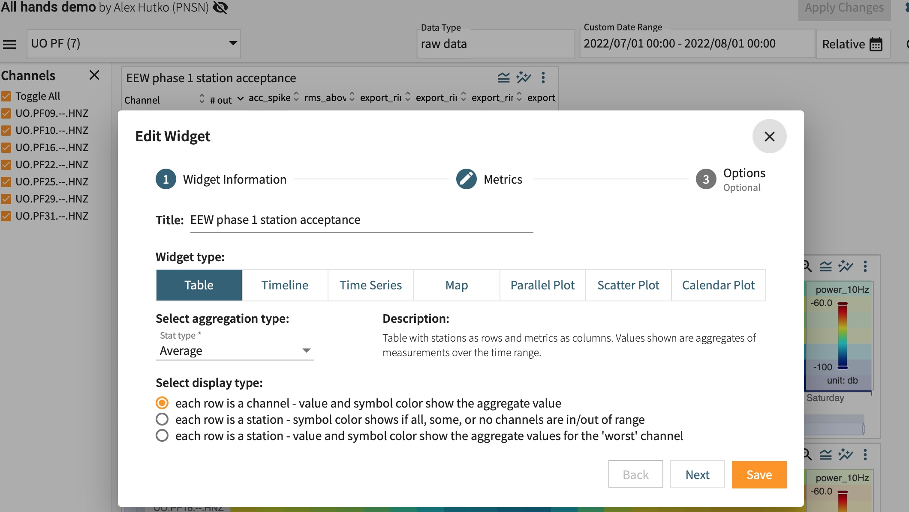
Creating widgets in your dashboard

Slide 7
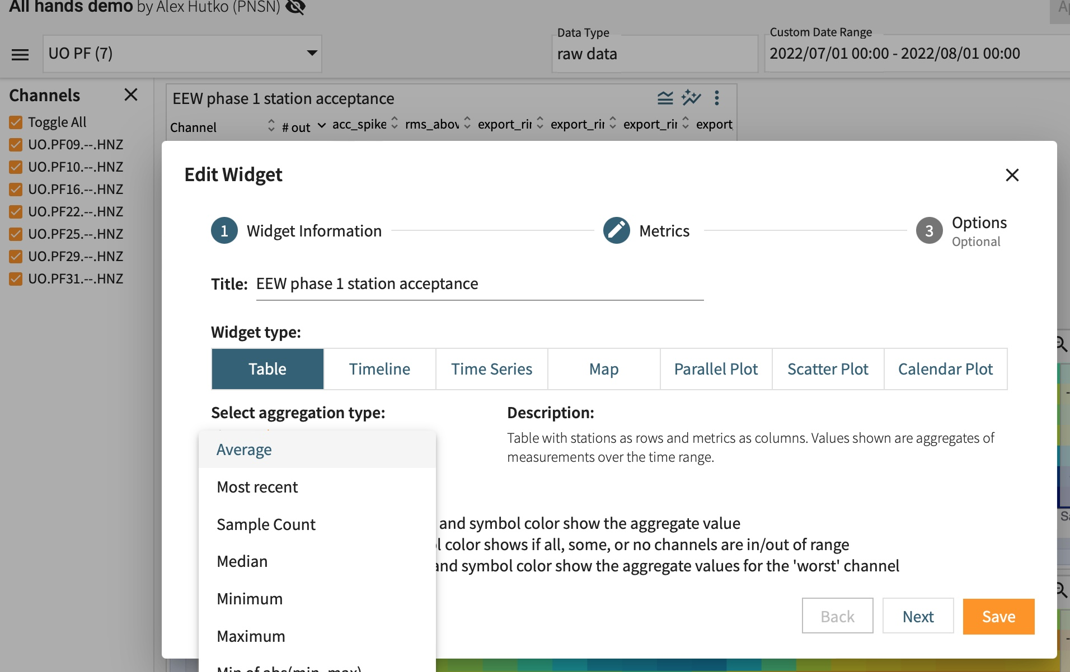
Creating widgets in your dashboard

Slide 8
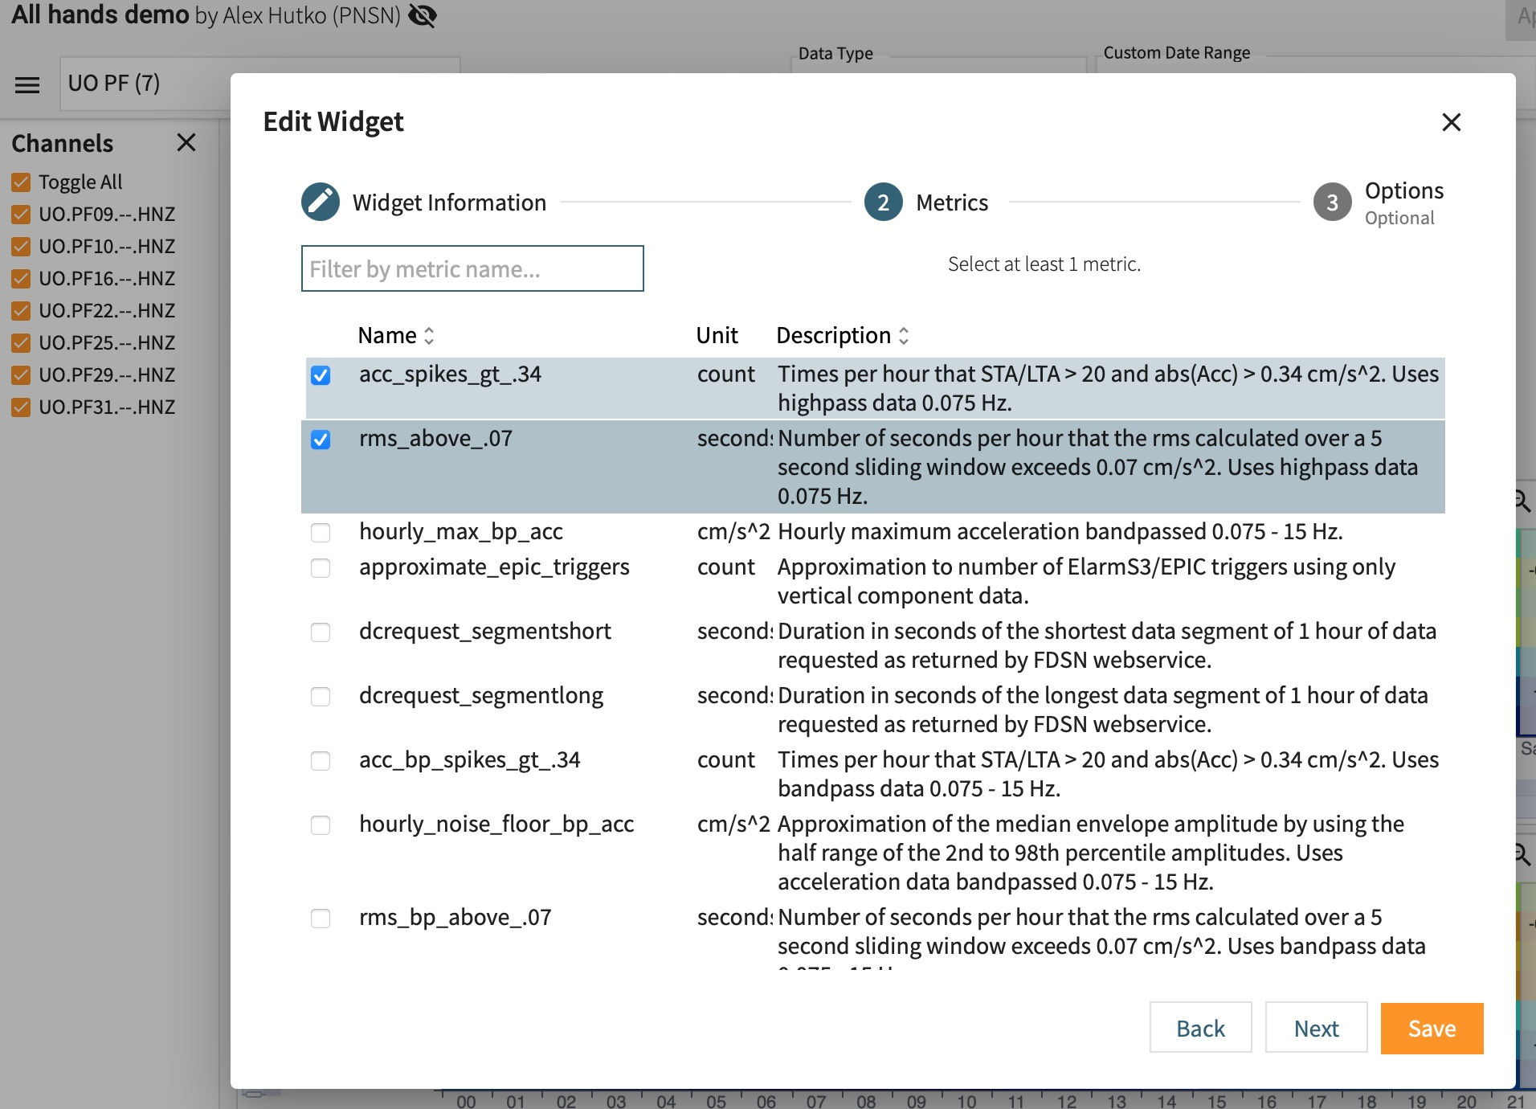
Creating widgets in your dashboard

Slide 9
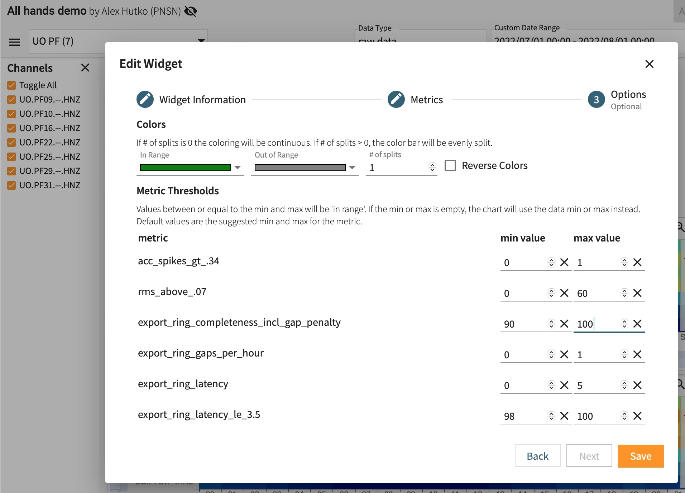
Creating widgets in your dashboard

Slide 10
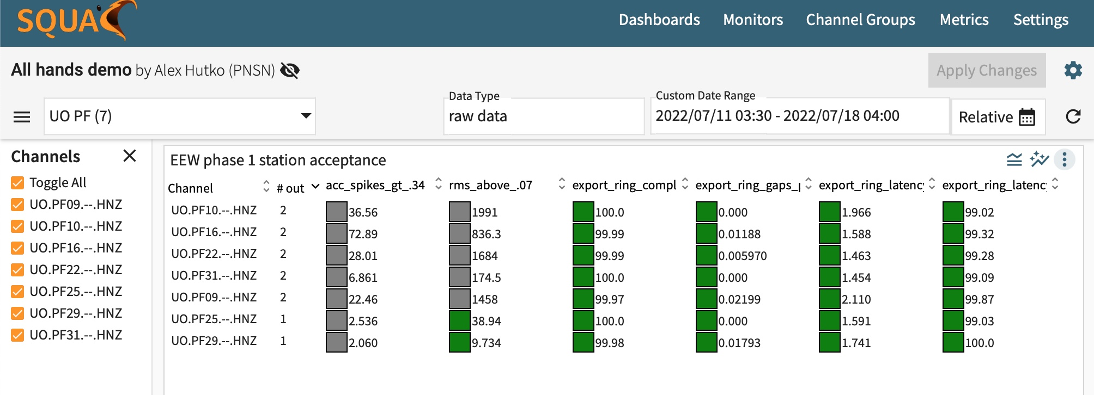
Table widget:
Single view of multiple metrics over a time window
Notes:
“agg” is the count of metrics that are failing the user-defined thresholds.

Slide 11
Timeline- think: SeisNetWatch with thresholds/color gradients
Notes:
We’ll color gradients

Slide 12
Timeline- think: SeisNetWatch with thresholds/color gradients
Notes:
We’ll color gradients

Slide 13
Timeline- think: SeisNetWatch with thresholds/color gradients
Notes:
We’ll color gradients

Slide 14
Timeline- think: SeisNetWatch with thresholds/color gradients
Notes:
We’ll color gradients

Slide 15
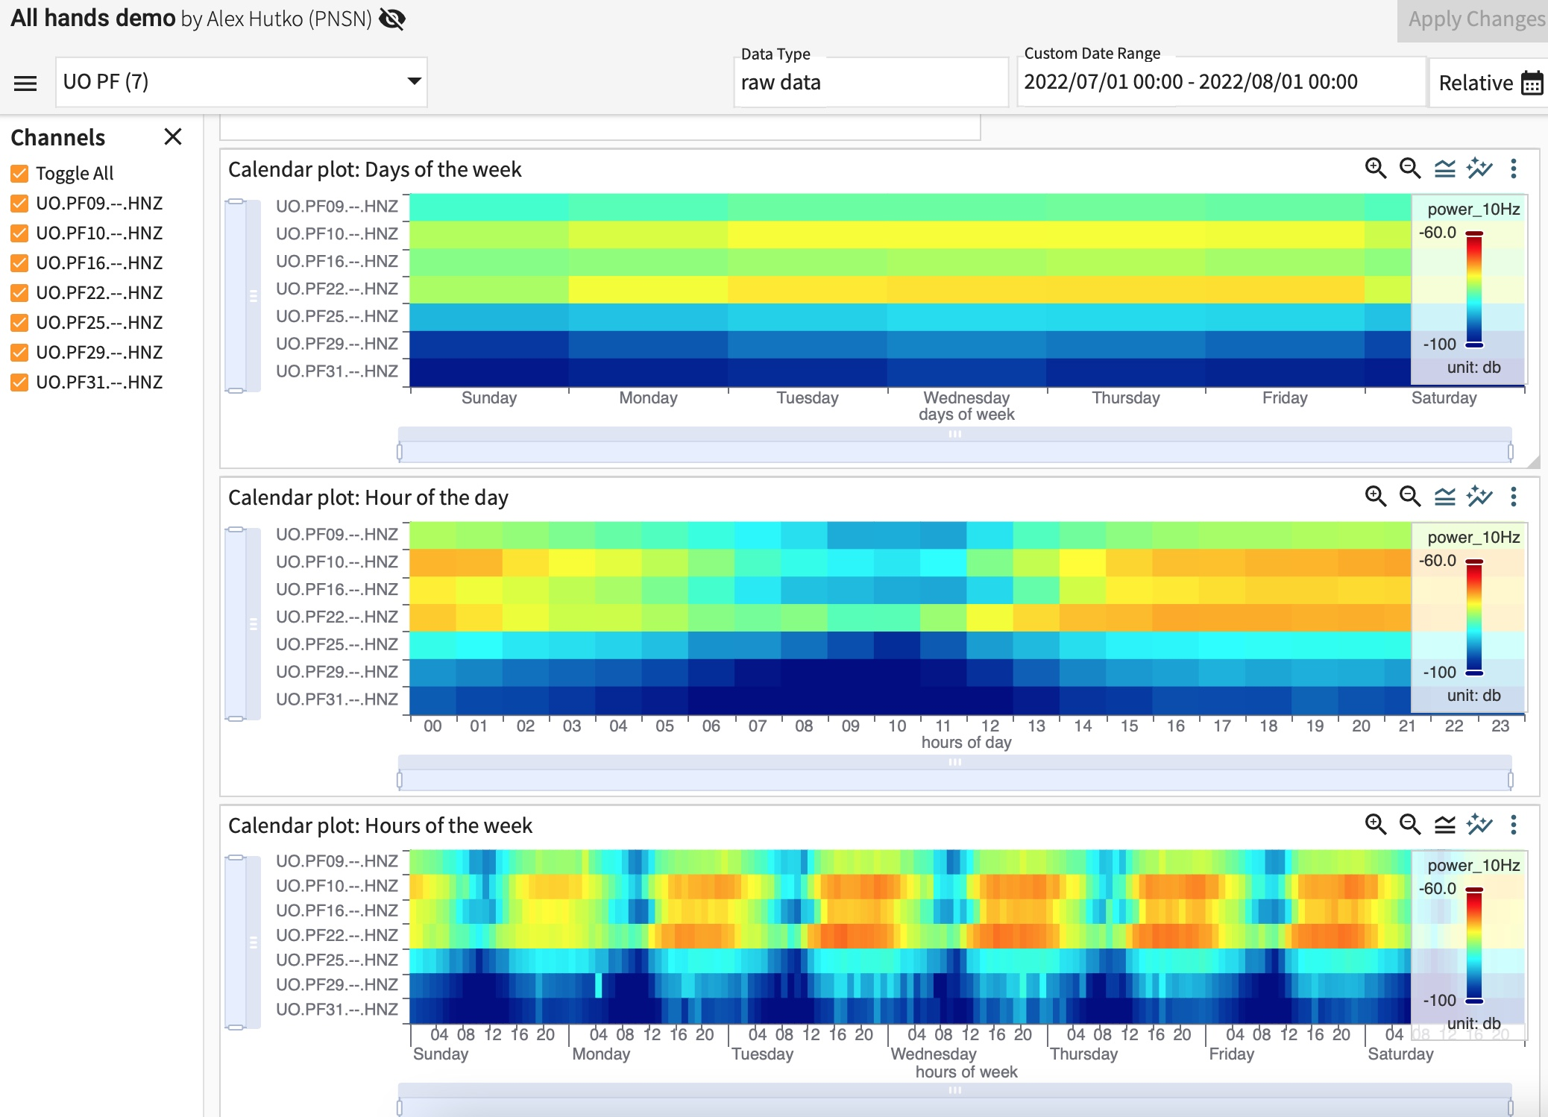
Timeline- think: SeisNetWatch with thresholds/color gradients
Calendar plots!
Notes:
We’ll color gradients

Slide 16
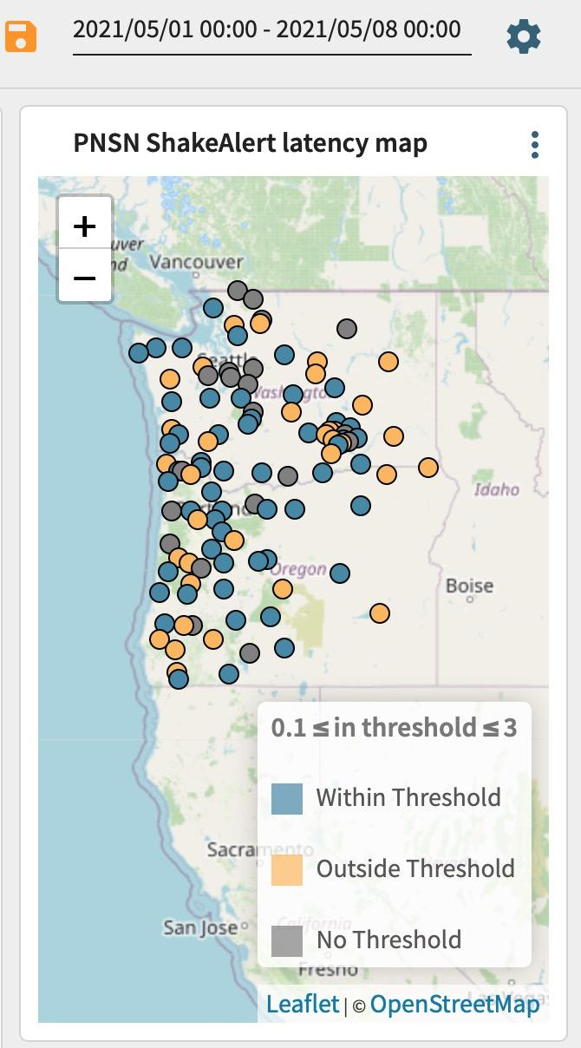
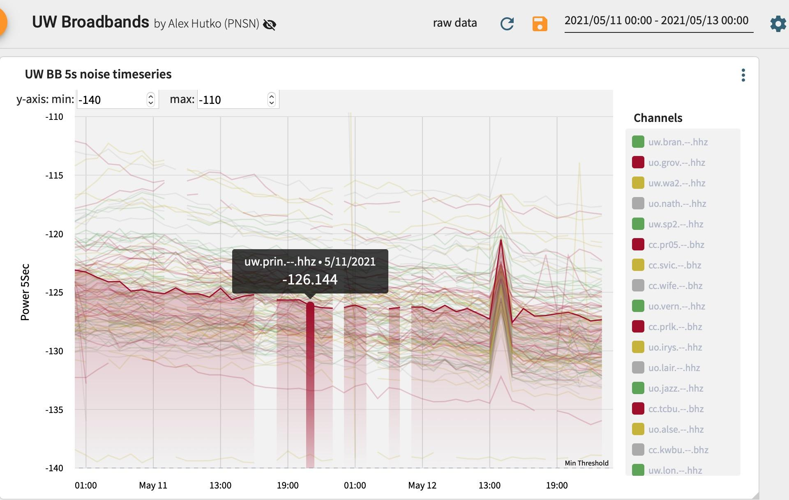
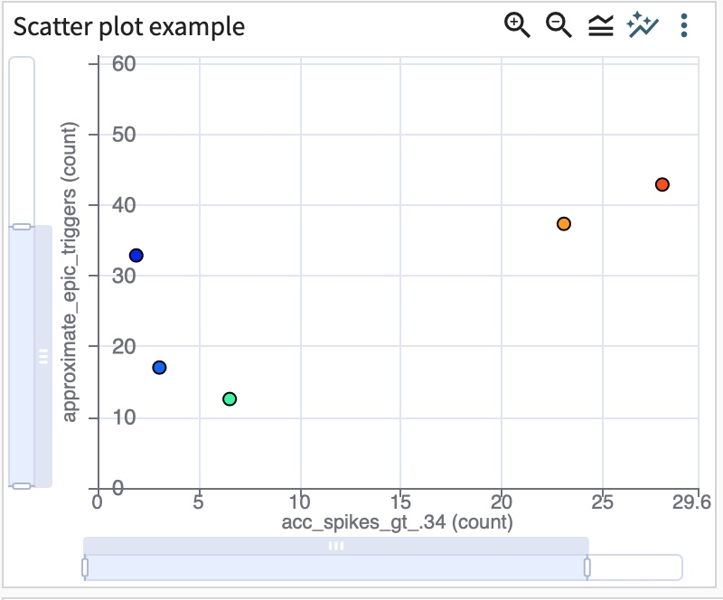
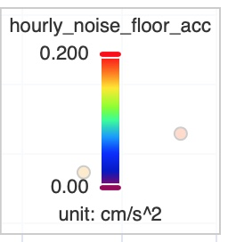
Notes:
Map view that looks similar to MUSTANGular because Kyla is the dev who made both.

Slide 17
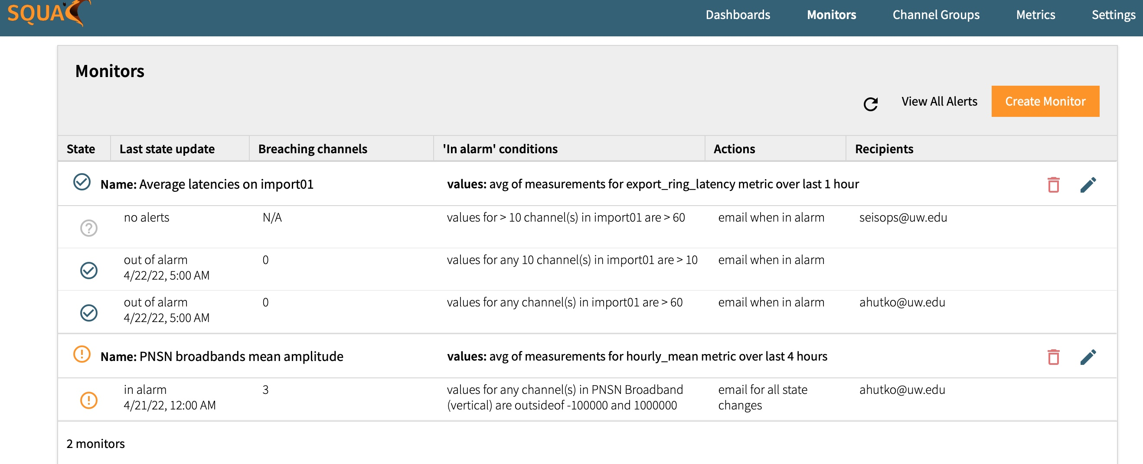
Alarms
Notes:
Here is an overview of what was just set up. You see:
Some are now out of alarm with the time stamp.
Some have never gone into alarm.
Some are in alarm and it shows the number of channels breaching the thresholds.

Slide 18
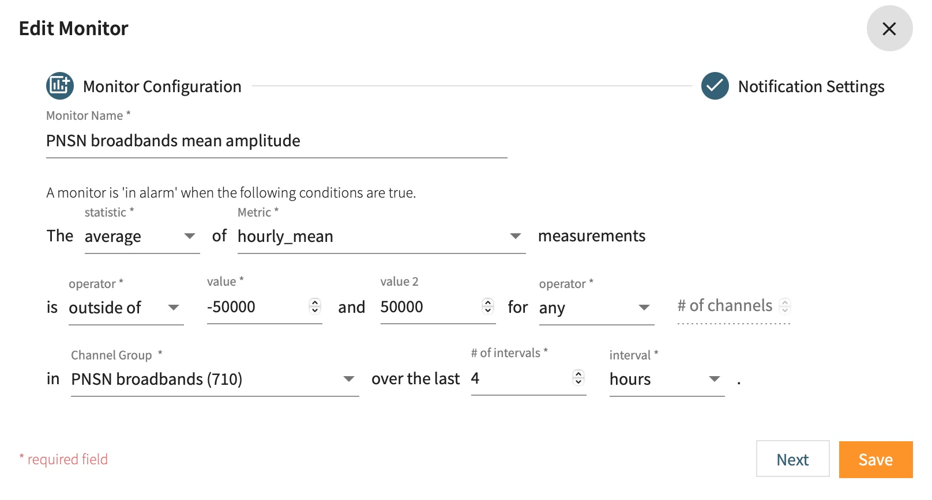
Alarms
Notes:
- measurement upload counts
Is it within a range of two numbers or outside of the range.
- raw measurements or stats of data
- Granularity of time windows can be minutes/hours/days

Slide 19
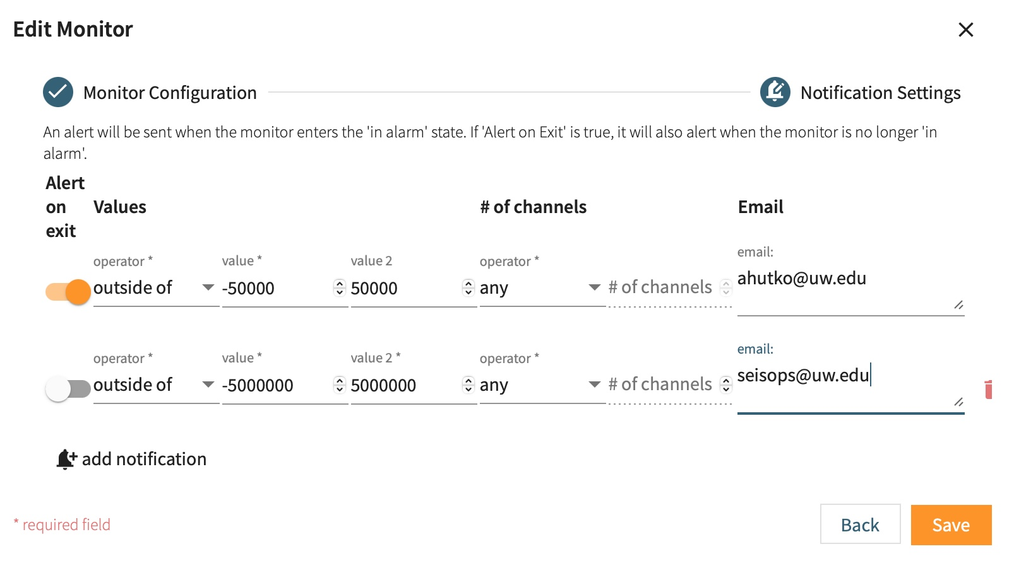
Alarms
Notes:
- measurement upload counts
Is it within a range of two numbers or outside of the range.
- raw measurements or stats of data
- Granularity of time windows can be minutes/hours/days

Slide 20
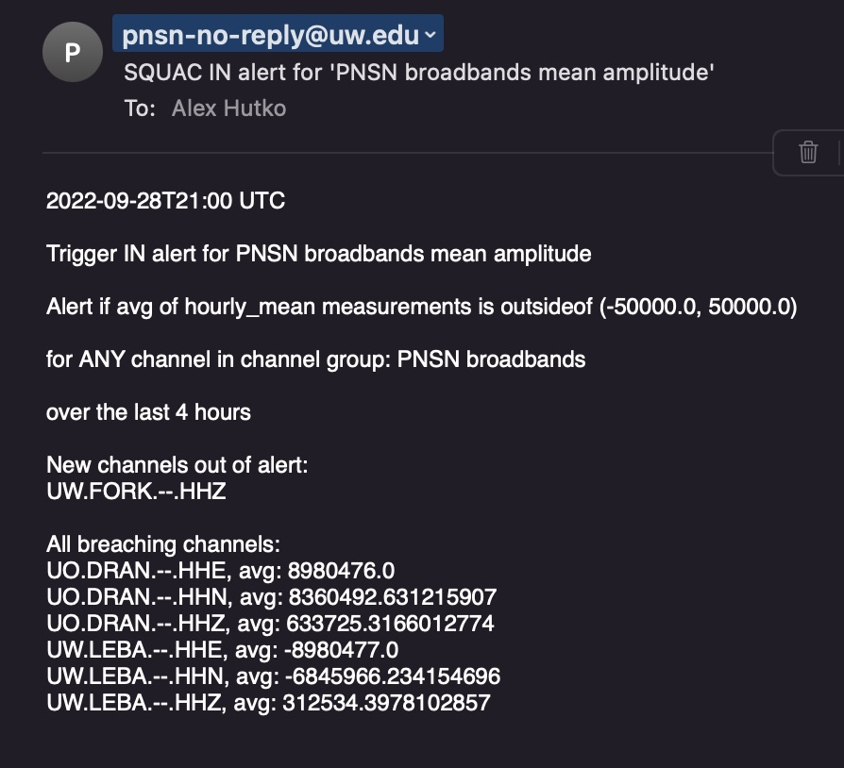
Alarms
Notes:
Email includes all the alarm information including newly breaching channels, as well all breaching channels.
Can also use as a monitor on metric uploads → tell you if a machine is down or out of memory

Slide 21
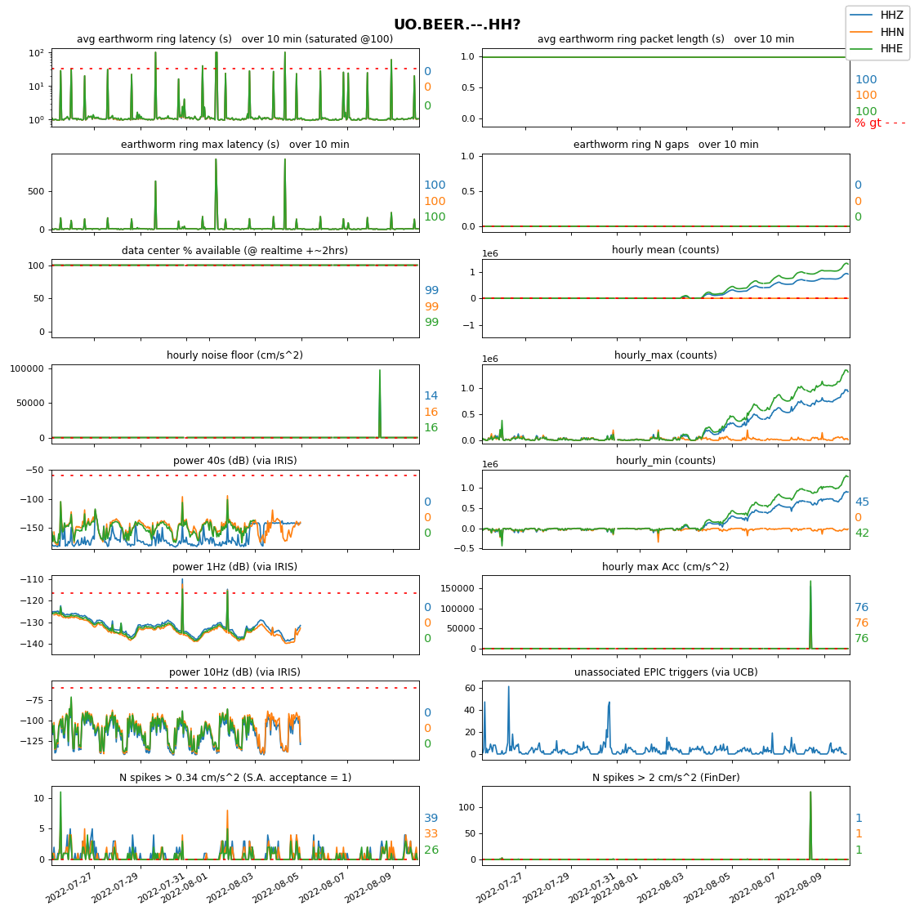
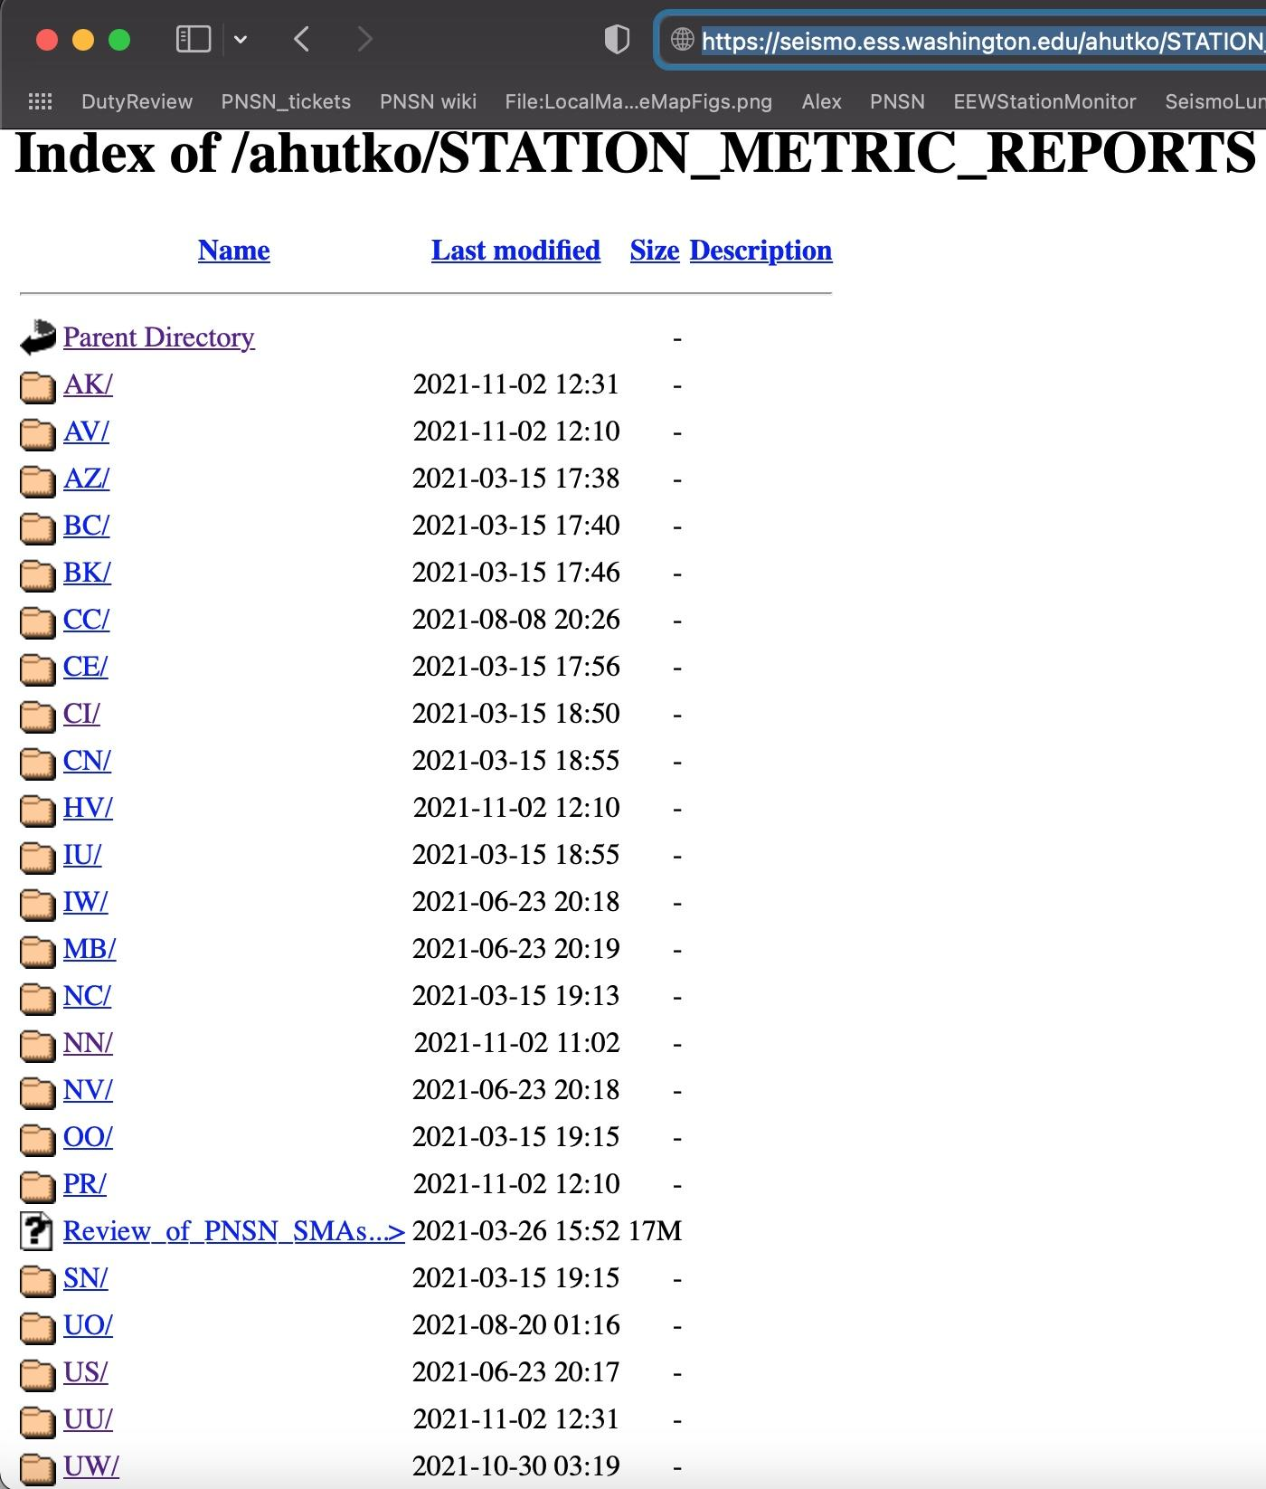
Station Metrics Reports -updated 2x/week
-covers last 3 weeks
https://seismo.ess.washington.edu/ahutko/STATION_METRIC_REPORTS/

Slide 22
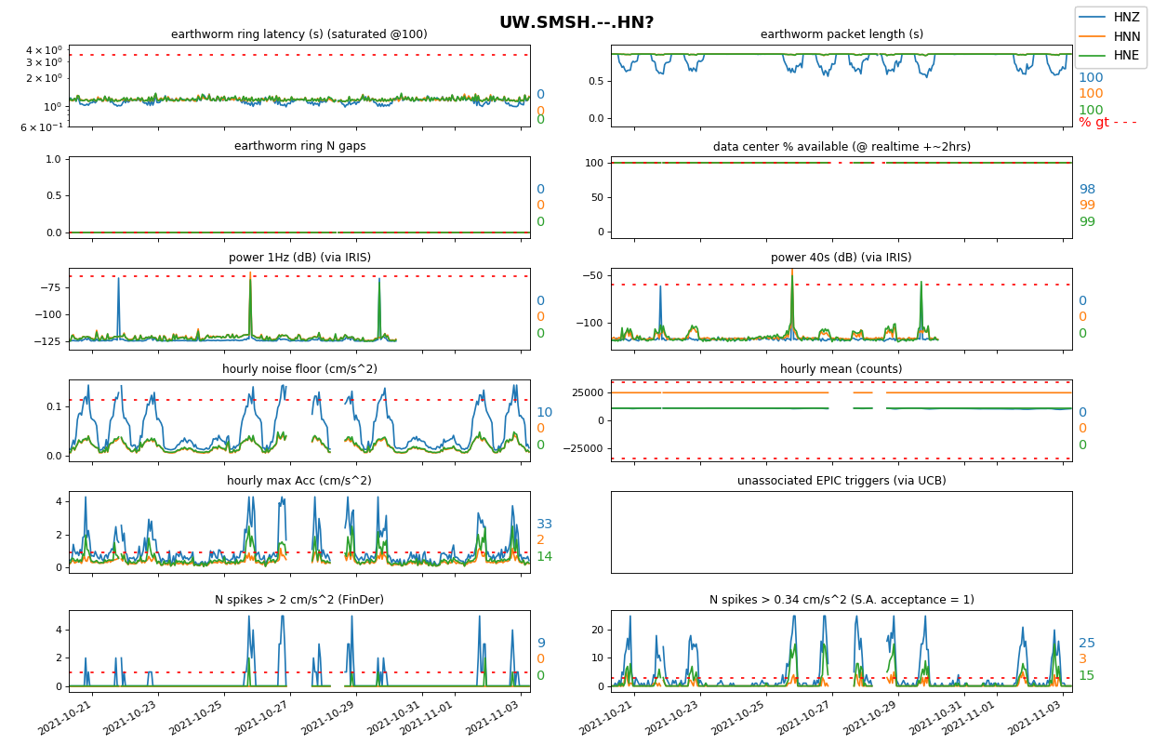

Slide 23
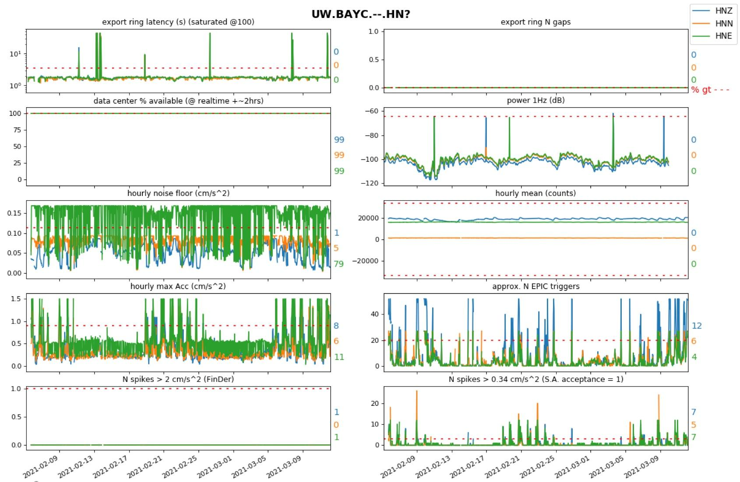
Use case:
Techs were informed something wrong w HNE. pier was coupled to house foundation :-(
Notes:
https://seismo.ess.washington.edu/ahutko/STATION_METRIC_REPORTS/
Only PNSN & ShakeAlert stations are being sniffed for latency & gap info.
These Station Metric Reports have >40k measurements shown. Red dashed lines show the median value at the 95th percentile worst station in the PNSN for the shown metric aka typical values for a “bad” station. Colored numbers show % of time measurements exceed the red dashed line…. I.e. % of time it is really bad for that metric.

Slide 24
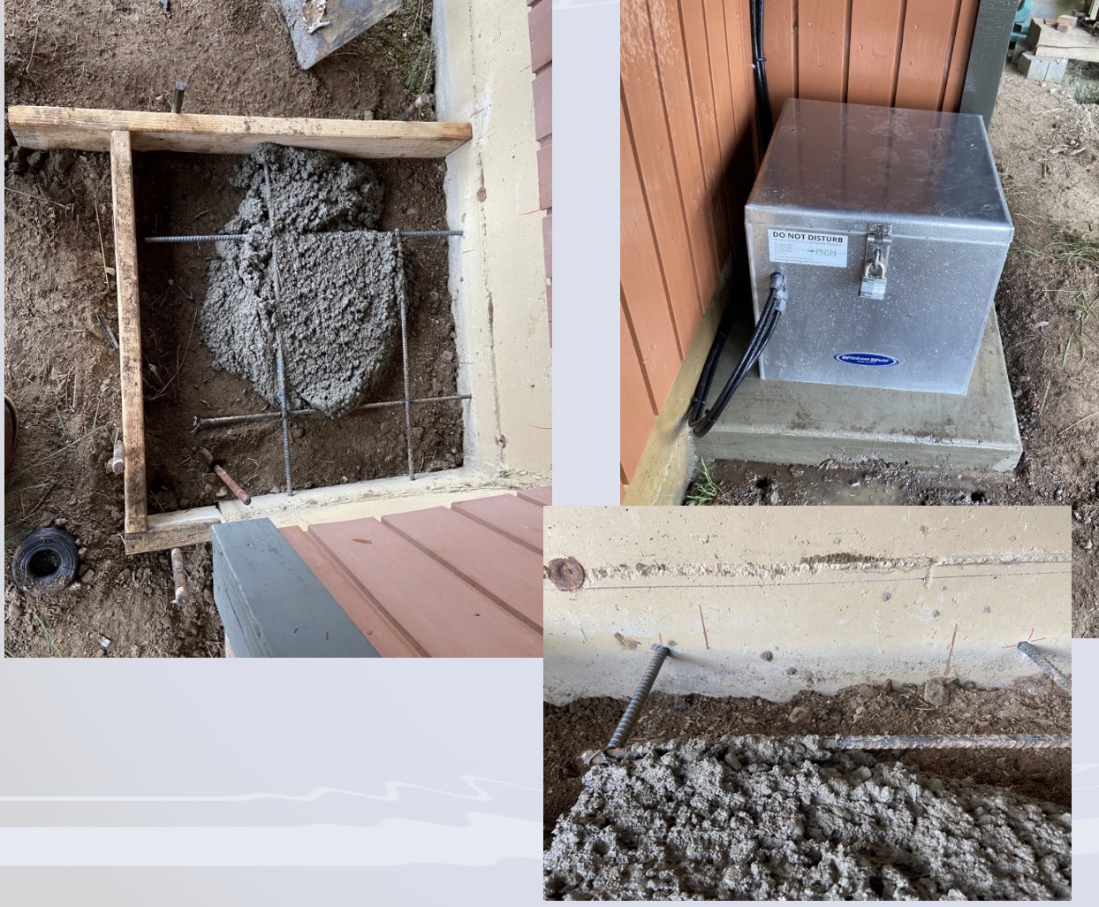
Use case:
Techs were informed something wrong w HNE. pier was coupled to house foundation :-(
Notes:
https://seismo.ess.washington.edu/ahutko/STATION_METRIC_REPORTS/
Only PNSN & ShakeAlert stations are being sniffed for latency & gap info.
These Station Metric Reports have >40k measurements shown. Red dashed lines show the median value at the 95th percentile worst station in the PNSN for the shown metric aka typical values for a “bad” station. Colored numbers show % of time measurements exceed the red dashed line…. I.e. % of time it is really bad for that metric.

