Slide 1
A one-stop shop for network status? Developing an application for a diverse set of users
Carl Ulberg, Kyla Marczewski, Alex Hutko, Renate Hartog
University of Washington
SSA 2023
Notes:
We realize we’re reinventing the wheel and there are other systems like Mustang, but those were initially turned for the high quality GSN broadband network. As an RSN and ShakeAlert partner with both broadbands and strong motions, many in urban areas, those systems didn’t meet our needs.

Slide 2
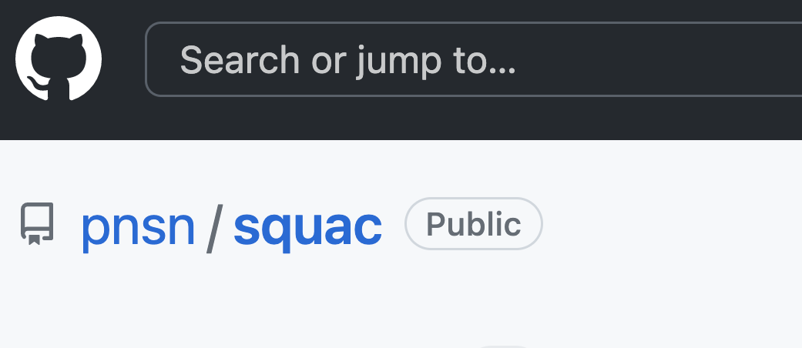
Seismic Quality Assurance Console
GUI
django backend API
simple python read/write scripts
Notes:
Squac -> angular framework
Squacapi -> Django python web framework, scalable!!
Squacapi_client -> data mining

Slide 3
What is SQUAC?
It’s a fancy metrics database & interface tuned for PNSN+ANSS+ShakeAlert
Contributor source agnostic; currently 8 sources
~11 Million measurements/day (>125/sec), ~75Gb/month
Metrics:
waveform – N big/small bumps, power, noise floor, peak Acc, …
SOH – latency, gaps, completeness at datacenter
Variable granularity: 10 min/hourly/daily/monthly
Channel groups: flexible use cases
AWS ~$500/mo
EC2 2-5 servers (autoscaled)
RDS db ~3 Billion measurements
S3 archive ~5 Billion measurements
Notes:
11 million – these come from every station in ANSS
Channel groups- early on we found that different user groups had different channel grouping needs. Managers cared about entire networks and NET codes were good enough to group, while techs tended to "own "subsets of stations. SQUAC was built around the channel group concept from day 1 which has its pros and cons.
Originally hosting the db locally but it was very slow, aws allows for more flexible and responsive scaling
Rds – postgres
Total metrics: 77
Total channels: ~40k (37 networks)
Total squacapi_production size: 822 GB
Archives back to 2020
Ec2: t3a.large
RDS: db.t3.xlarge

Slide 4
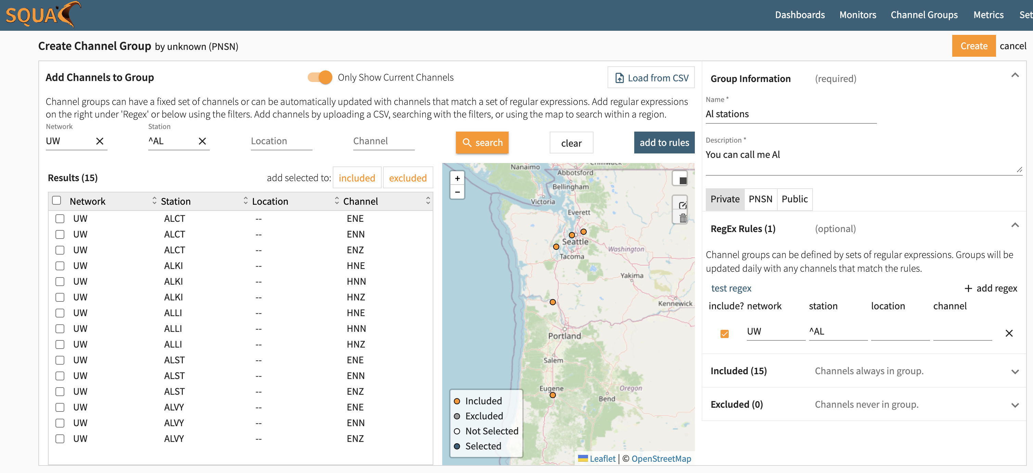
Channel groups
Automagical updating
Notes:
Flexible, editable “flexible search parameters”
Recently added features include:
loading channel list from CSV
using “flexible search parameters” to keep channel groups updated daily from FDSN data centers

Slide 5
Dashboards/widgets
Notes:
7 total widget (plot/figure) types
The idea behind the dashboards is you set it up once and then either forget about that detail or you can change time ranges or channel groups on the fly
Recently added widget types:
Calendar
Parallel
Scatter

Slide 6
Timeline – like SeisNetWatch with flexible color gradients
Notes:
epic triggers – day/night signal at some channels

Slide 7
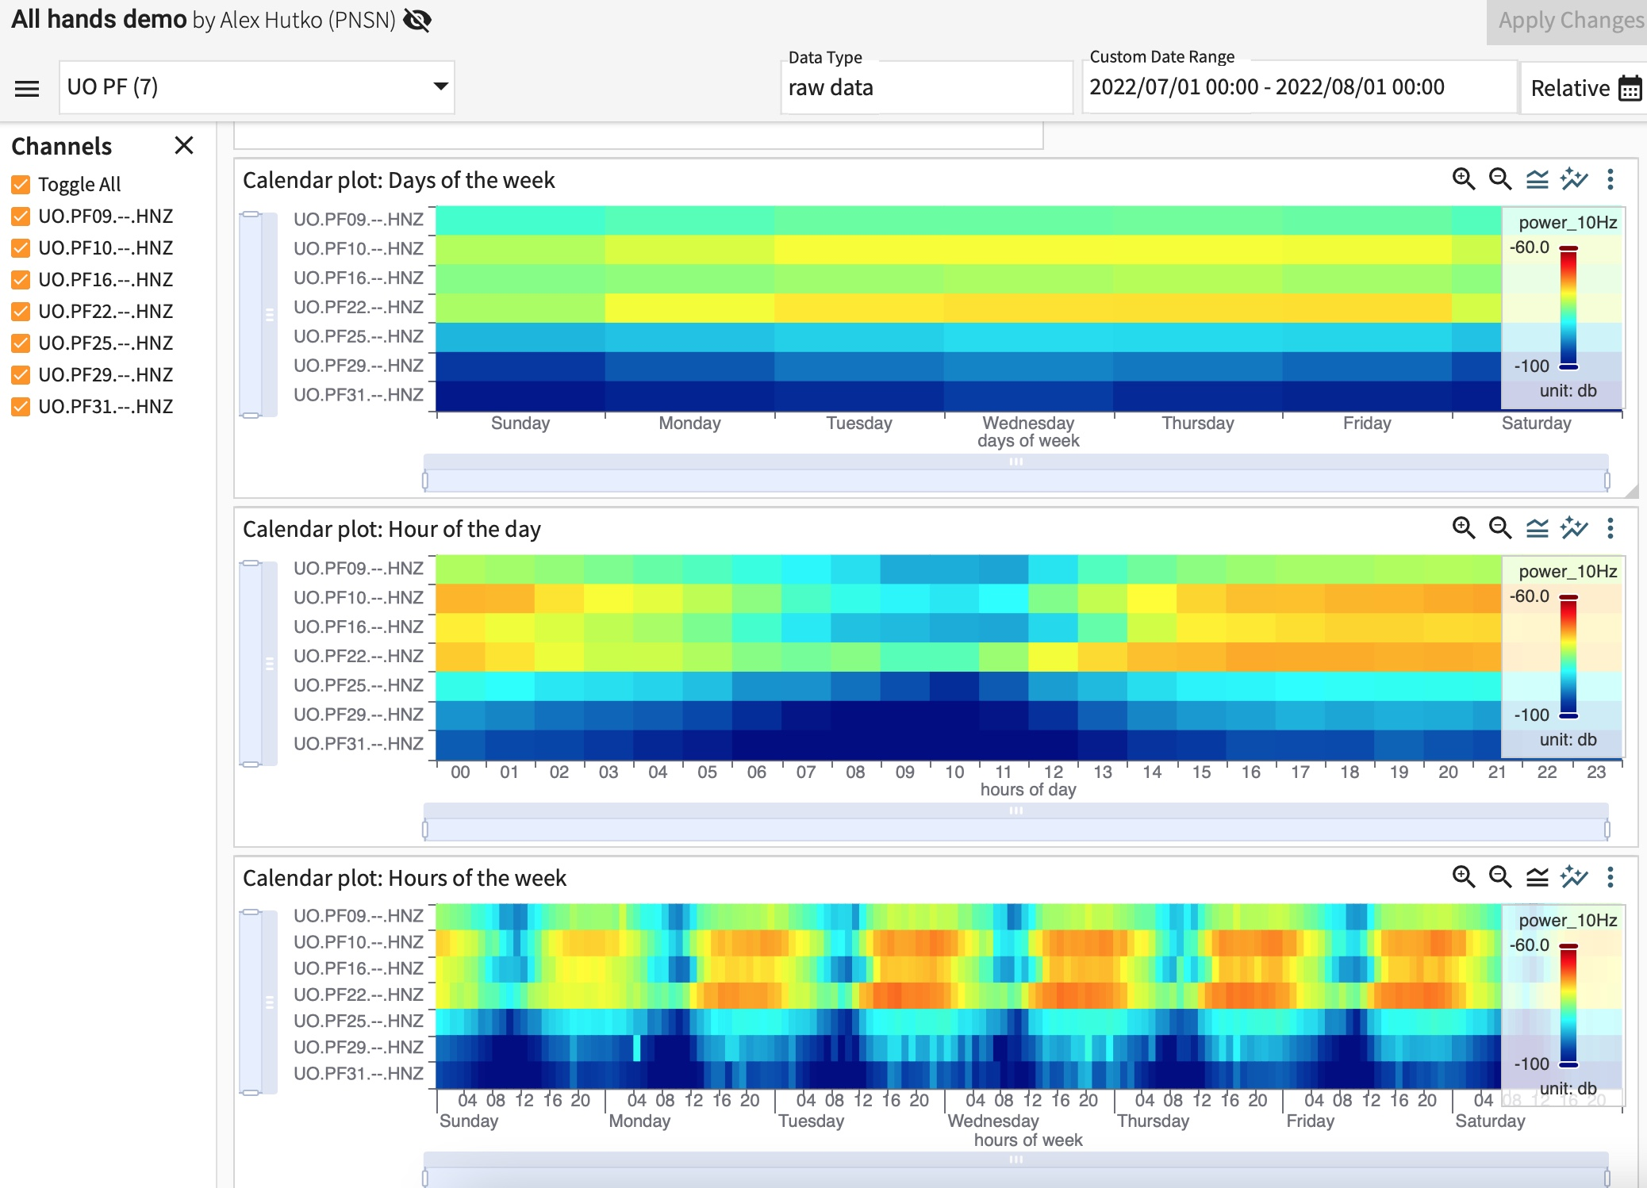
Calendar plots!

Slide 8
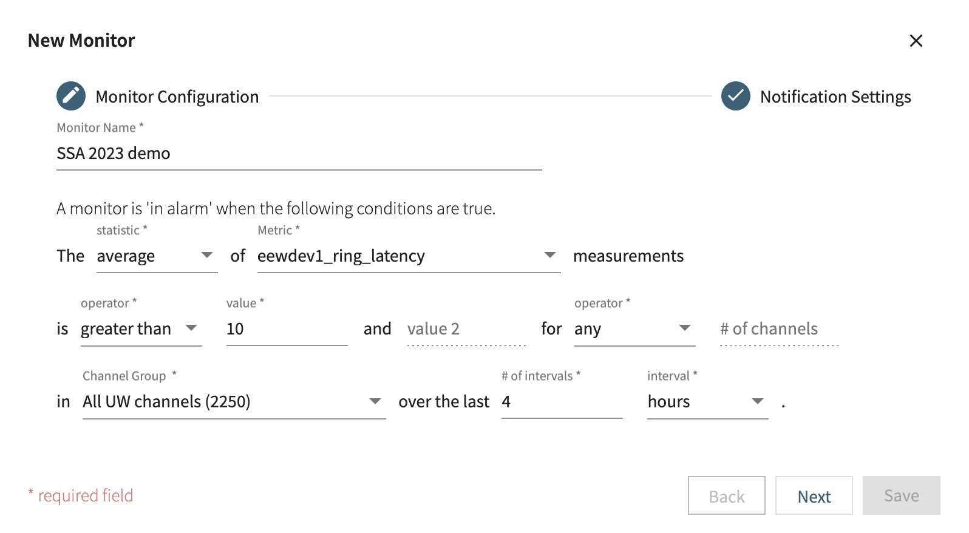
Alarms

Slide 9
Alarms
Notes:
New feature:
- Daily digest. Summarize alerts for the last day (to avoid over-alerting)

Slide 10
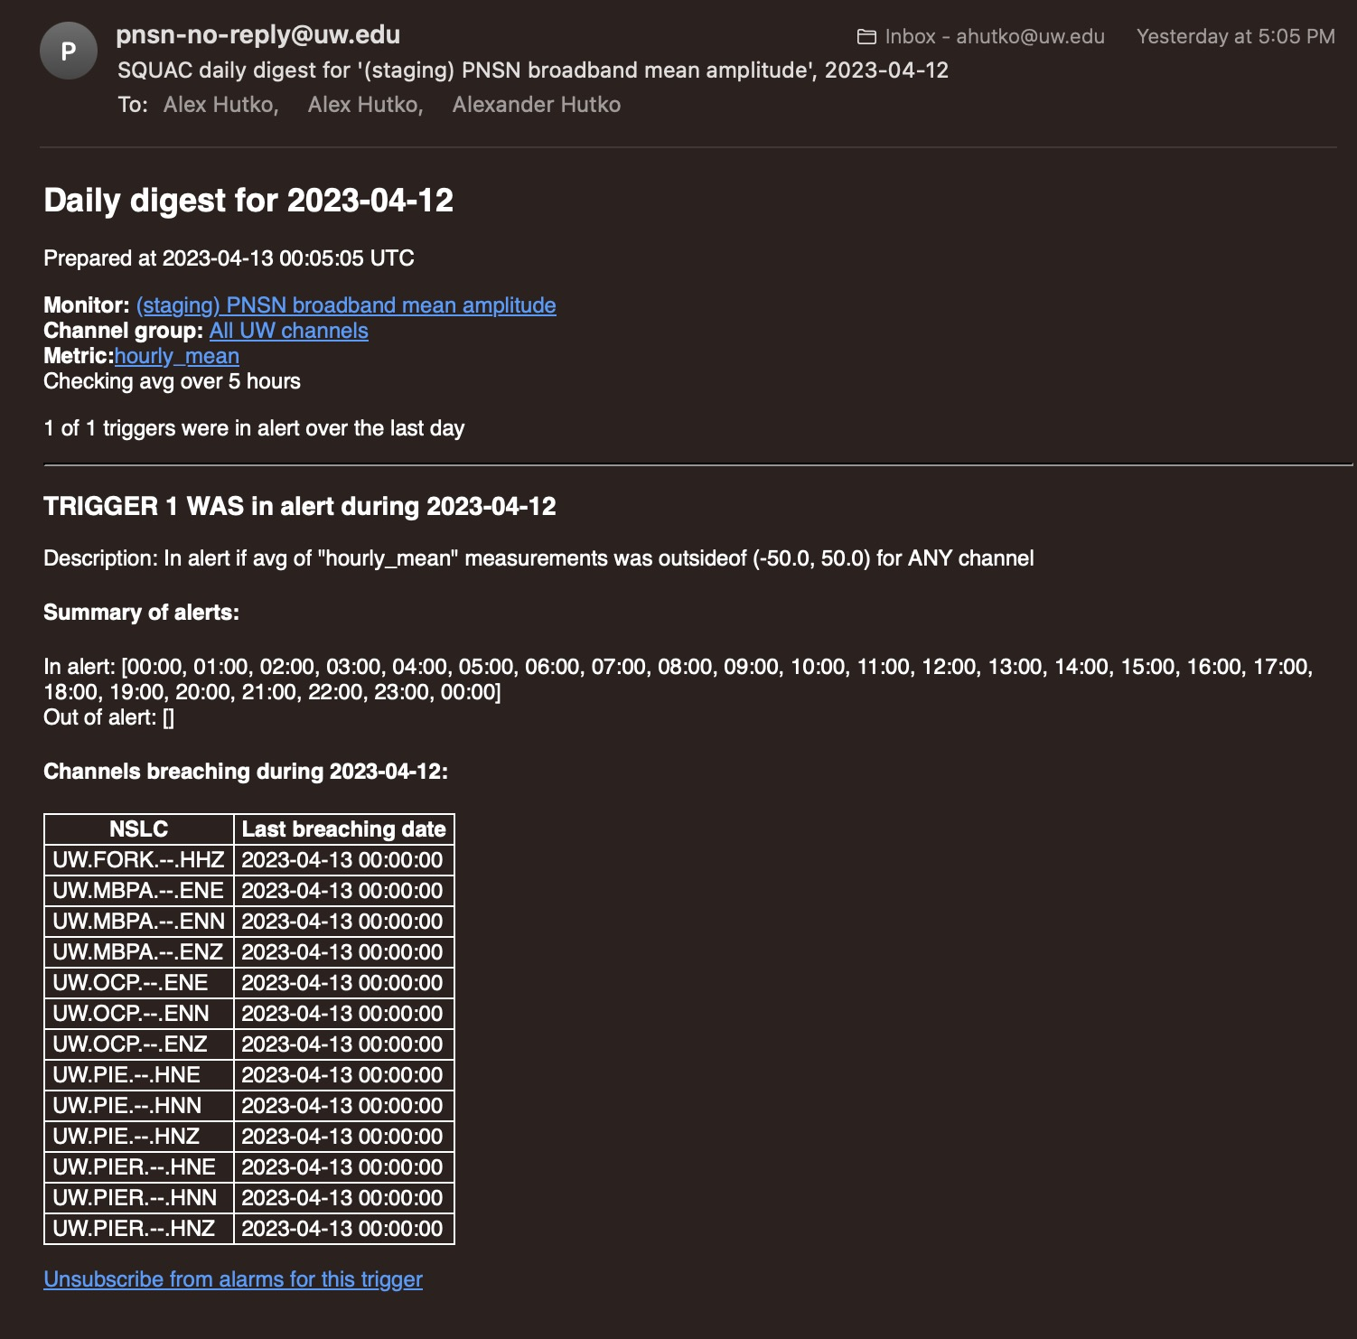
Daily digest email

Slide 11
Alert detail page
Scroll down for more…

Slide 12
Alert detail page

Slide 13
Alert detail page
Notes:
In this graph and most of the widget plots, hovering over lines or points will bring up more detailed info.

Slide 14
Use case 1: field techs
2021-02-09
2021-03-09
2021-02-09
2021-03-09
Updated 2x/week:
https://seismo.ess.washington.edu/ahutko/STATION_METRIC_REPORTS/
Notes:
This is similar to a dashboard, but just a static image generated twice a week looking back at the last 4 weeks and put up on a webpage. These quick pre-generated images have been very useful. In this case, you can see in the noise floor the green trace (East component) clearly has an issue. The concrete pier at this site was accidentally coupled to the house's foundation on the other side of which was a fridge
Generated for every station in ANSS twice a week looking back in time three weeks.

Slide 15
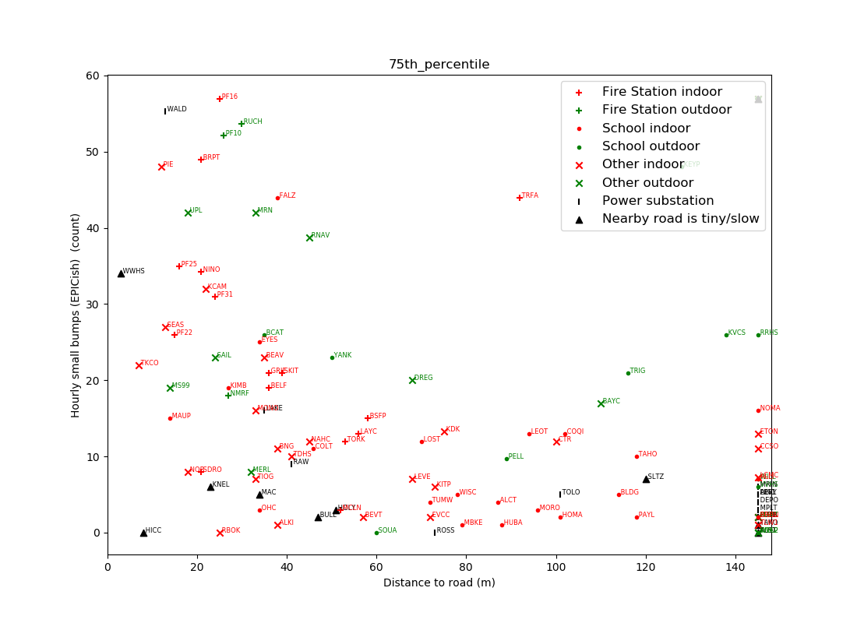
Use case 2: network seismologists
60
How far away from a road should instruments be placed?
50 m
40
Hourly small bumps (EPICish) (count)
20
0
0
50
100
150
Distance to road (m)
Notes:
Heres an example of data mining using squac to help siters know what the minimum distance to keep away from roads is. The answer is about 50m and that is true when you're counting bumps triggering the ShakeAlert algorithm like in this plot or when you look at background noise levels and are concerned with triggering rates and detection thresholds appropriate for an RSN.

Slide 16
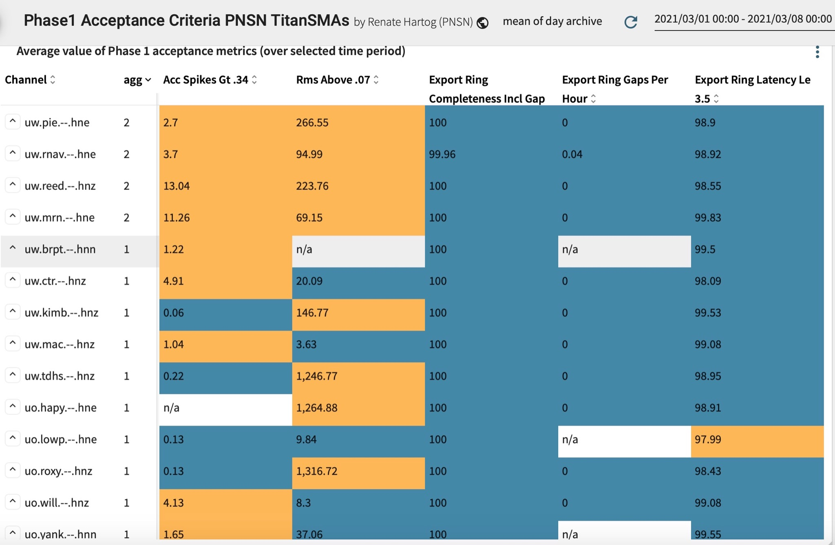
Use case 3: ShakeAlert station acceptance
Notes:
Widget example where you can peek at ShakeAlert station acceptance status in real-time over whatever time period you want.

Slide 17
SQUAC-lusion
High-performance, cloud based database of metrics with alarms is really useful for a regional seismic network.
Designed with diverse users in mind
squac-help@uw.edu
https://seismo.ess.washington.edu/ahutko/STATION_METRIC_REPORTS/
Notes:
Before starting we played w Tableau and other packages which were too slow and we needed something that can instantly scale up. This was a few years ago, and maybe things have changed with other APIs/software packages, but we’ve found AWS databases to be very high performance regardless of request load for both uploads and downloads.

