Slide 1
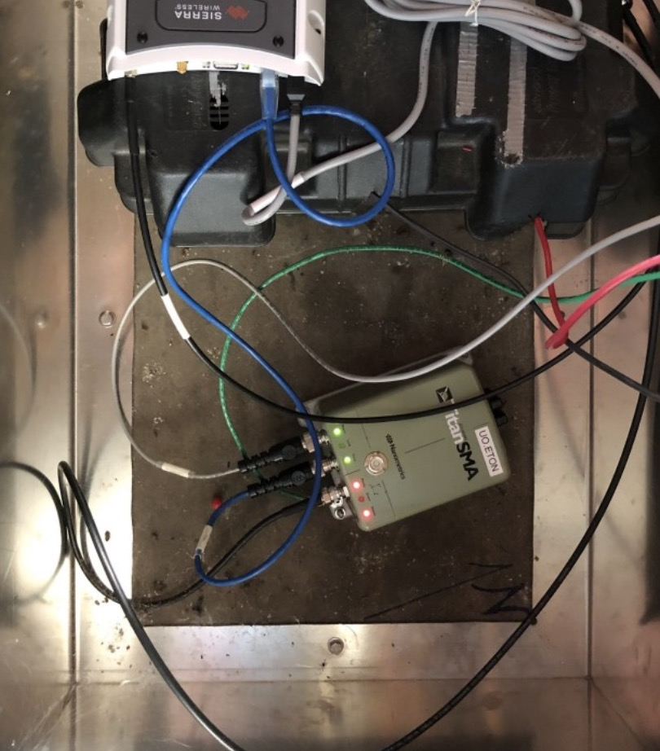
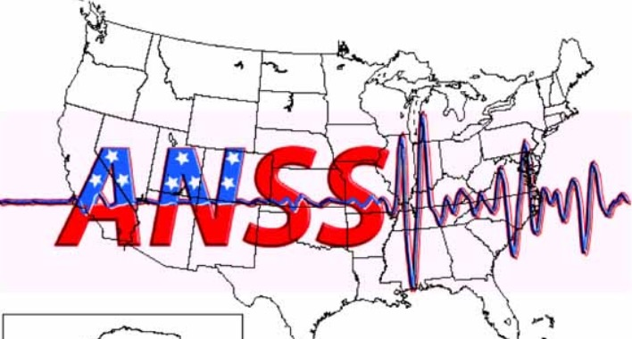
Assessing SMA installs across & best practices
ahutko@uw.edu 2021.03.22T17:00 UTC

Slide 2
TLDR
Quick n’ dirty overview of quality for each station:
https://seismo.ess.washington.edu/ahutko/STATION_METRIC_REPORTS
Install a station less than 40m from not-only-slow traffic?

Slide 3
Summary
-Less than 30m from traffic: keep lookin.
-Try to get at least 50m away from a road with traffic going faster than parking lot speeds, where traffic is more than 5 cars per hour during the day. Beyond ~70m cars won’t be why your station is a bad site. Less than 50m but near stop signs, roundabouts, tight spaces where cars only go very slow seem to be OK. <5 cars going by per hour at peak, e.g. certain 1 lane access roads, seem to be OK.
-Calm rivers aren’t that bad, though try to get away >50m from falling/white water. 3m from a small man made waterfall (UW.WWHS) = bad.
-Please take a “context” photo from far away that show the station in proximity to what you think might make noise: HVAC, generator, fridge, tower, solar panels, river... Also please add orientation, e.g your finger pointing North.
-An undergrad should go through all IRIS/SIS Lat/Lon and confirm with photos in nextcloud; usually if those are wrong, shop files are different and correct.
-Try to get away from “sails” (towers, solar panels) and decouple outdoor stations as much as possible from big structures. Low foot traffic indoor can be OK, big HVAC units within a few feet can be an issue, small heaters seem to be OK.
-Dams and power substations that are >50m from trafficy roads are all very good stations. UO.WALD at 13m from road is the bad one; even UO.LAKE at 34m from road is only “approaching worrisome”.

Slide 4
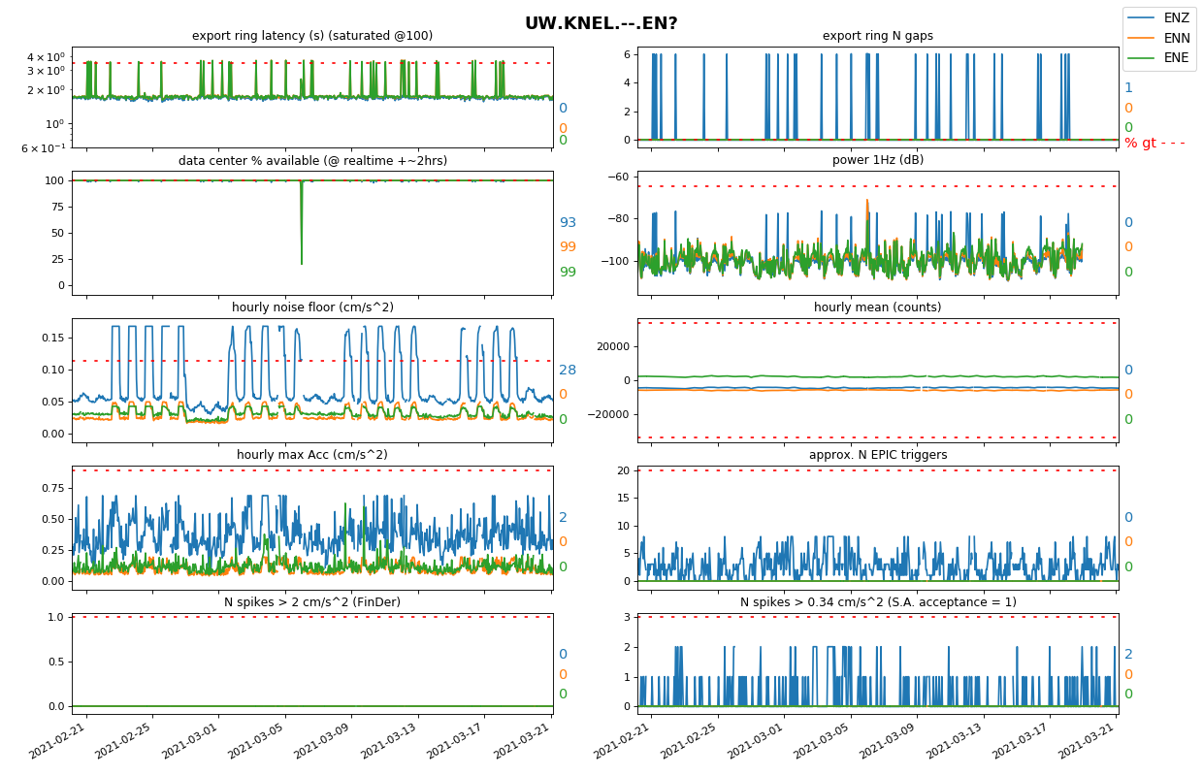
Station reports
https://seismo.ess.washington.edu/ahutko/STATION_METRIC_REPORTS
% of time above BAD - - - - - line
Noise floor:
“can I detect small nearby quakes?”
(not a priority for 3ch sites, but nice to have)

Slide 5
Station reports
https://seismo.ess.washington.edu/ahutko/STATION_METRIC_REPORTS
% of time above BAD - - - - - line
cares about these
How many small bumps each hour
How many big bumps each hour
Hourly “damn, I can feel that” bumps

Slide 6
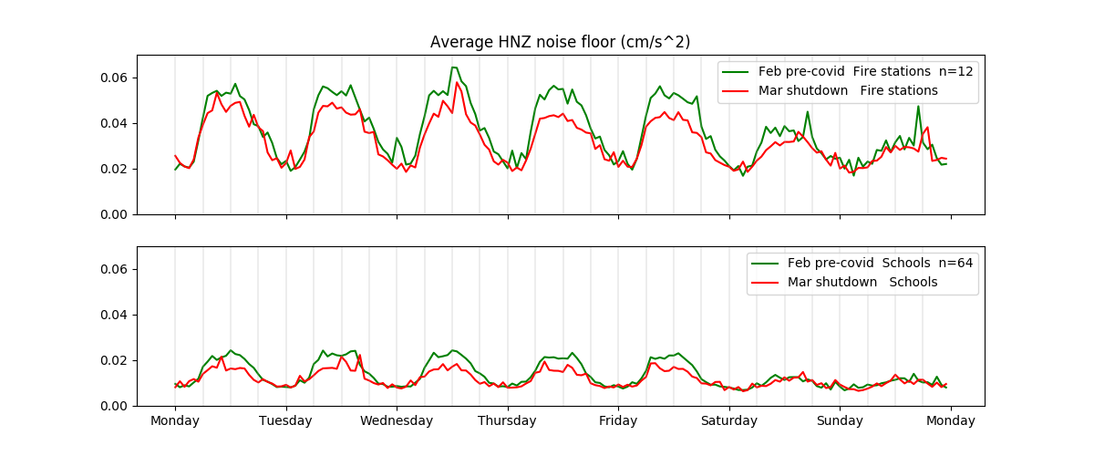
vs
Apples to apples normal vs covid shutdown comparison

Slide 7
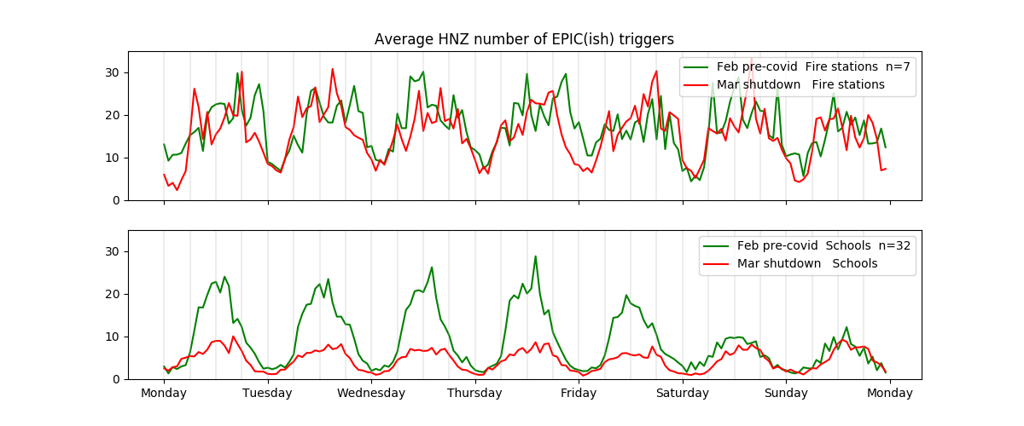
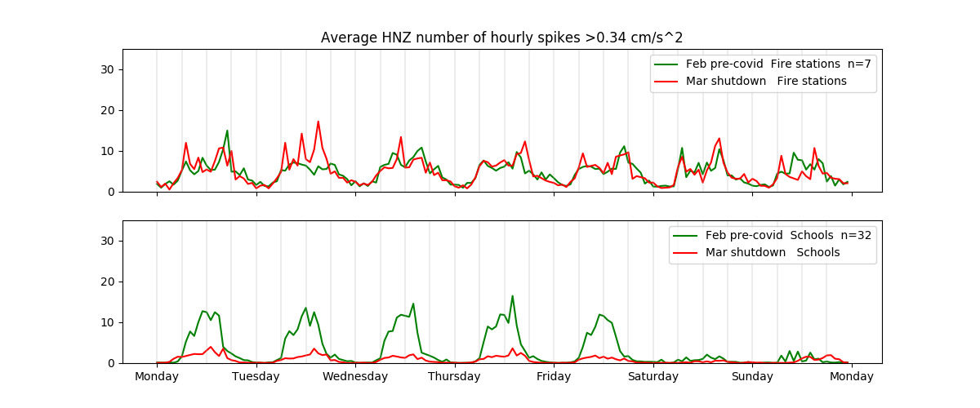
Small bumps
vs
Big bumps

Slide 8
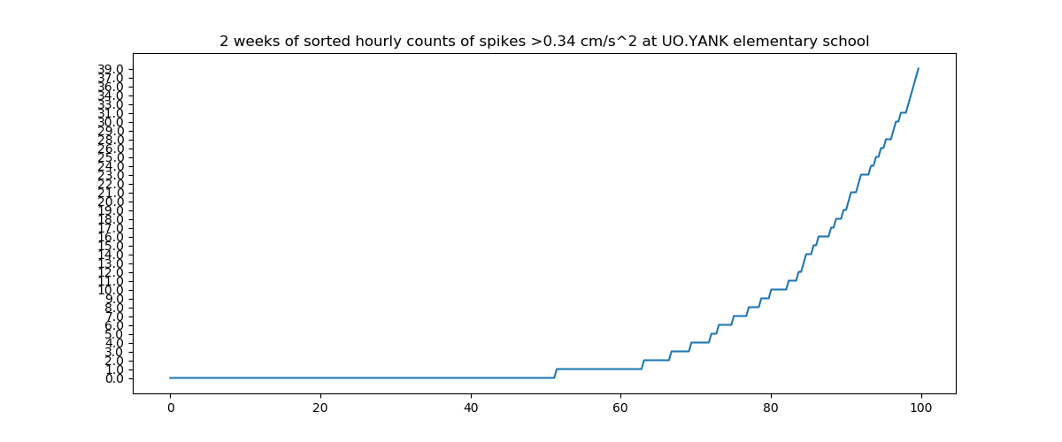
For coordinators group:
2 week average is not fair… Look at 80th percentile or 10am – 2pm

Slide 9
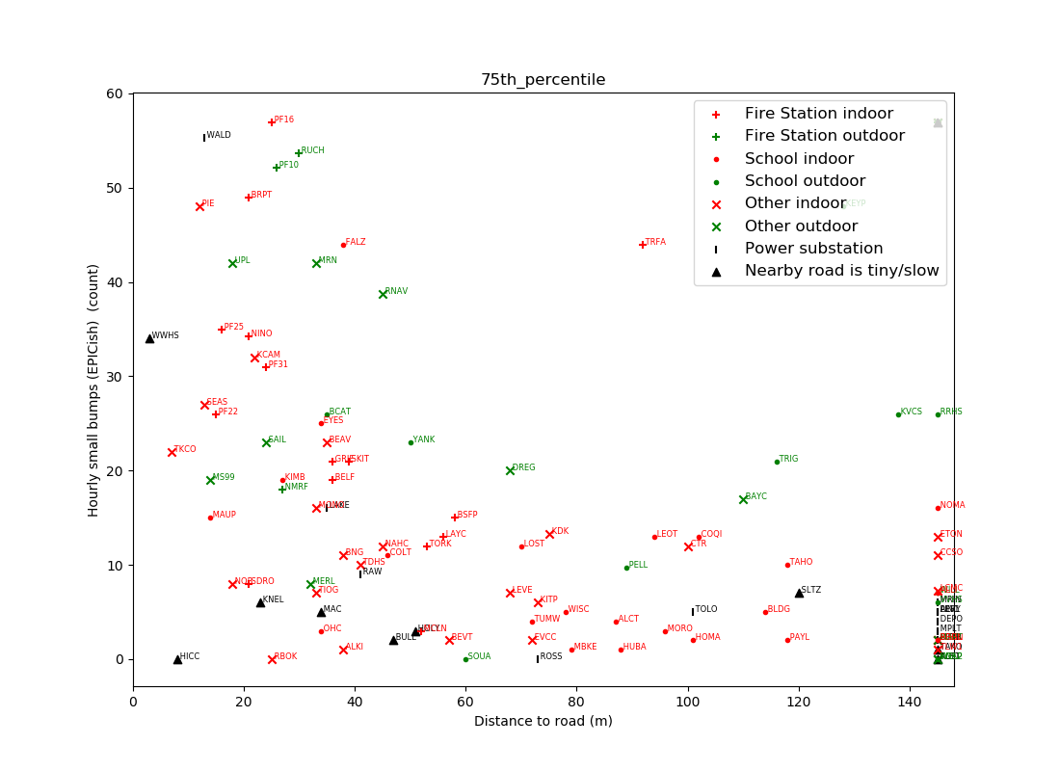
Measured over 2-4 weeks, pre-covid if possible. 75th percentile highest values are plotted (captures “what does it look like during business hours”)
>140m

Slide 10
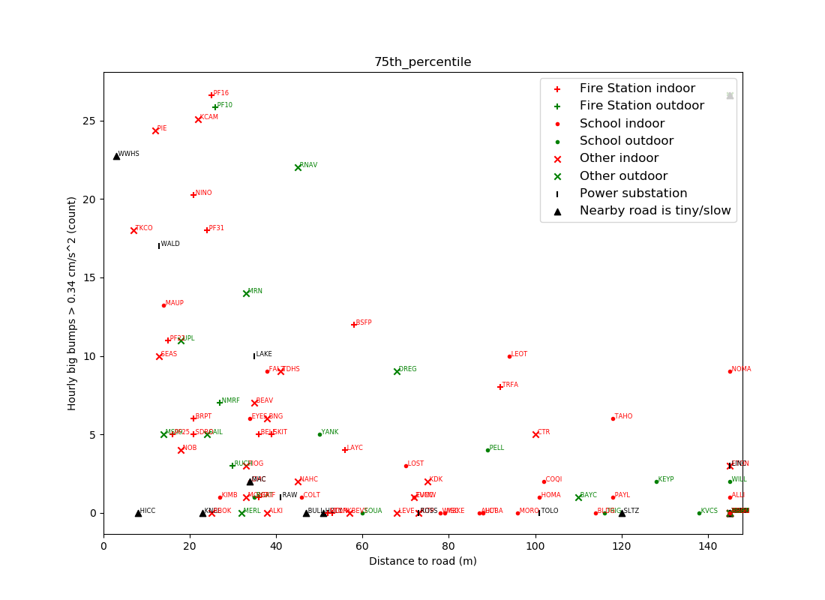
3m from 1m wide creek waterfall
possible future goalpost for ShakeAlert acceptance?
>140m

Slide 11
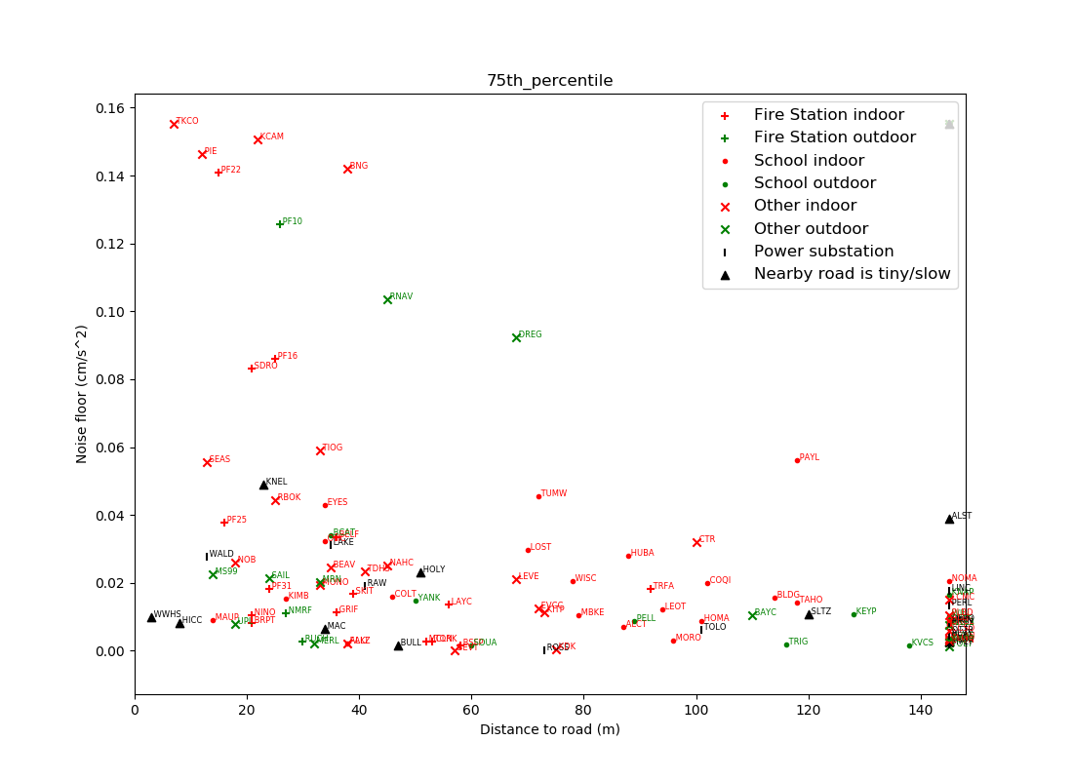
below this line is “nice to have” for ANSS purposes; not very relevant for ShakeAlert
>140m

Slide 12
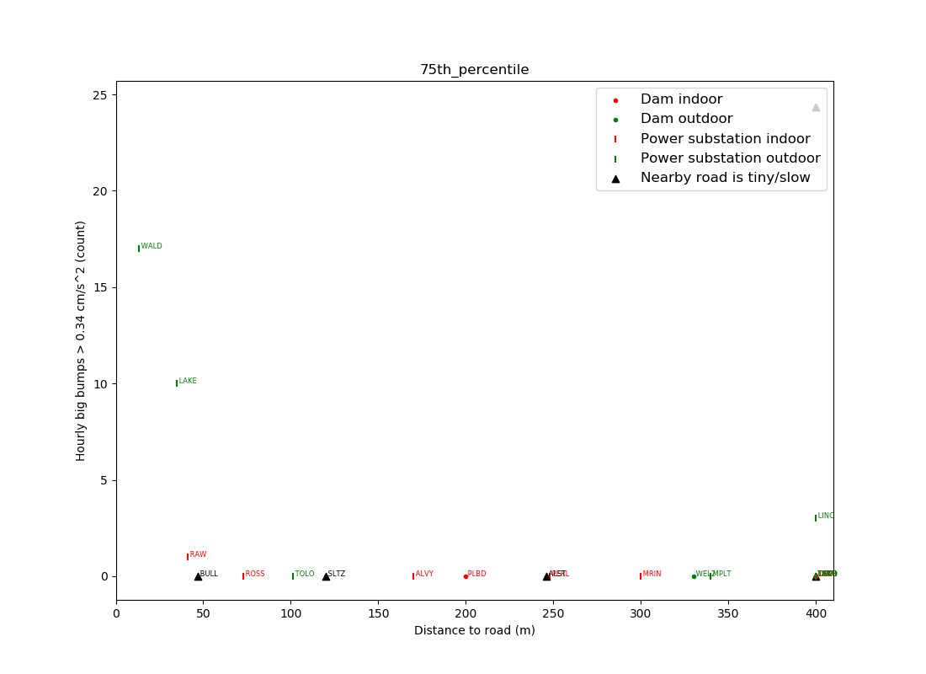
Only dams and power substations.
Noise floor and “small bumps” metrics look similar- very good stations aside from UO.WALD (13m from road).
UO.LAKE (34m from road) is “Not great, but probably squeaks by S.A. acceptance”
UW.WEL1 ”on” dam is bad (not plotted). UW.WEL2 200m away just off of dam is good

Slide 13
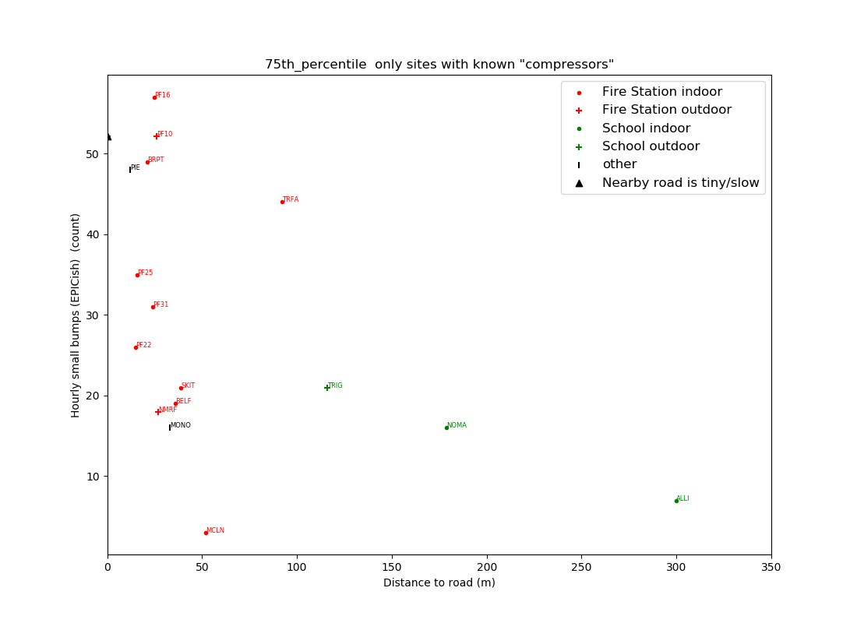
Only stations labeled by tech with “known compressor or other loud thing nearby”
-Noise floor not affected very much by this.
-Most the the bumps are not big. But they are frequent.

Slide 14
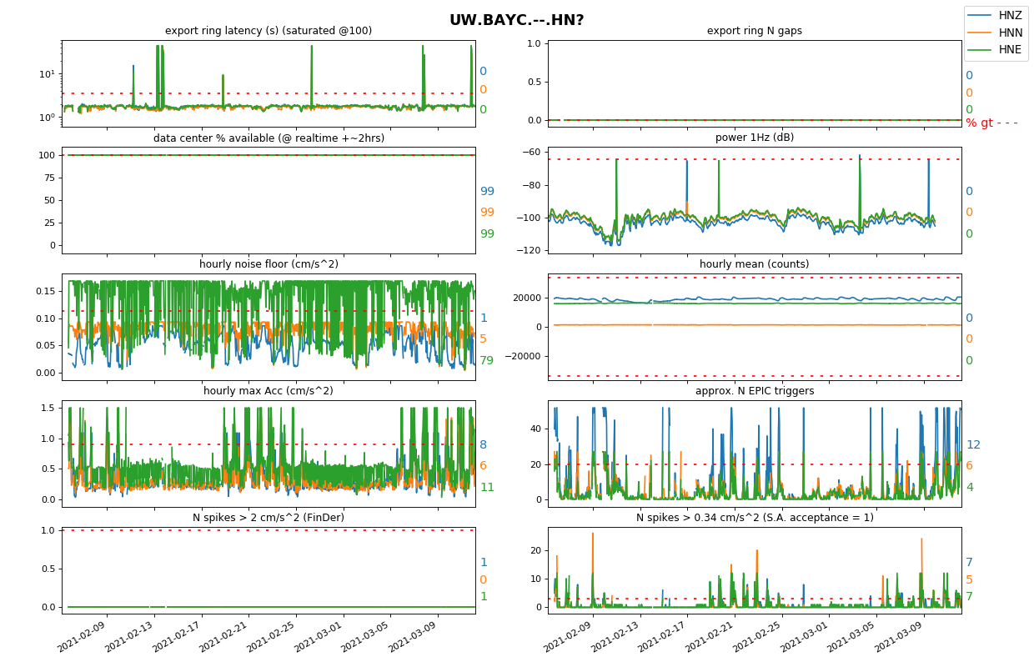
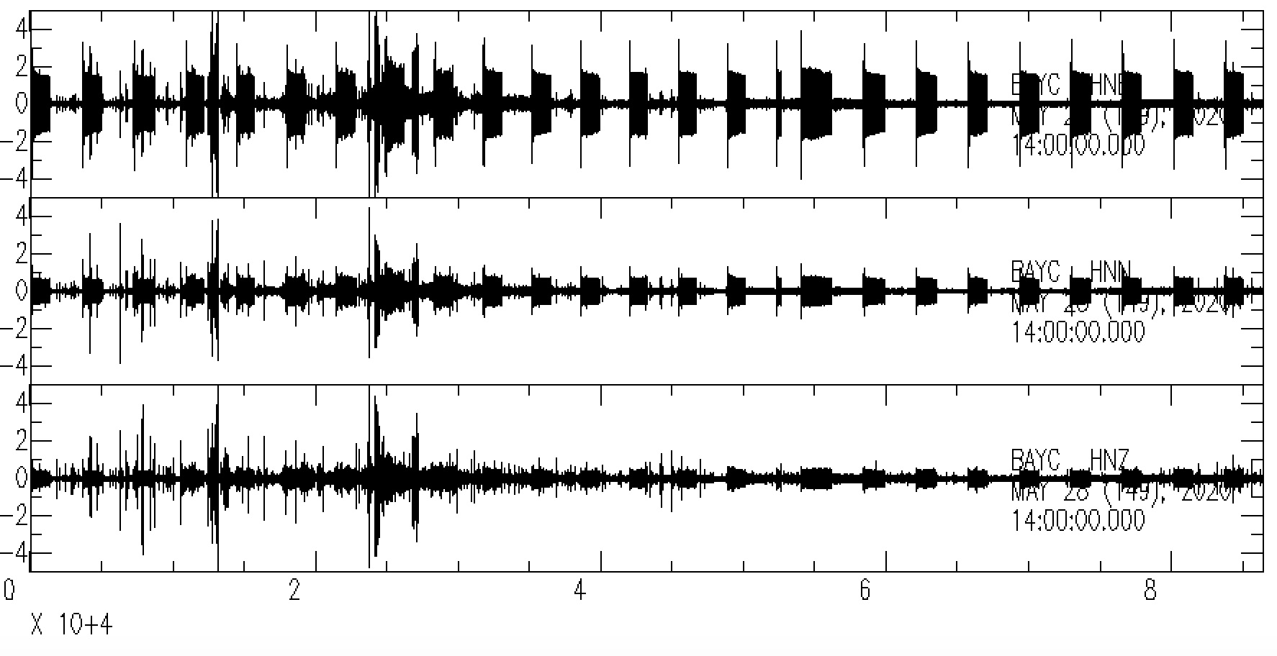
Using a station report to identify a problem.
HNE component clearly much higher noise floor than other components.
A day’s worth of data with noise floors reaching 0.2 cm/s^2 which probably couldn’t see a M2 only 50km away.
mm/s^2
1 day of data at UW.BAYC

Slide 15
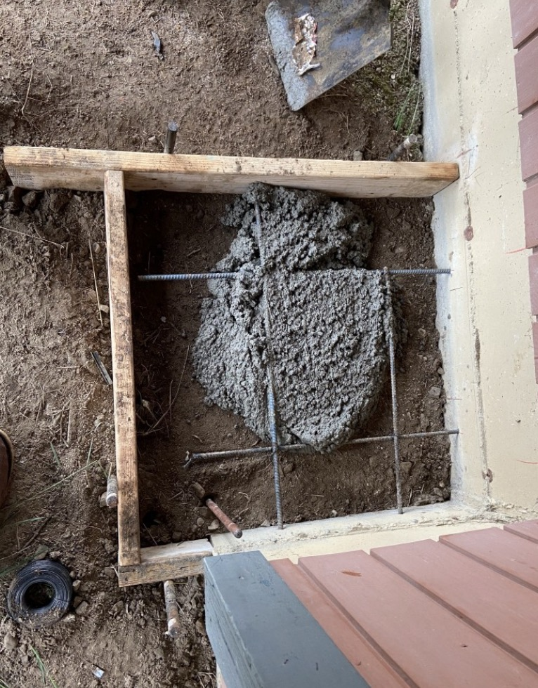
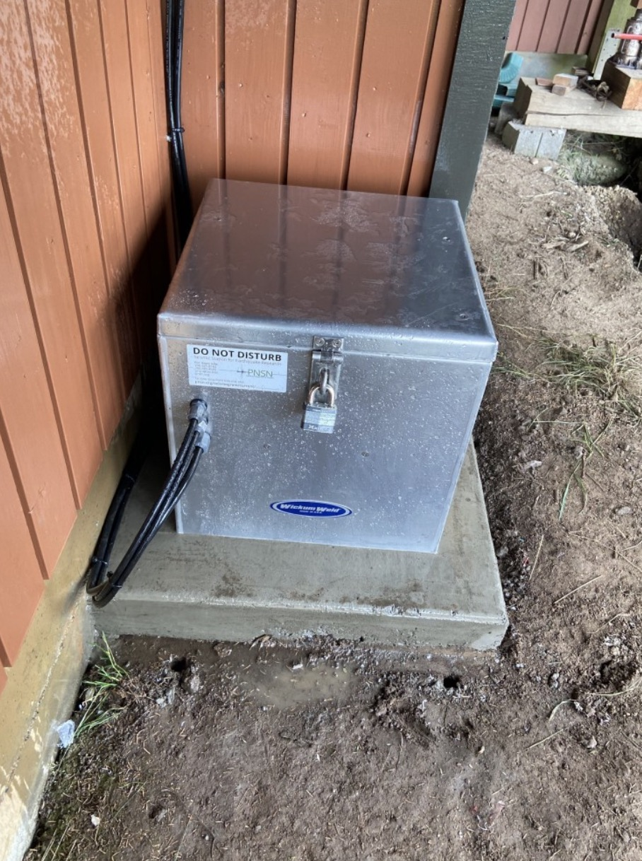
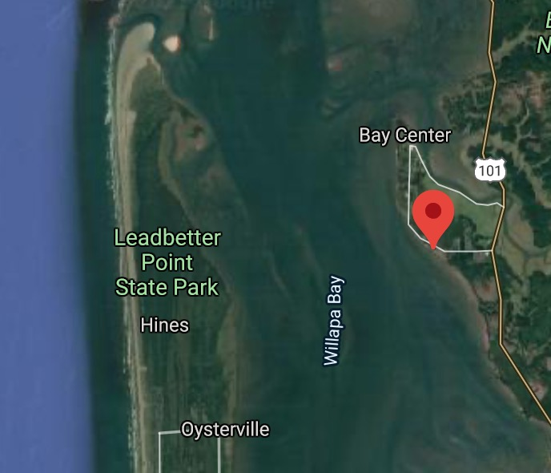
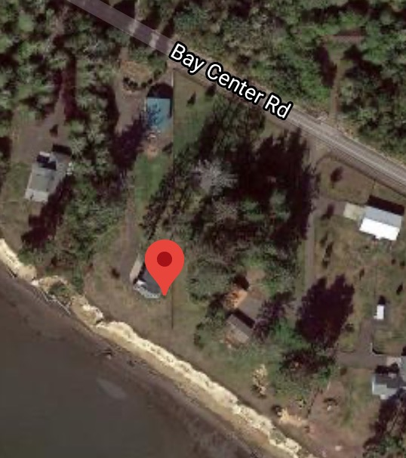
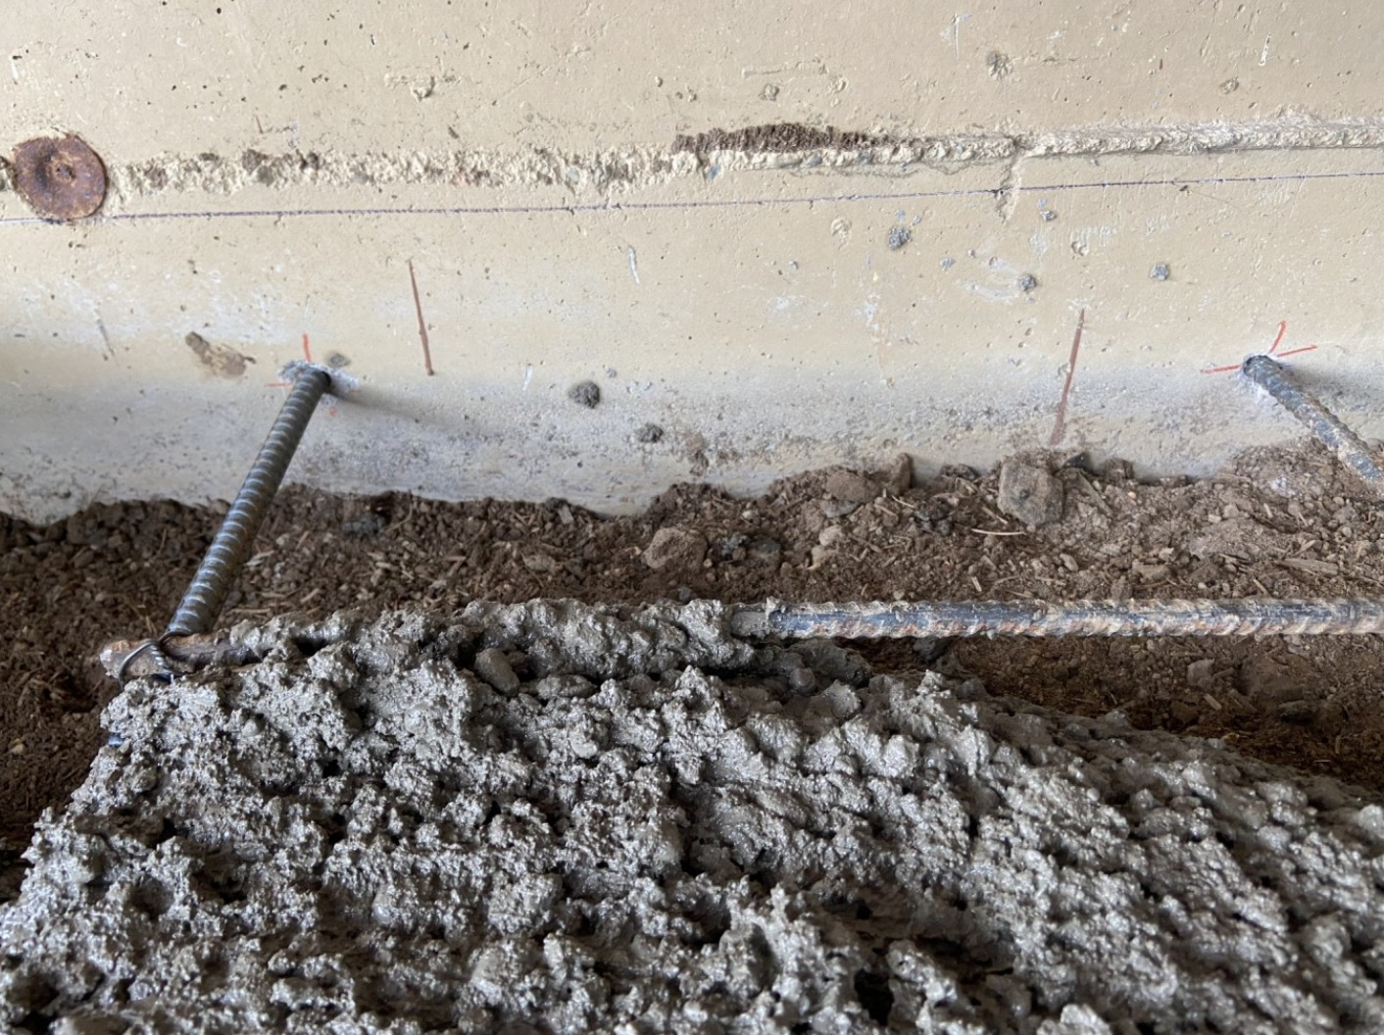
UW.BAYC coupled to building with a fridge on other side of wall?? = no Bueno.

Slide 16
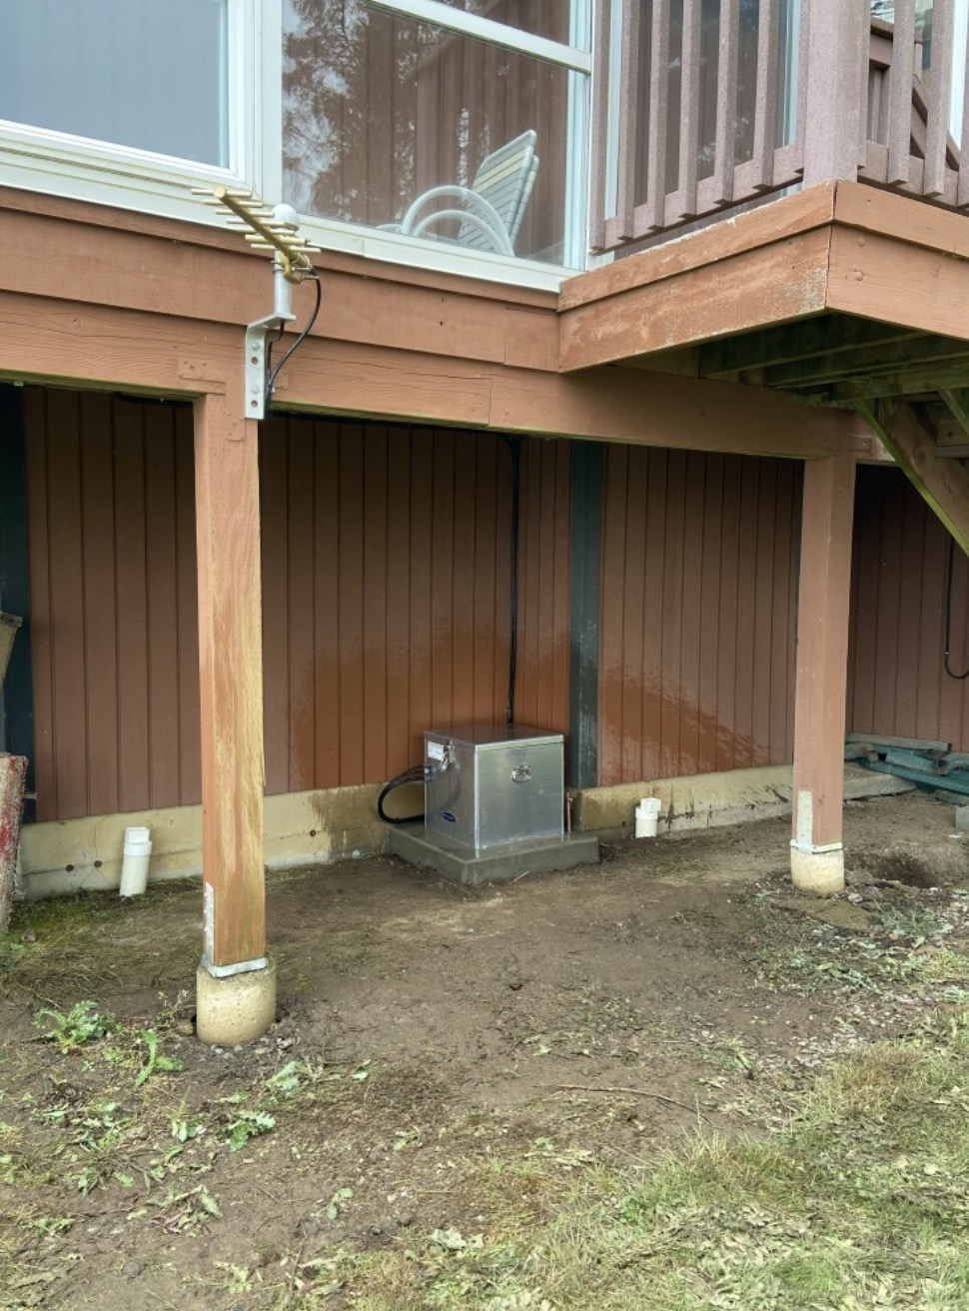
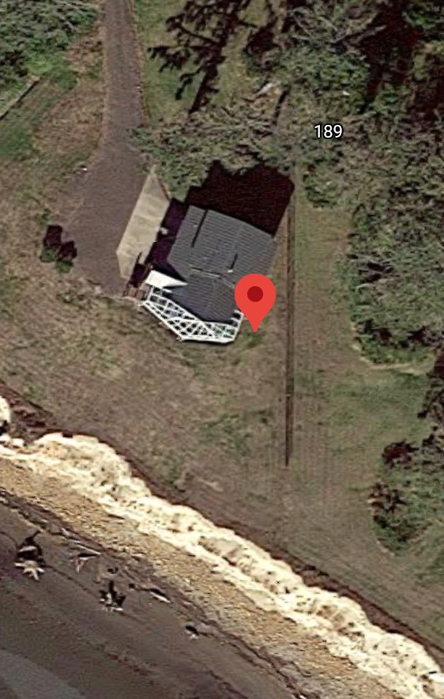
Directional & “big picture” photos help, please take them. No bueno:

Slide 17
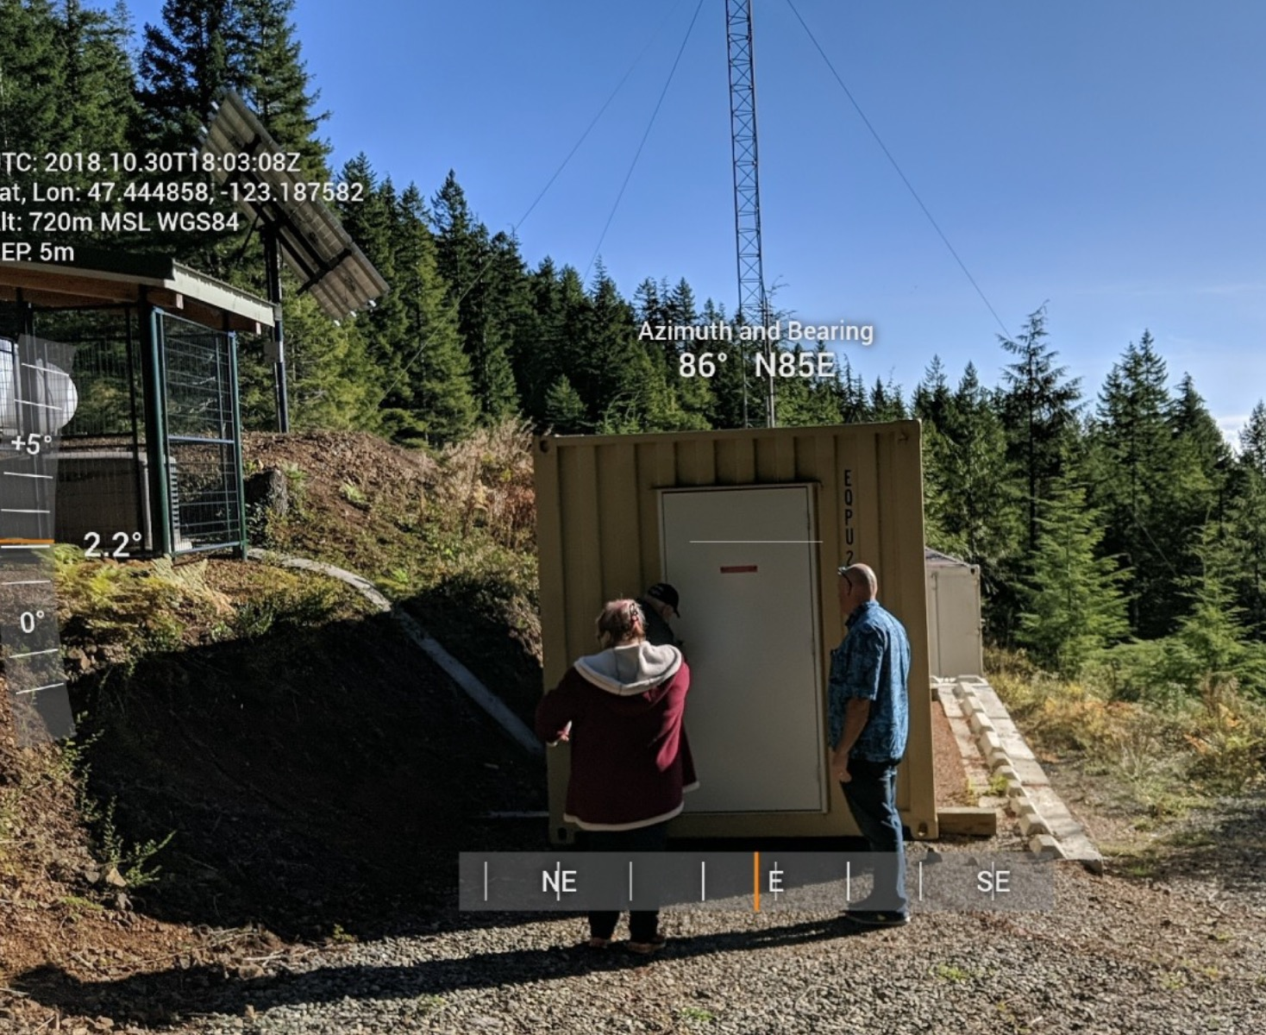
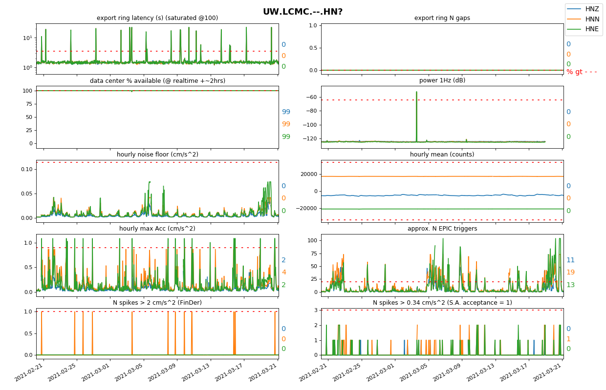
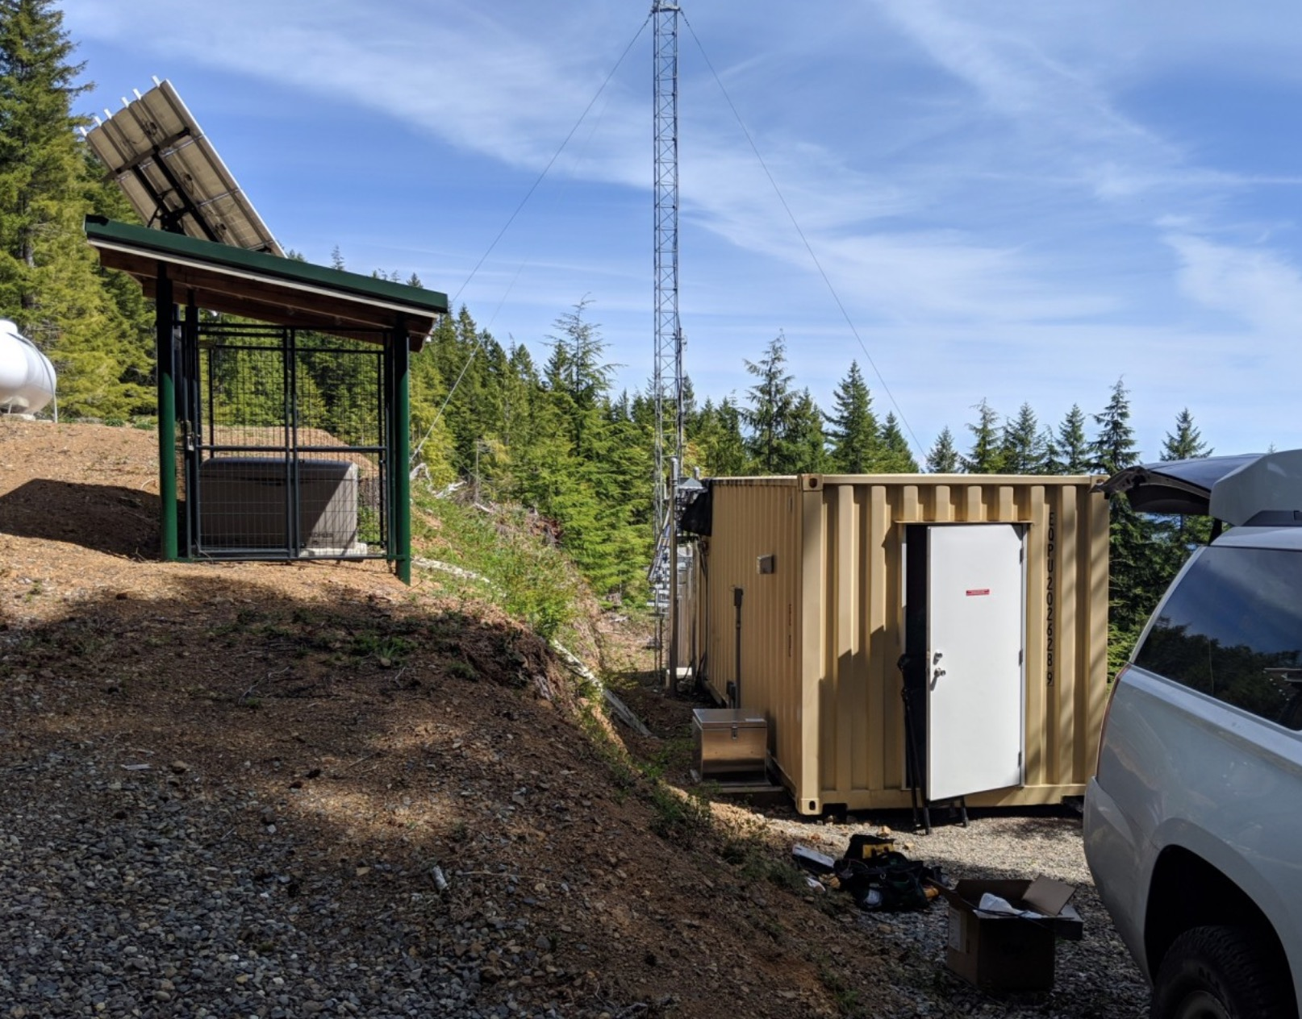
UW.LCMC Thank you for taking these photos that show station, tower, and generator with orientation and ability to gauge distances. Great remote station! Sensitive to very many triggers during windy times, but they are low amplitude.

Slide 18
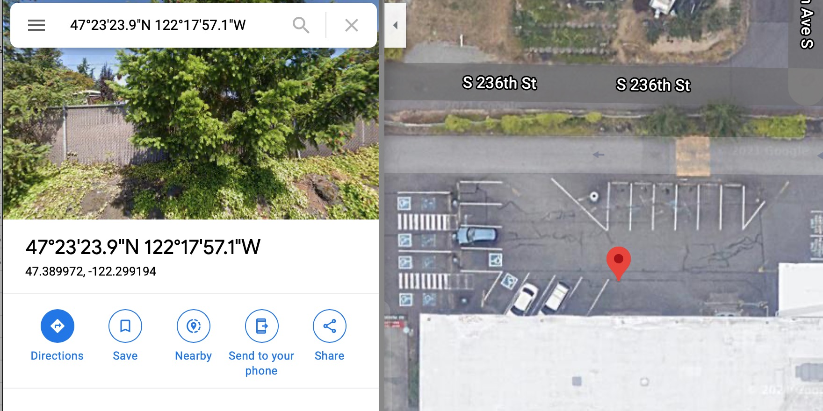
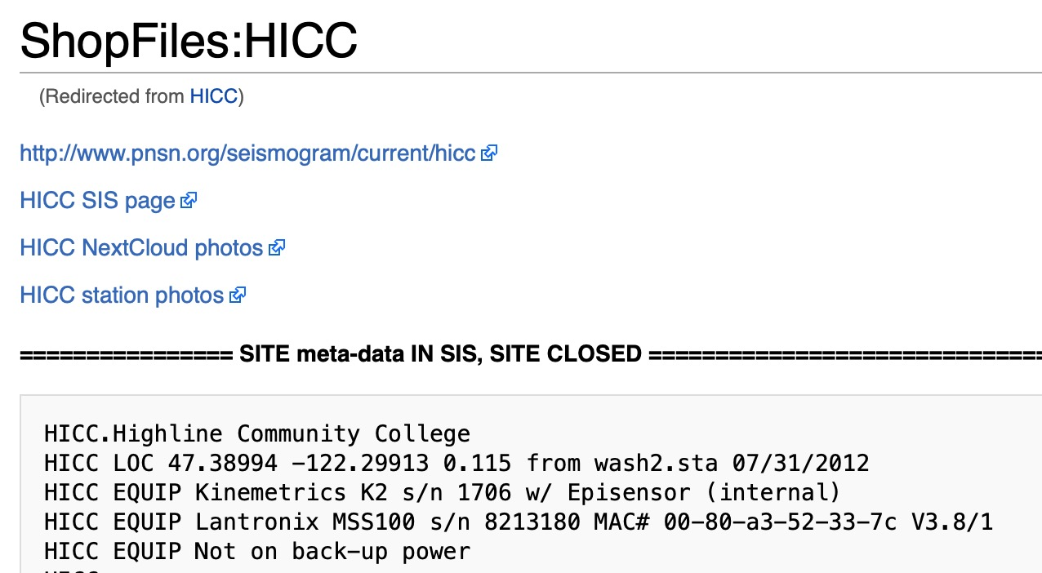
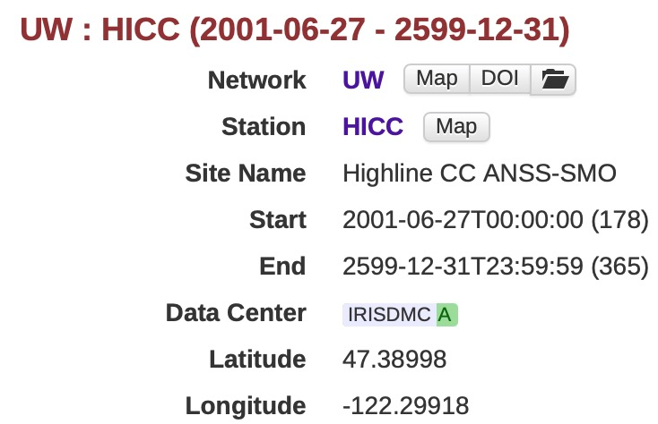
UW.HICC coordinates need to be updated (moved S by 4m)

Slide 19
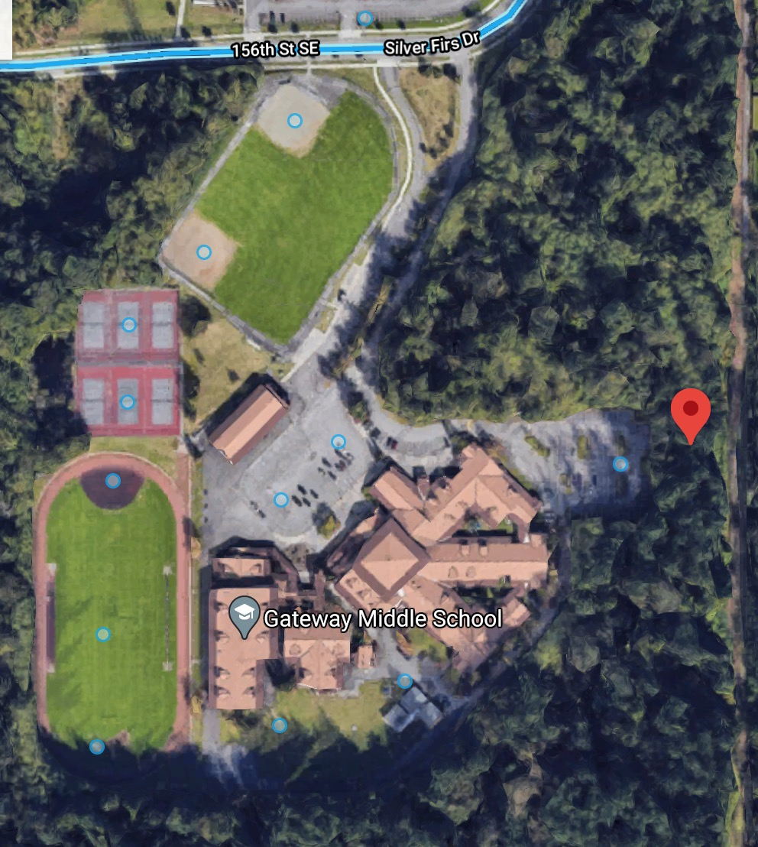
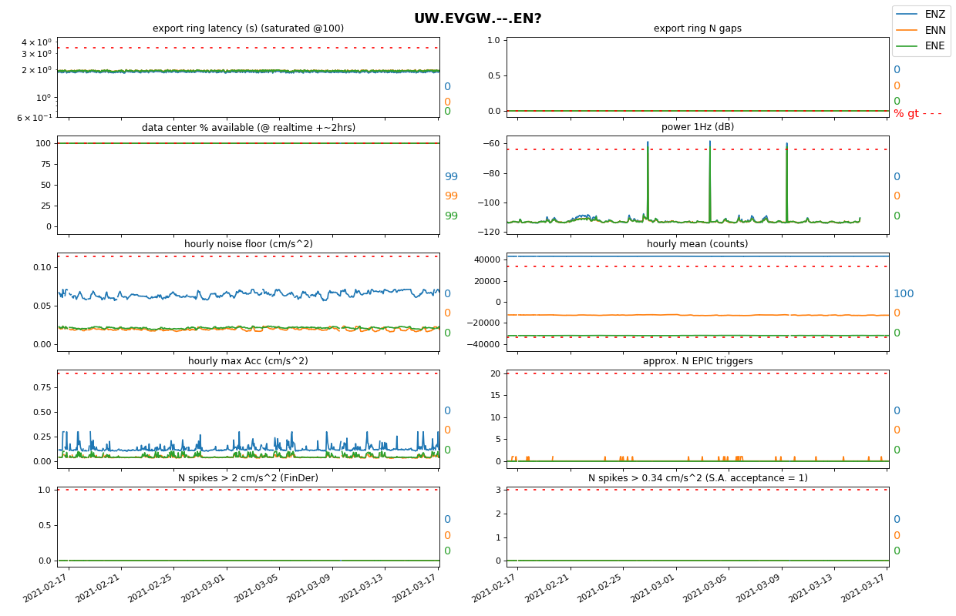
Limited school in session, excellent “indoor” station.
Metadata needs to be checked, 70m off.
Have undergrad verify IRIS/SIS coordinates w google maps and pnsndocs?

Slide 20
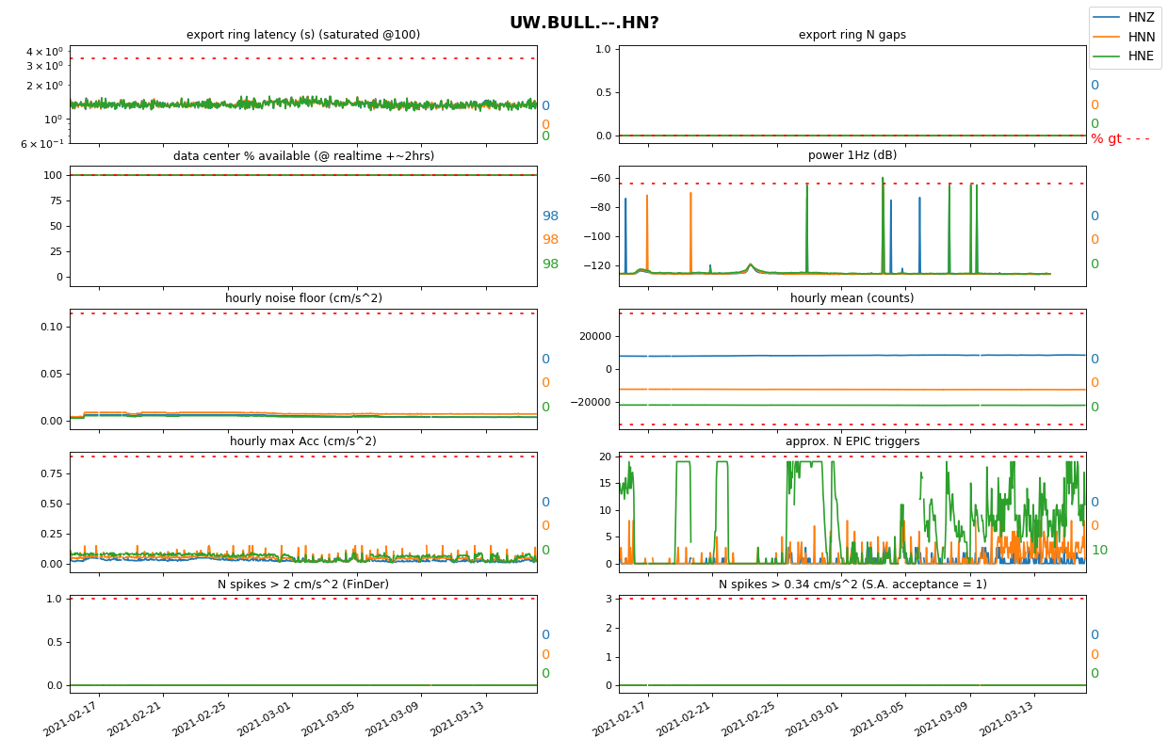
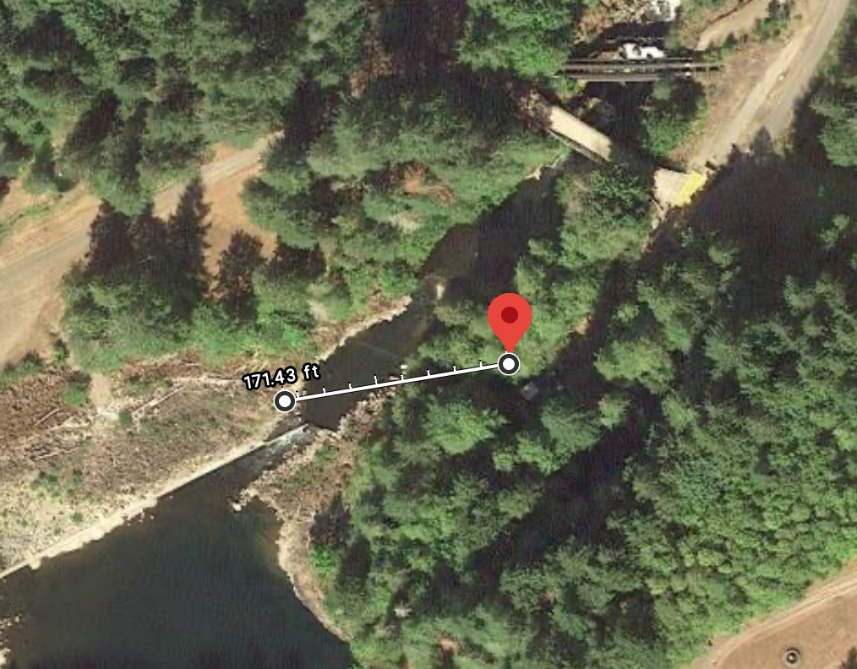
Rivers
Rivers: All the noise issues are only on E component → it’s only the white water that matters.
Note to coordinators: station review pages shows EPIC triggers are very low… this is because noise is mostly on E not Z component.

Slide 21
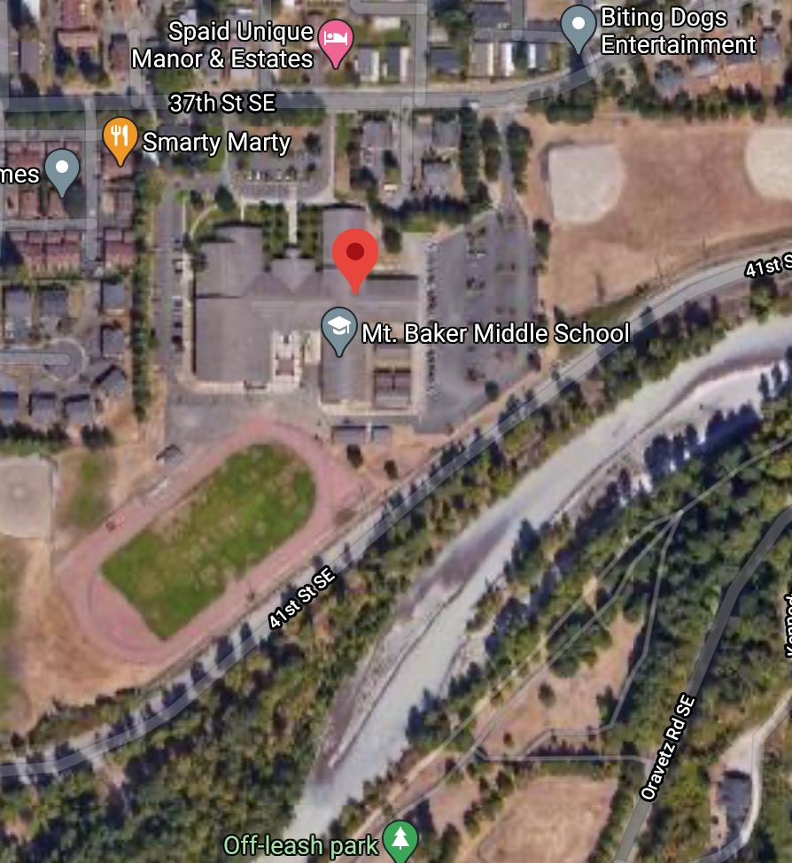
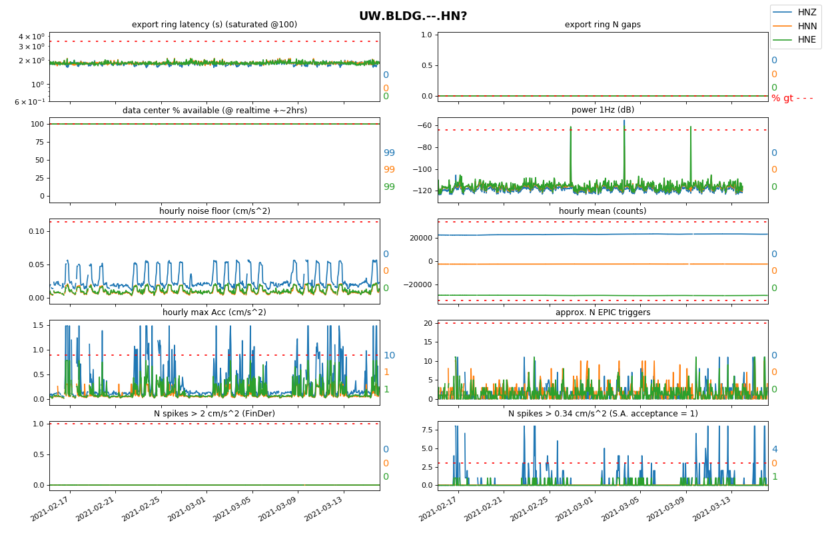
Rivers
UW.BLDG: most issues are business hours → RIVER at 150m doesn’t affect station

Slide 22
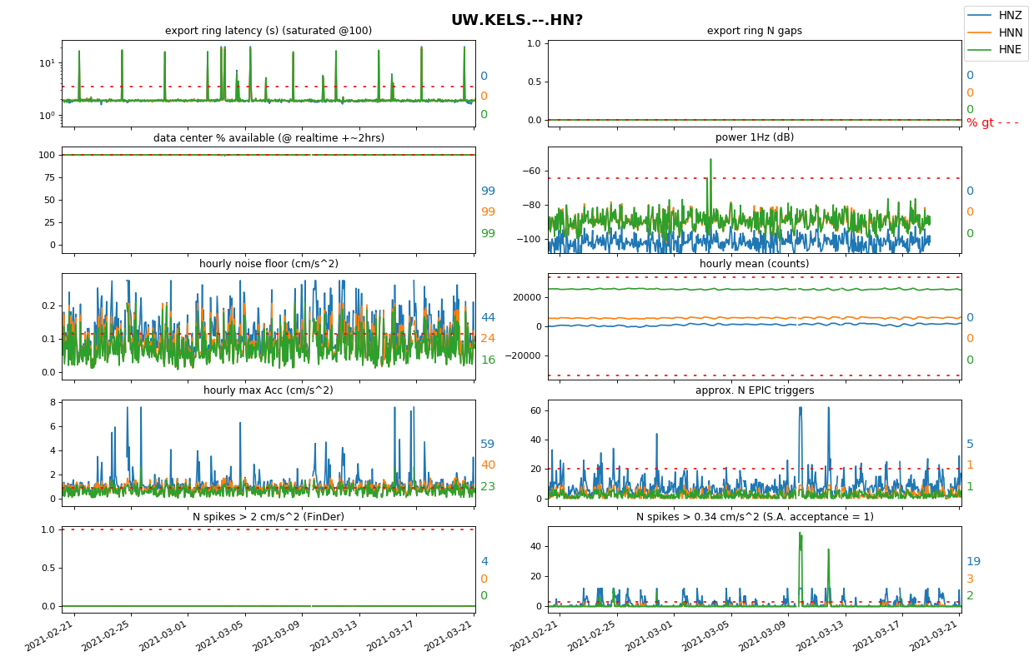
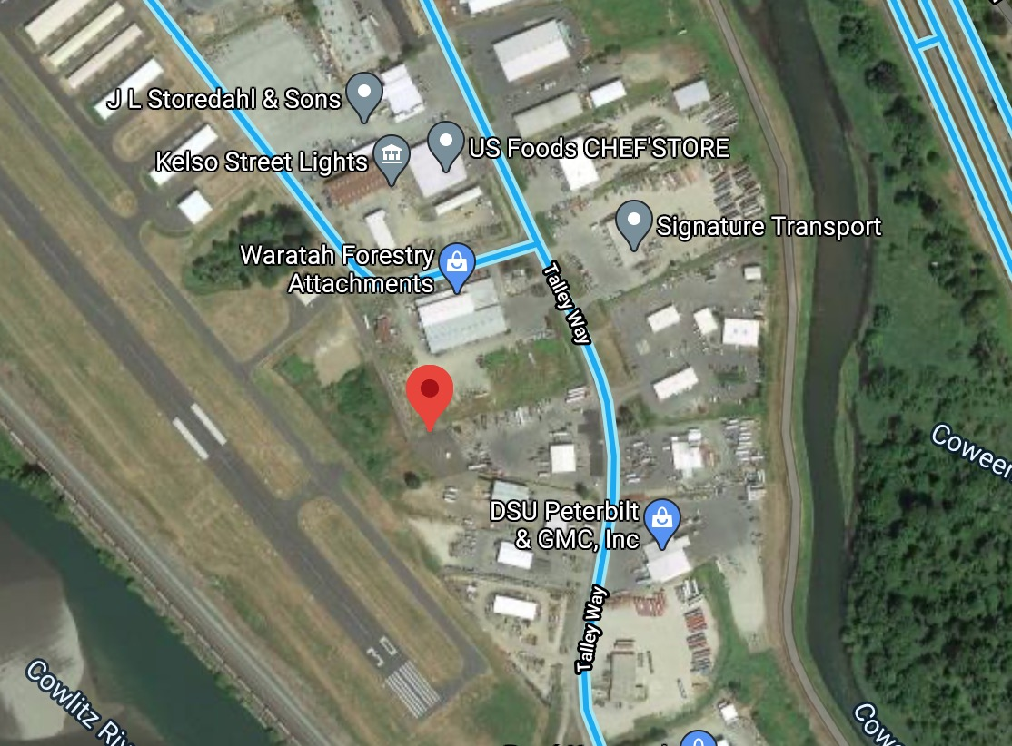
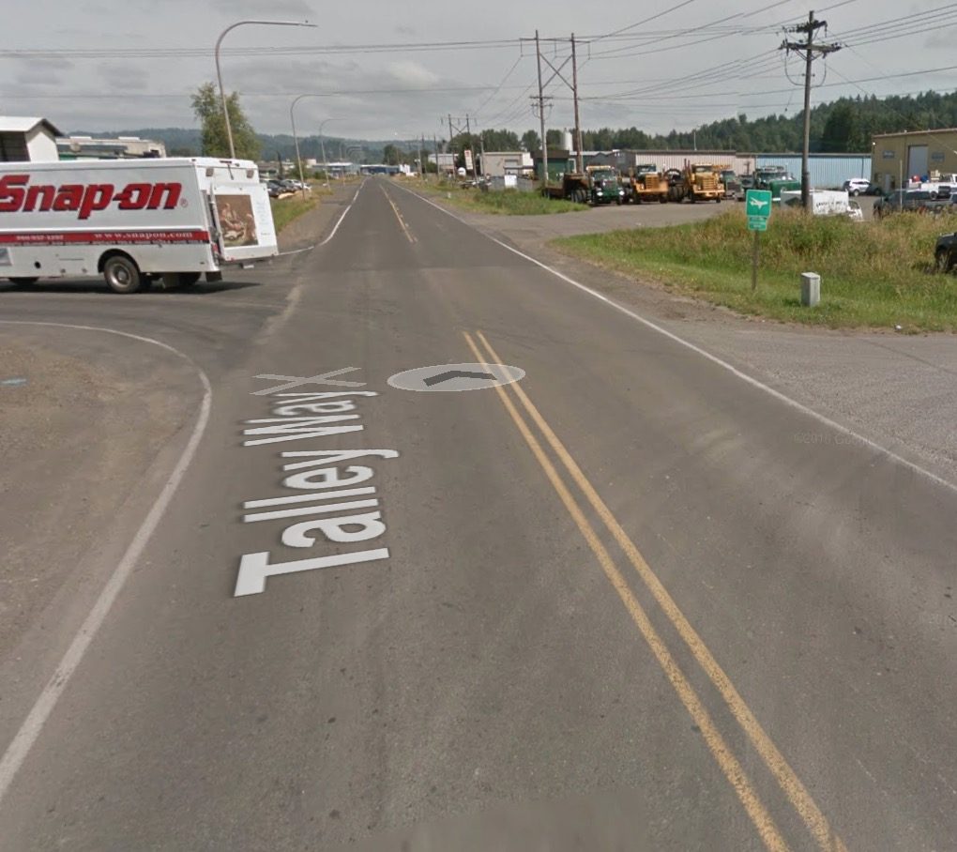
Rivers
UW.KELS pretty high noise floor, not diurnal… maybe from the big river 250m away or something industrial?

Slide 23
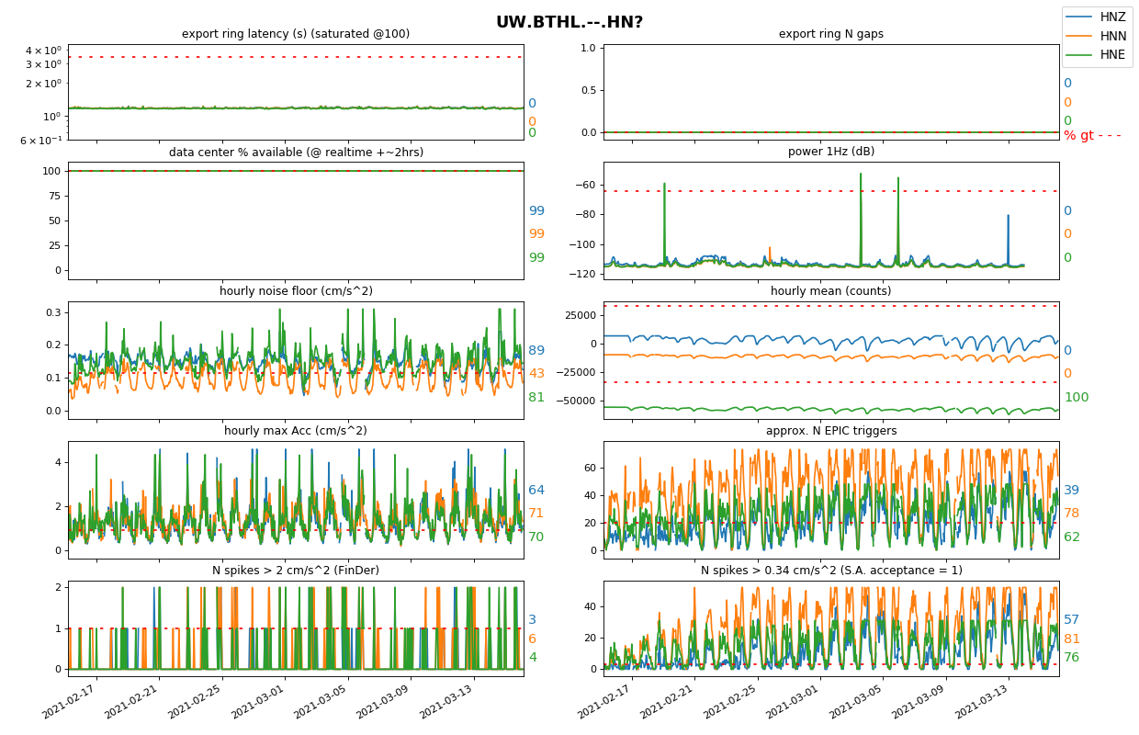
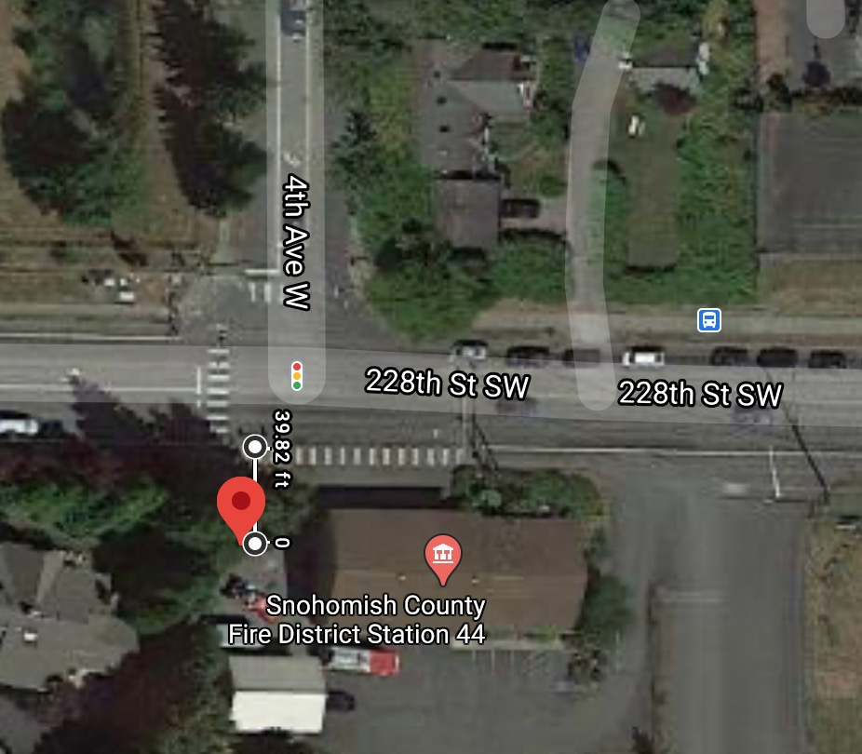
Distance to road
Ummm…. No.

Slide 24
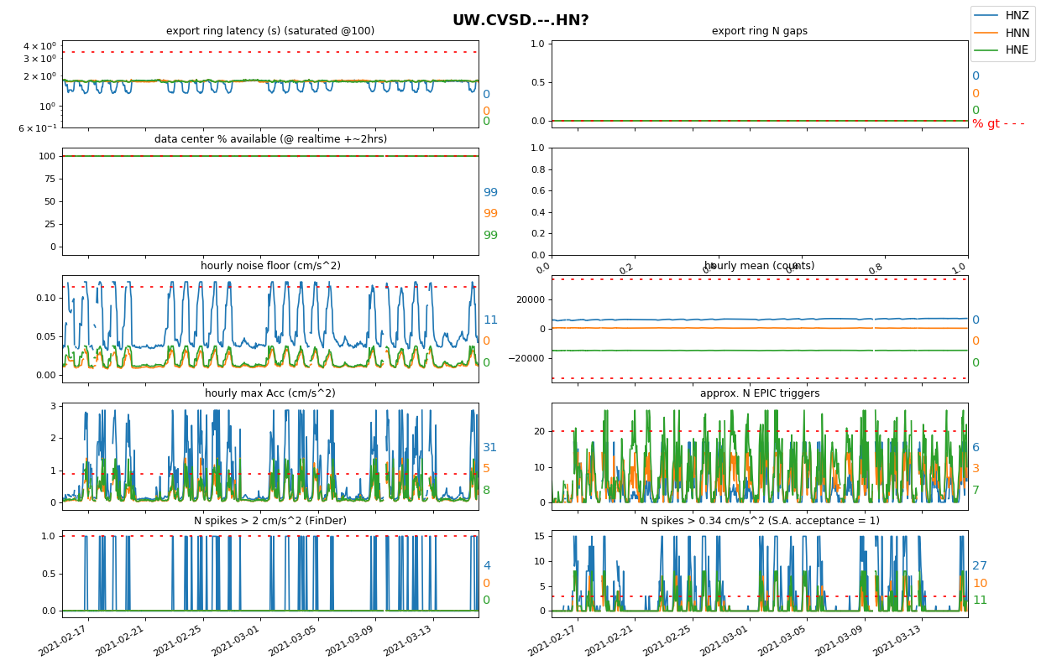
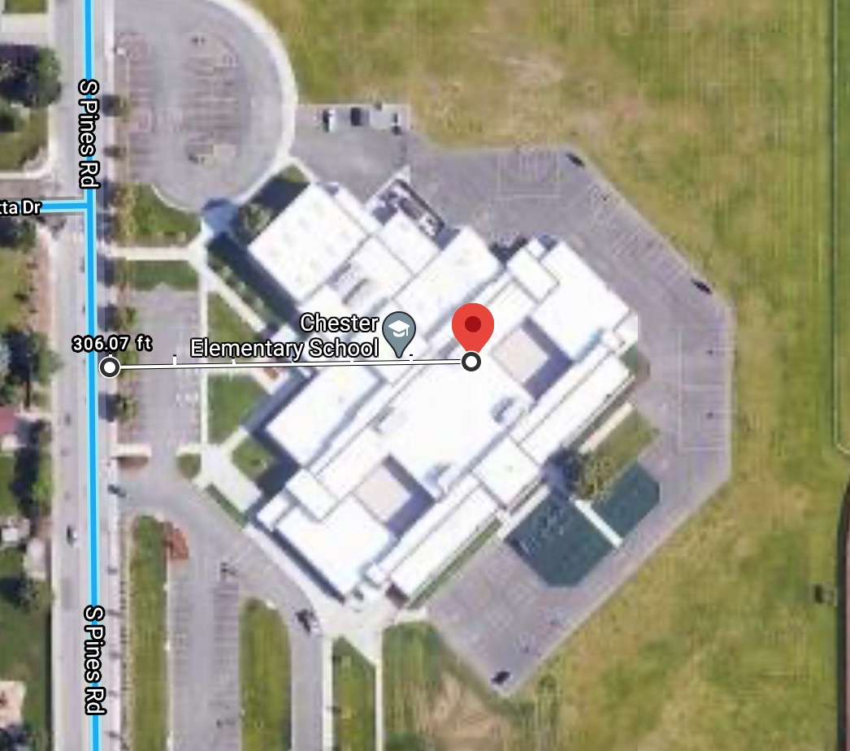
Distance to road
UW.CVSD School in session in Spokane. Not a great station, but useful.
Most significant noise is weekday only → likely foot traffic → 92 m from road is far enough to hide car noise.

Slide 25
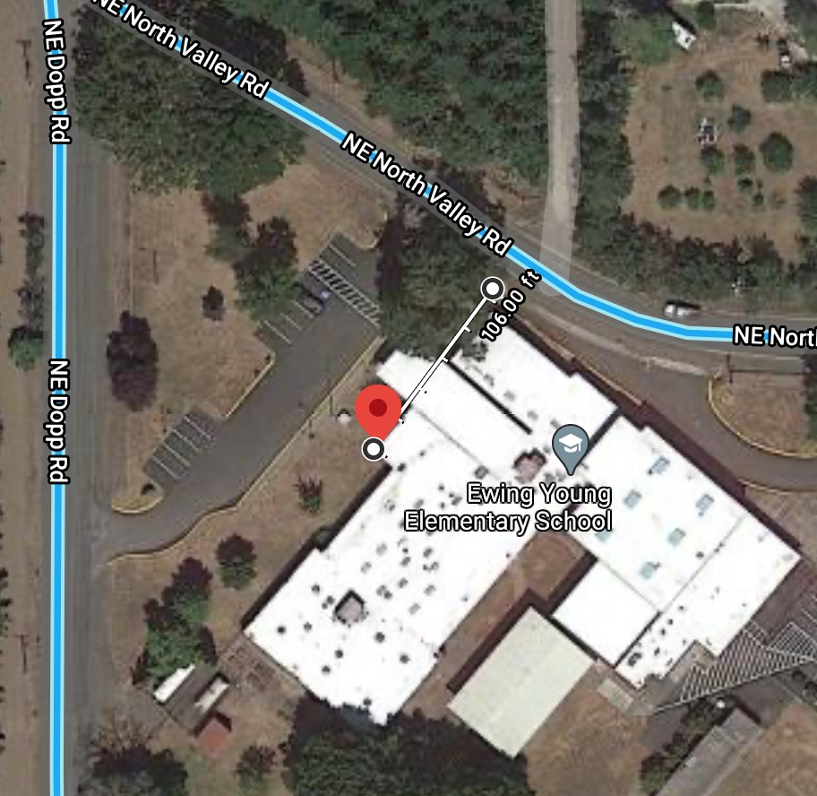
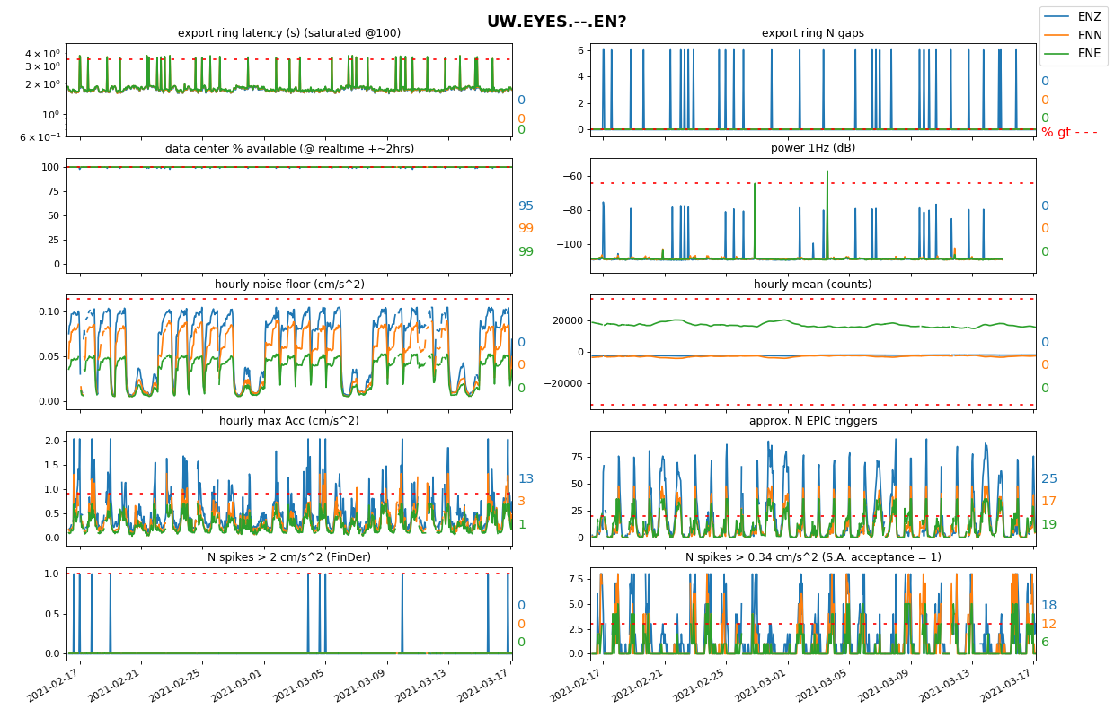
Distance to road
UW.EYES
HNE is quiet, so unlikely driveway noise → probably foot noise?
Nearby road only 34m away.

Slide 26
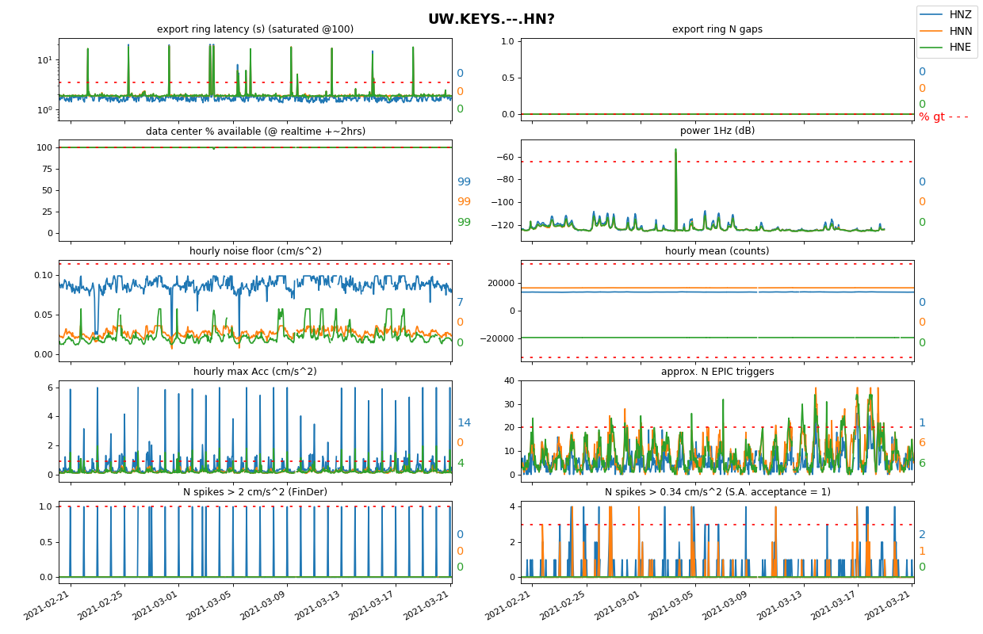
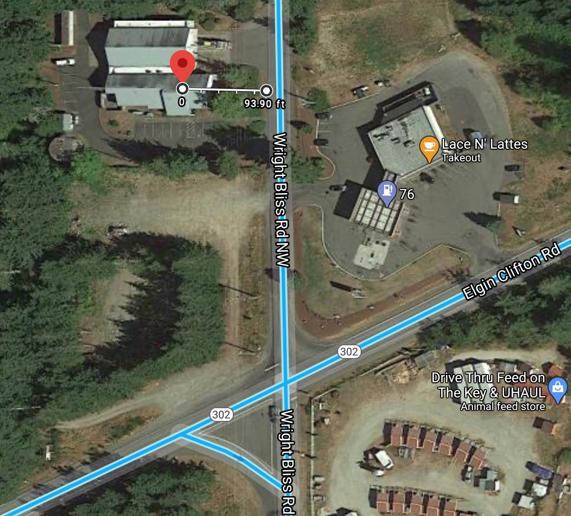
Distance to road
Only 28m to road, but 100m from stop sign

Slide 27
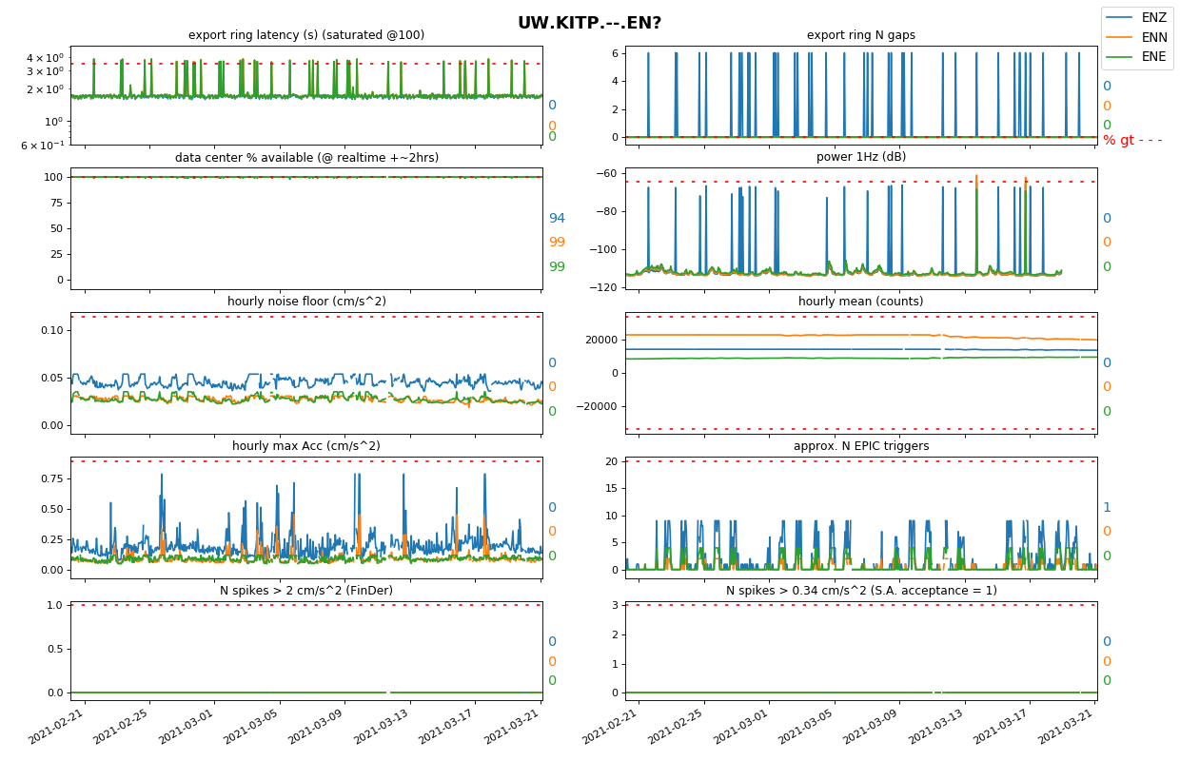
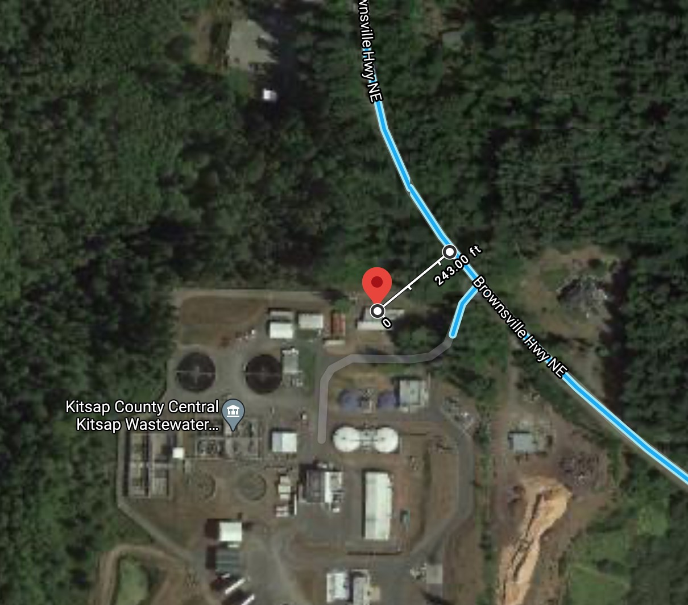
Distance to road
Excellent example of consistently decent station at 74m to otherwise isolated road.

Slide 28
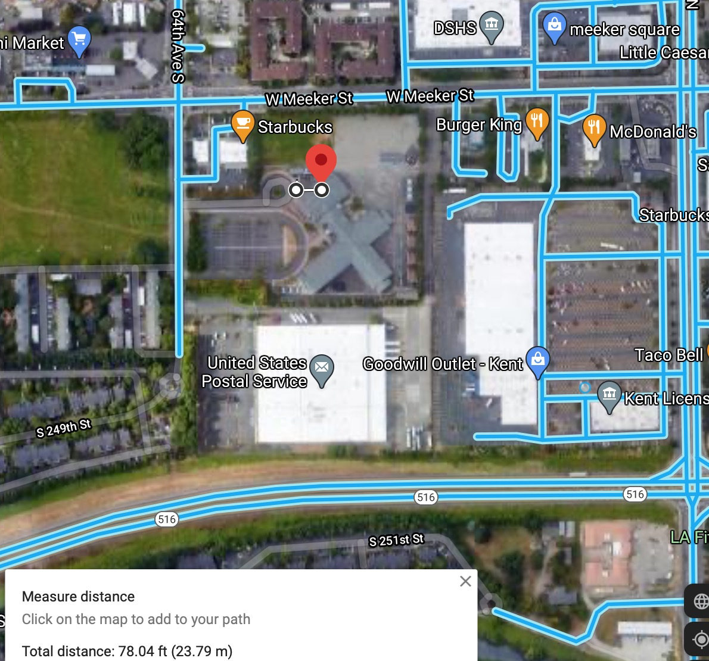
Distance to road
Excellent example of not terrible very urban school, 24m to roundabout, 78m to road. (currently closed)
*Roundabout traffic is very slow, so road is likely biggest player
Pre-covid 75th percentile: 0.05 cm/s^2 noise floor, 6 EPIC triggers/hr, 0 spikes at 0.34 cm/s^2

Slide 29
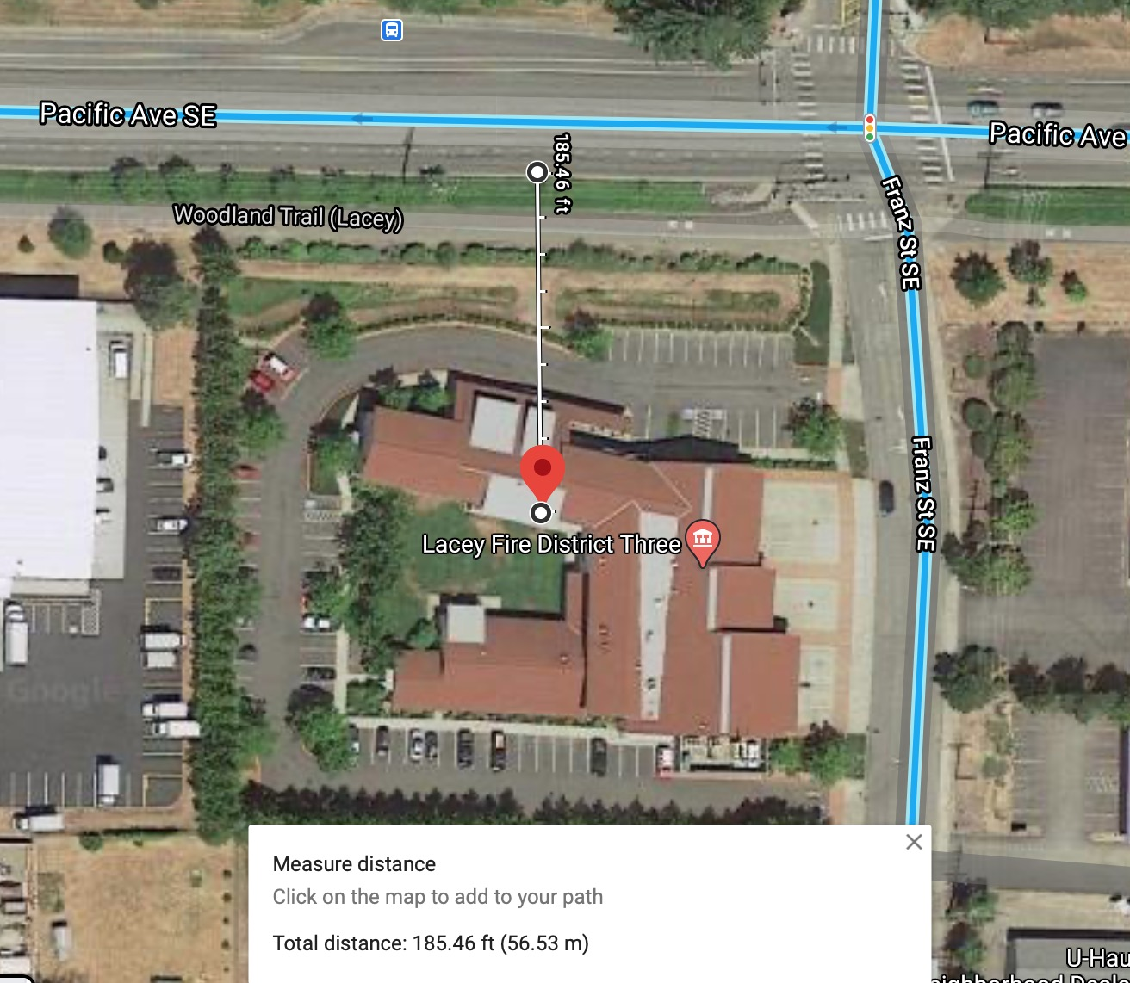
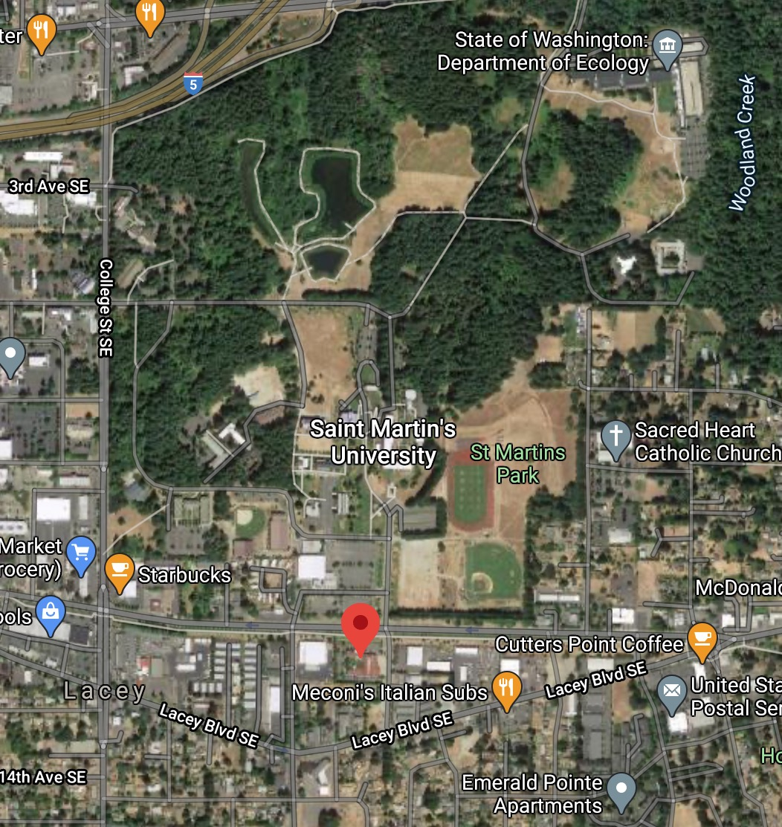
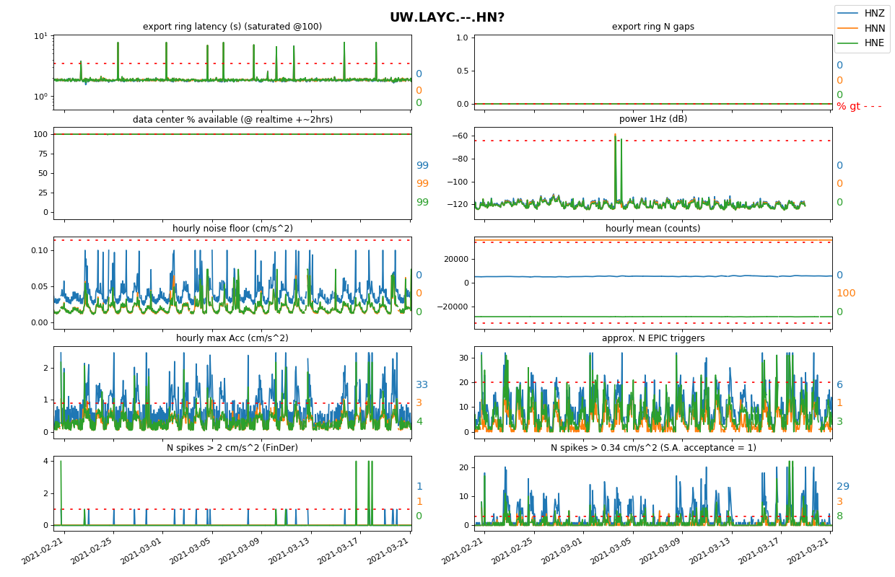
Distance to road
UW.LAYC: good example of an urban “good enough” station at 56m. Maybe try at St Martin U?

Slide 30
HVAC
UW.LARL 100m from road, but HVAC on other side of wall. 240 EPIC triggers/day.
Try to avoid…

Slide 31
Towers & interstates
I5 is at 170m is not a factor Feb 14ish = snow days, days beforehand had similar very high noise floor values → not an I5 effect.
UW.RBOK = portland

Slide 32
Private homes
Private homes can be good sites.
UW.LEVE, in a barn 67m to road, 85m to calm river, 14m to house.

Slide 33
Private homes
Private homes can be good sites.
UW.MAC
-34m to road, but it’s just a dead end and a corner → low& slow traffic
-Road for nearby apt complex to NE is 44m but has a speed bump
-No busy road for along distance
-Parking lot to SE is 70m away

Slide 34
Private homes
Private homes can be bad sites.
UW.MRN
-How busy is that road?
-Very diurnal pattern suggests its road traffic

Slide 35
Seattle Center- currently a pretty good station (100m to road), heavy foot traffic recently?

Slide 36
Dams
108 vs 330m from falling water, off dam vs on fill (soft rock)
Not many spikes at either, but huge noise floor difference.

Slide 37
FIN

Slide 38
UW.BAYC
1mgal = 0.001 cm/s^2
HMSC plot shows 0.3 mg noise floor
Station plots never see hourly noise floor fall below ~0.02 cm/s^2 (20mg), typical is 0.15 cm/s^2 (150 mg)
Titan figure is from pnsndocs page, might have been wrong early configuration?
mm/s^2

Slide 39
UW.LEWL

Slide 40
Is this a recentering of the BB (Cascadia)?
Aluminum oxide settling.

Slide 41
Very foot traffic heavy, but not awful. Different during non-covid times?

Slide 42
Super quiet when school not in session.

