Slide 1
SSA 2022
Data Mining a Large Station Metrics Database to Guide Station Siting
Alex Hutko, Kyla Marczewski, Carl Ulberg

Slide 2
SSA 2022
Introduction Conclusion
High-performance, cloud based database of metrics with alarms is really useful for a seismic network.
Roads are most noisy within 50m
Notes:
Here’s my conclusion.

Slide 3
Seismic Quality Assurance Console
GUI
django backend API
simple python read/write scripts
SSA 2022
Notes:
SQUAC is our Metrics database effort.
We’ve been working on it for over 3 years with lots of lessons learned.
Well documented wiki pages with examples

Slide 4
What is SQUAC?
It’s a fancy metrics database & interface tuned for PNSN
Notes:
Not too dissimilar from MUSTANG but tuned for PNSN as an ANSS RSN (often SMAs) and ShakeAlert partner.
There are many overlapping needs, but still some differences.
Now that we’ve done it, appreciate how much effort goes behind MUSTANG/DQA.

Slide 5
What is SQUAC?
It’s a fancy metrics database & interface tuned for PNSN
Metrics: waveform- N big/small bumps, power, noise floor, peak Acc...
SOH- latency, gaps, completeness at datacenter
Variable granularity: 10 min/hourly/daily/monthly
Contributor source agnostic; currently 8 sources
Notes:
Waveform based thing many are familiar with like power, but those don’t capture “bumps” well.
-16 full time CPUs @PNSN
-power from IRIS MUSTANG
-latency/gaps sniffed at 4 ShakeAlert centers on dev machines
-Caltech and Berkeley are contributing trigger counts for different algorithms

Slide 6
What is SQUAC?
It’s a fancy metrics database & interface tuned for PNSN
Metrics: waveform- N big/small bumps, power, noise floor, peak Acc...
SOH- latency, gaps, completeness at datacenter
Variable granularity: 10 min/hourly/daily/monthly
Contributor source agnostic; currently 8 sources
AWS EC2 w RDS db, 2-10 servers (autoscaled), S3 archive ~$500/mo
~2 Billion measurements (400 GB)
9 Million measurements/day (>100/sec)
Performance: Create_or_overwrite ~80 measurements/sec
Read ~500 measurements/sec
Notes:
We tried hosting the database on a local machine, and it was just terrible performance.
-16 full time CPUs @PNSN
We’ll soon be calculating in the cloud.

Slide 7
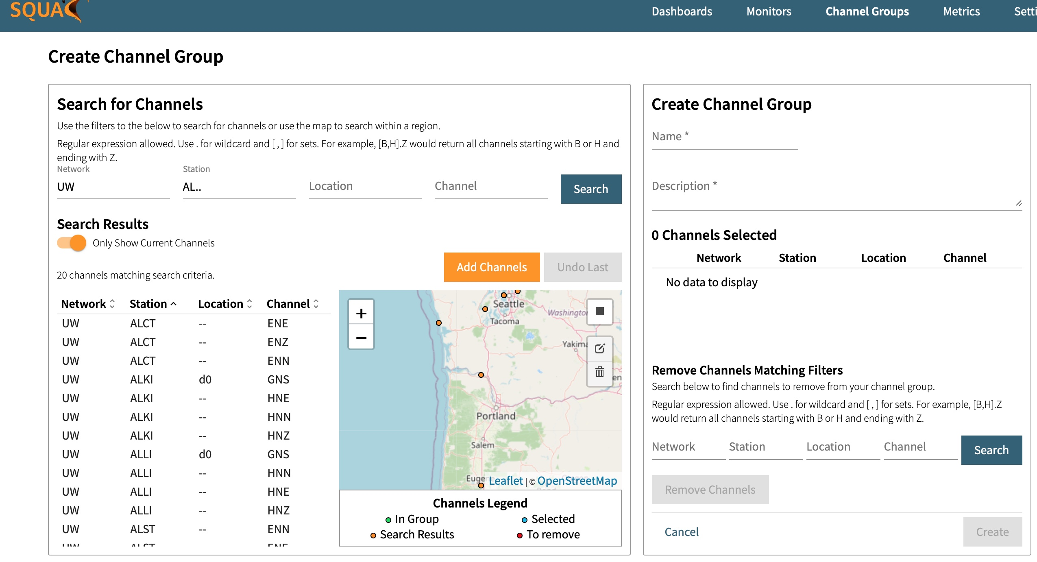
Creating your channel group
Notes:
Can plot raw measurements or any of a dozen statistics.

Slide 8
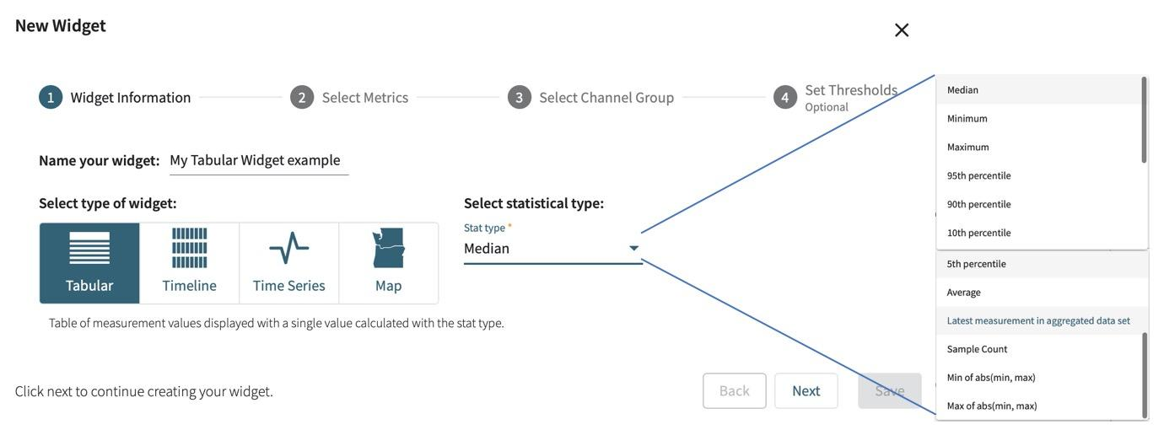
Creating your dashboards
Notes:
Can plot raw measurements or any of a dozen statistics.

Slide 9
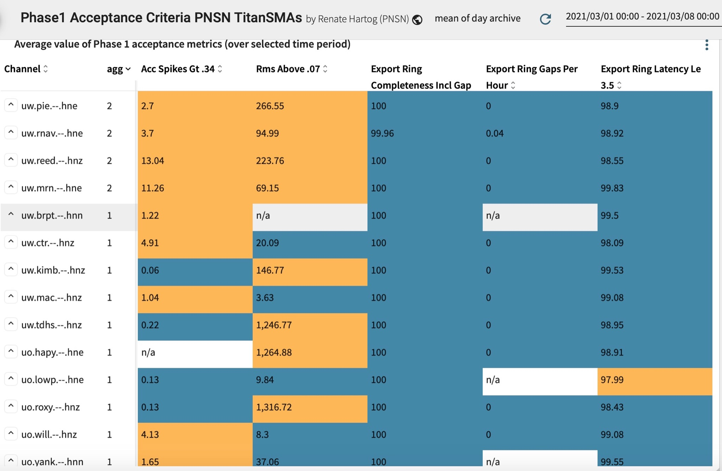
Table widget:
Single view of multiple metrics over a time window
Notes:
“agg” is the count of metrics that are failing the user-defined thresholds.

Slide 10
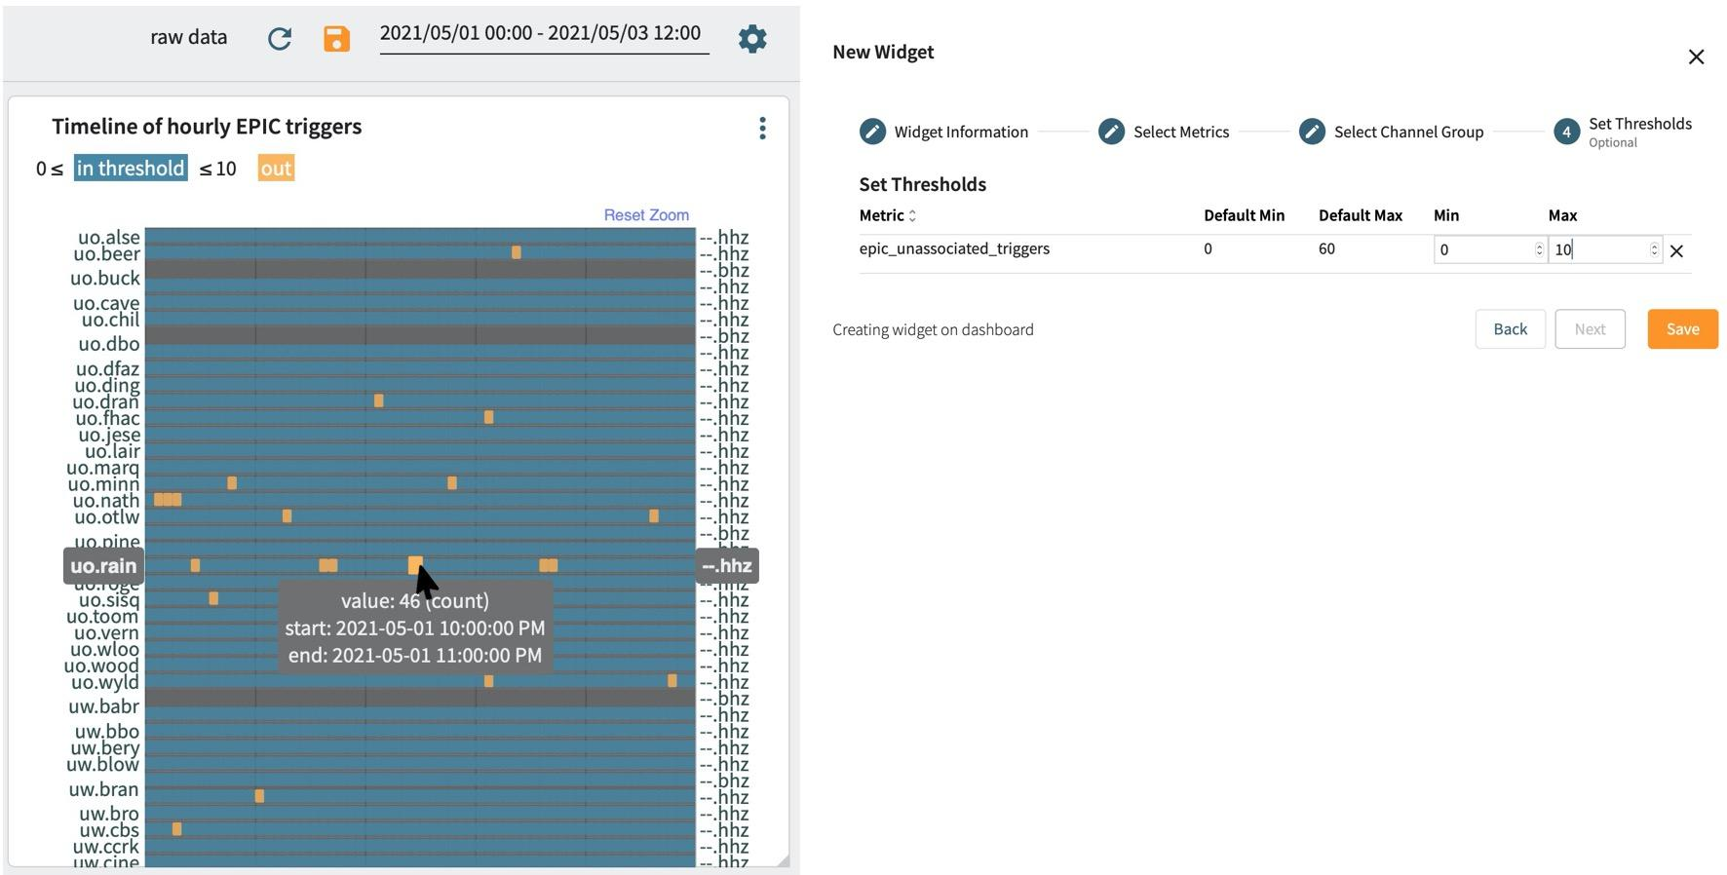
Timeline- think: SeisNetWatch with thresholds/color gradients
Notes:
We’ll color gradients

Slide 11
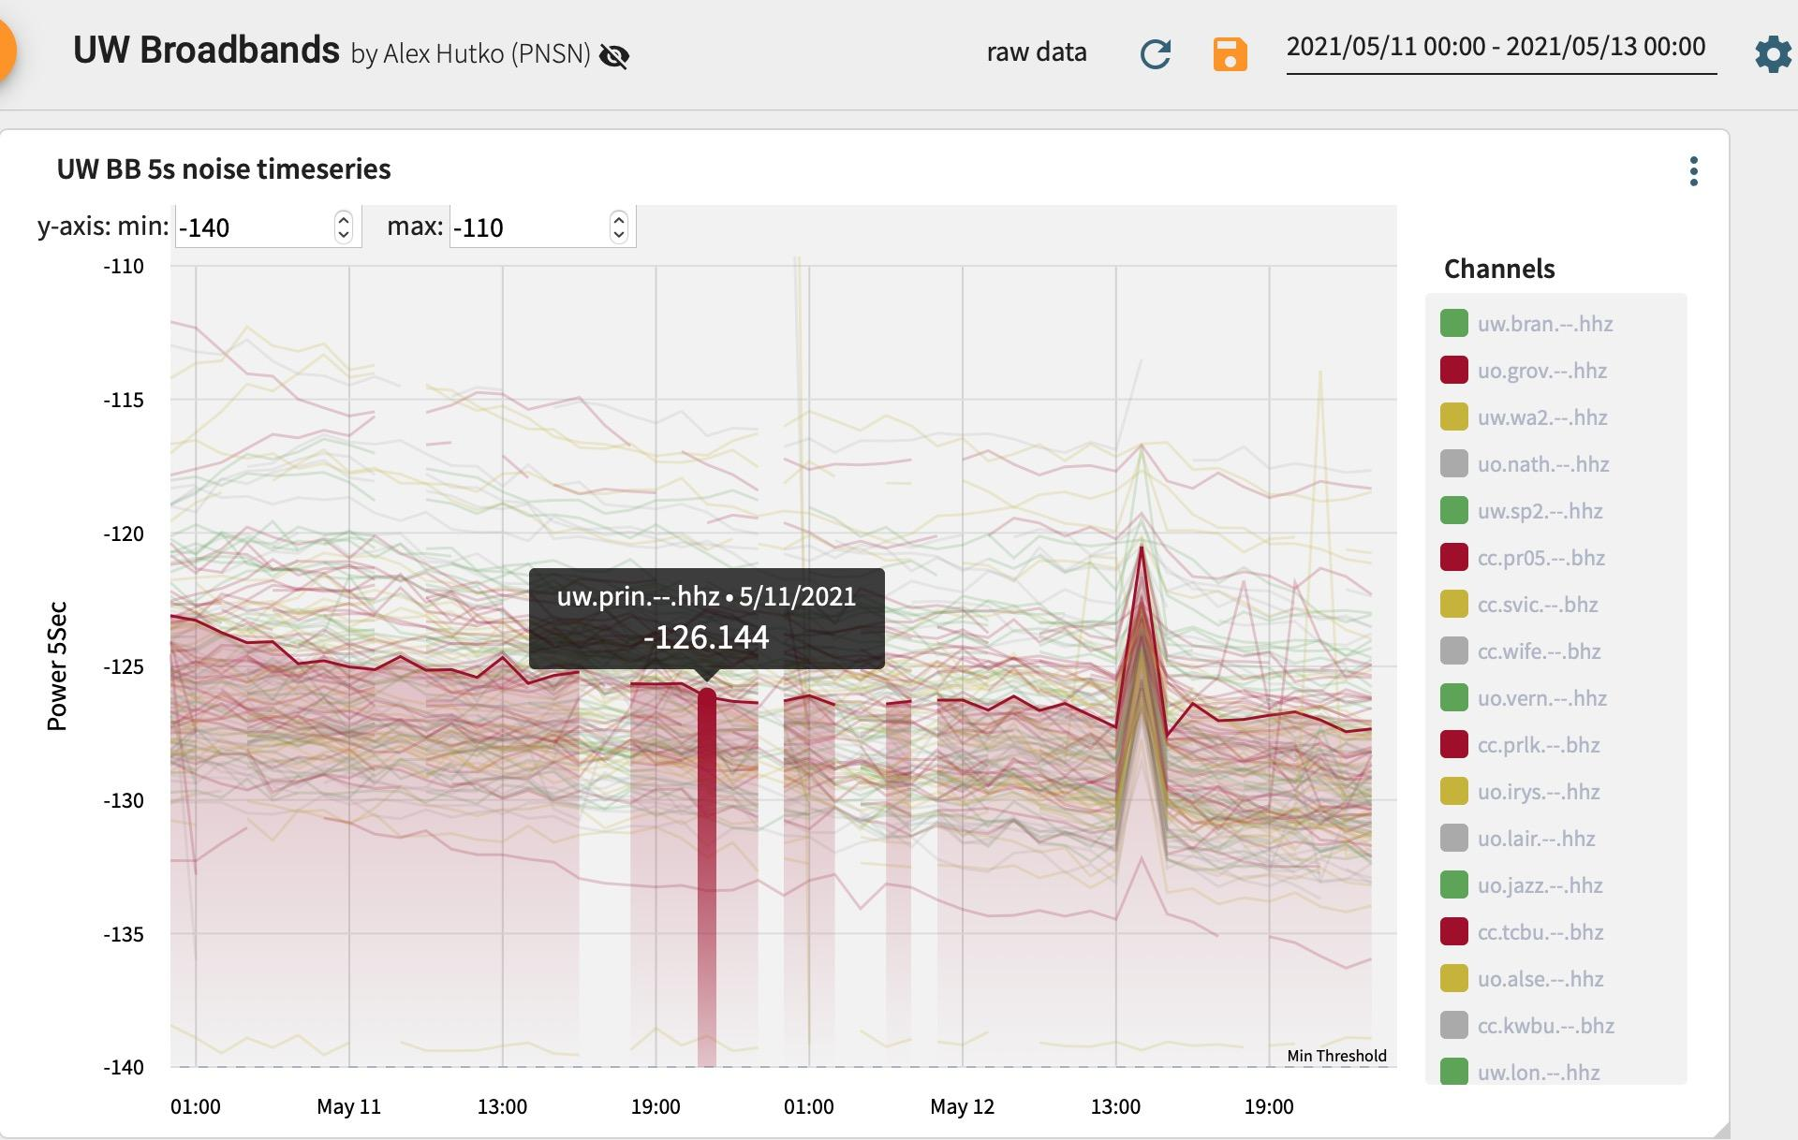
Notes:
Timeseries for detailed view of raw values

Slide 12
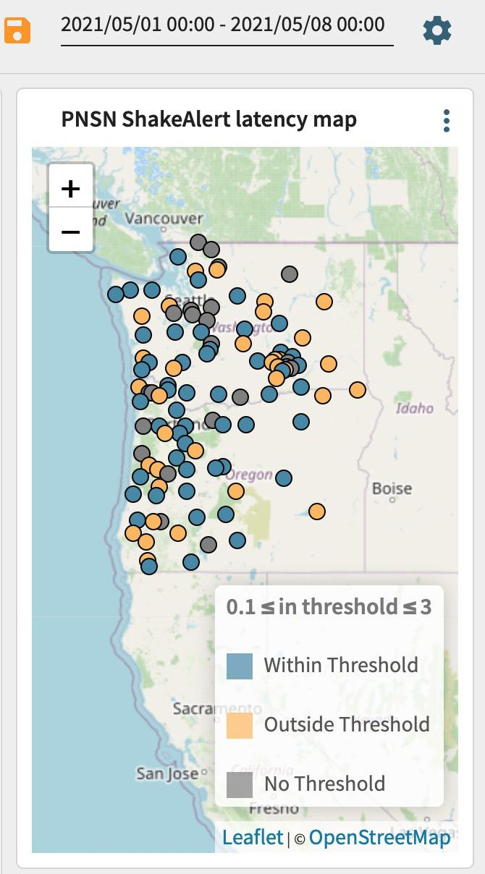
Notes:
Map view that looks similar to MUSTANGular because Kyla is the dev who made both.

Slide 13
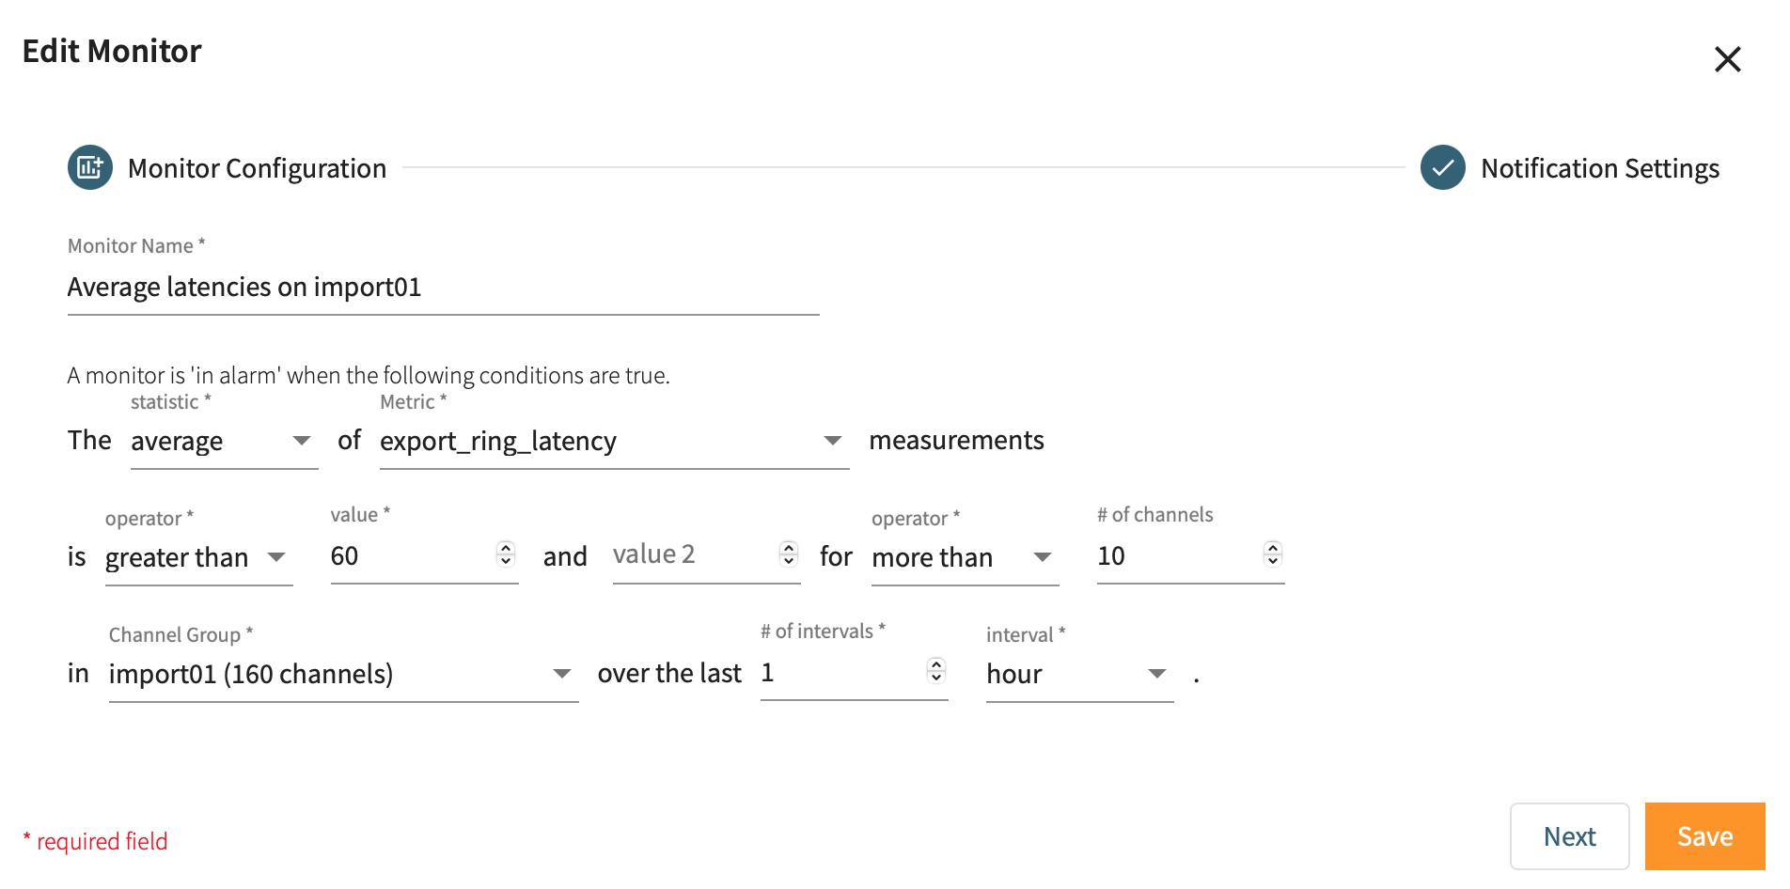
Alarms
Notes:
- measurement upload counts
Is it within a range of two numbers or outside of the range.
- raw measurements or stats of data
- Granularity of time windows can be minutes/hours/days

Slide 14
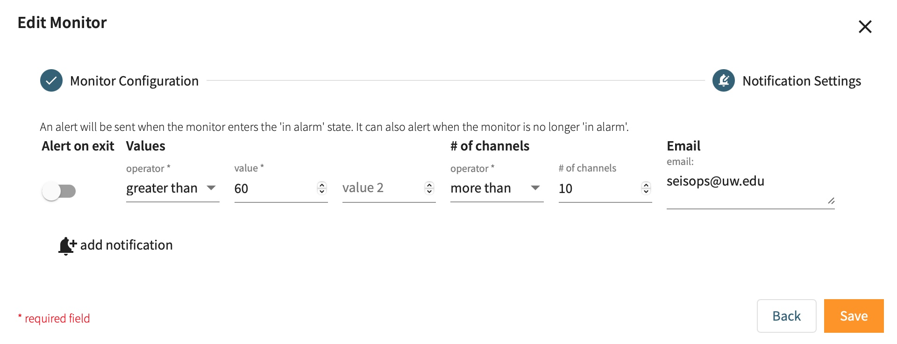
Notes:
This is what we just set up and if you want to add additional alarms

Slide 15
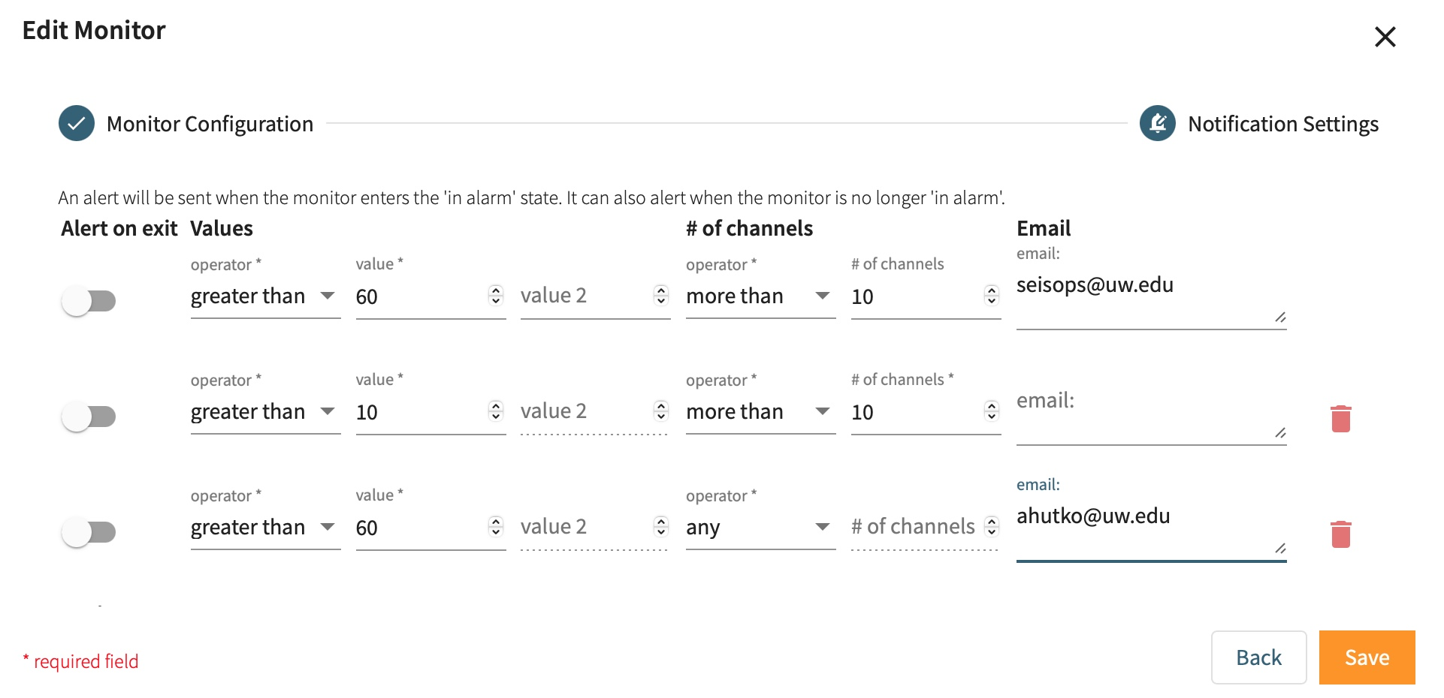

Slide 16
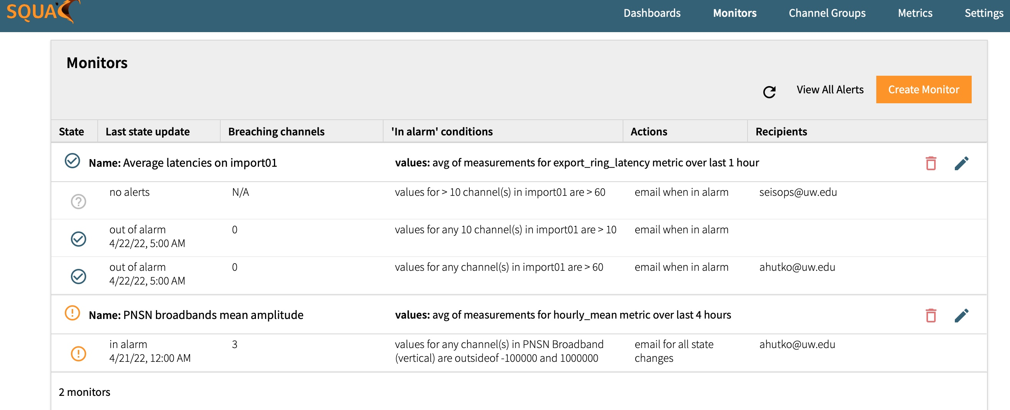
Alarms
Notes:
Here is an overview of what was just set up. You see:
Some are now out of alarm with the time stamp.
Some have never gone into alarm.
Some are in alarm and it shows the number of channels breaching the thresholds.

Slide 17
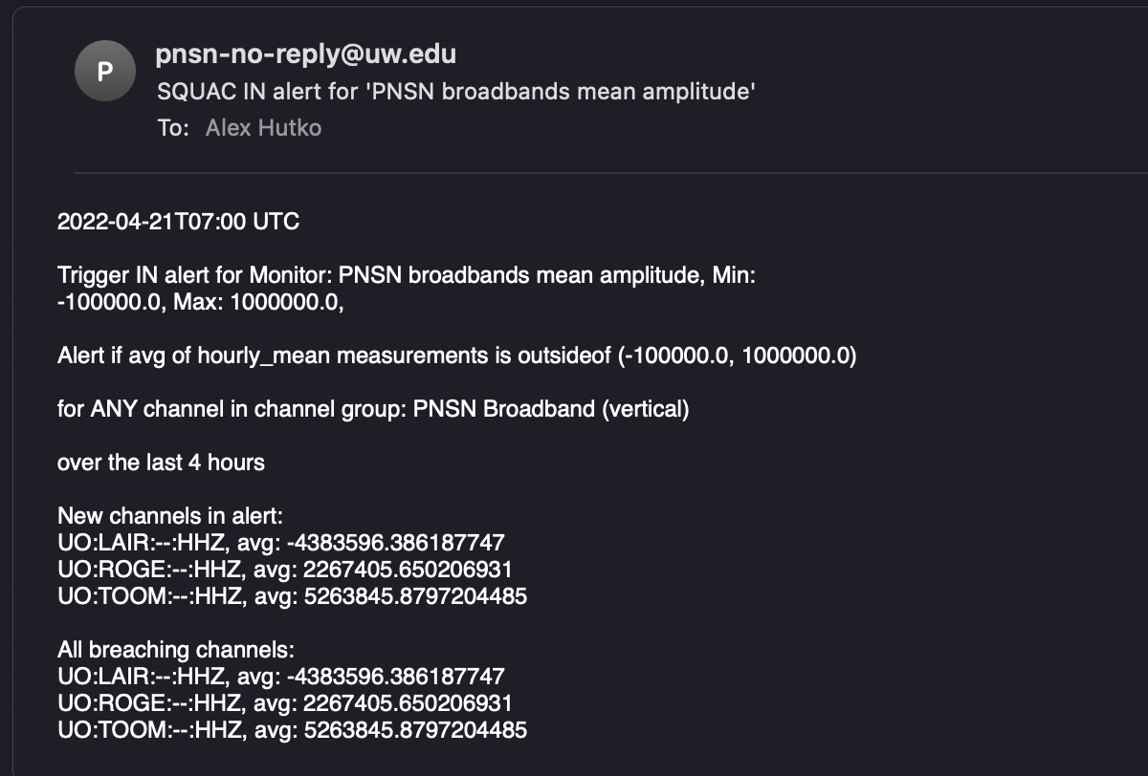
Alarms
Notes:
Email includes all the alarm information including newly breaching channels, as well all breaching channels.
Can also use as a monitor on metric uploads → tell you if a machine is down or out of memory

Slide 18
Holistic views & Data mining
Notes:
Shifting gears on use cases of the database.

Slide 19
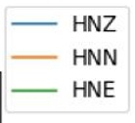
Use case: holistic report of station over past few weeks
Notes:
Strong motion station at an elementary school.

Slide 20
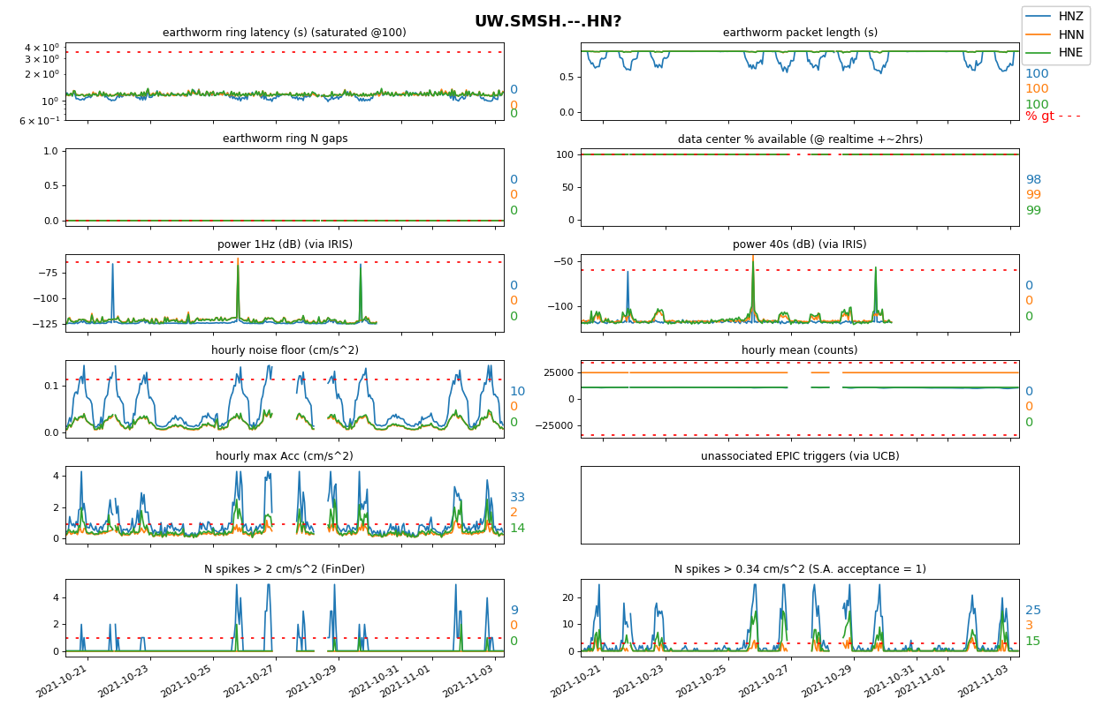
Use case: holistic report of station over past few weeks

Slide 21
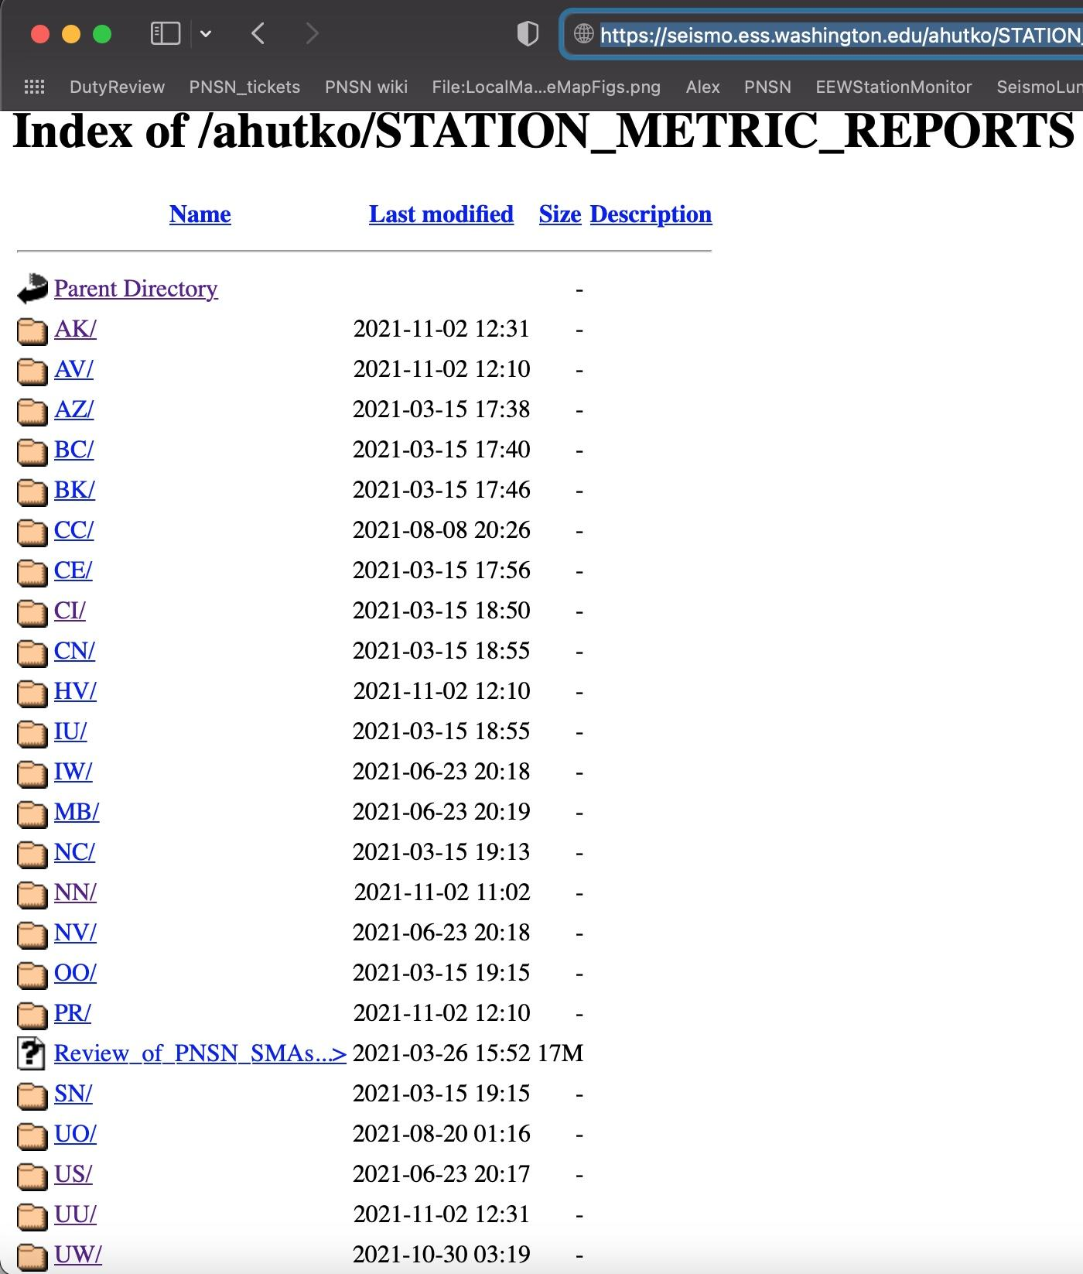
Use case: holistic report of station over past few weeks
Reports for most stations in ANSS:
Updated 2x/week: https://seismo.ess.washington.edu/ahutko/STATION_METRIC_REPORTS/

Slide 22
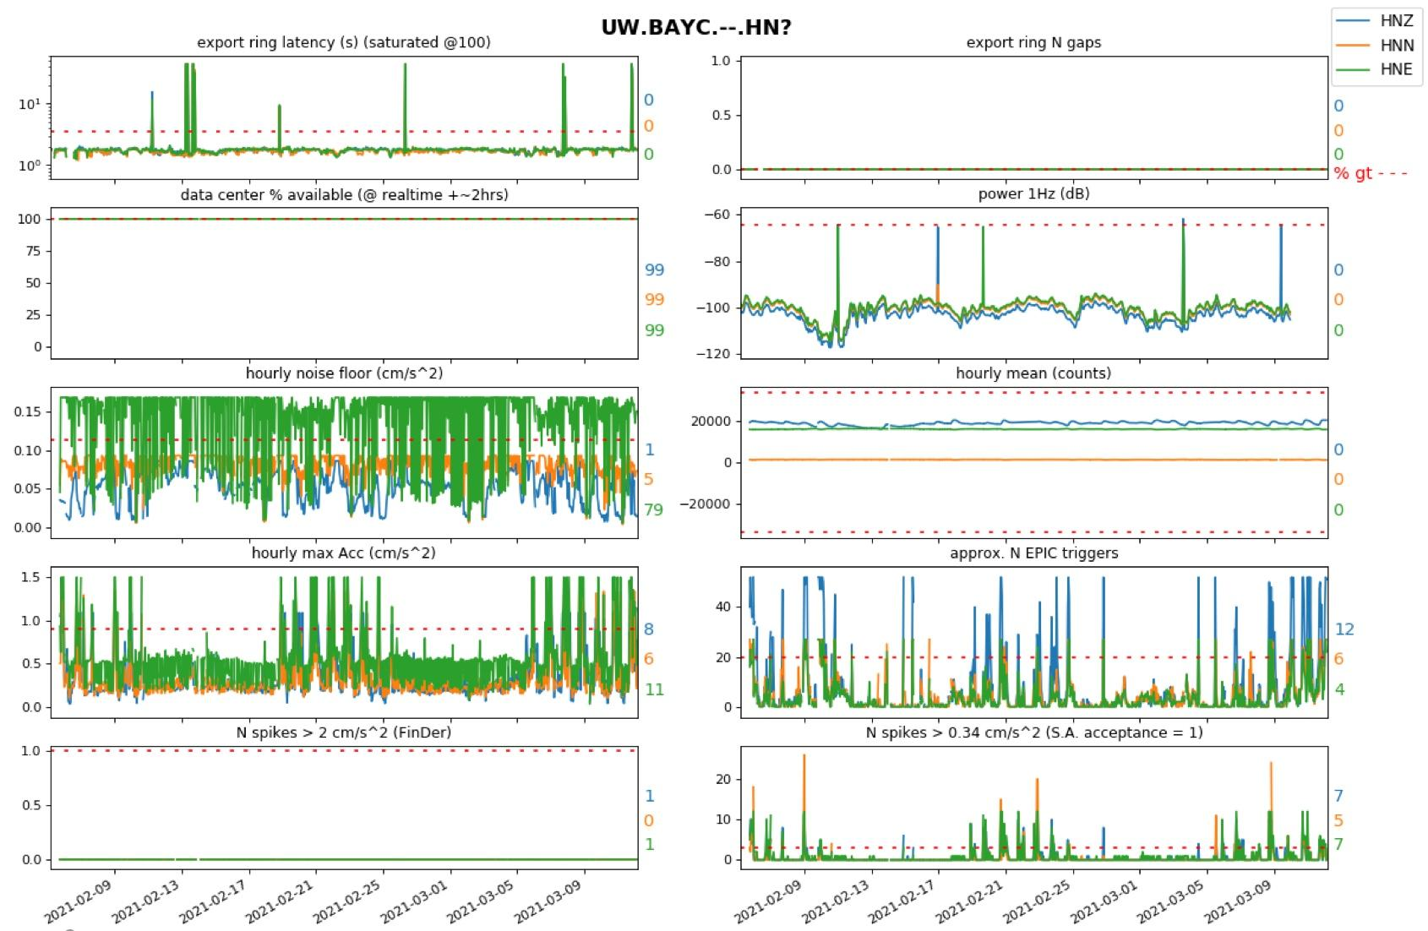
Use case: holistic report of station over past few weeks
Reports for most stations in ANSS:
Techs were informed something wrong w HNE. pier was coupled to house foundation :-(
Updated 2x/week: https://seismo.ess.washington.edu/ahutko/STATION_METRIC_REPORTS/
Notes:
https://seismo.ess.washington.edu/ahutko/STATION_METRIC_REPORTS/
Only PNSN & ShakeAlert stations are being sniffed for latency & gap info.
These Station Metric Reports have >40k measurements shown. Red dashed lines show the median value at the 95th percentile worst station in the PNSN for the shown metric aka typical values for a “bad” station. Colored numbers show % of time measurements exceed the red dashed line…. I.e. % of time it is really bad for that metric.

Slide 23
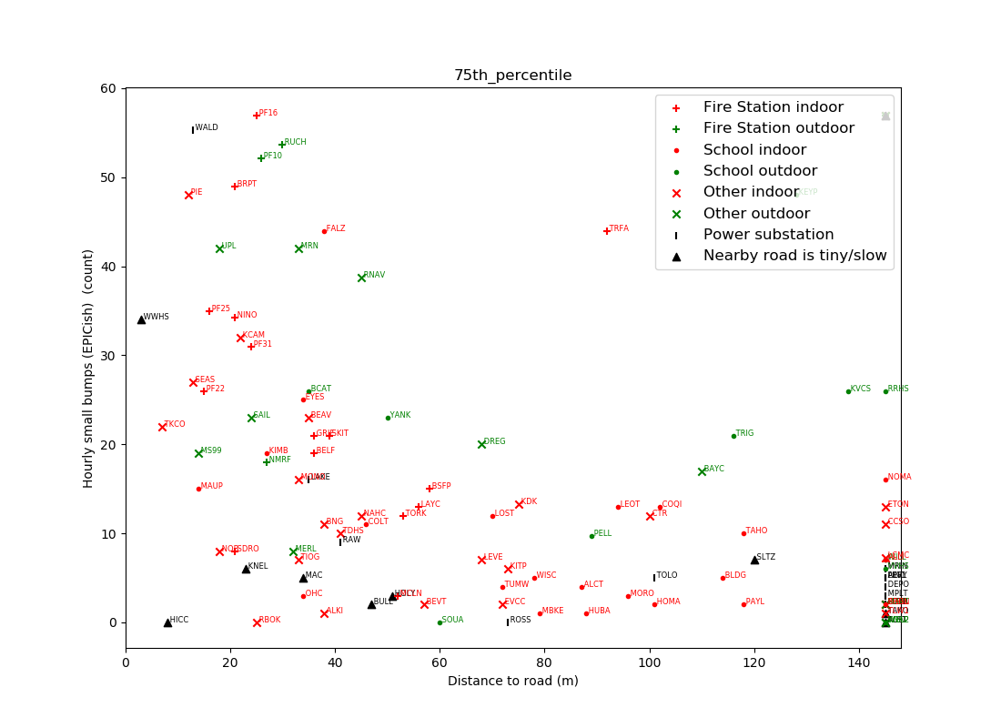
How far away from a road should I go?
Hourly count of small bumps (EPIC triggers)
50
40
30
20
10
0
0
20
40
60
80
100
120
Distance to road (m)
Notes:
This is about 100 PNSN strong motion stations
Colors and symbols are indoor/outdoor, fire station/school etc
Distance to road is the distance to not-slow traffic. Not speed bumps and roundabouts and stop signs.
75th percentile highest values are plotted which captures “what does it look like during business hours”

Slide 24
How far away from a road should I go?
Hourly count of small bumps (EPIC triggers)
50
50 m
40
30
20
10
0
0
20
40
60
80
100
120
Distance to road (m)
Notes:
75th percentile highest values are plotted which captures “what does it look like during business hours”

Slide 25
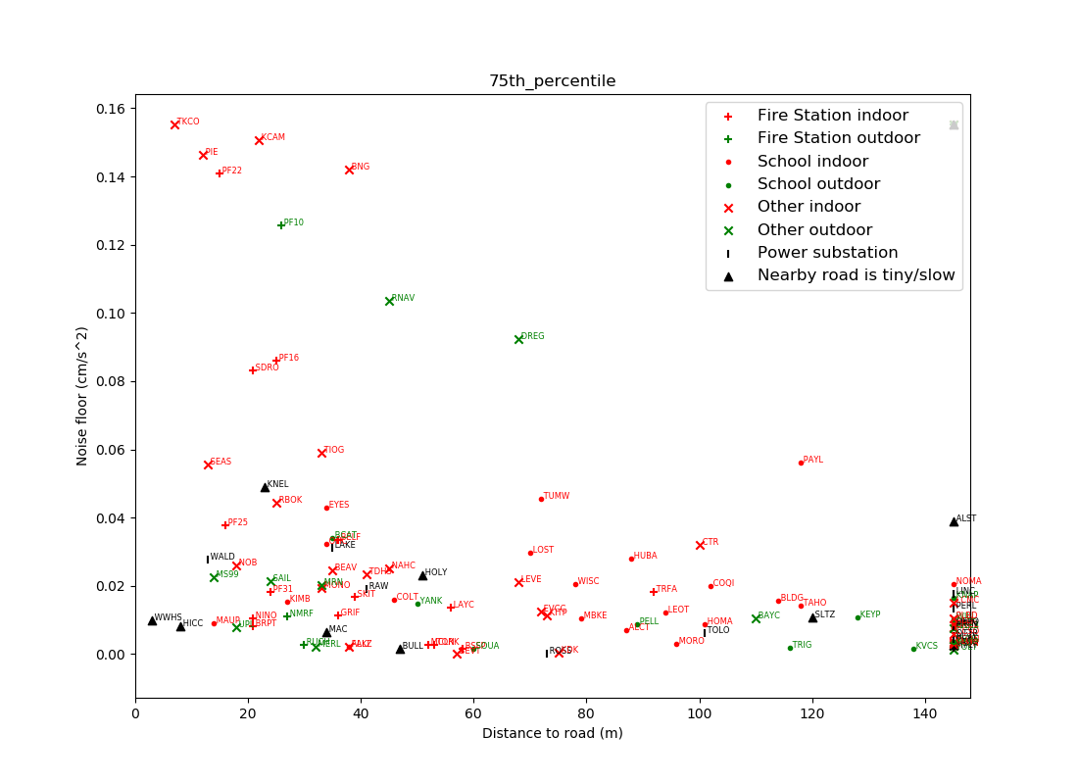
How far away from a road should I go?
Noise floor
0.14
0.12
cm/s^2
0.1
0.08
0.06
0.04
0.02
0
0 20 40 60 80 100 120 140
Distance to road (m)

Slide 26
How far away from a road should I go?
Noise floor
0.14
50 m
0.12
cm/s^2
0.1
0.08
0.06
0.04
0.02
0
0 20 40 60 80 100 120 140
Distance to road (m)

Slide 27
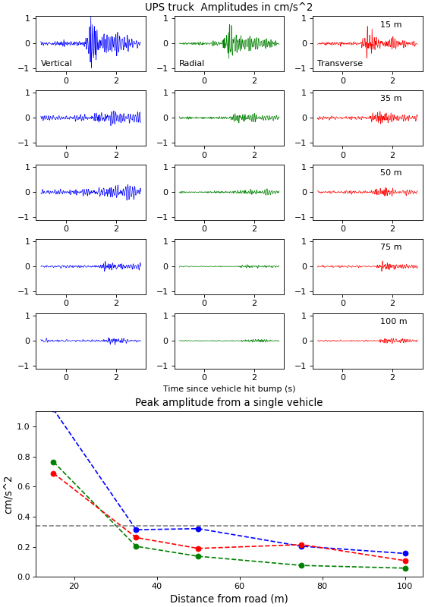
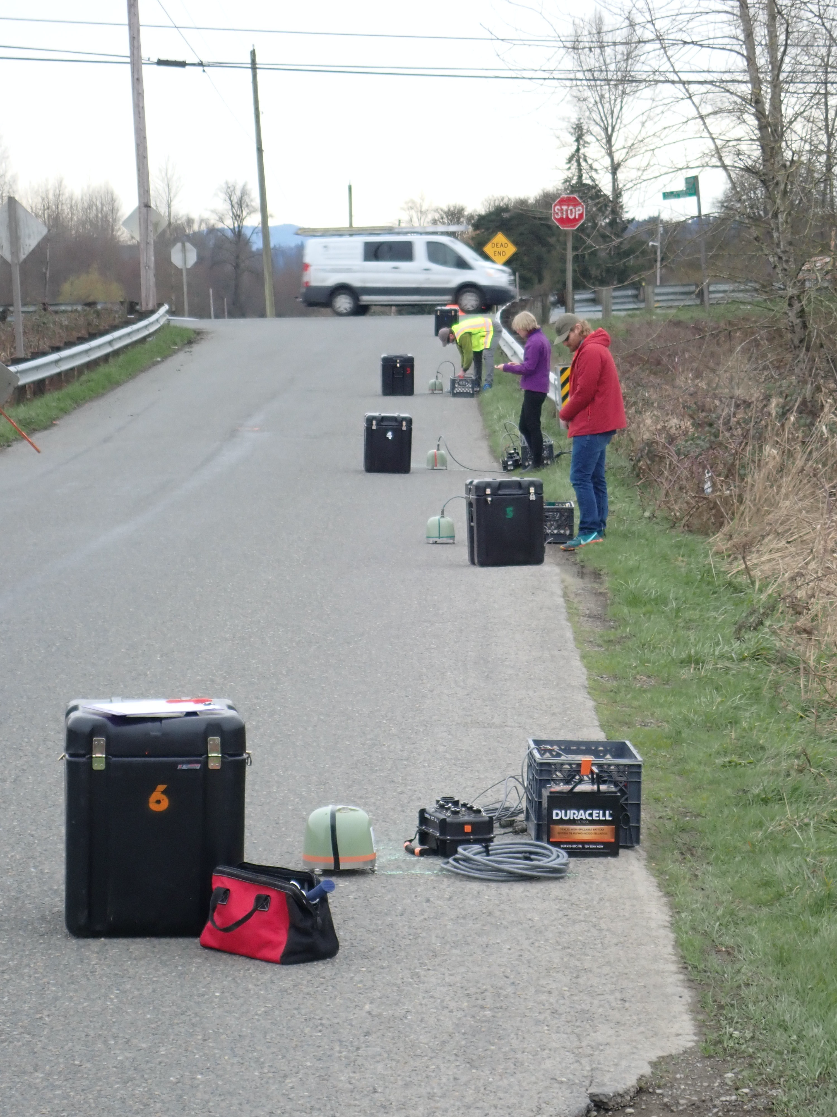
Road noise experiment
50 m

Slide 28
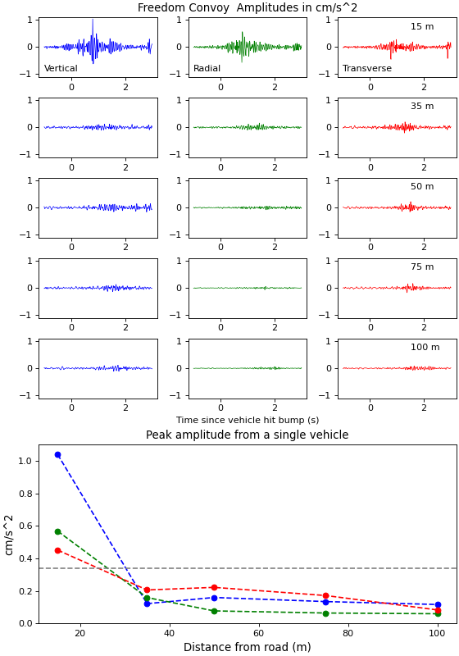
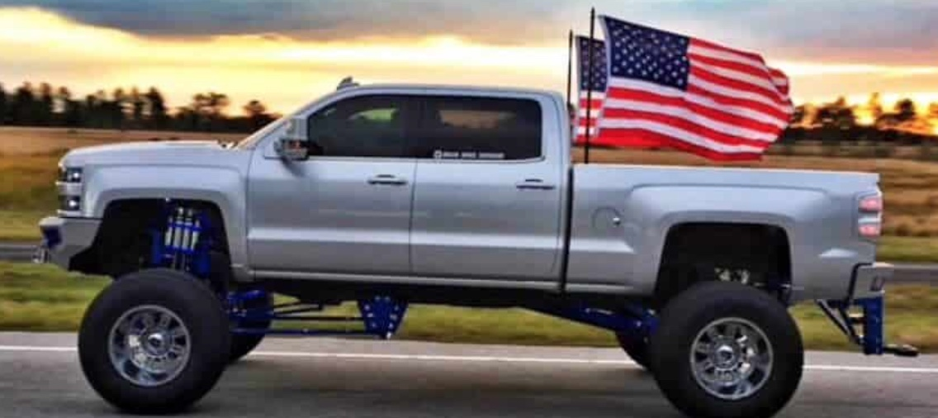
Road noise experiment

Slide 29
SSA 2022
Introduction Conclusion
High-performance, cloud based database of metrics with alarms is really useful for a seismic network.
Roads are most noisy within 50m
squac-help@uw.edu
Notes:
Two part talk: database then data mining

