Slide 1
Slow Slip in Cascadia
Noel M. Bartlow
University of California – Berkeley

Slide 2
Introduction
Slow slip events, sometimes called slow earthquakes, are fault slip that happens too slowly to emit seismic waves
  Durations range from hours to decades
Found in subduction zones around the world, and on large strike-slip faults where they are sometimes called creep events
Slow slip found to
precede large megathrust
earthquakes in Japan and
Chile
Schwartz and Rokosky (2007), Rev. Geoph.

Slide 3
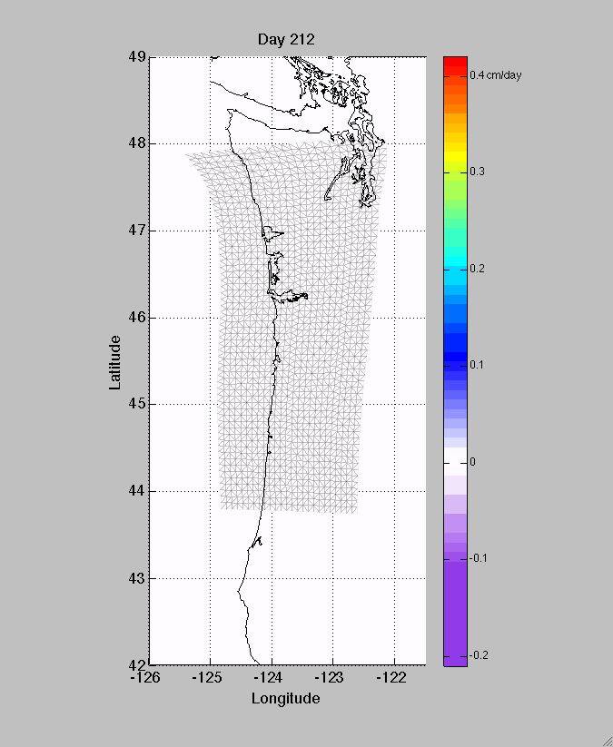
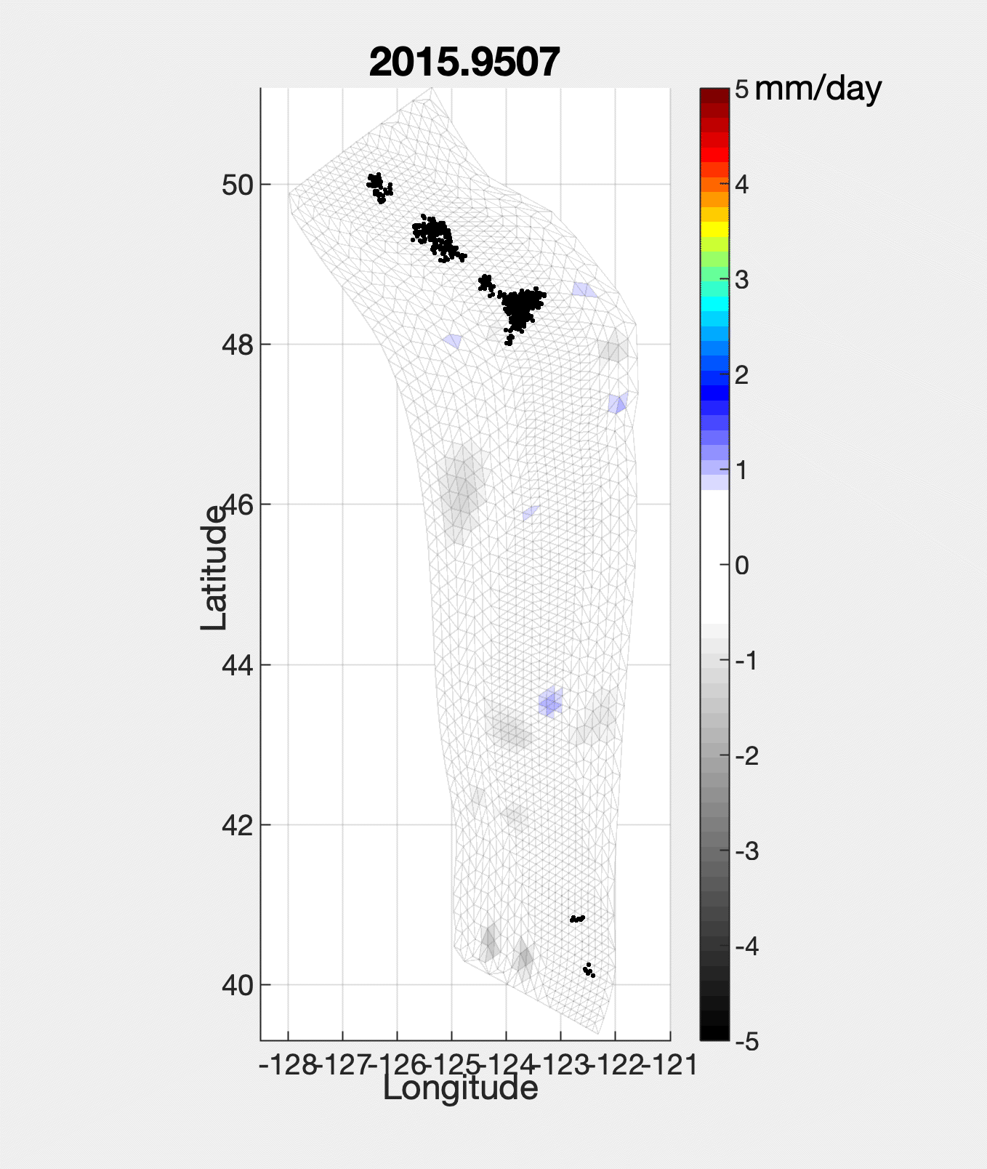
ETS in Cascadia
Slow Slip in Cascadia occurs with tectonic tremor, together termed Episodic Tremor and Slip or ETS. Tremor represents less than 0.1% of energy released.
Rogers and Dragert (2003), Science
Bartlow et al. (2011), GRL
Bartlow et al., unpublished

Slide 4
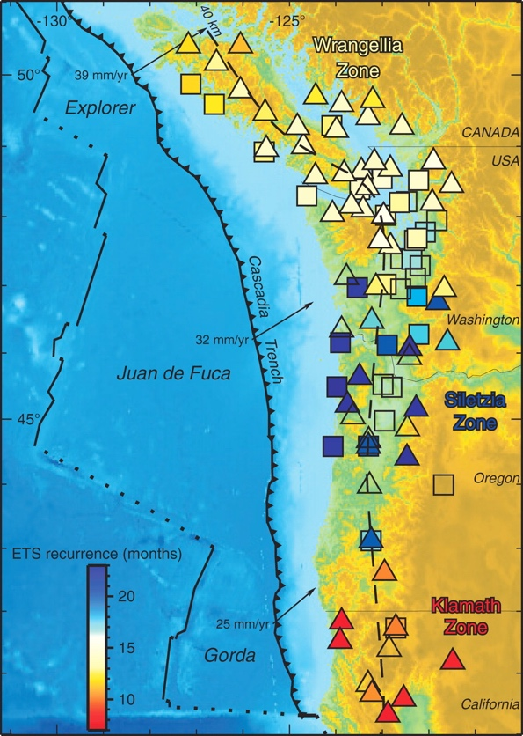
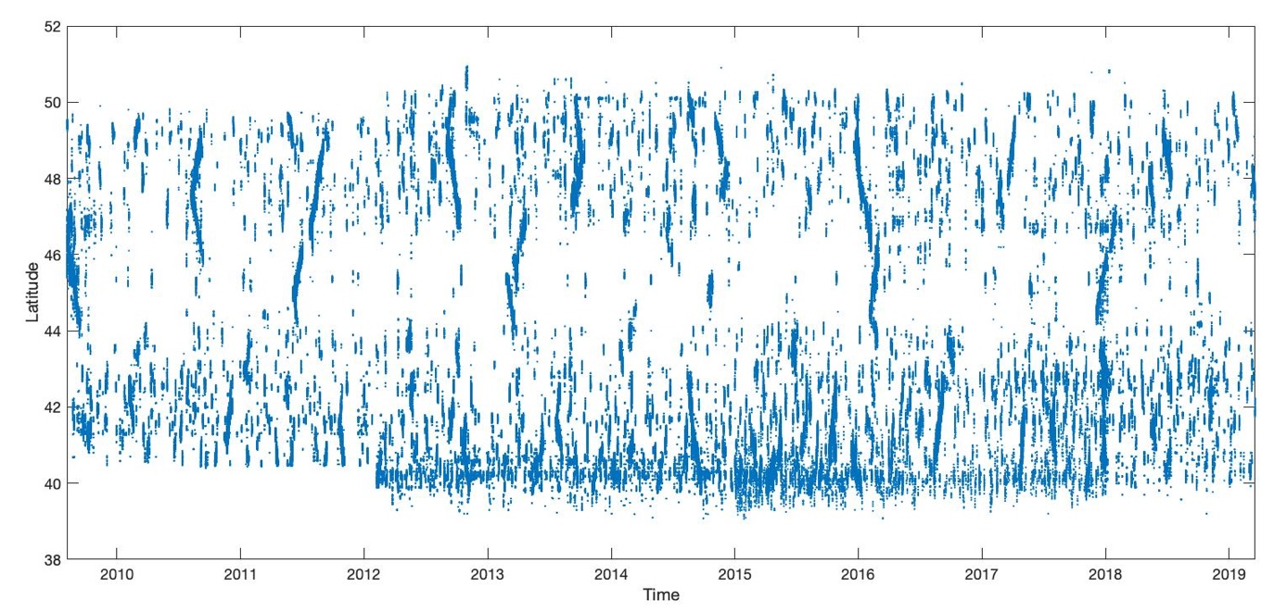
ETS in Cascadia
ETS occurs at regular intervals which vary along strike
Brudzinski and Allen (2007), Geology
Catalog modified by Aaron Wech from pnsn.org/tremor

Slide 5
ETS in Cascadia
ETS tremor shows smaller scale variations in both space and time
Tremor occurs repeatedly in the same areas, pointing to something structural
Different “flavors” of rapid tremor migrations, Ghosh et al. (2012), JGR
Rapid Tremor Reversals, Houston et al. (2011), Nat. Geosci.
LFE families from Chestler and Creager, 2017
Notes:
Streaks, Rapid Tremor Reversals, both types of Rapid Tremor Migrations

Slide 6
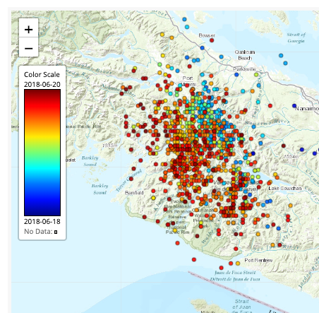
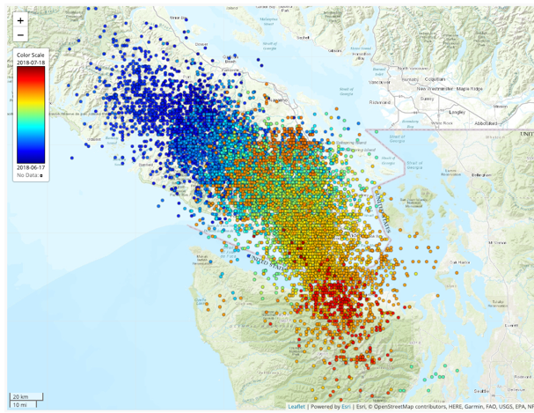
ETS in Cascadia
Shallow tremor is more episodic, deep tremor is more continuous
ETS nucleates on the downdip edge of the ETS zone, propagates updip until it fills the ETS zone, then propagates along strike
Pnsn.org/tremor
Wech and Creager (2011), Nature Geosci.
Increasing downdip distance, depth

Slide 7
ETS in Cascadia
ETS nucleates on the downdip edge of the ETS zone, propagates updip (unbounded growth) until it fills the ETS zone, then propagates along strike (bounded growth)
Events may “die” anywhere in
this process, giving rise to
a distribution of sizes
Moment scales as T³
(unbounded) or T (bounded),
assuming growth
at constant stress drop
Gomberg et al. (2016), GRL

Slide 8
Cascadia in Context
Similar to Nankai, Japan, Cascadia’s ”sister” subduction zone
Northern Japan also appears to have ETS, but shallower
Evidence for ETS-like events in parts of Alaska and Mexico
Nishikawa et al. (2019), Science
Hirose and Obara (2010), JGR

Slide 9
What is tremor, exactly?
Composed of individual Low-frequency earthquakes (LFEs) which can be found by template matching
  Focal mechanisms are consistent with plate interface slip
LFE P first arrival LFE S moment tensor inversion
Shelly et al. (2017), Nature
Slow Slip moment tensor megathrust moment tensor

Slide 10
What is tremor, exactly?
Mechanical explanations:
  1) Discrete slip surface featuring small, velocity-weakening asperities surrounded by slow slip region. Asperities “pop” seismically when loaded by surrounding slow slip, producing LFEs
    Physics based models usually assume this
Preferred model of Chestler and Creager, 2017 based on estimates of LFE slip , individual LFE patch sizes, and LFE family sizes

Slide 11
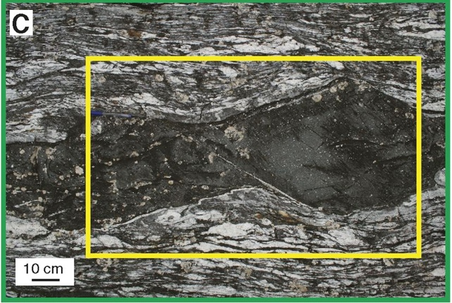
What is tremor, exactly?
Mechanical explanations:
  2) Ductile flow within within a narrow distributed shear zone is slow slip.
    (a)LFEs occur as frictional failure of brittle lenses within ductile matrix. Maybe inconsistent with LFE focal mechanisms or observed interactions between LFEs
    (b) LFEs occur as frictional failure along foliations and/or contacts between lenses and the matrix
Hayman et al. (2014), Geology
Fagereng et al. (2014), GRL

Slide 12
What is the relationship between tremor and slip?
Does slip extend updip of tremor?
Bartlow, in revision
Hall et al. (2017), G³

Slide 13
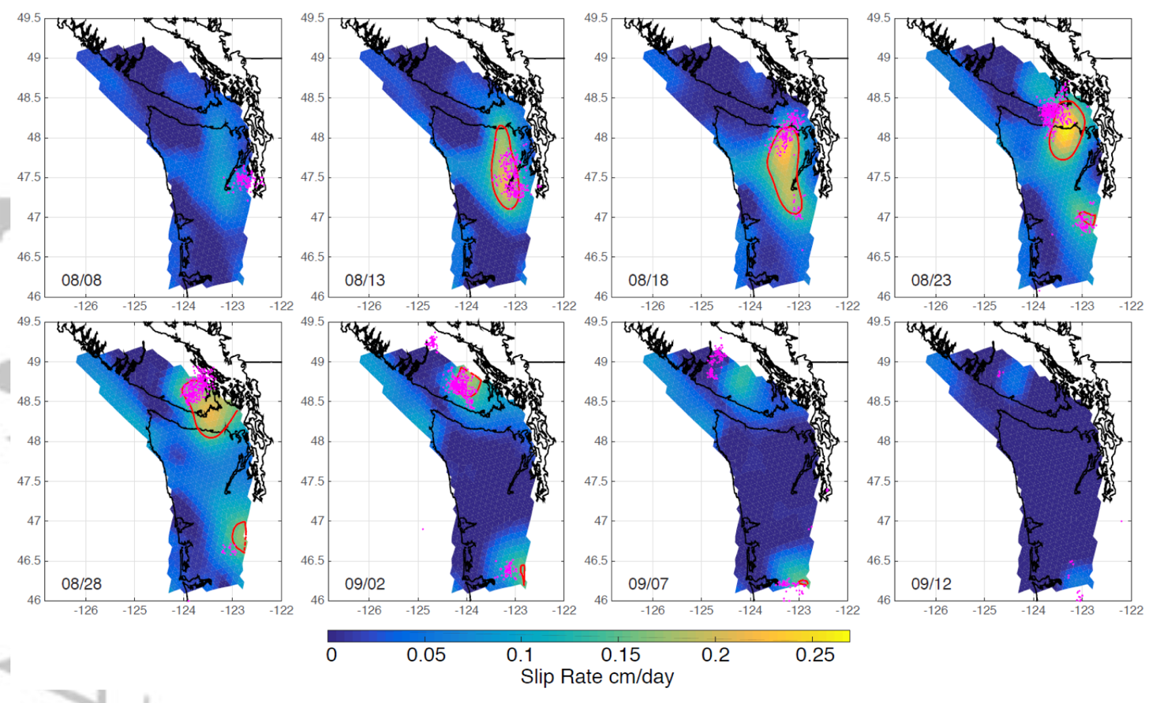
What is the relationship between tremor and slip?
Does tremor lead peak slip?
2010 ETS event
Hall et al. (2019), G³

Slide 14
Where is ETS relative to the locked zone?
Comparisons of tremor and locking models show a “gap” between the ETS zone and the bottom of the strongly locked zone
Bruhat and Segall (2016), JGR found that the
“gap” is necessary to fit the long-term GPS
velocities, coastal leveling data, and ETS
offsets in the northern segment.
Wang and Trehu (2016), J. Geodynamics
Bruhat and Segall (2016), JGR
ETS zone
Notes:
Bruhat and Segall (2016

Slide 15
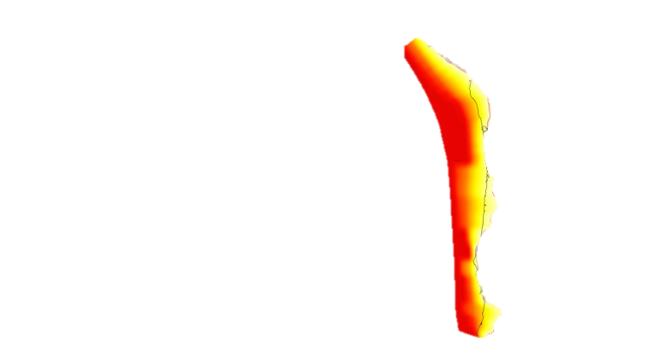
Where is ETS relative to the locked zone?
Comparison with locking model of Schmalzle et el. (2014)
Bartlow, in revision
Notes:
Bruhat and Segall (2016

Slide 16
What gives rise to ETS events, mechanically?
At the downdip edge of the locked zone, there is an expected transition from velocity weakening to velocity strengthening behavior
  More-or-less equivalent to brittle-ductile transition
Slow slip expected in the conditionally stable region between velocity strengthening (locked) and velocity weakening (creeping) regions
Does not explain the “gap” between ETS and locked zone
Gomberg et al. (2016), GRL

Slide 17
What gives rise to ETS events, mechanically?
Another explanation: Fluids!
  From dehydration reactions
  Fluids may release updip in ”porosity waves” which may drive ETS recurrence (Skarbek and Rempel (2016), G³)
Dilatancy during slip causes pore pressures to decrease, increasing resistance to slip and keeping it slow (e.g. Segall et al. (2010), JGR)
Skarbek and Rempel (2016), G³
Notes:
Slow slip may occur both in frictional transitions and zone of high fluid pressure, but fluid pressure is preferred explanation in Cascadia due to presence of the “gap”

Slide 18
How does ETS modulate earthquake probabilities?
Stress from ETS events loads locked zone
Without a “gap”, earthquakes in numerical models start with slow slip events
Previous studies of the effect of ETS stress on earthquake probabilities did not account for the gap
This question should be re-examined
Segall and Bradley (2012), GRL

Slide 19
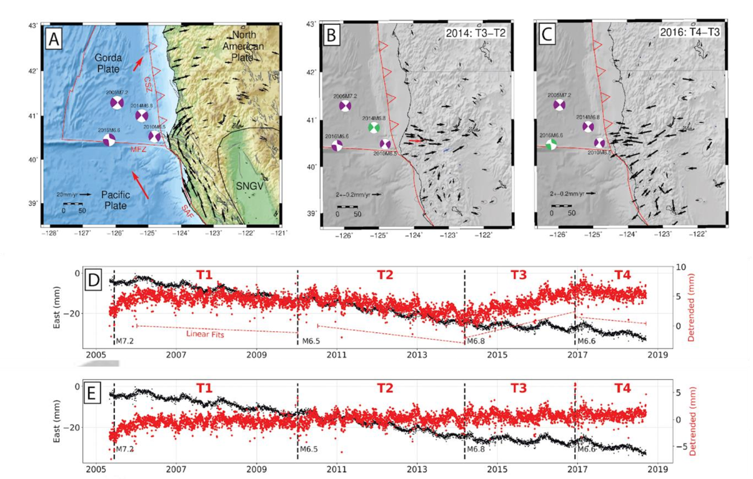
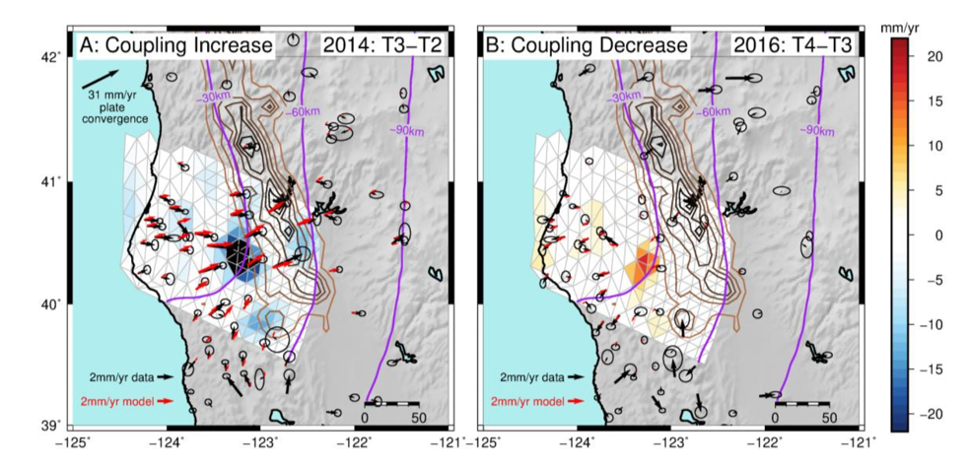
Coupling changes updip from ETS zone
In southern Cascadia, we recently found dynamically induced coupling changed updip from the ETS zone, in the “gap”
Materna et al. (2019), GRL

