Slide 1
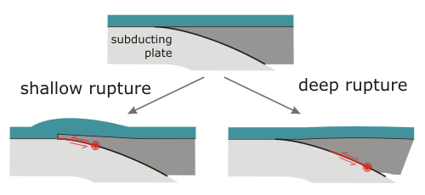
Tsunami generation, propagation and impacts
Bre MacInnes
Central Washington University
Notes:
Since this conference is focused on earthquakes, I’m going to mainly focus on summarizing the latest science about the generation of tsunamis and how earthquake models affect tsunamis

Slide 2
Social motivation of tsunami research
How will the tsunami impact the coast (height, inundation, current speeds, etc.) and when will it arrive?
Should we give an exact number if we might be wrong (by a lot)?
What information should we feel confident in?
What do we need to know to answer these questions?
How can we get better?

Slide 3
Outline
How does the earthquake affect the tsunami?
How are earthquake models of Cascadia being used today?
Future directions

Slide 4
How does the earthquake affect the tsunami?
“Latest science” considerations:
Complexity of rupture
Surface rupture vs. buried rupture
Heterogeneity of the megathrust
Horizontal vs. vertical deformation
Duration of rupture

Slide 5
How does the earthquake affect the tsunami?
earthquake slip
seafloor deformation
Rule of thumb: more slip or shallower rupture, bigger tsunami
tsunami
Image : https://all-geo.org/highlyallochthonous
Notes:
Understanding how the earthquake translates into the tsunami is important for interpreting what the tsunami will be like
Especially considering our earthquake models are themselves representations of what actually happened (or will happen)
Often slip to seafloor deformation is a fairly standard approach (using Okada, 1985) and may consider seafloor deformation to be equal to sea surface deformation

Slide 6
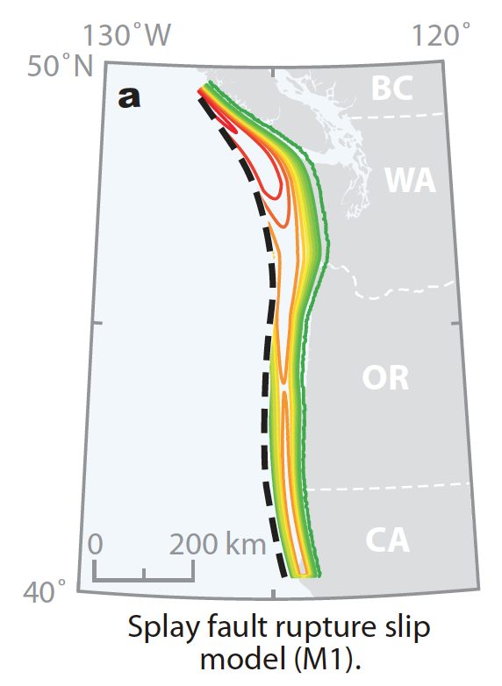
Simple vs. complex slip
How does the earthquake affect the tsunami?
Seafloor deformation
Witter et al., 2011
Image from Diego Melgar
Notes:
Of course the earthquake IS complex, but how does our representation of that slip affect our expectations of the tsunami.
“We found that a uniform slip scenario predicts much lower tsunami amplitudes and generally less coastal subsidence than scenarios that assume bell-shaped distributions of slip” (Carvajal and Gubler, 2017)

Slide 7
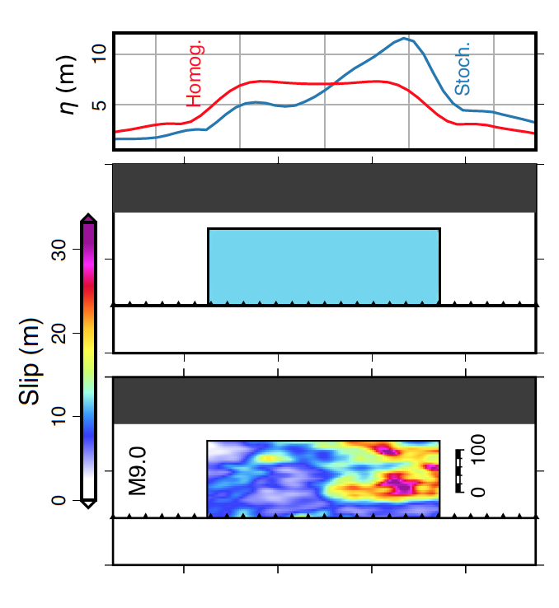
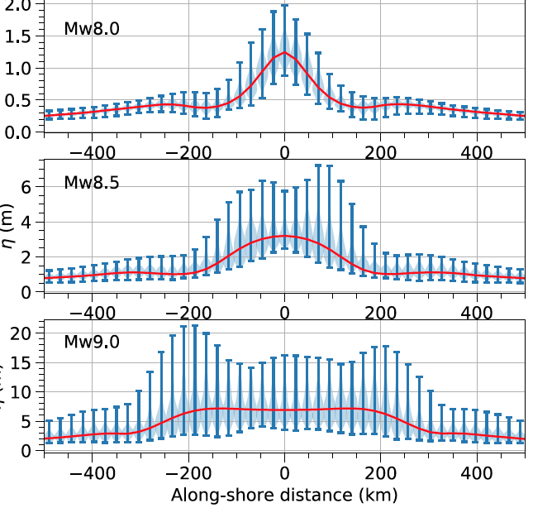
Simple vs. complex slip
How does the earthquake affect the tsunami?
Range of tsunami from stochastic slip
Along shore distance
Tsunami height
Tsunami height
Uniform slip
Tsunami from uniform slip
Tsunami height
Stochastic slip
Tsunami height
Melgar et al., 2019
Notes:
200 stochastic earthquake sources height at the coast
Quote from Melgar et al., 2019: “For example, at … 220 km along shore, the homogenous model predicts a value of 6.5 m for an M9 earthquake, meanwhile, the heterogeneous models predict that the range of expected tsunami amplitudes for that magnitude is between 2.5 and 18 m.”

Slide 8
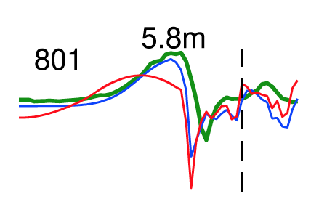
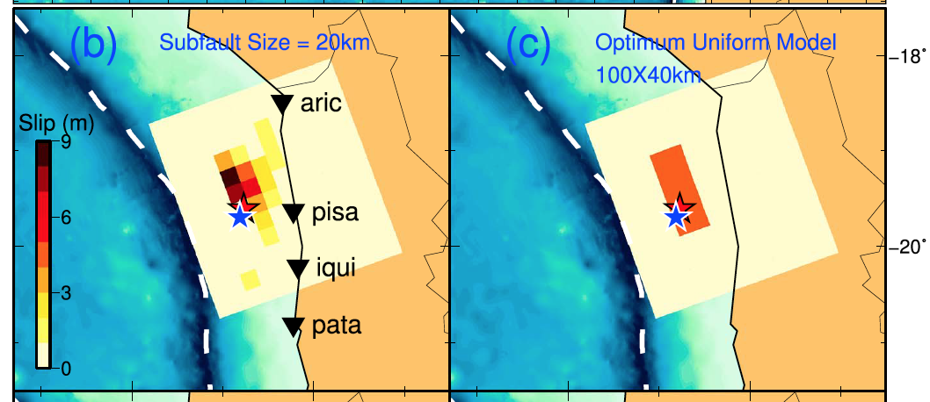
Simple vs. complex slip
How does the earthquake affect the tsunami?
Tsunami at a gauge
Observation
Along shore distance
Concentrated uniform slip
Wide uniform slip
Complex solution
Concentrated uniform slip
Wide uniform slip
Melgar et al., 2019
An et al., 2018
Notes:
An et al. (2018), by analyzing a number of recent significant tsunamis, suggest that a source that is deliberately forced to be more compact than the earthquake could be used as a good practical solution and force higher tsunami amplitudes

Slide 9
Surface rupture vs. buried rupture
How does the earthquake affect the tsunami?
“The real-time determination of whether a megathrust rupture reaches the trench is nearly impossible
“Tsunami earthquakes”
Higher maximum wave from surface rupture
Affects maximum wave arrival time
Tung and Masterlark, 2018
Image Witter et al., 2011
Notes:
(Tsunami earthquake)
Nearest on land GPS receiver is 120 km away
Less shaking produced from shallower rupture so can be missed in seismic signals

Slide 10
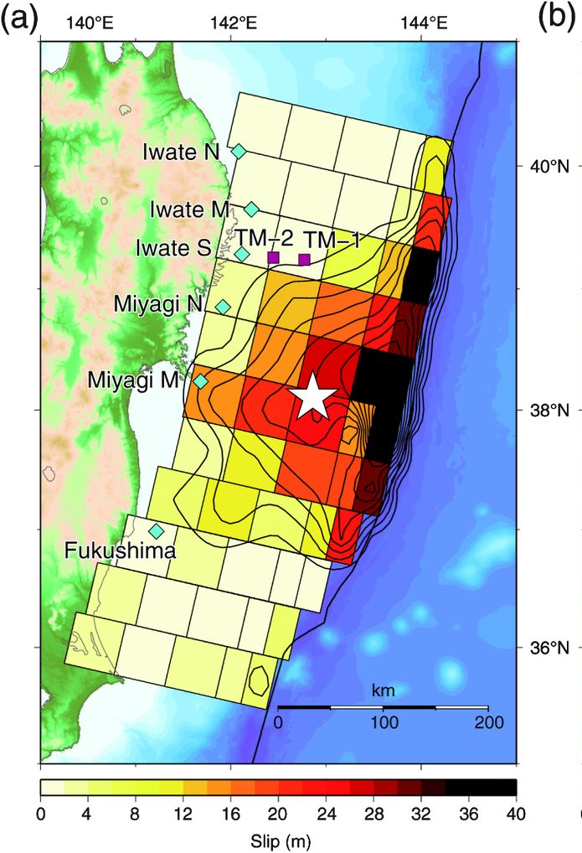
How does the earthquake affect the tsunami?
2011 Tohoku tsunami was the result of two locations of slip
Complex solution needed
Rupture to trench AND buried rupture
Satake et al., 2013

Slide 11
How does the earthquake affect the tsunami?
2011 Tohoku tsunami was the result of two locations of slip
Sanriku: 10-25 m high tsunami
High waves in Sanriku from rupture near trench
Long inundation in Sendai from buried rupture
Sendai: 5 km inundation
Satake et al., 2013
Notes:
Quoted from Satake et al., 2013:
A very large slip (approximately 25 m) in the deep part off Miyagi at a location similar to the previous 869 Jogan earthquake model was responsible for the initial rise of tsunami waveforms and the recorded tsunami inundation in the Sendai and Ishinomaki plains. A huge slip, up to 69 m, occurred in the shallow part near the trench axis 3 min after the rupture initiation. This delayed shallow rupture extended for 400 km with more than a 10‐m slip, at a location similar to the 1896 Sanriku tsunami earthquake, and was responsible for the peak amplitudes of the tsunami waveforms and the maximum tsunami heights measured on the northern Sanriku coast (Satake et al., 2013)
Figure caption for black and white figure (part b deleted): The computed tsunami inundation areas in (a) the Sendai Plain and (b) the Ishinomaki Plain from the deep, shallow, and composite (the 2011) slips. The inundation area is defined as the land grids where the flow depth is >0.5 m. The inundation areas from the deep slip (gray) and the 2011 slip (lighter gray) models are almost identical, whereas the inundation area from the shallow slip (darker gray) is much smaller. Also shown (as thick solid curves) are the observed tsunami inundation areas estimated by GSI (Nakajima and Koarai, 2011).

Slide 12
Heterogeneity of the megathrust interface
How does the earthquake affect the tsunami?
Blue = smaller tsunami if uniform crust
Modeling weaker crust near trench
Change in Young’s Modulus and Poisson’s ratio down-dip
Up to ~20% difference in tsunami wave height
Red = higher tsunami if weaker near trench
Difference between models
Tung and Masterlark, 2018
Notes:
Lotto et al., 2018 modeled pore pressure changes

Slide 13
Vertical and horizontal components of seafloor deformation
How does the earthquake affect the tsunami?
… and role of seafloor bathymetry
Vertical deformation
Horizontal deformation
Lotto et al., 2018
Notes:
From Lotto et al., 2018: “Rupture in Cascadia is buried beneath the seafloor, but causes a tsunami that is highly complex due to the rough seafloor bathymetry.”
“ To the extent that its bathymetric ridges are coherent along strike we expect them to play a major role in tsunami generation”

Slide 14
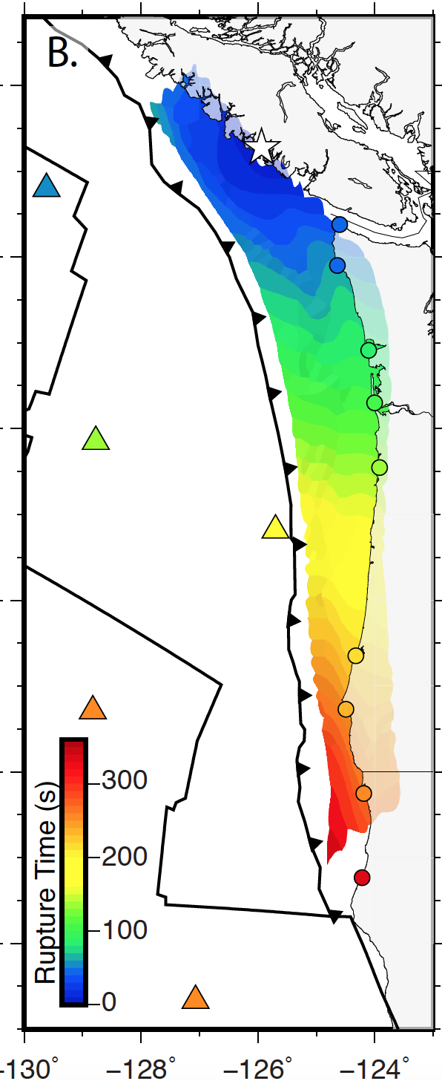
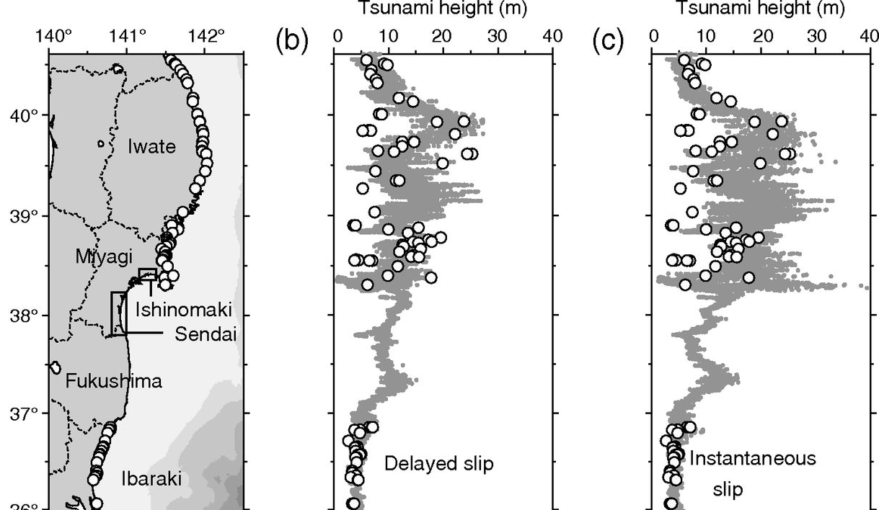
Velocity and duration of rupture
How does the earthquake affect the tsunami?
Williamson et al., 2019
Observations (circles)
Model includes rupture occurred over time
Model assumes rupture occurred at once
Satake et al., 2013
Notes:
Rupture velocity and duration is generally not an issue, but because Cascadia can have 800+km long rupture… Williamson et al., 2018
Figure caption: Satake et al., 2013 “(a) Locations of measured tsunami heights compared with (b) coastal tsunami heights computed from delayed slip and (c) instantaneous slip: circles, inundation heights; squares, tsunami heights in port (Tsuji et al., 2011). The rectangles in the map (a) show the area for inundation computations.”

Slide 15
How are earthquake models of Cascadia being used today?
Notes:
There are other source models, but I’m particularly interested in their use for studying tsunamis

Slide 16
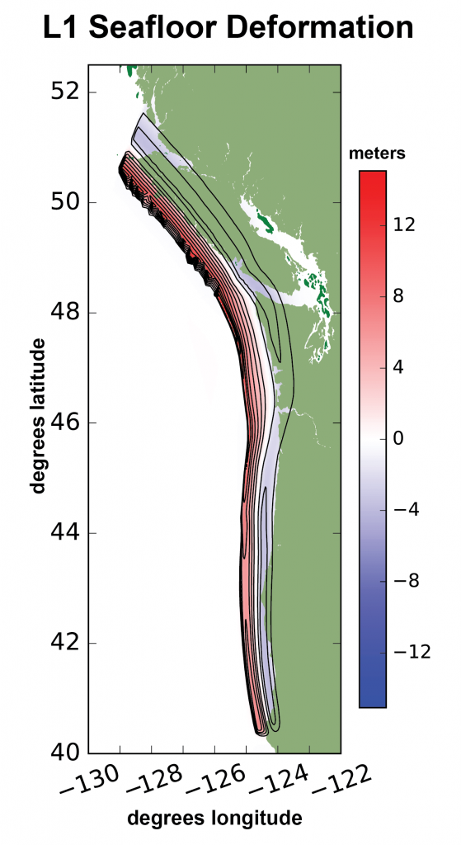
Earthquake used by WA Geological Survey for inundation mapping
How are earthquake models of Cascadia being used today?
L1 source (Witter et al., 2011)
With northern extension
Based on the geological record (on land and offshore)
Represents a tsunami with an inter-event time of 680-800 years.
Notes:
Larger than 1700 (and longer inter-event time than since 1700), but not considered the largest in the geological record for Cascadia
Also the source used for NOAA’s inundation models available online

Slide 17
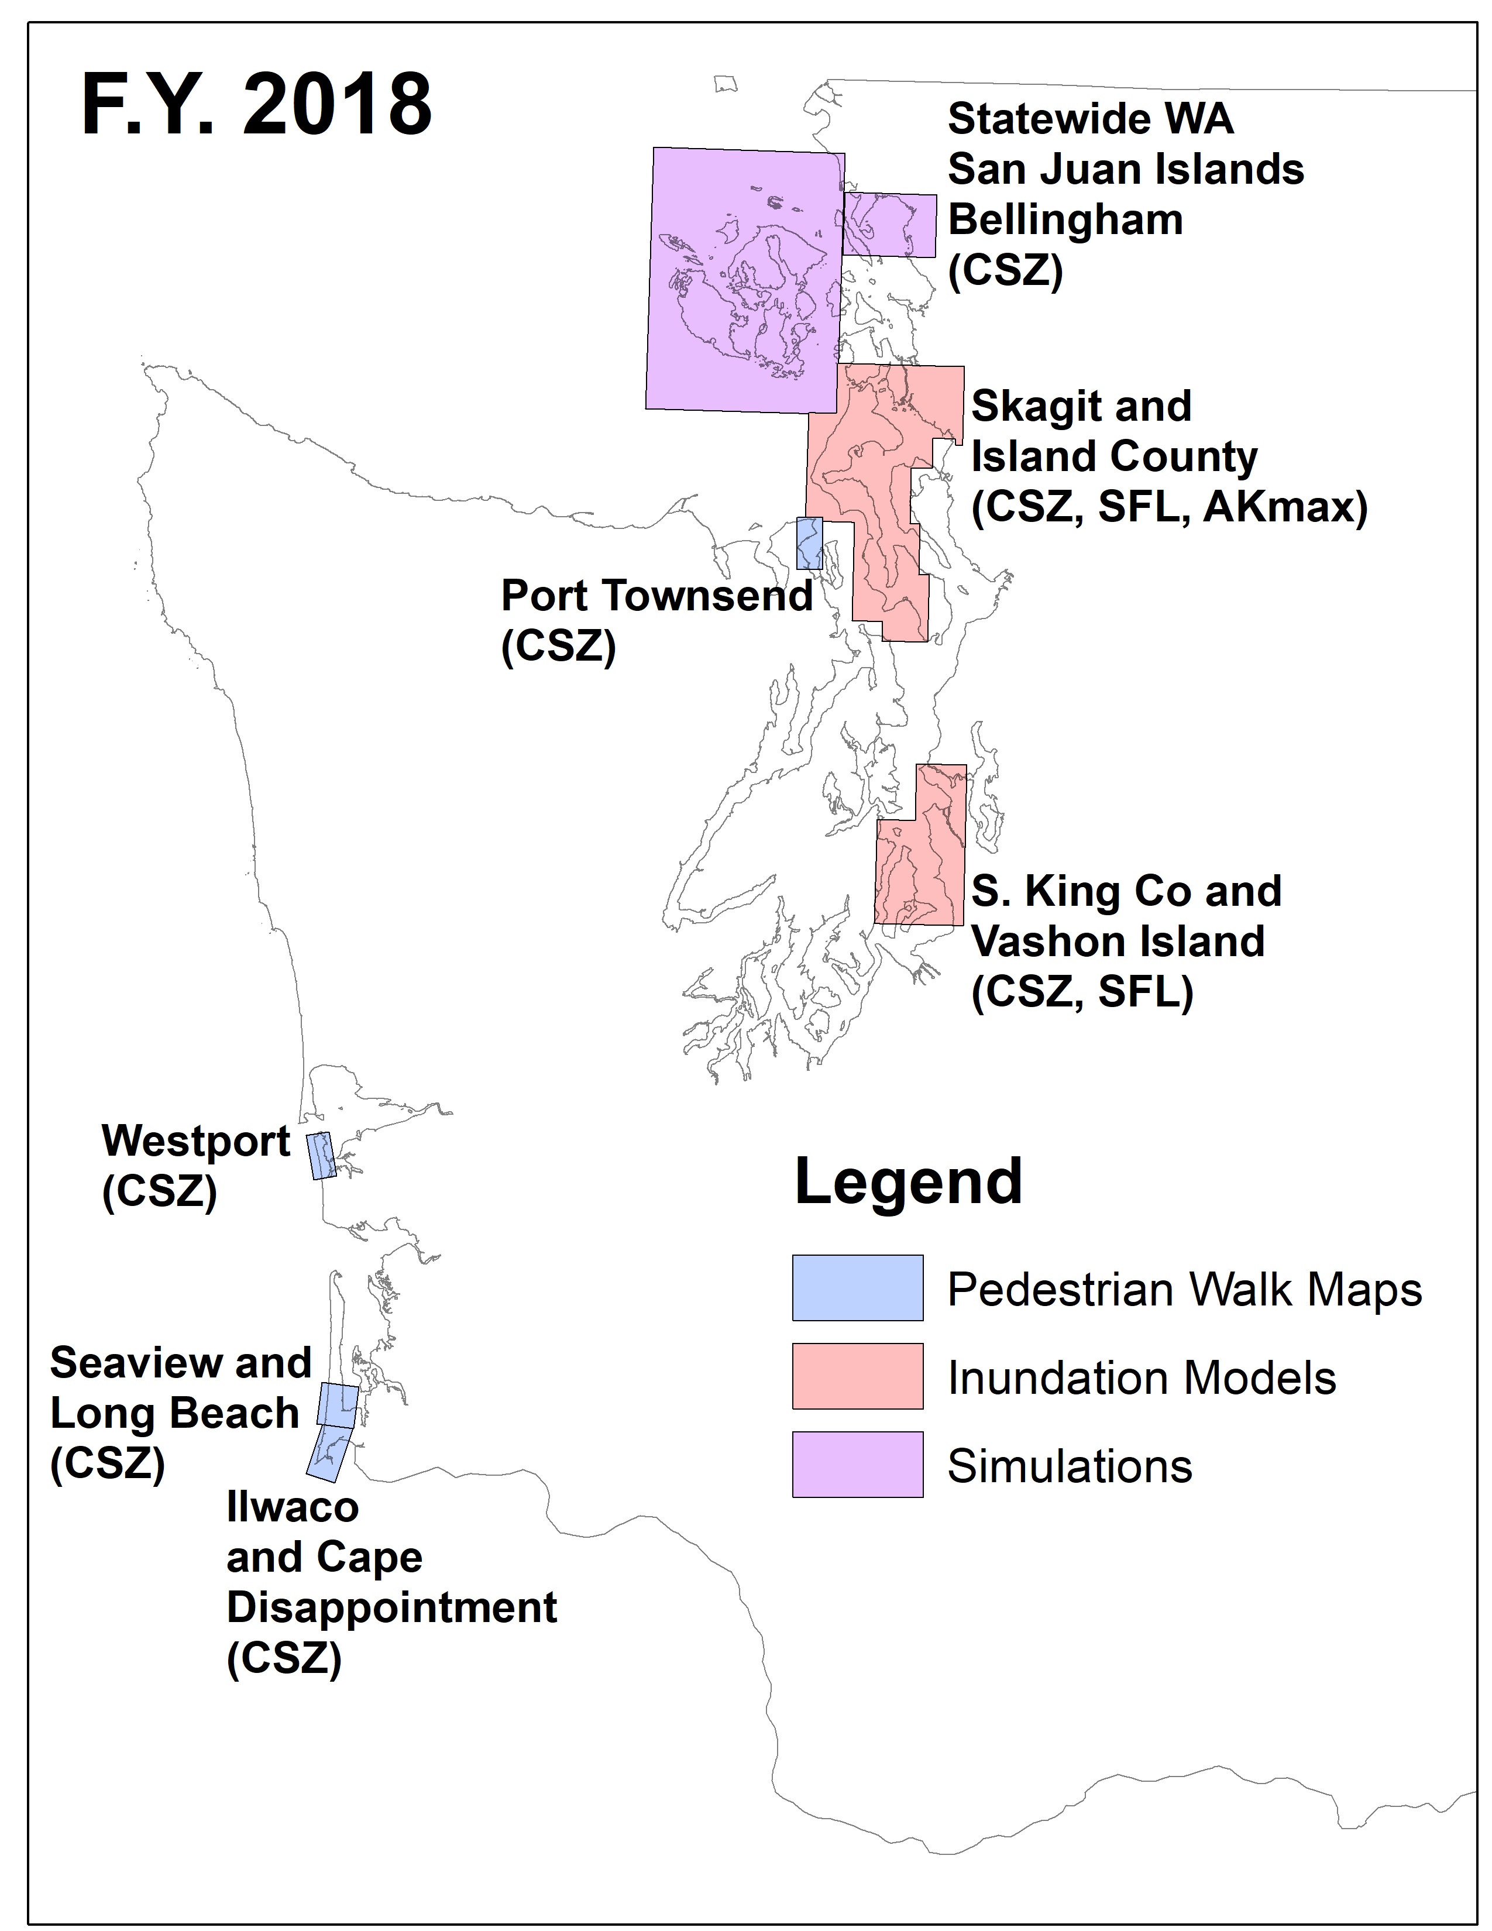
WA Geological Survey
How are earthquake models of Cascadia being used today?
F.Y. 2019
F.Y. 2020
Publicly available tsunami forecasts

Slide 18
Synthetic earthquakes
How are earthquake models of Cascadia being used today?
1300 complex earthquakes Mw 8.7-9.2 (Melgar et al. 2016; Ruhl et al., 2017; Williamson et al., 2018 )
Image from Diego Melgar
Notes:
Developed to test GNSS solutions in real time
Include timing, variable rupture

Slide 19
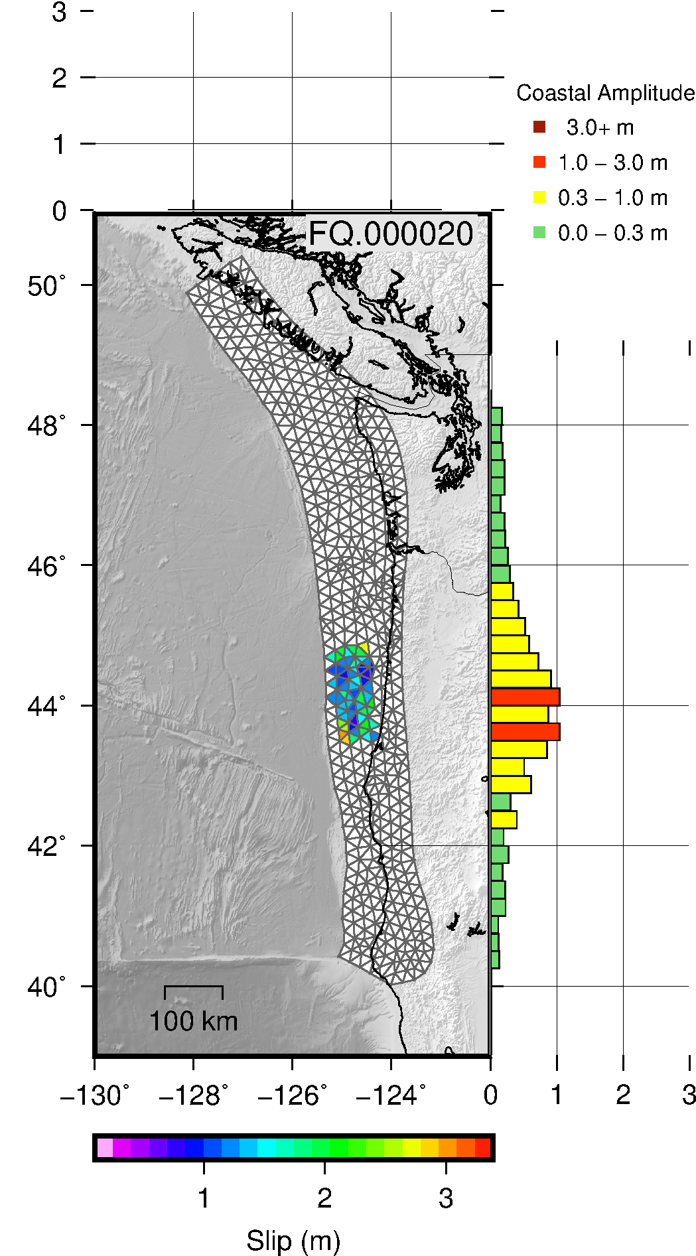
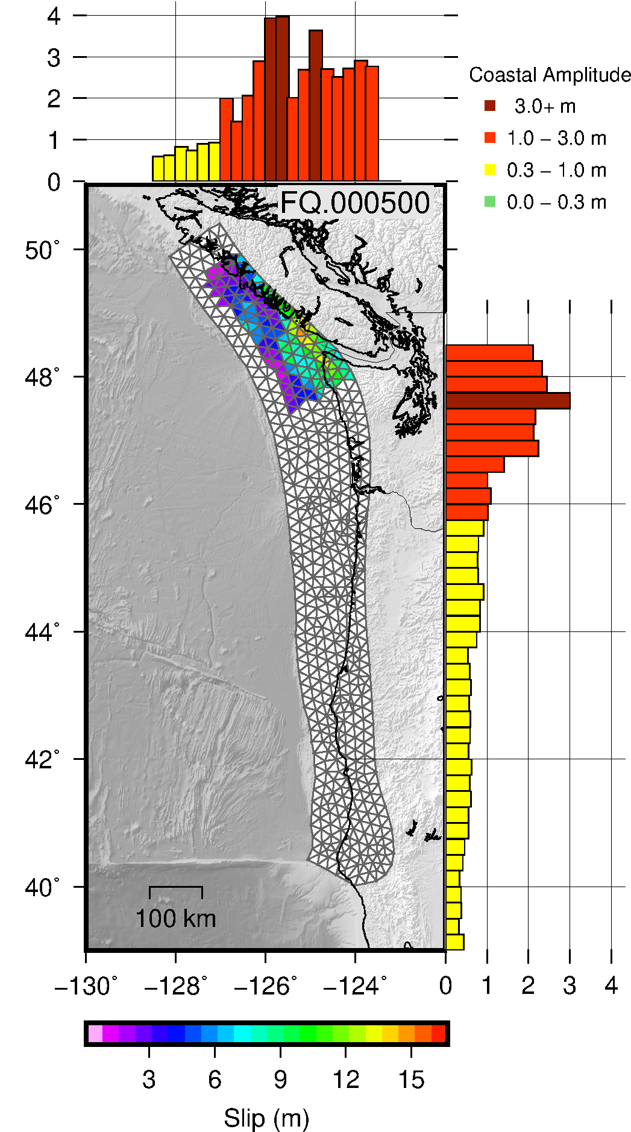
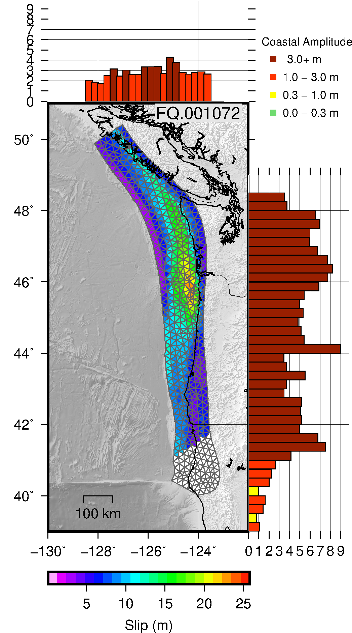
How are earthquake models of Cascadia being used today?
Synthetic earthquakes
Figure provided by Amy Williamson

Slide 20
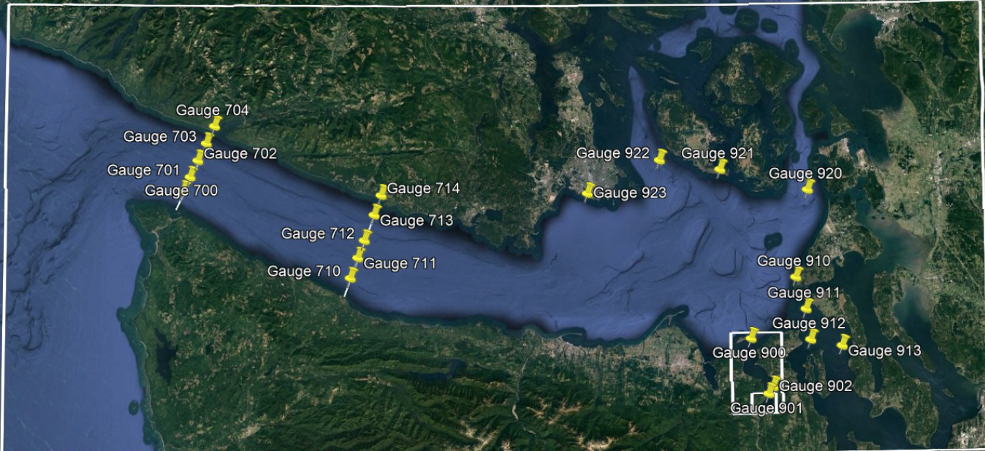
Results from 1300 synthetic earthquakes
How are earthquake models of Cascadia being used today?
Gauge 712
Tsunami modeling from Xinsheng Qin; Figure provided by Randy LeVeque

Slide 21
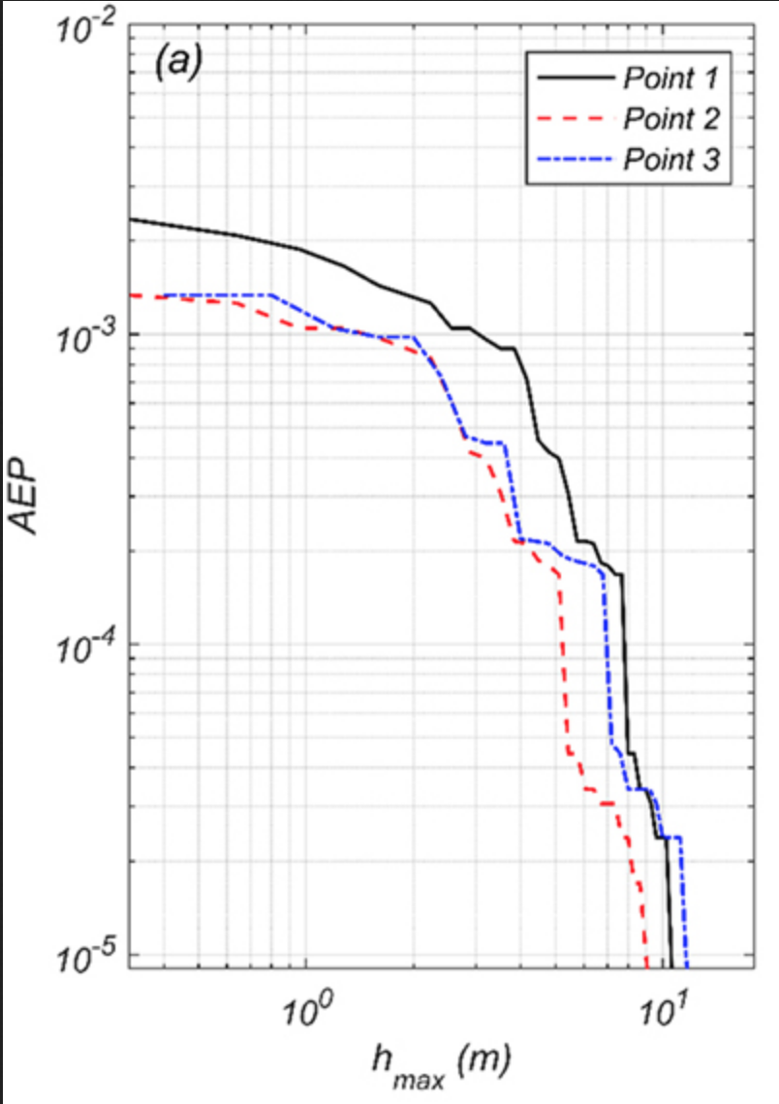
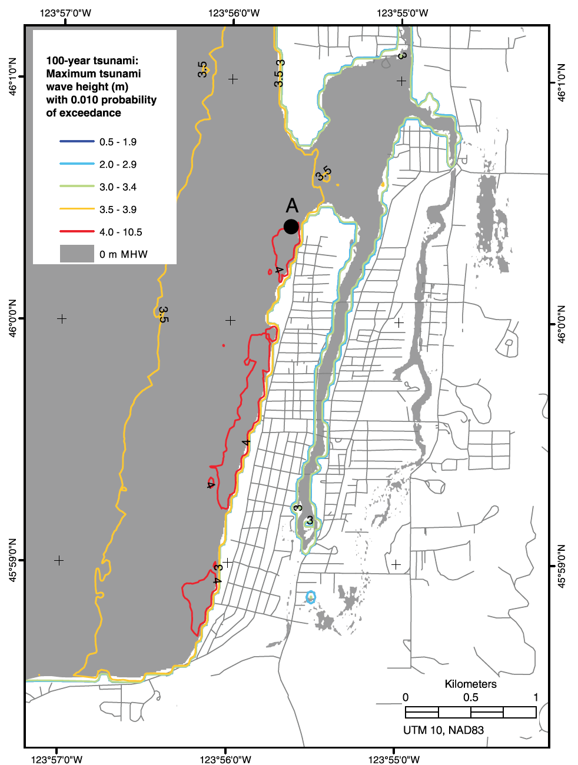
Probabilistic analysis
How are earthquake models of Cascadia being used today?
3 points in Seaside, OR
Considers tsunami impacts as a probability rather than a “worst-case” scenario
Annual exceedance probability
1
10
Gonzalez et al., 2009
Park et al.., 2017

Slide 22
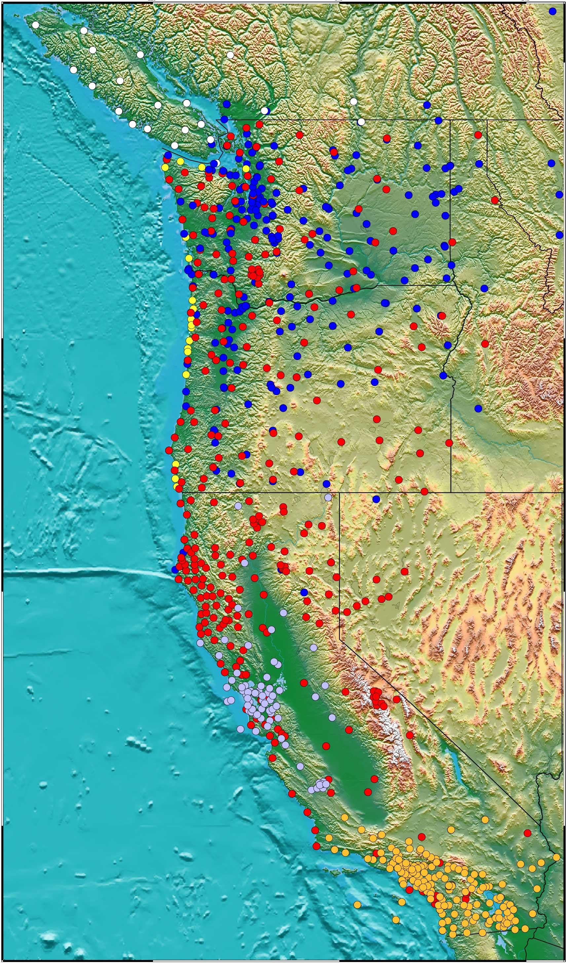
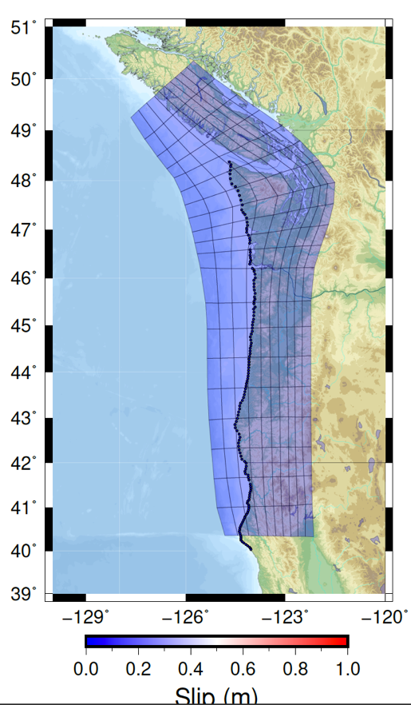
How are earthquake models of Cascadia being used today?
Active earthquake inversion from geodetics; coupled to tsunami model
West coast real-time GNSS
~500 stations in Cascadia
Operated by:
PBO (UNAVCO)
CWU (PANGA)
SCIGN/USGS (Pasadena)
USGS (Menlo Park)
UC Berkeley (BARD)
UCSD-SIO (OCRTN)
Notes:
Associated with ongoing projects to advance earthquake early warning

Slide 23
Future directions
Reminder from the first slide
Social motivation: How will the tsunami impact the coast and when will it arrive?
Should we give an exact number if we might be wrong (by a lot)?
What information should we feel confident in?
My opinion:
Our effort should be focused on the infrastructure to observe the tsunami immediately (i.e. ignore the earthquake) and to rapidly predict the tsunami’s coastal impact
Notes:
There is so much we can’t predict about what the next event will be like, that our effort should be focused on creating the infrastructure to observe the tsunami immediately (i.e. ignore the earthquake) and rapidly predict what the coastal impact will be
Offshore GPS, Offshore buoys, etc.
Note from Randy: Xinsheng was hoping to apply some machine learning techniques using this as training data to try to generate a fast forecast model that could take new observations at the entrance to the Strait and produce a rapid forecast for many places around the sound.

Slide 24
References
An, C., Liu, H., Ren, Z., & Yuan, Y. (2018). Prediction of tsunami waves by uniform slip models. Journal of Geophysical Research: Oceans, 123(11), 8366-8382.
González, F.I., Geist, E.L., Jaffe, B., Kânoğlu, U., Mofjeld, H., Synolakis, C.E., Titov, V.V., Arcas, D., Bellomo, D., Carlton, D. and Horning, T., 2009. Probabilistic tsunami hazard assessment at seaside, Oregon, for near‐and far‐field seismic sources. Journal of Geophysical Research: Oceans, 114(C11).
Lotto, G.C., Jeppson, T.N., Dunham, E.H., 2018, Fully Coupled Simulations of Megathrust Earthquakes and Tsunamis in the Japan Trench, Nankai Trough, and Cascadia Subduction Zone, Pure and Applied Geophysics, https://doi.org/10.1007/s00024-018-1990-y
Melgar, D., R. J. LeVeque, D. S. Dreger, and R. M. Allen (2016), Kinematic rupture scenarios and synthetic displacement data: An example application to the Cascadia subduction zone, J. Geophys. Res. Solid Earth., 121, 6658–6674, doi:10.1002/2016JB013314.
Melgar, D., Williamson, A. L., & Salazar-Monroy, E. F. (2019). Differences between heterogenous and homogenous slip in regional tsunami hazards modelling. Geophysical Journal International, 219(1), 553-562.
Park, H., Cox, D.T., Alam, M.S., Barbosa, A.R., 2017, Probabilistic Seismic and Tsunami Hazard Analysis Conditioned on a Megathrust Rupture of the Cascadia Subduction Zone, Front. Built Environ., doi: 10.3389/fbuil.2017.00032
Satake, K., Fujii, Y., Harada, T., Namegaya, Y., (2013) Time and Space Distribution of Coseismic Slip of the 2011 Tohoku Earthquake as Inferred from Tsunami Waveform Data. Bulletin of the Seismological Society of America ; 103 (2B): 1473–1492. doi:https://doi.org/10.1785/0120120122
Witter, Robert C., Yinglong Zhang, Kelin Wang, George R. Priest, Chris Goldfinger, Laura L. Stimely, John T. English, and Paul A. Ferro. (2011) "Simulating tsunami inundation at Bandon, Coos County, Oregon, using hypothetical Cascadia and Alaska earthquake scenarios." Oregon Department of Geology and Mineral Industries Special Paper 43: 57.
Tung, S., & Masterlark, T. (2018). Sensitivities of Near‐field Tsunami Forecasts to Megathrust Deformation Predictions. Journal of Geophysical Research: Solid Earth, 123(2), 1711-1735.

