Slide 1
Cascadian Ground Failure
Mapping CSZ 1700 and 2xxx landslides
alex grant – USGS
with contributions from Joe Wartman, Sean LaHusen, and Alison Duvall (UW), Will Struble and Josh Roering (UO), and Jon Perkins (USGS)
Notes:
Hundreds if not over a thousand landslides within this image, and almost certainly 1700 landslides…but nothing confirmed.

Slide 2
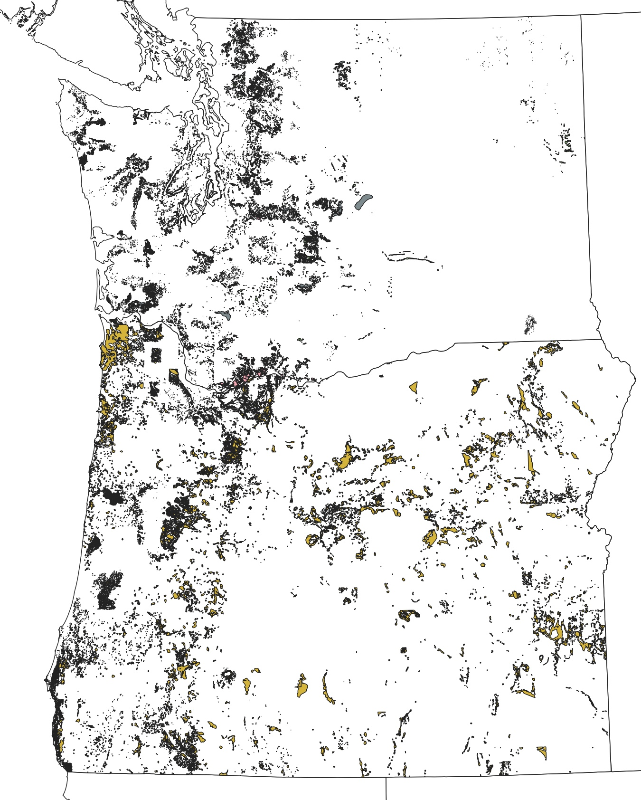
Ground Failure in Washington and Oregon
Right: An incomplete inventory of landslides in the PNW
Washington DNR and Oregon DOGAMI
Notes:
Very active landscape responding to tectonic, climatic, and volcanic forcing. Landslides in the historic era range from mountain collapse (BotH, MSH) to nuisance slumps…

Slide 3
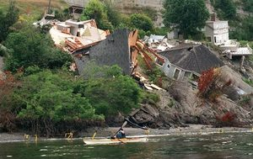
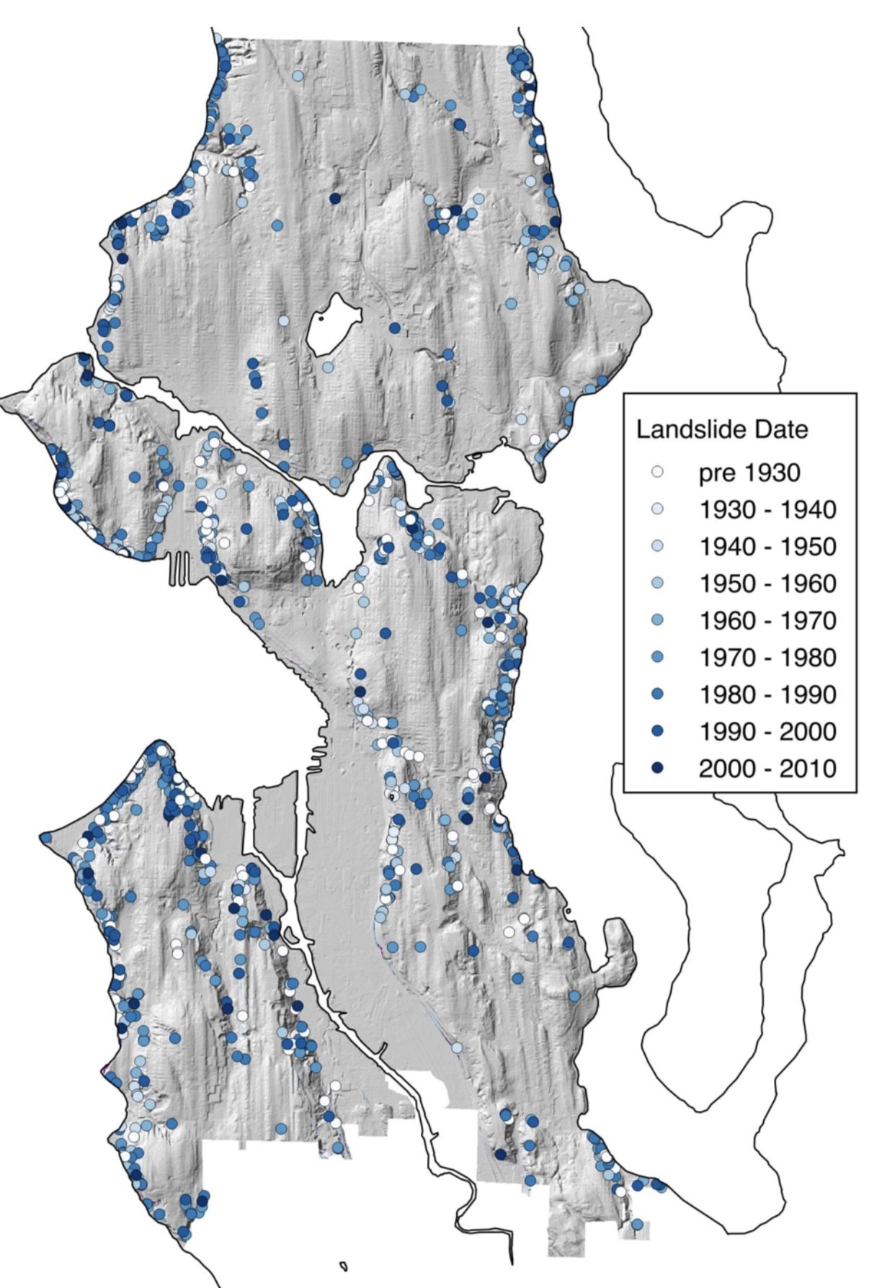
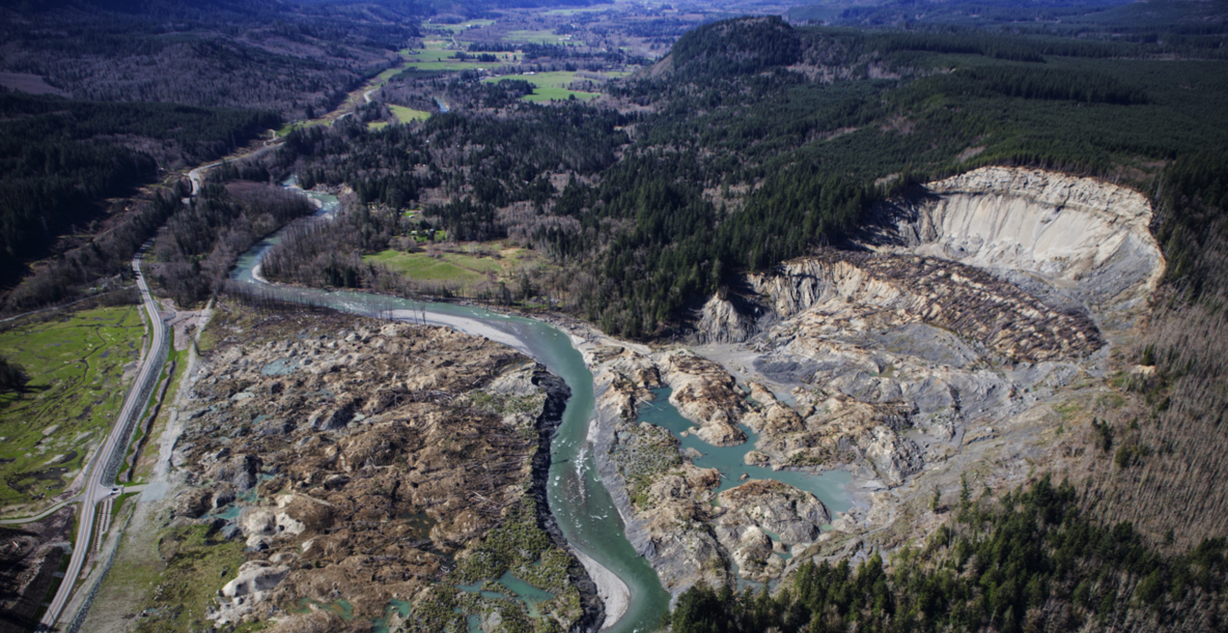
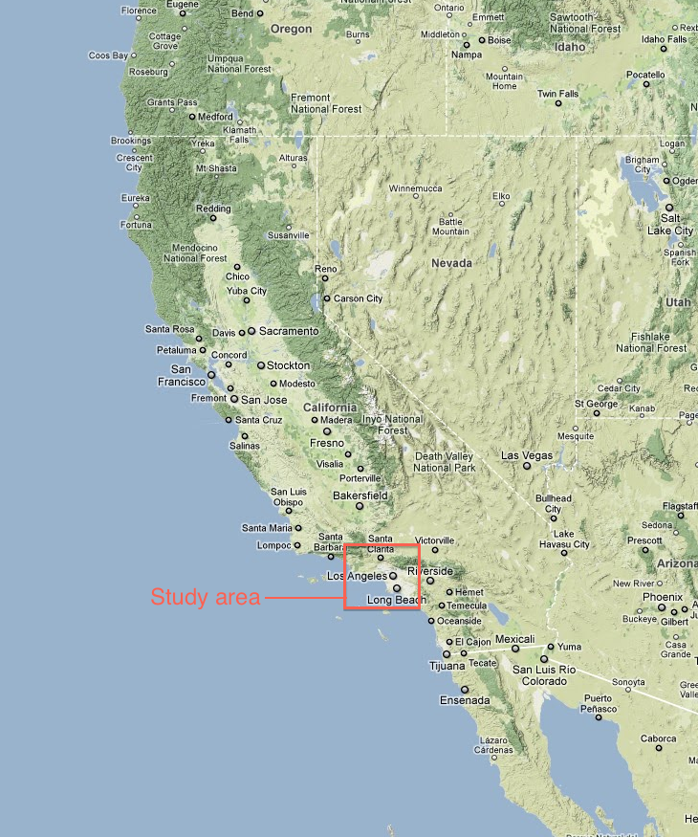
Perkins Lane
Oso
Seattle Landslide Inventory (showing events through 2010)
Sources: Seattle Times, https://data.seattle.gov/dataset/City- Of-Seattle-Environmentally-Critical-Areas/zwze-9nv3
Notes:
and recently have reminded us of the terrible human consequences of landslides up in Oso.

Slide 4
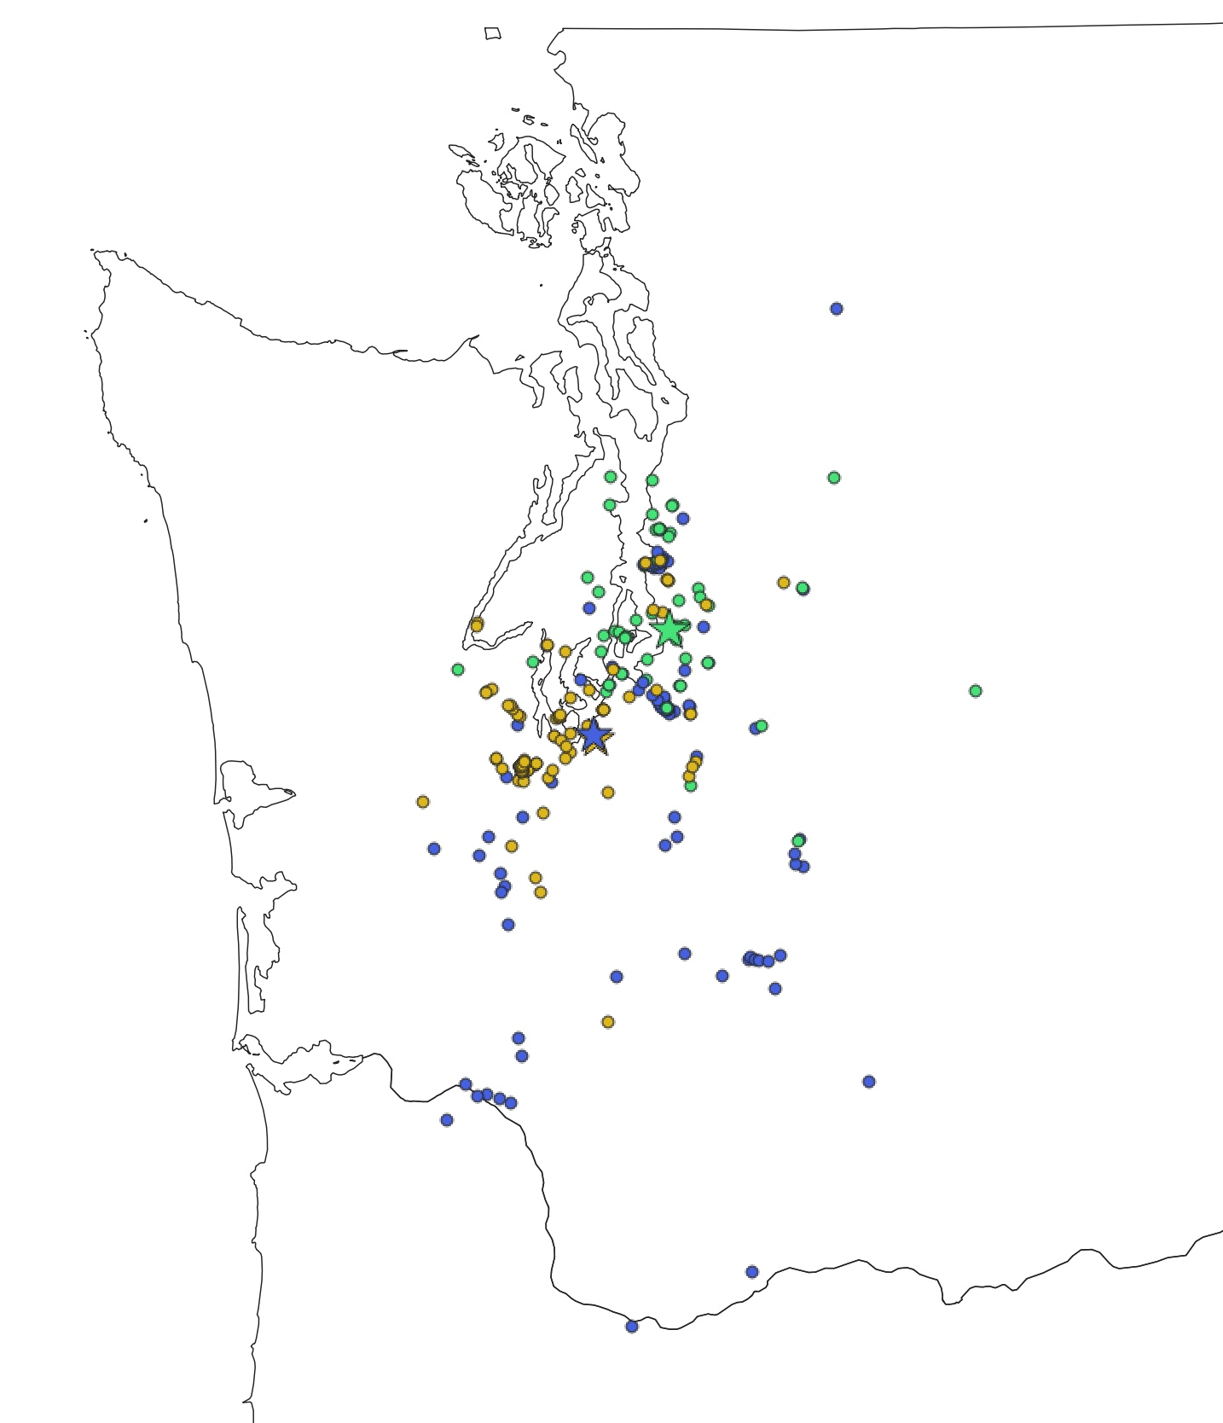
Coseismic Ground Failure in Washington
Partial or reported observations of landslides, ground cracking, and liquefaction
M6.7 1965
M6.8 2001
M6.7 1949
Compiled by Washington DNR from published and unpublished sources

Slide 5
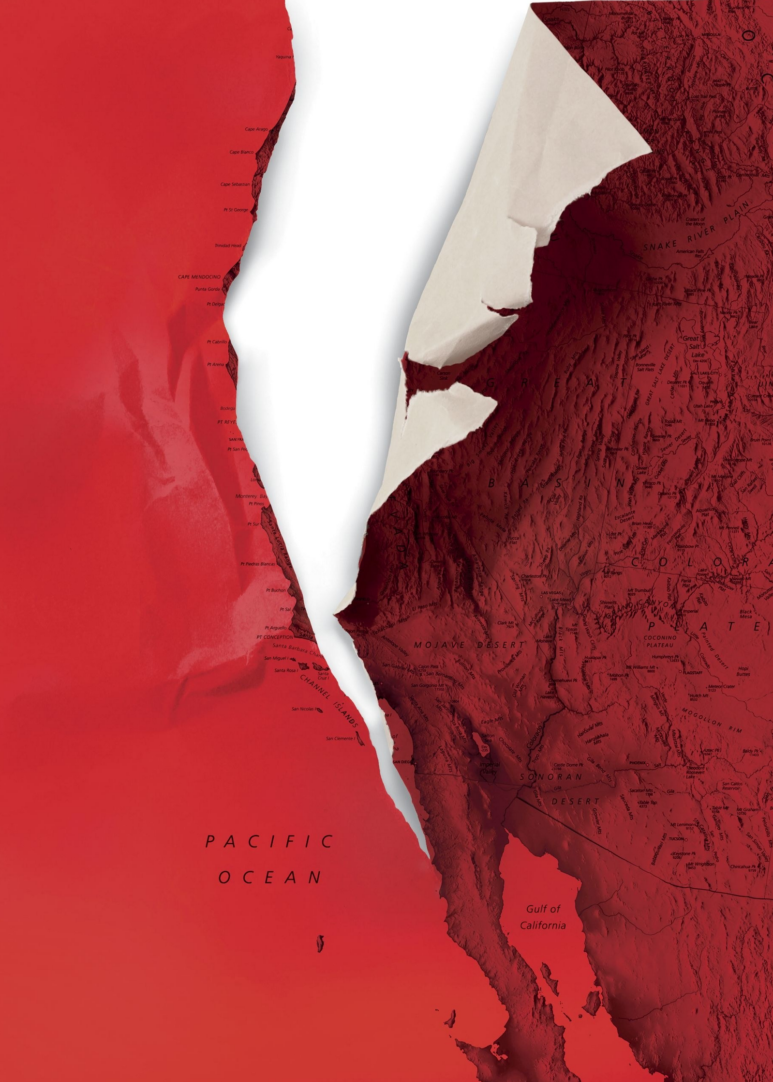
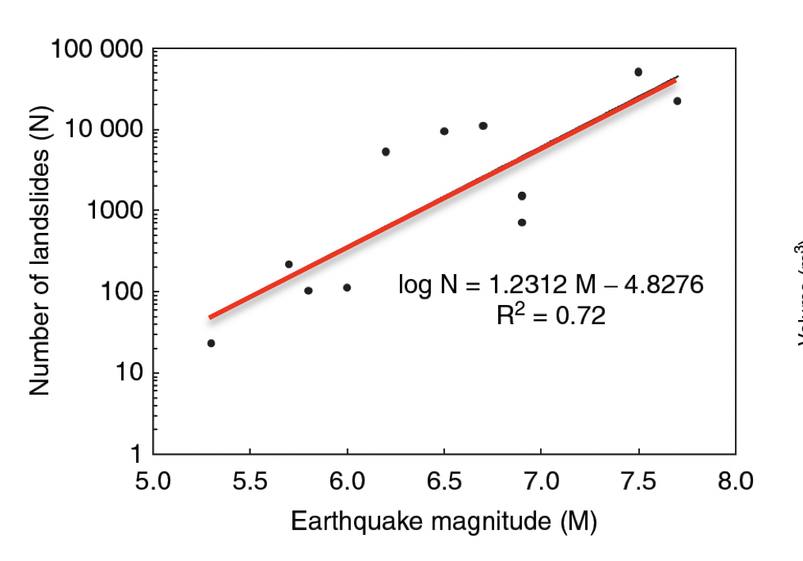
"The shaking from the Cascadia quake will set off landslides throughout the region—up to thirty thousand of them in Seattle alone, the city’s emergency-management office estimates."
M9.0: N ~ 1.8M
Sources: Kathryn Schulz, The New Yorker; Keefer (2002)
Notes:
From the world of popsci: we have the potential cataclysm of the really big one. A great subduction zone earthquake along the CSZ that levels everything west of I-5 and triggers 30,000 landslides within Seattle. But what is actually more likely to happen, and what do we know from around the world and active PNW research

Slide 6
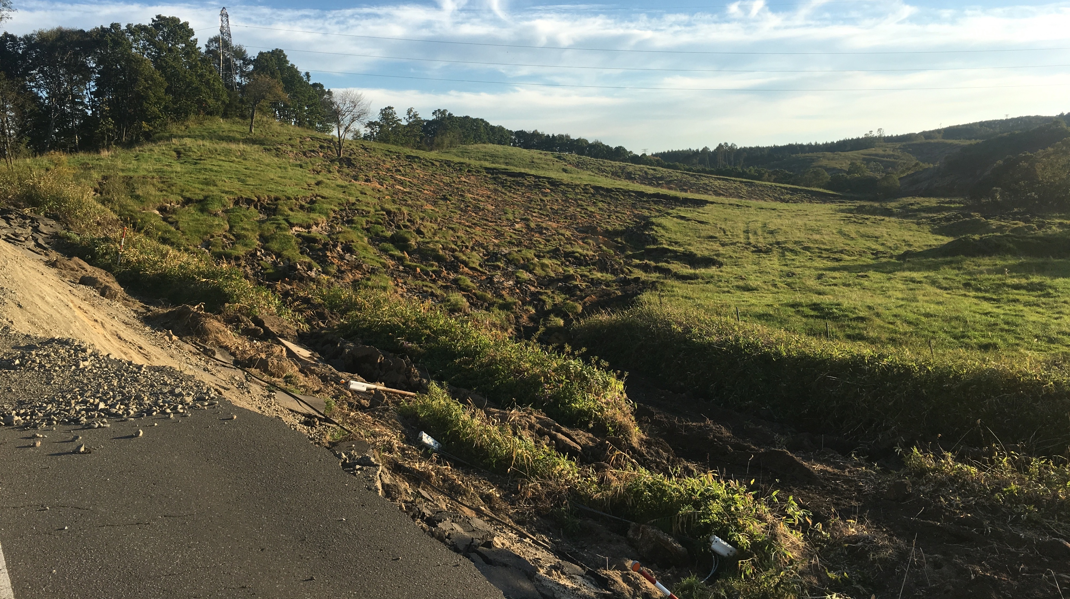
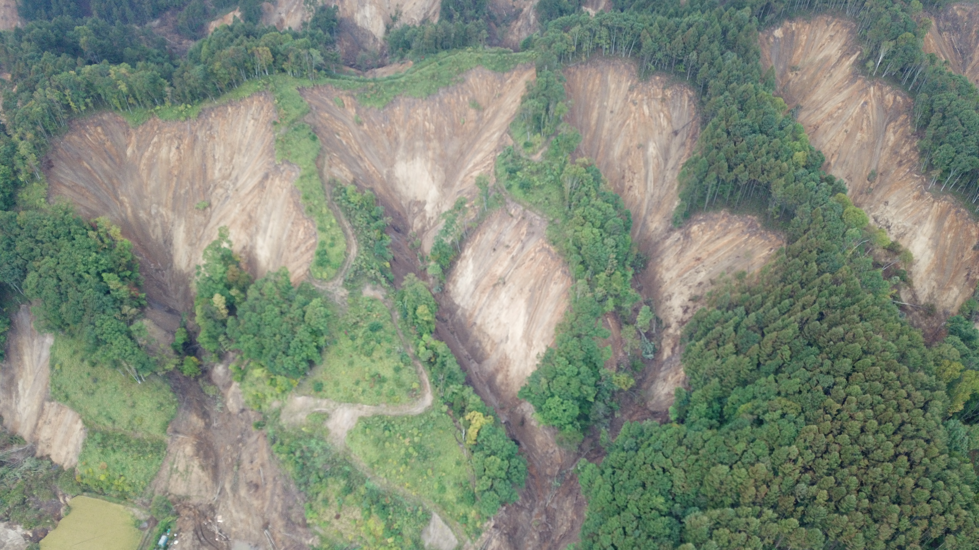
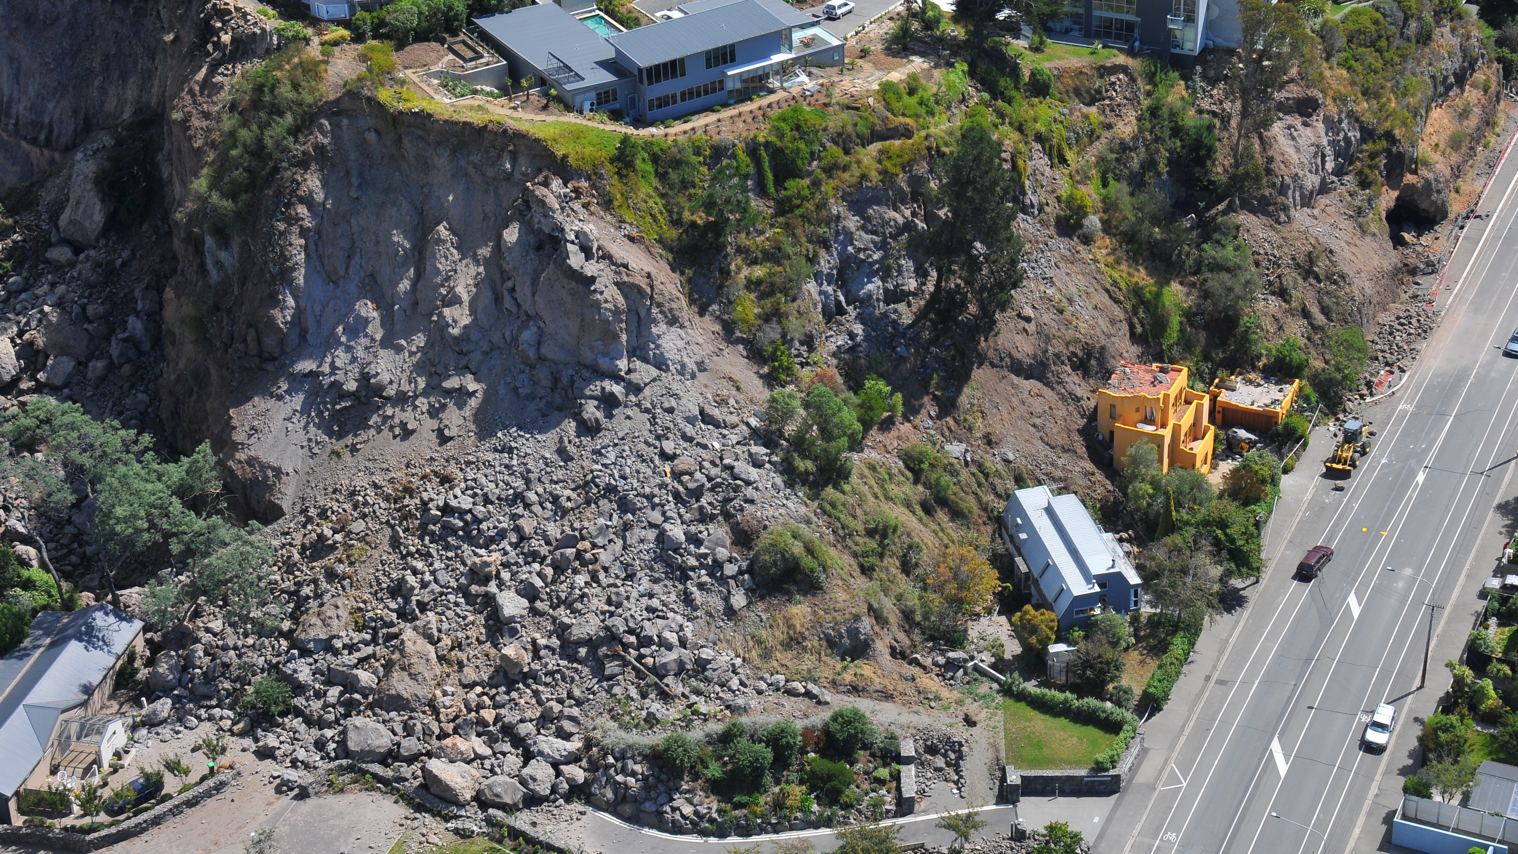
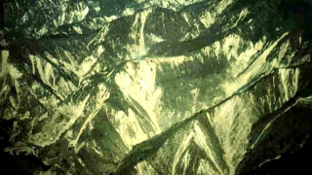
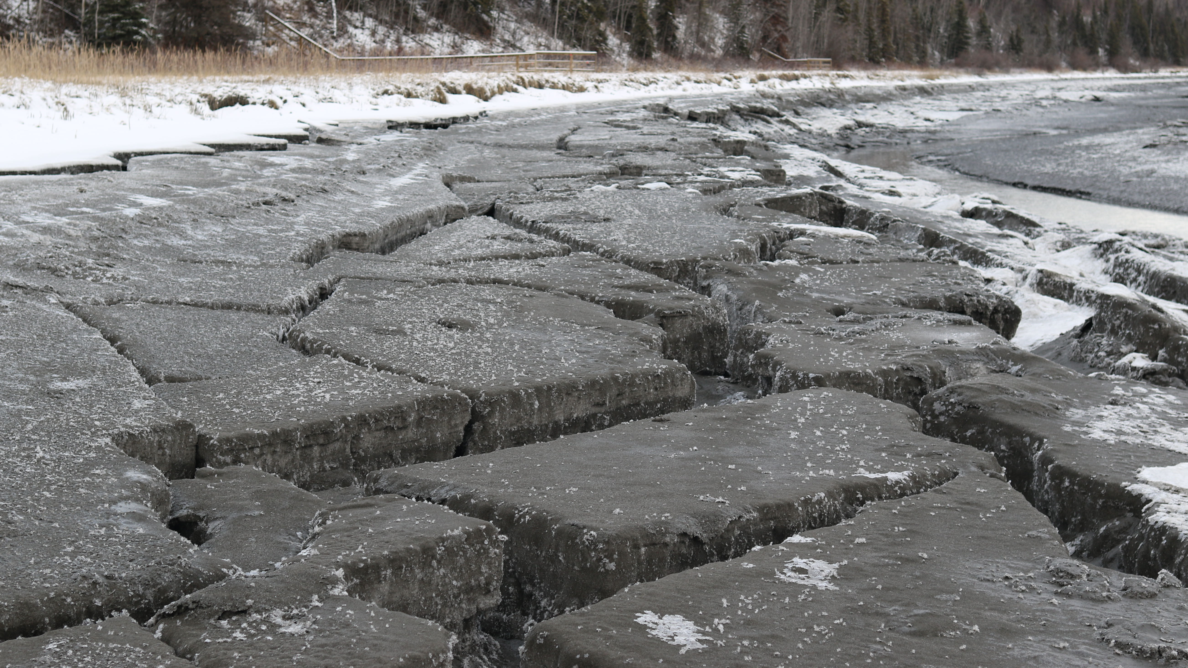
Coseismic Ground Failure
Many shapes and sizes:
landslides, rockfall, flow slides, liquefaction and lateral spreads, etc.
Widespread Consequences:
Potential for loss of life and property over hundreds to thousands of square km

Slide 7
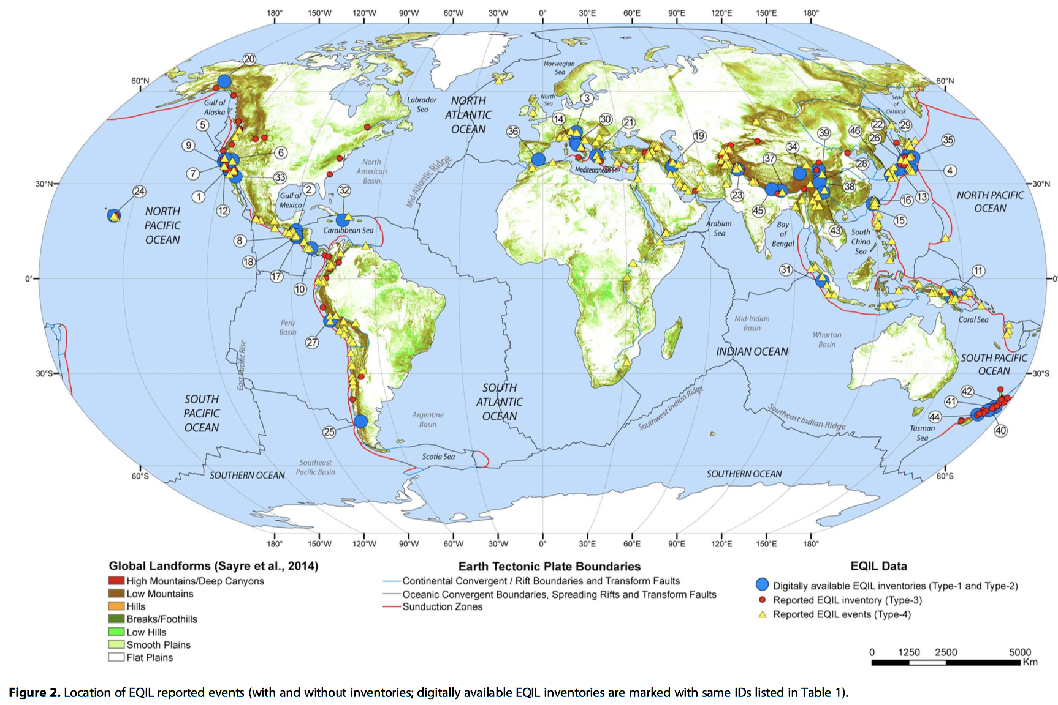
Coseismic Ground Failure
Global ground failure inventories are leveraged to estimate future landslide (and liquefaction) probabilities
Landslide Probability
Notes:
In the face of highly variable landslide mechanics, spatial heterogeneity, and limited data, regional and global ground failure modeling is highly empirical. We map coseismic ground failure and then throw statistical models at them, which means we generally need to have good inventories of the phenomena we’re chasing. The problem is, we have two semi-complete inventories of great SZ earthquakes.

Slide 8
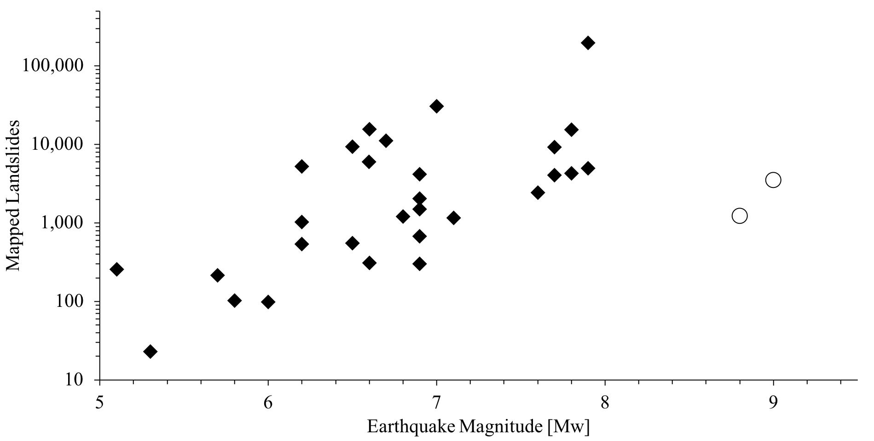
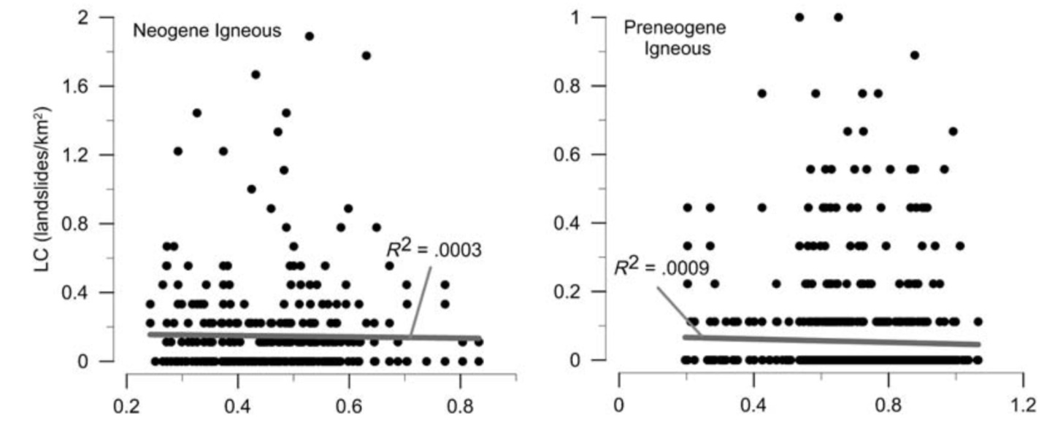
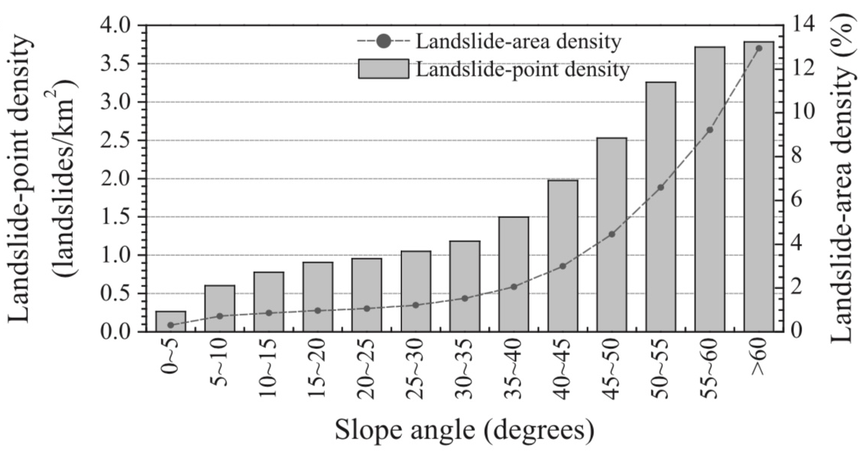
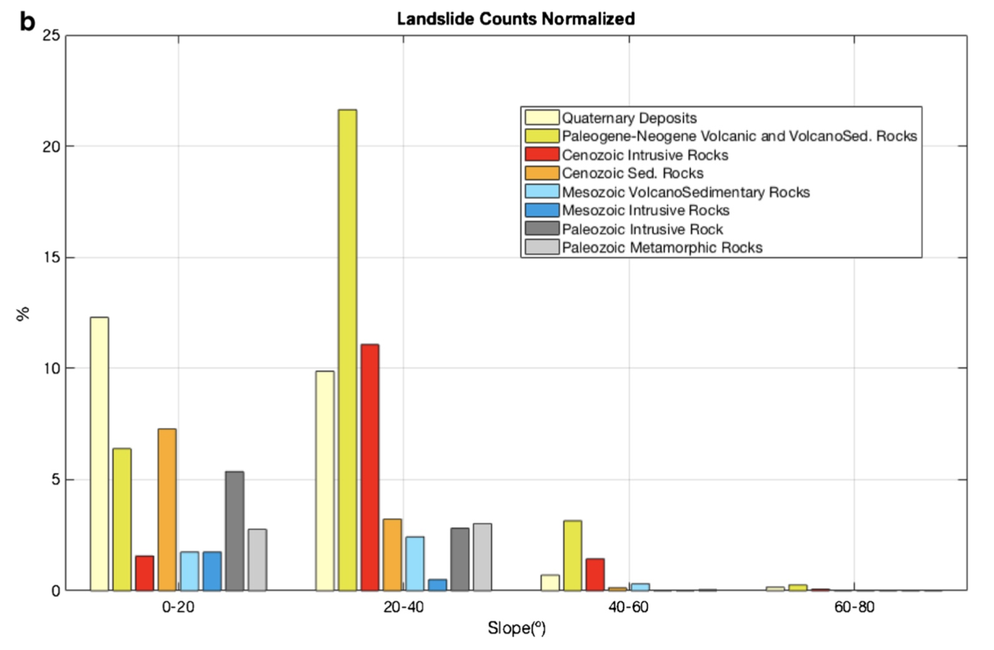
Coseismic Ground Failure
General Trends*:
Larger earthquakes produce more landslides
Slides follow shaking and slope
*Except in Subduction Zones
Alaska [est.]
Tōhoku-oki
Maule
PGA (%)
e.g., Wenchuan [Dai et al.]

Slide 9
SZ Coseismic Ground Failure
In the absence of (much) subduction zone ground failure data, two parallel solutions:
Go find the data
Appeal to physical / theoretical models

Slide 10
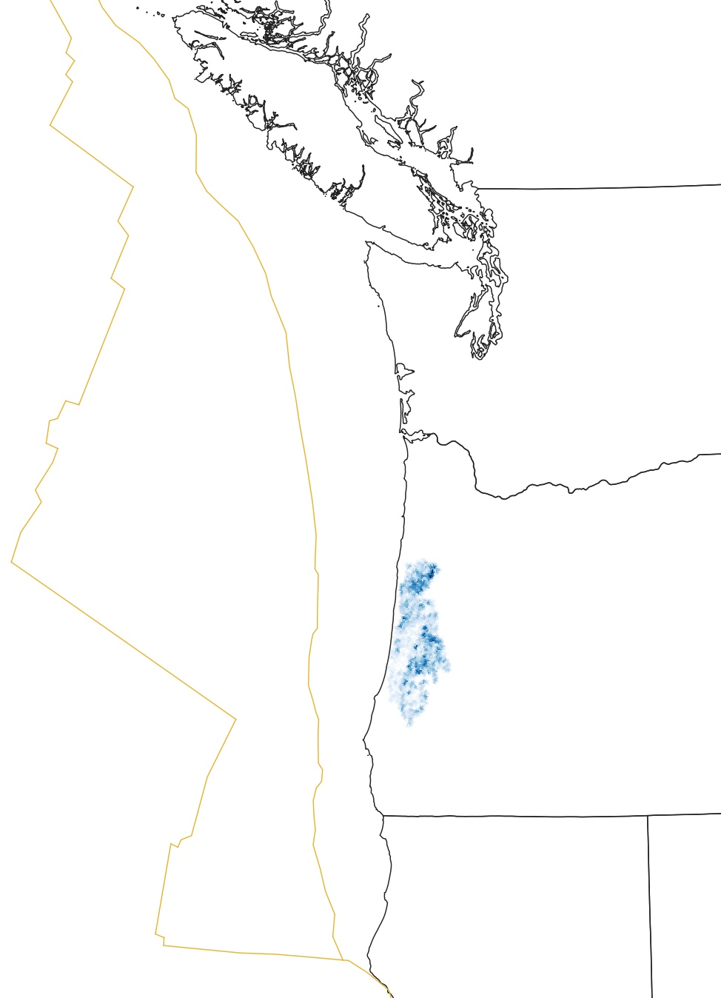
Cowichan history of a landslide destroying a village near Nanaimo (likely 1700, unmapped)
Lake Quinault (Leithold et al., 2017) and Lake Washington (Karlin et al., 2004) landslide deposits dated to ~1700 (high age uncertainty)
Evidence of liquefaction along the lower Columbia and coastal streams, attributed to 1700 (high age uncertainty)
Calibrated-roughness dating suggest a few hundred landslides may be attributable to a 1700 CSZ earthquake (very high age uncertainty); Parallel dendrochronology study has not yet identified 1700 landslides
Slope stability analysis of three large rockslides (Schulz et al., 2012) requires strong seismic triggering [0.5 – 1g], approximate age constraint to ~1700

Slide 11
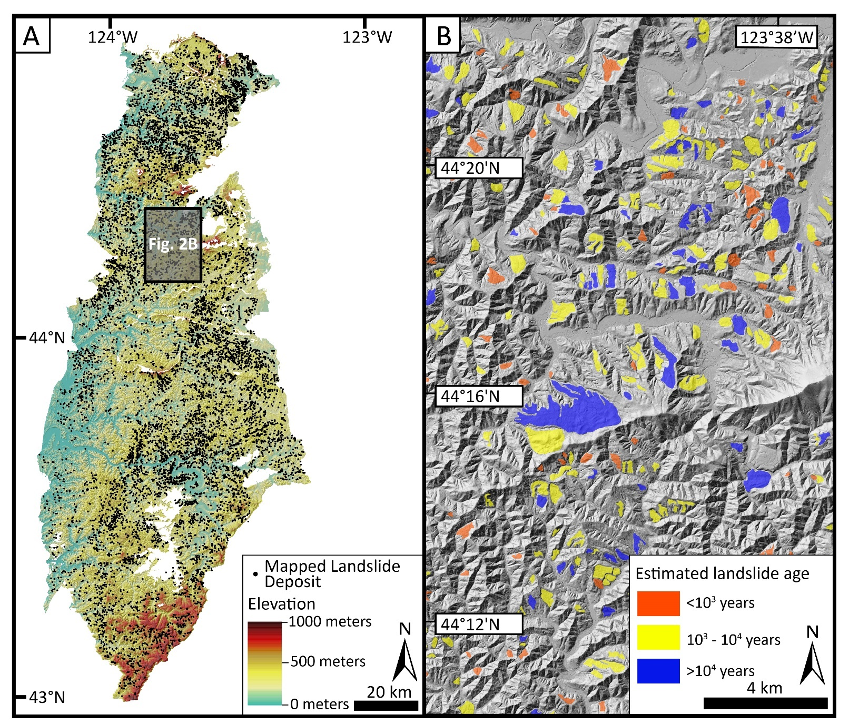
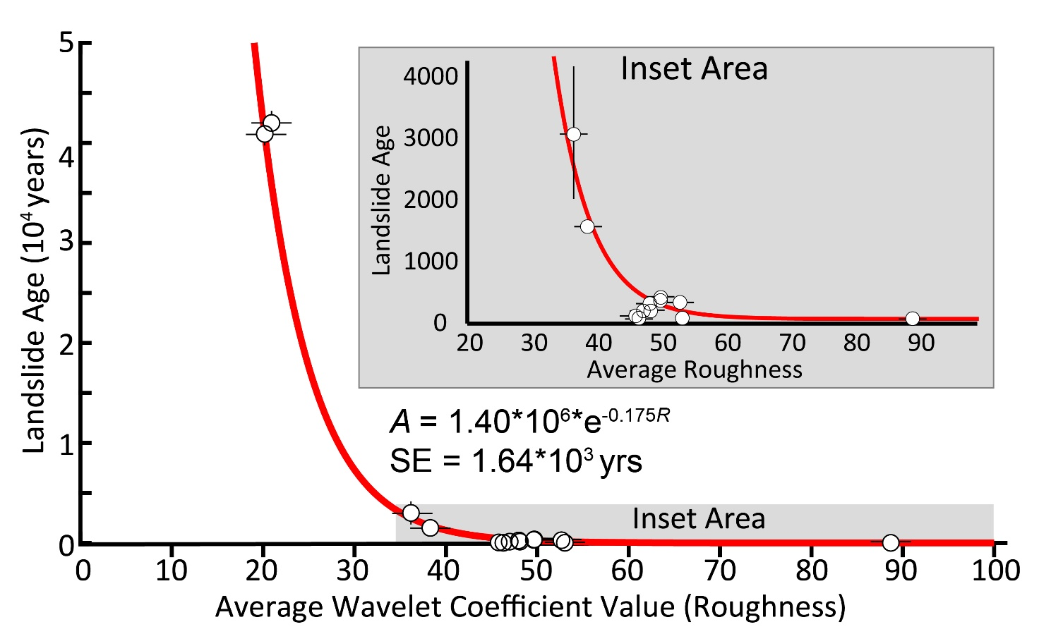
Cascadia Subduction Zone Landslides
Known dendrochronology and ¹⁴C ages of landslides used to calibrate an Age-Roughness correlation for lidar-mapped landslides
Notes:
Focusing on slides dated to ~1700, developing synthetic landslide inventories to test likelihood observed pulse of ~300yo slides are from a single event.

Slide 12
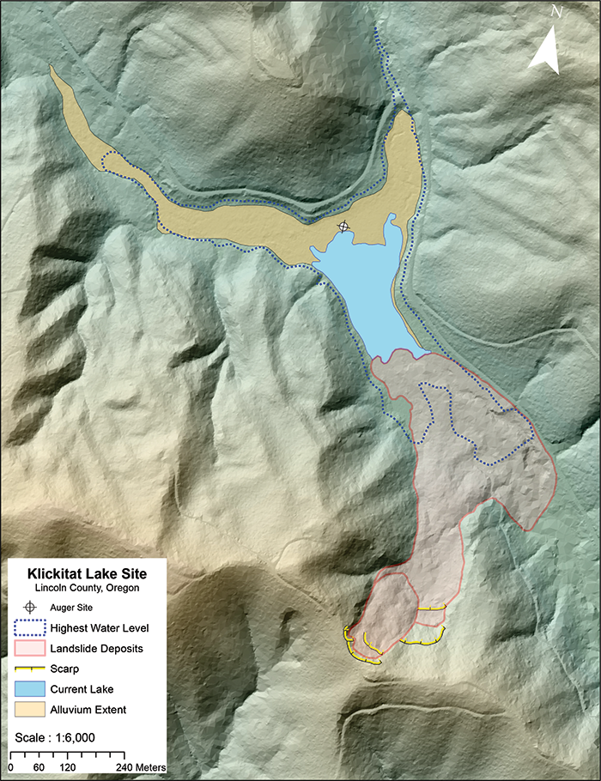
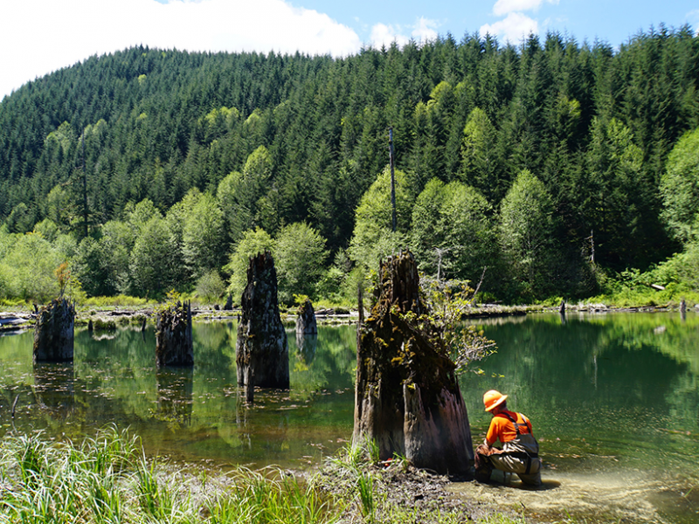
Cascadia Subduction Zone Landslides
Oregon led effort to use Dendrochronology (seasonal to annual precision) dating to identified landslide dam formation in 1700

Slide 13
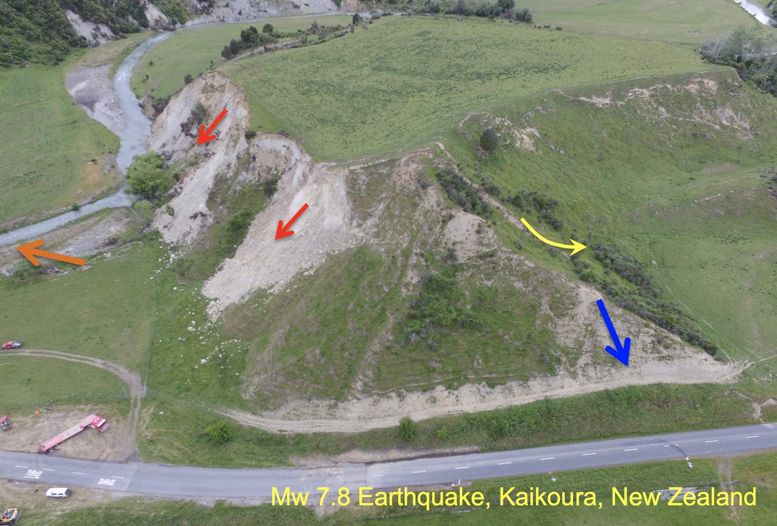
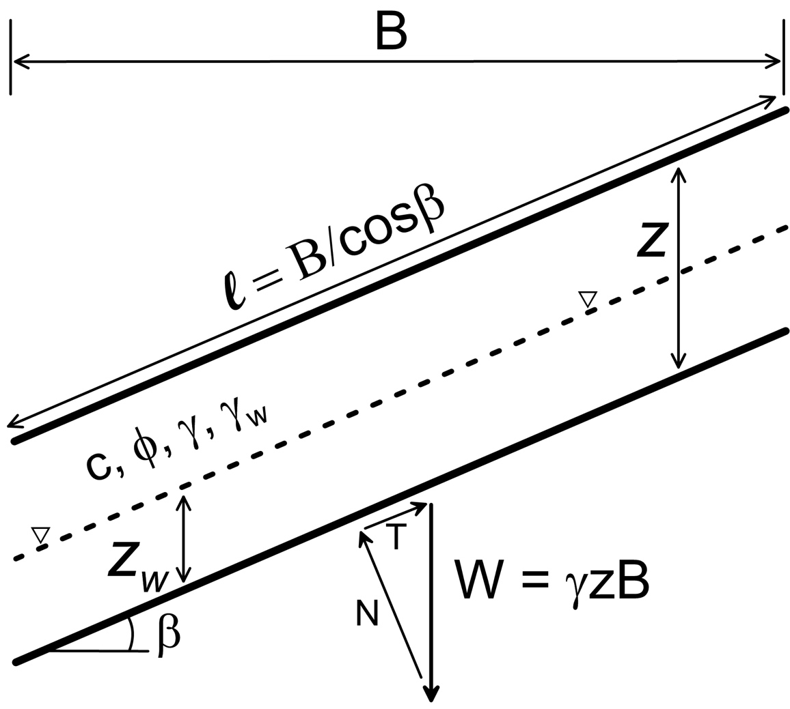
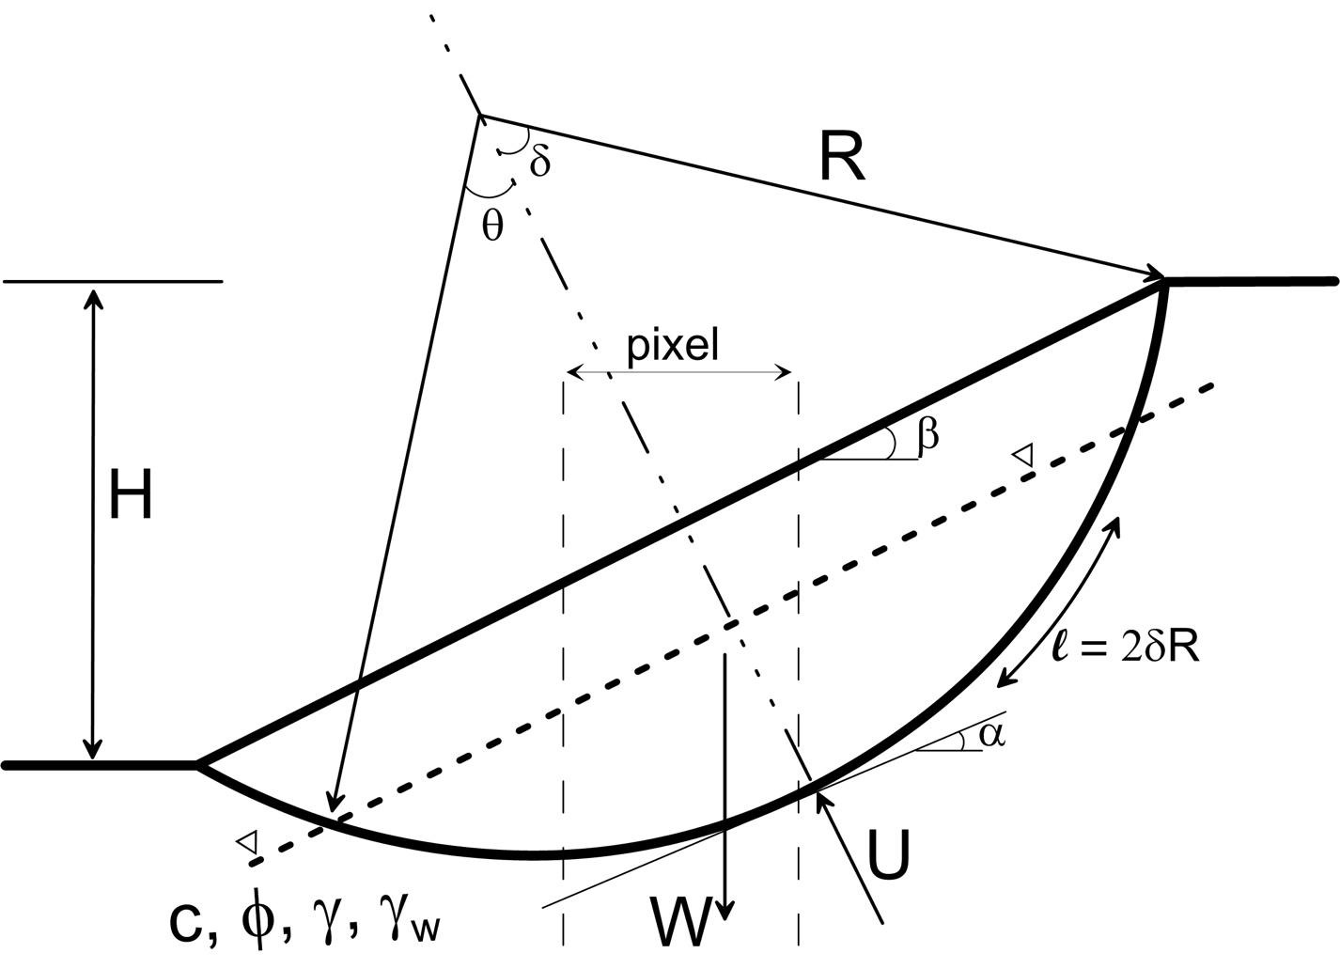
Cascadia Subduction Zone Landslides
Forecasting Hazard:
Modeling a suite of likely failure modes from simple physically-based models
Rock-slope failures
Rotational slump
Lateral
spread
Shallow failure
Rock-slope failures
Shallow failure
Rotational slump
Grant et al., 2016; Pollock et al., 2019

Slide 14
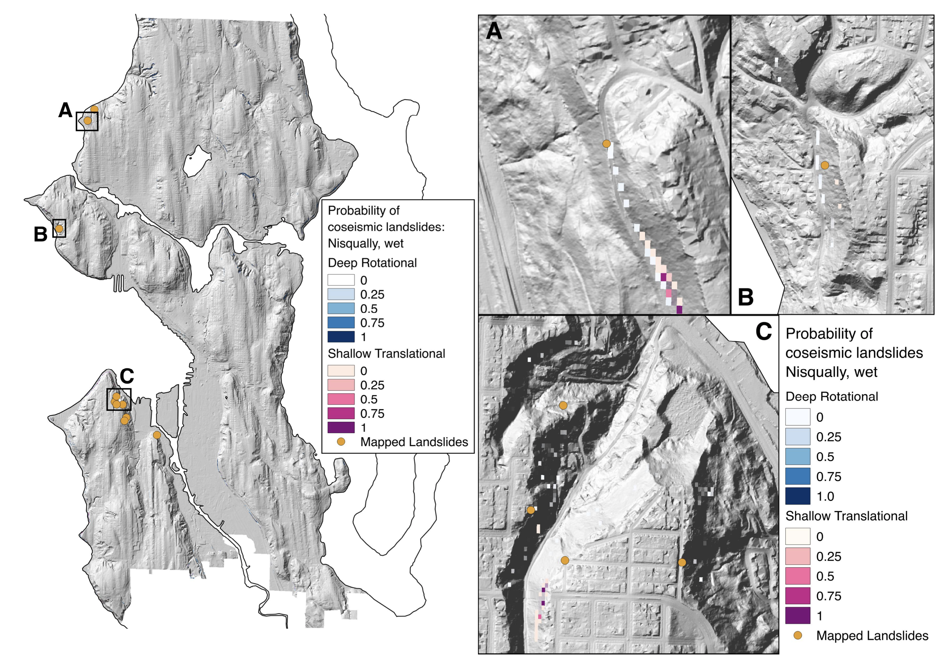
Cascadia Landslide
Prediction
Modeled landslide likelihood in agreement with mapped 2001 Nisqually landslides

Slide 15
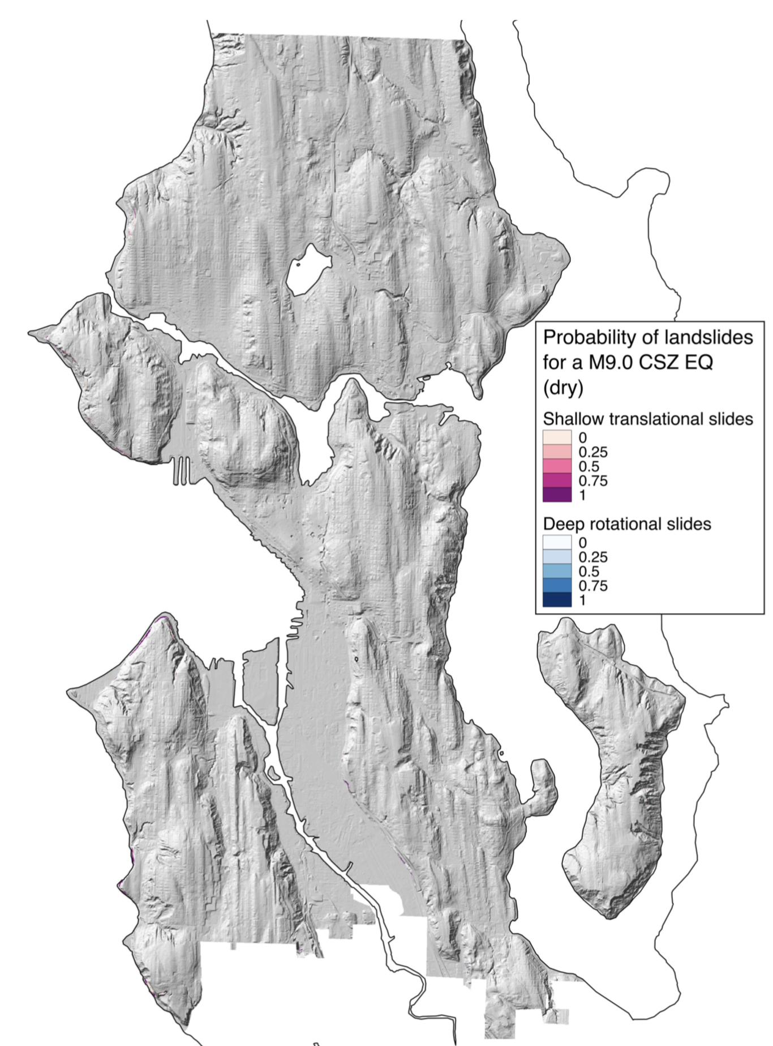
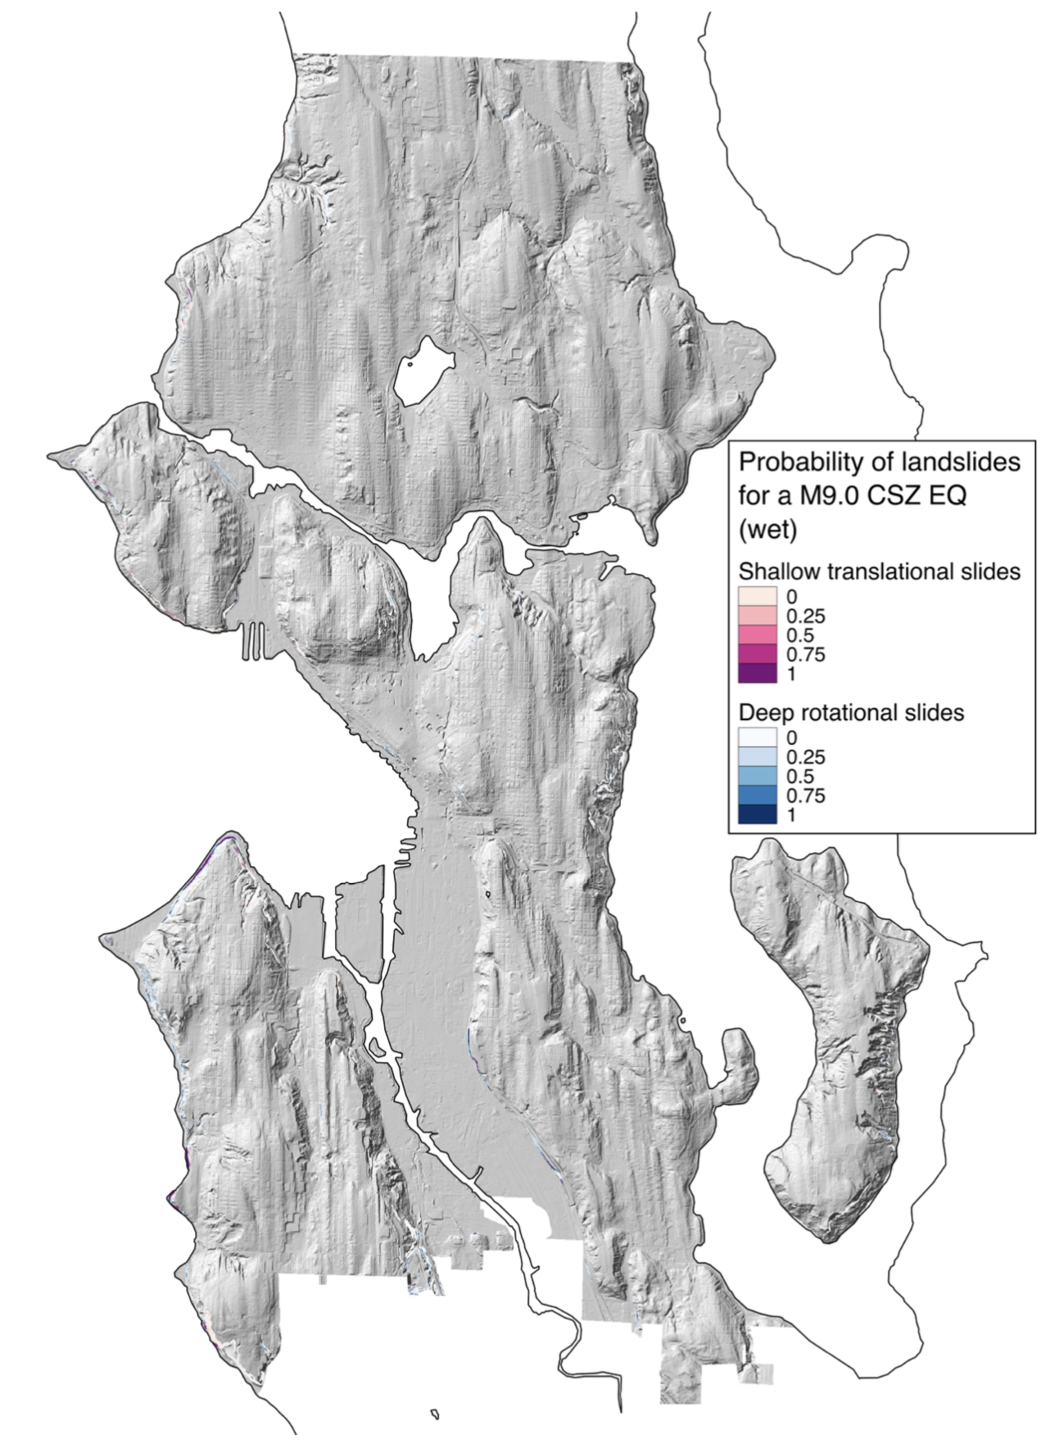
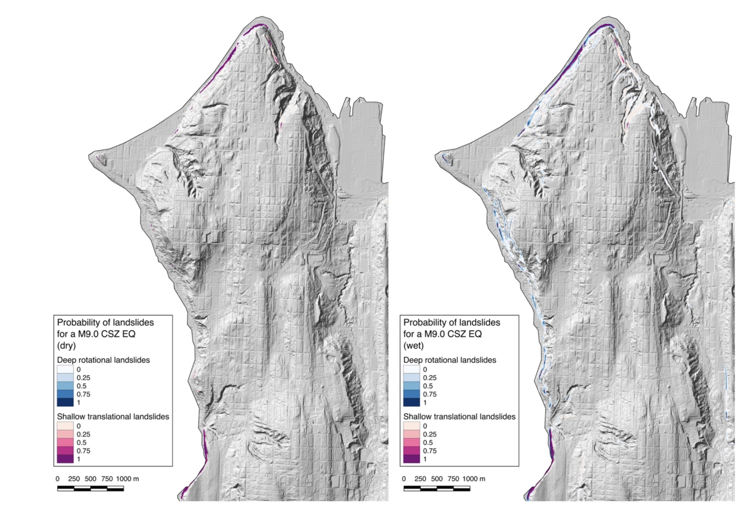
Cascadia Landslide
Prediction
M9.0 CSZ Synthetics
Limited landslide hazard expected in Seattle
Potentially strong seasonality effect
Summer Groundwater
Winter Groundwater
Notes:
Area effected by deep rotational slides: 0.18km² (dry) to 1.13km² (wet); 515% seasonal increase
For shallow slides: 0.56km² (dry) to 0.59km² (wet); modest seasonal increase
The above areas span from ~35 to ~225 football fields

Slide 16
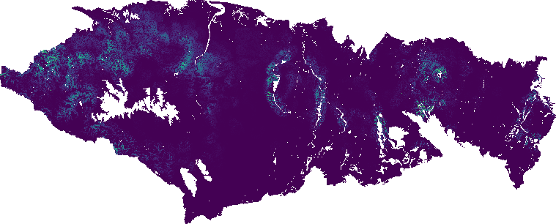
Cascadia Landslide
Prediction
Active work to model regional (and full margin) CSZ 2xxx hazards calibrated to available 1700 evidence
~1700 LS Density
N
High: 0.7 slides/km²
Low: 0 slides/km²
M9.0 Landslide Likelihood

Slide 17
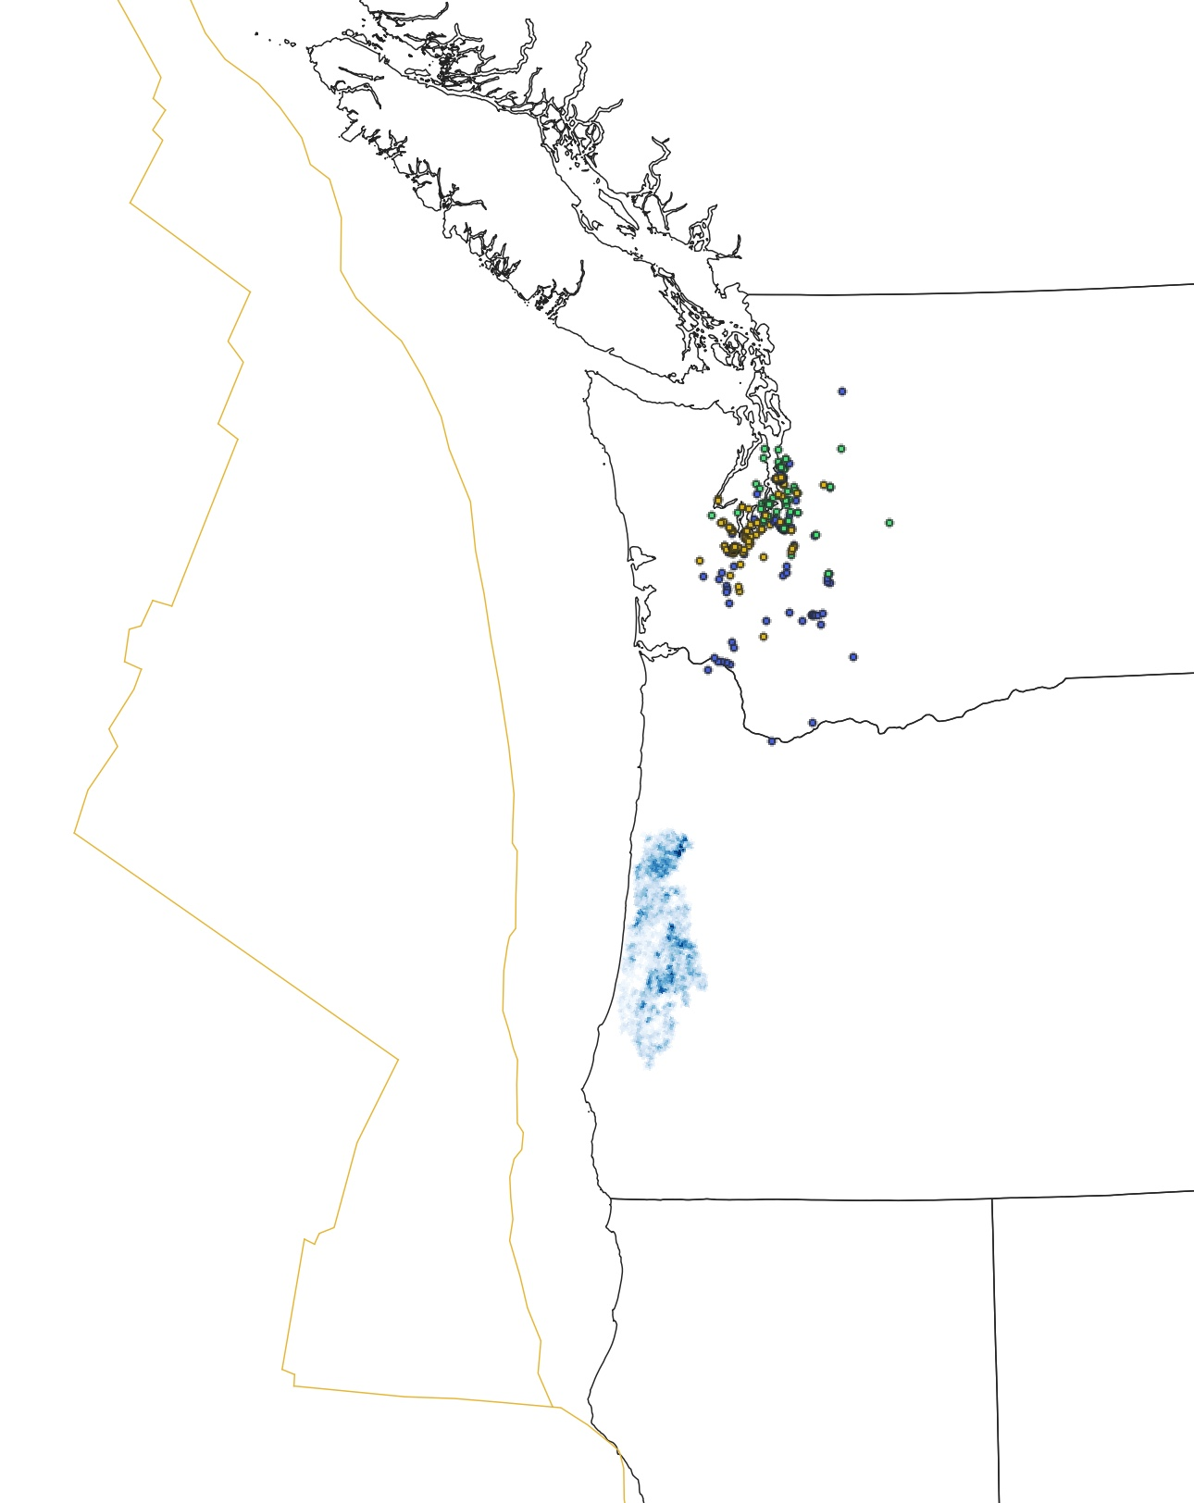
PNW Coseismic Ground Failure
Looking ahead
Massive mapping opportunities
CSZ evidence on/off-shore, in lakes
Other earthquake inventories
Modeling challenges linking observations from Japan, Chile, AK, and elsewhere to the PNW
Leveraging the above to provide best-estimates of future coseismic impacts

