Slide 1
Lessons from recent earthquakes elsewhere
Yajing Liu
McGill University
Pacific Northwest Earthquake Science Workshop
5 November 2019

Slide 2
Discoveries in seismic source process
from recent earthquakes
Slow slip and/or repeating earthquakes prior to megathrust ruptures
Interseismic locking and coseismic slip
Large slip promoted by dynamic weakening
Reactivation of hidden/inactive faults
…
Events | Magnitude | Fatalities | Economic impact
2011/03/11 Tohoku-Oki, Japan | 9.0 | 15,897 | $360B
2012/09/05 Nicoya, Costa Rica | 7.6 | 2
2014/04/01 Iquique, Chile | 8.2 | 6 | $100M+
2016/11/14 Kaikoura, New Zealand | 7.8 | 2 | $1.8B
2019/07/04-06 Ridgecrest, US | 7.1, 6.4 | 1 | $5.3B
2008/09/18 Gofar, East Pacific Rise | 6.0
…
Notes:
Iquique tsunami ~ 2 m

Slide 3
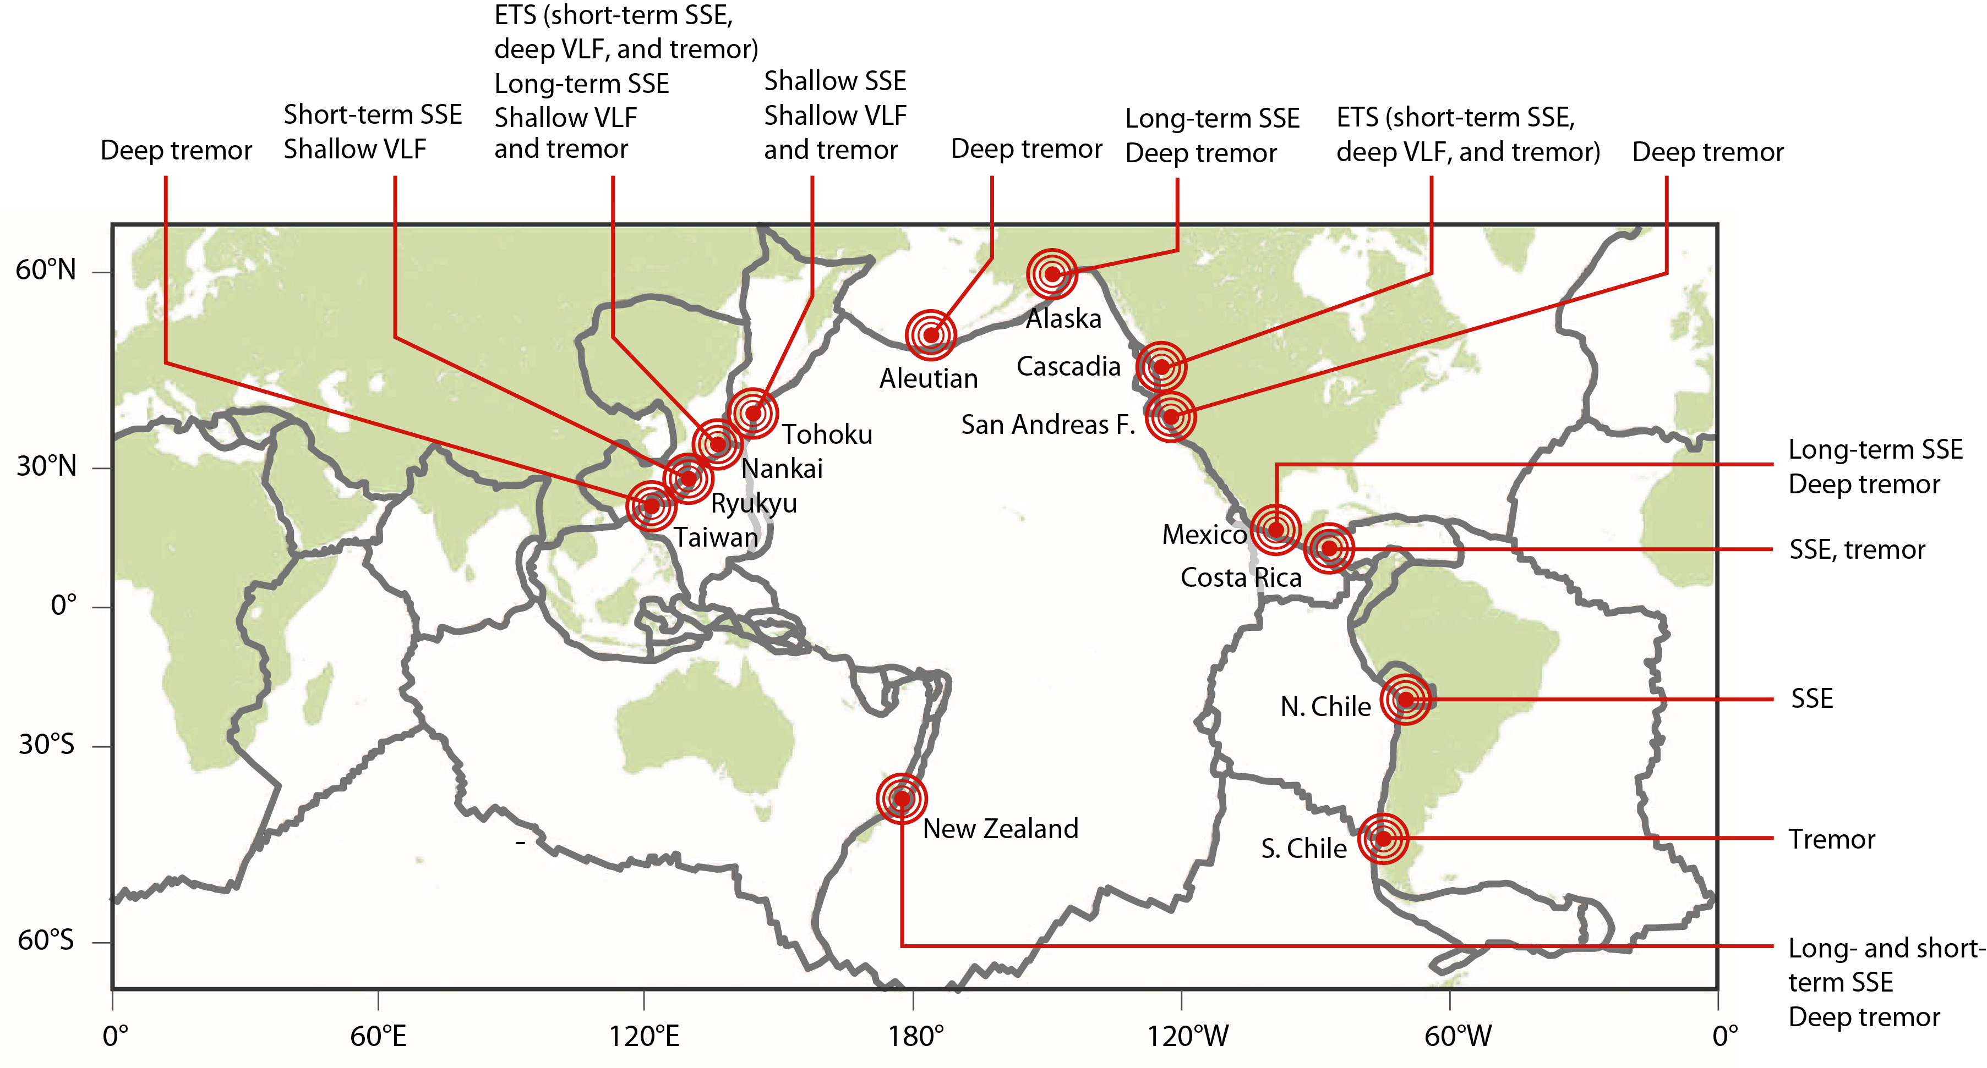
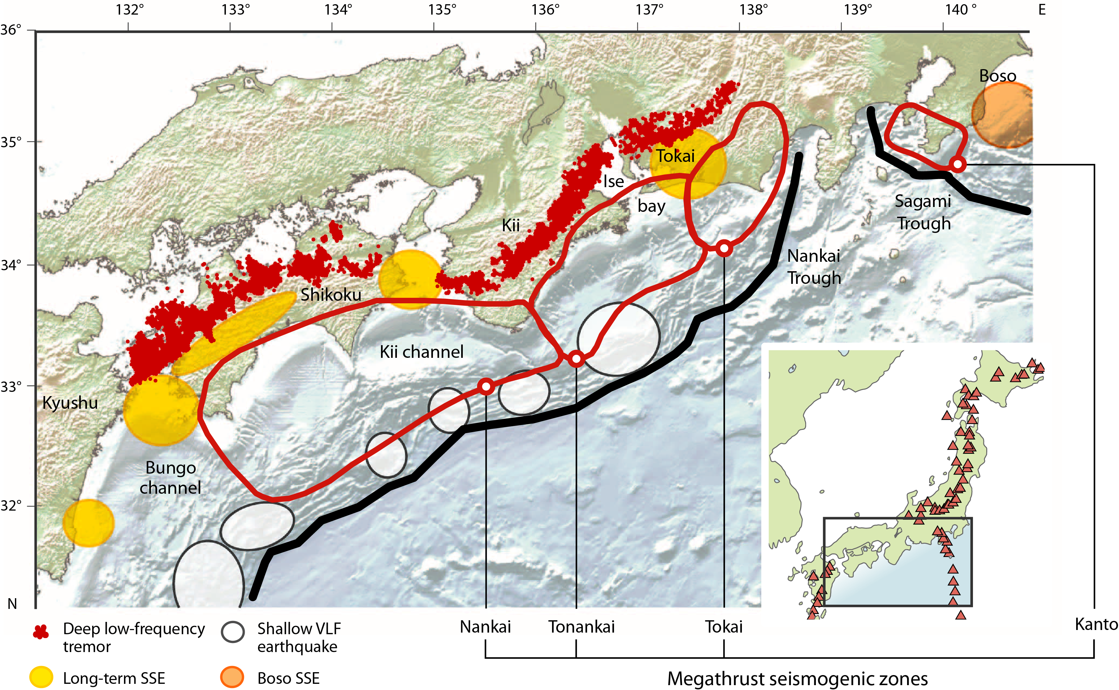
Slow slip/repeating earthquakes before megathrust ruptures
[Obara and Kato, 2016]
Slow slip phenomena in global subduction zones, source areas surround (sometimes overlap with) megathrust seismogenic zones
How would slow slip alter the stress state on the seismogenic zone and affect megathrust rupture?

Slide 4
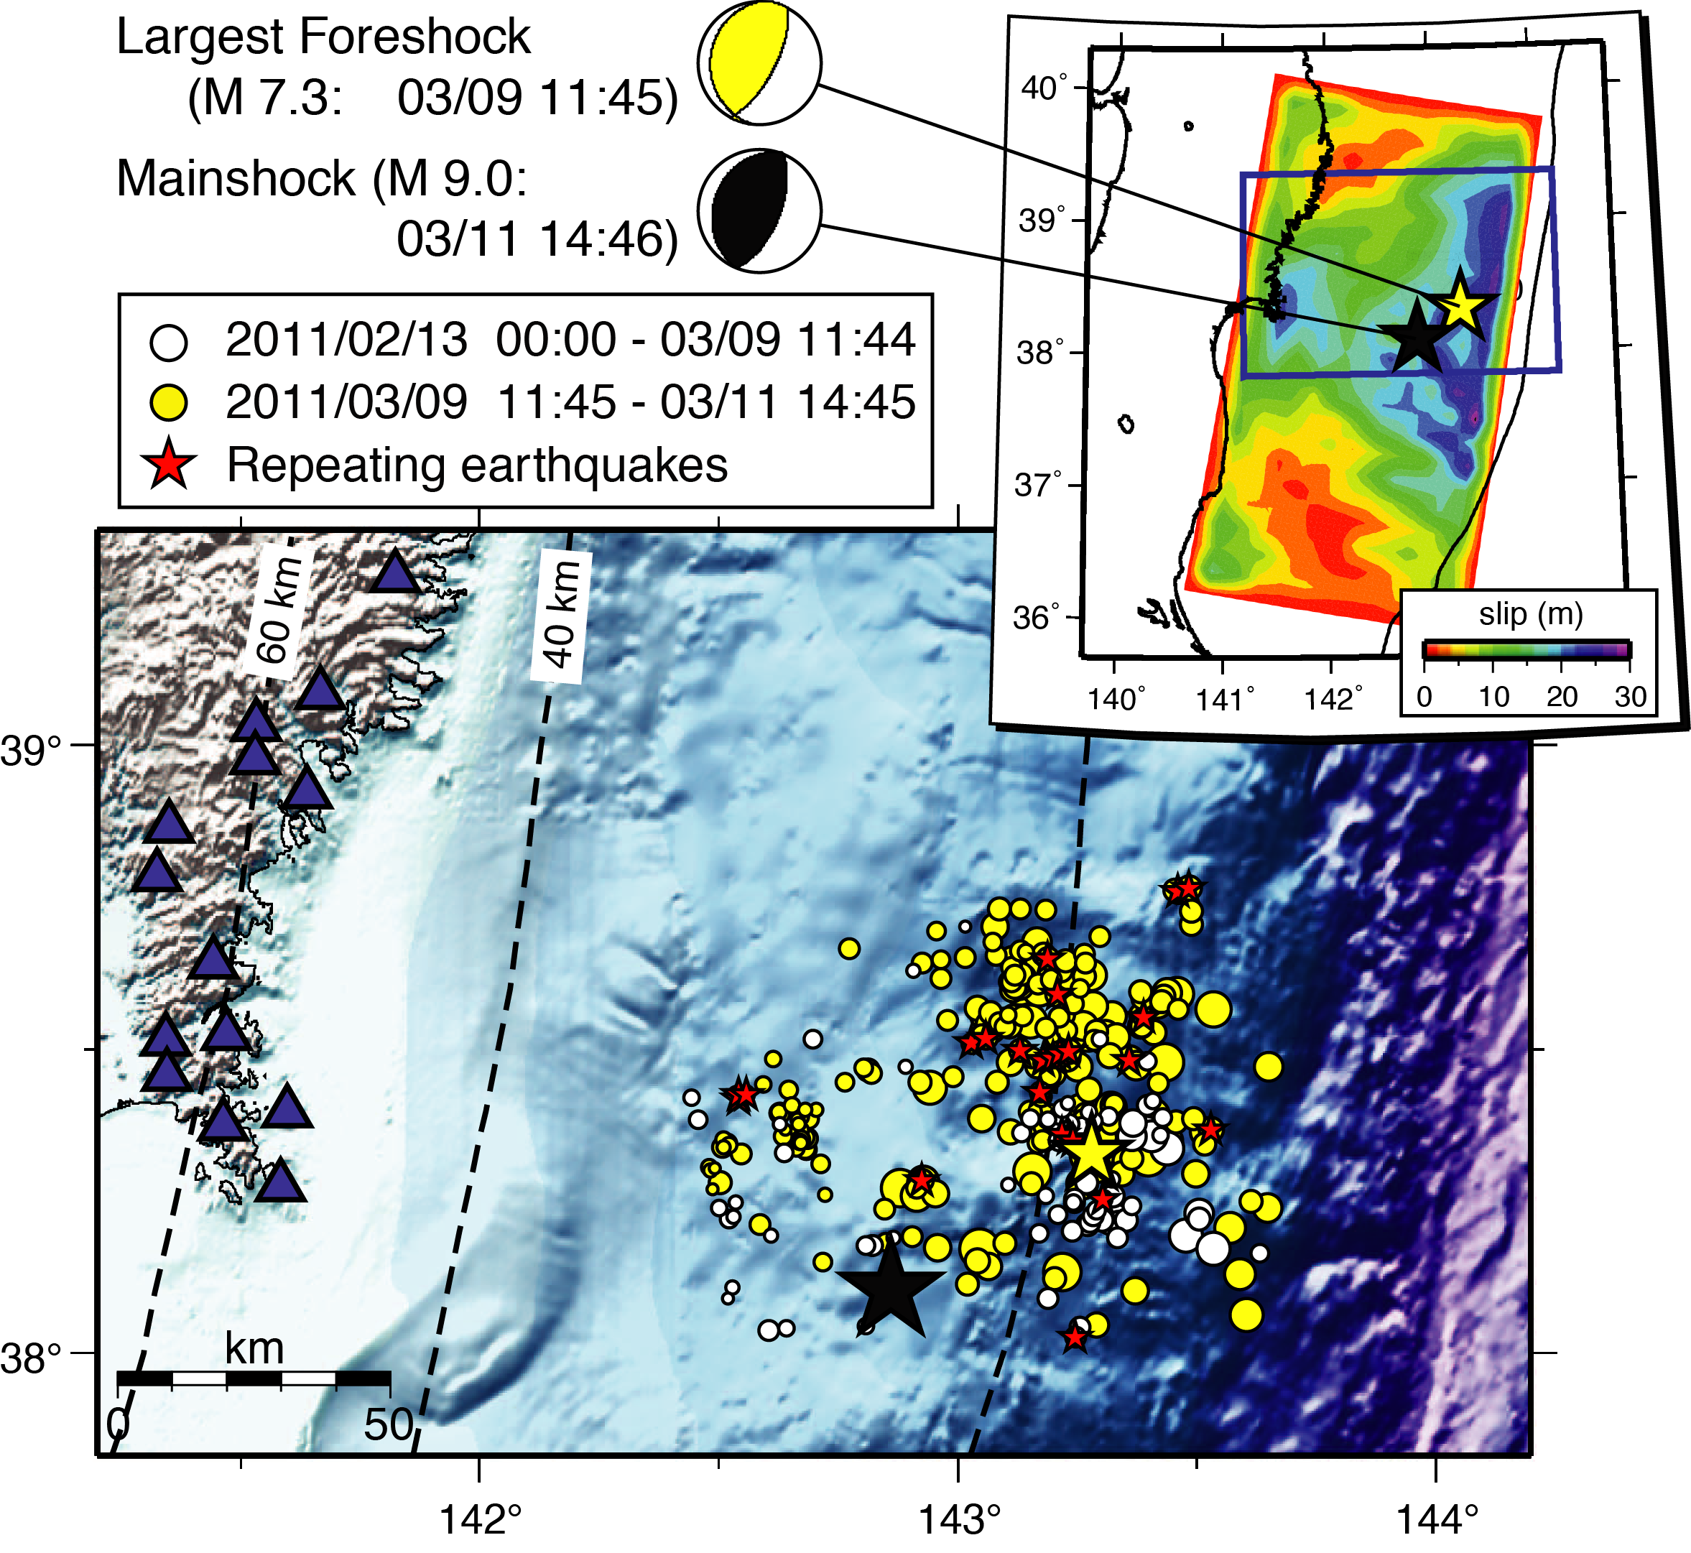
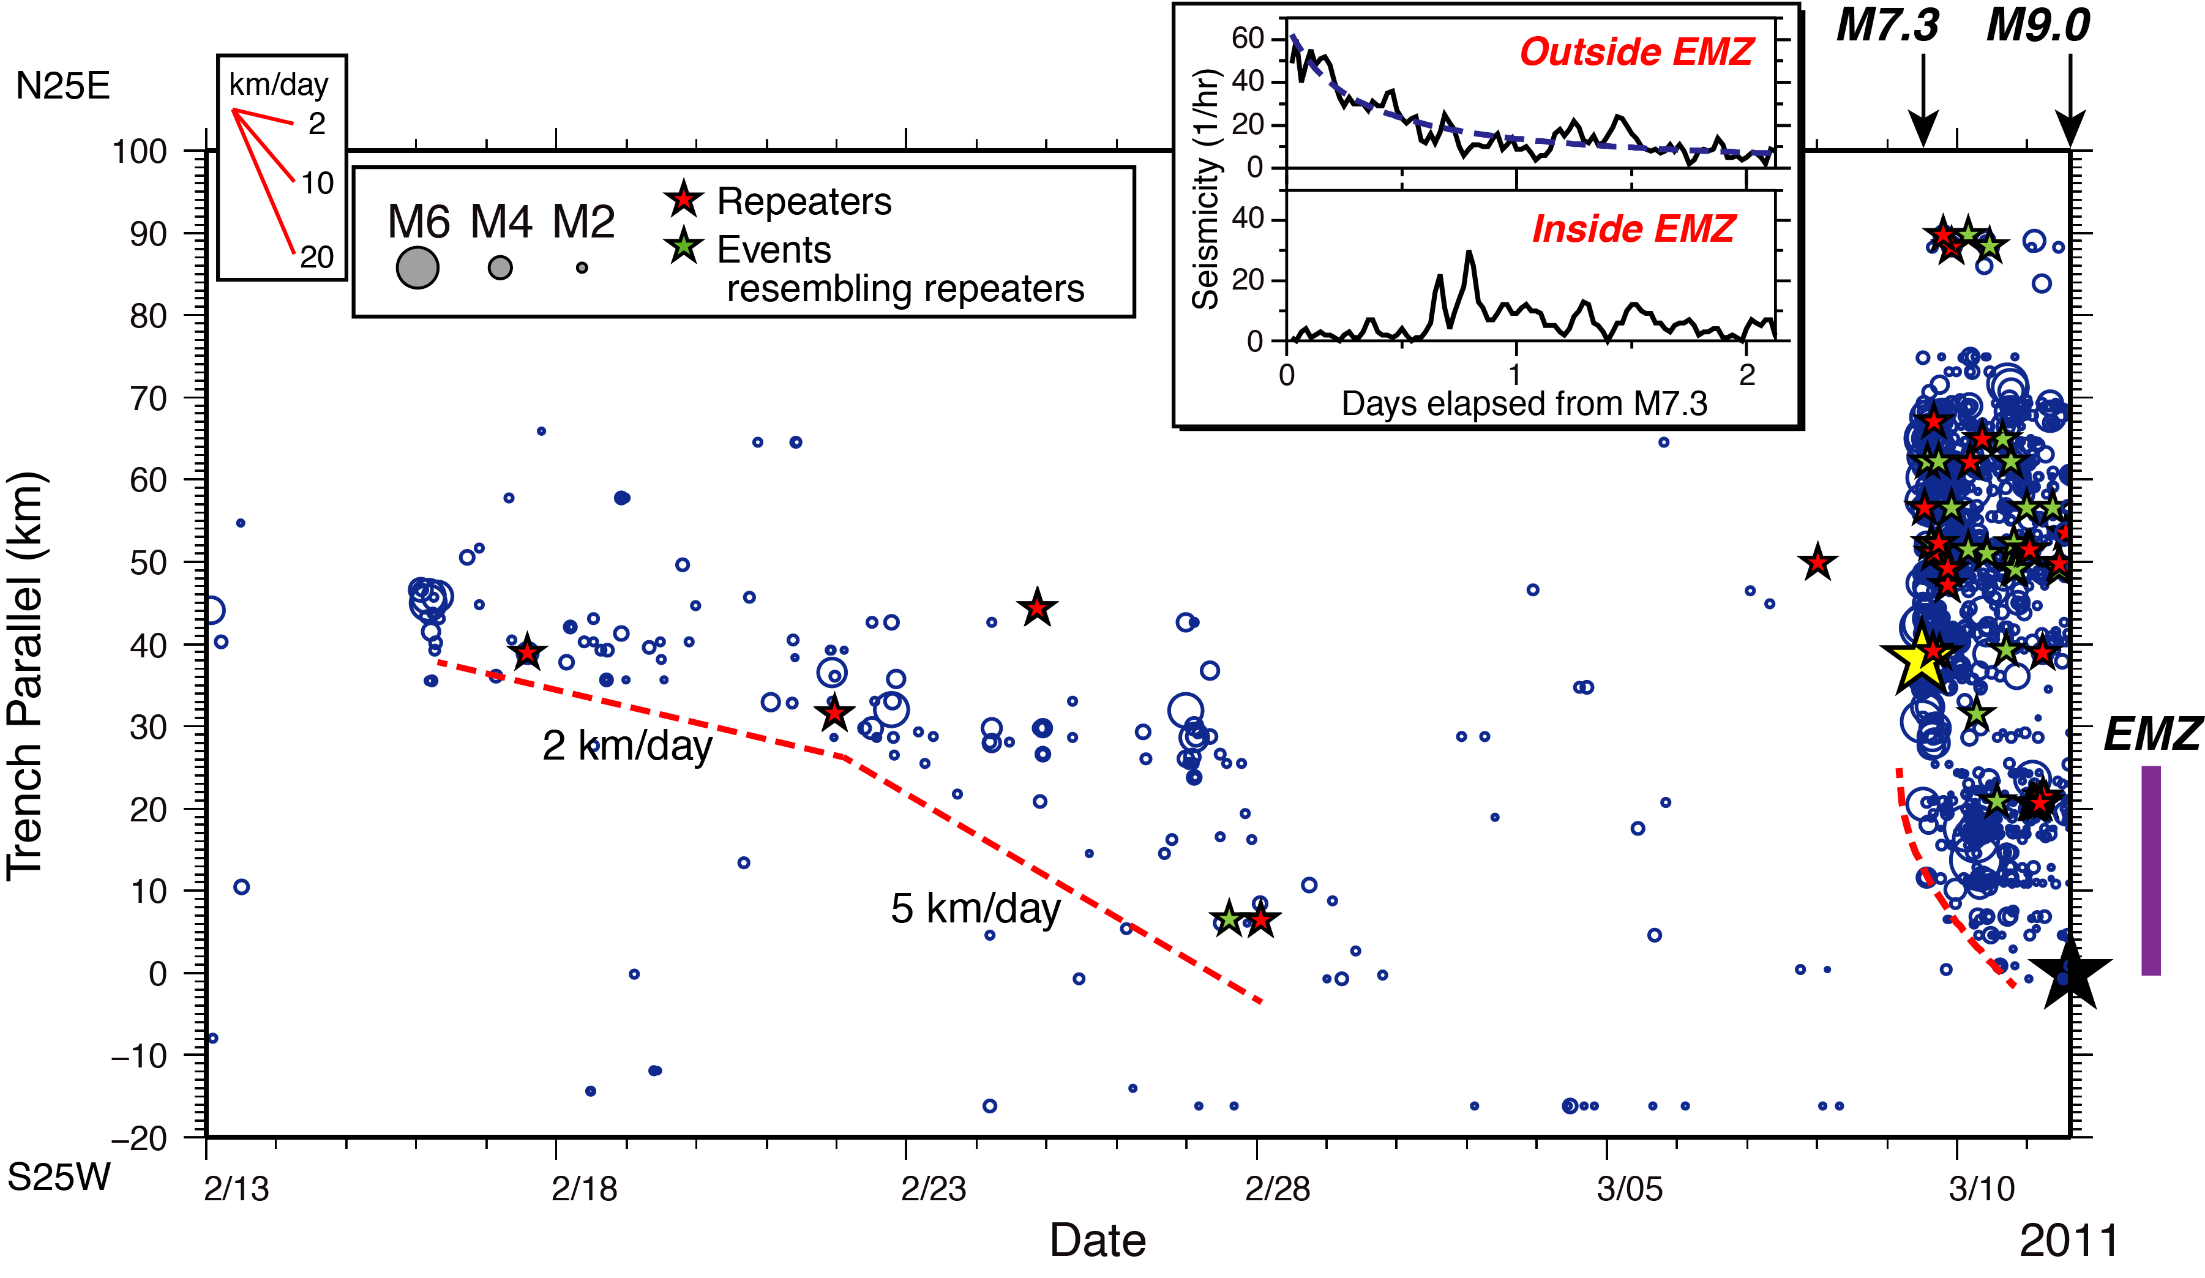
Slow slip prior to 2011 Tohoku M9 – repeating earthquakes
[Kato and Obara, 2012]
Two sequences of seismicity migration between M7.3 foreshock and M9 mainshock
Second episode of higher migration speed, but no accelerating occurrence of foreshocks close to the M9 hypocenter
Total equivalent cumulative slip (based on seismic moment of repeating events) ~ 20 cm prior to the M9 rupture
Slow slip inferred from ocean bottom pressure gauge and onshore strainmeter measurements [Ito et al., 2013]

Slide 5
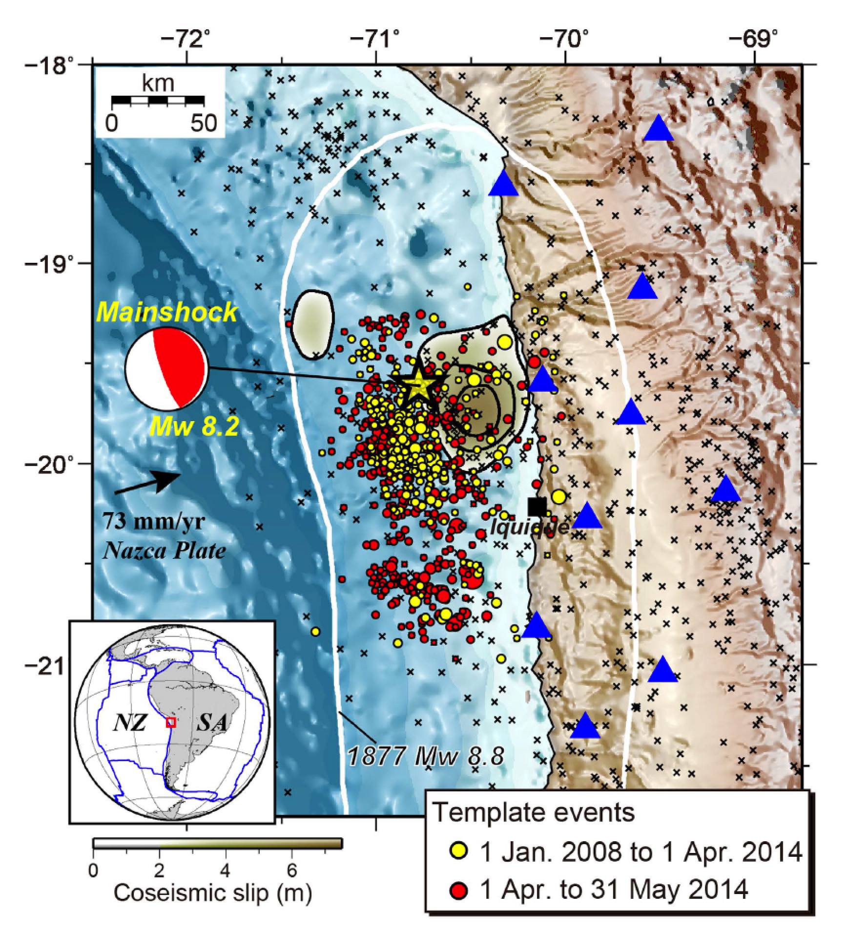
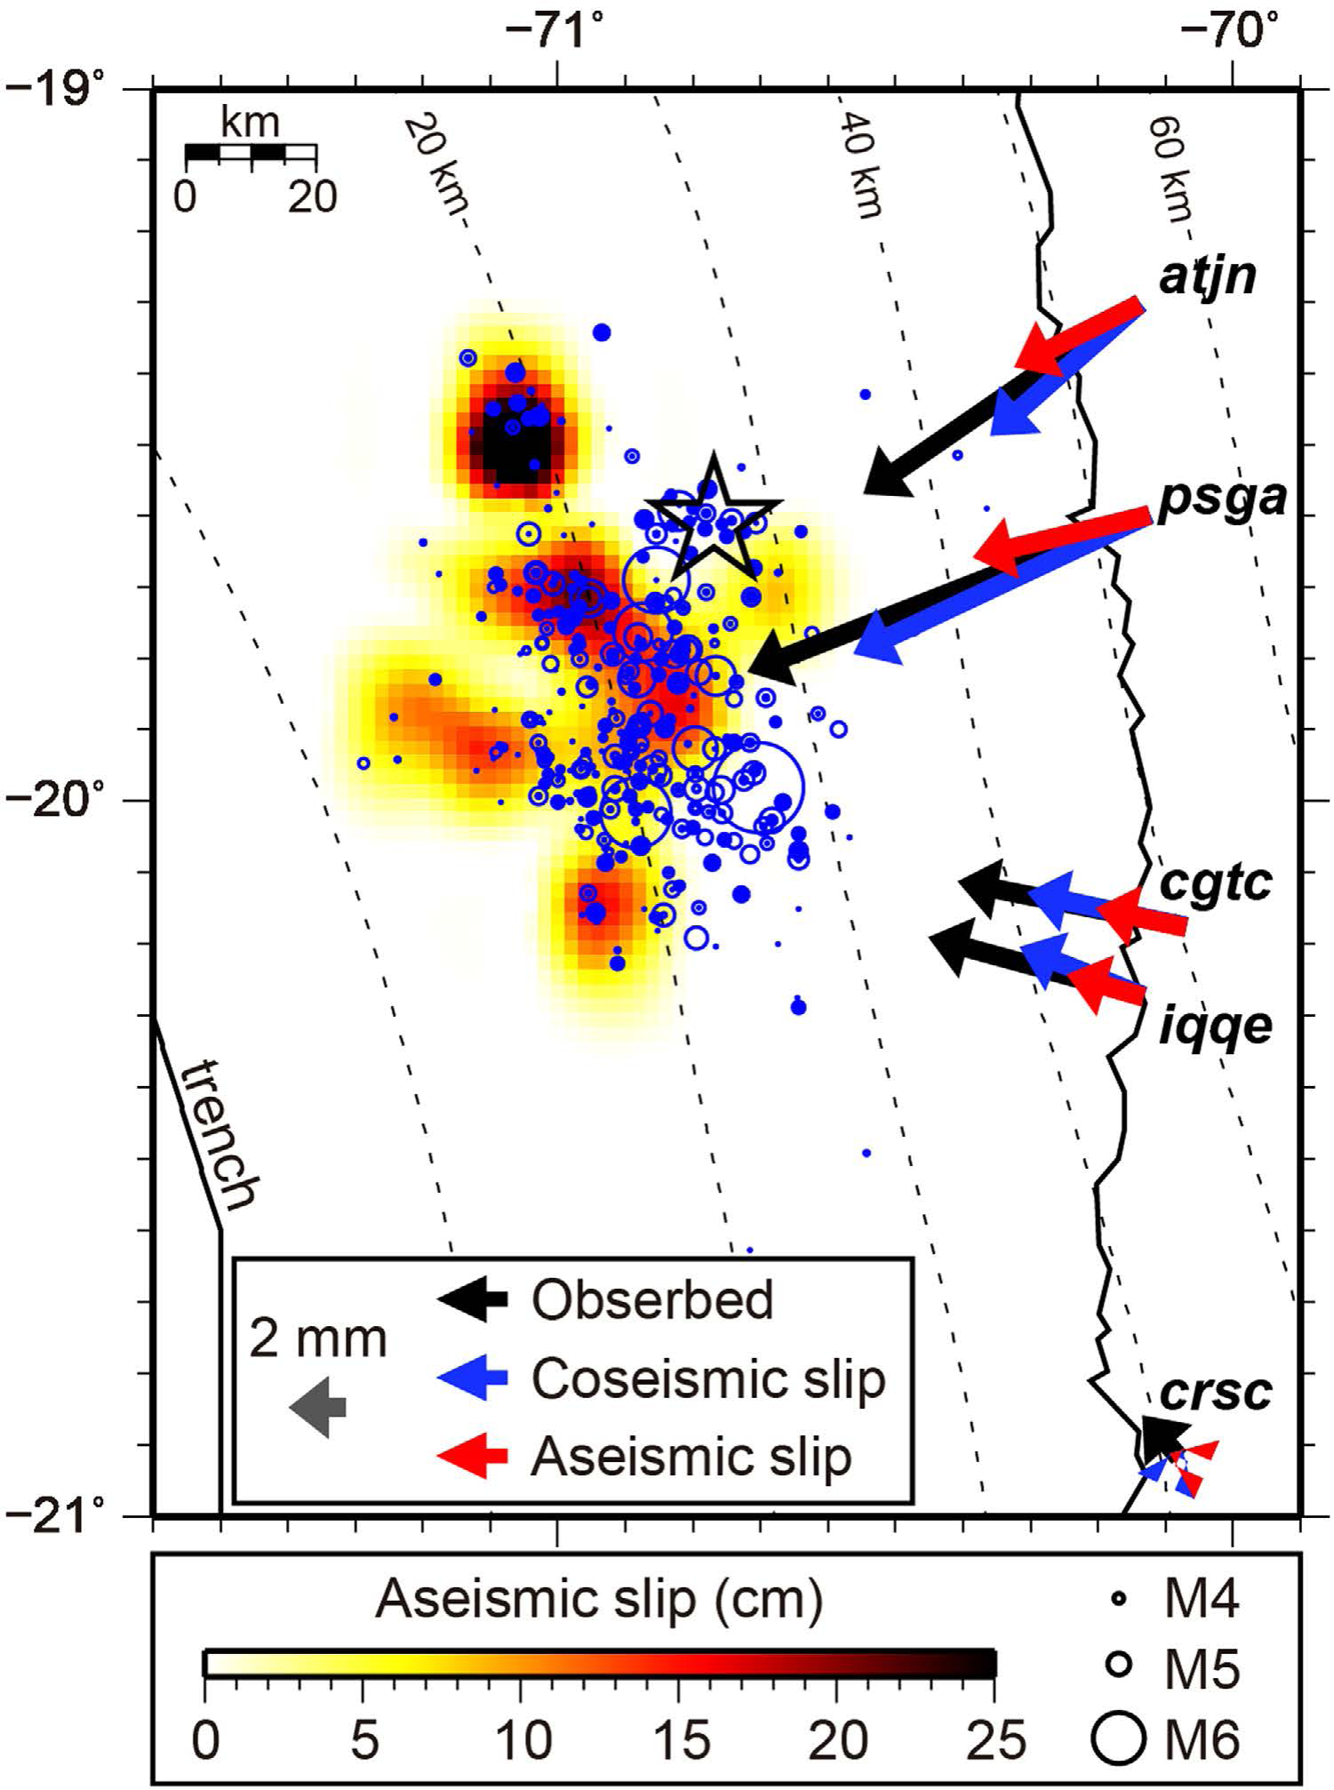
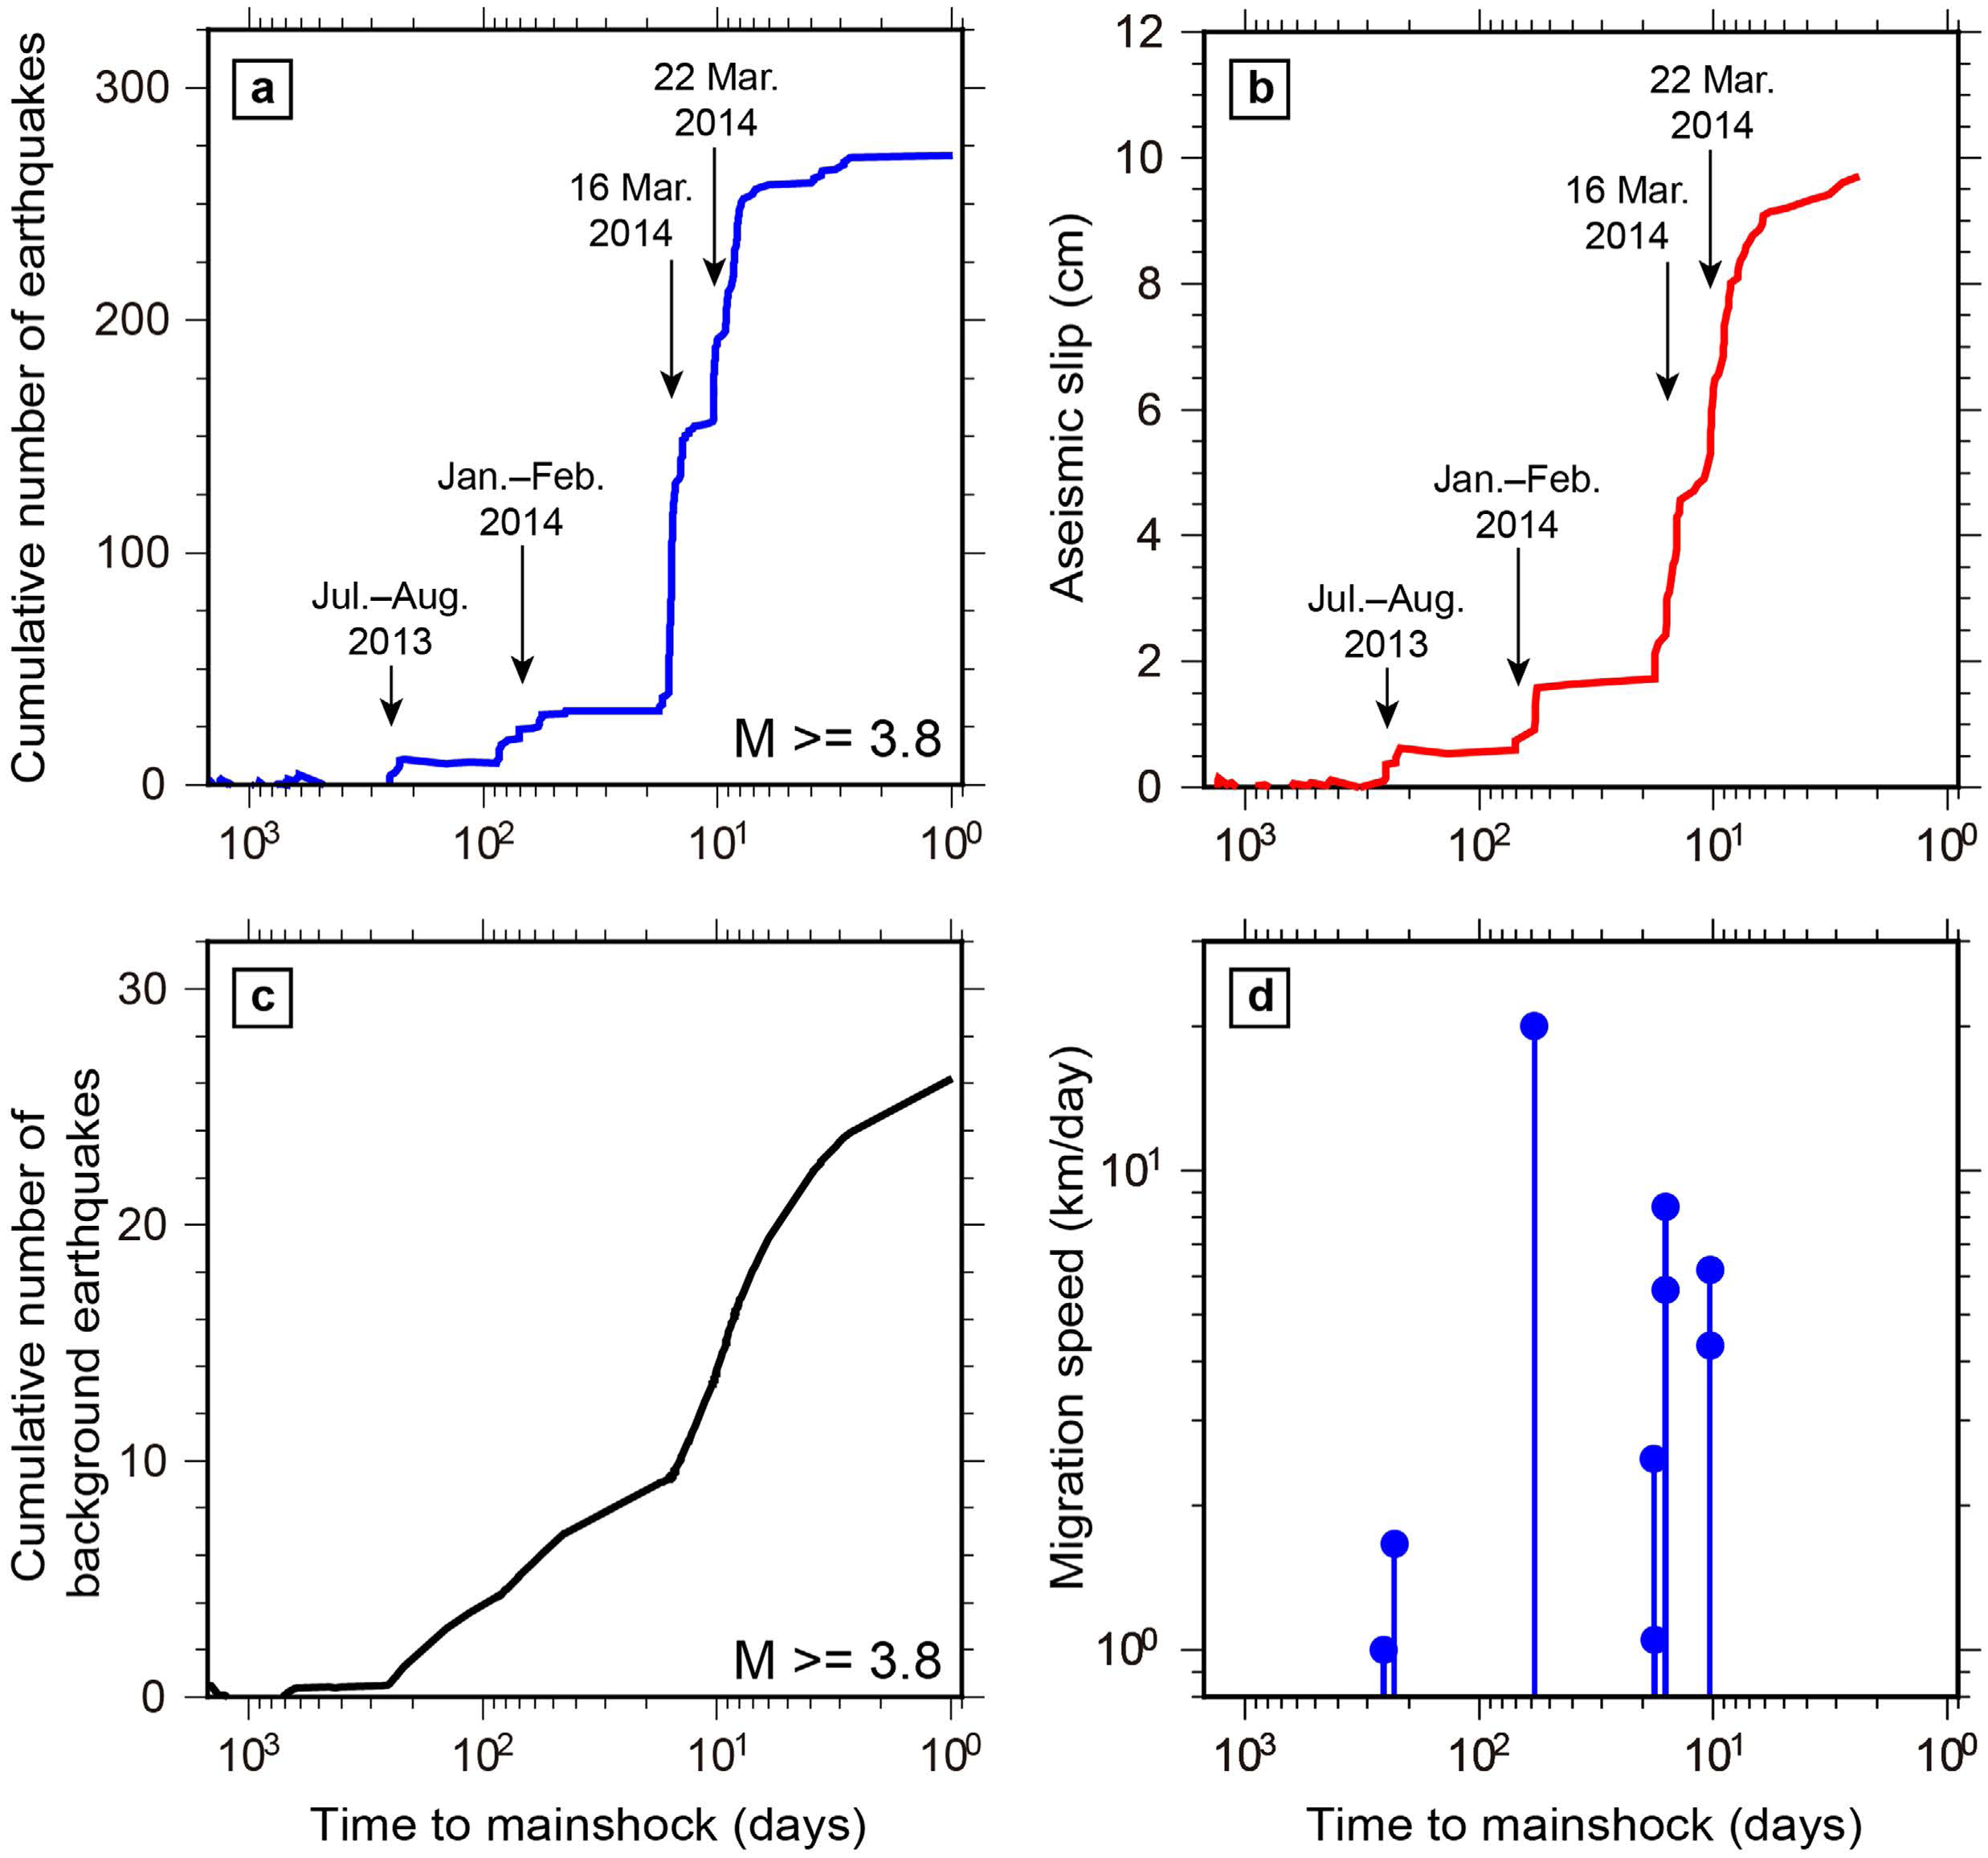
Slow slip prior to 2014 Iquique M8.2 – repeating earthquakes
[Kato et al., 2016]
Three episodes of seismic swarms and repeating earthquakes, bilateral along-strike and down-dip migration 1-10 km/day
Total equivalent cumulative slip ~ 10 cm
Bouchon et al. (2013) ~ 70% of large interplate earthquakes are preceded by foreshock sequences mediated by slow slip
Notes:
Seismic swarms on OTFs that do not culmulate to a major event
Seafloor geodesy instrumentation development offshore Vancouver Island

Slide 6
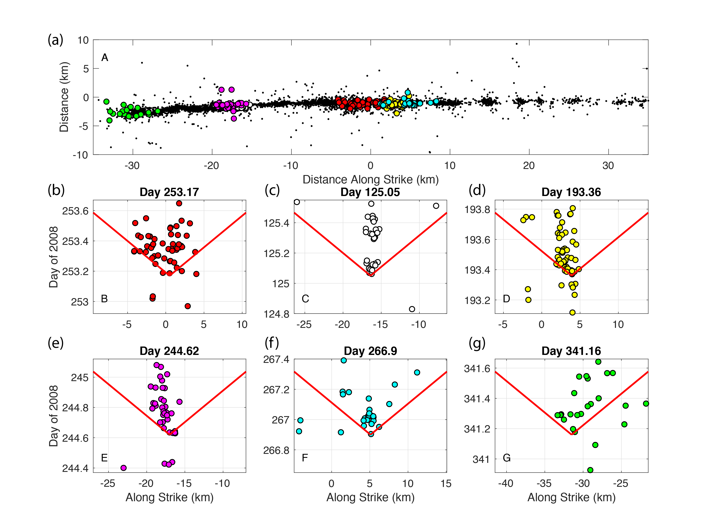
Seismic swarms and possible slow slip on oceanic transform faults
Persistent M6 ruptures segmented by barriers hosting intensive swarms and foreshocks on Gofar Transform Fault, East Pacific Rise
Swarm migration may be driven by aseismic slip, as a result of strong dilatancy effect, which also stops M6 ruptures
Deep seismic swarm possibly driven by aseismic slip in the mantle on Blanco Transform [Kuna et al., 2019]
[McGuire et al., 2012]
M6 ruptures
1 km/hr
[Froment et al., 2014; Liu et al., in review]
Notes:
Seismic swarms on OTFs that do not culmulate to a major event
Seafloor geodesy instrumentation development offshore Vancouver Island

Slide 7
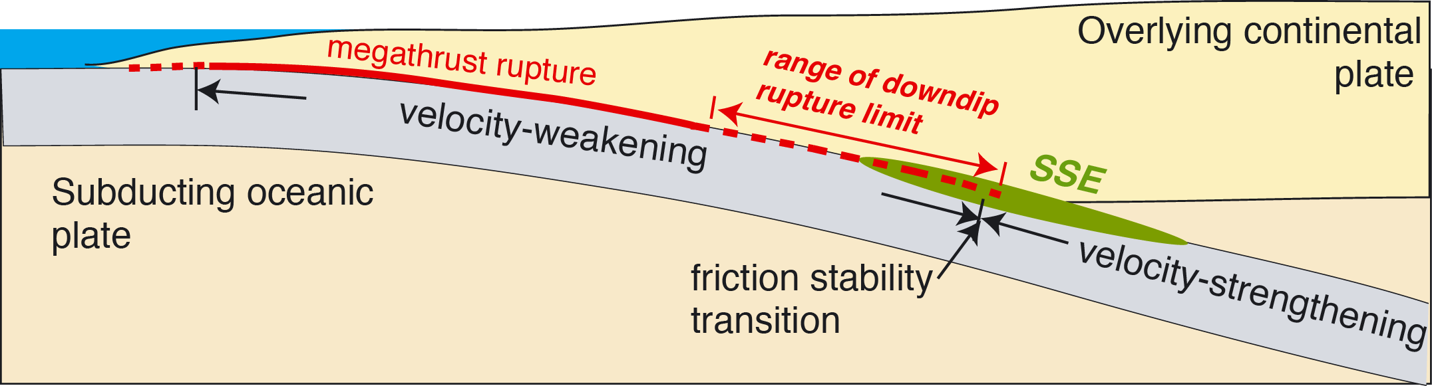
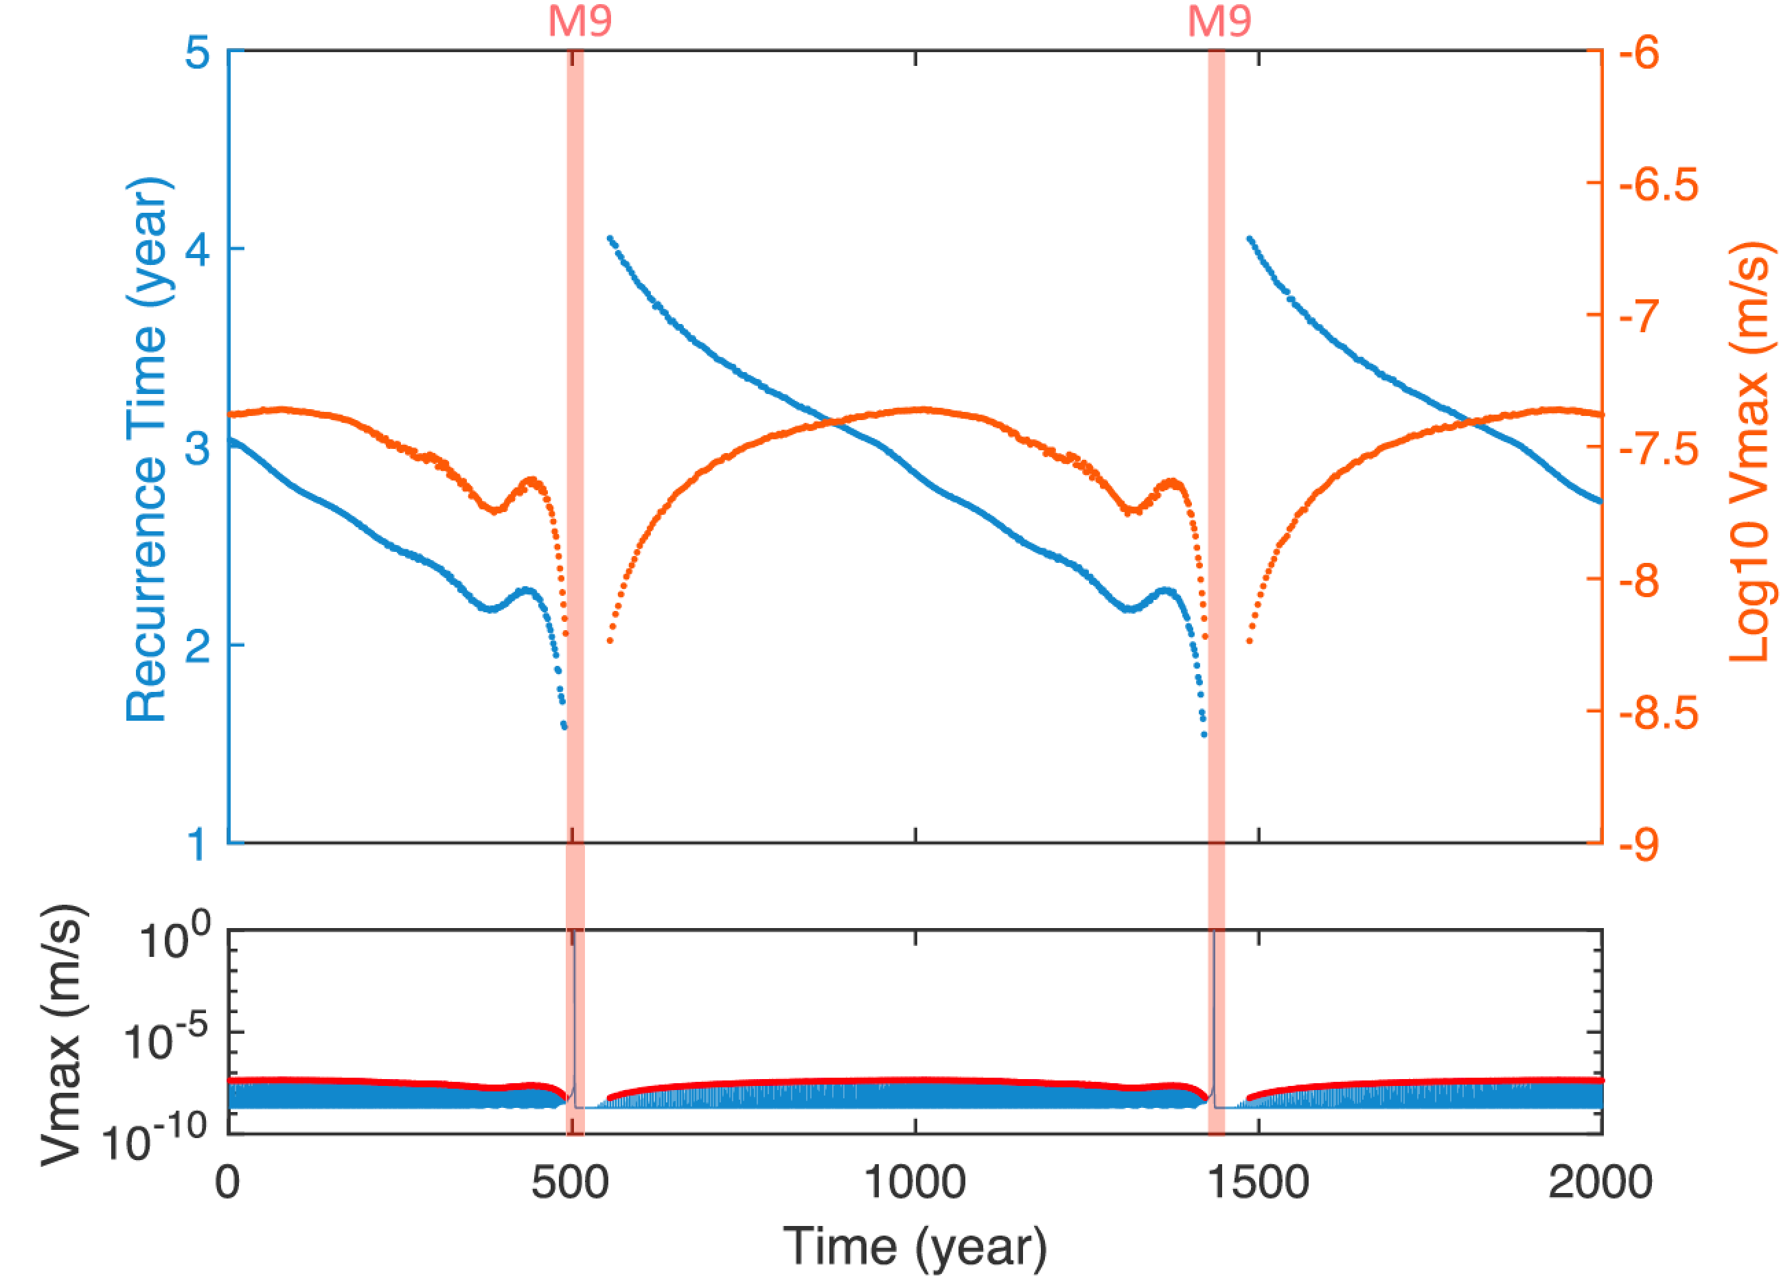
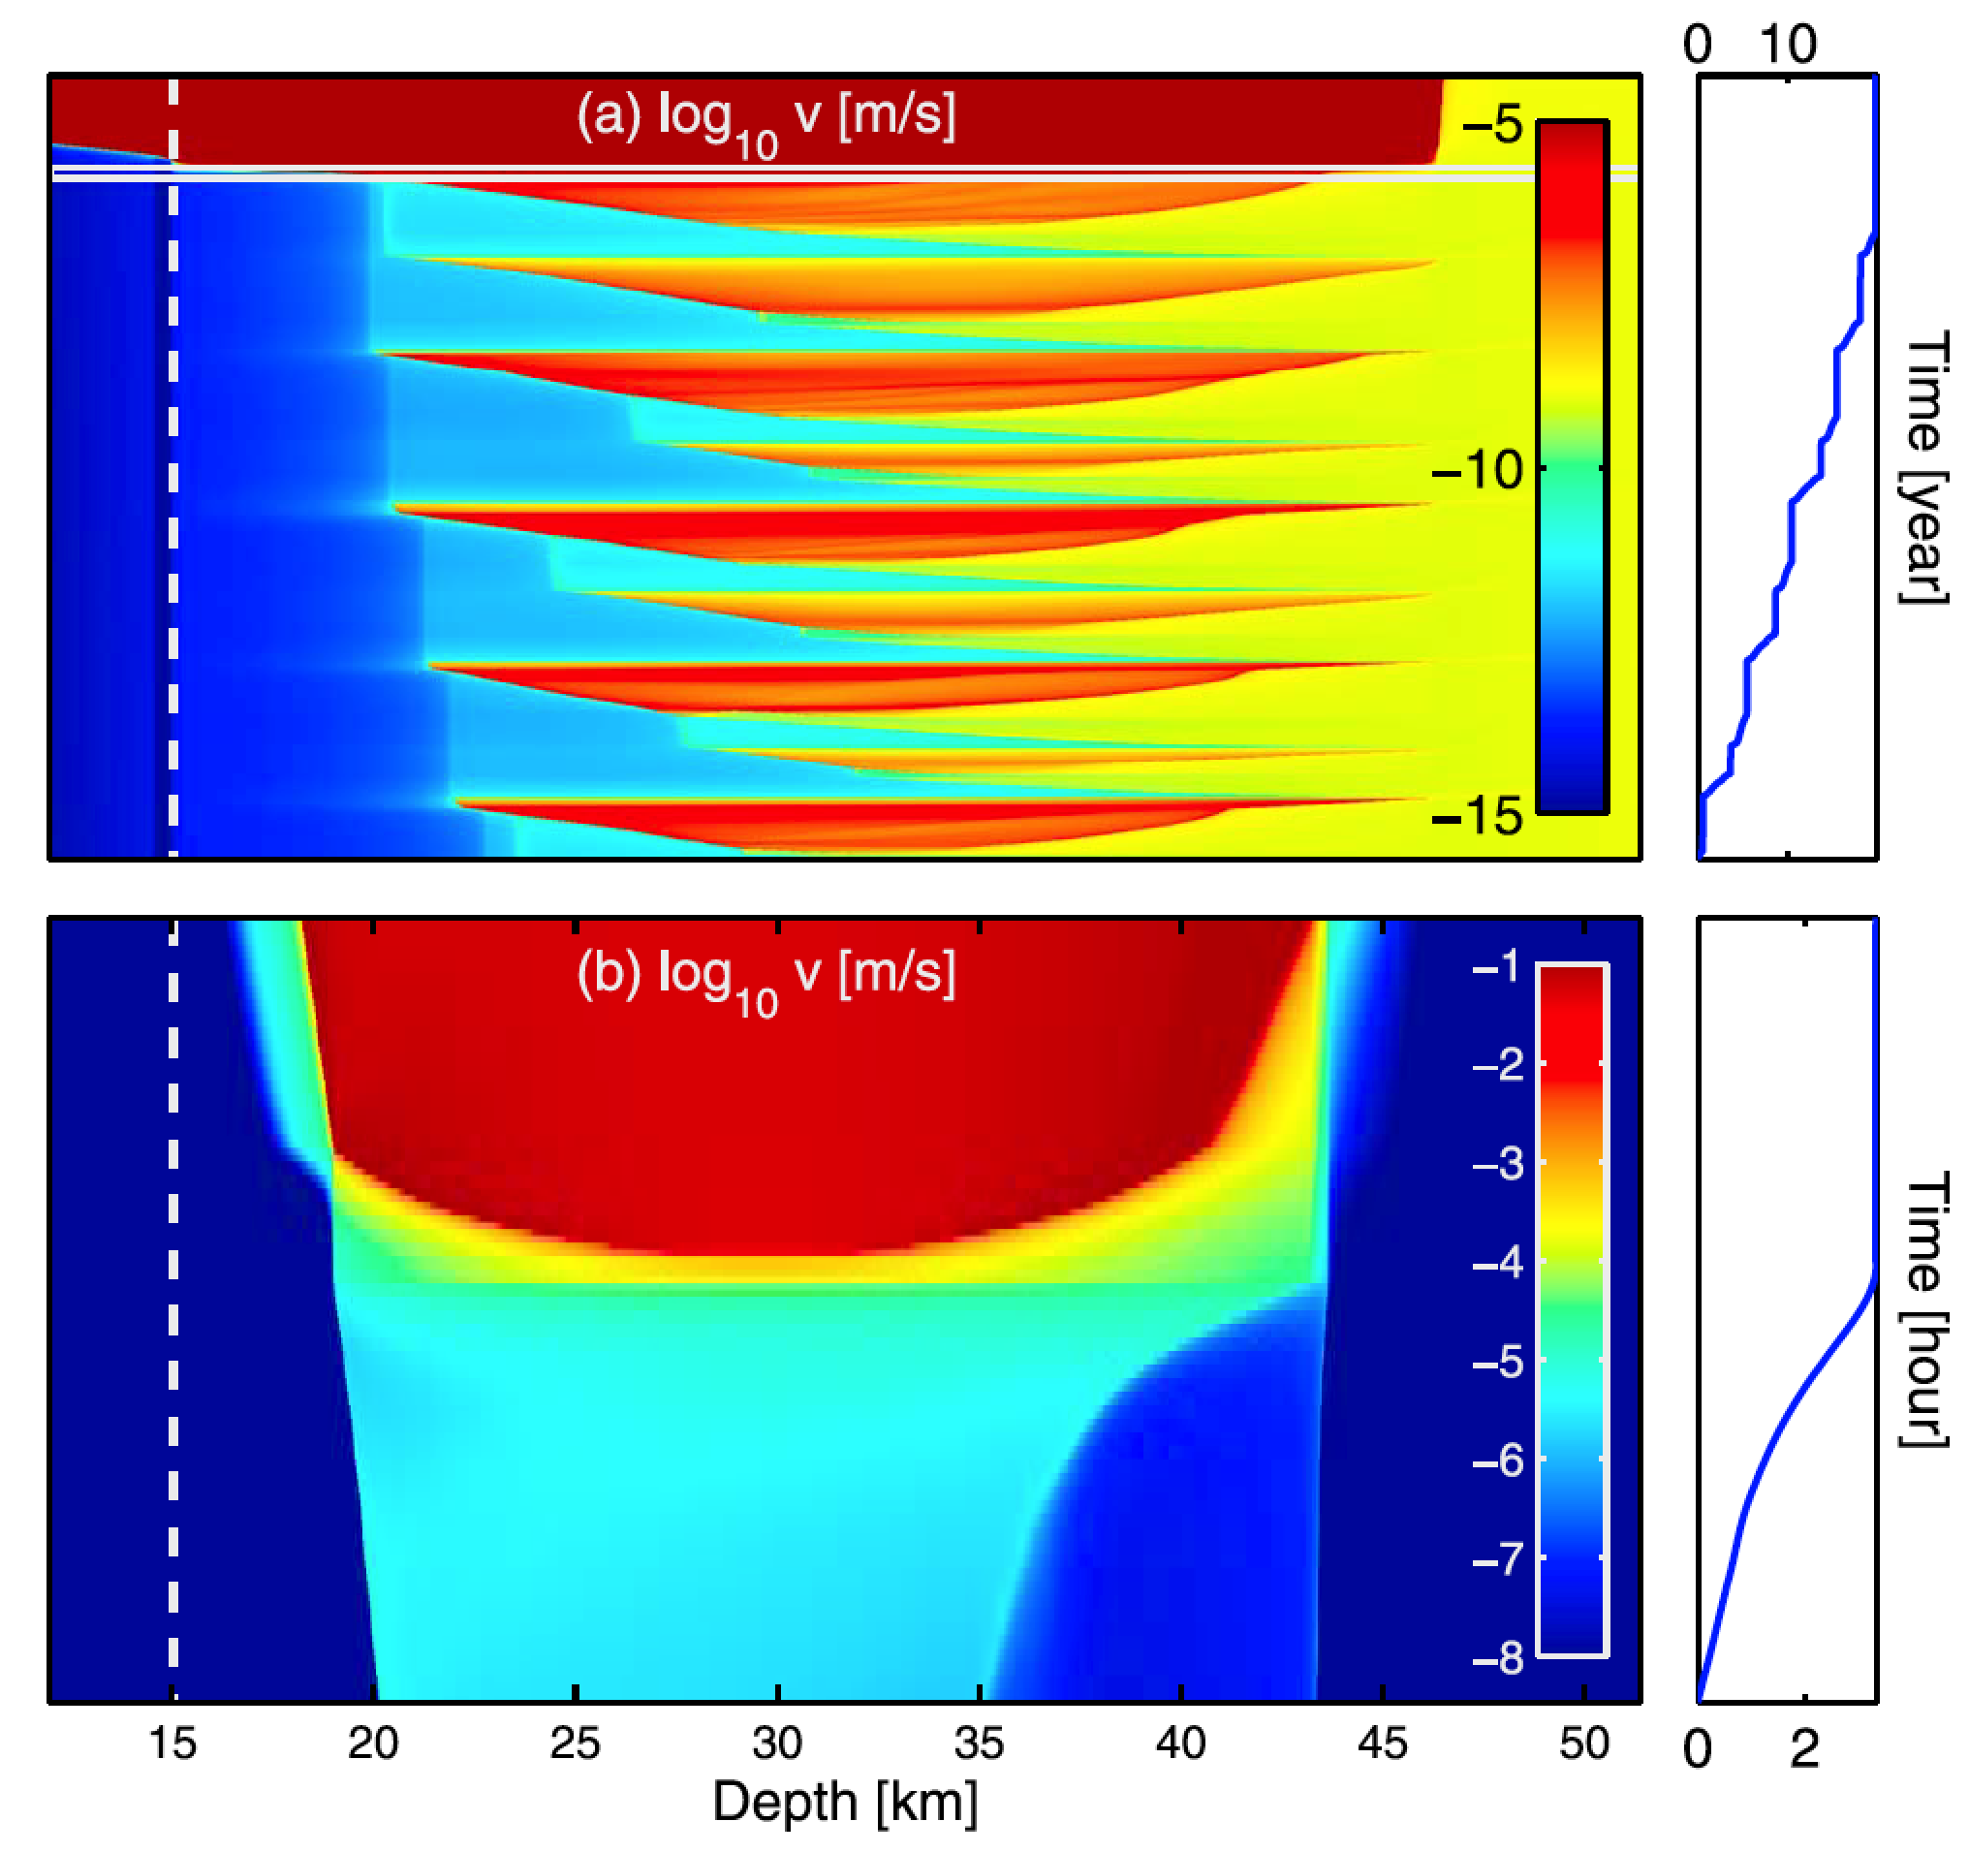
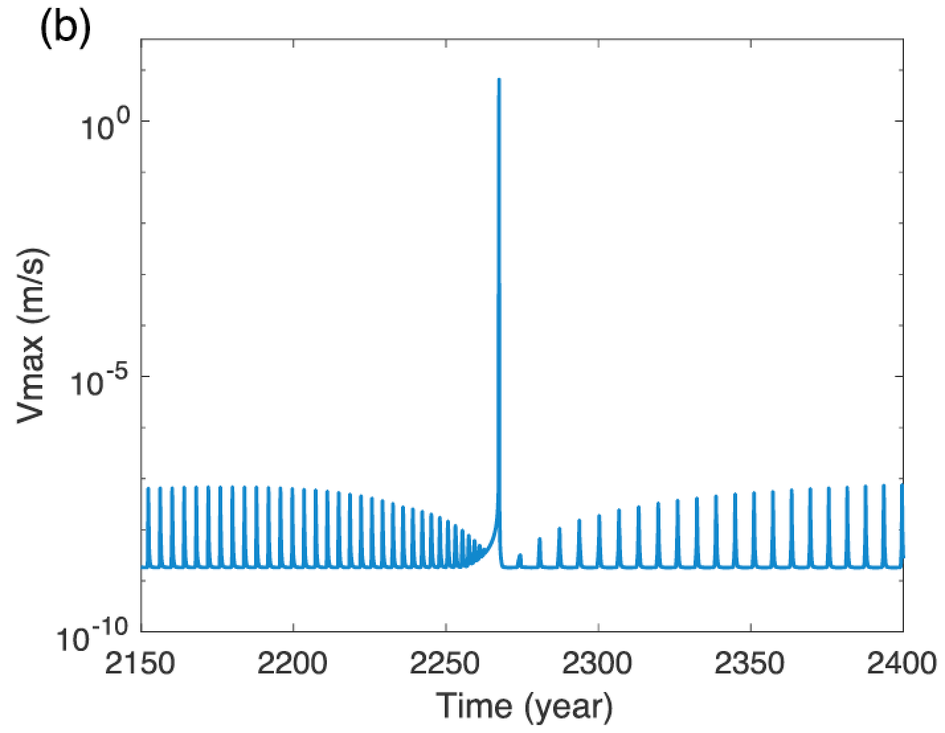
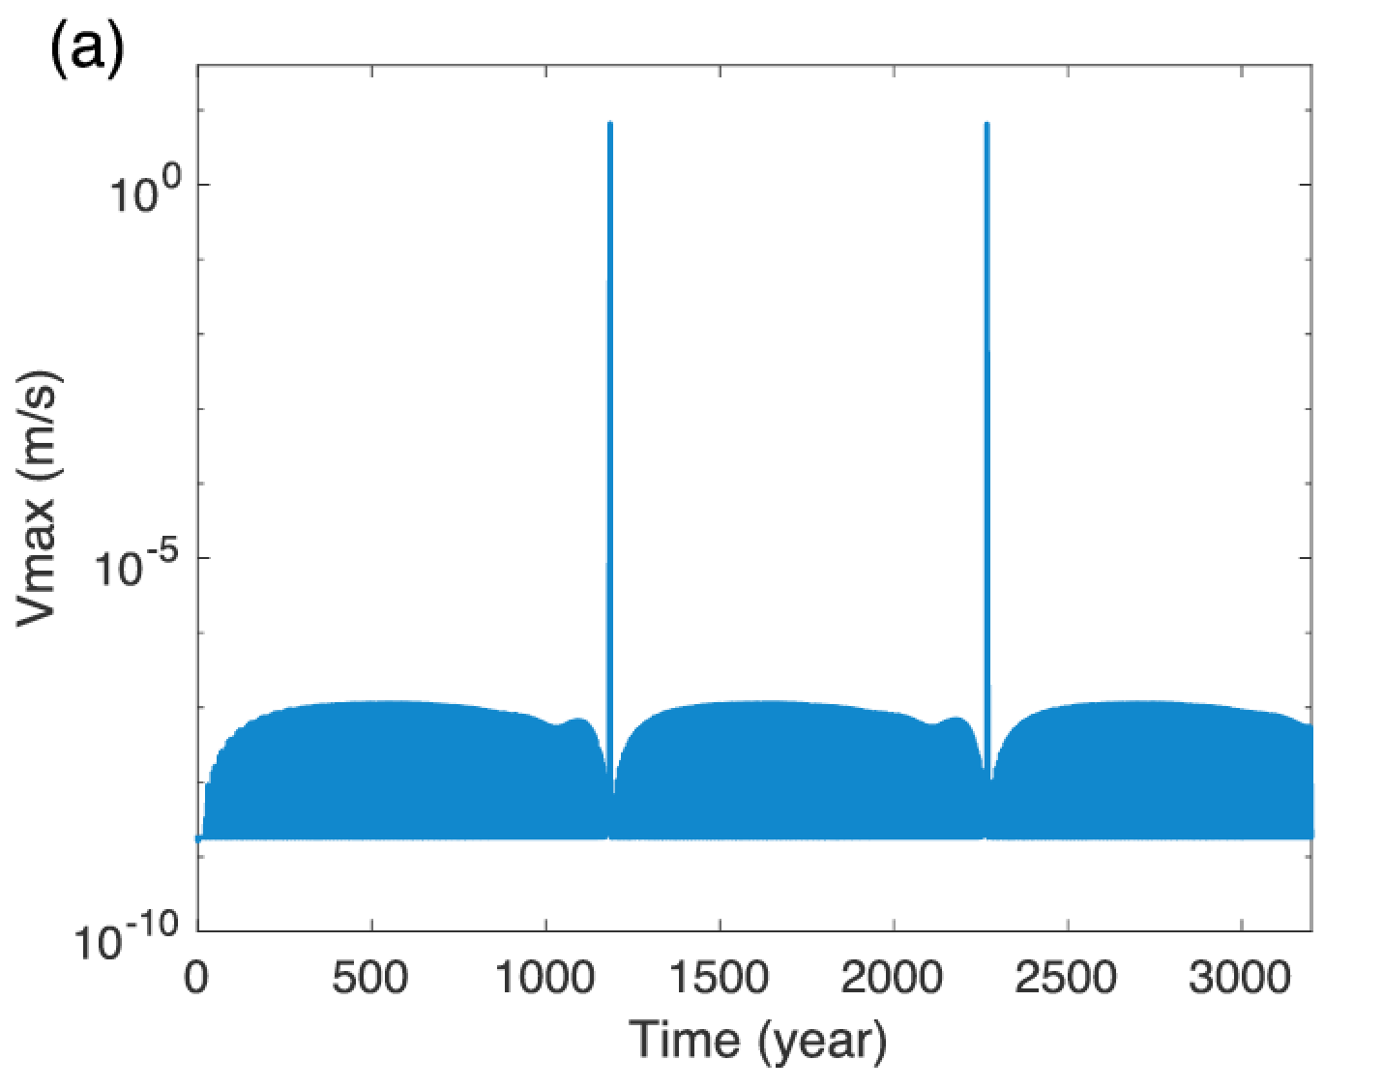
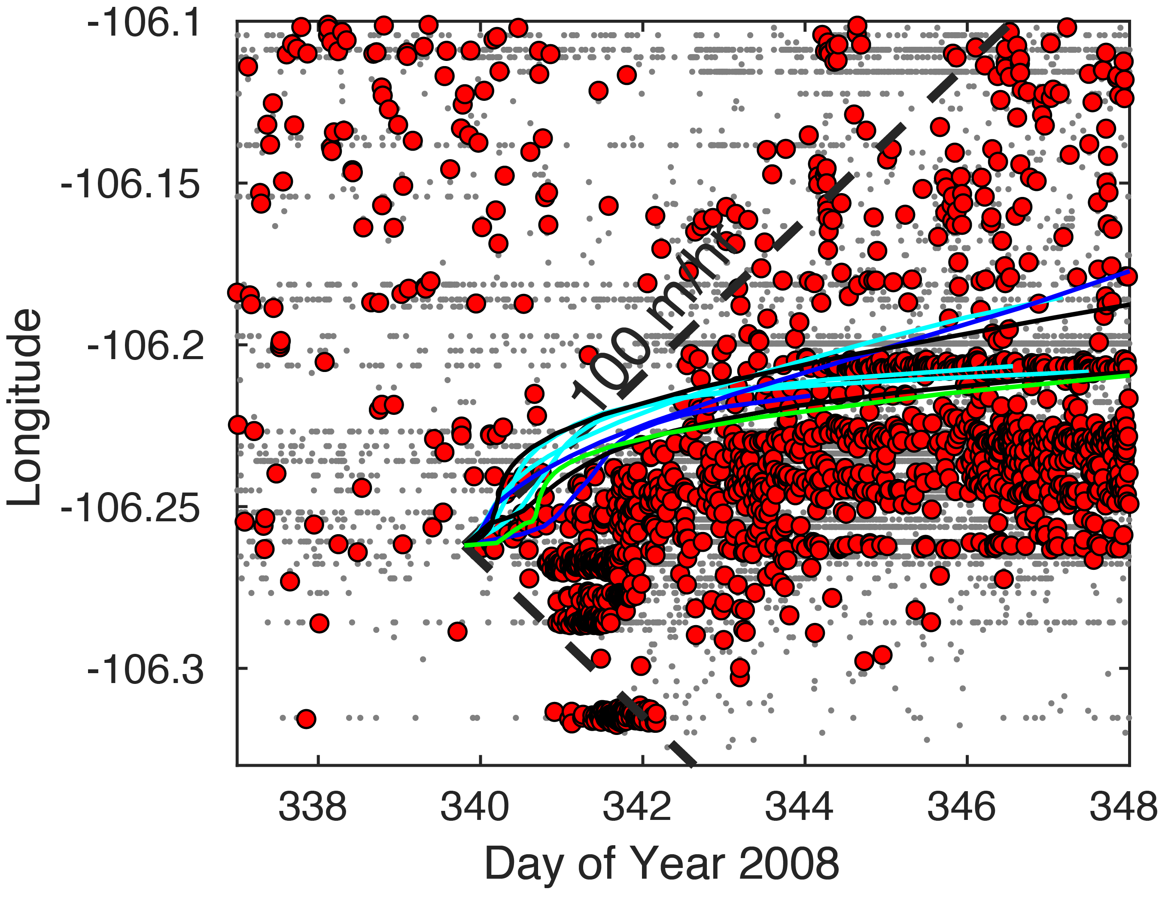
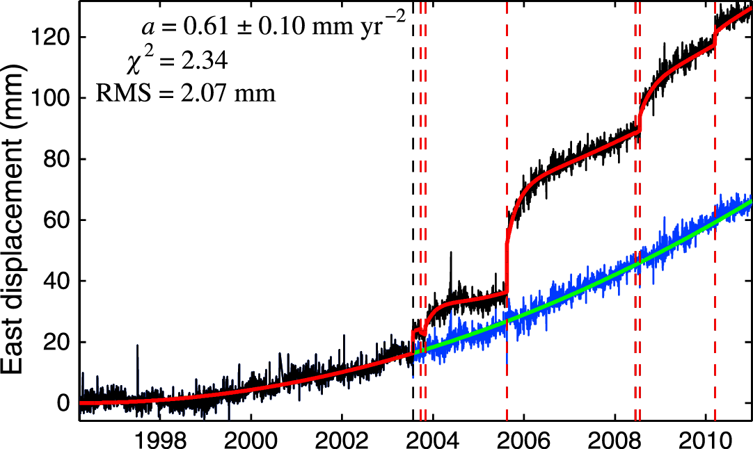
Slow slip prior to earthquake ruptures - simulations
2D fault, “standard” rate-state friction
1D fault, R-S w. dilatancy and thermal pressurization
[Segall and Bradley,
2012]
[Luo and Liu, 2018]
Use constraints from short-term and long-term geodetic time series, derived fault locking and seismicity migration, toward a predicative modeling approach
[Liu et al. , in review]
[Mavrommatis et al. 2014]

Slide 8
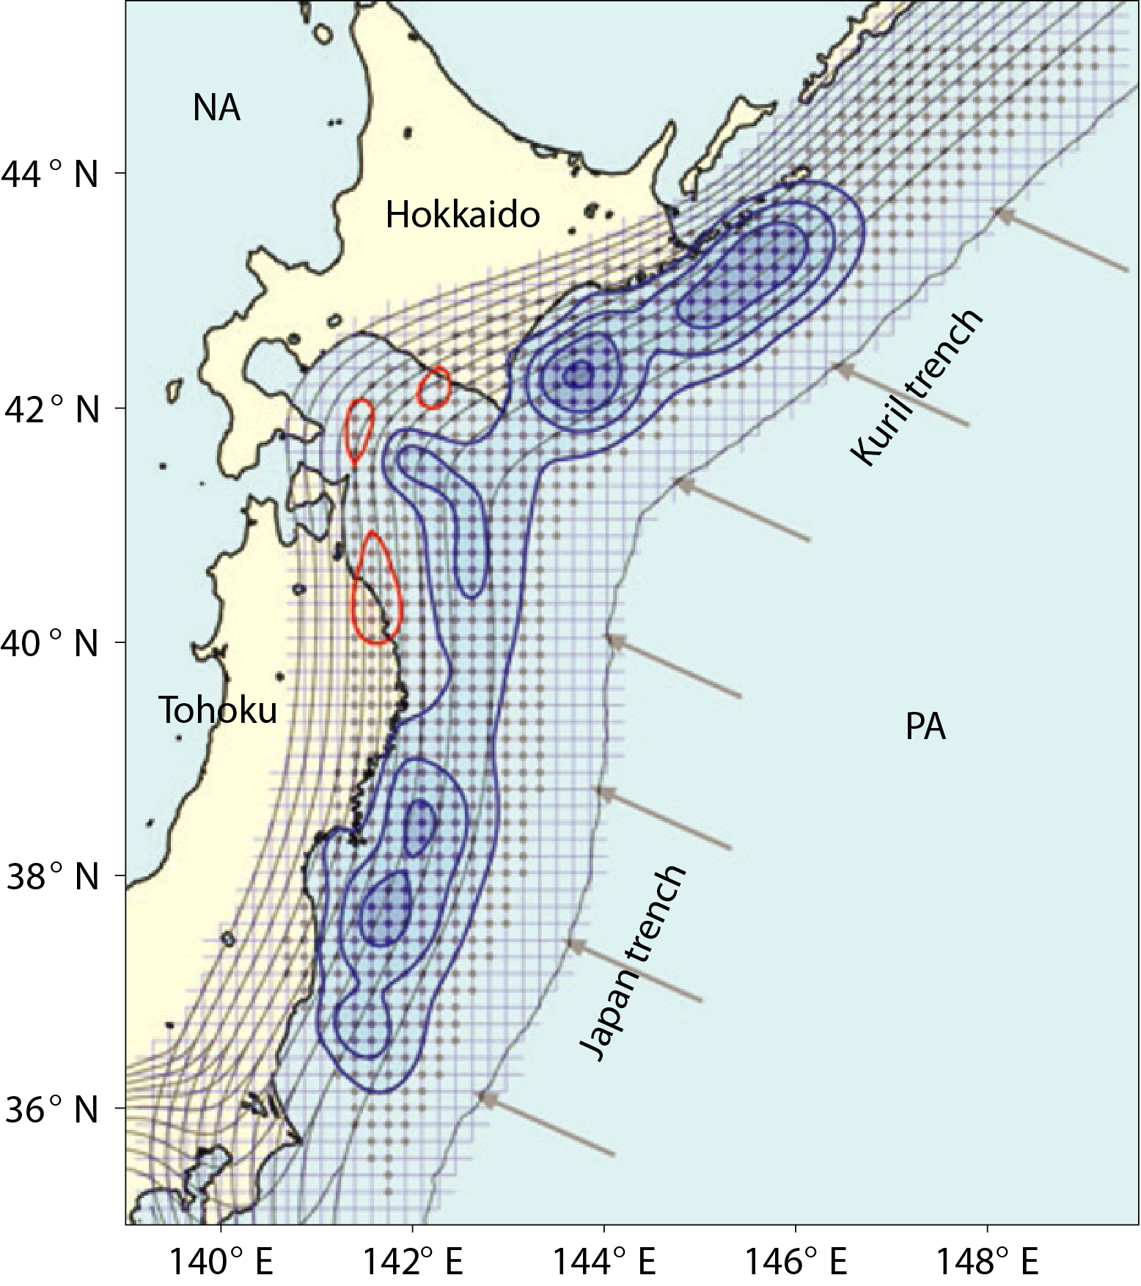
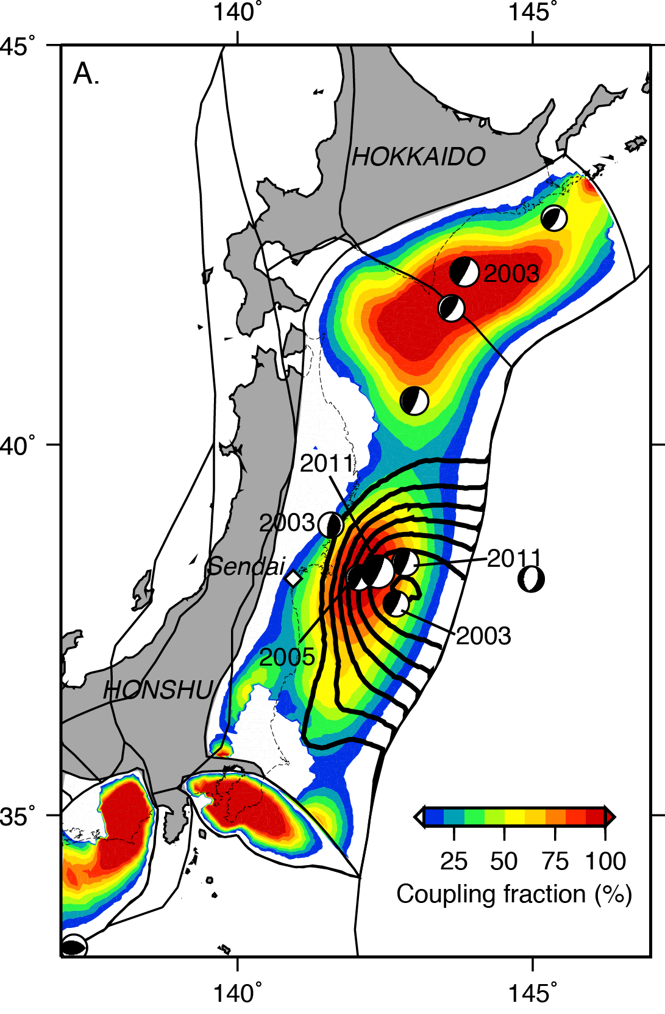
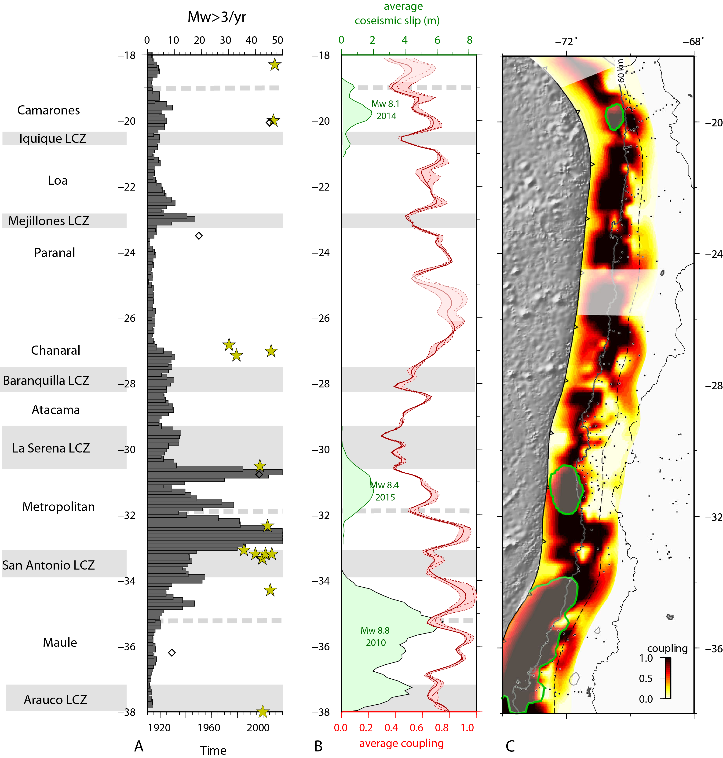
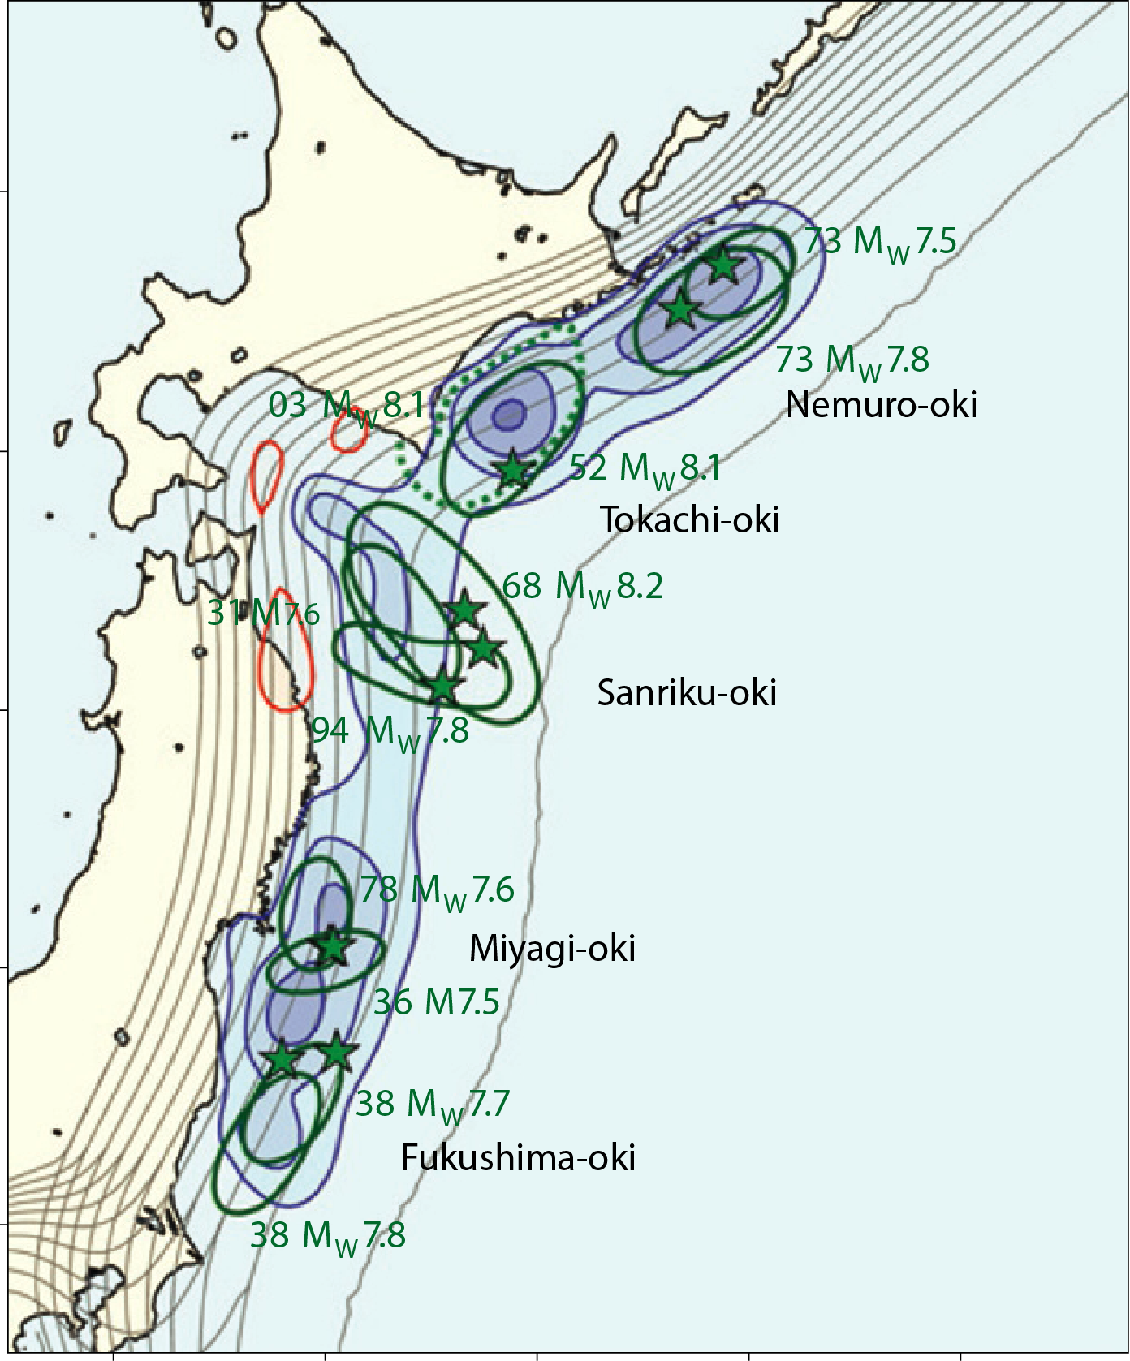
From interseismic locking to coseismic slip
[Loveless and Meade, 2011]
[Hahshimoto et al., 2009]
Long-term geodetic inversion locking maps provide a powerful indication of future potential rupture areas
Prediction capability hindered by lack of (sparse) seafloor geodetic measurements and operation of dynamic weakening mechanism(s)
[Métois et al., 2016]
Notes:
Does a good job predicting where downdip limit is, not poorly for updip
No slip deficit doesn’t necessarily mean no coseismic slip (Papatea block)
Hashimoto: 1996-2000 GPS

Slide 9
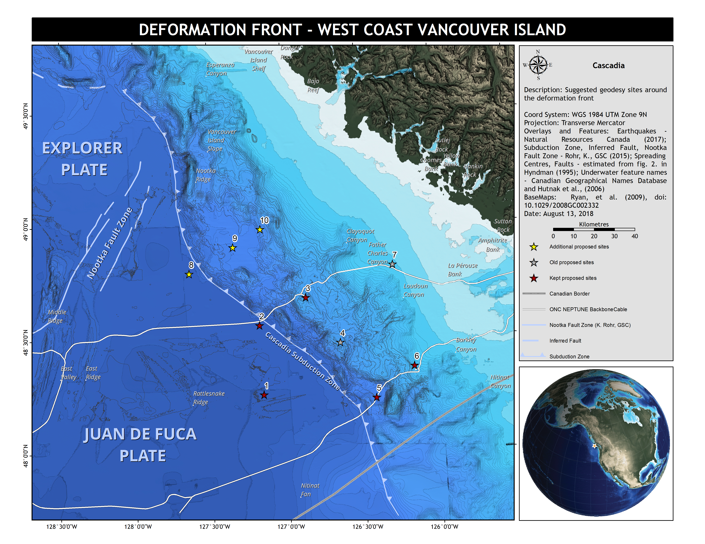
From interseismic locking to coseismic slip
[Loveless and Meade, 2011]
[Hahshimoto et al., 2009]
Long-term geodetic inversion locking maps provide a powerful indication of future potential rupture areas
Prediction capability hindered by lack of (sparse) seafloor geodetic measurements and operation of dynamic weakening mechanism(s)
[Martin Heesemann, UVic]
Notes:
Does a good job predicting where downdip limit is, not poorly for updip
No slip deficit doesn’t necessarily mean no coseismic slip (Papatea block)
Hashimoto: 1996-2000 GPS

Slide 10
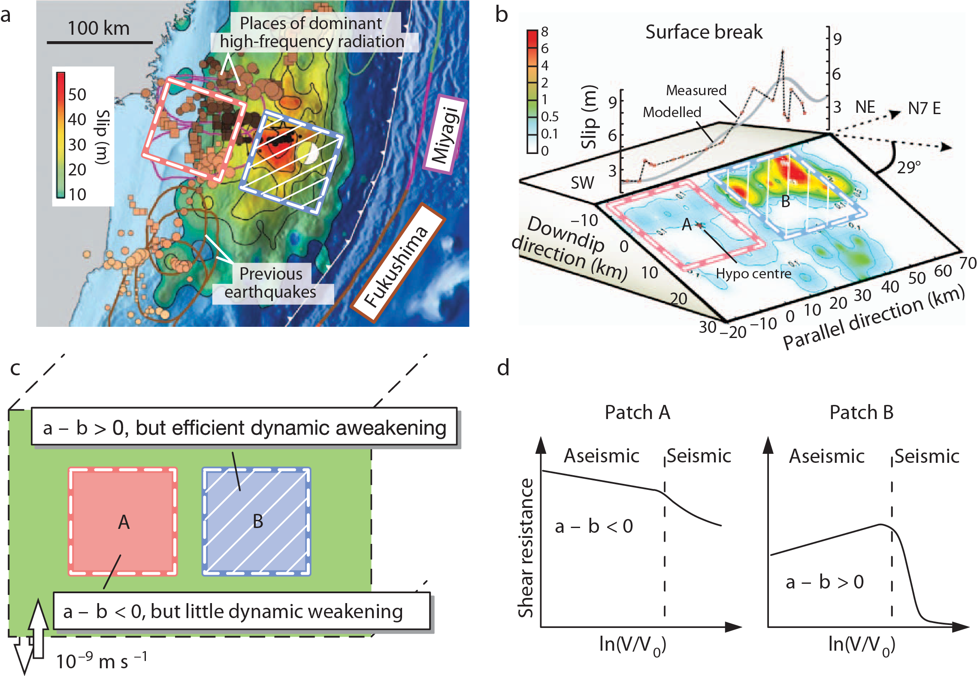
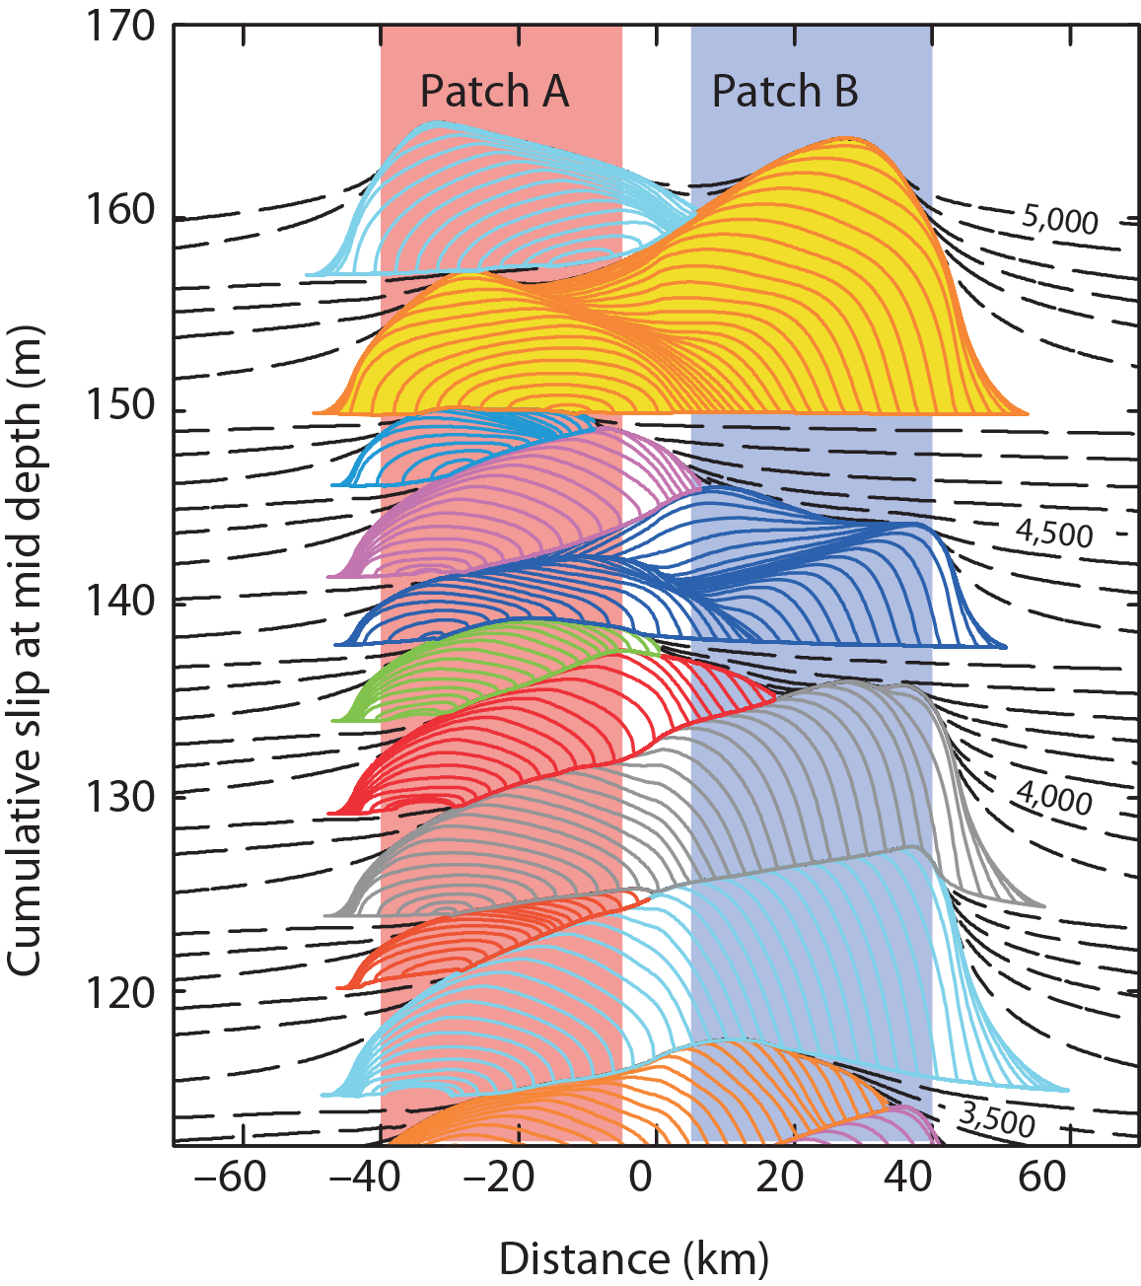
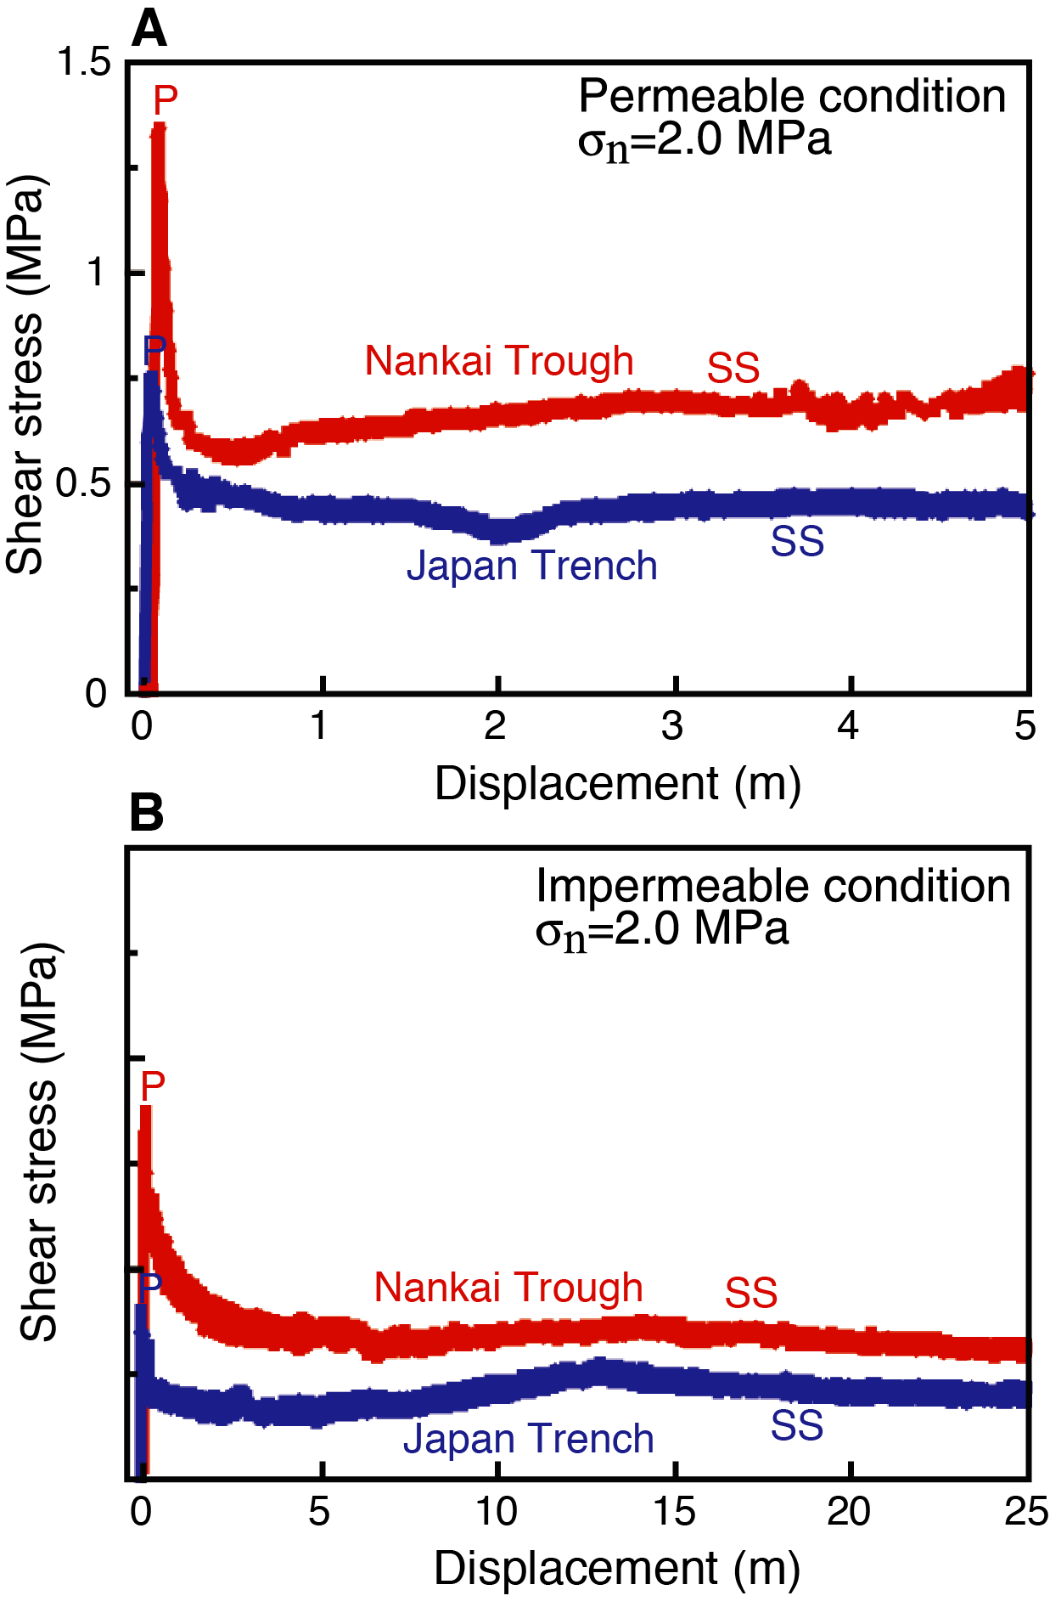
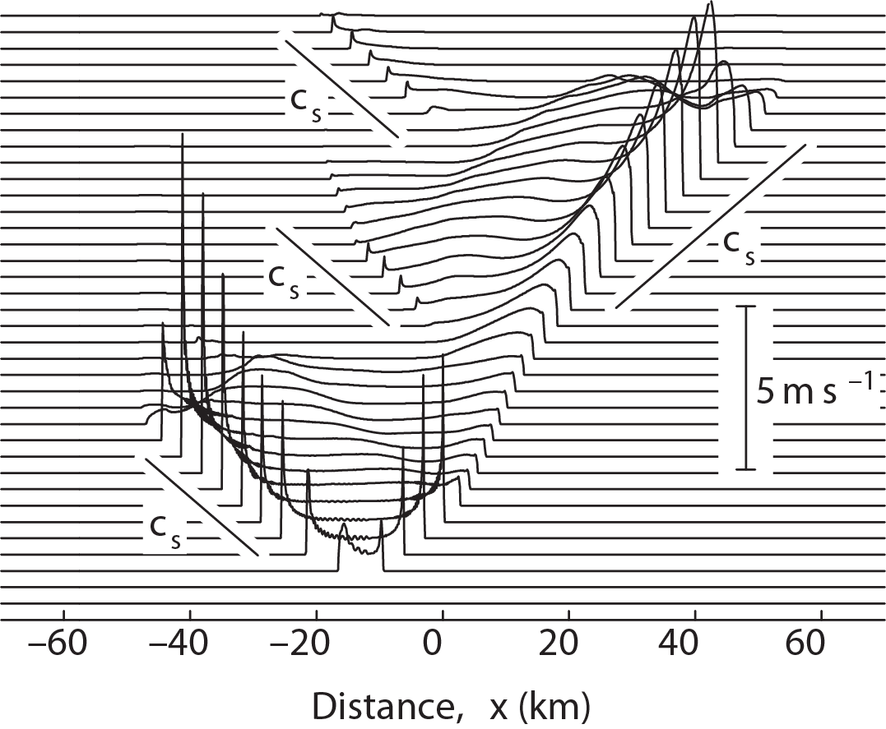
Dynamic weakening promotes large coseismic slip
Dynamic weakening mechanisms:
Thermal pressurization
Frictional melting
Silica-gel lubrication
…
JFAST décollement sample
friction experiments
[Noda and Lapusta, 2013]
2011 Tohoku-oki M9: downdip nucleation and high-frequency radiation, updip greater coseismic slip
1999 Chi-chi M7.3: SW nucleation (unstable friction), NE greater coseismic slip (stable friction)
[Ujiie et al., 2013]

Slide 11
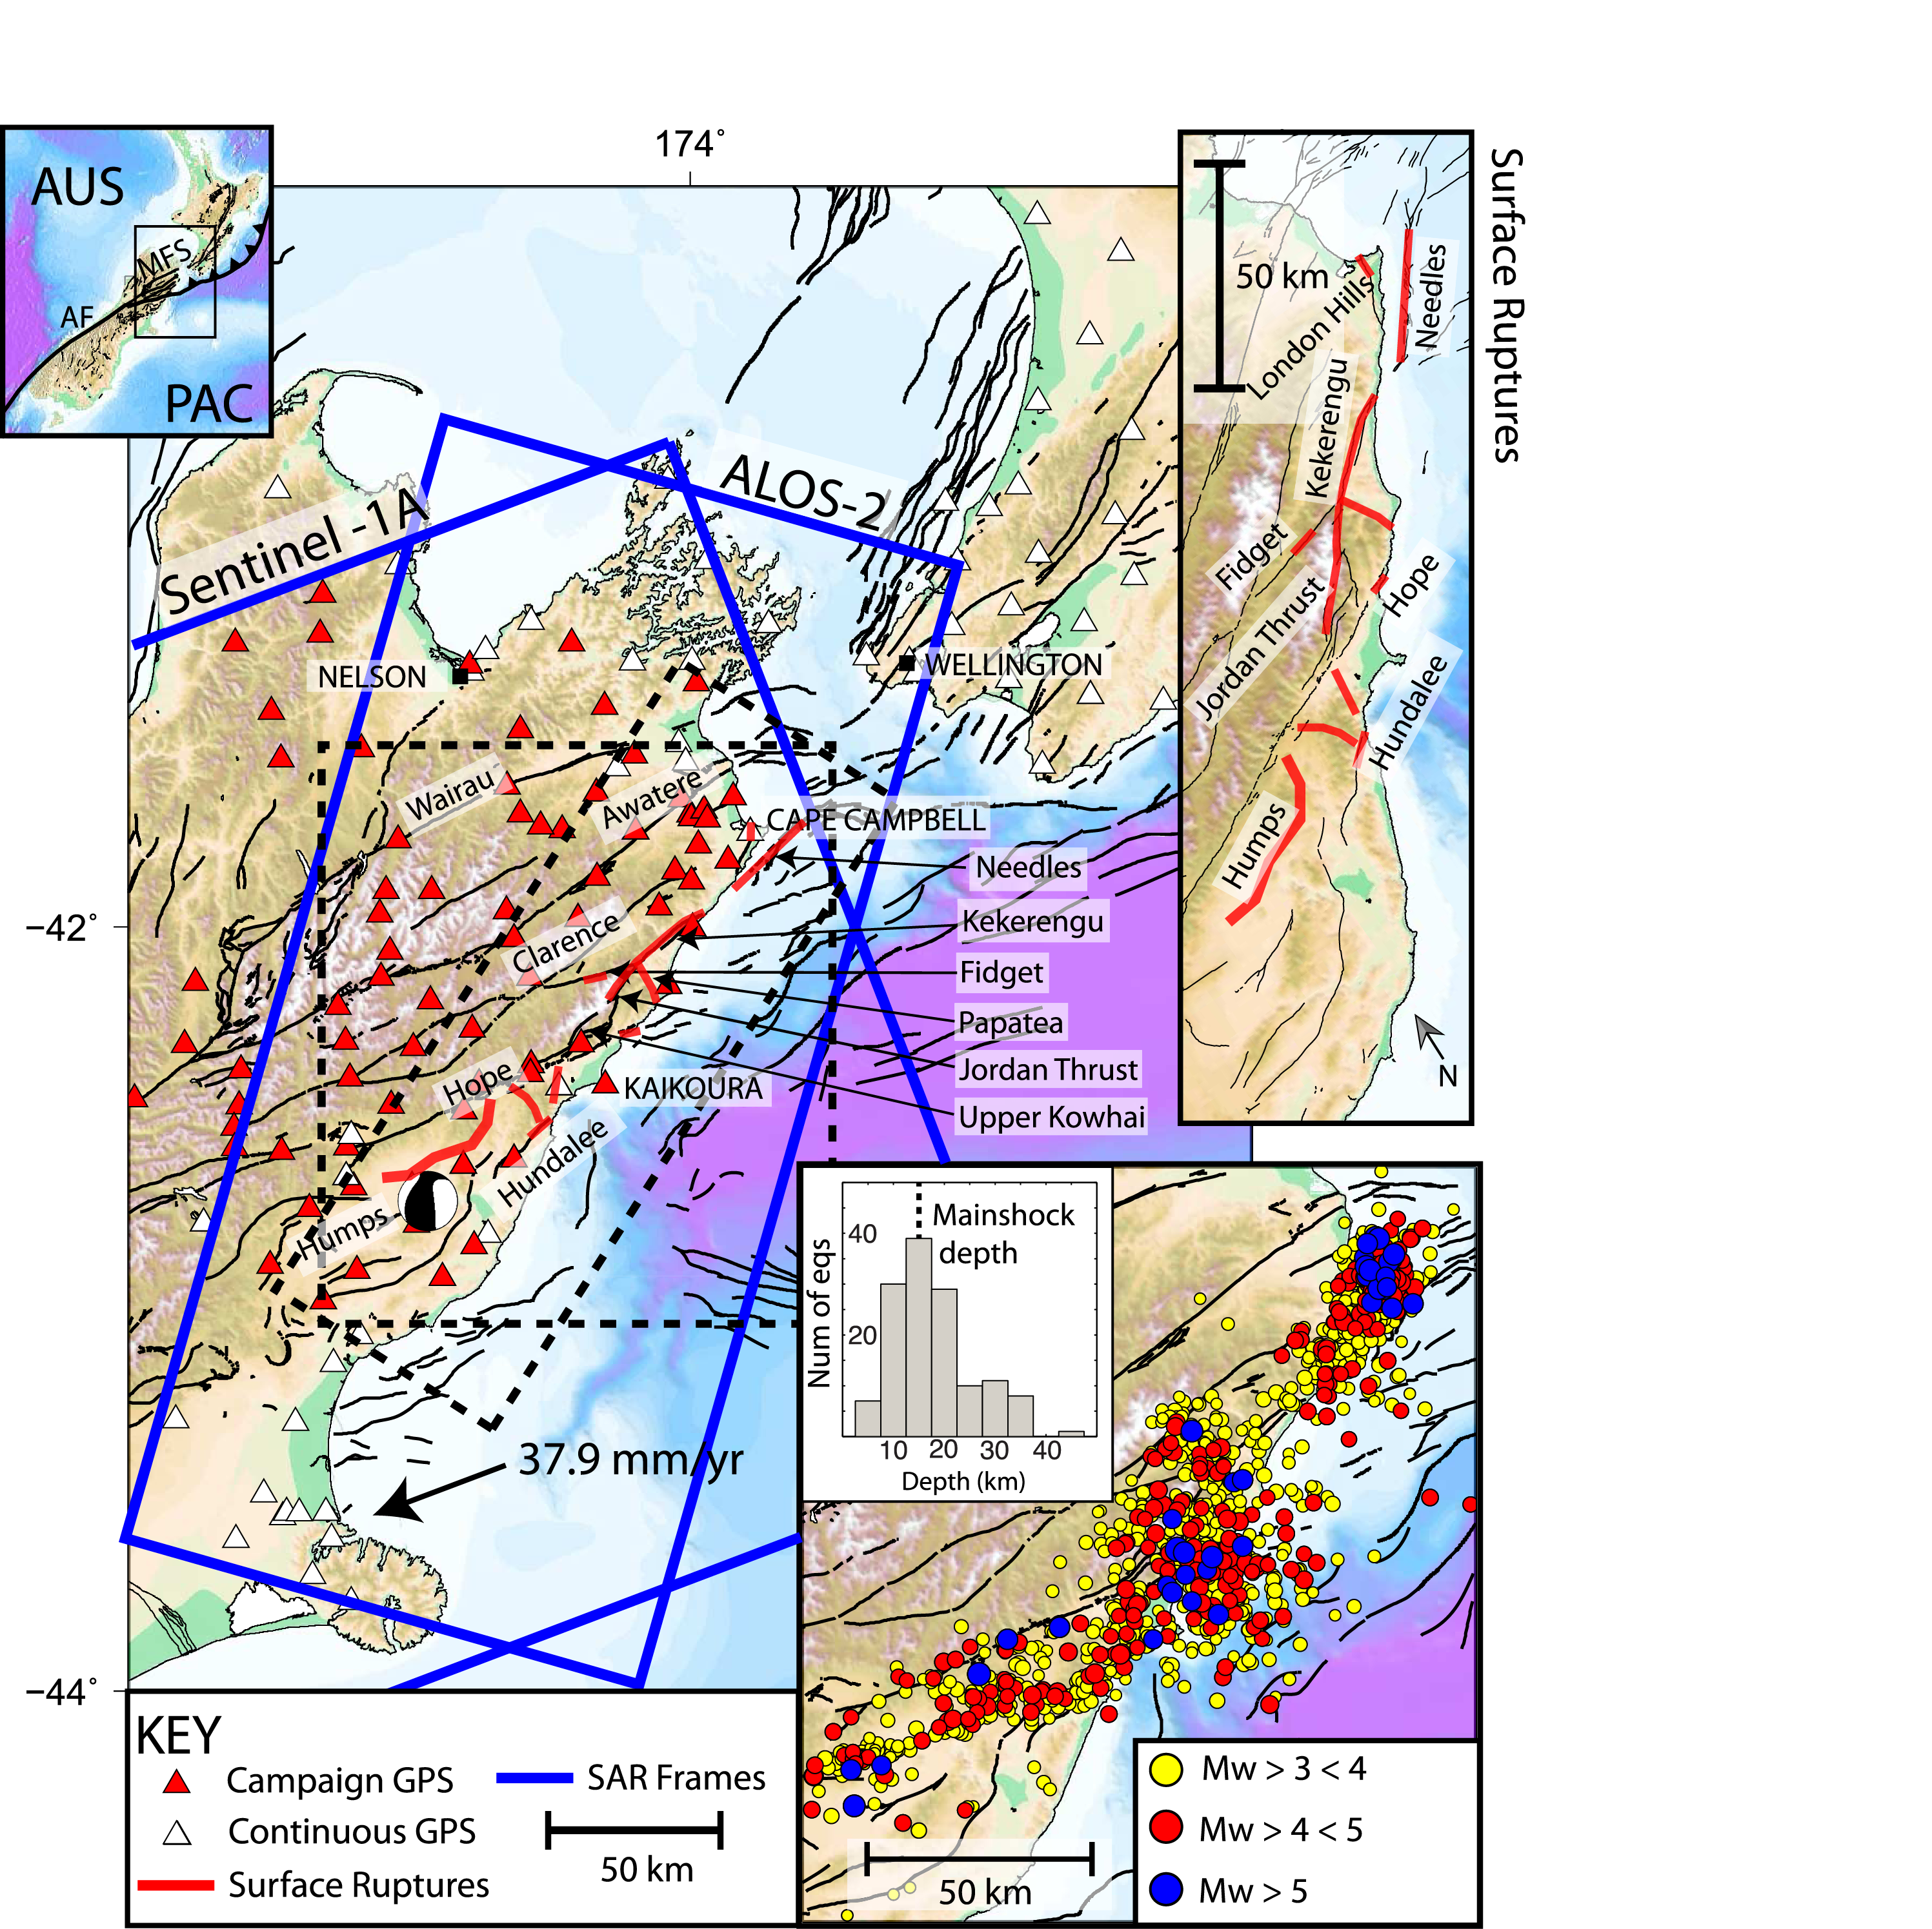
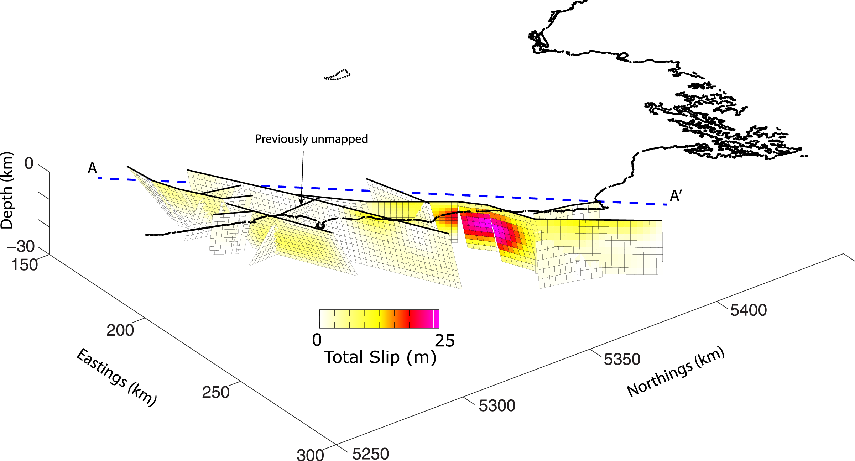
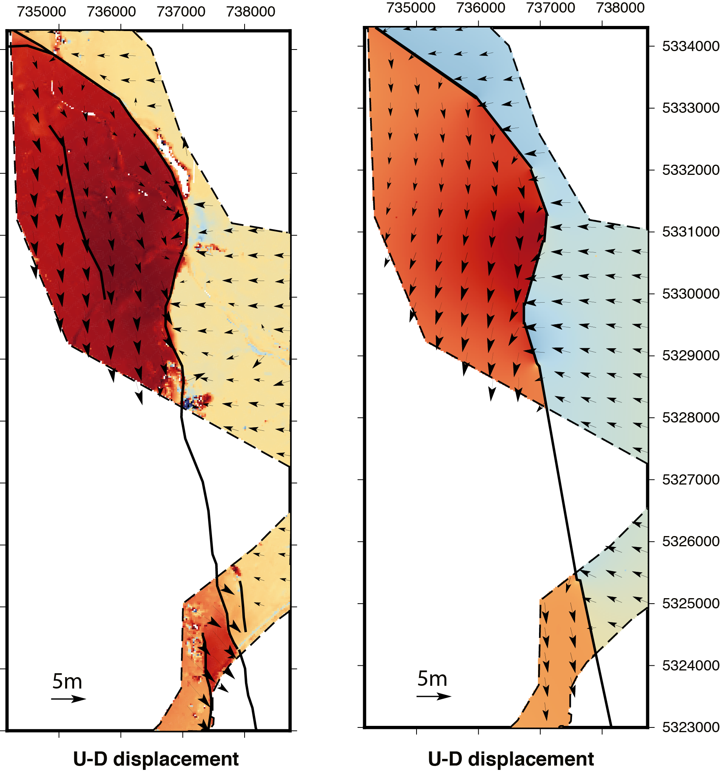
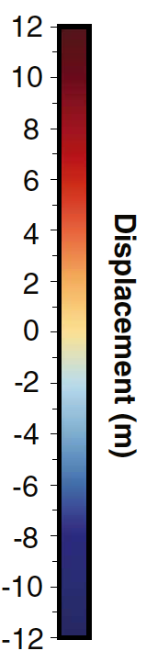
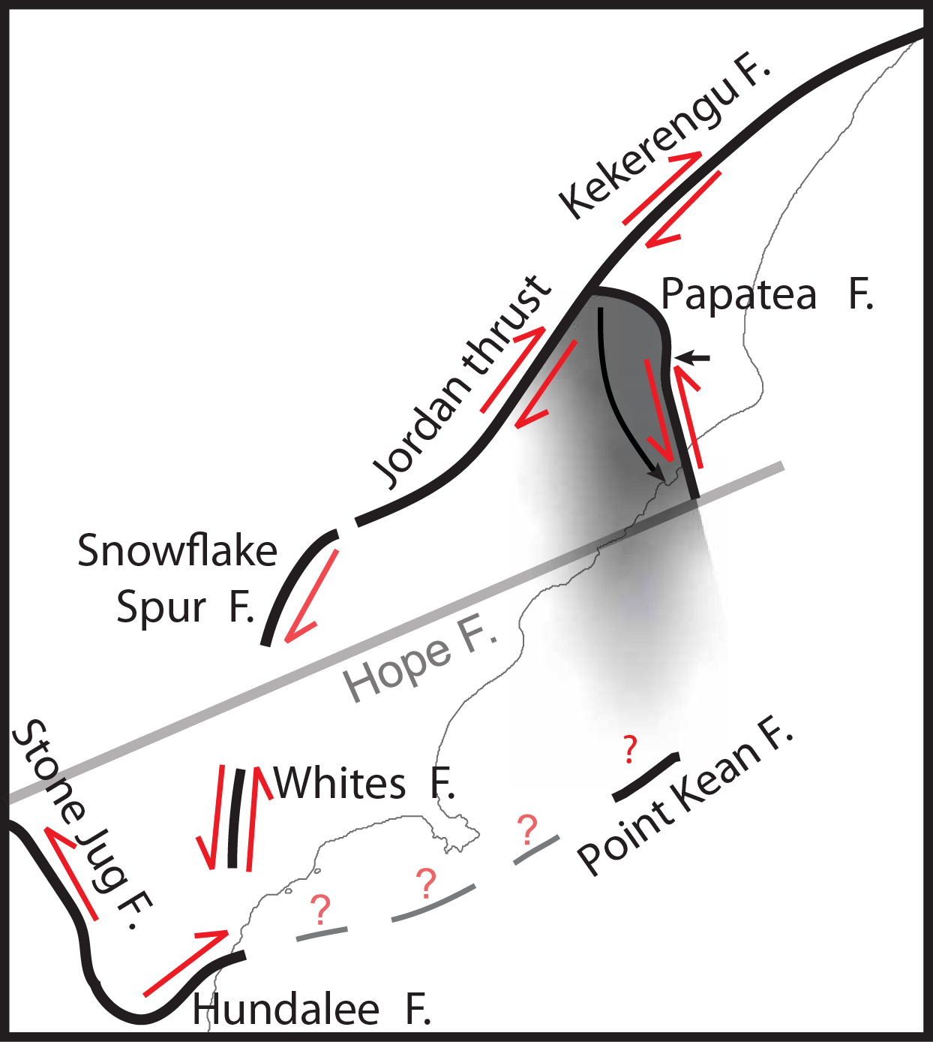
Multi-fault rupture, anelastic slip
2016 Kaikoura M7.8
3D LiDAR
Elastic dislocation model
[Diederichs et al., 2019]
Asymmetric displacements cannot be fit by elastic dislocation model; no geological evidence for strong material contrast → anelastic slip, large uplift forced by neighboring, elastic fault ruptures
Dynamic ruptures can active faults without apparent strain accumulation.
[Hamling et al., 2017]
Surface ruptures along at least 12 major faults

Slide 12
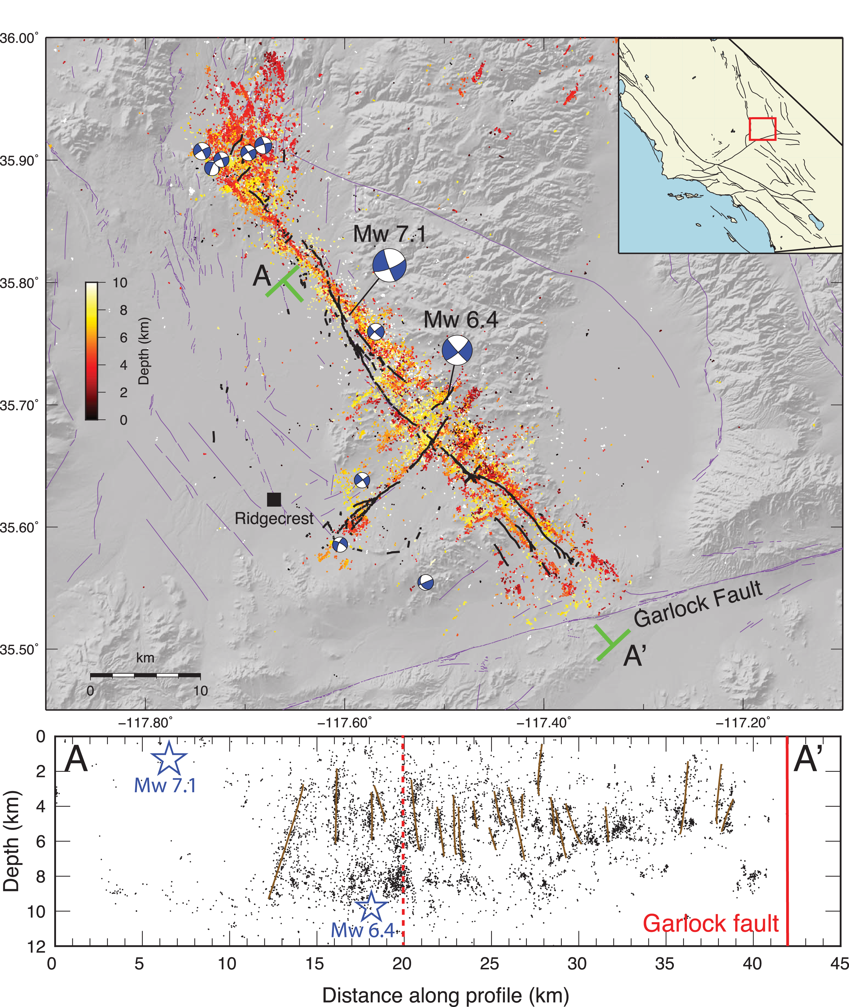
Multi-fault rupture, anelastic slip
2019 Ridgecrest M6.4, M7.1
[Ross et al., 2019]
Over 20 orthogonal faults cut through profile AA’

Slide 13
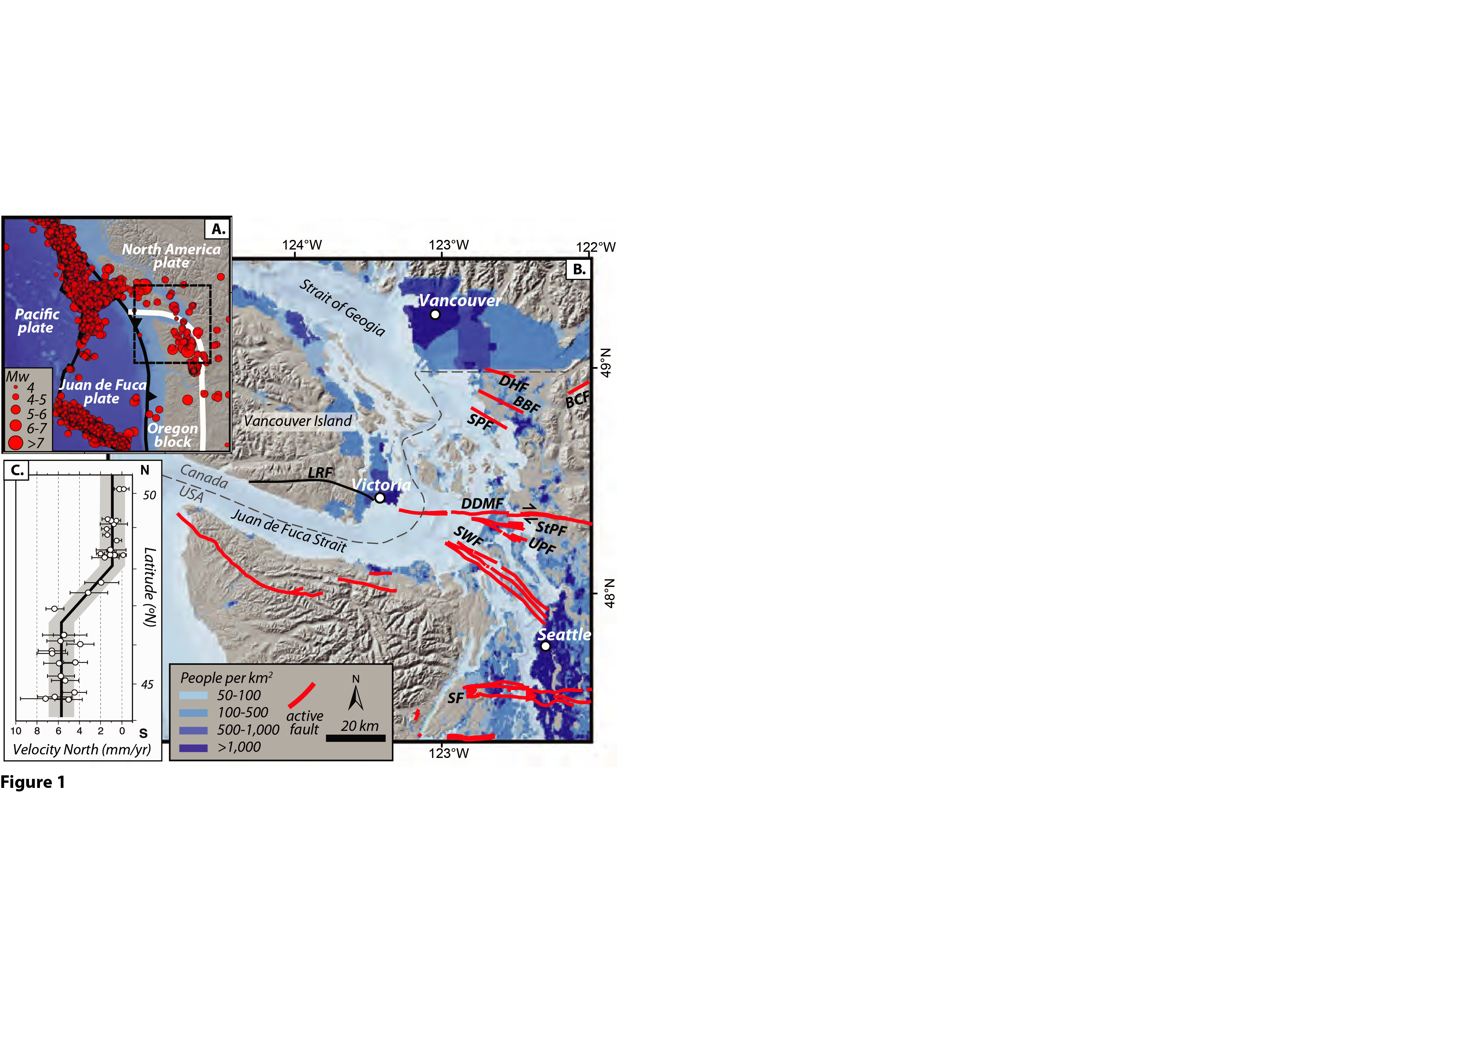
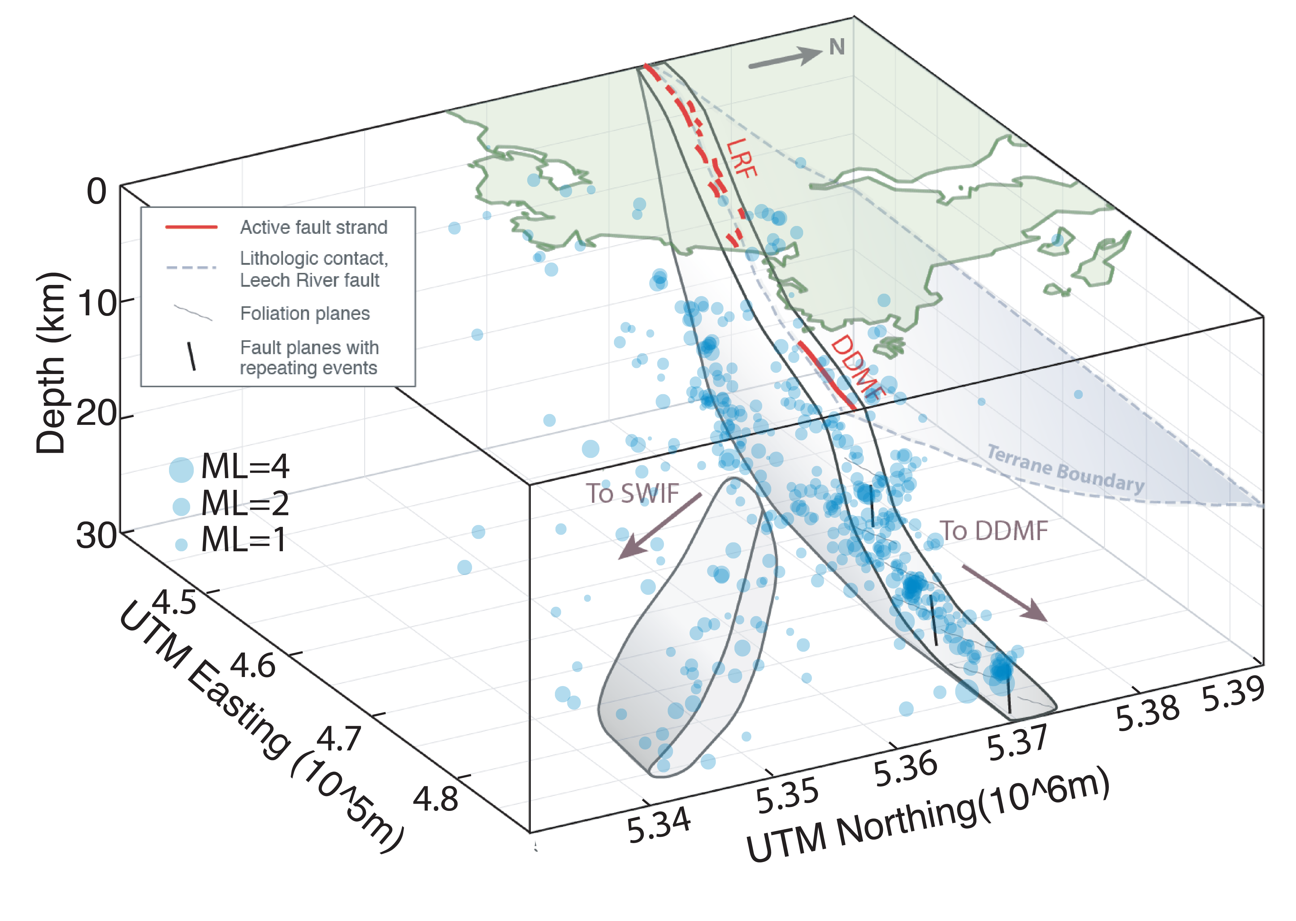
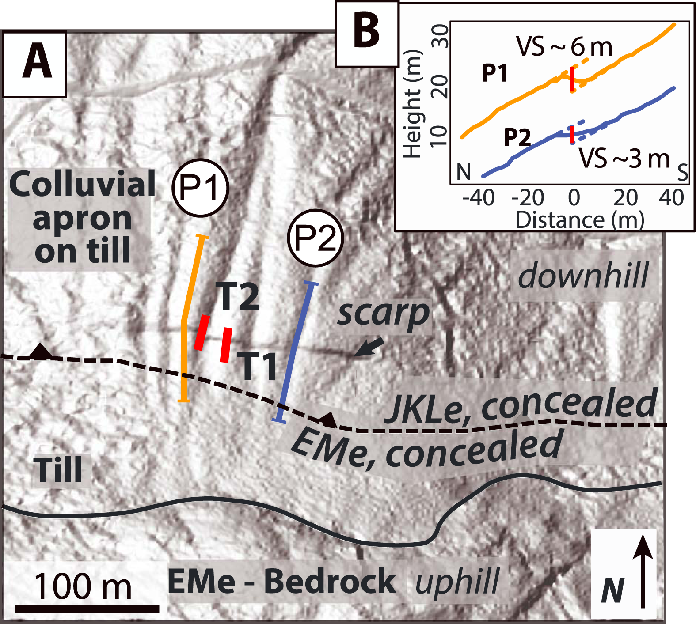
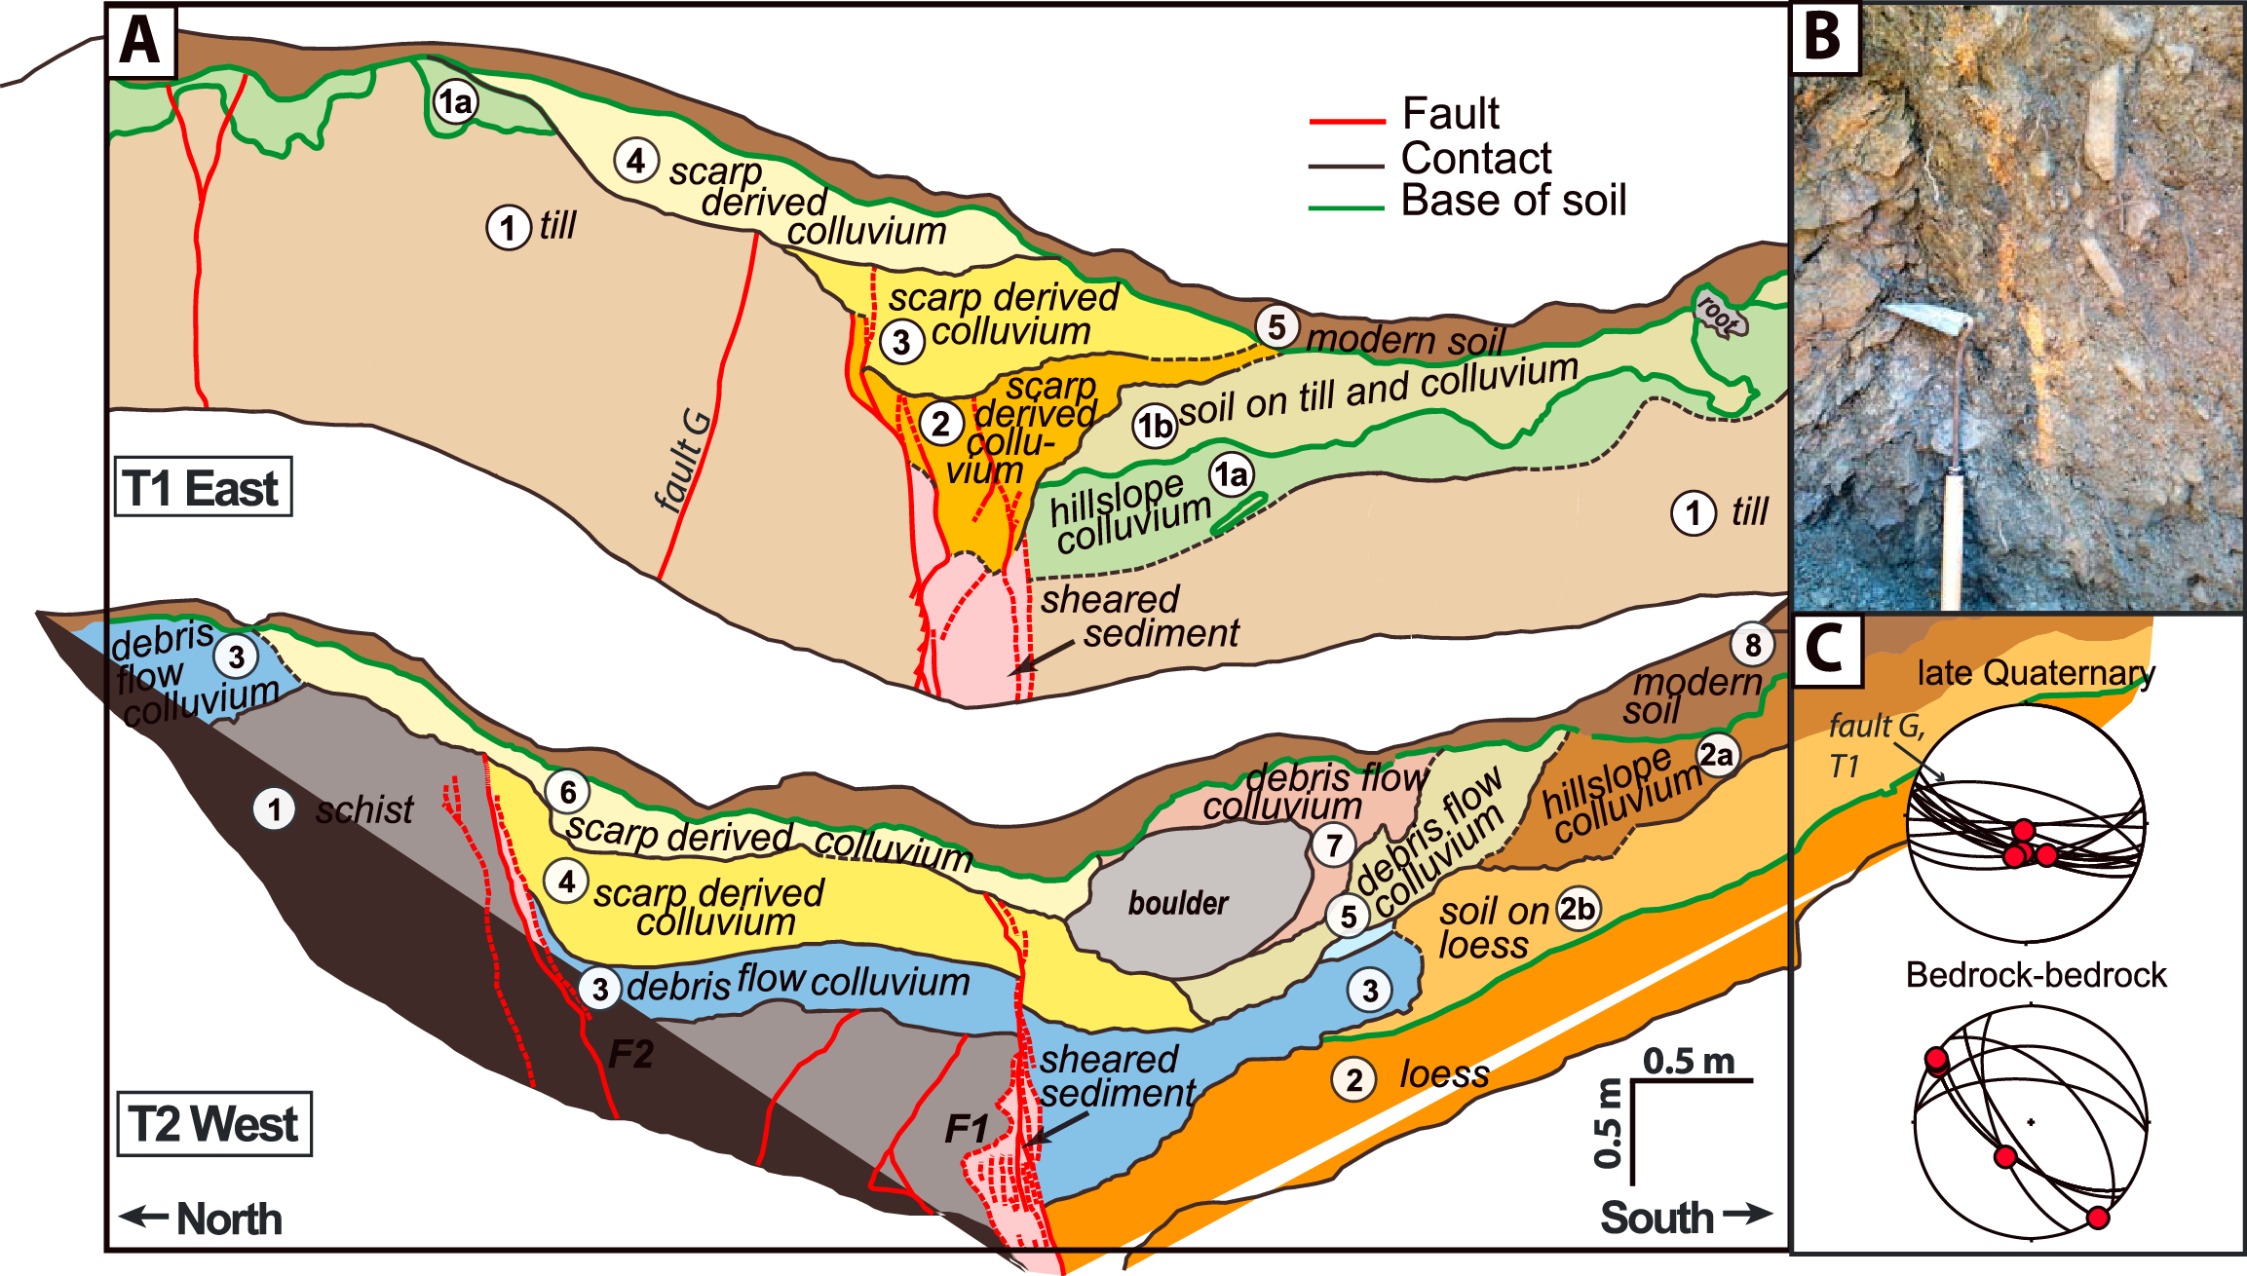
Northern Cascadia forearc faults
Leech River Fault
[Li and Liu, in prep]
Geological surveys, including a paleoseismic trenching study, along the Leech River Fault suggest LRF was active in late Quaternary, produced three surface-rupturing events in the last ~ 9 kyr, capable of generating M>6 earthquakes.
Relocated seismicity indicates fault branching offshore to DDMF and SWF. Rupture scenario simulations need to consider effects of geometric complexities.
[Morell et al., 2018]

Slide 14
Discoveries elsewhere and implications for PNW
Foreshocks and repeating earthquakes, possibly mediated by slow slip, could indicate initiation of fault unlocking.
  Differentiate seismic swarms that do lead to a large earthquake
  Improve seafloor geodetic instrumentation
Interseismic locking is useful for identifying future rupture areas.
  Predict rupture extent, total coseismic slip
  Use observations to constrain and improve physics-based predicative models
Dynamic weakening can induce large slip.
  Integrate field, laboratory and numerical simulations of earthquake sequences and dynamic ruptures
Reactivation of hidden/inactive faults
  Fault mapping, paleoseismic study, microseismicity precise location, rupture scenario simulation

Slide 16
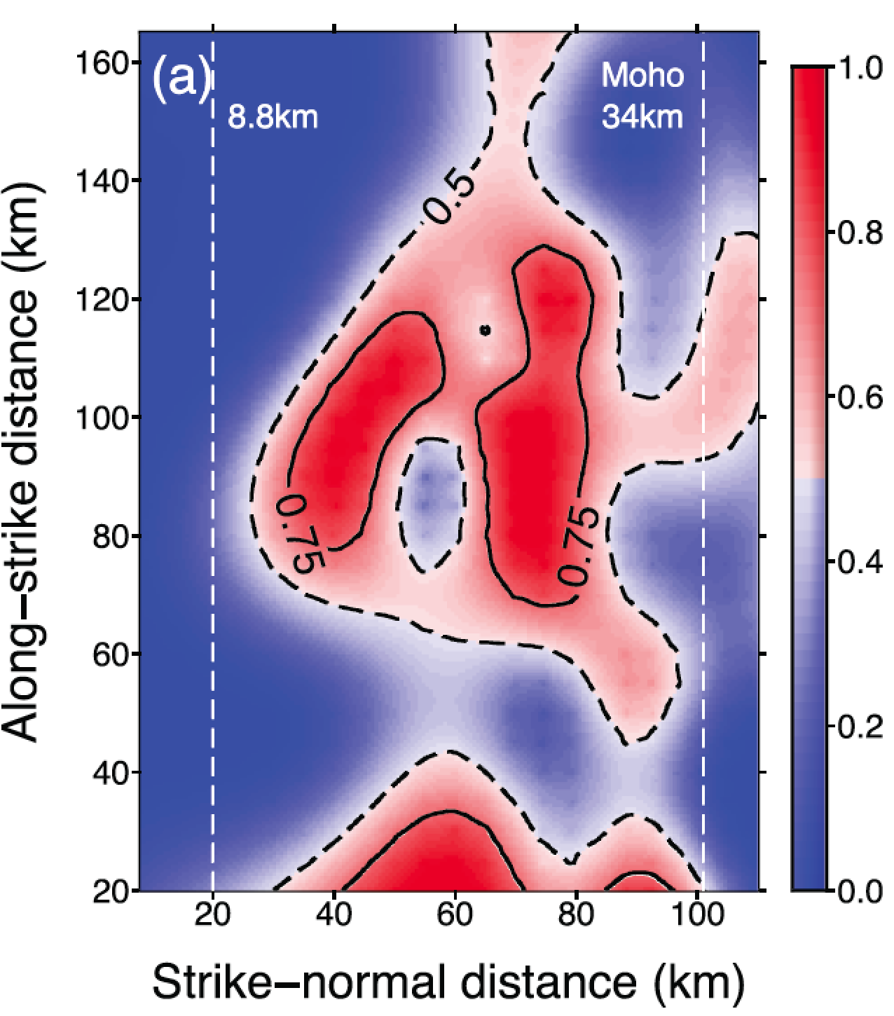
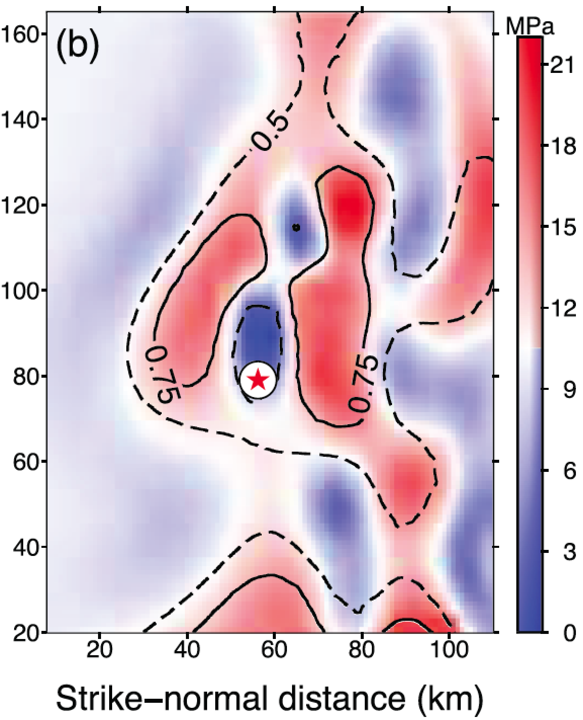
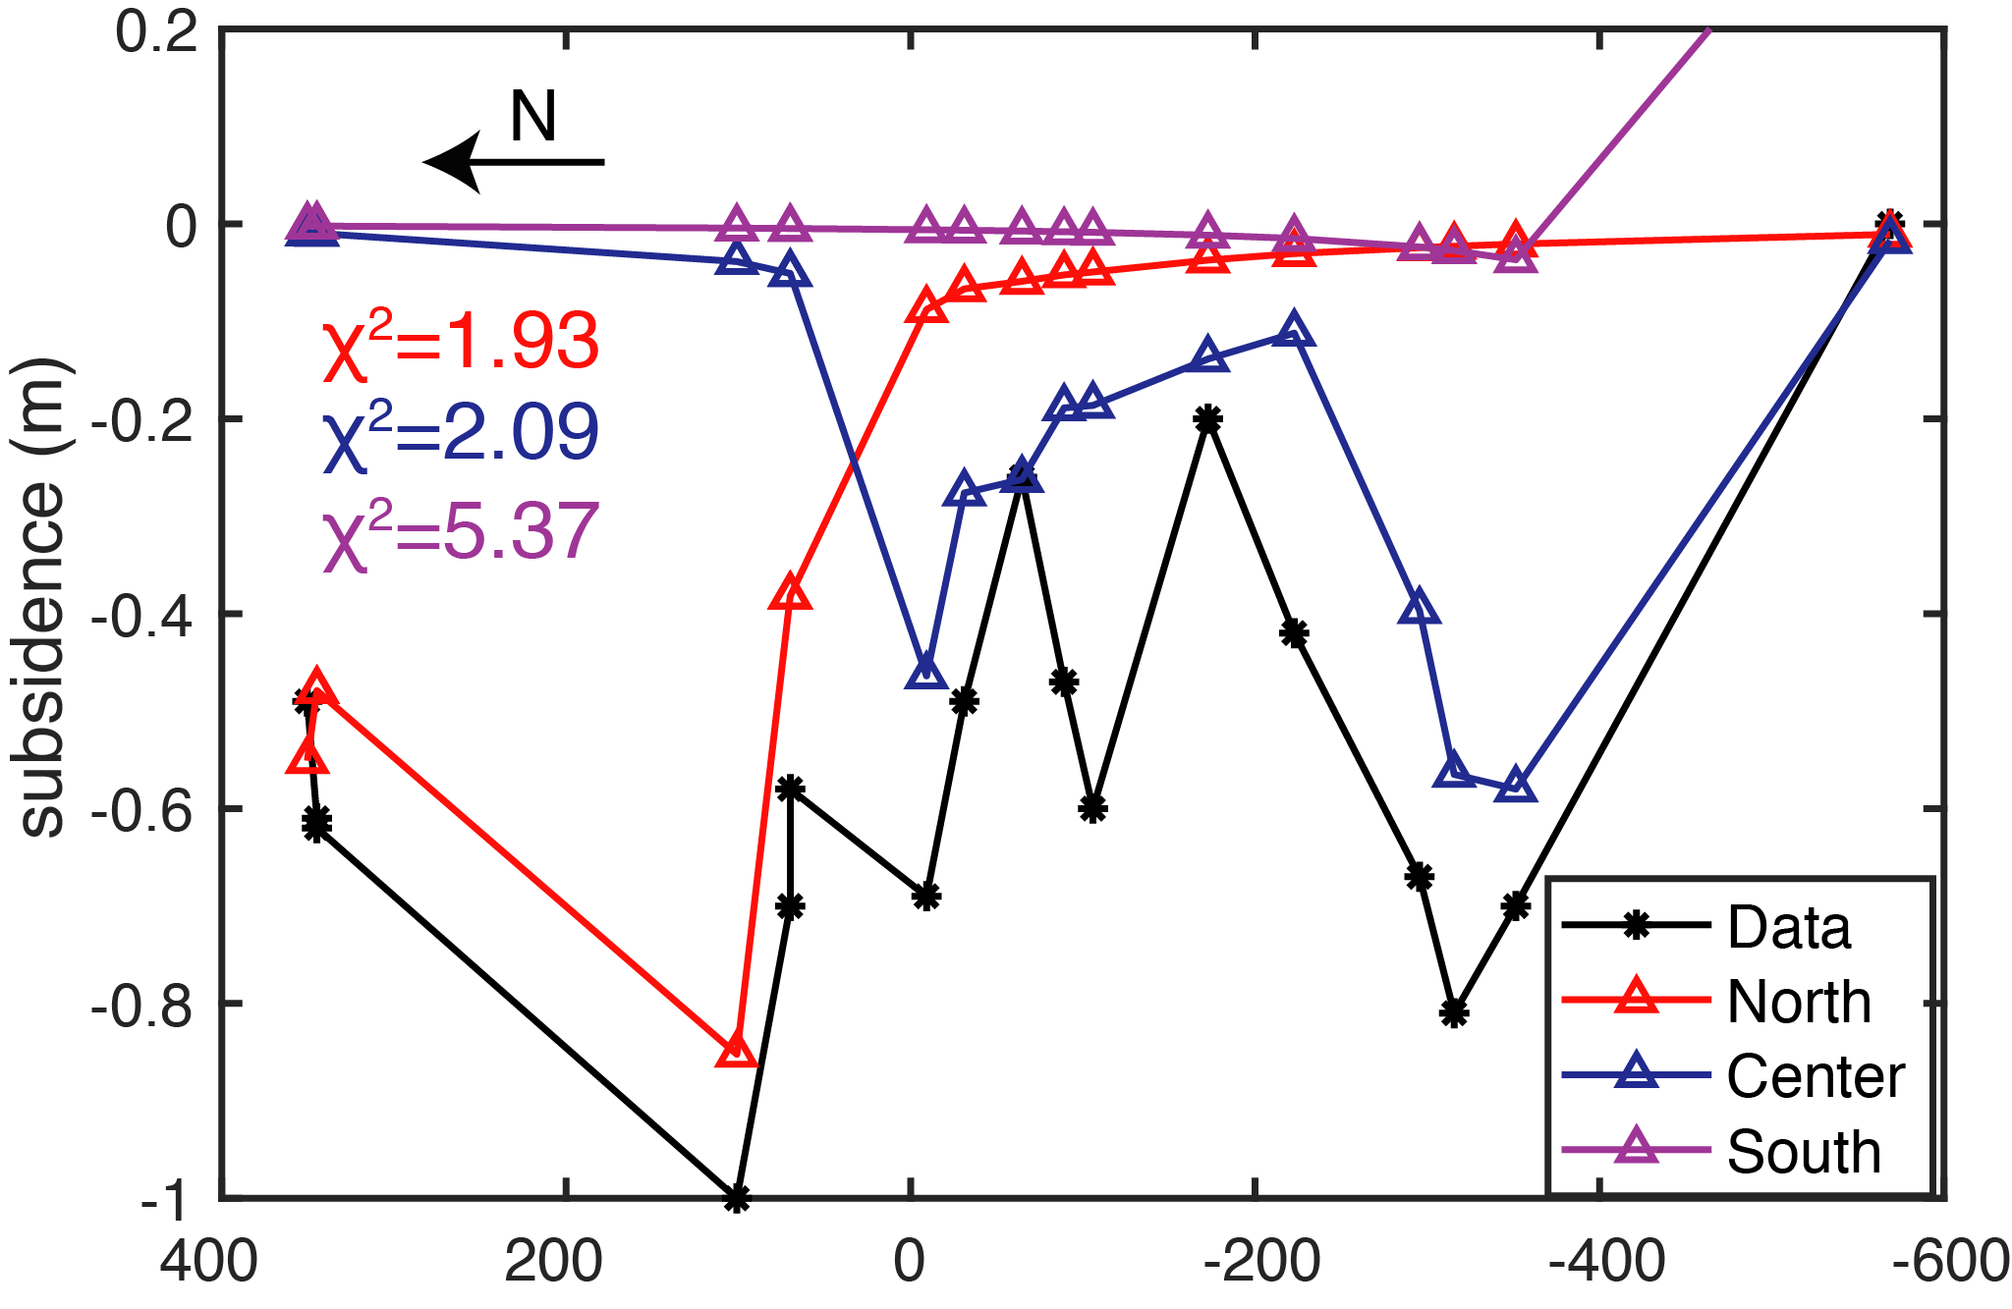
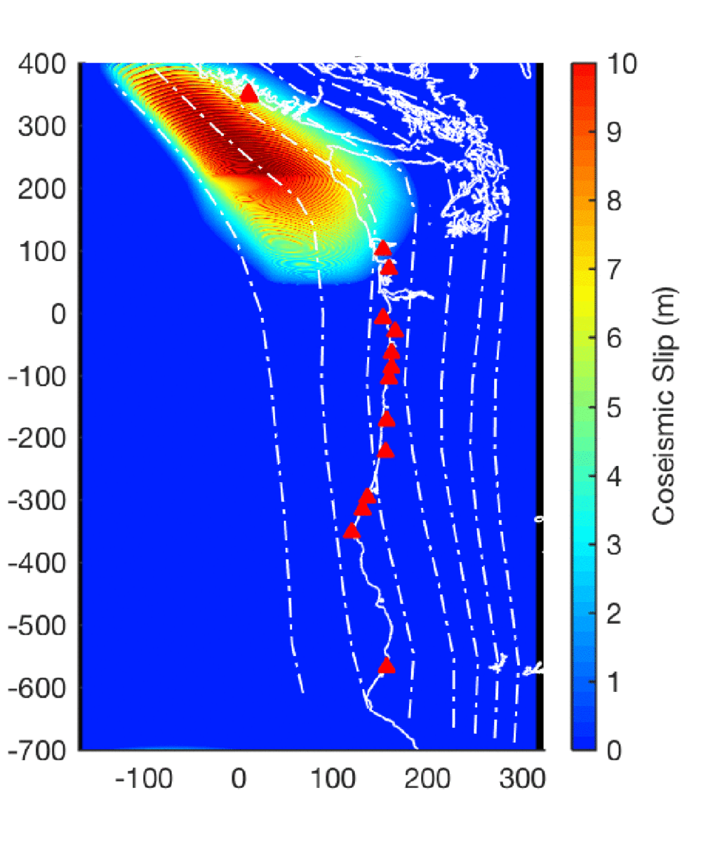
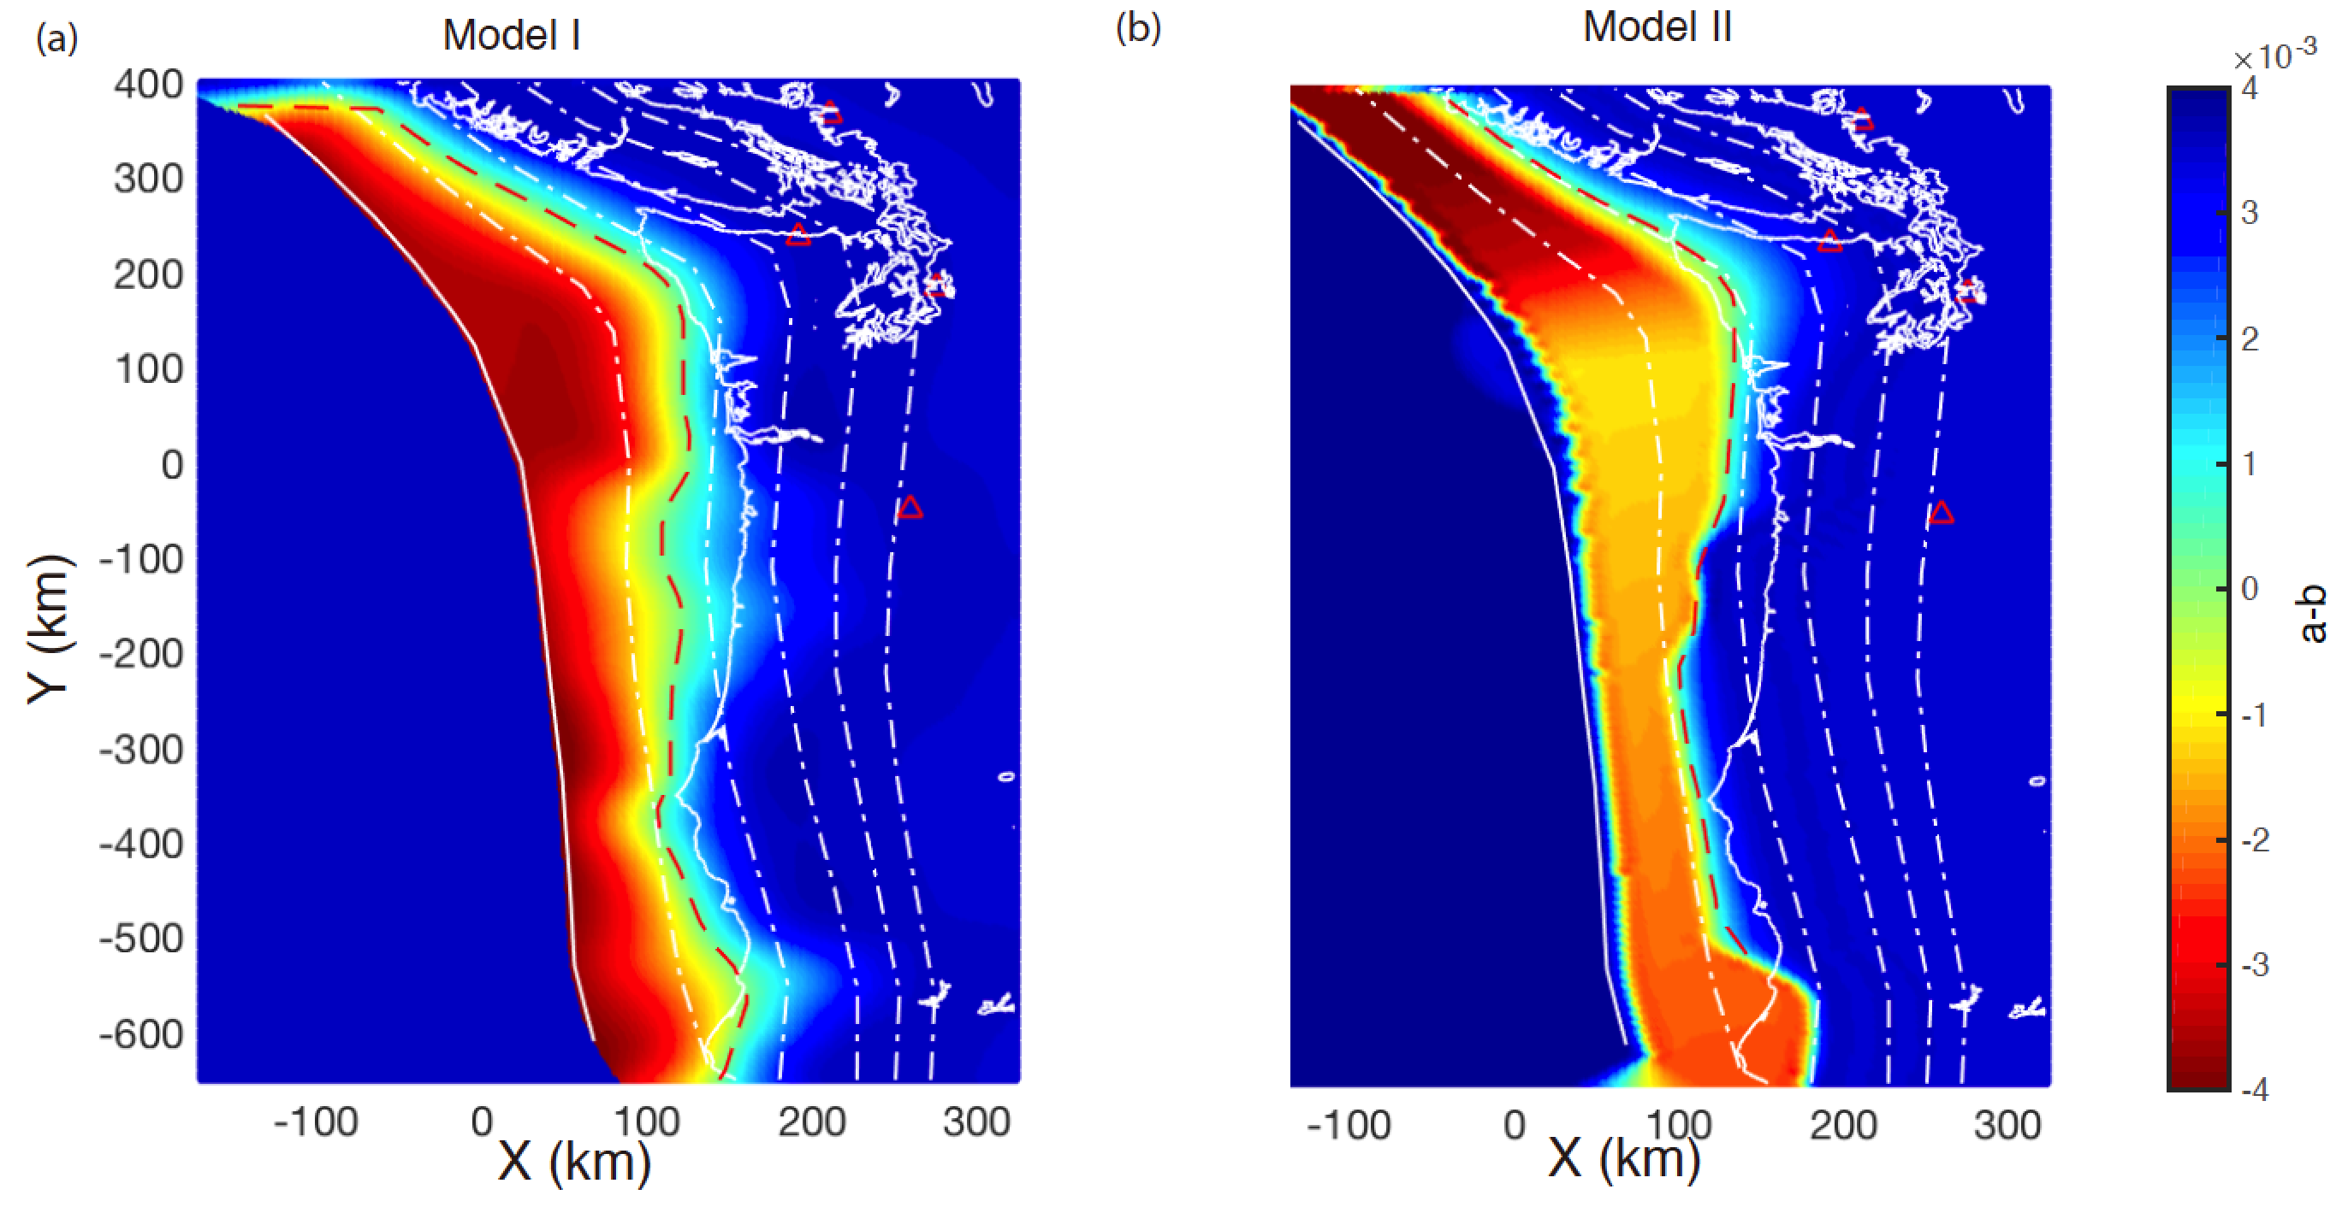
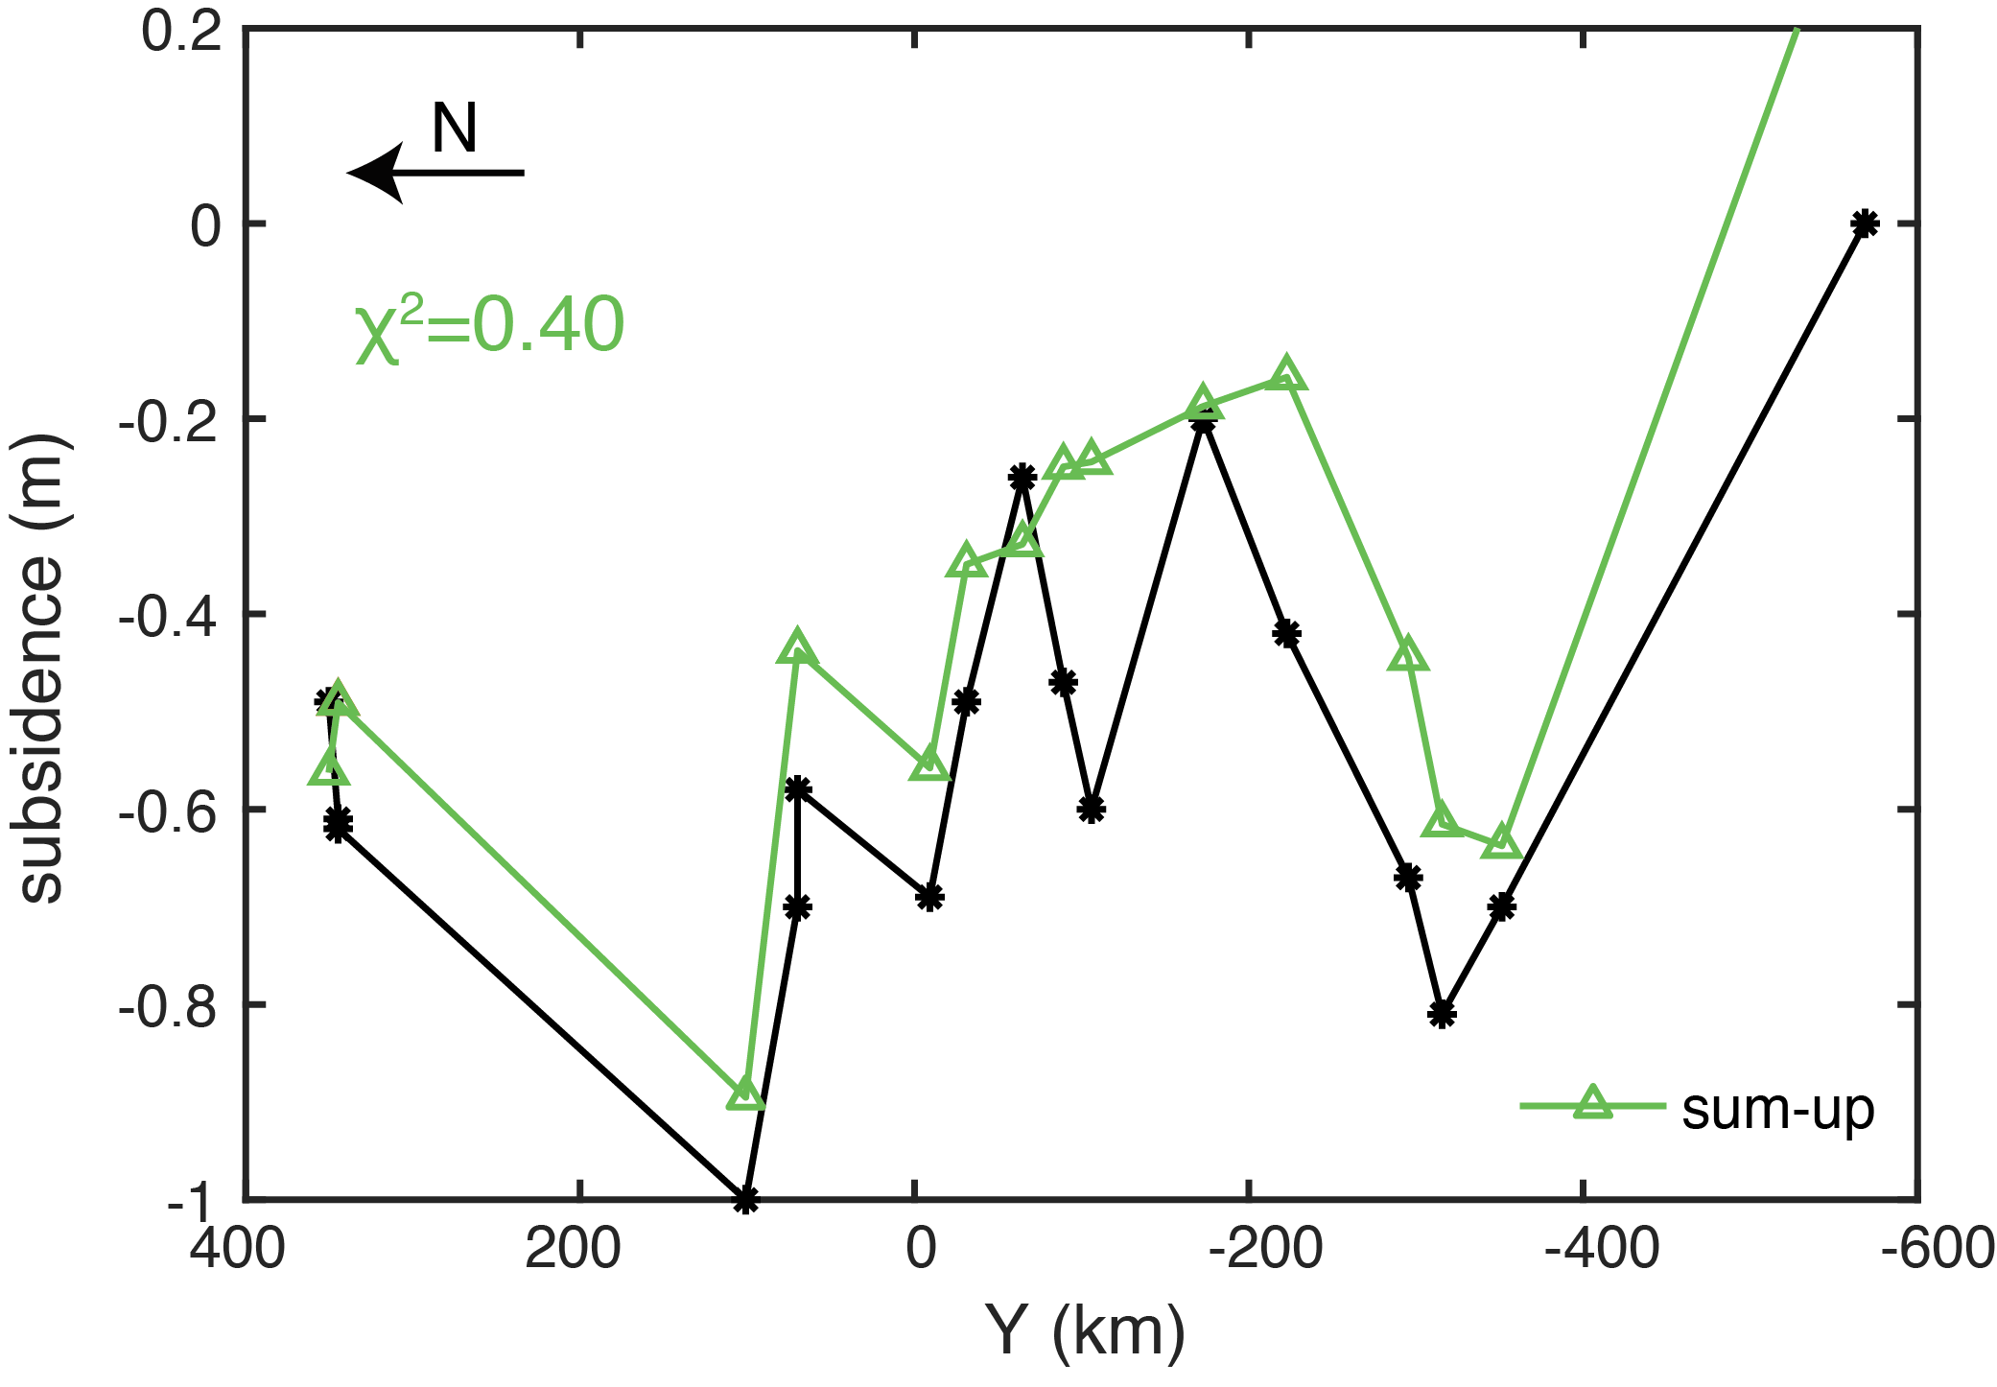
Use interseismic locking to inform rupture and slip simulations
Interseismic locking model
Initial shear stress
Assumptions:
  Peak strength
  Weakening distance
  Nucleation zone
[Yang et al., 2019]
Rate-state friction stability parameter
Rupture scenarios
[Schmalzle et al., 2014]
[Burgette et al., 2009]
[Li and Liu, in prep]
Notes:
Model 1: continuous GPS; model 2: tidal gauge leveling

