Slide 1
Actual and Aspirational Offshore Geodesy (and Seismology)
William Wilcock
Pacific Northwest Earthquake Science Workshop
Seattle, November 5, 2019
Notes:
Lot of ground to cover so I thought I would start with the motivation

Slide 2
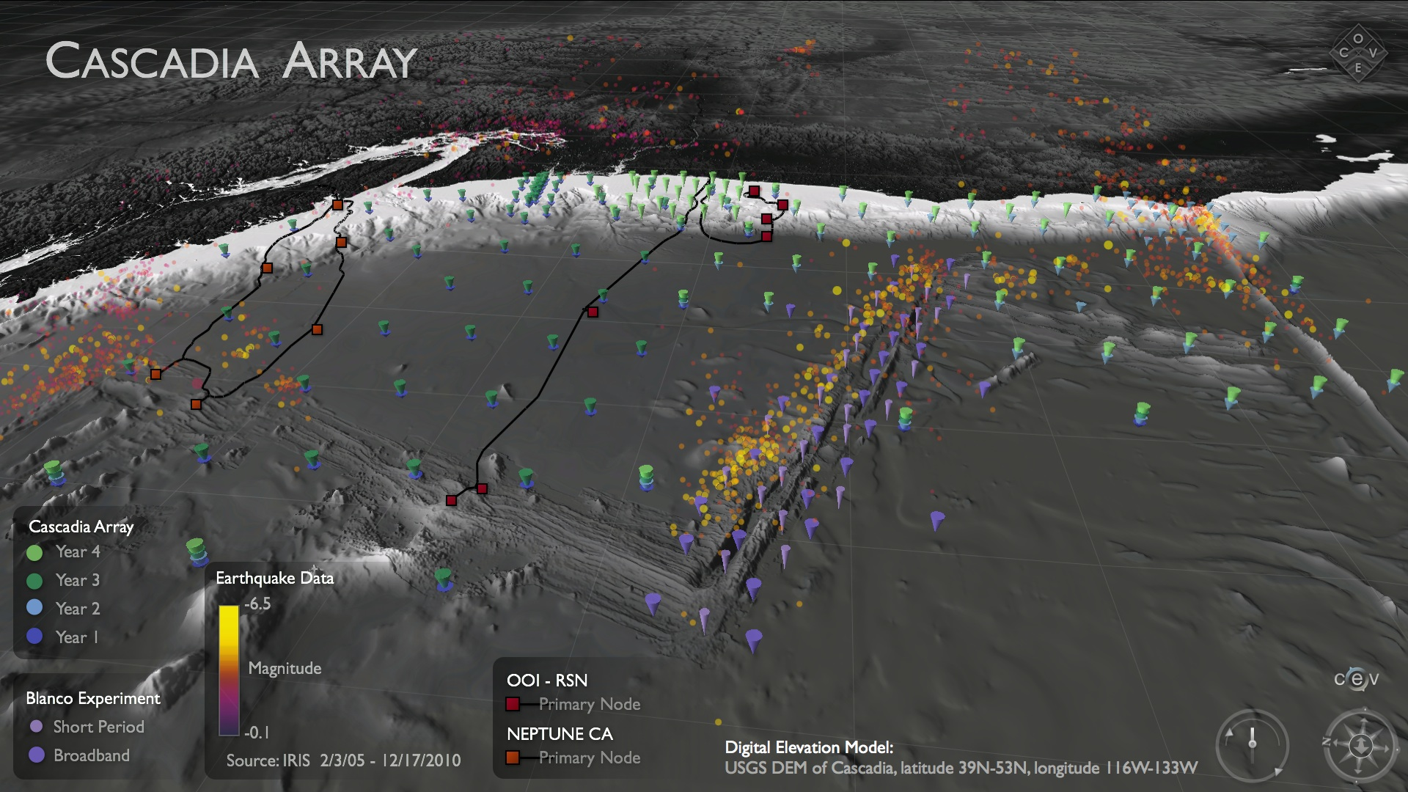
2011-15
Seismology
COLZA 2008-10
SeaJade 2010, 2014

Slide 3
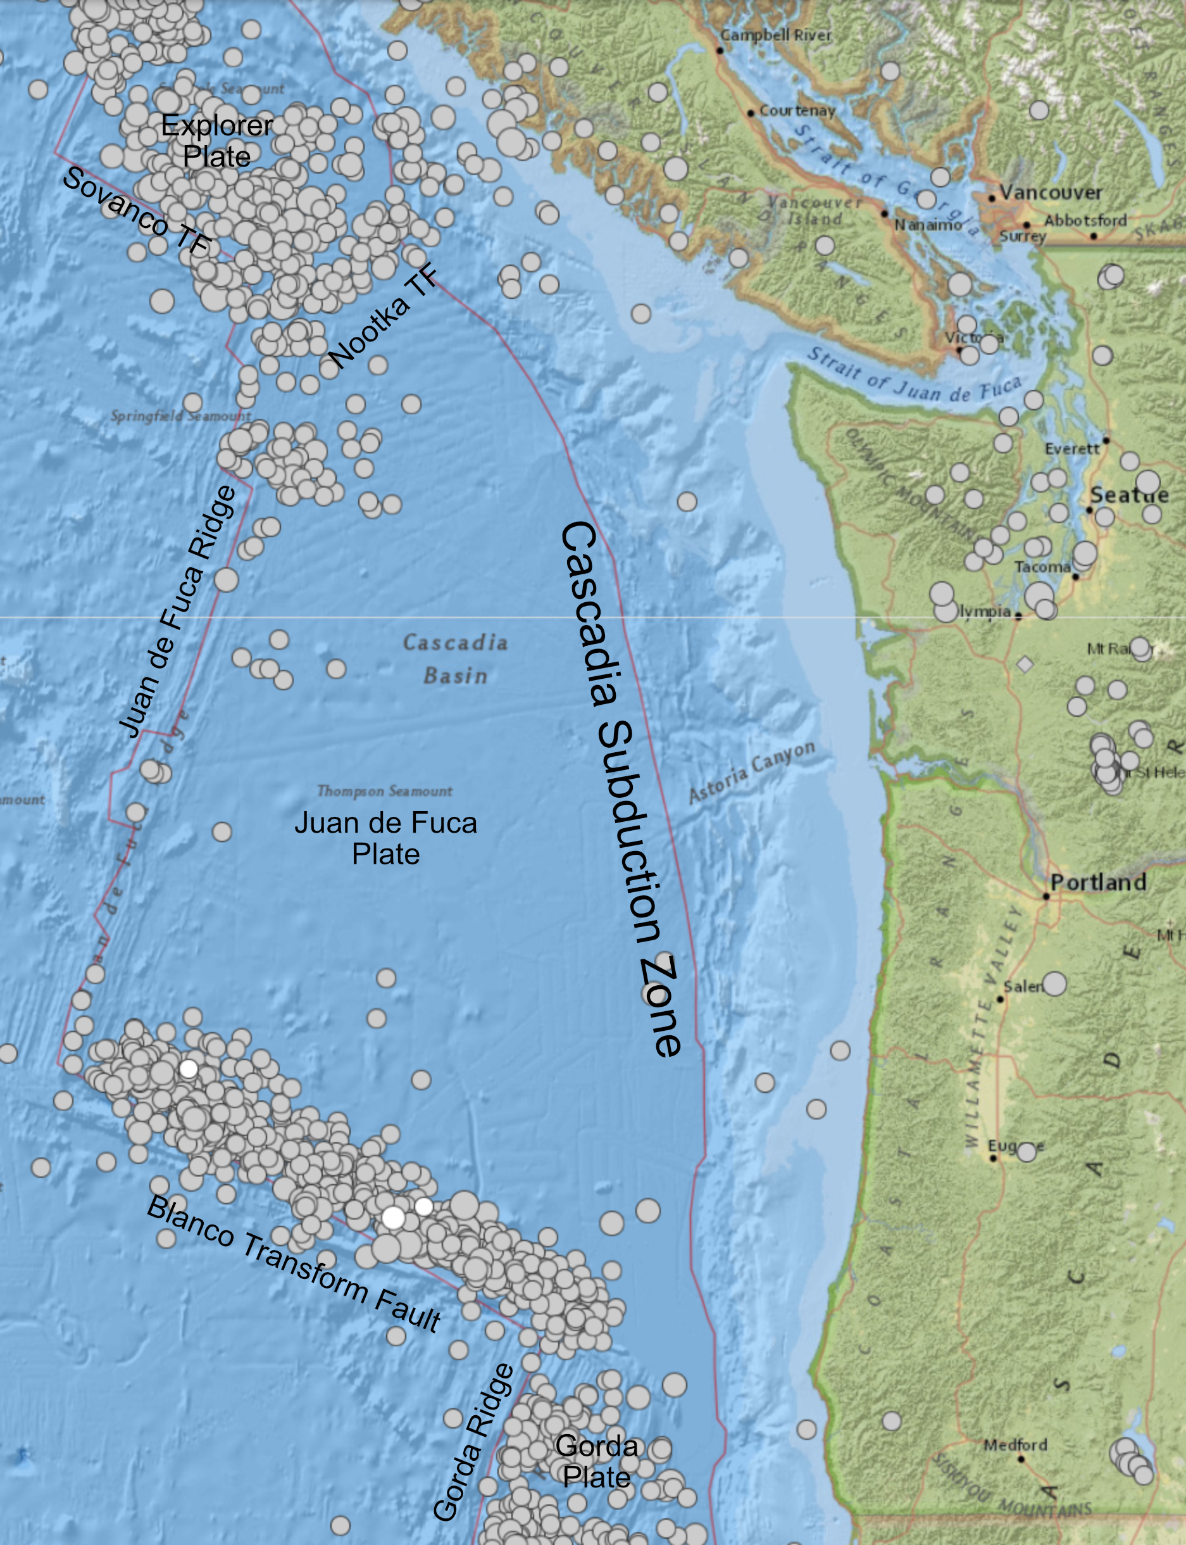
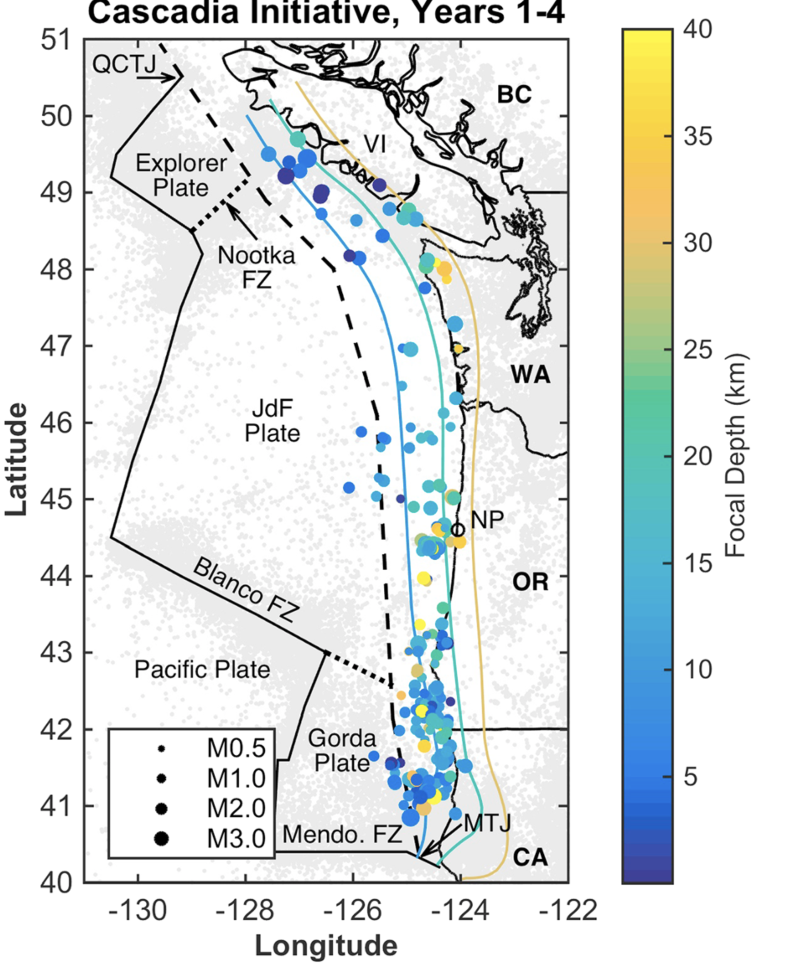
Offshore Seismicity
Stone et al., 2018

Slide 4
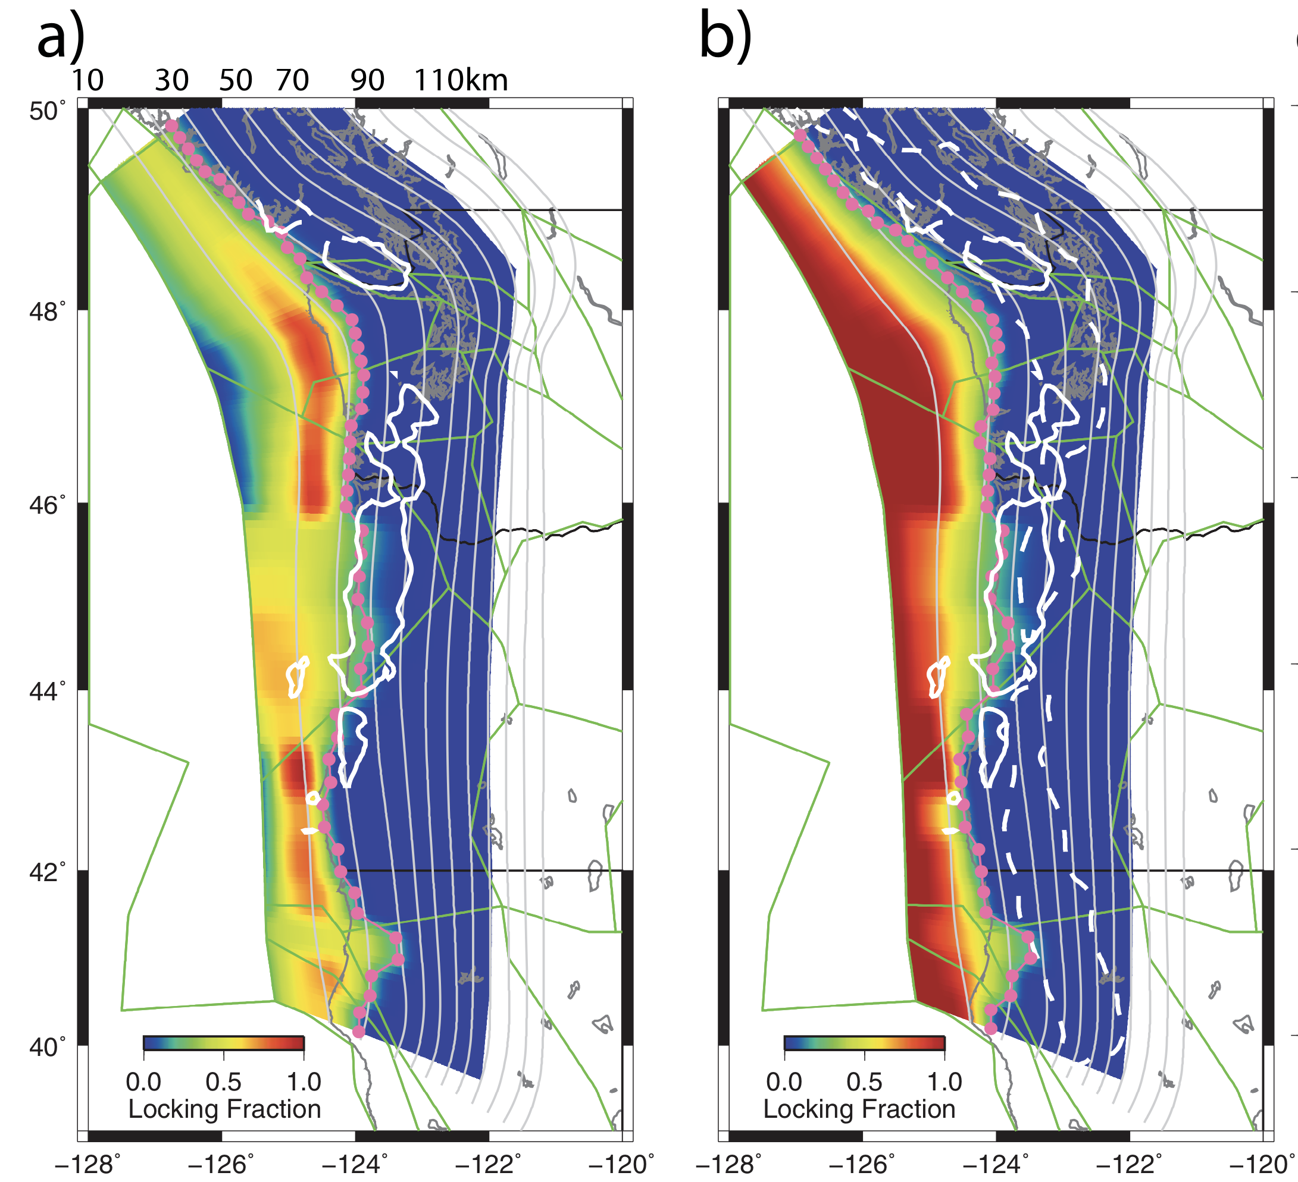
Offshore Geodesy Motivating Goals
Interseismic strain accumulation on the megathrust.
Transient fault slip & creep at the trench.
Partitioning of strain within the prism.
Slide courtesy of David Schmidt
Schmalzle et al., 2006

Slide 5
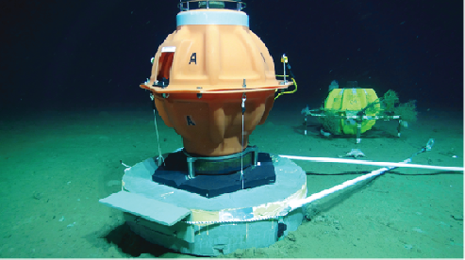
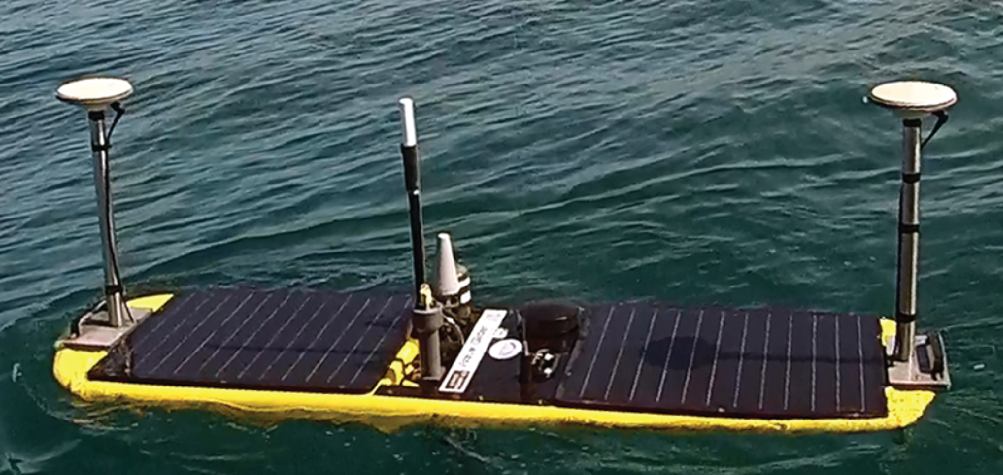
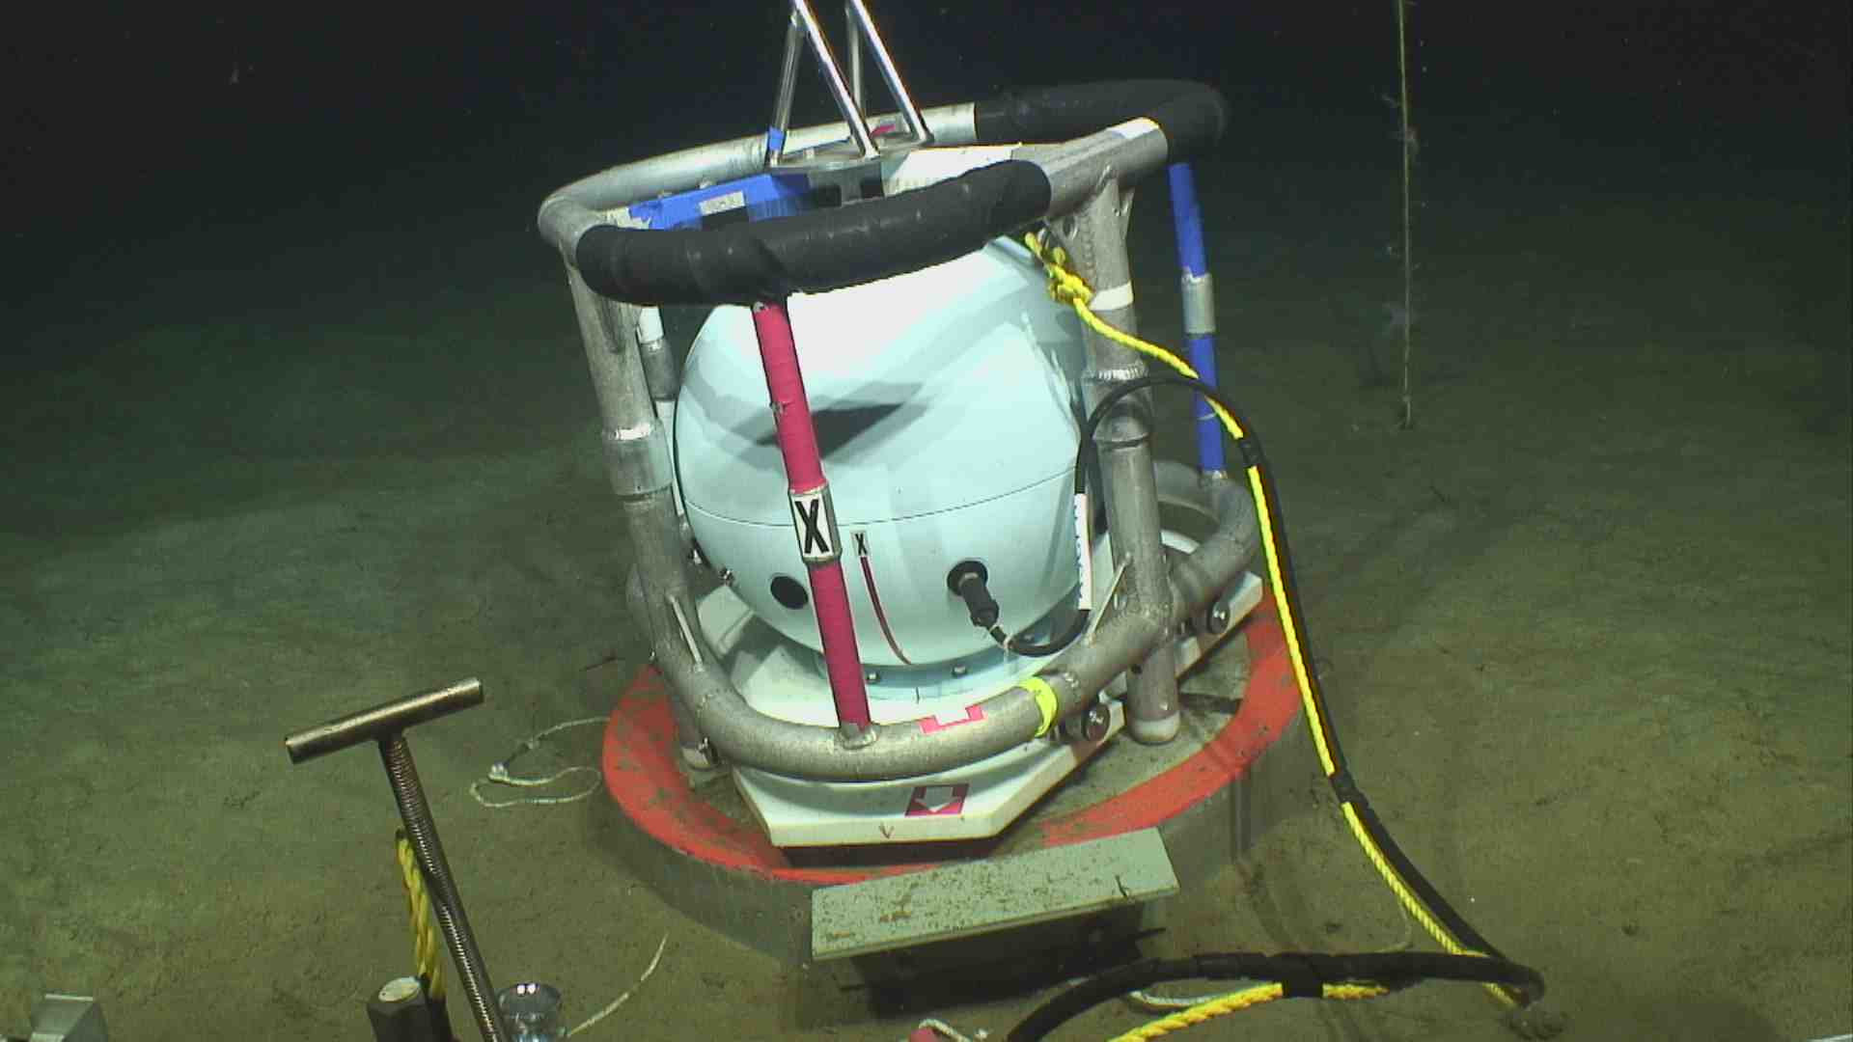
Seafloor Geodetic Techniques
GPS-A
Transponder
Horizontal Deformation
  GPS-Acoustic
  Fiber optical strain
  Acoustic ranging & mesh networks
Vertical Deformation
  Pressure (APG, ASCPR, A-0-A)
  Gravity
  Tilt
  Differential bathymetry (Ship/AUV)
Formation strain
  Borehole instruments (i.e. CORKS)
  Fluid flow
WaveGlider
ASCPR
Slide courtesy of David Schmidt

Slide 6
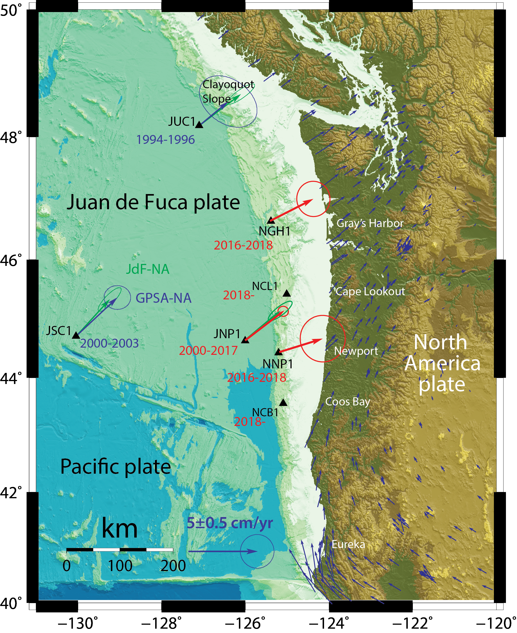
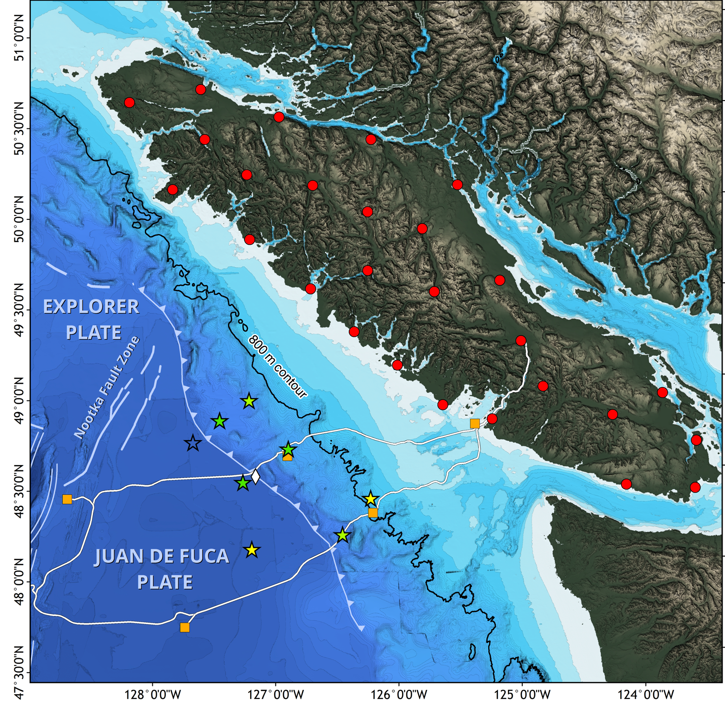
GPS-Acoustic
SIO - UW
ONC
Chadwell
& Schmidt
Installed
Planned
Martin Heesemann

Slide 7
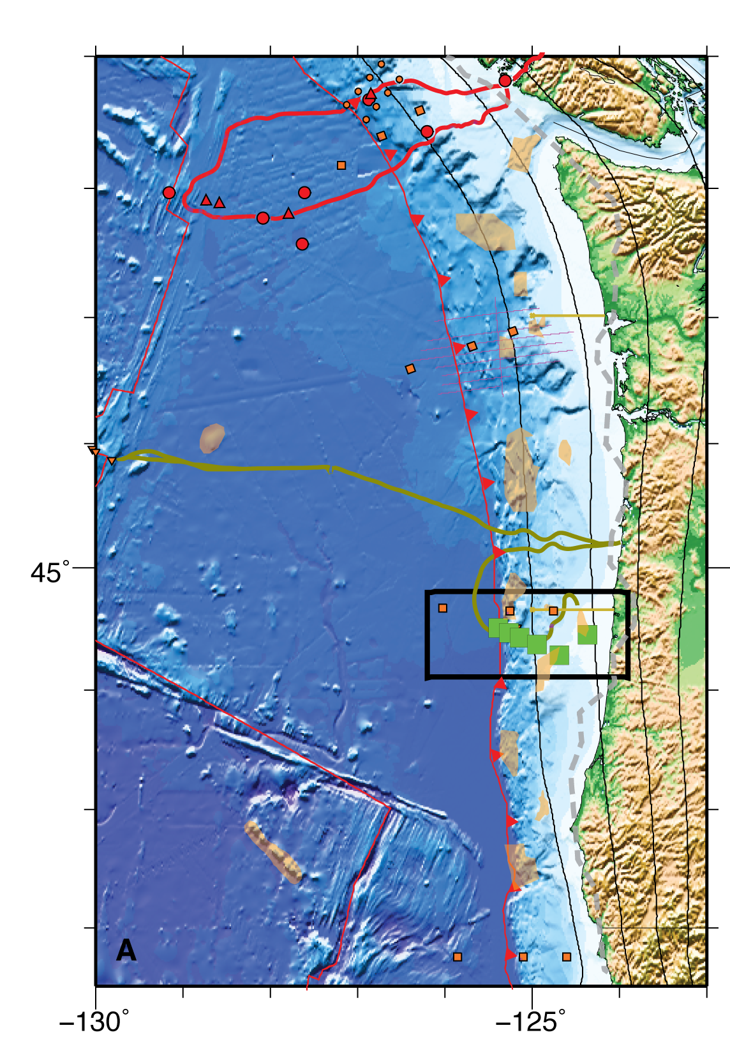
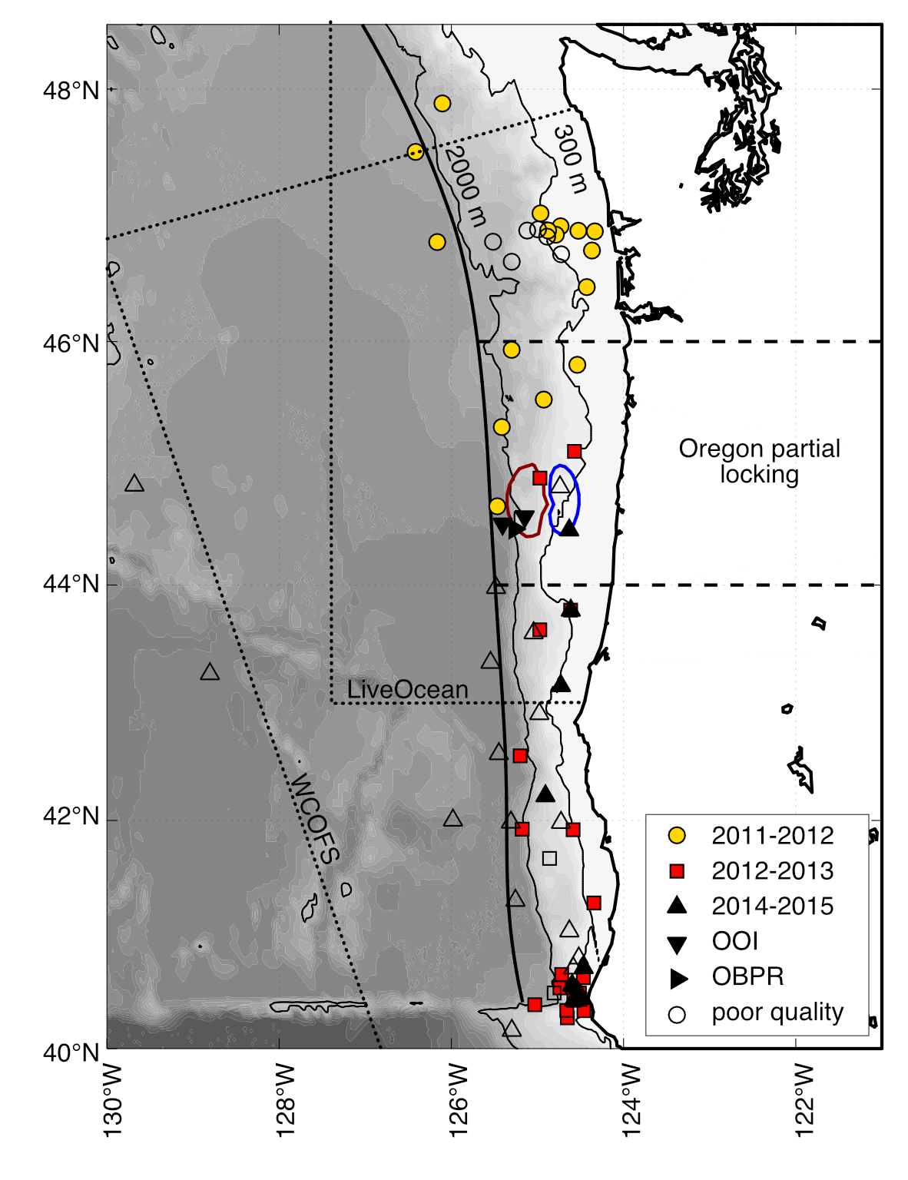
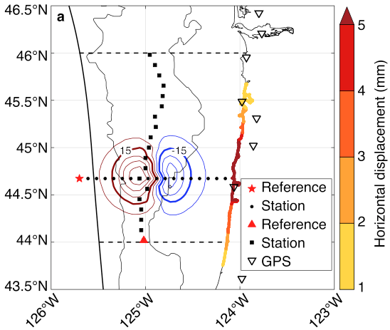
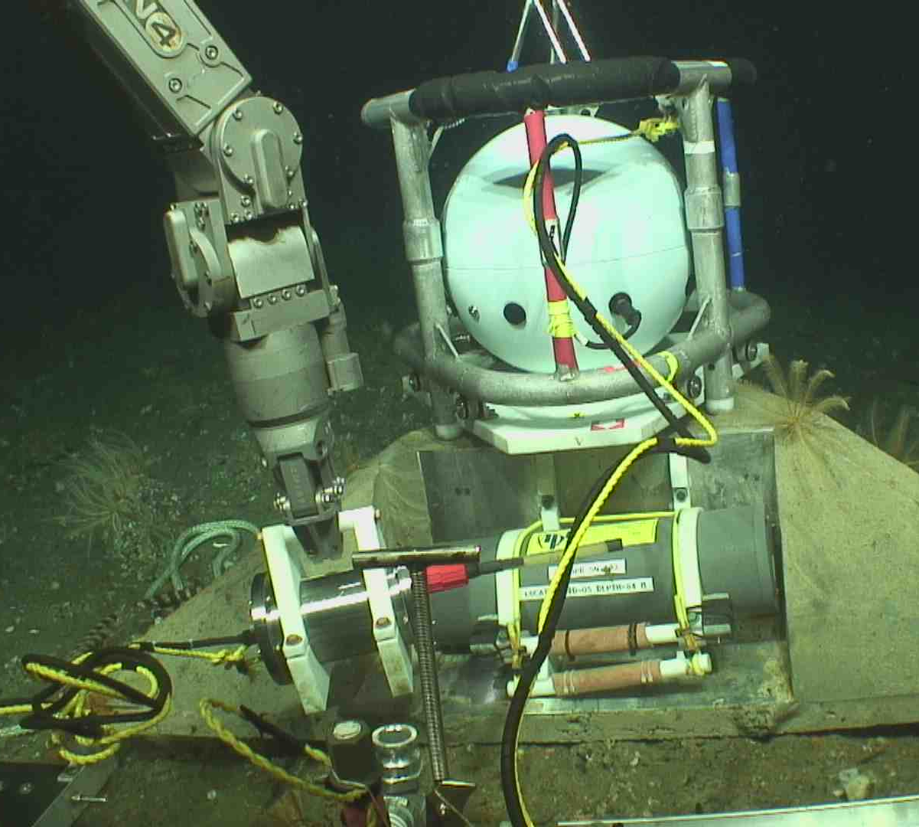
Seafloor Pressure - I
Cascadia Initiative – Slow Slip
UCSD-UW Collaboration since 2015
OR Secular Strain SIO – UW
Fredrickson et al. (2019)
Bottom pressure from the Cascadia Initiative
  2011-2015
ASCPR Profile
  Benchmarks off Oregon

Slide 8
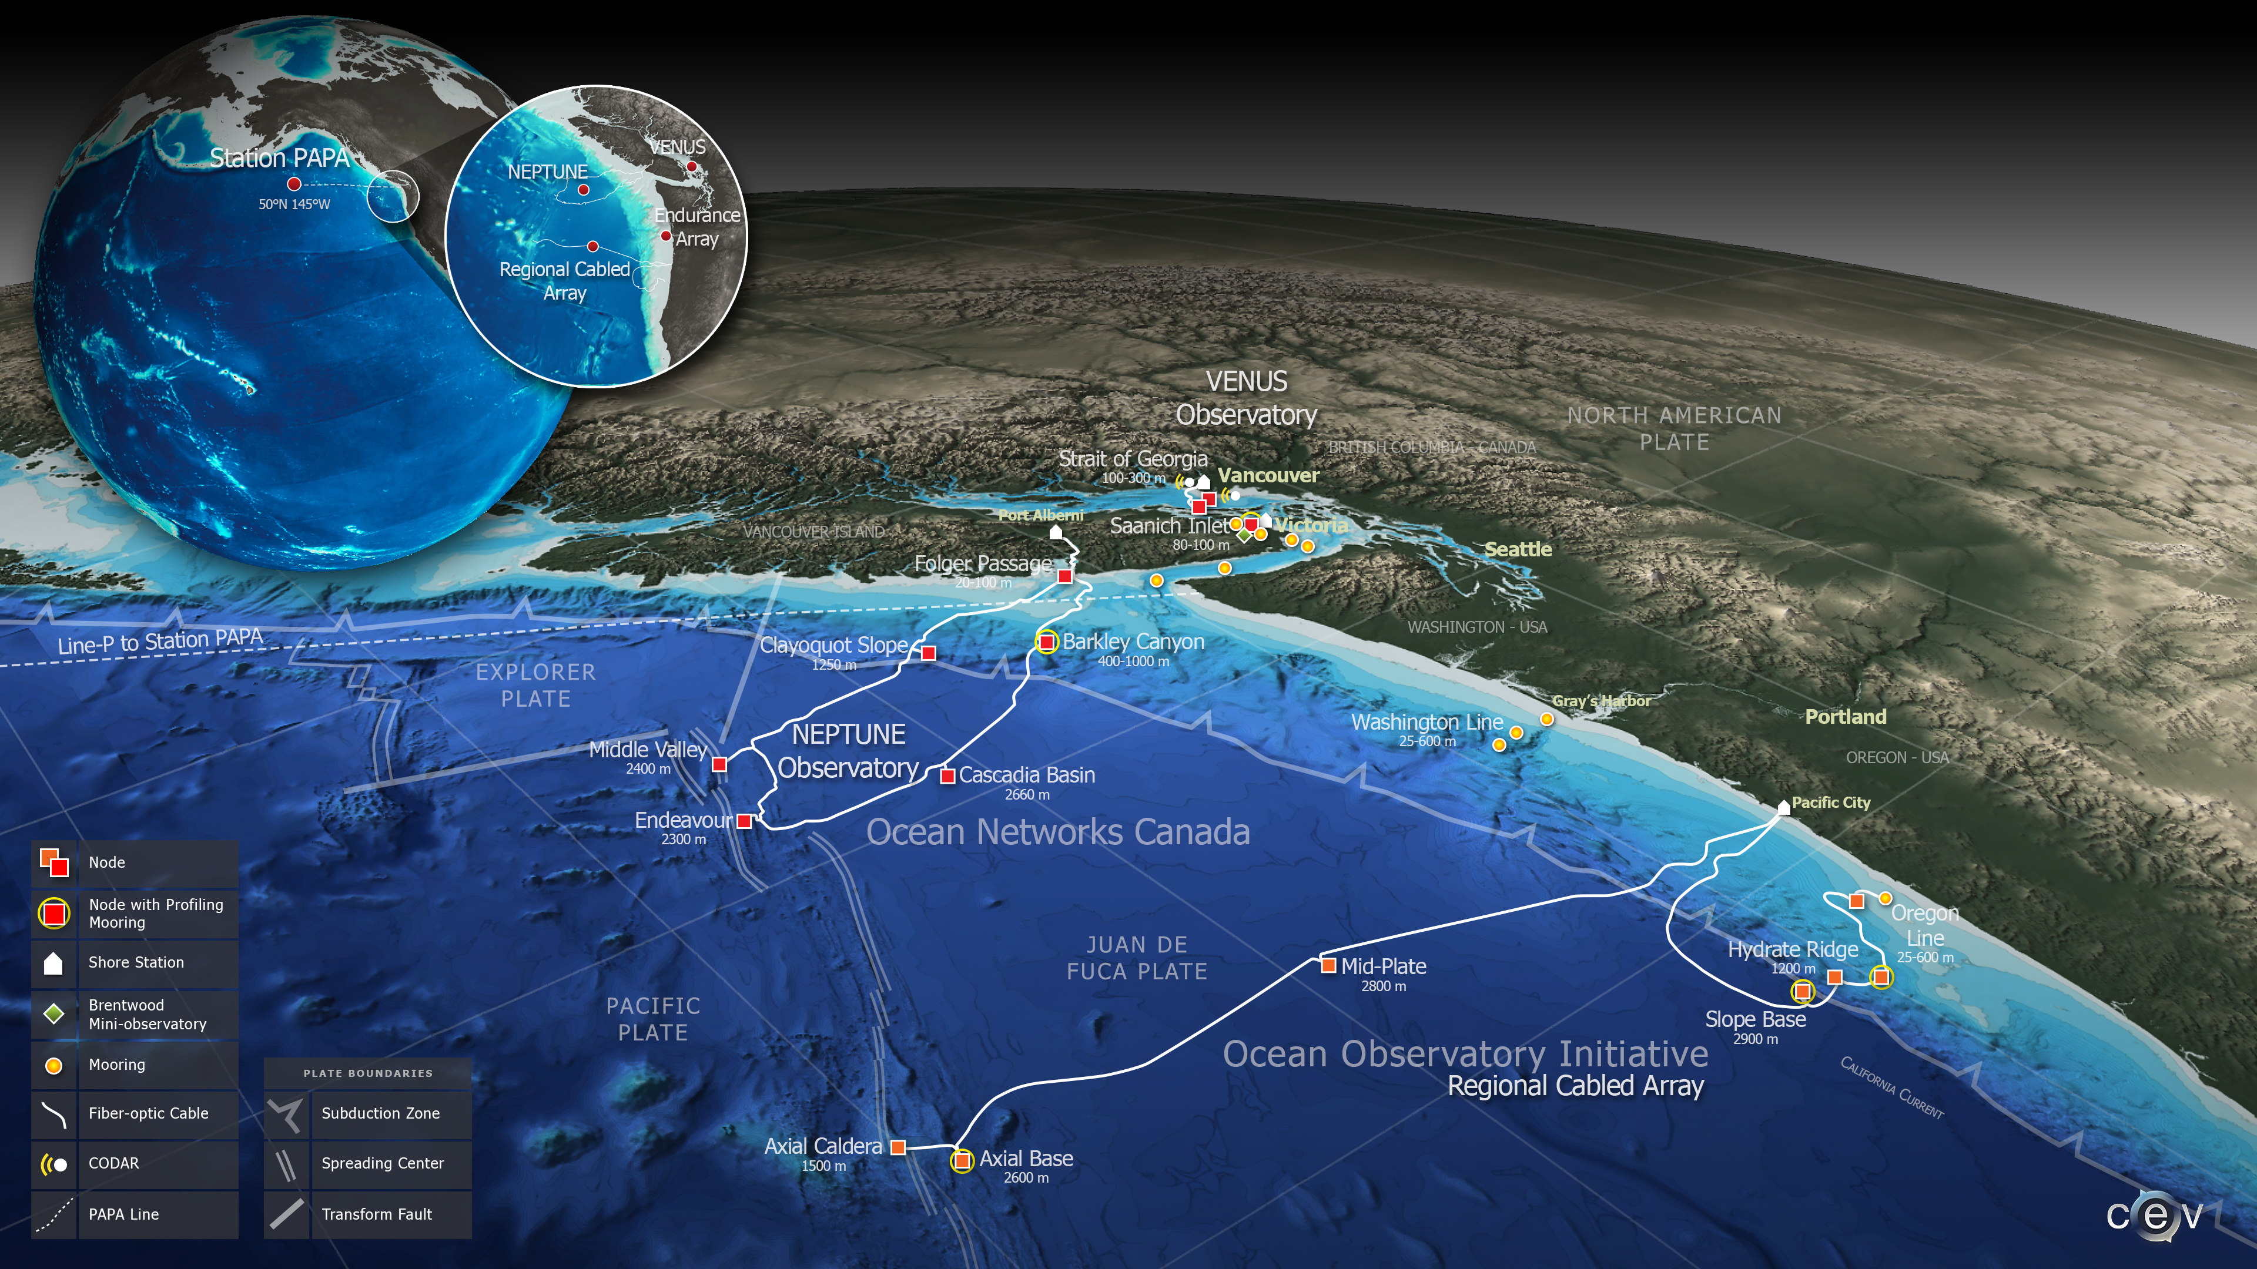
Seafloor Pressure - II
Cabled Observatories

Slide 9
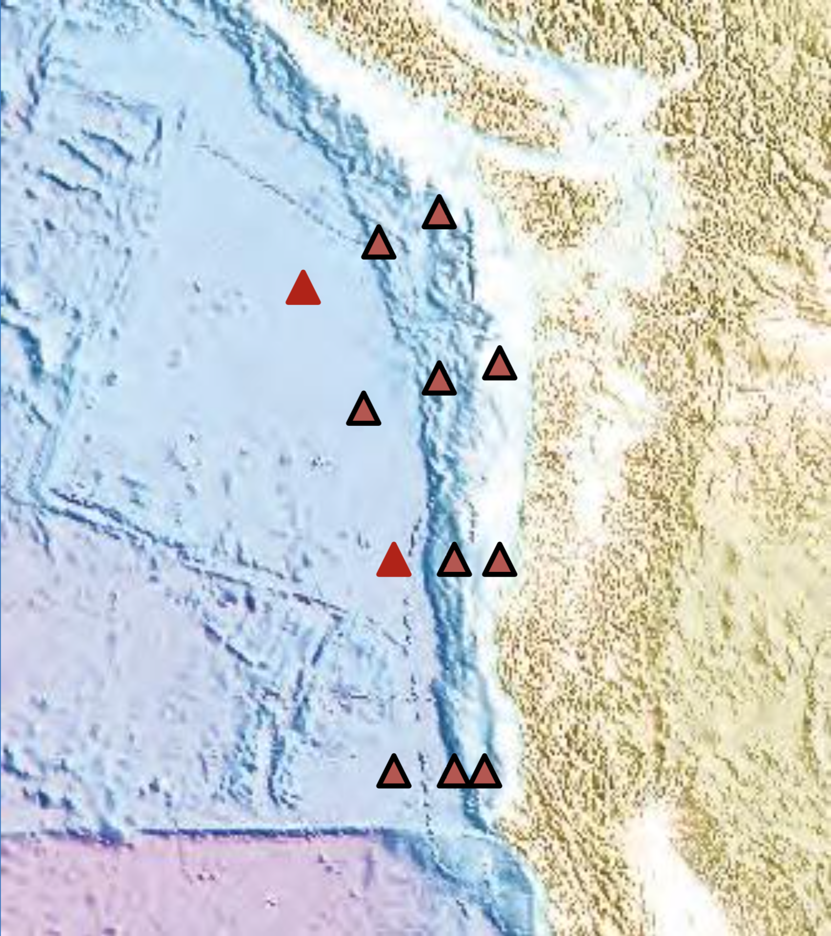
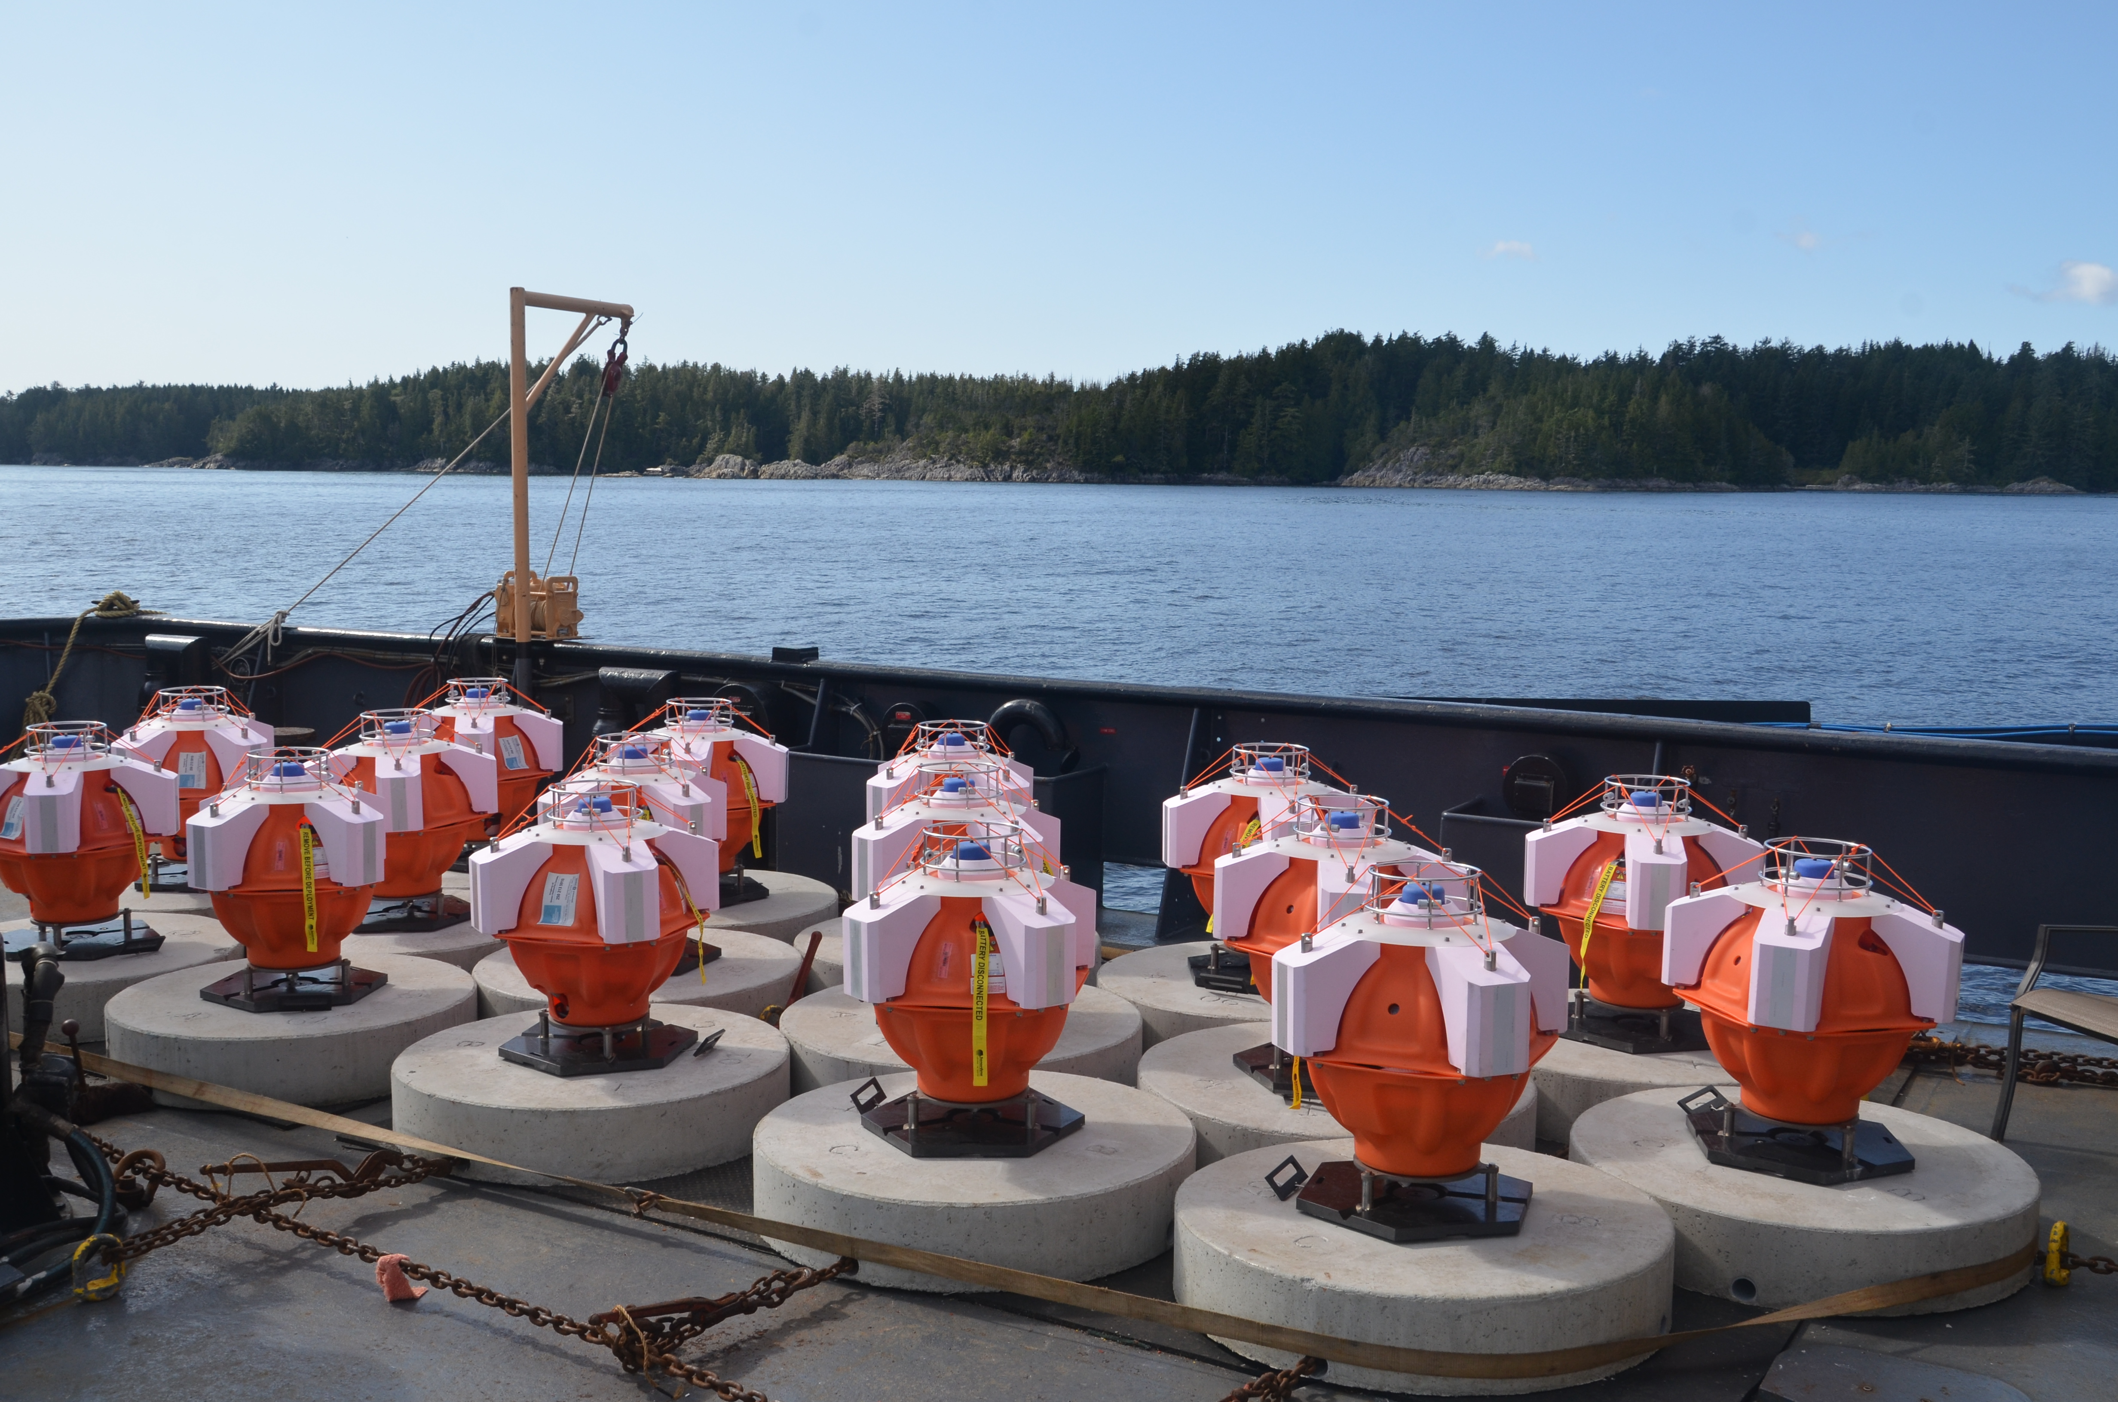
Aspirational GPS-A
Dave Chadwell’s concept from 2012
Picture from Martin Heesemann

Slide 10
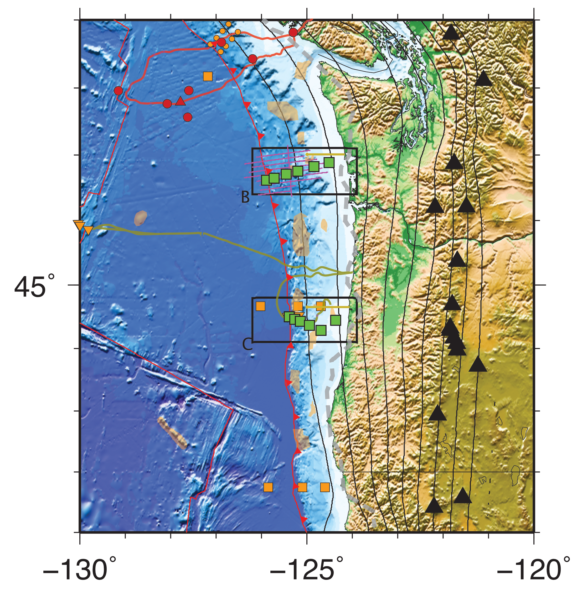
Aspirational Pressure Geodesy
Slow Slip Off Oregon
M_{W} 6.4
M_{W} 5.9
WA Secular Strain Profile
M_{W} 6.4
Low Δσ
Fredrickson et al. (2019)

Slide 11
Seafloor Geodetic Techniques
GPS-A
Transponder
Horizontal Deformation
  GPS-Acoustic
  Fiber optical strain
  Acoustic ranging & mesh networks
Vertical Deformation
  Pressure (APG, ASCPR, A-0-A)
  Gravity
  Tilt
  Differential bathymetry (Ship/AUV)
Formation strain
  Borehole instruments (i.e. CORKS)
  Fluid flow
WaveGlider
ASCPR
Slide courtesy of David Schmidt

Slide 12
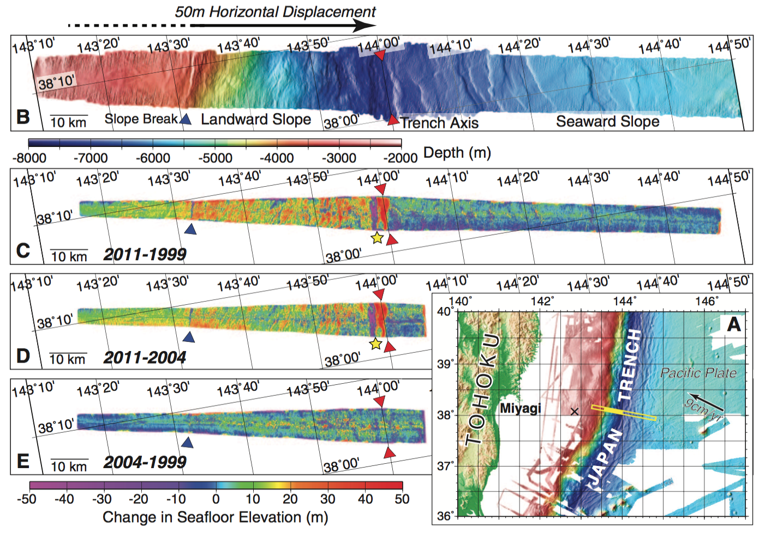
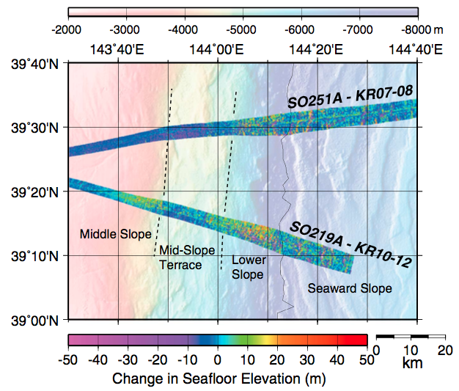
Bathymetric Differencing: the Tohoku-Oki 2011 Earthquake
Miyagi
Sanriku
Horizontal multibeam resolution: ~250 m
Horizontal displacement: 50 ± 20 m
Horizontal displacement: 4-56 m, depending on location, uncertainty of 3-13 m
Slide courtesy of John DeSanto
Fujiwara et al. (2011, 2017)

Slide 13
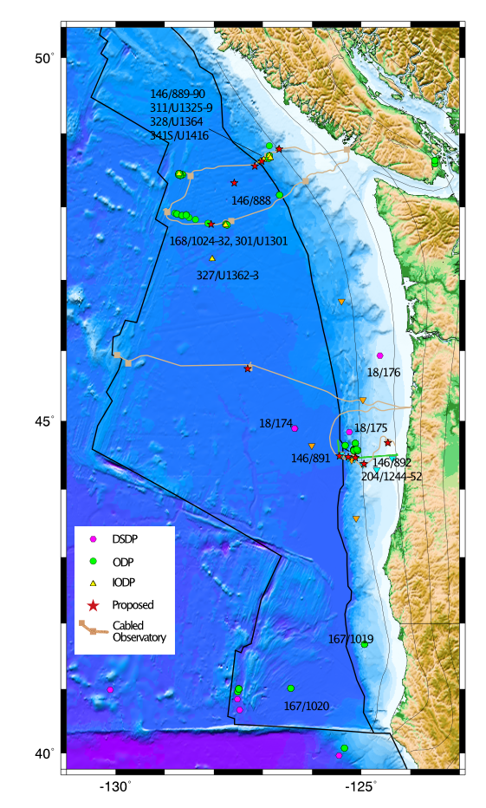
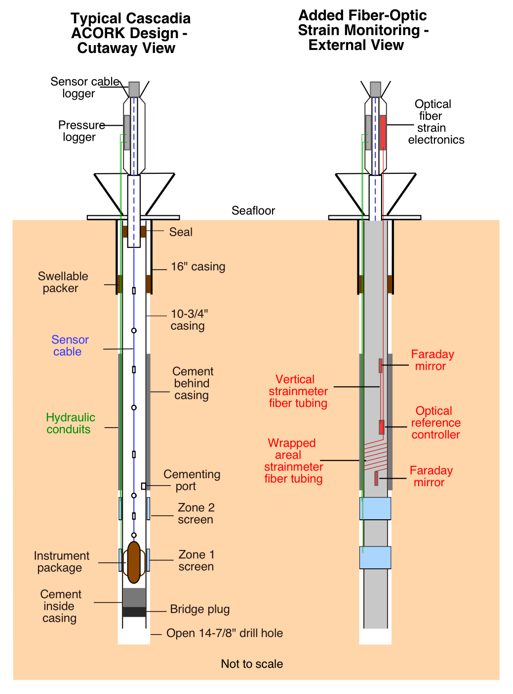
Newly Proposed Cabled Borehole Observatories in Cascadia
Tobin, Davis, Wilcock, Heesemann, and others, 2019

Slide 14
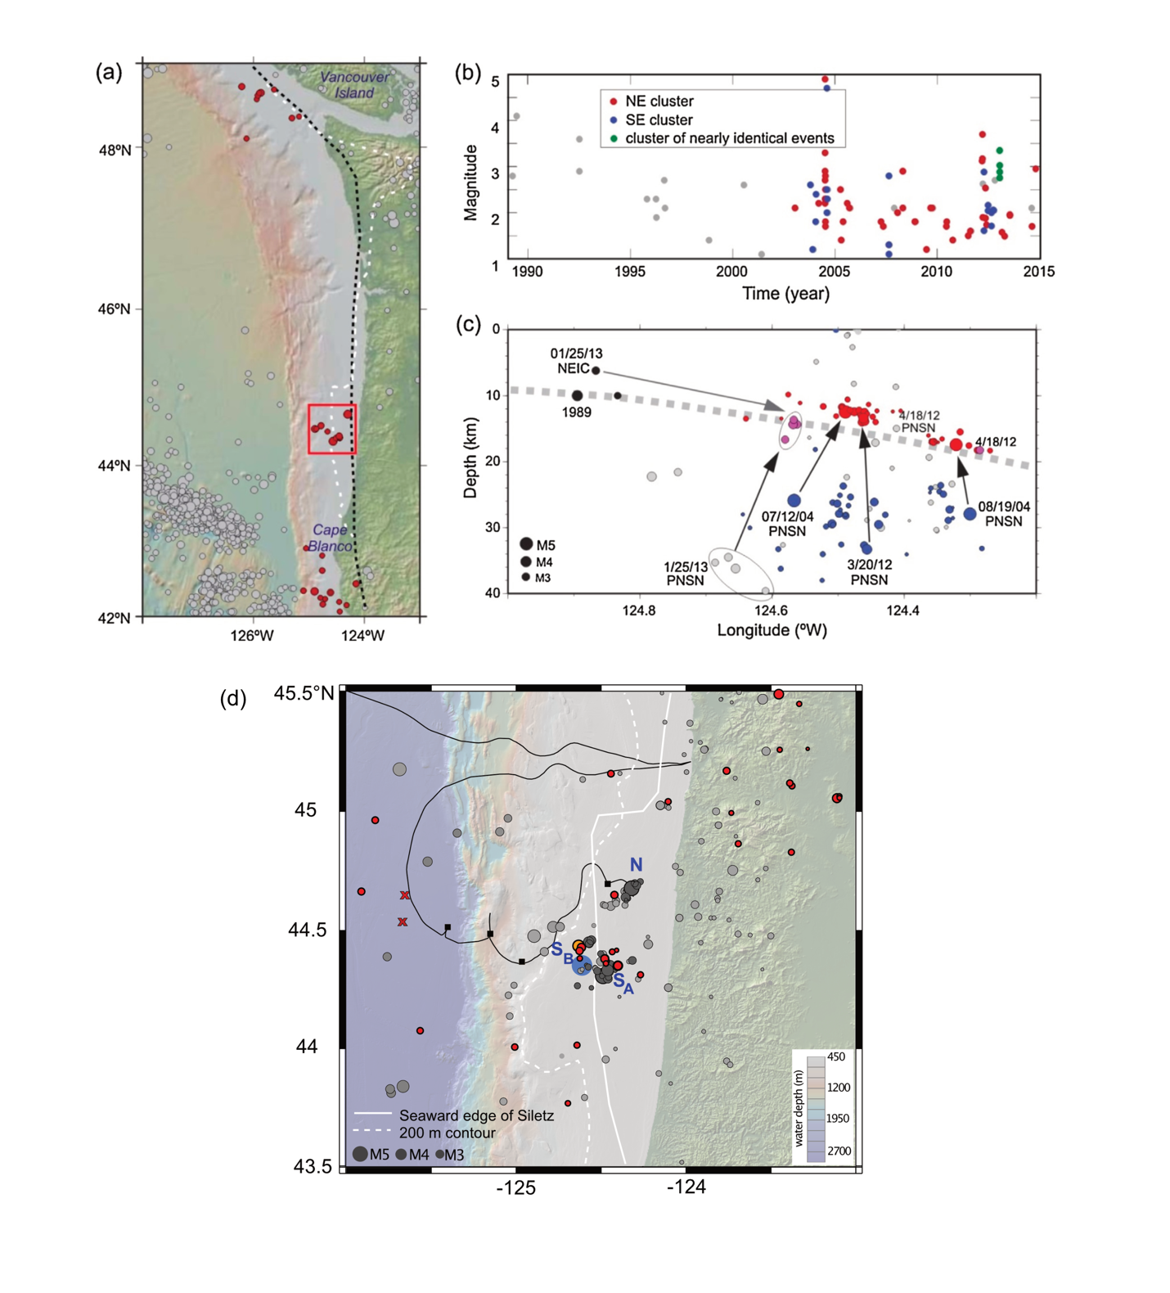
Utilize the OOI Cabled Array
OOI code near north cluster
Primary Proposed Drill Sites
Tréhu et al. (2018)

Slide 15
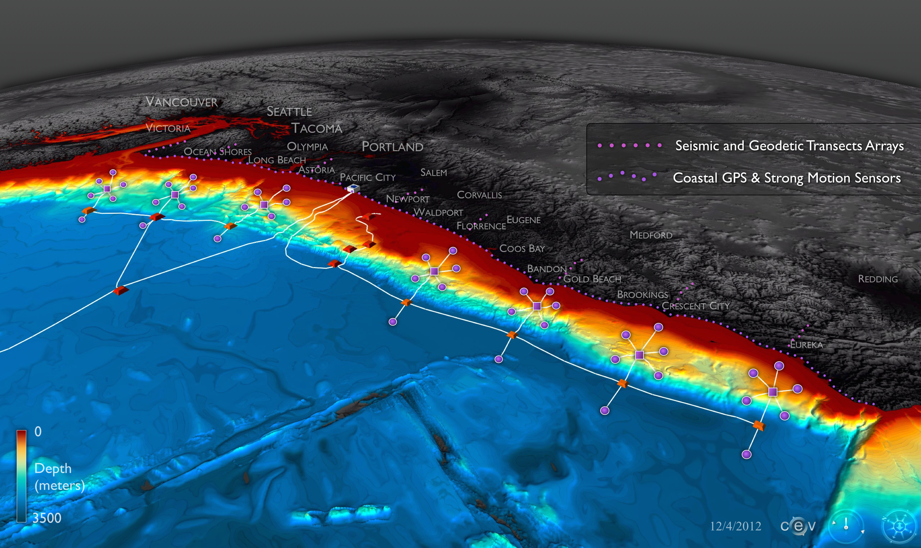
Early Warning (and Hazards Science) Offshore Cascadia
White Paper: http://www.cascadiaoffshore.org

