Slide 1
Applications of Borehole Strain data to Pacific Northwest Earthquake Research
Aseismic slip: Evelyn Roeloffs
EEW: Noha Farghal, Andy Barbour, John Langbein

Slide 2
Constraining relation of tremor and aseismic slip with strainmeter time series
Tremor data from pnsn.org, GPS strain data from UNAVCO

Slide 3
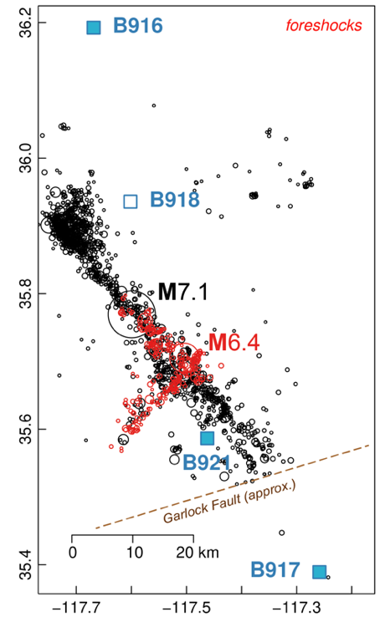
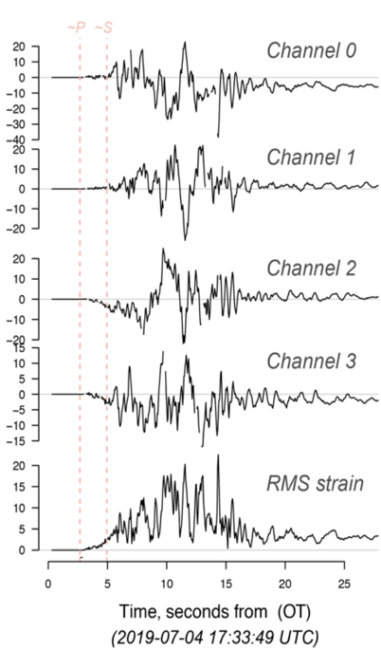
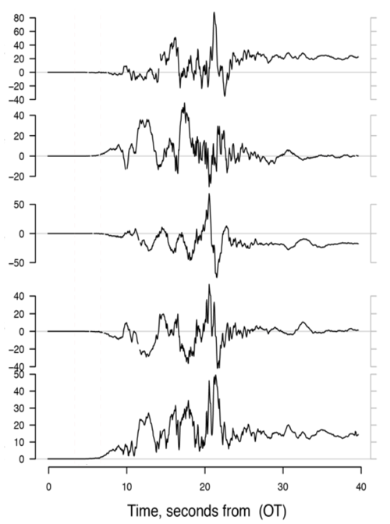
Strainmeter data for EEW applications: work by Noha Farghal, Andy Barbour, John Langbein
Near-source Broadband (0 – 20 Hz) Strain Recordings:
2019 Ridgecrest Sequence
M6.4 foreshock
M7.1 mainshock
Microstrain
Time, seconds from OT
Time, seconds from OT
Farghal, Barbour, Langbein, in prep
Notes:
High frequency strain records from station B921 during the M6.4 earthquake of July 4th, 2019 and the the M7.1 earthquake of July 6th, 2019. The map shows the earthquake sequence and locations of the closest strainmeters. They show the strains from each channel, and the RMS strain calculated from those records for the M6.4 foreshock and the M7.1 mainshock.

Slide 4
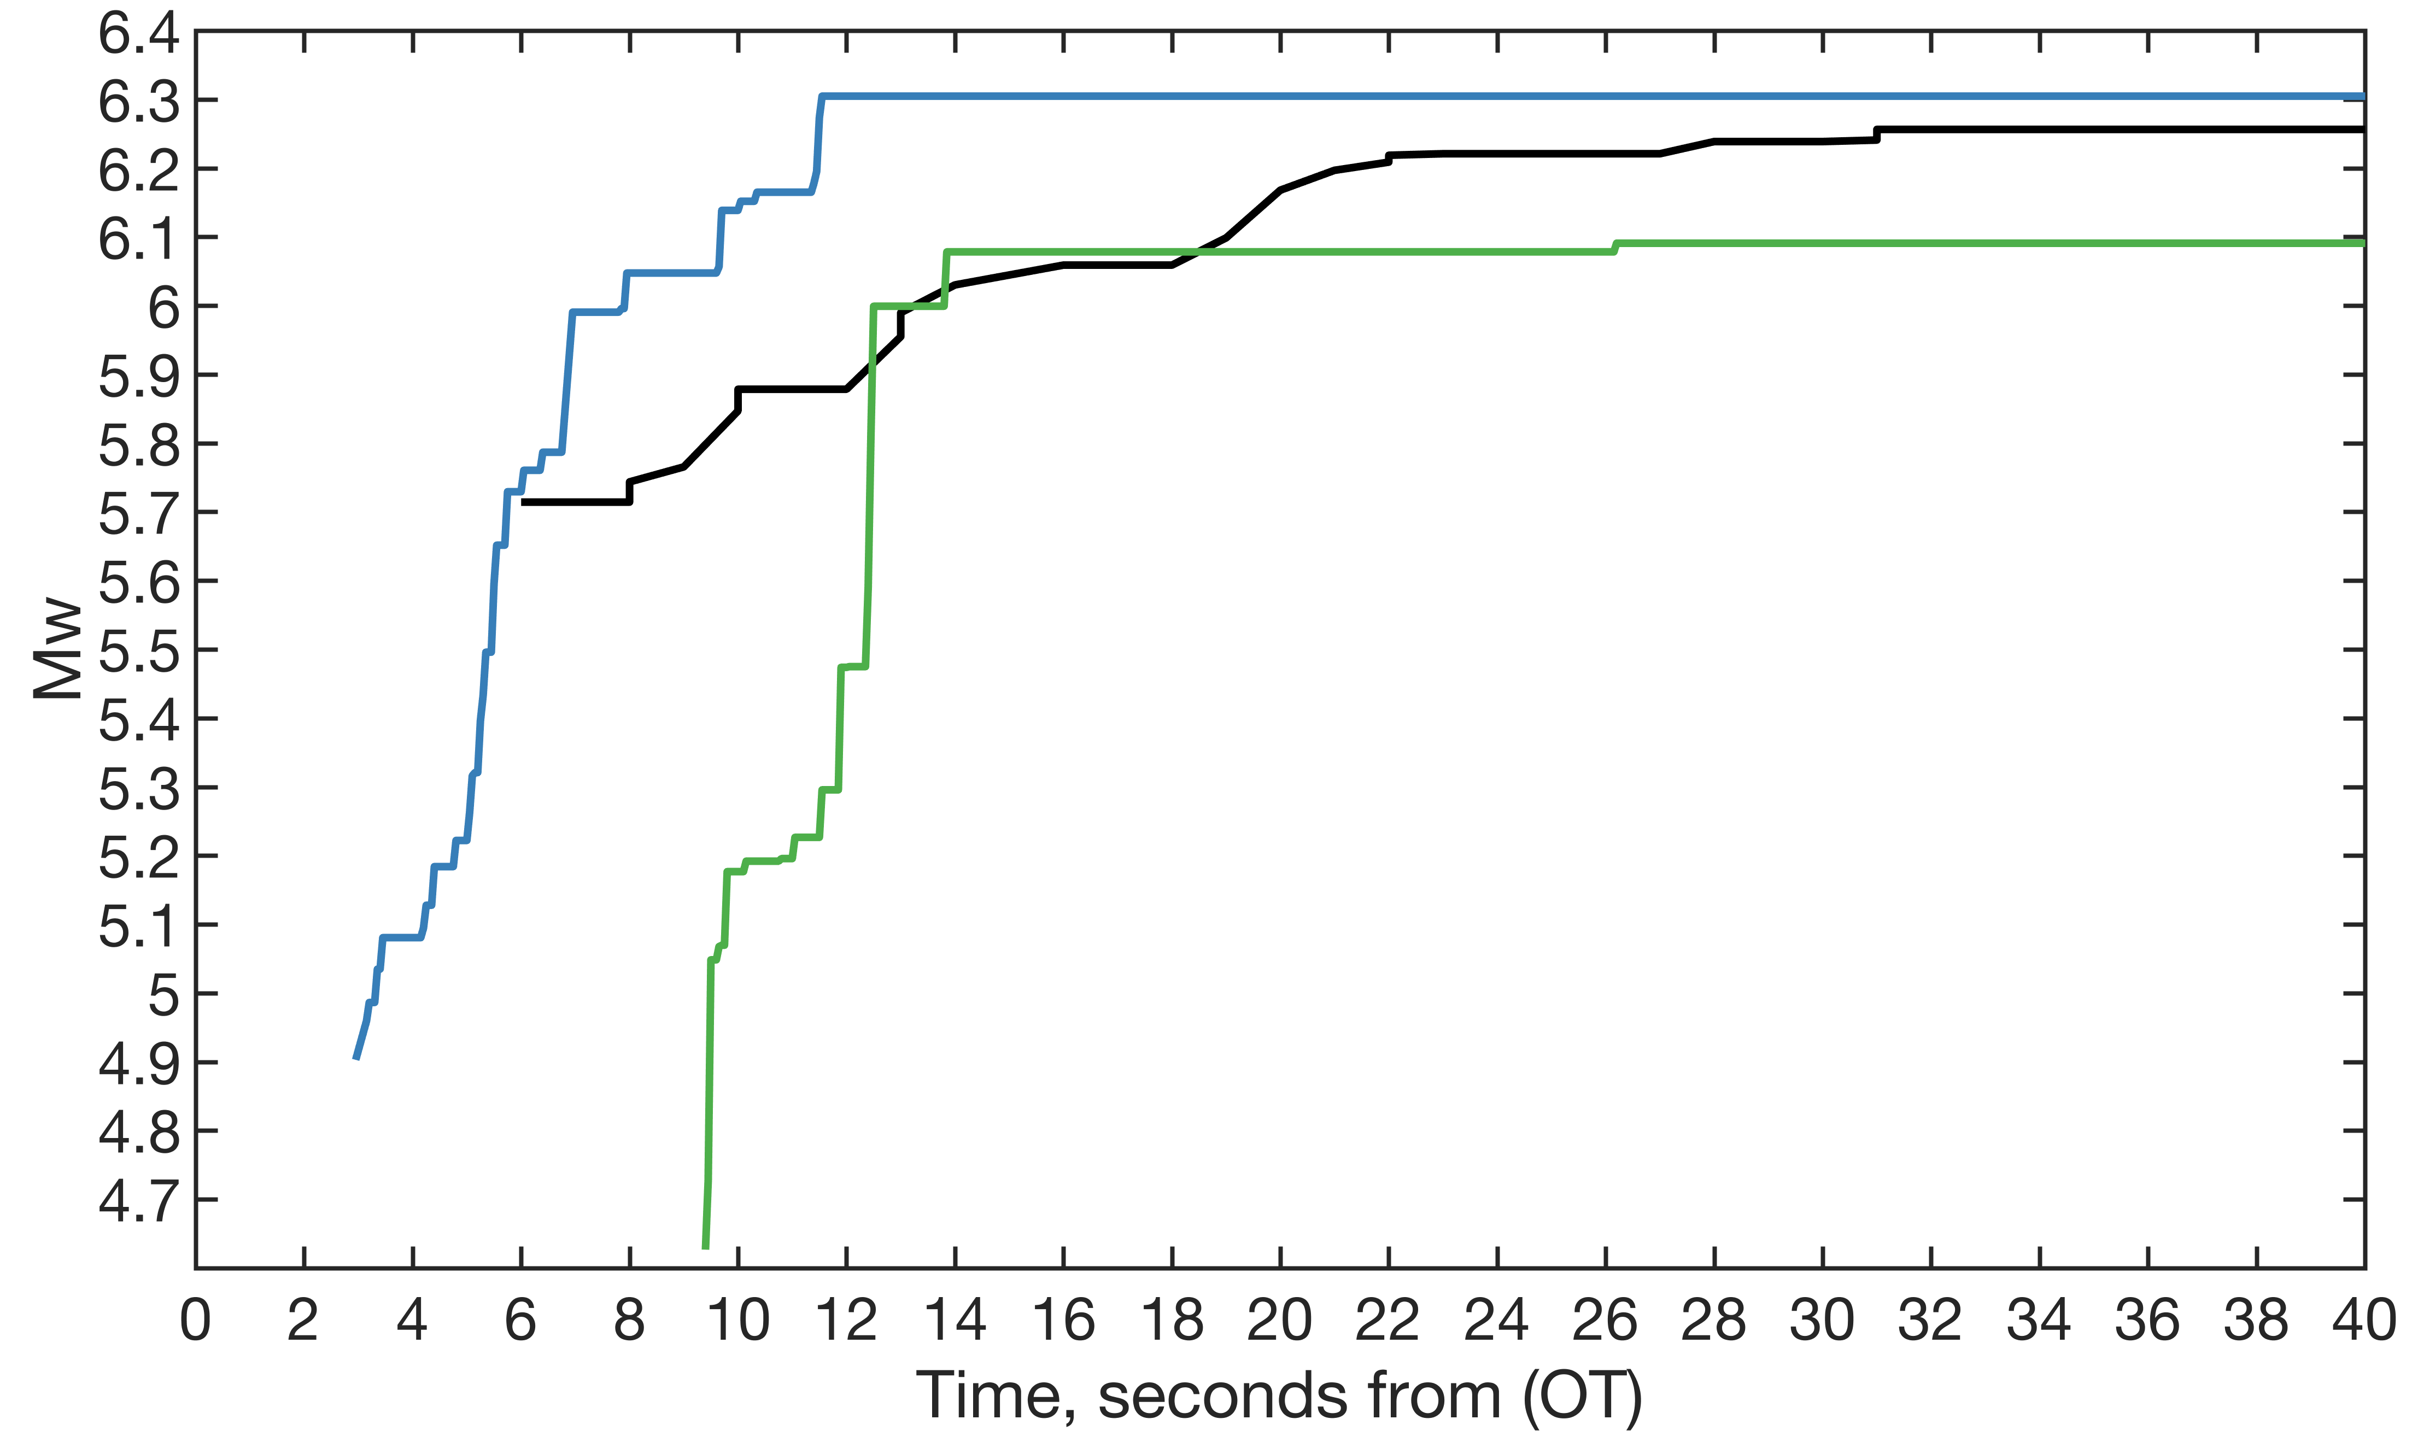
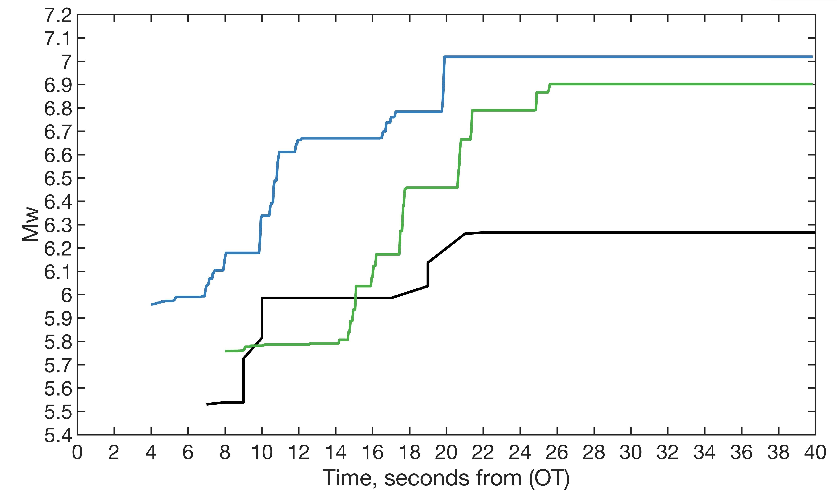
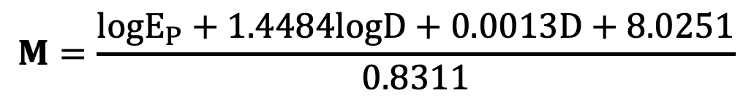
Strainmeter data for EEW applications: work by Noha Farghal, Andy Barbour, John Langbein
Testing Strain-based Magnitudes Against ShakeAlert Updates
Ridgecrest M6.4 foreshock
Station B921 (17.4 km)
Station B917 (41.5 km)
ShakeAlert
Ridgecrest M7.1 mainshock
Station B921 (25 km)
Station B917 (51.5 km)
ShakeAlert
$$M=\frac{logE_{P}+1.4484logD+0.0013D+8.0251}{0.8311}$$
Farghal, Barbour, Langbein, in prep
Notes:
Left: They used 4445 records of strain for earthquakes with magnitudes >= 3.5 and hypocentral distances smaller than 500 km to find an empirical relation between moment magnitudes , peak dynamic RMS strains recorded by GTSM, dilatometers, and SES, as in the equation below, and hypocentral distance.
Right: Comparison of strain-derived magnitudes for the Ridgecrest M6.4 foreshock of July 4th, 2019, and the M7.1 mainshock of July 6th, 2019. The colored curves show the results of applying this Equation to the strain output from PBO stations, B921 (blue line) and B917 (green line), compared to the magnitude (alert) update issued by the ShakeAlert (black line). The magnitude updates from the strainmeters at stations B921 and B917 for the M7.1 earthquake in the same sequence were significantly closer to the earthquake’s final magnitude than that reported by ShakeAlert. The final magnitude of the earthquake reported by ShakeAlert was M6.3, while that reported by the two PBO stations B921 and B917 were M7.0 and M6.9, respectively. Even if we account for data latency by delaying the strain-based magnitude estimates by a second or two, the potential for the ShakeAlert system to query strainmeter data for timely magnitude estimates still holds.

