Slide 1
Visualization on Shaky Ground?
How to Display an Aftershock Forecast
Max Schneider
Department of Statistics
University of Washington

Slide 2
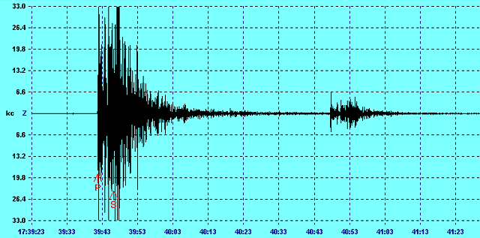
http://www.geocities.ws/CapeCanaveral/Hangar/7195/index4.html

Slide 3
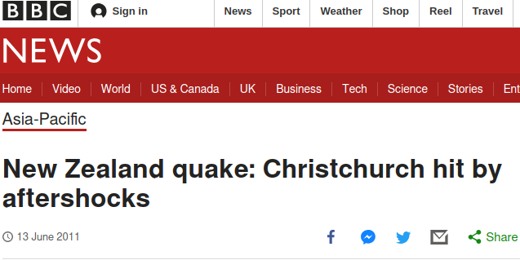
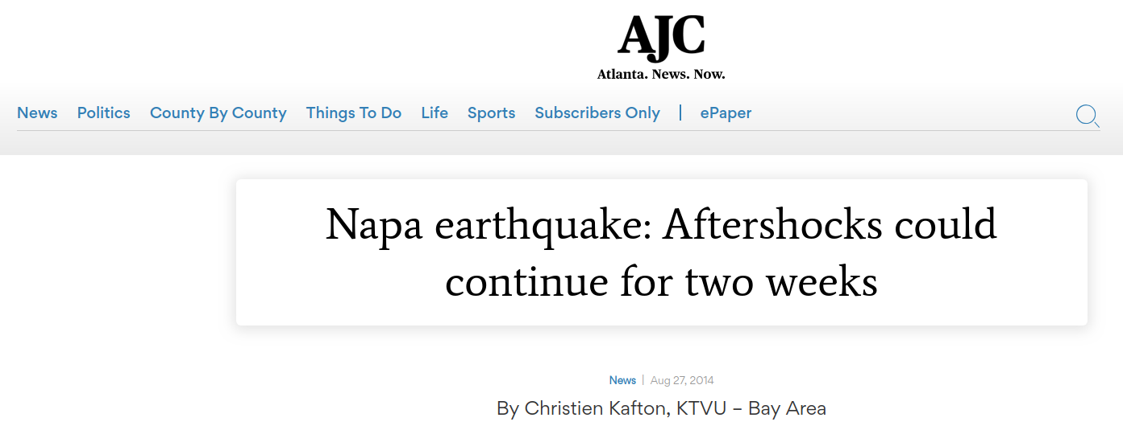
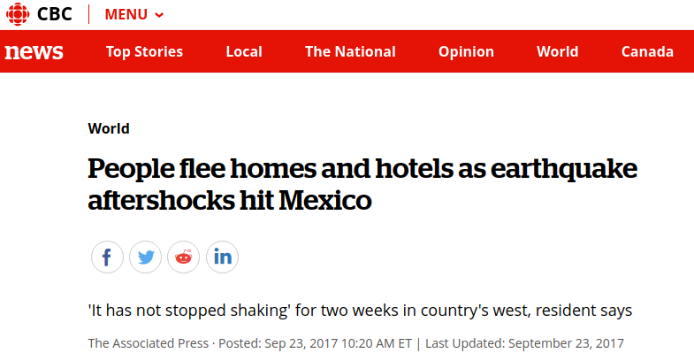
https://www.amazon.co.uk

Slide 4
“Perhaps the most unanimous agreement ... pertained to the utility of receiving estimates of the probability of aftershocks. Emergency managers all stated that
even if uncertain, probabilities would be useful for prioritizing and scheduling recovery activities.”

Slide 5
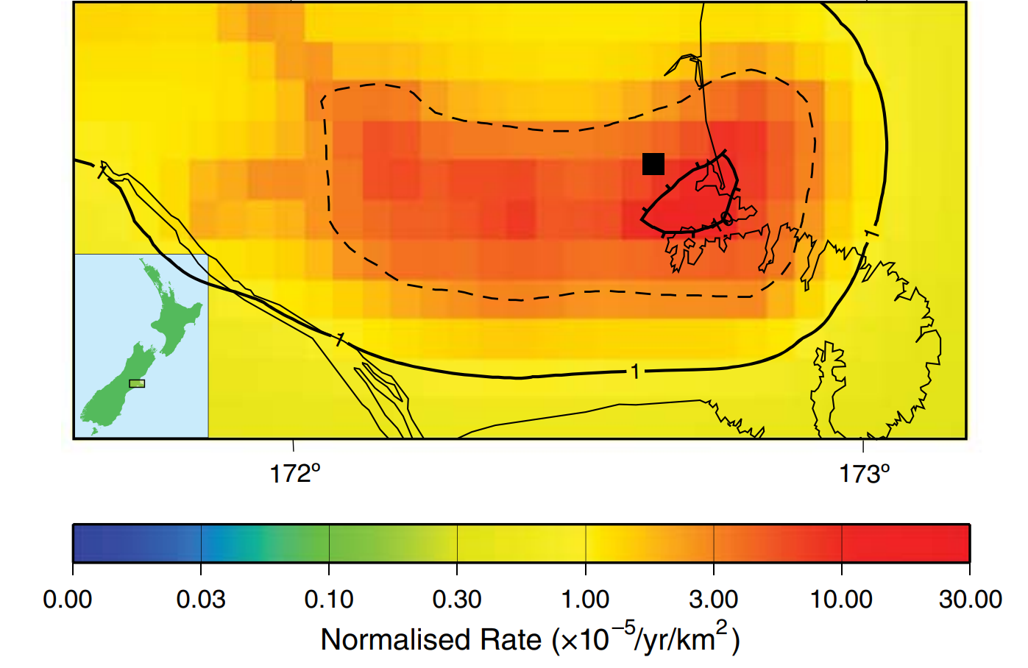

Slide 6
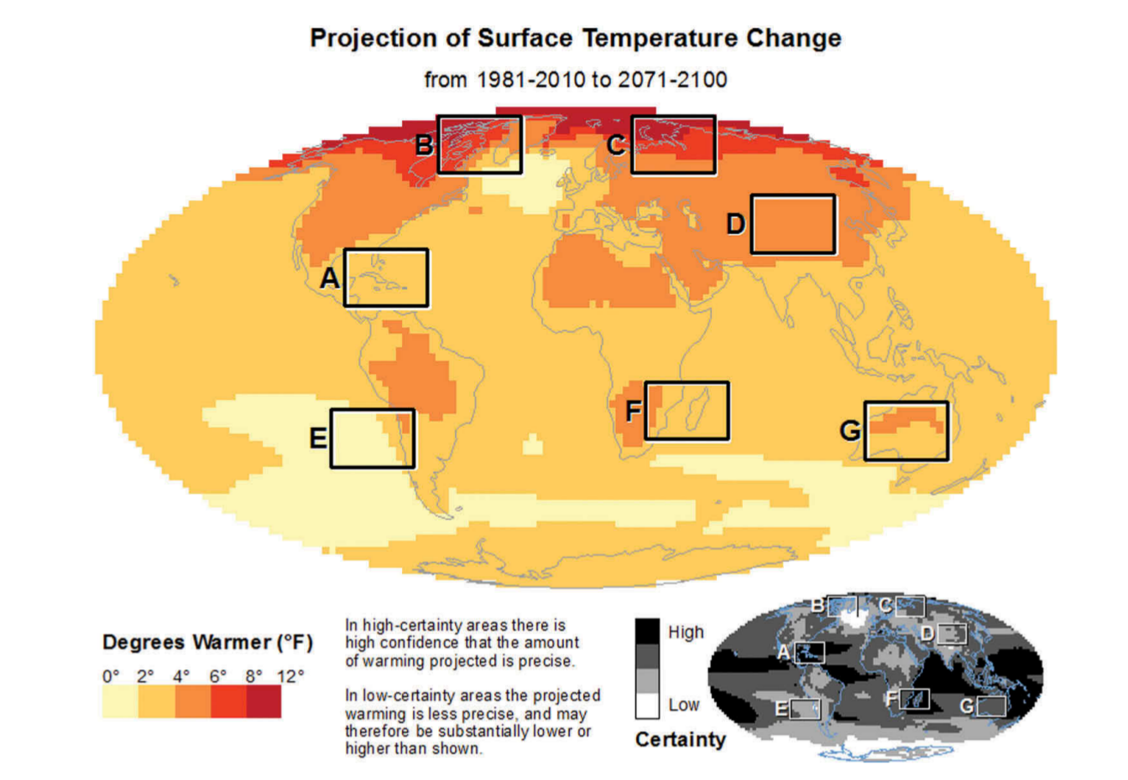
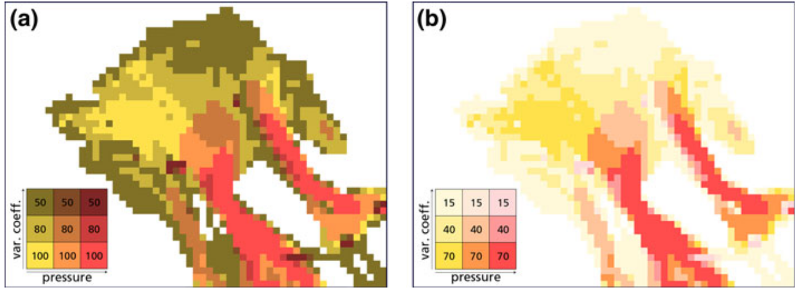
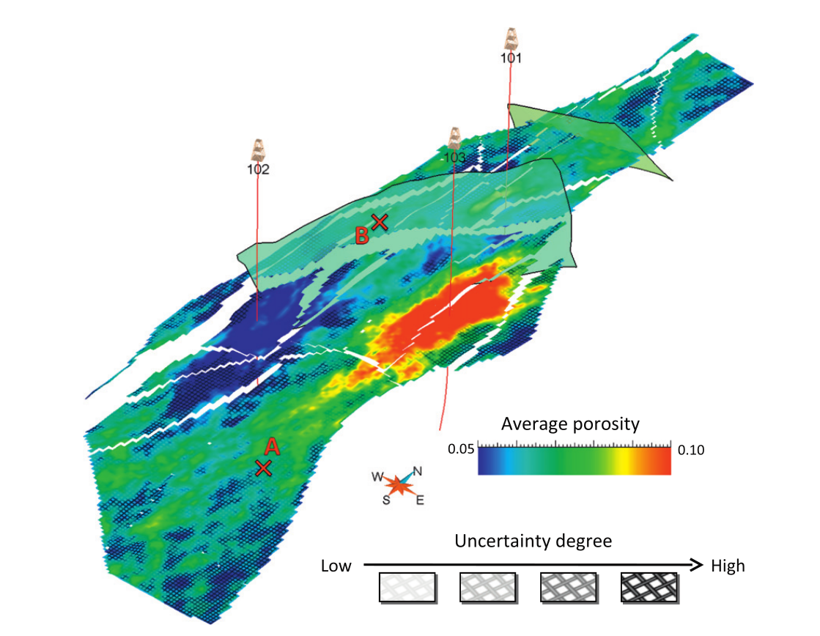
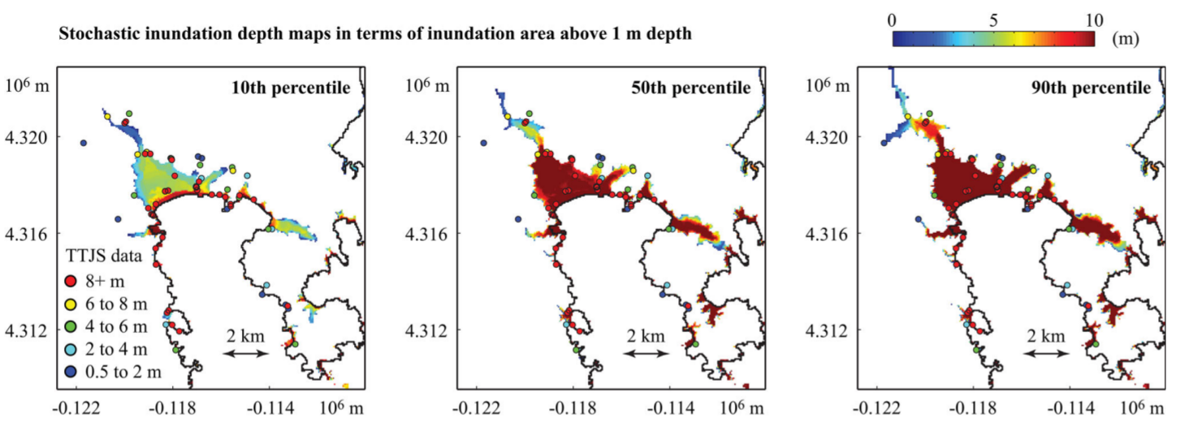
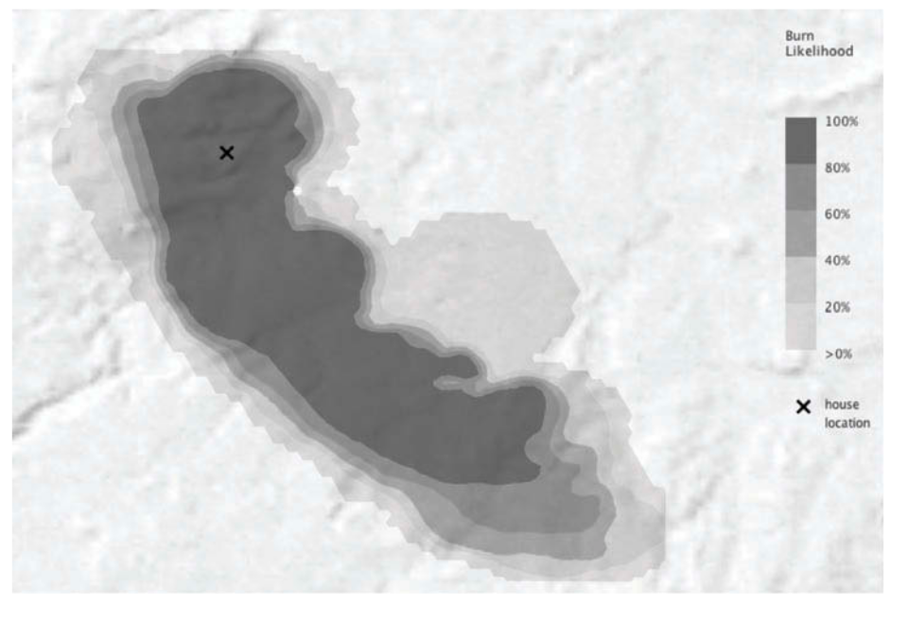
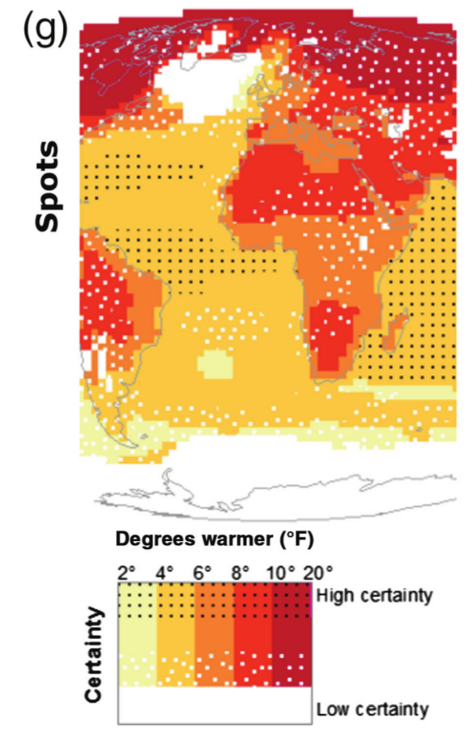
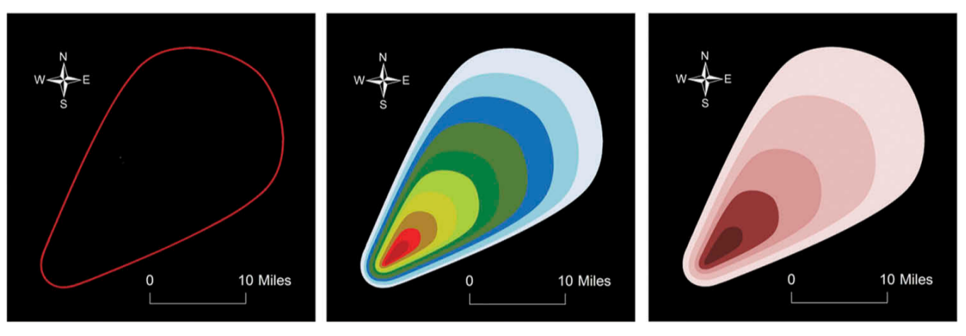

Slide 7
https://www.instacart.com/kroger/products/154487-kroger-one-size-fits-all-vinyl-gloves-50

Slide 8
https://observatorio.cisde.es/tag/captain-douglas-j-ten-hoopen/
https://about.me/maximiliandixon
https://twitter.com/jdschelling
https://www.heraldnet.com/news/county-leader-served-at-tomb-of-the-unknown-soldier/

Slide 11
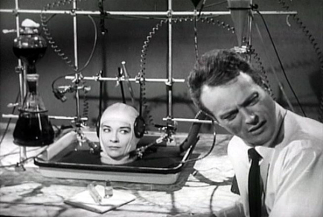
http://guerre-bacteriologique.over-blog.fr/pages/A_human_subjects_and_experiments-9015437.html

Slide 12
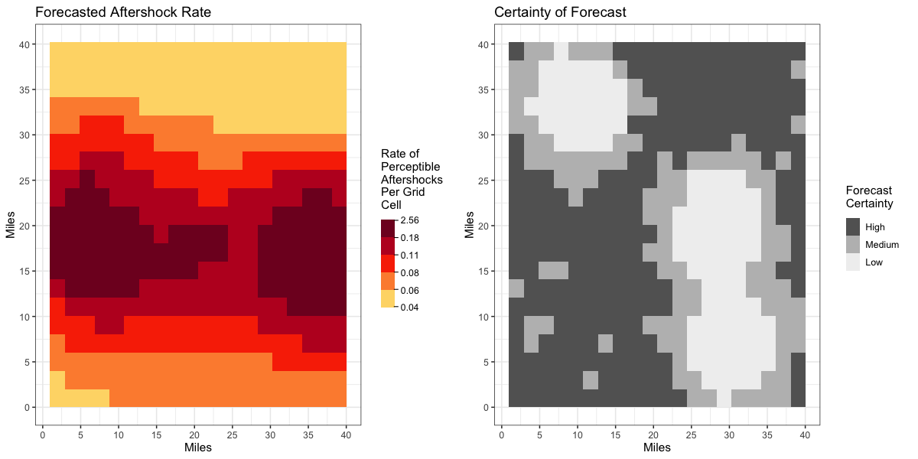
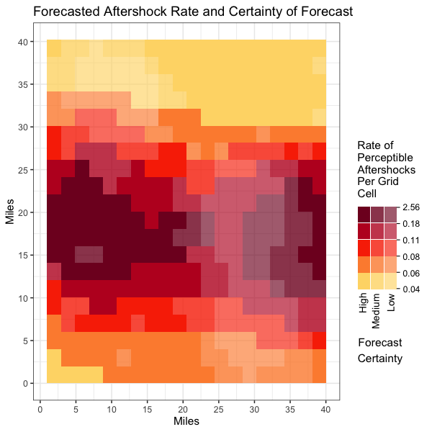
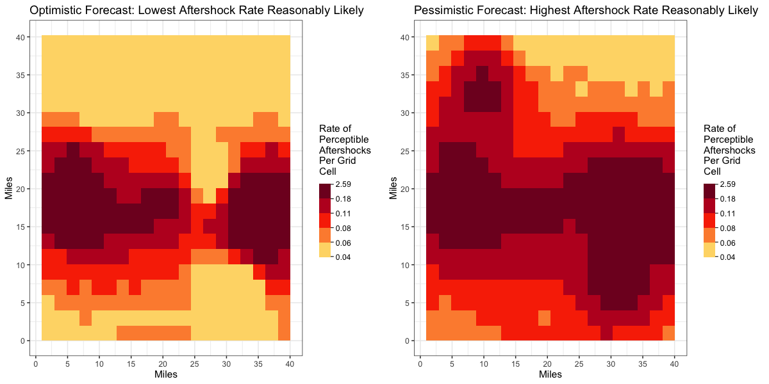
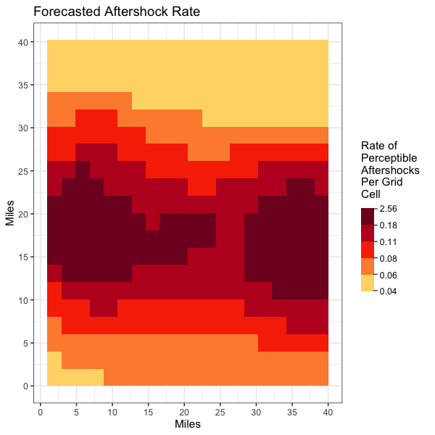
vs.

Slide 13
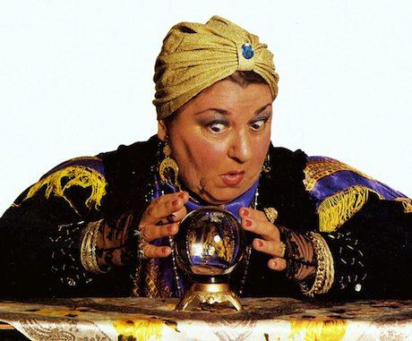
Effective Uncertainty Visualization does:
https://tvtropes.org/pmwiki/pmwiki.php/Main/SuperSpeedReading
https://www.am1st.com/tricks-of-the-forecasting-trade/fortune-teller-1/
http://www.ifairer.com/articles/how-to-clear-english-reading-comprehension-easily-1-8559-IFR.html
https://stylesage.co/blog/when-predictions-wont-cut-it-preparedness-will/

Slide 14
Map Reading Tasks
1. Read off variables.
Give the forecast/ certainty level for a marked location.
2. Read between variables.
Click on a location that has particular forecast/ certainty level.
vs.

Slide 15
Prediction Task
3. Comparative prediction.
Consider two marked areas: which do you predict will have more aftershocks?
vs.

Slide 16
Questions? Suggestions?
Let’s chat.
maxs15@uw.edu

