Slide 1
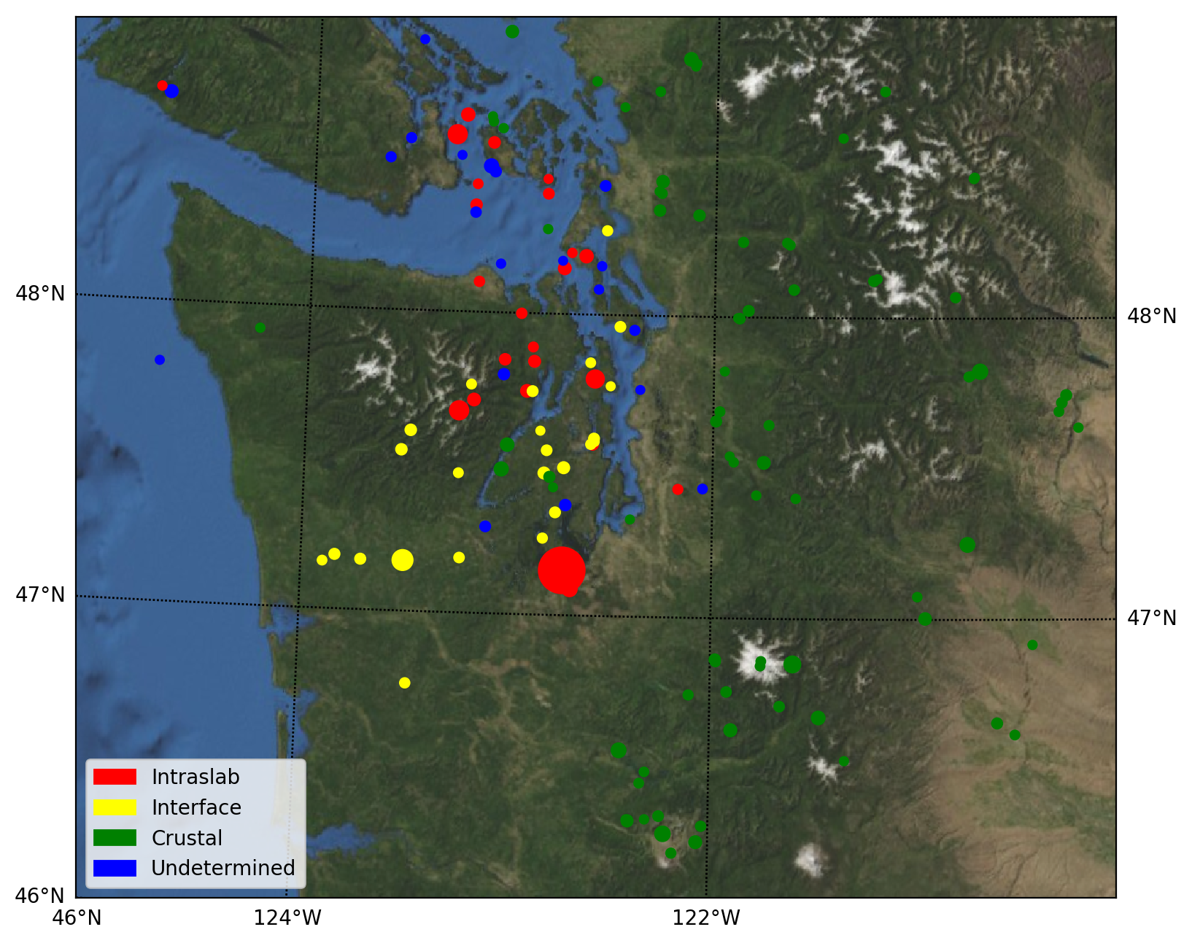
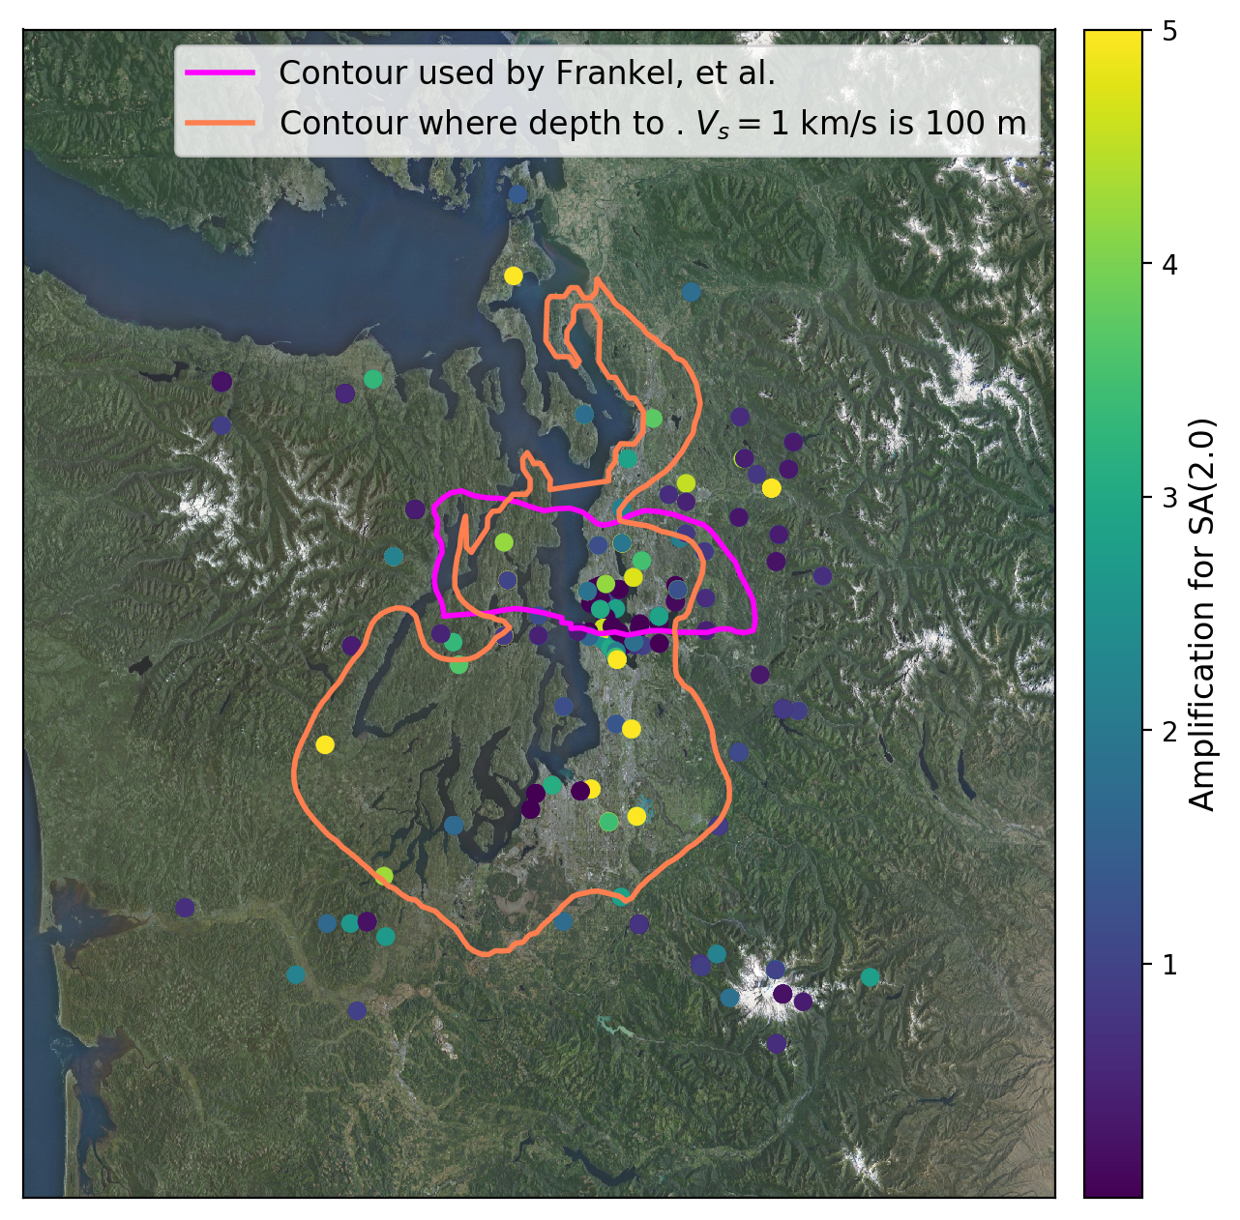
Regional ground-motion amplification effects in the Pacific NW
Morgan Moschetti collaborators: John Rekoske, Eric Thompson, …
U.S. Geological Survey, Golden, Colorado
Pacific Northwest Earthquake Science Workshop, Nov. 5, 2019

Slide 2
Source- and path-dependent amplification
(Bowden and Tsai, 2017)
(Frankel et al., 2009)
(Wirth et al., 2019)
(Denolle et al., 2014)

Slide 3
Regional ground motion amplification,
Cook Inlet region, Alaska

Slide 4
Average effects, Cook Inlet region, Alaska
T=0.3 s
T=3.0 s
Comparison of basin-scaling—ground-motion amplification as a function of sediment thickness
Regional amplification patterns—sites that, on average, experience higher/lower ground motions

Slide 5
Source-dependent analysis, Cook Inlet, AK
Anchorage
Augustine
T=0.3 s
Denali
Anchorage
T=3.0 s
Augustine

Slide 6
Source-dependent analysis, Cook Inlet, AK
Anchorage
Augustine
T=0.3 s
Denali
(Wirth et al., 2019)
Anchorage
T=3.0 s
Augustine

Slide 7
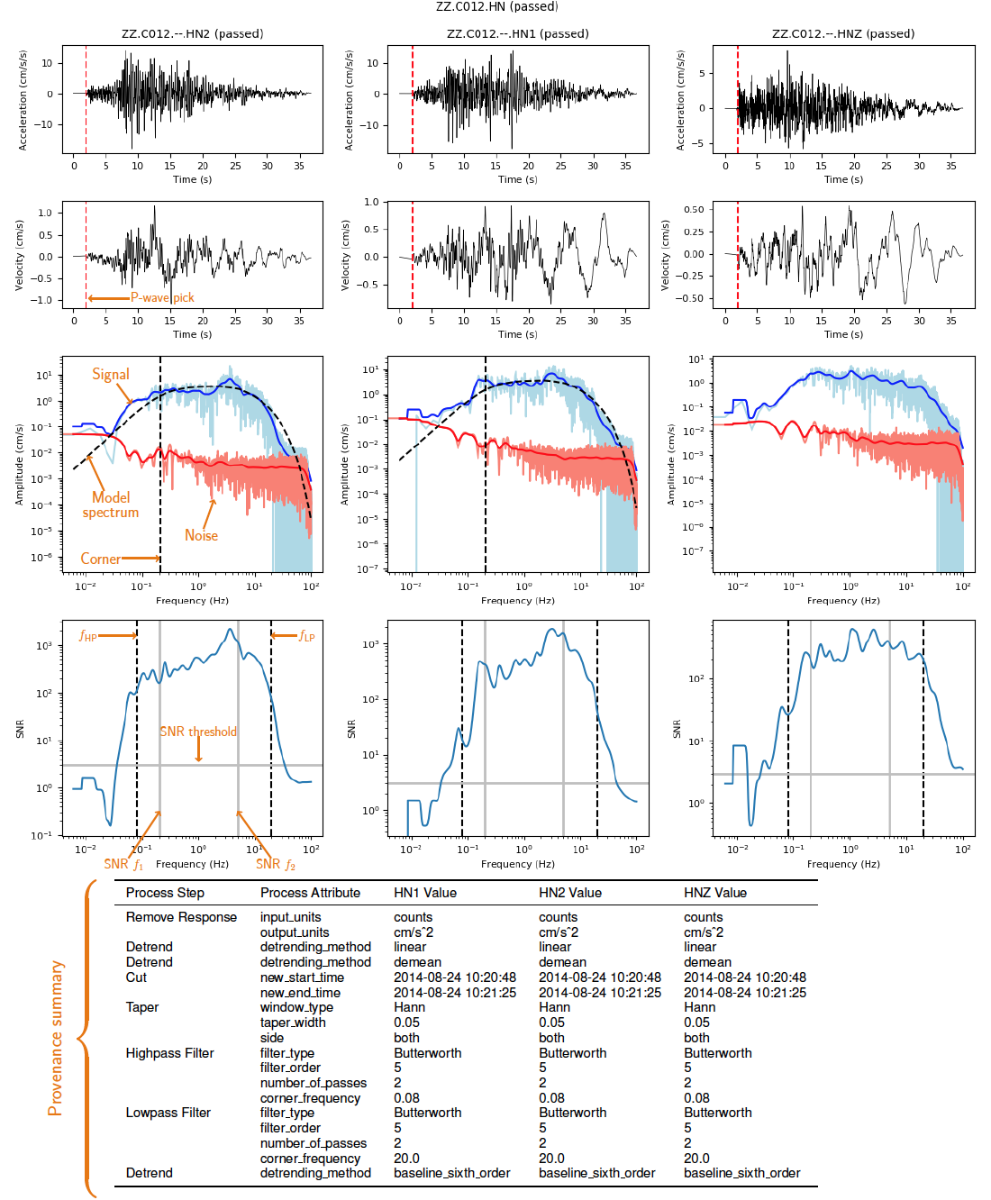
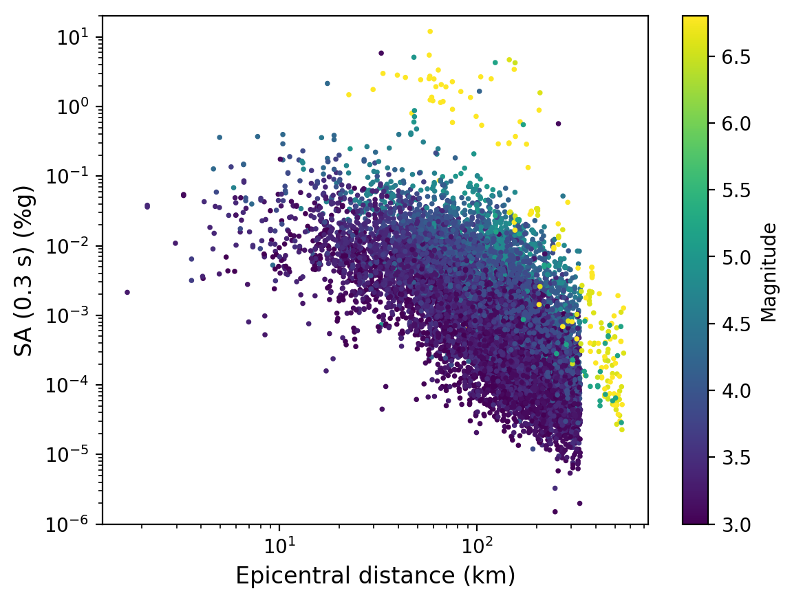

Application to Pacific NW

