Slide 1
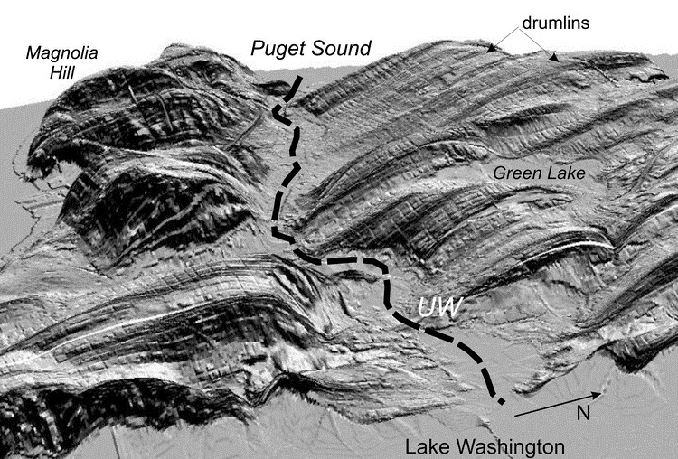


Topographic response to ground motion from modeled Seattle Fault earthquakes
Presented by: Ian Stone (UW)
Additional Contributors: Erin Wirth & Arthur Frankel (USGS), John Vidale (USC/SCEC)
PNW Earthquake Science Workshop
Nov. 5th, 2019
Picture Source: Troost and Booth, 2008
Notes:
Hello there, my name is Ian Stone, and I am a graduate student at the University of Washington. Today I am going to share some preliminary results from work modeling the effects of topography on site response in the city of Seattle, in Washington State. This work was done with contributions from Erin Wirth, John Vidale, and Art Frankel.

Slide 2
Background
Topography can significantly amplify earthquake ground motion under special conditions
  Amplification arises from shape focusing and/or structural resonance
However, topographic amplification is difficult to predict
  Dependent on source location, topography shape, seismic wave frequency, etc.
With larger, more advanced computing resources, it is becoming easier to model topographic effects at scale
Notes:
Topography is known to have significant effect on site response under special circumstances. A combination of shape focusing and structural resonance can cause ground motion to increase significantly at the top of a mountain or ridge in certain locations. However, the effects of topography are not typically considered during most seismic hazard analysis. This is because the effect is so variable and localized, not to mention it often manifests at higher frequency ranges, making it difficult to predict without significant computing resources. As computing resources improve, though, it becomes more feasible to run high resolution ground motion simulations, and incorporating topography into seismic hazard analysis is becoming a more reasonable option.

Slide 3
Research Motivation
Are we likely to see topographic amplification in Seattle?

Slide 4
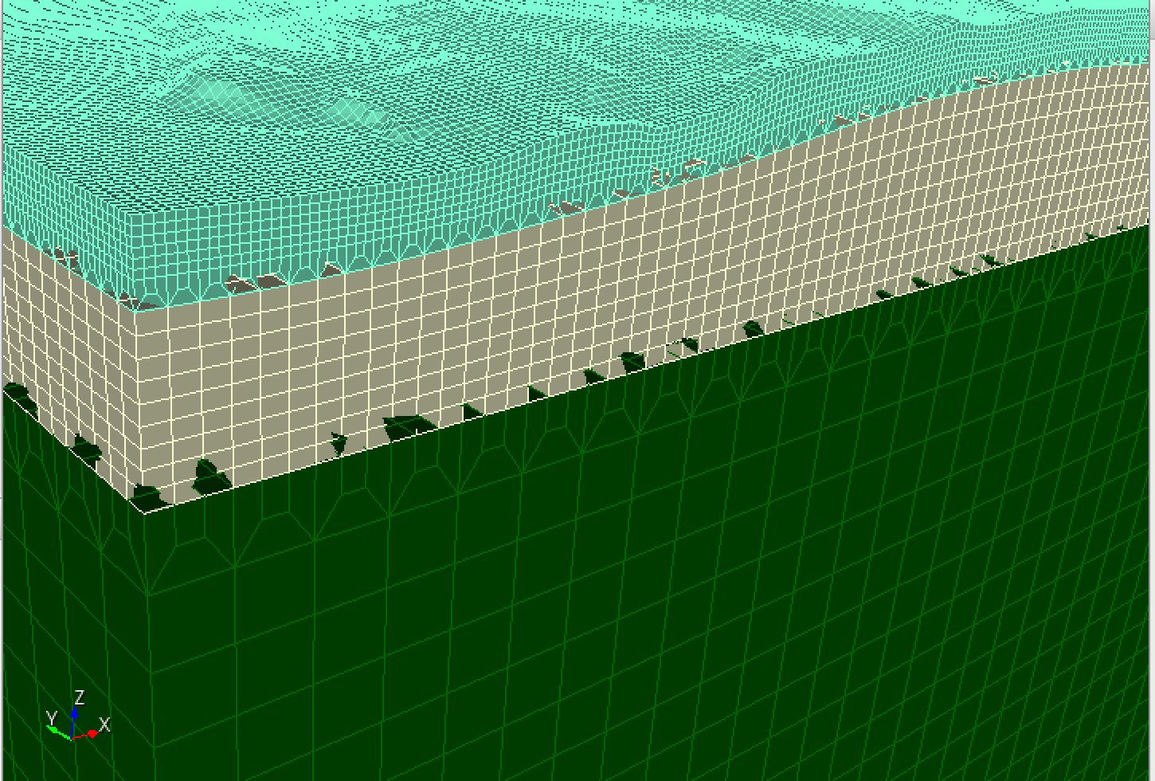
Mesh
Parameters:
Modeling with Specfem3D
Surface topography, bathymetry has 30m sampling
Mesh spacing decreases near the surface to accommodate lower velocities and topography
Accurate up to ~3Hz
0-200m: 33m mesh spacing
30m topo. sampling
200-1200m: 100m mesh spacing
1200-9000m: 300m mesh spacing

Slide 5
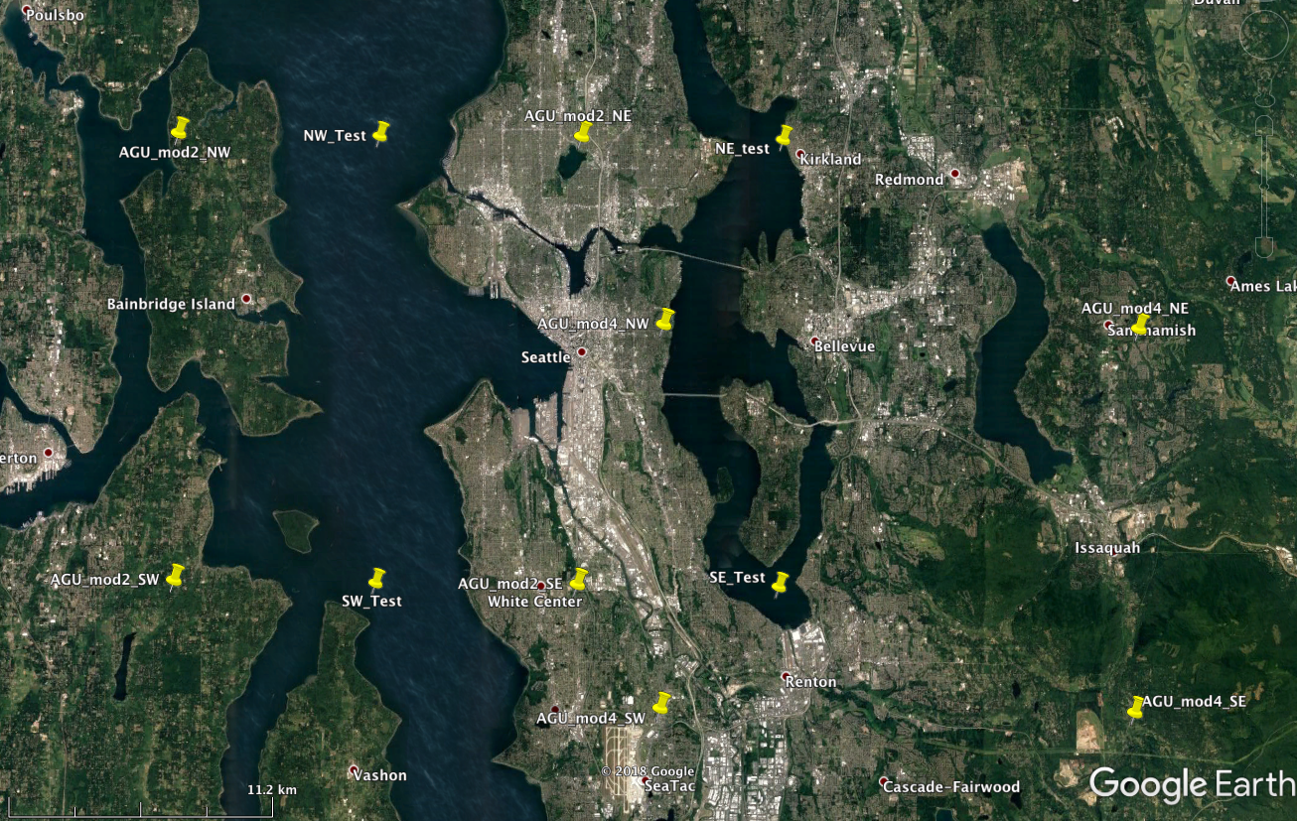
Subset Model Area
3 sources
M4.0 at 4km depth
Thrust fault dipping at 45° to the south
1
2
3
3D Velocity model used for each area
~10km

Slide 6
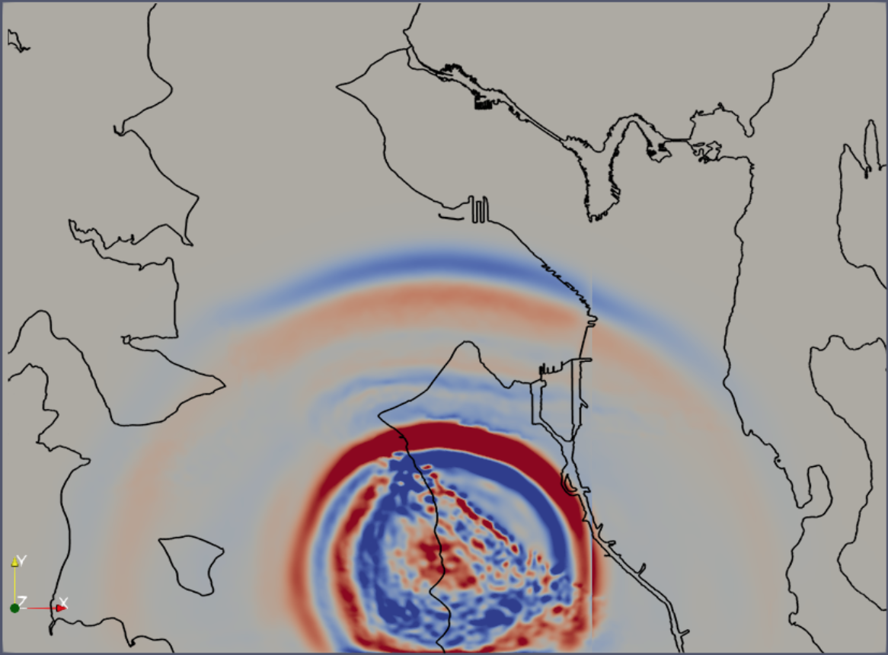
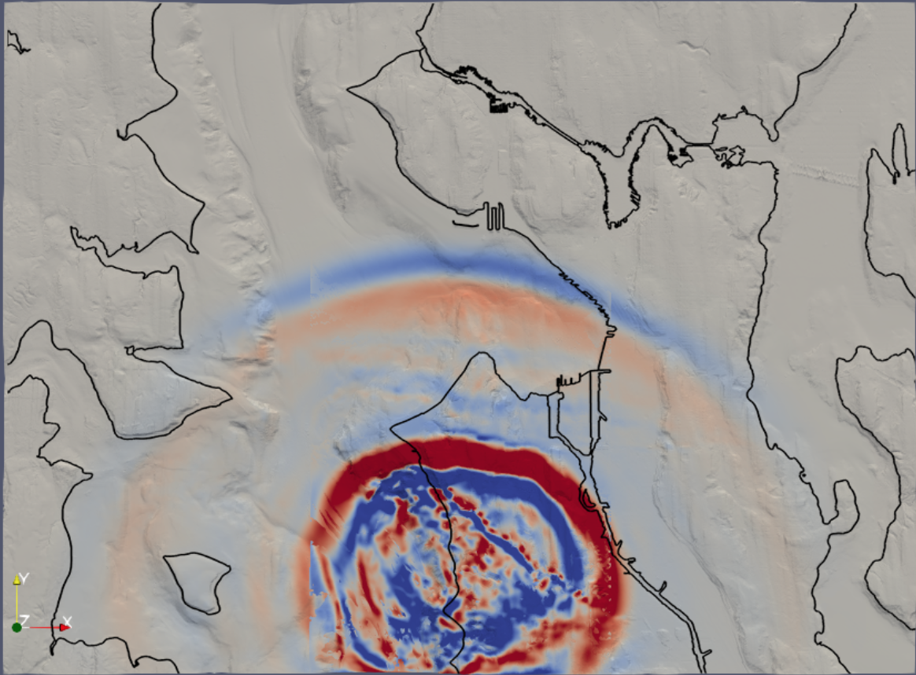
Results: Wavefield Snapshots, 3.85s
NON-TOPOGRAPHY
TOPOGRAPHY

Slide 7
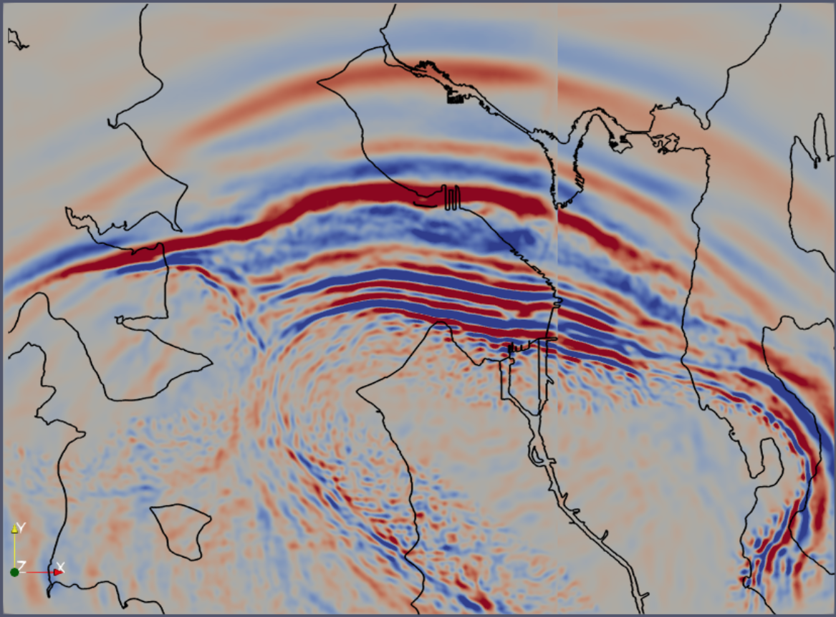
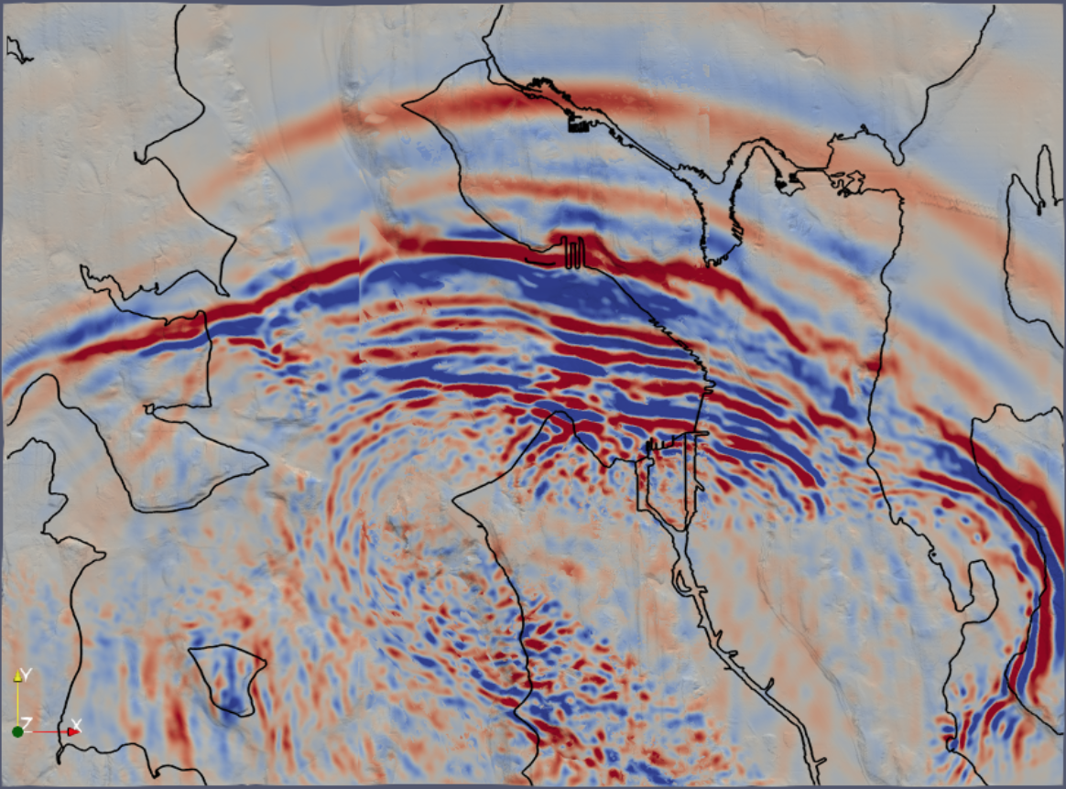
Results: Wavefield Snapshots, 8.58s
NON-TOPOGRAPHY
TOPOGRAPHY

Slide 8
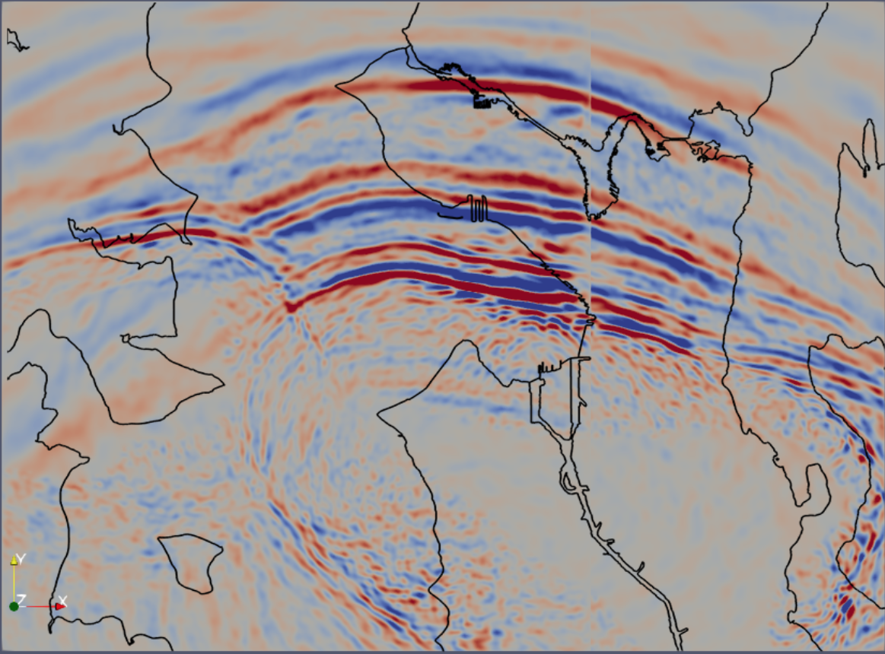
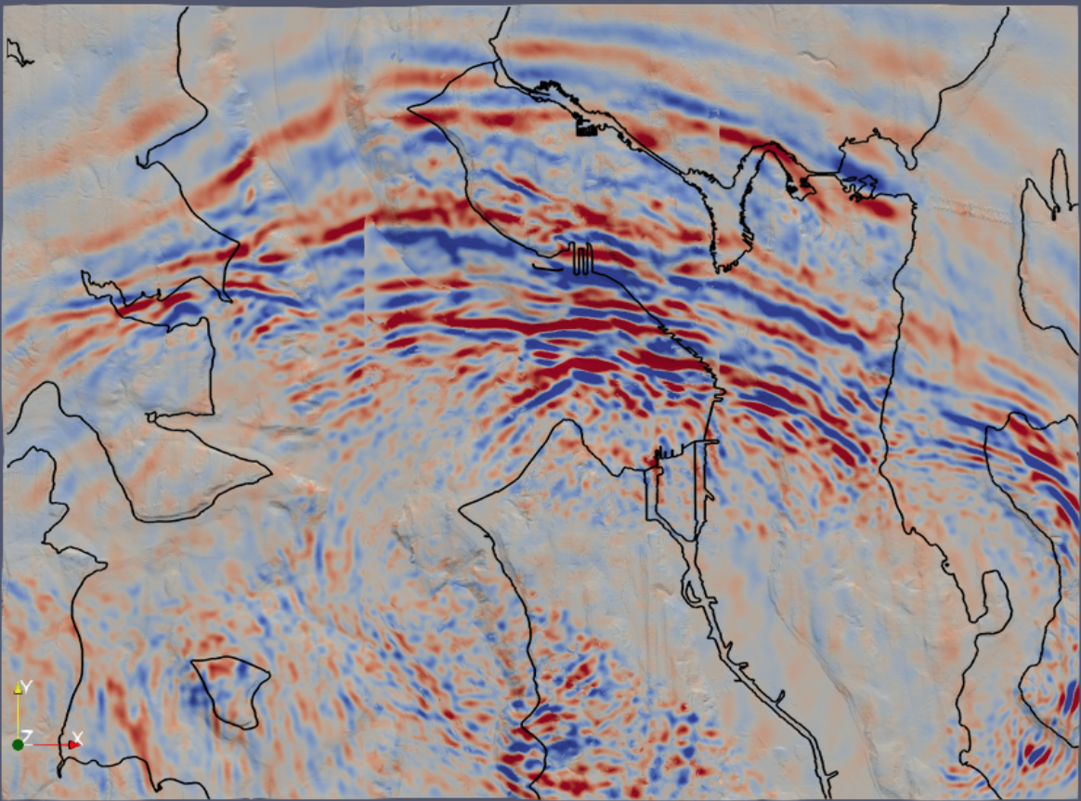
Results: Wavefield Snapshots, 10.85s
NON-TOPOGRAPHY
TOPOGRAPHY

Slide 9
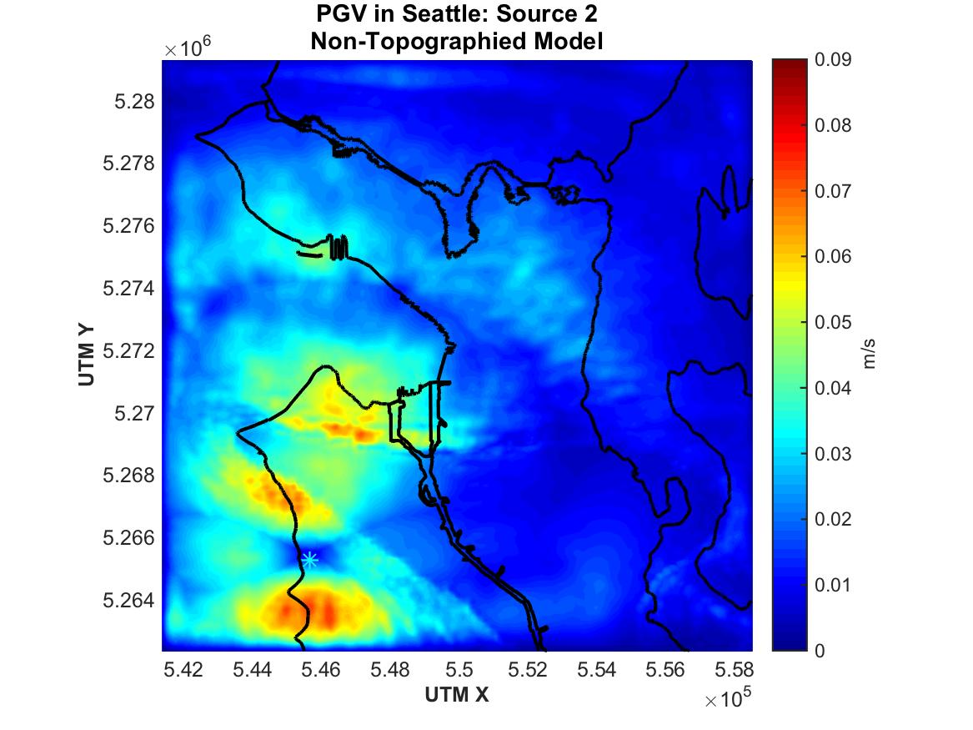
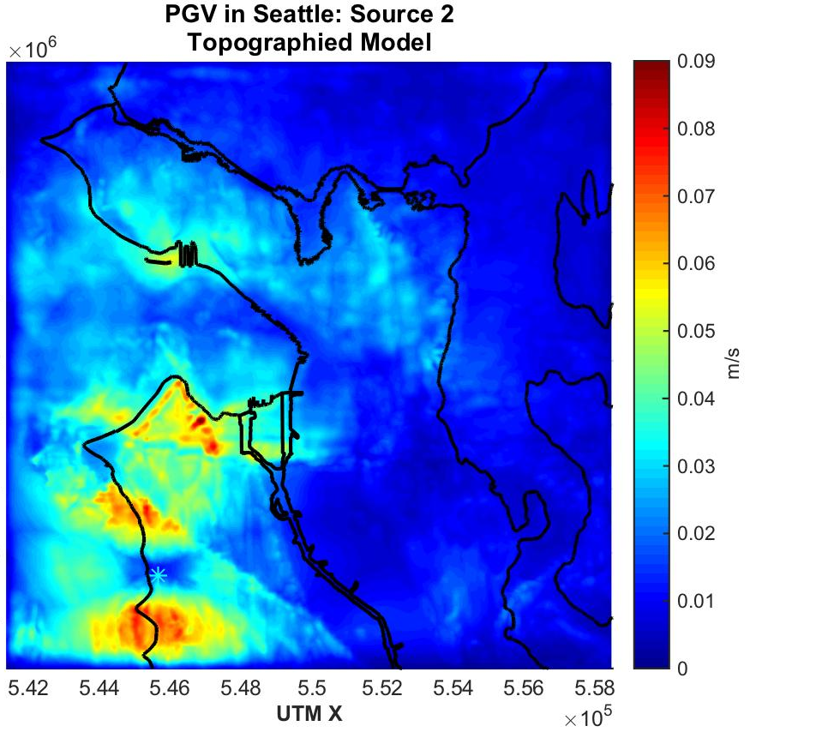
Results: PGV Comparison
Notes:
We can also compare the peak ground velocity to constrain the difference between the topographied and non-topographied models.

Slide 10
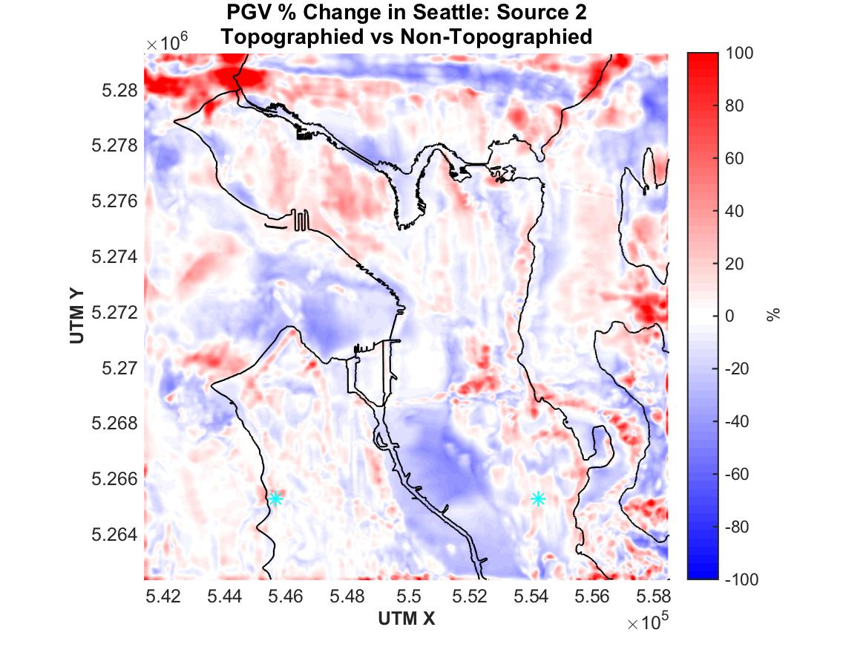
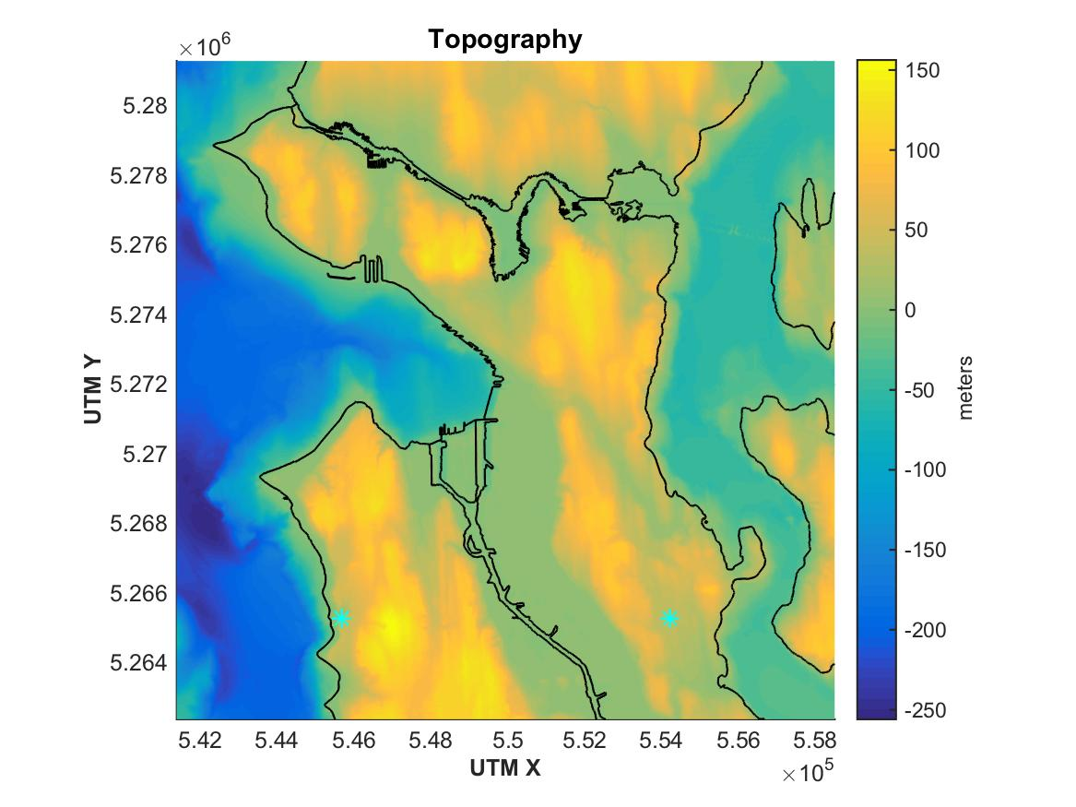
Discussion: PGV Ratio
Notes:
This map shows the percent difference in PGV between the topographied and nontopographied models. Warm colors indicate an increased PGV in the topographied simulation relative to the non-topographied simulation. Cool colors represent a decrease in response.

Slide 11
Discussion: PGV Ratio
General Observations:
Amplification generally occurs at the top of hills, on cliffs, and well-oriented slopes
Deamplification occurs at topographic lows and areas shielded by other topography

Slide 12
Discussion: PGV Ratio
General Observations:
PGV values for most locations range from +/-30%, with some larger localized variations
+45%
-20%
-40%
+30%
Notes:
We can quantify these general trends as well.

Slide 13
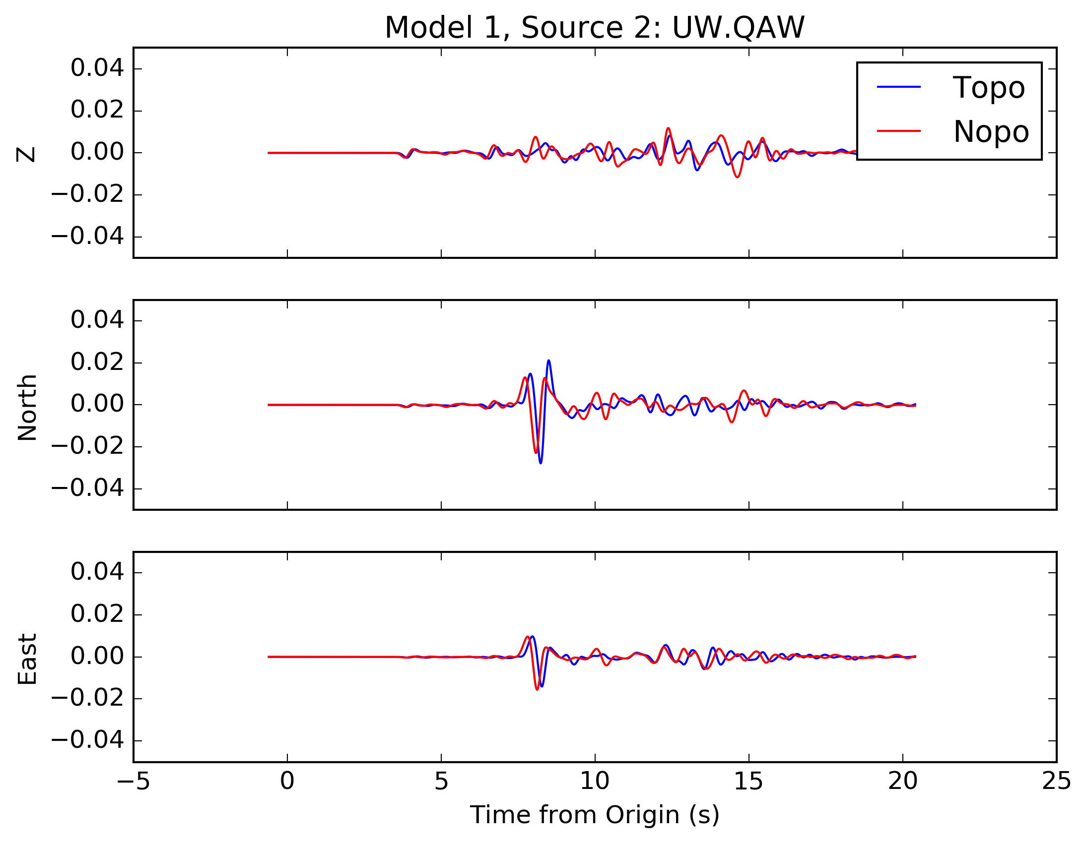
Discussion: Seismograms
(m/s)
Notes:
If we look at timeseries from these locations, we can see which components of the wavefield were most affected by the addition of topography.

Slide 14
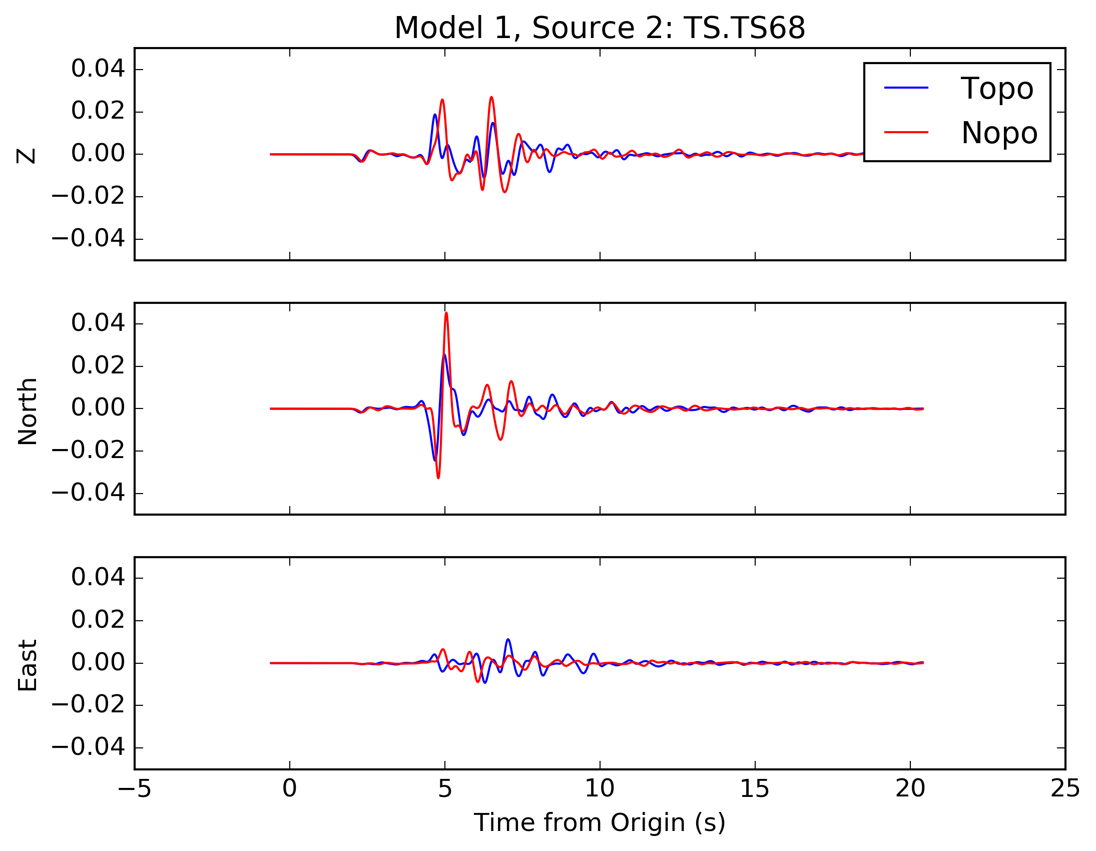
Discussion: Seismograms
(m/s)

Slide 15
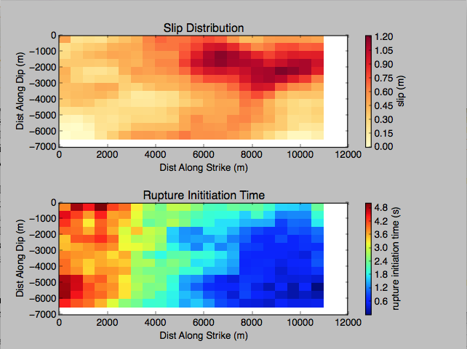
Continuing Work
Characterization of response to M6.5-7.0 events
  Constrain effects of distributed source, lower frequency contents
  Working with finite fault sources from Seattle Urban Hazard Maps

Slide 16
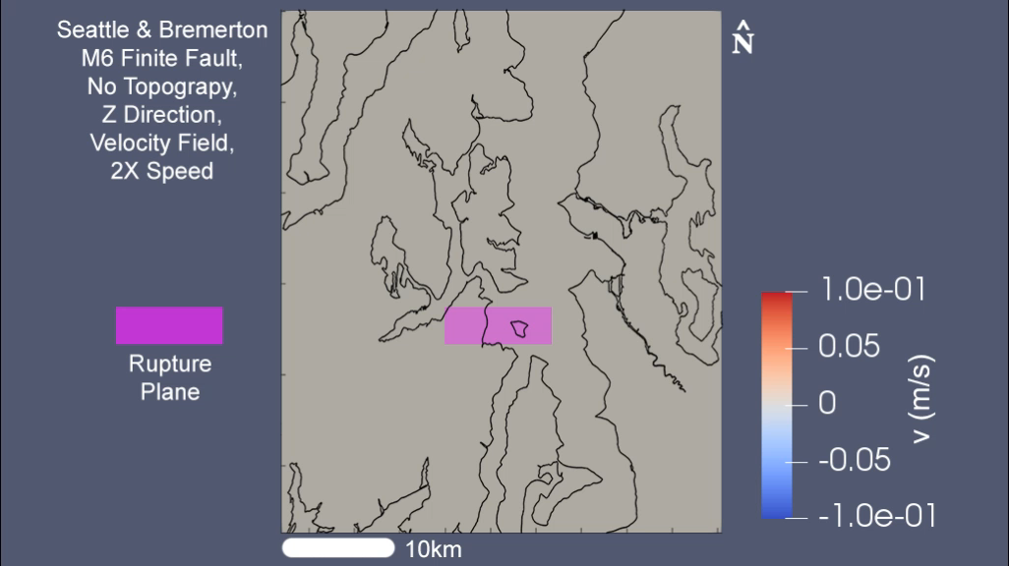
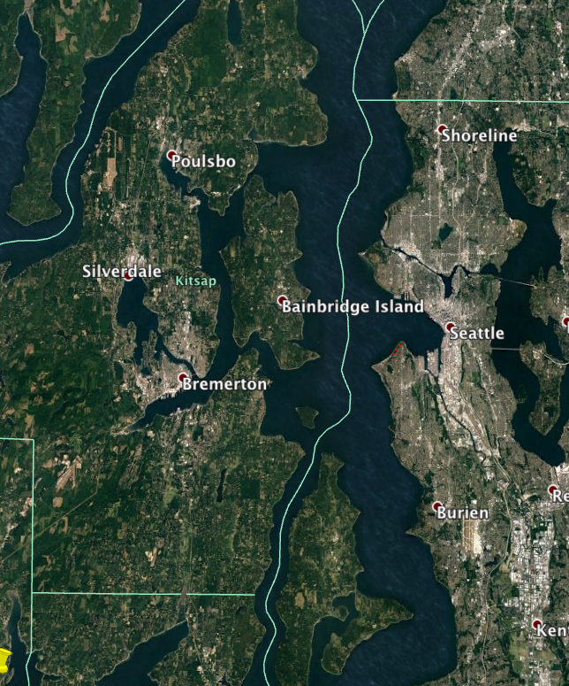
Simulation of M6 Earthquake
w/ finite fault
W
Vertical Velocity Field, 2X speed
- Seattle
- Bremerton
Notes:
To verify the quality of the method and model, we first simulated a small nearby earthquake. This earthquake was magnitude 3.3, and happened over near Bremerton in 2015. Shown here is the vertical component of the velocity field for the simulation, played at 2 times speed. We found after running this simulation that our synthetic data generally matched the arrival times and response spectra of the real data. Also, we were able to match the Sp minus S times fairly well within the Seattle basin, which implies that our velocity model is appropriate there.

