Slide 1

Site Amplification, Basin Effects, and Source Parameters of Earthquakes in the Portland, Oregon Region
Art Frankel
U.S. Geological Survey
Seattle, WA
Pacific Northwest Earthquake Science Workshop, November 5, 2019

Slide 2
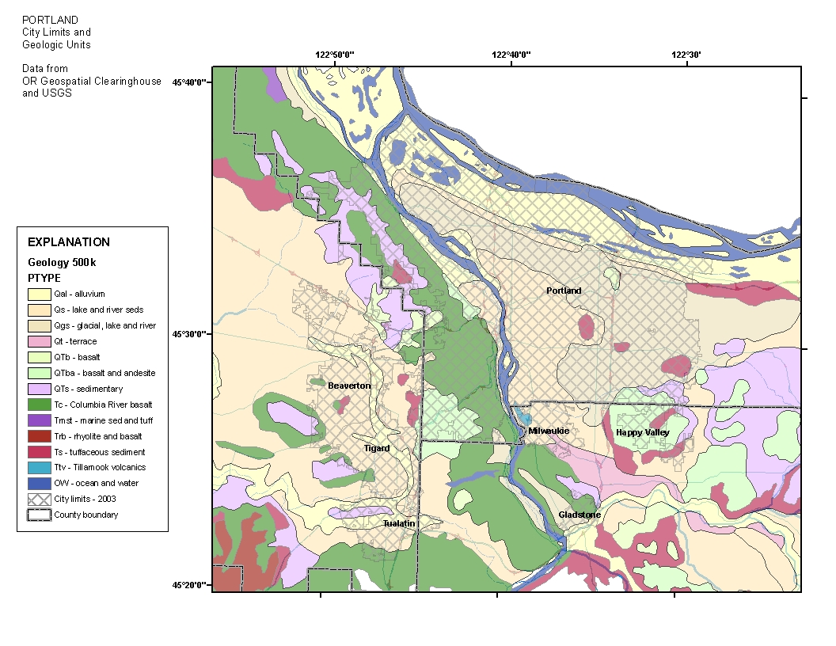
USGS seismic array for Portland area, operating since 2005
LEVE
DREG
SAIL
PFS6
ALBR
LOES
Portland
Basin
RBOK
David Carver
installed
stations.
David Bowen
maintains
array. Some
stations
recently
transferred
to PNSN
BEAV
CRCK
CHIN
Tualatin
Basin
CSOK
HAOK
Geologic map from DOGAMI
(station locations are approximate)

Slide 3
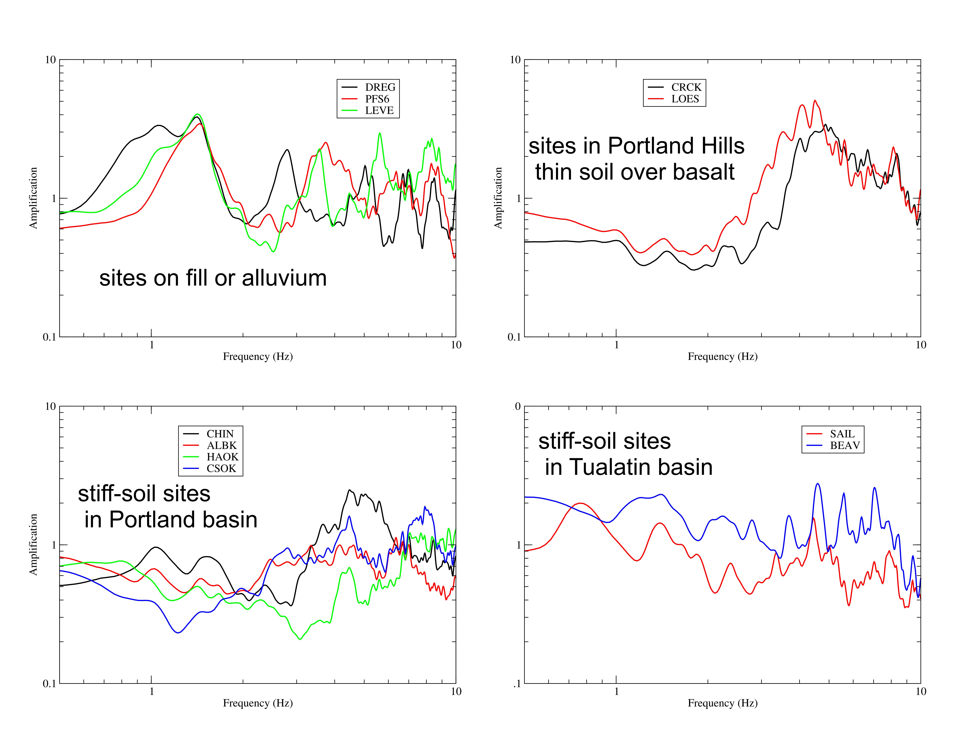
Site amplification relative to rock site RBOK from inversion of spectra from 10 local earthquakes M3-4

Slide 4
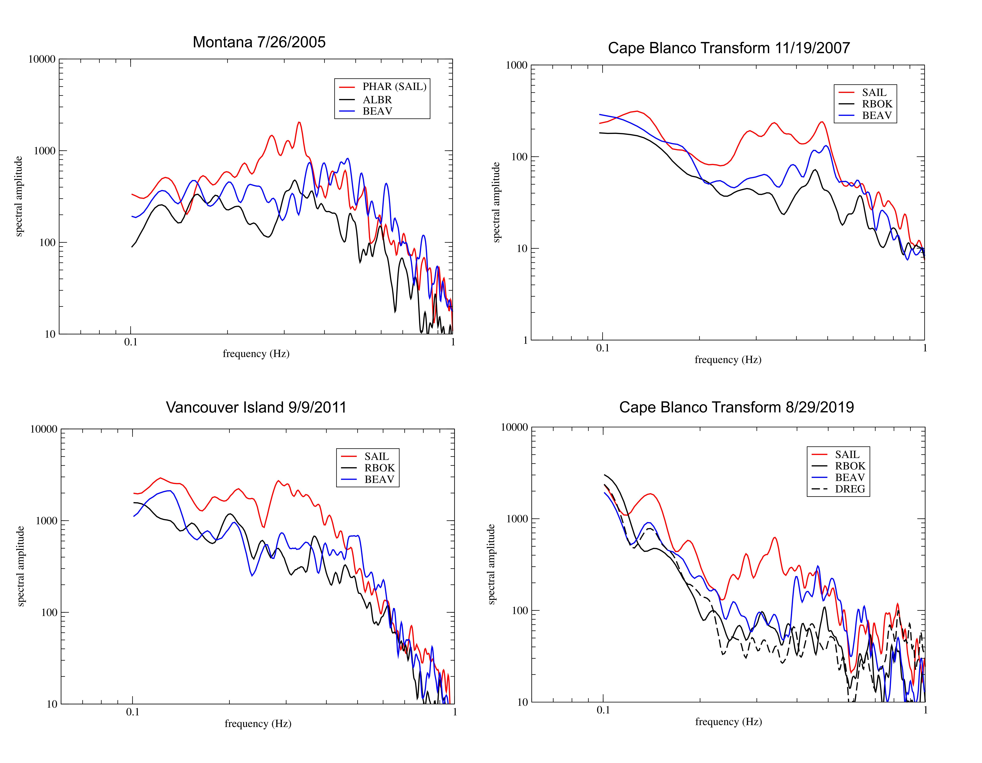
Spectra from regional earthquakes M5.7 to 6.4 showing amplification of sites in Tualatin basin (red and blue lines)
at 0.2 -0.7 Hz, compared to rock site and soil sites in Portland basin (black lines)

Slide 5
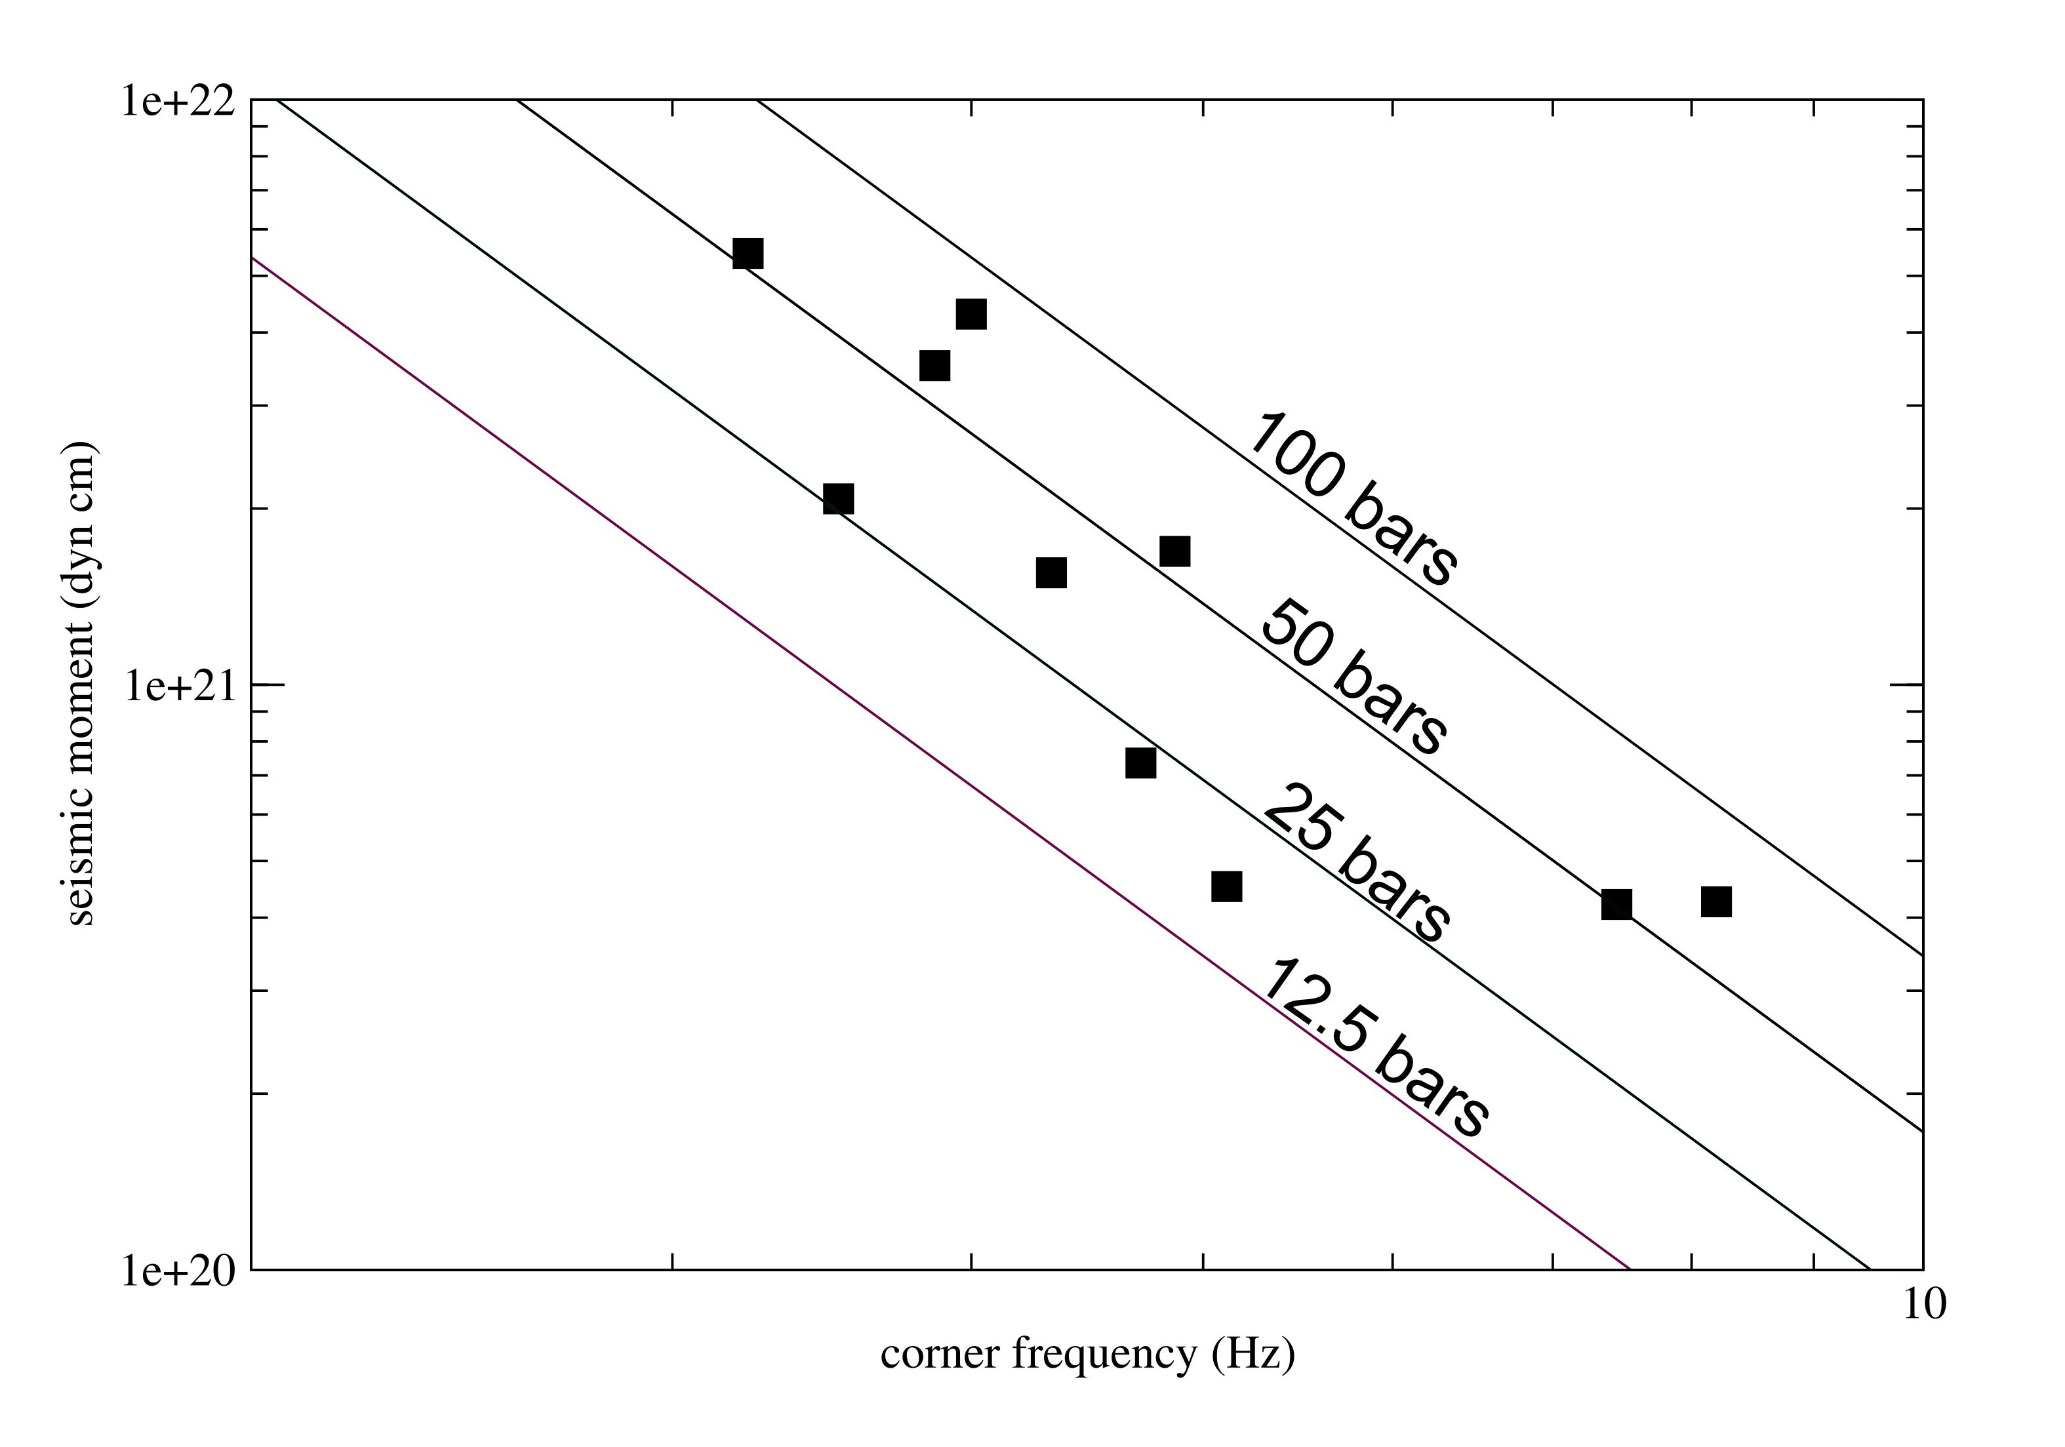
Preliminary stress drop determinations for M3-4 earthquakes around Portland,
using corner frequencies and seismic moments determined from inversion of spectra
2

Slide 6
Tualatin basin is deeper than
Portland basin in terms of max. depth to
bedrock (about 500m vs. about 200m)
and max. depth to basement (6 km vs 2 km;
McPhee et al., 2014)
Bill Stephenson (USGS) is using data from
DOGAMI and results from McPhee et al.,
(2014) to improve 3D velocity
model for Portland area.
We will be making 3D earthquake
simulations for the Portland area
to improve predictions of ground shaking
for future M8-9 interface, M6-7 crustal, and
possible M6 intraslab earthquakes
BEAV
SAIL
Figure from Blakely et al. (2004)

