Slide 1
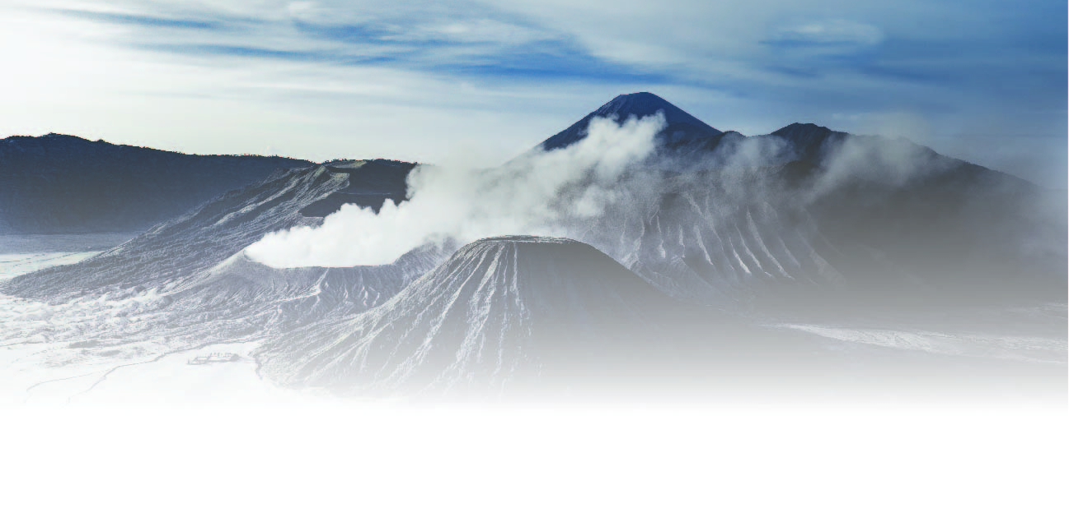
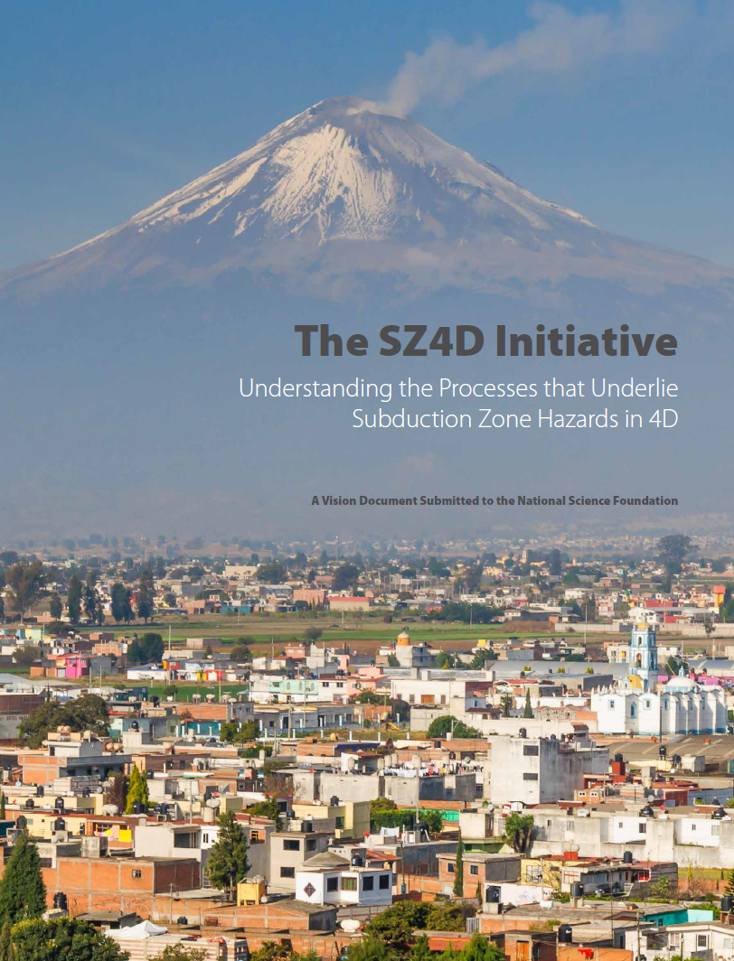
Planning the Modeling Collaboratory for Subduction Zone Science (MCS)
Gabriel Lotto & Thorsten Becker
Steering Committee: Alison Duvall, Amanda Thomas, Charles Connor, Eric Dunham, Helge Gonnermann, Ikuko Wada, Kaj Johnson, Kyle Anderson, Leif Karlstrom, Magali Billen, Mark Behn
PSN Earthquake Science Workshop, 11/5/2019

Slide 2
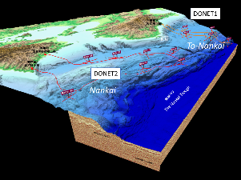
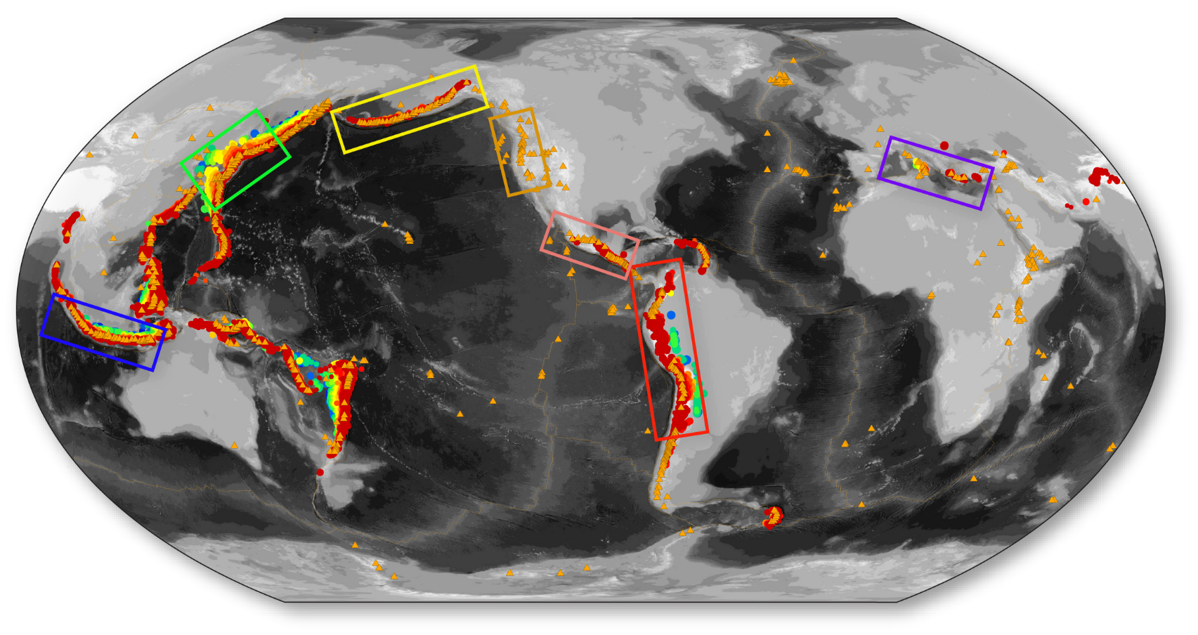
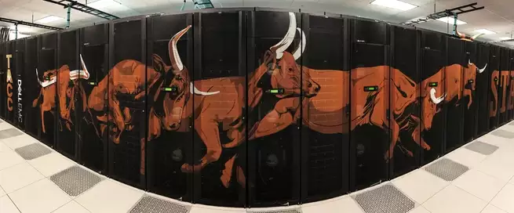
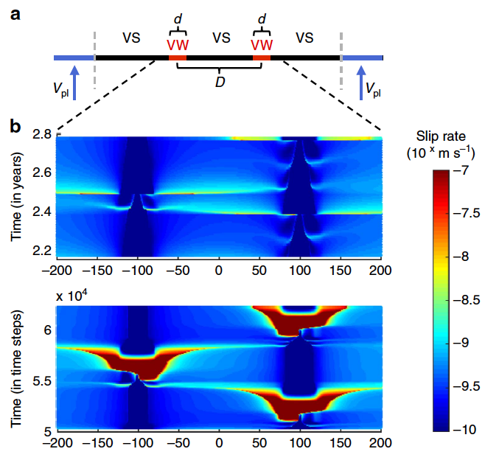
MCS connections and partnerships
Regional megathrust modeling
Global observatory integration
High-performance computing
Liu & Lapusta (2016)
Fundamental physics models
Notes:
A major part of building a community modeling system involves forging new connections and strengthening current connections to large regional sensor networks and currently existing community efforts like SCEC, CIG, EPOS CSDMS, etc. And if we look at the back end of our analog lego model, we can see that we need some infrastructure to support our shiny, colorful results. So we need to partner with computational centers like TACC in Texas, or with federal agencies like NASA or the national labs. We also need support from funding agencies, like NSF and NASA

Slide 3
www.sz4dmcs.org
Join us for our upcoming workshops
and several cyber-infrastructure webinars
Workshop 1: Fluid and Melt Transport
Fluid migration & fracture formation in magma systems
Lithosphere-scale magma transport
Microscopic and short-time-scale processes
Workshop 2: Megathrust Modeling
Sequences of earthquakes & aseismic slip
Dynamic rupture and tsunamis
Geodynamics and surface processes
Workshop 3: Volcano Modeling
Location, timing, and magnitudes of volcanic eruptions on an arc scale
How does the lithosphere influence magma transport?
May 30 – June 1, 2019
Minneapolis, MN
October 7 - 9, 2019
Eugene, OR
Mid 2020
Location TBD
twitter: sz4d_mcs
Notes:
The RCN will organize three workshops and a series of webinars over the few three years. The workshops will focus on finding knowledge gaps in our understanding of subduction zone physics, as well as interactions between physical processes and models.

