Slide 1
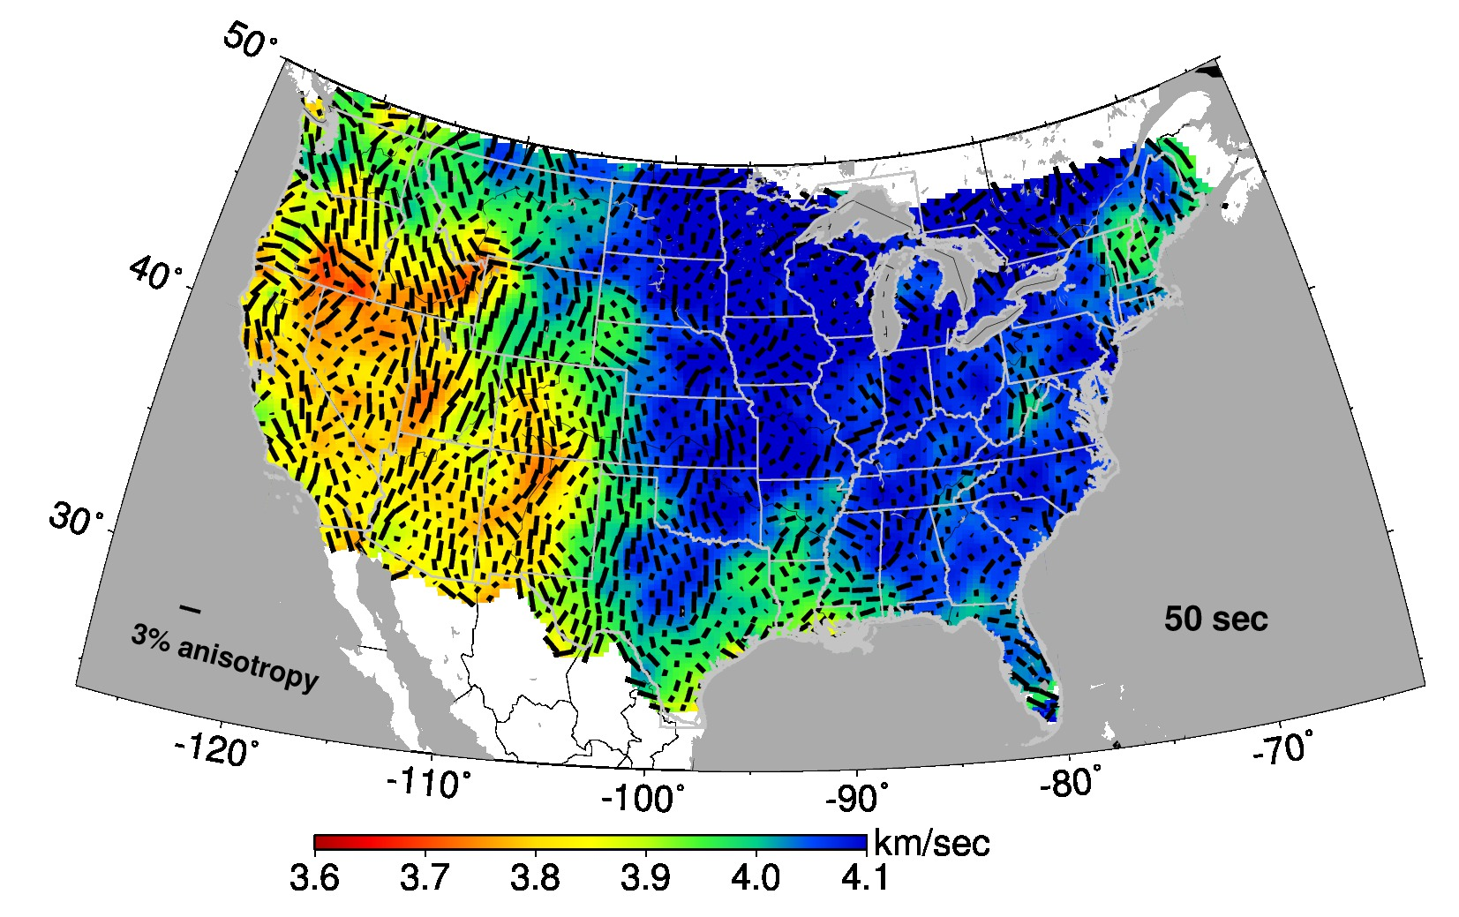
Seismic surface wave anisotropy in the Pacific Northwest
Fred F. Pollitz, U.S. Geological Survey, Moffett Field, CA
Notes:
Figure plotted with con.cC-anis.50s-allUS

Slide 2
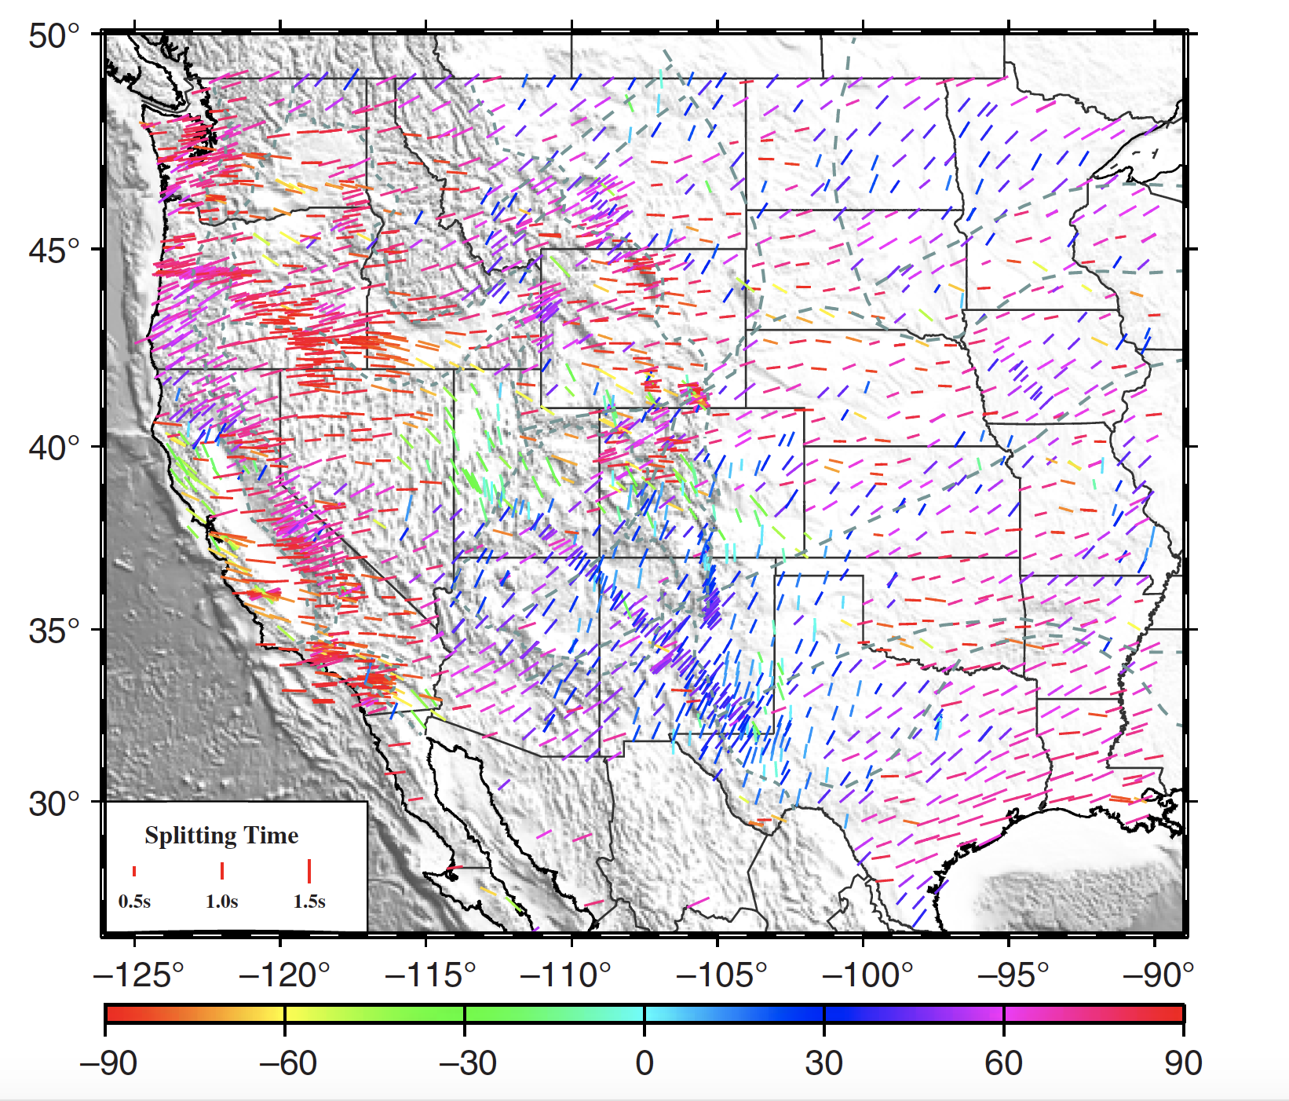
SKS, SKKS, and PKP splitting
measurements
Average fast velocity direction over
indefinite depth range
Need additional information to
obtain depth dependence of
azimuthal anisotropy
Station average XKS splitting parameters
(Yang et al., 2016 SRL)

Slide 3
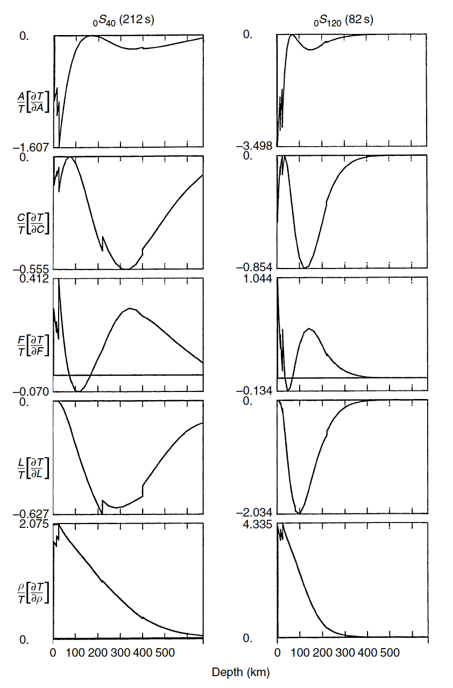
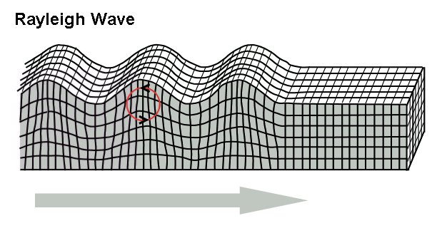
₀S₂₀ (212 s)
₀S₁₂₀ (82 s)
Seismic Surface Waves
Different periods sensitive to
different depth ranges
2-φ anisotropy controlled by
A, F, and L sensitivity kernels
Montagner (2007)
Notes:
Montagner: “Note that three partials contribute to the 2--azimuthal terms, A-partial for Bc, Bs, F-partial for Hc, Hs, and the largest one L-partial for Gc, Gs.”
Montagner (2007) -- Deep Earth Structure – Upper Mantle Structure: Global Isotropic and Anisotropic Elastic Tomography

Slide 4
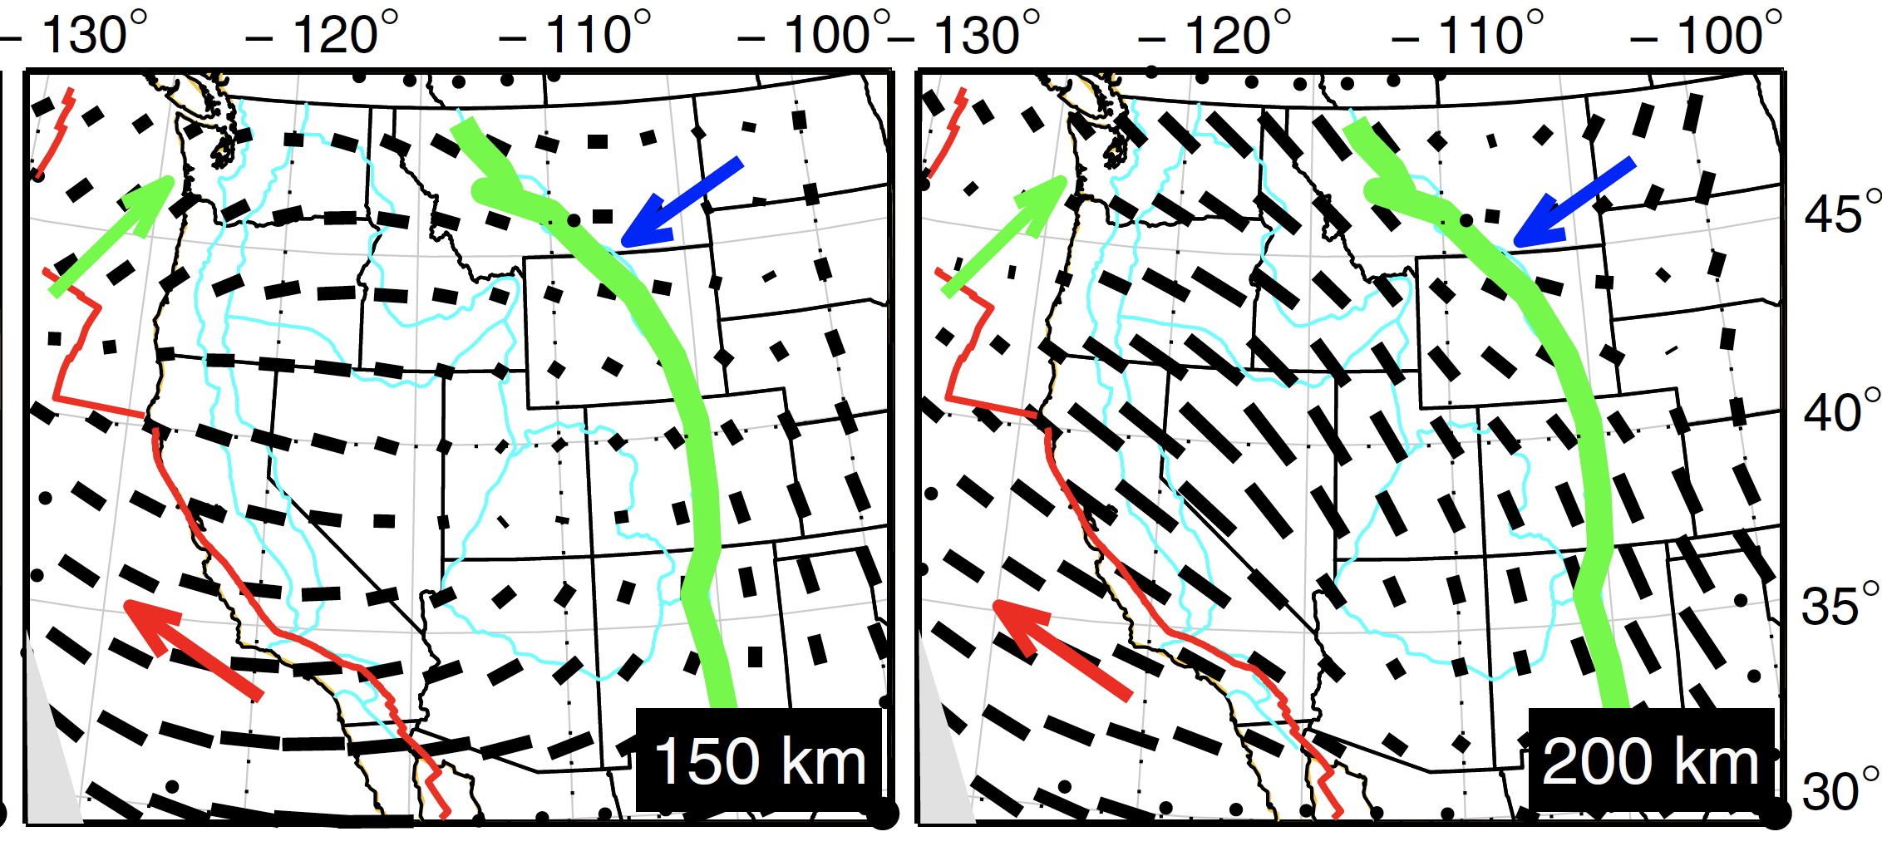
Yuan and Romanowicz (2010 EPSL)
Notes:
It is noteworthy that the trends of the fast-velocity axes are often N-ward or NW-ward in Yuan and Romanowicz’s maps, nearly perpendicular to the APM (absolute plate motion)
Direction, kind of confirming the same trends in my results. As with other studies, the anisotropy patterns in Yuan and Romanowicz’s maps seem unrealistically smooth.

Slide 5
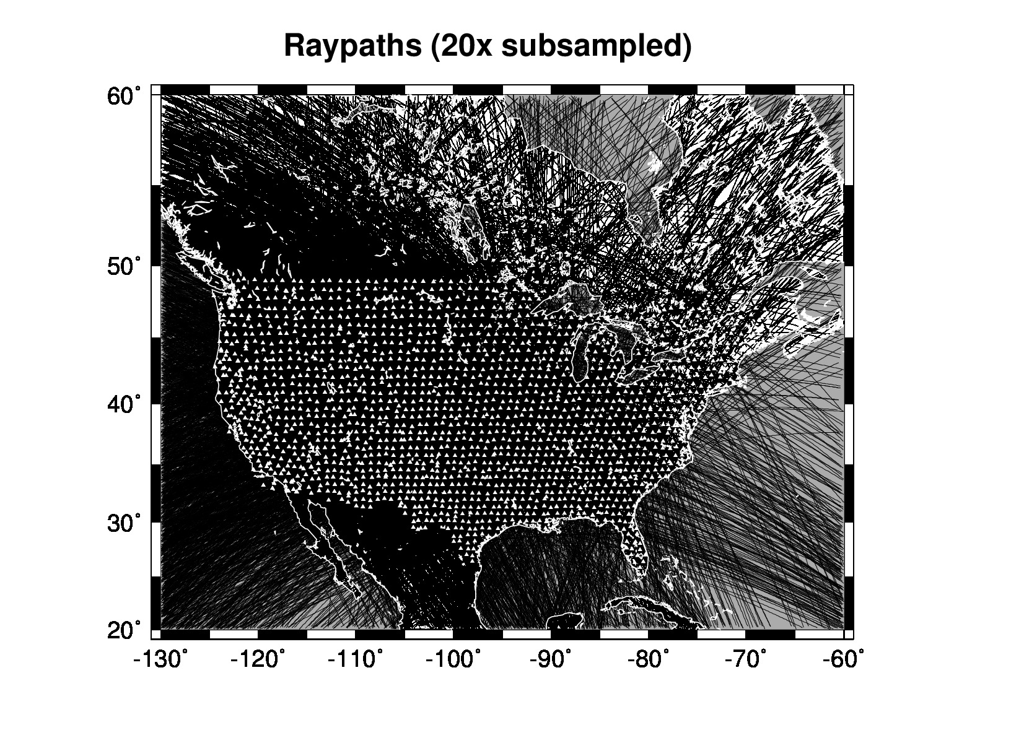
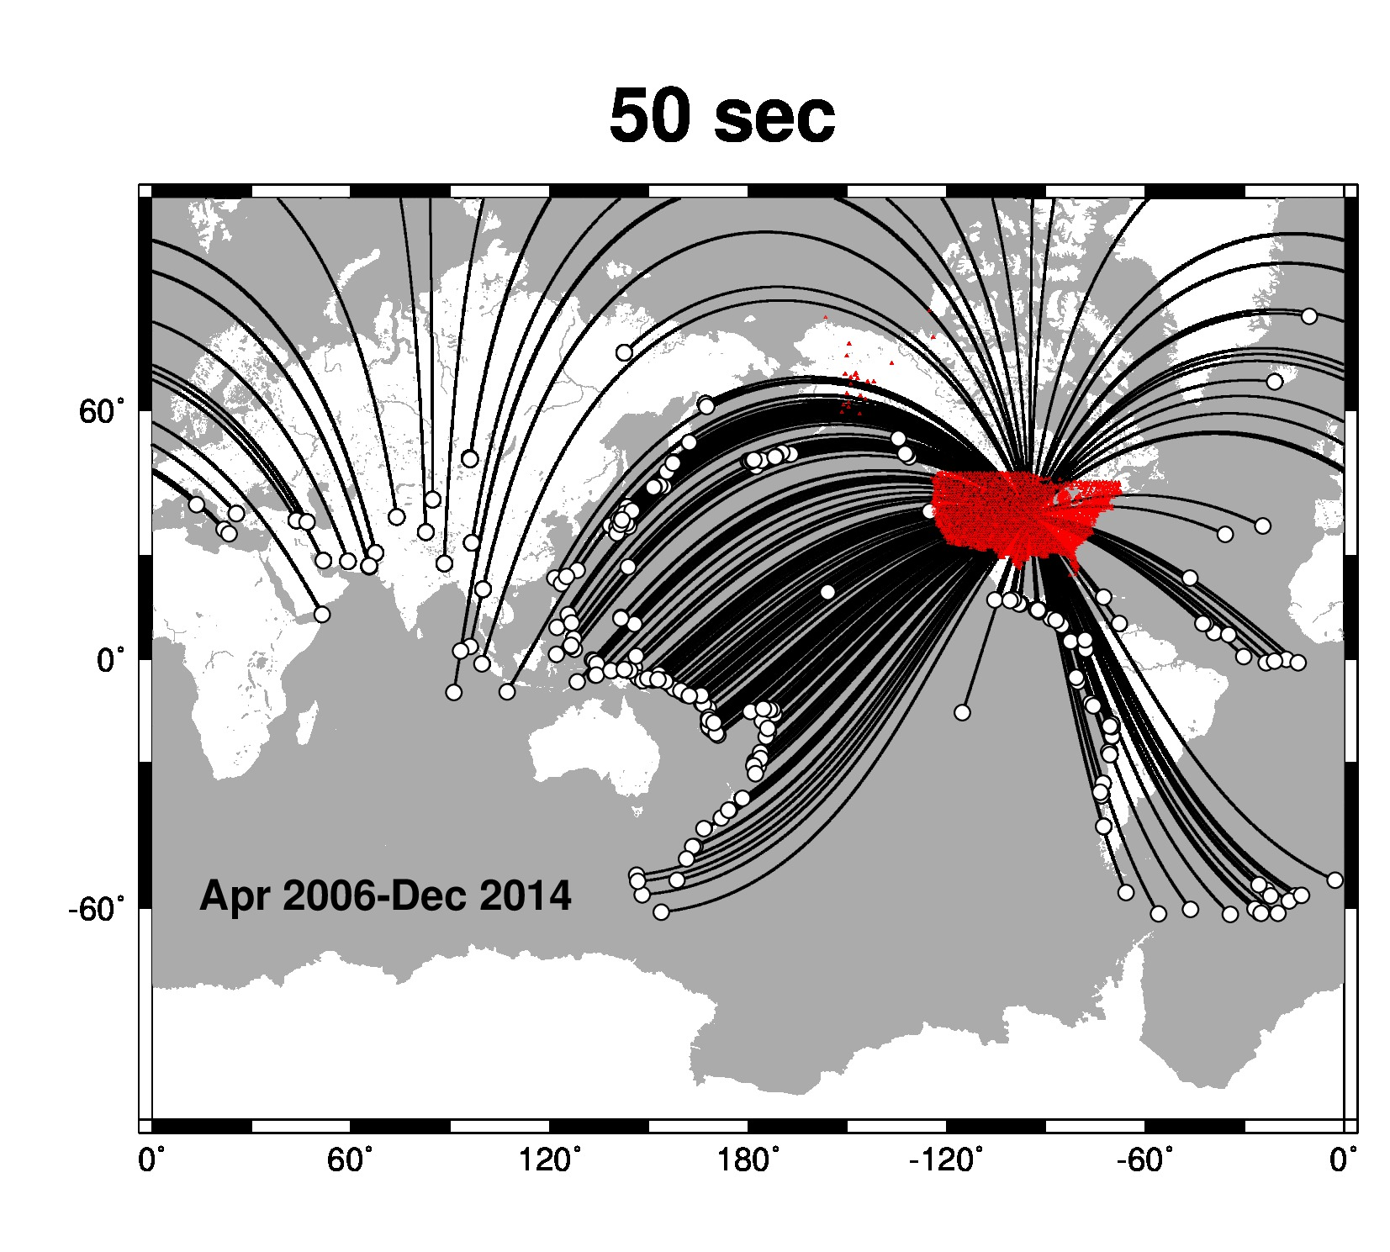
April 2006 – December 2014
171,058 vertical-component seismograms
399 M≥6.3 teleseismic sources
770,295 complex spectral amplitudes
Notes:
Transportable Array of Earthscope and regional permanent array stations

Slide 6
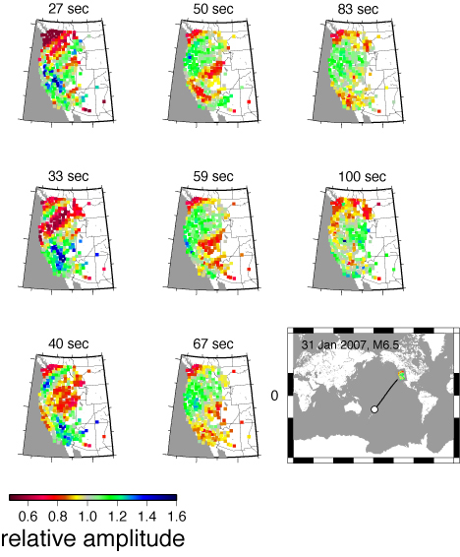
Notes:
From Pollitz (2008). Recorded wavefields have highly variable amplitudes → focussing and defocussing effects along teleseismic propagation path

Slide 7
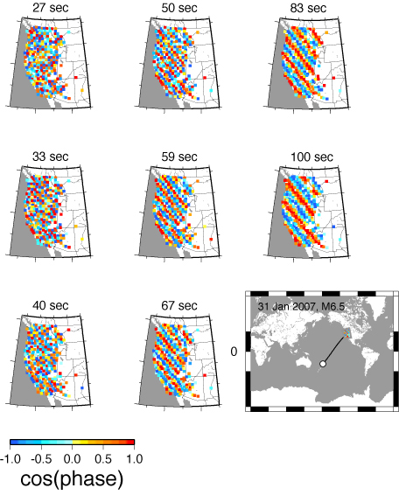

Slide 8
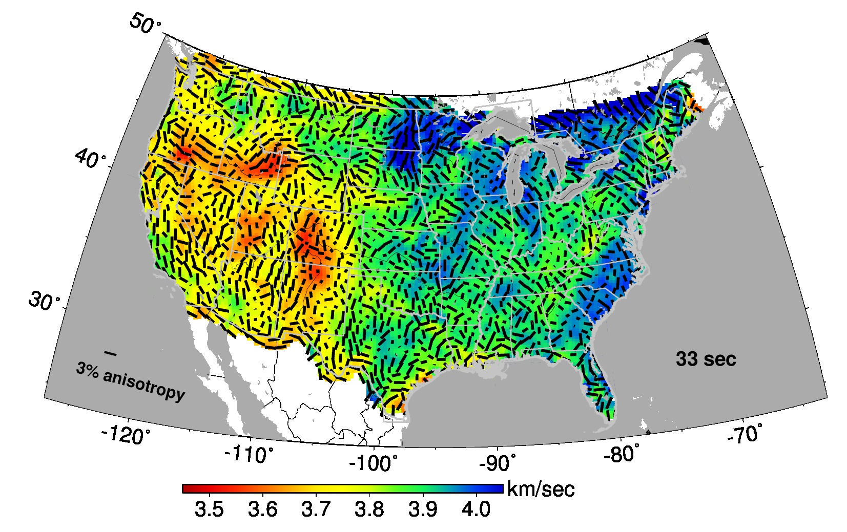
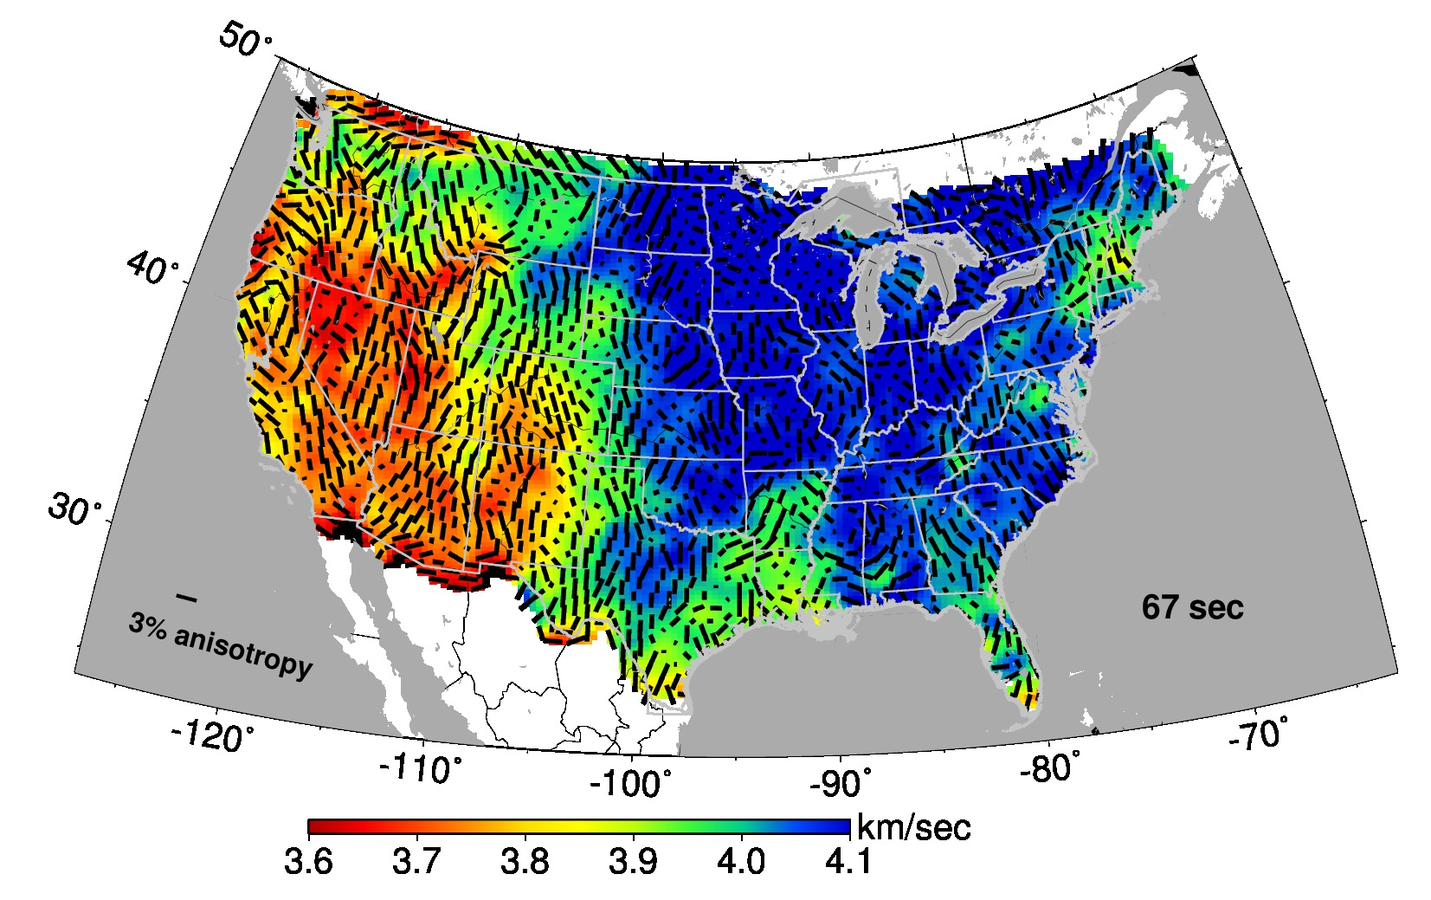

Slide 9
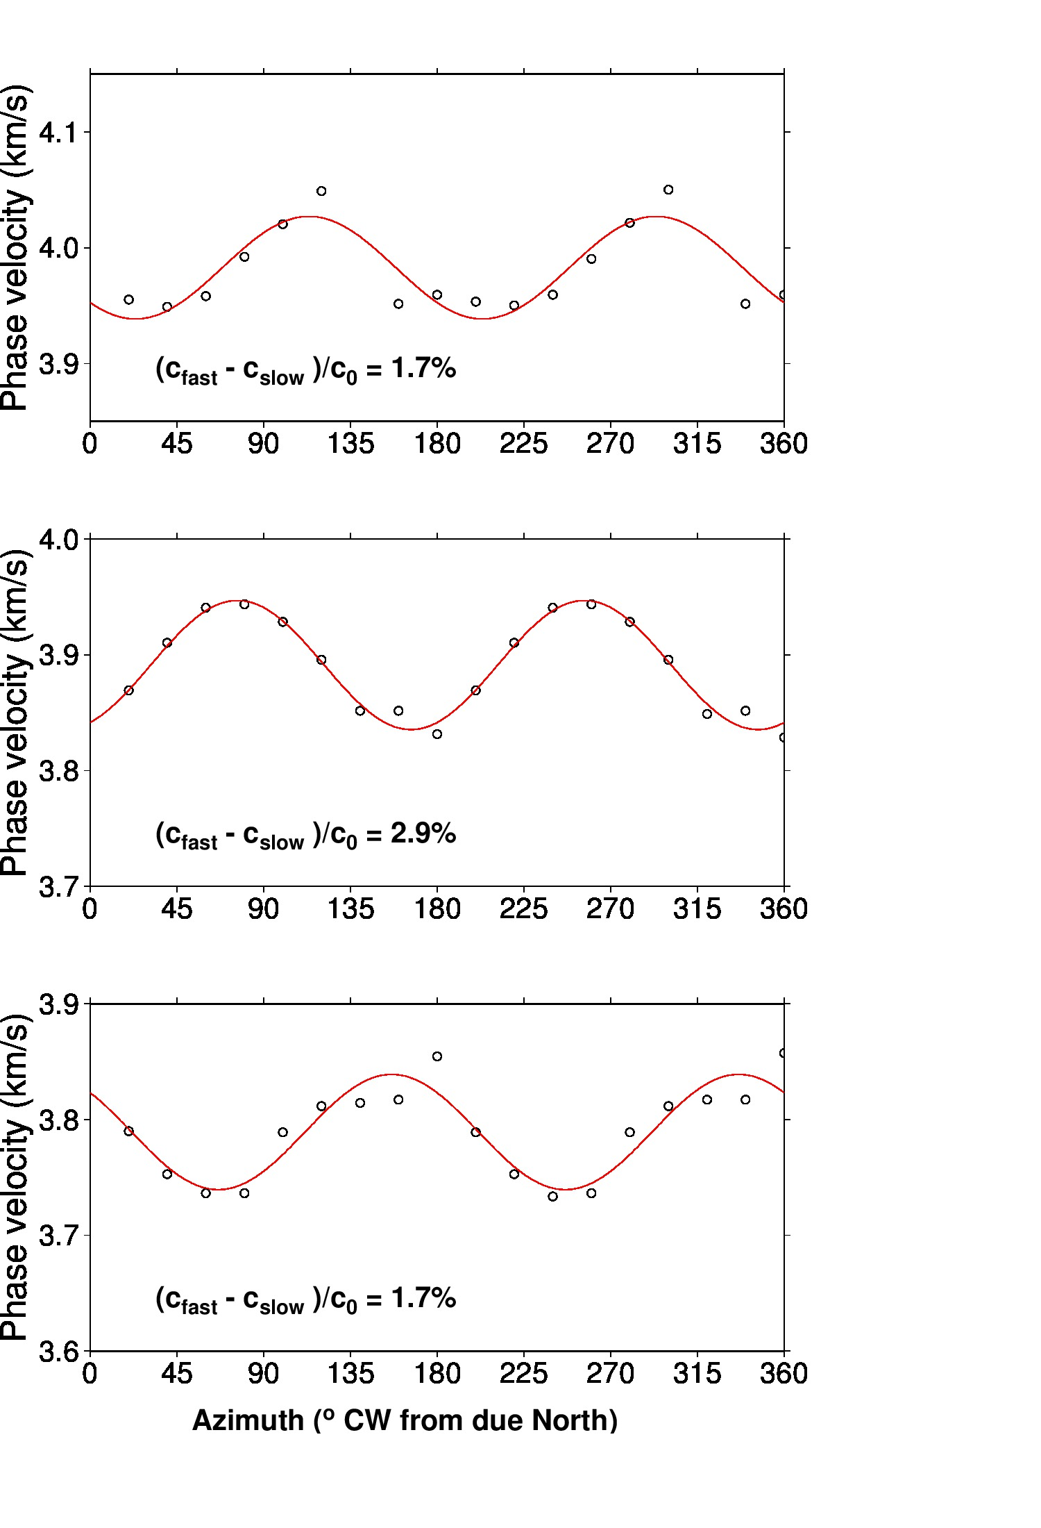
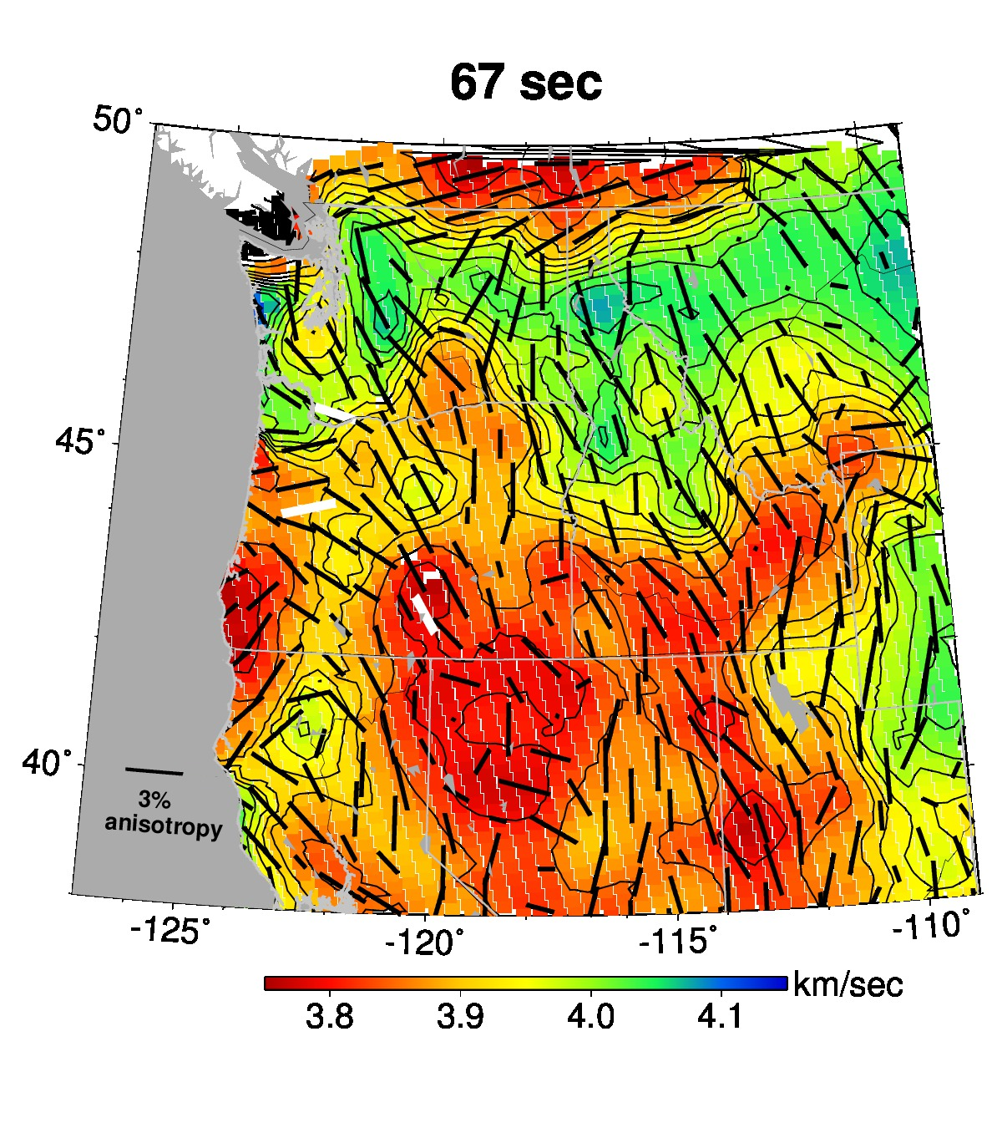
Notes:
The fast velocity direction is laterally variable, as established by the 2-phi phase velocity fits

Slide 10
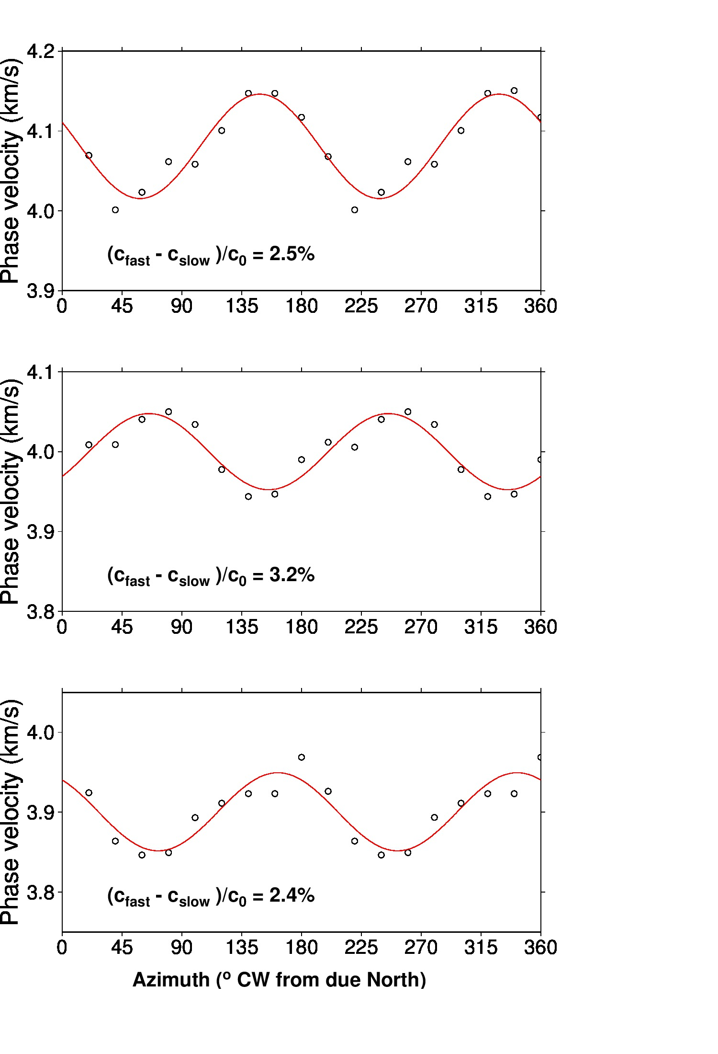
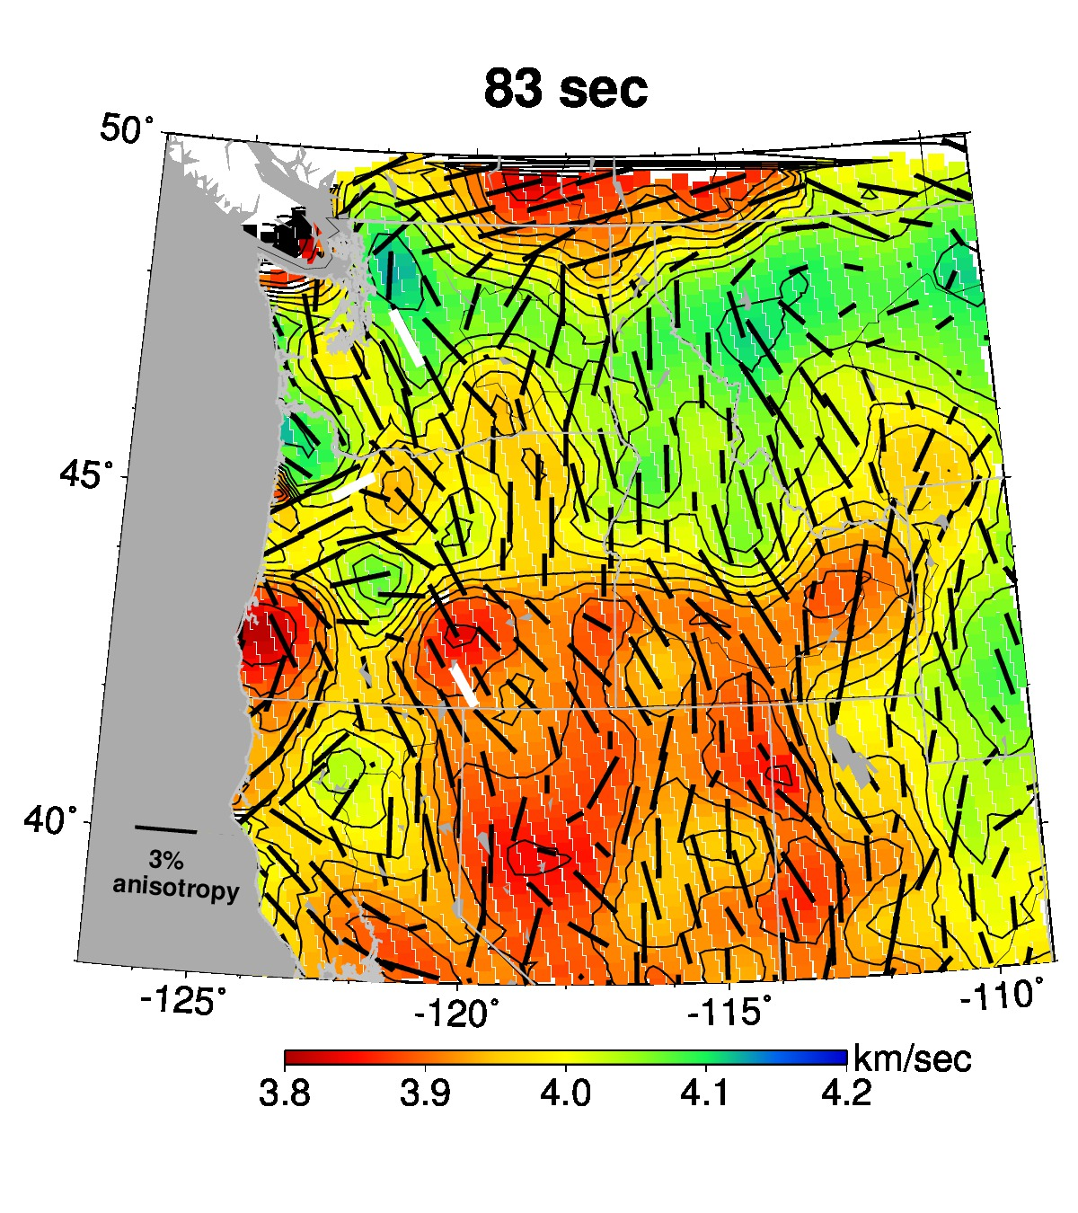
Notes:
The fast velocity direction is laterally variable, as established by the 2-phi phase velocity fits

Slide 11
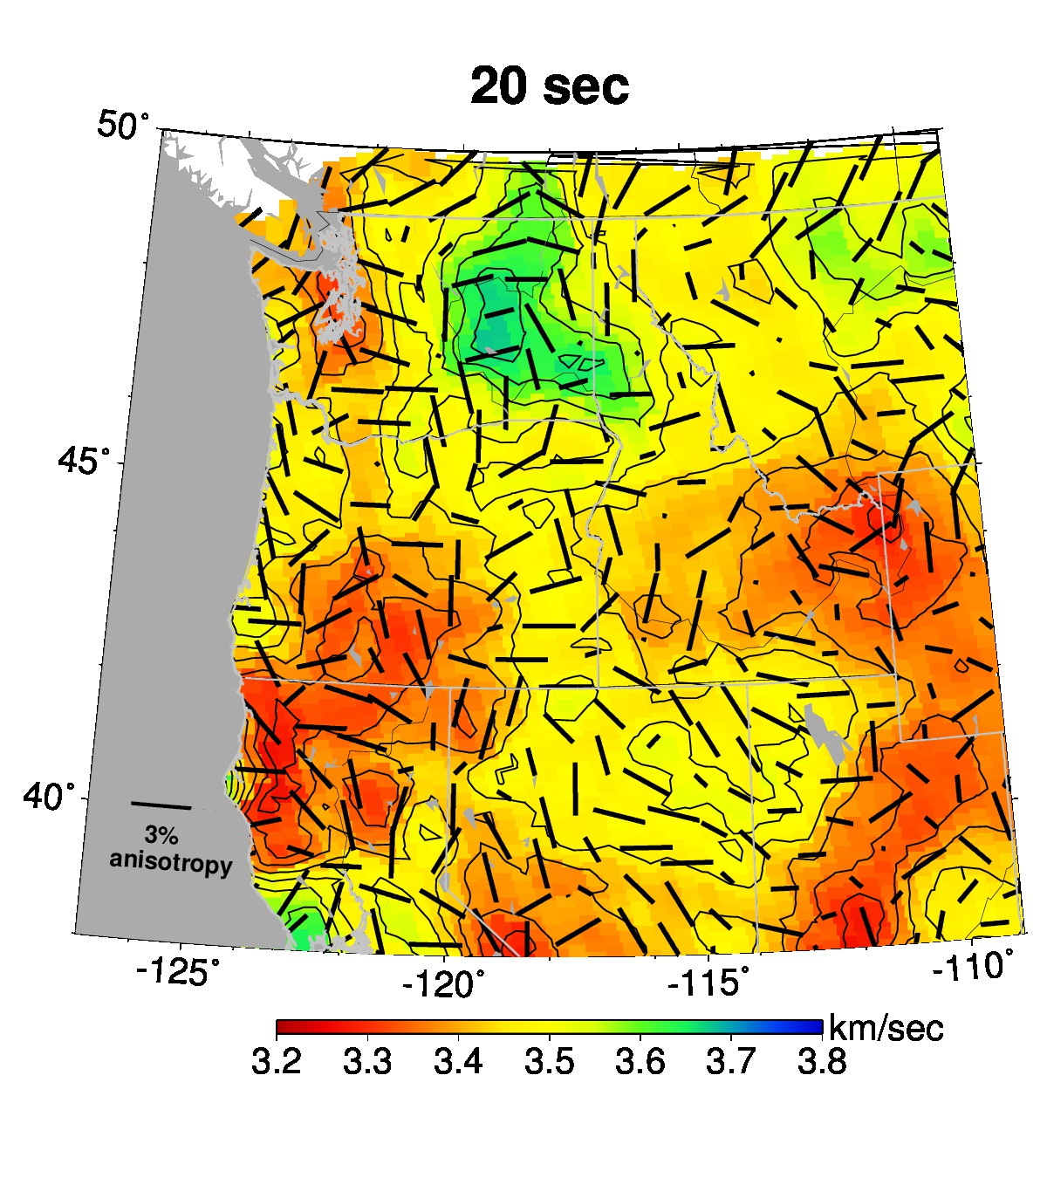
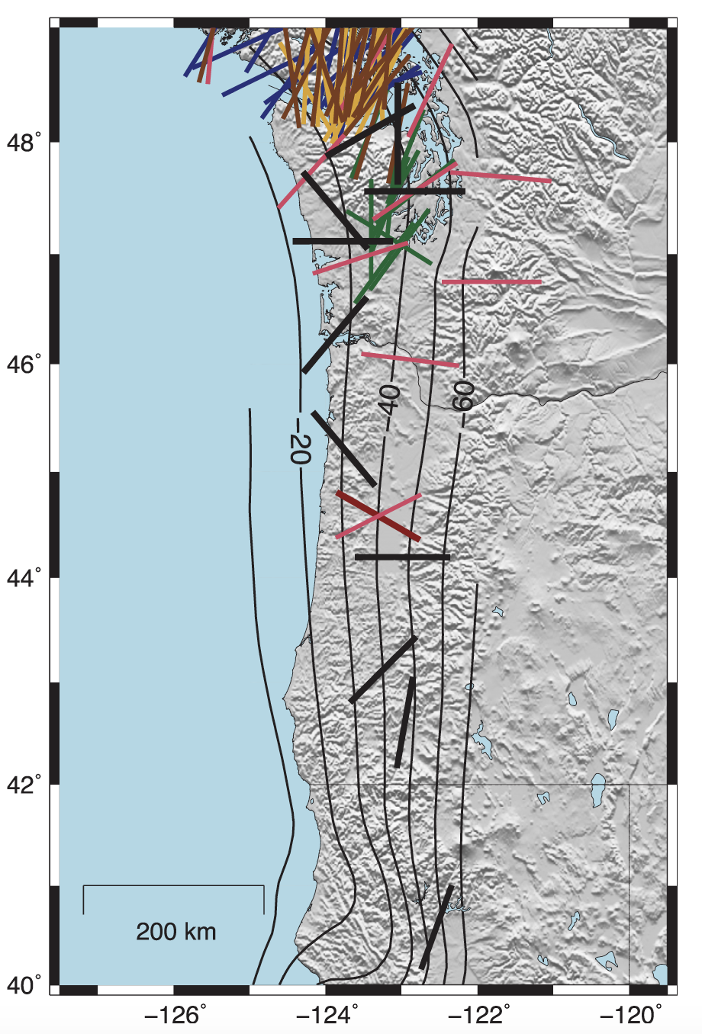
Lower crust slow-velocity directions
(Kreuger and Wirth, 2017)
Notes:
Kreuger and Wirth Figure 9b: “Orientations of slow anisotropy from previous studies (colored bars) and this study (black). Plotting is as described in Figure 2.”

Slide 12
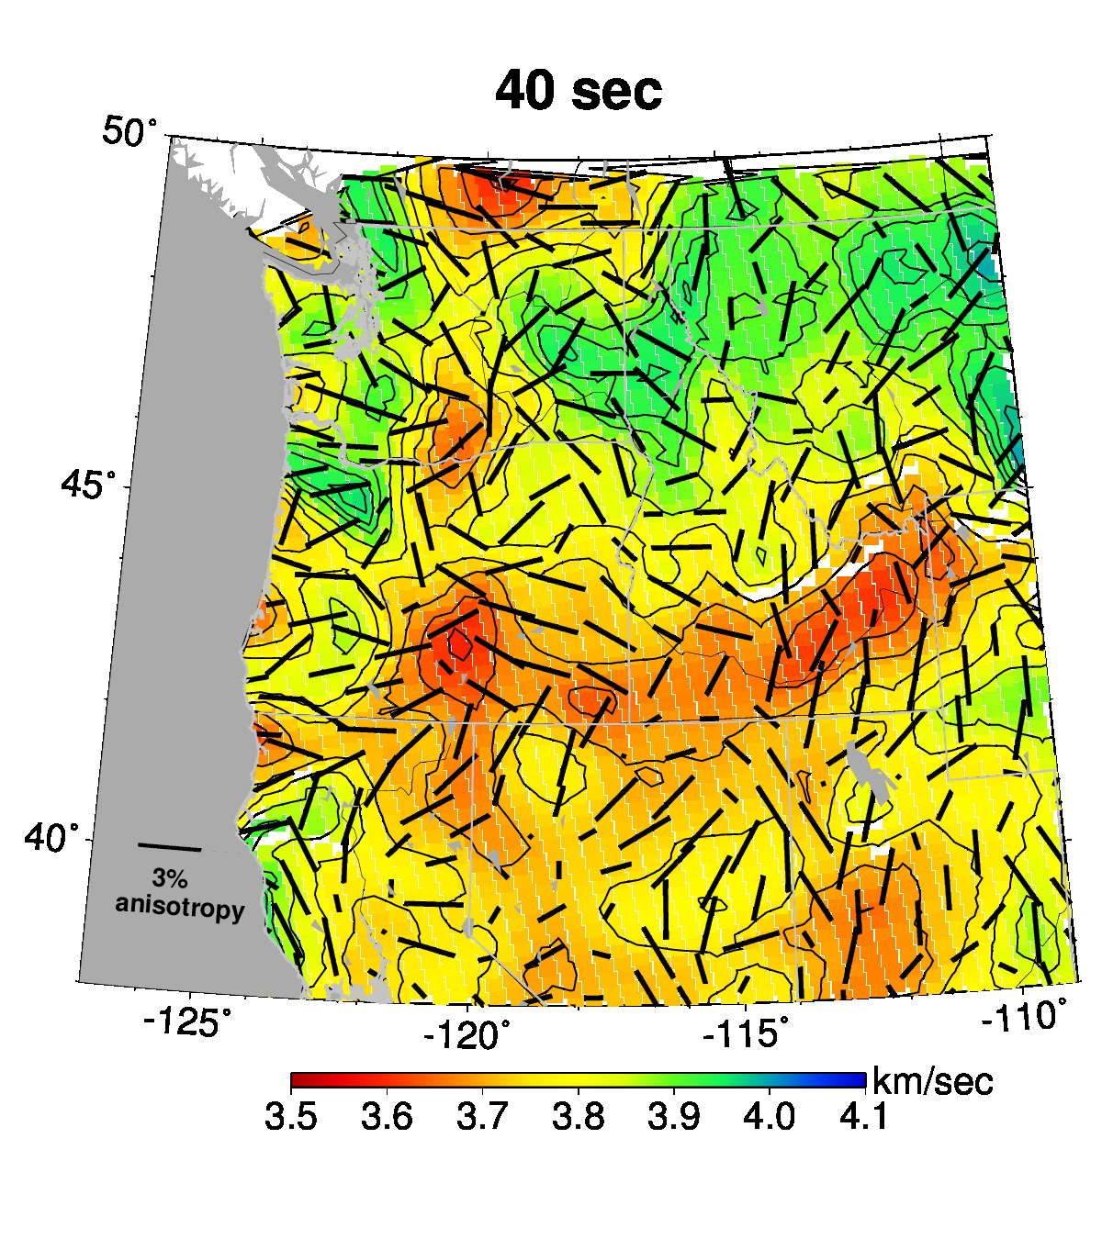
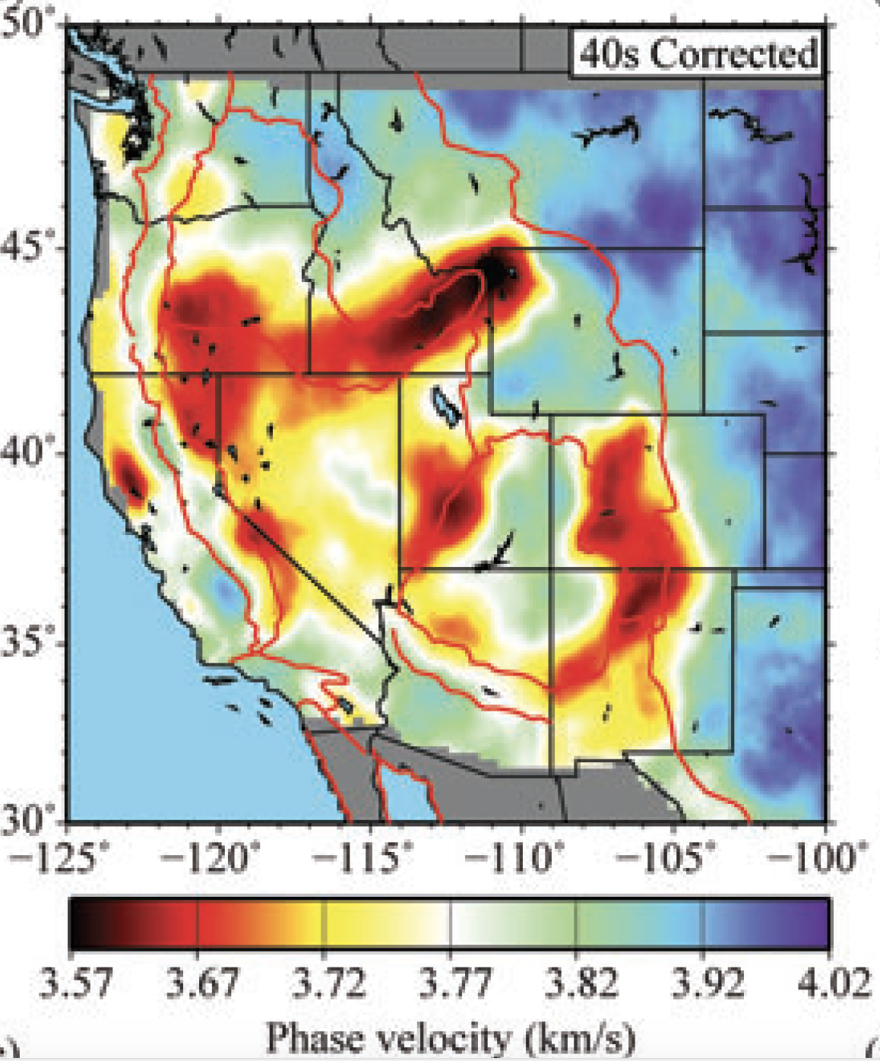
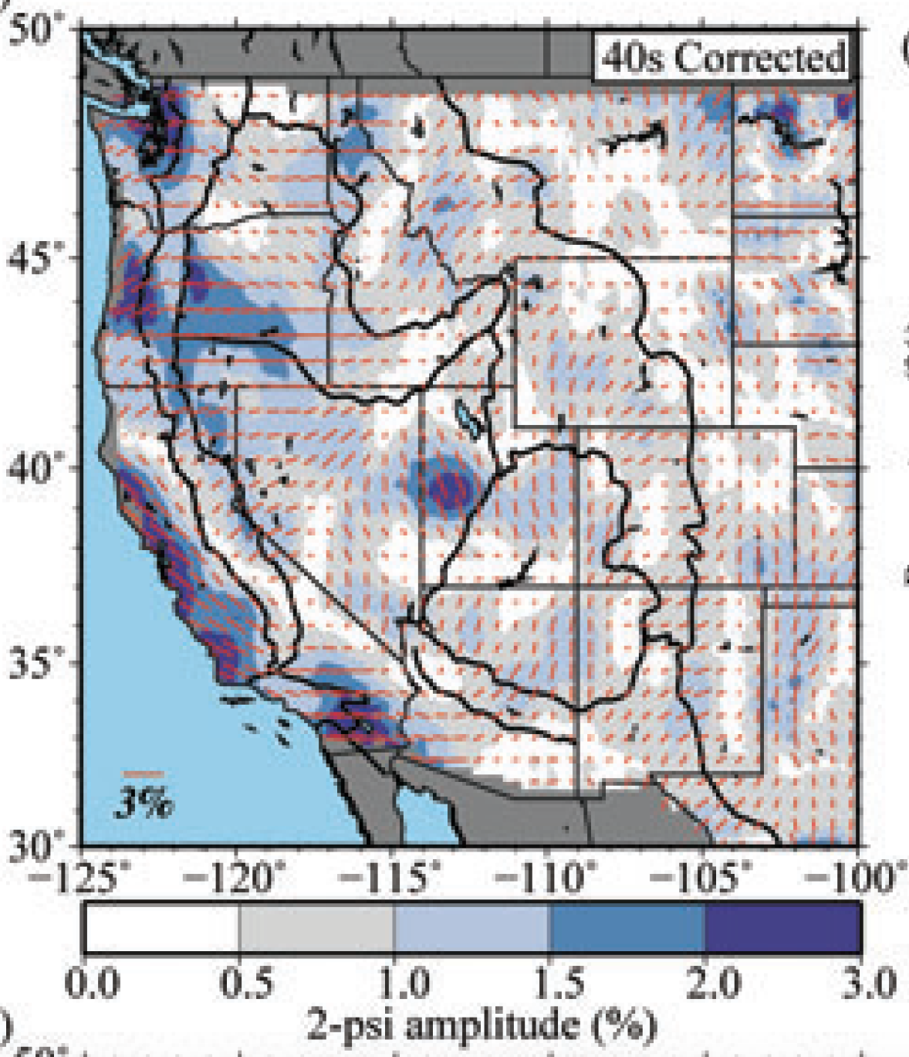
Lin and Ritzwoller (2010)

Slide 13
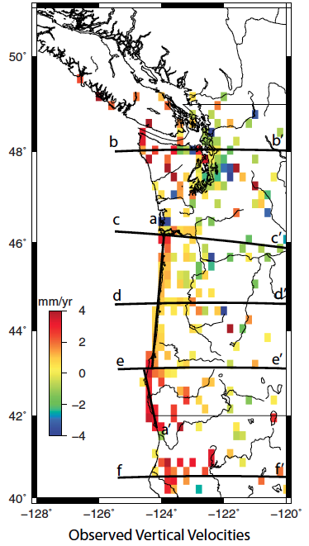
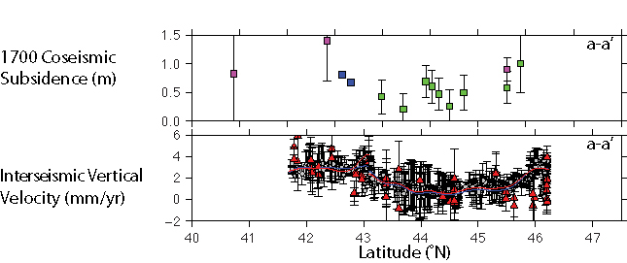
Role of forearc crust for controlling amount of locking
Reduced locking from 43 – 46ºN
→ Segmentation of Cascadia arc
Schmaltzle et al. (2014)
Notes:
Interseismic (GPS) uplift rate along coastal central Oregon (43-46 deg.N) is less than elsewhere (coastal Washington, southern Oregon and northern California). Subsidence accompanying the 1700 earthquake is also less along coastal central Oregon. This all points to lesser coupling and a wider transition zone under central Oregon. “Modeled locking distributions suggest a wide locking transition zone that extends inland under central Oregon.”

Slide 14
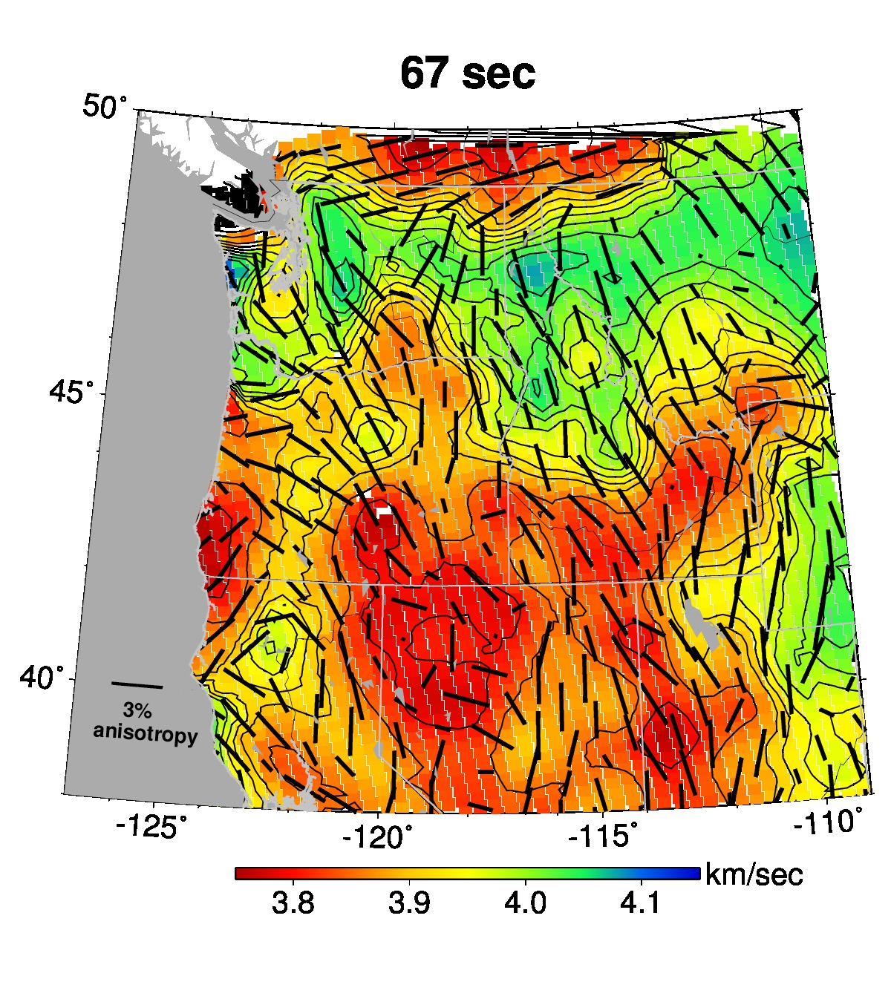
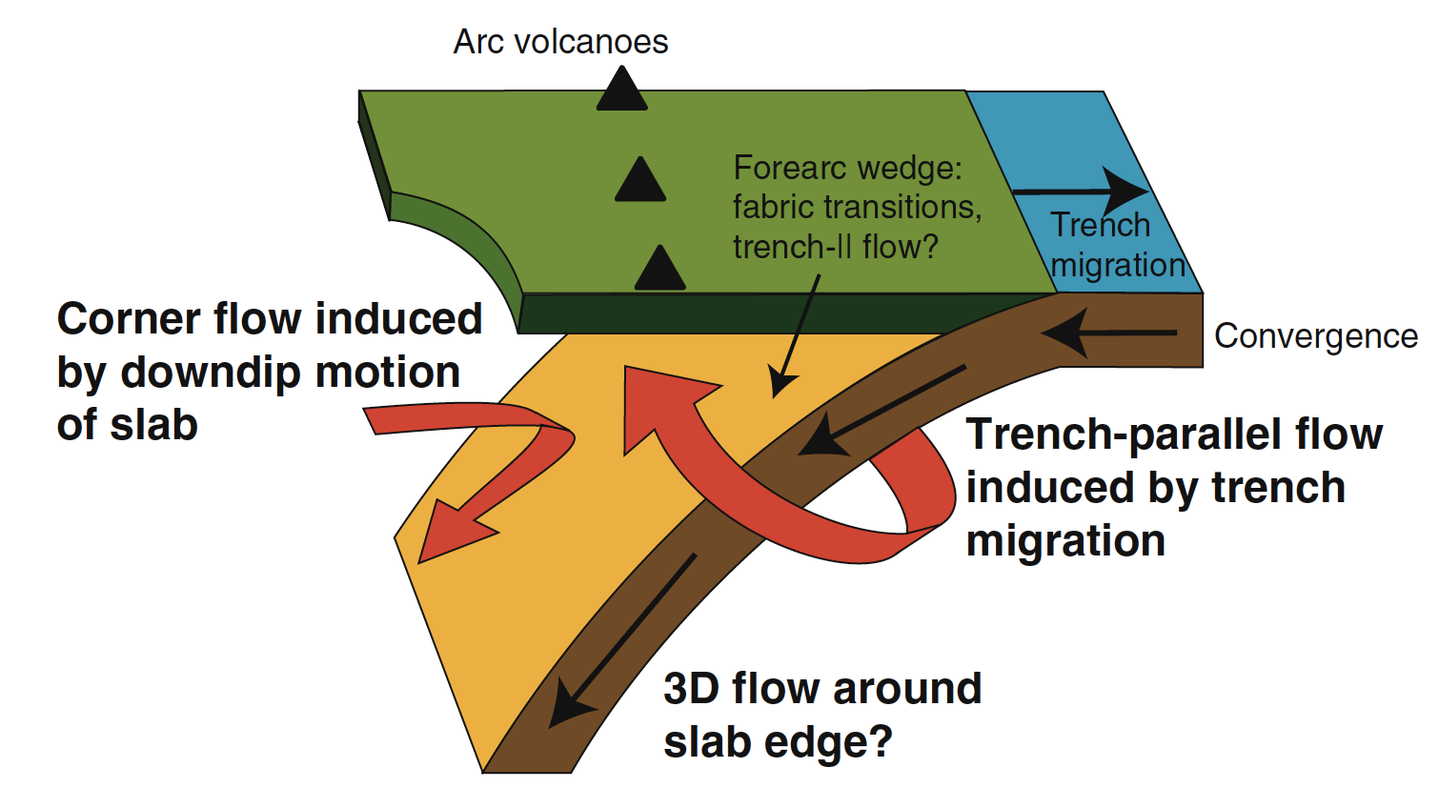
Is there segmentation in anisotropy?
Does it match segmentation in along-arc deformation style (GPS, tremor, slow slip)?
Does it result from segmentation in the rate of slab rollback?
Long and Silver (2009)

