Slide 1
Prehistoric, Headwater-Basin-Encompassing Debris-Avalanche Landslides, Northern California Coast Ranges:
Temporal Association With Plate Boundary Earthquakes
Harvey Kelsey, Humboldt State University, Arcata CA
Brian Sherrod, USGS, Seattle WA
Steve Angster, USGS, Seattle WA
J Scott Padgett, Geography, Durham Univ., UK

Slide 2
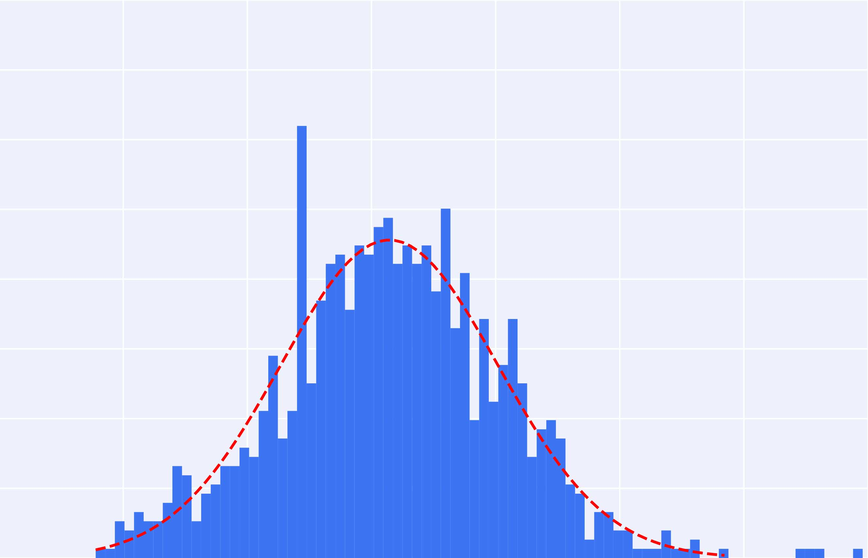
0.8
Size distribution: historic and prehistoric landslides
0.7
0.6
Historic
landslides
Prehistoric
headwater-basin-
encompassing
debris avalanches
n = 4
Avg volume = 4.93 x 10⁶
0.5
n = 978
Count in each bin (normalized to form a pdf)
0.4
Avg volume =
3.14 x 10³
0.3
0.2
0.1
1
2
3
4
5
6
7
Log₁₀ landslide volume (m³)

Slide 3
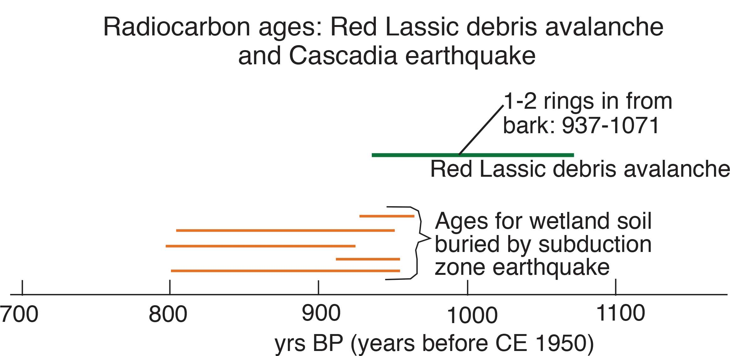
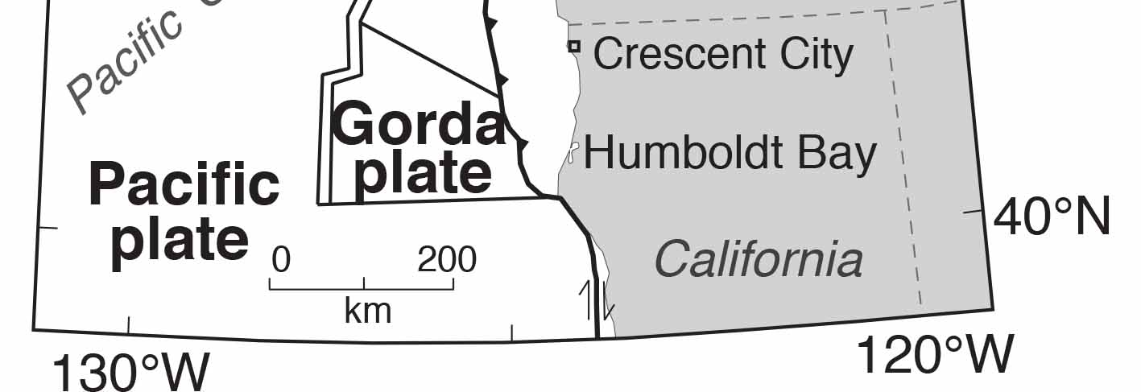
Red Lassic

Slide 4
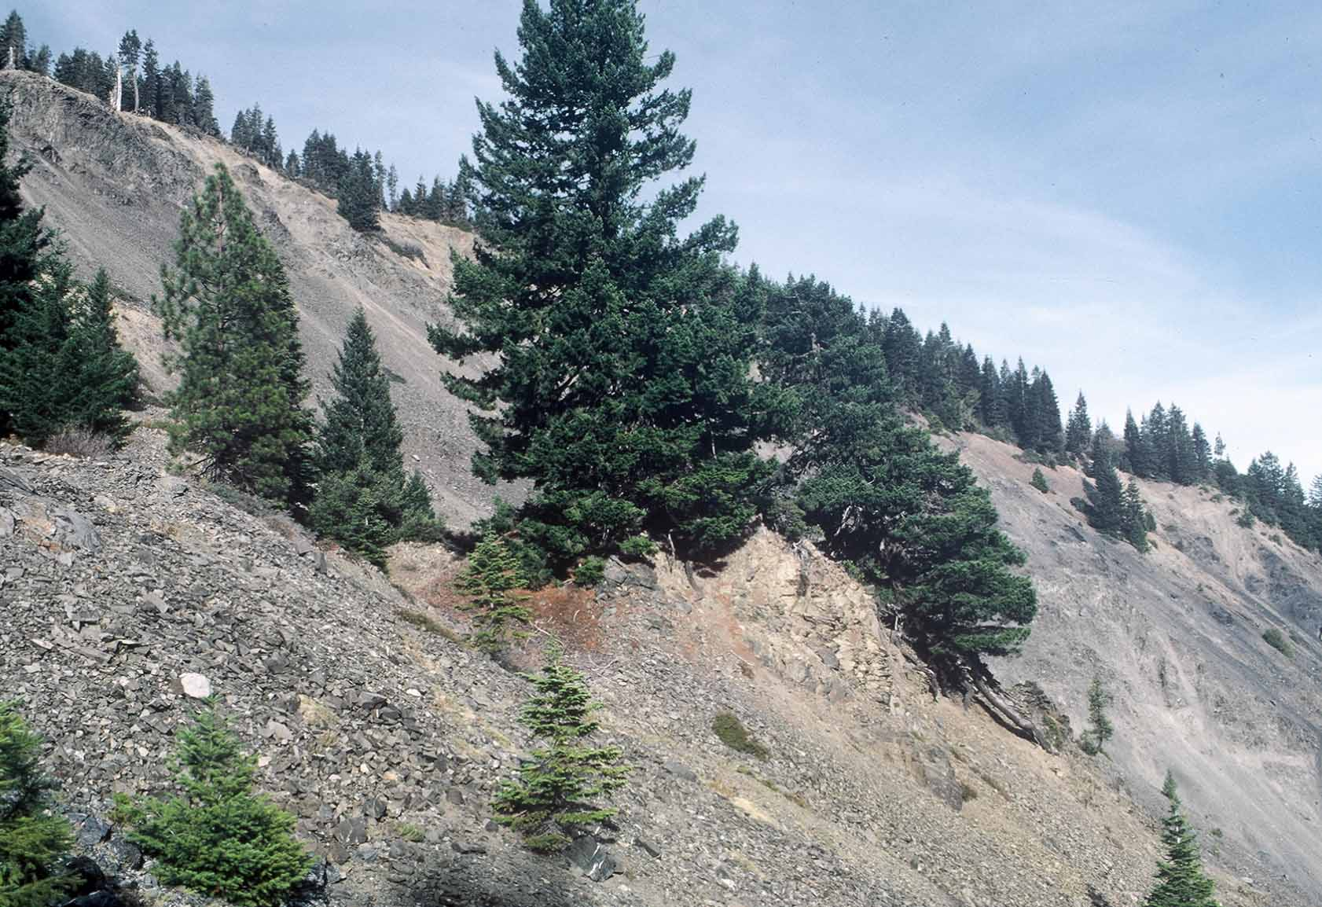
Tilted trees on
coherent mid-slope
slide block

Slide 6
Tilted trees on
coherent mid-slope
slide block

Slide 7
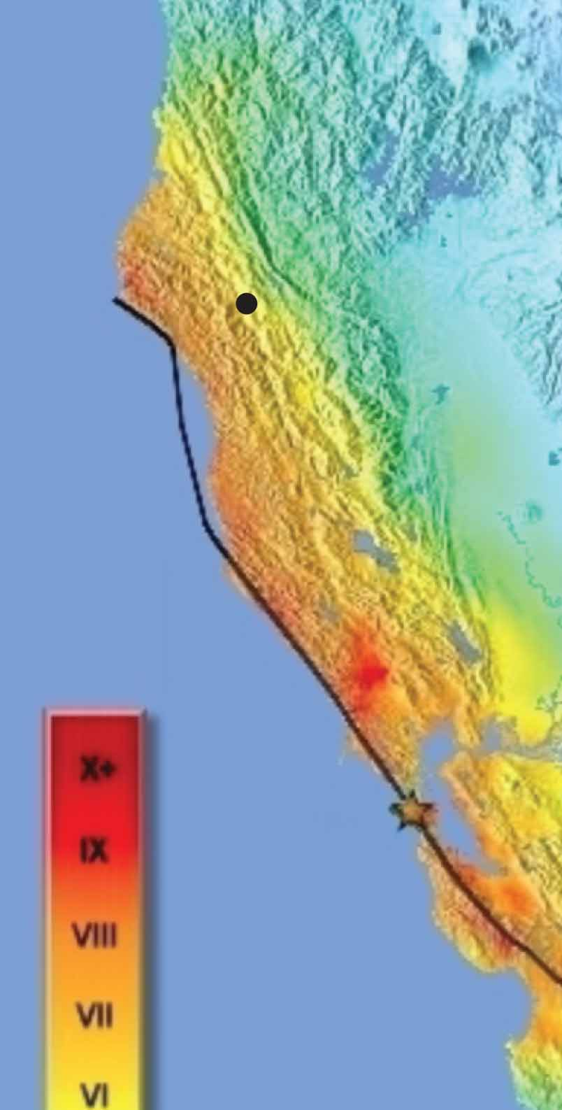
Age coincidence
CE 1902-1906: Inferred age of Mule Debris Avalanche
April 18, 1906: San Francisco earthquake
Northern California Coast Range:
Felt intensities in the VI-VII range
Mule Slide
Modified Mercalli Intensity Map
1906 San Francisco Earthquake
Boatwright and Bundock (2005)

Slide 8
Prehistoric, Headwater-Basin-Encompassing Debris-Avalanche Landslides:
Temporal Association With Plate Boundary Earthquakes

