Slide 1
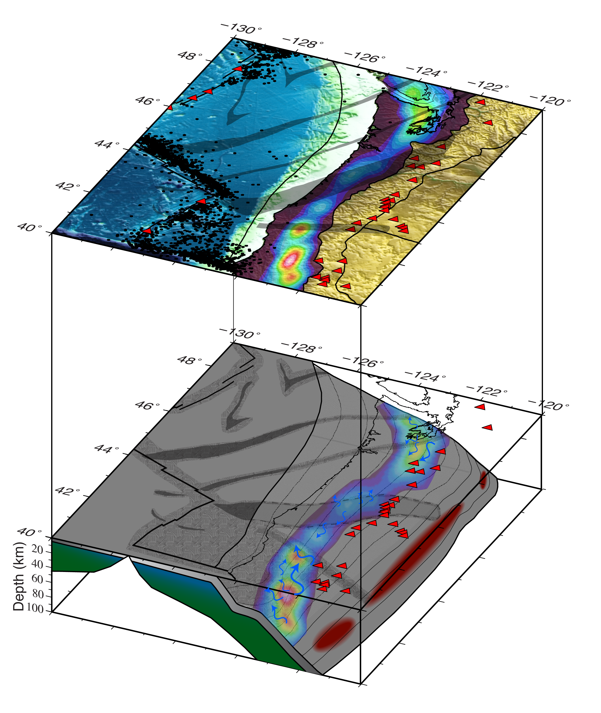

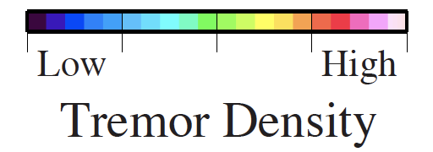
The seismic expression of hydration in the
crust and mantle of the Cascadia margin
Jonathan R. Delph
Post-doctoral Researcher
Amanda M. Thomas
Alan Levander
Fenglin Niu
Notes:
I would like to present new seismic images along the margin of Cascadia and investigate how these images relate to heterogeneities along the margin itself

Slide 2
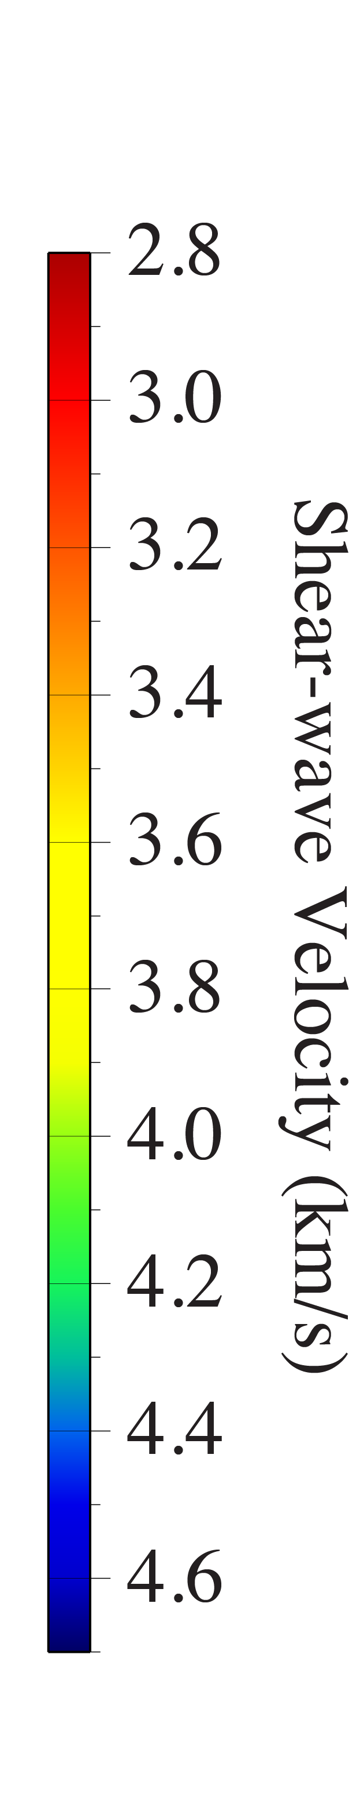
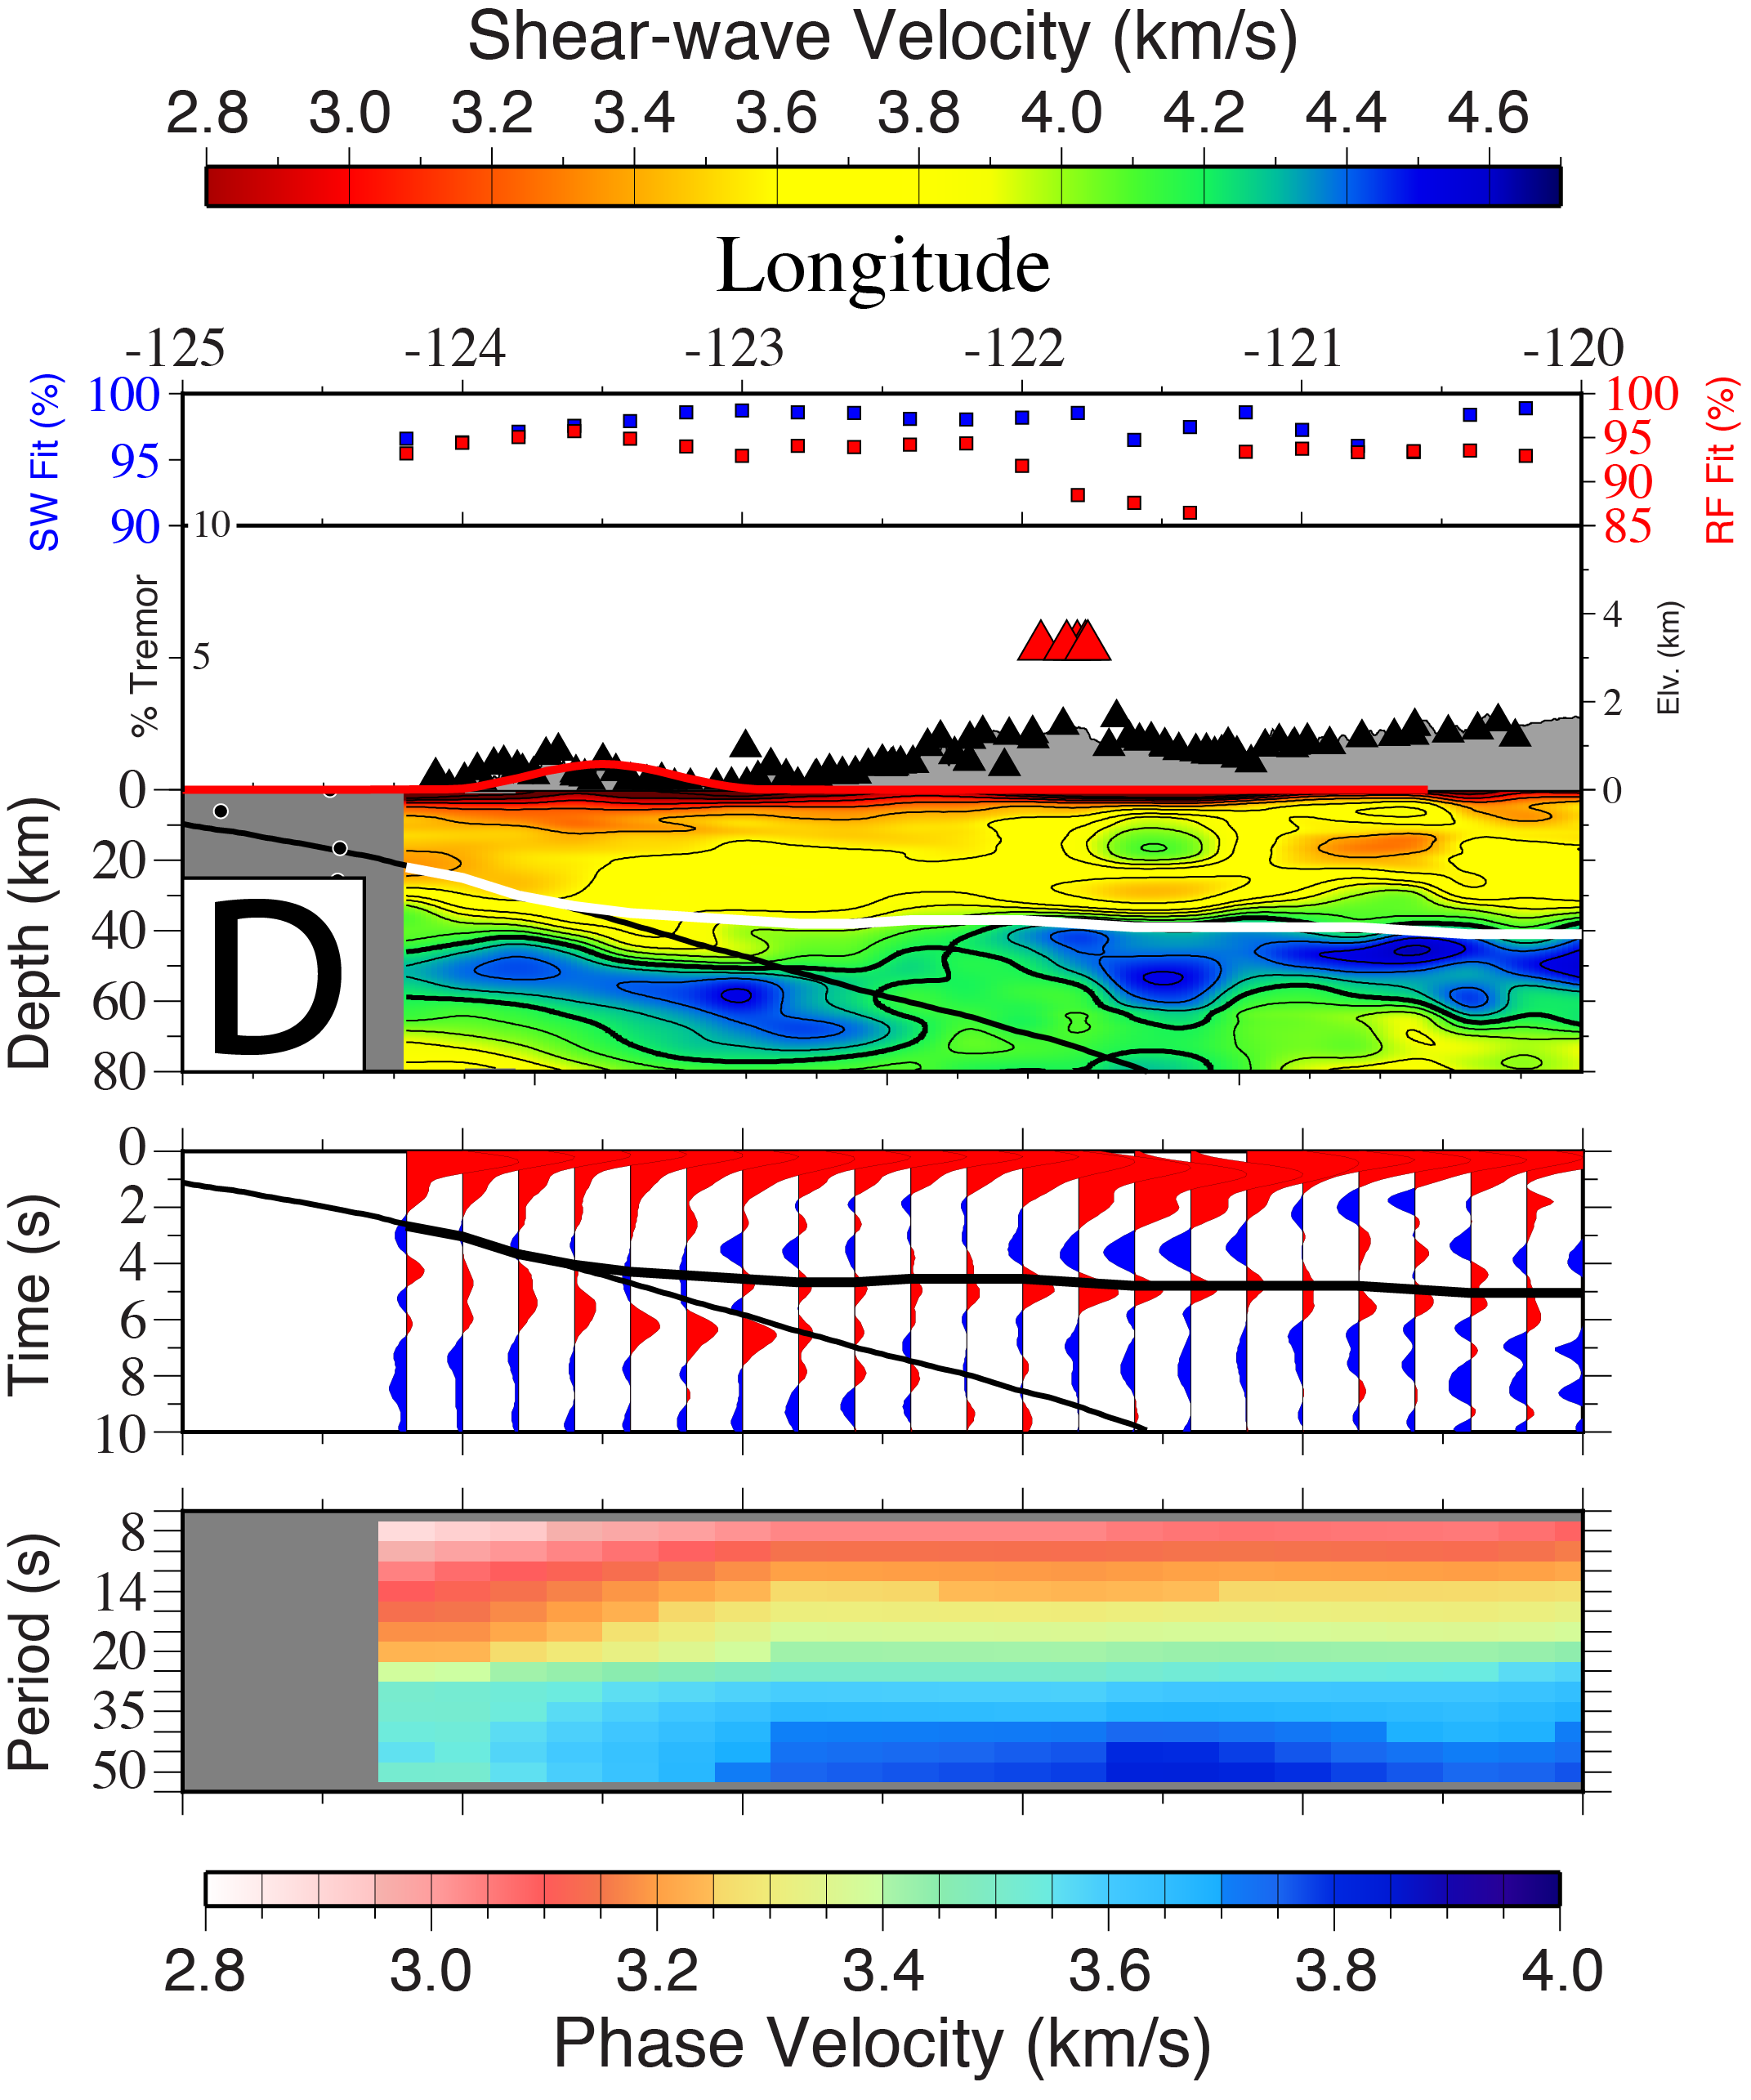
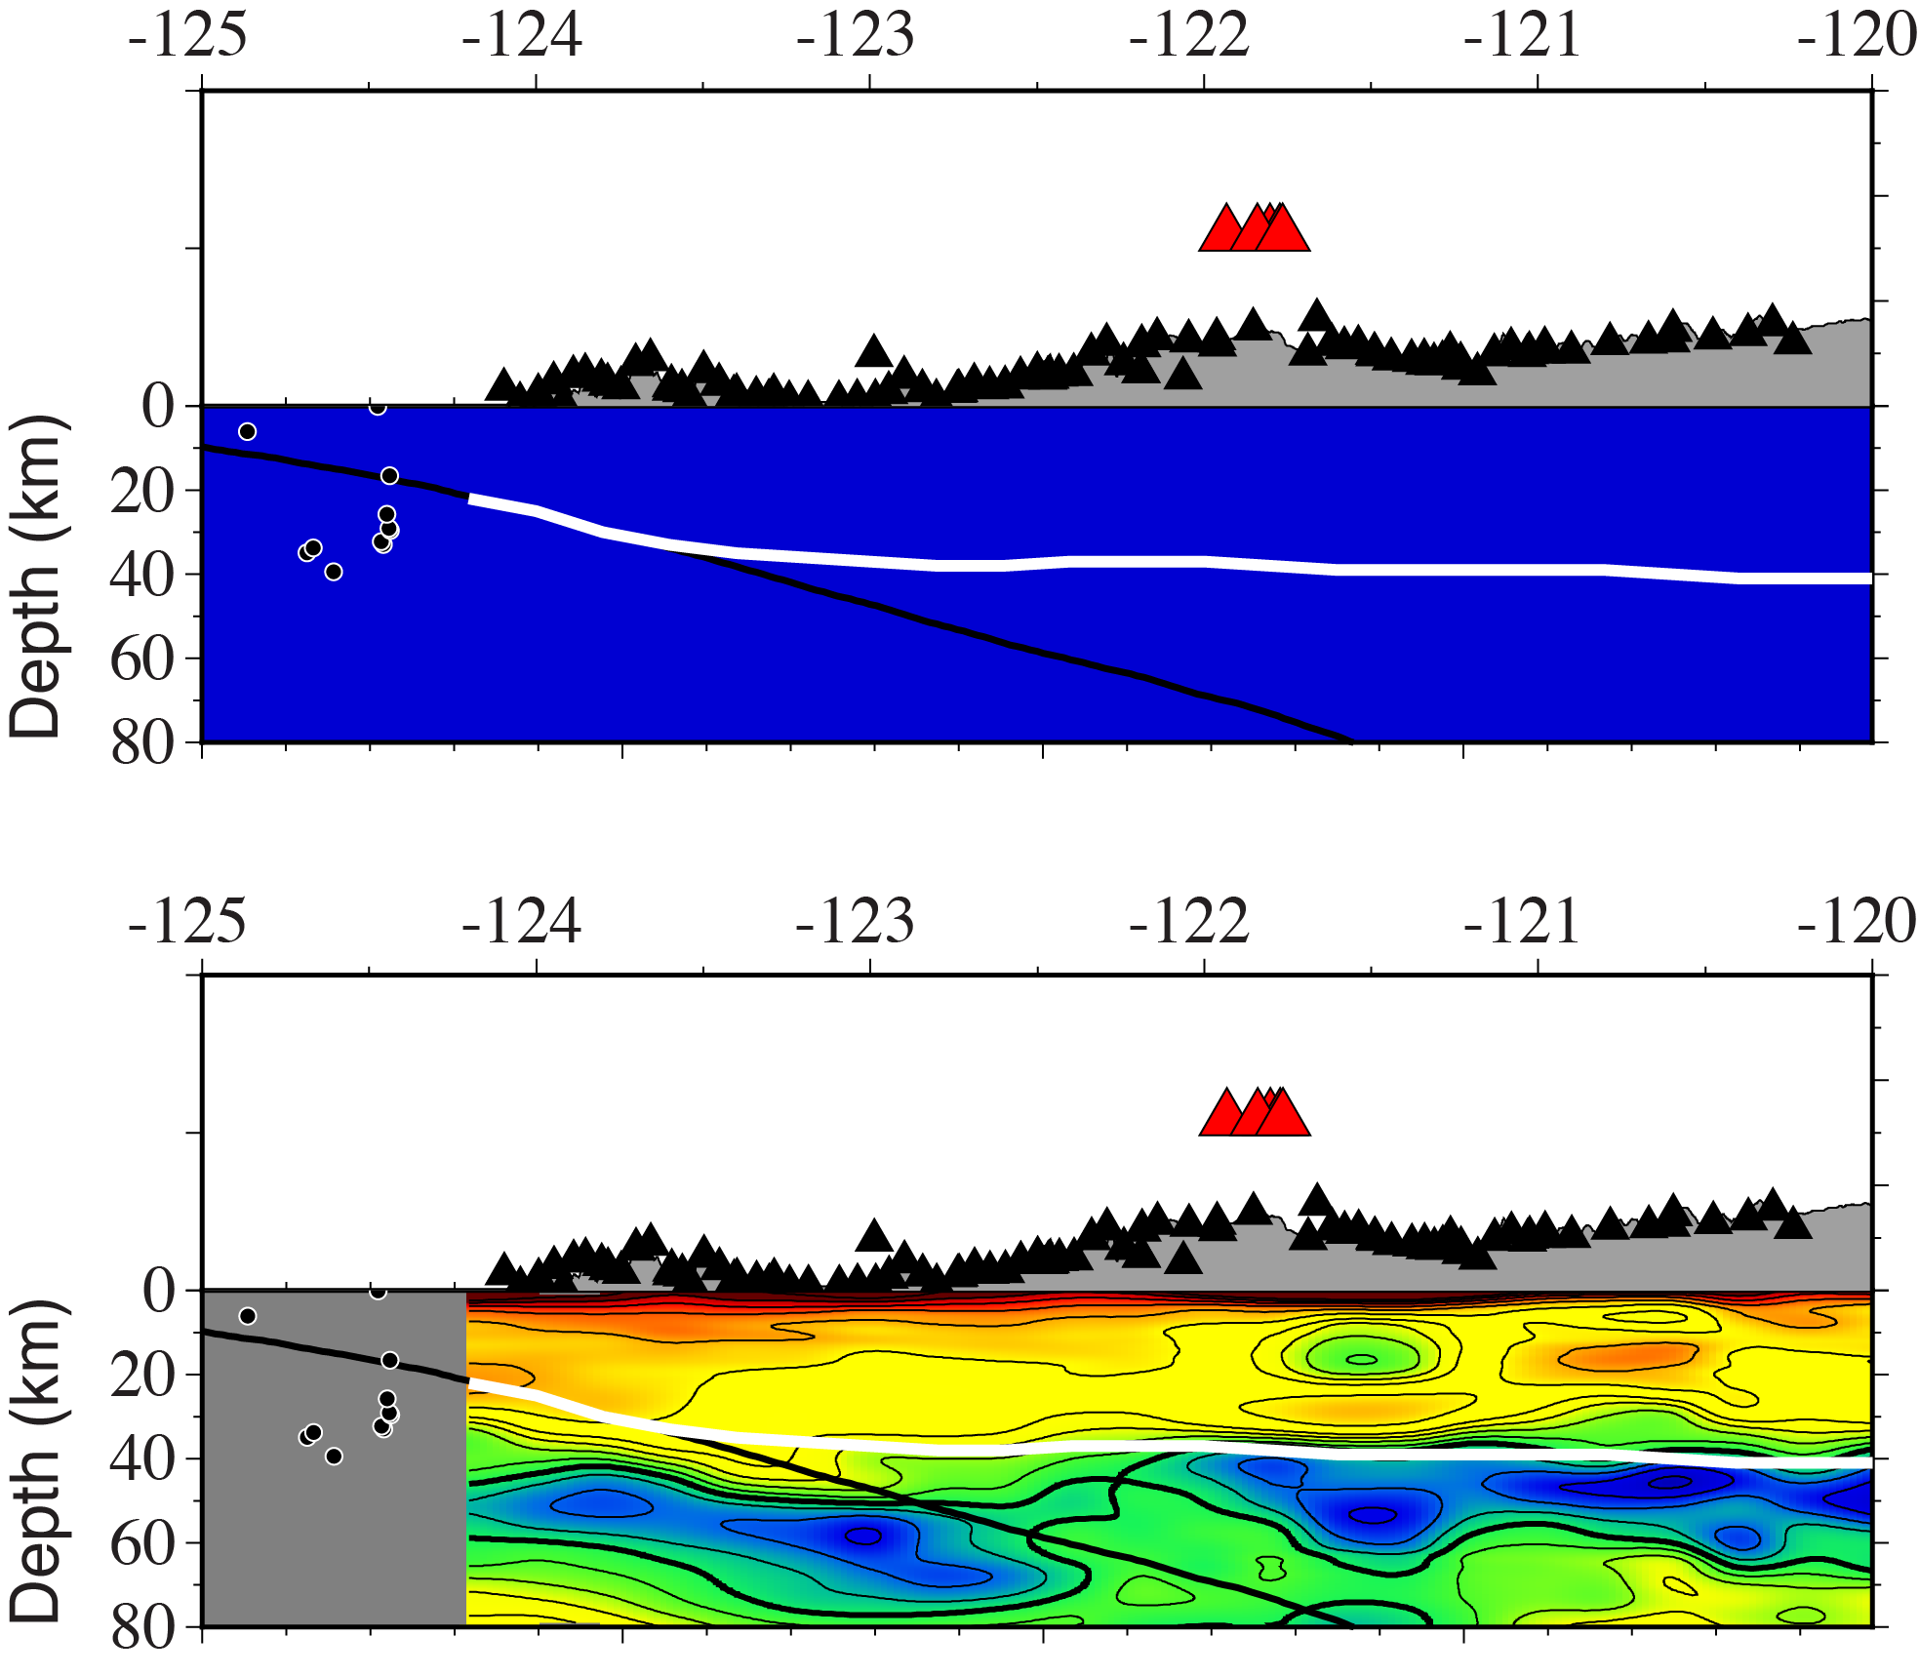
Imaging the crust and upper mantle
- The joint inversion of complementary datasets
Adaptive CCP Stacking
Starting Model
Moho
Top of Slab
Final Model
ANT Rayleigh Wave Dispersion

Slide 3
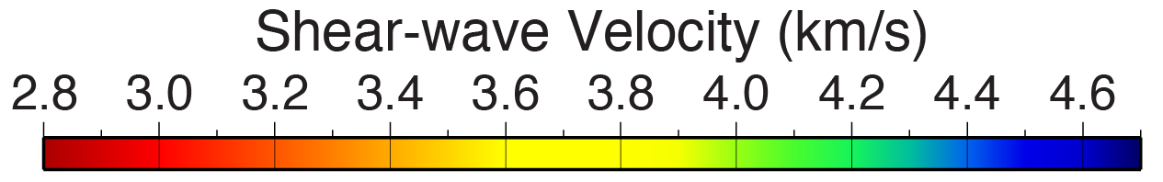
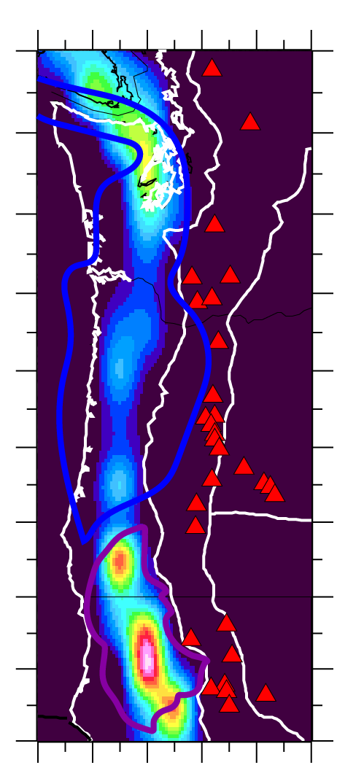
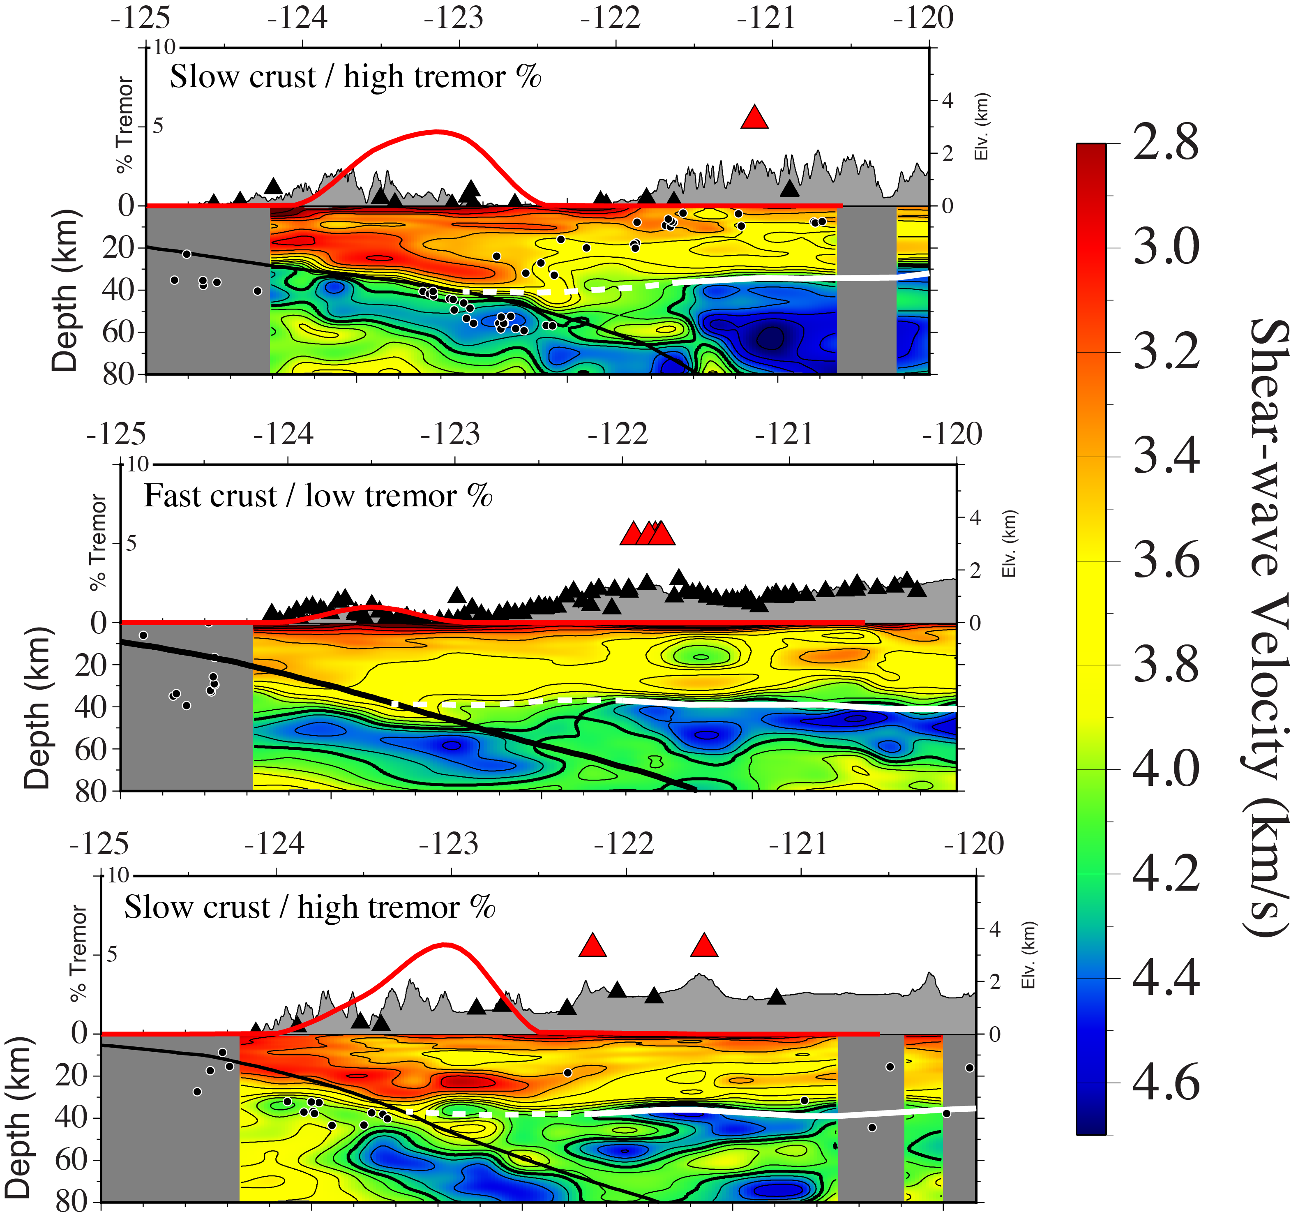
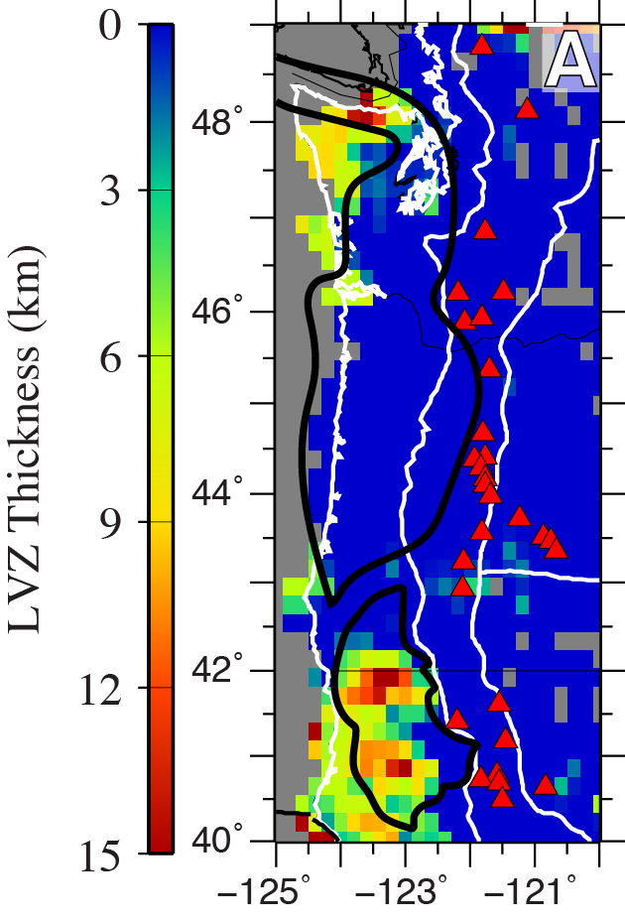
The seismic structure near NVT
Note low NVT

Slide 4
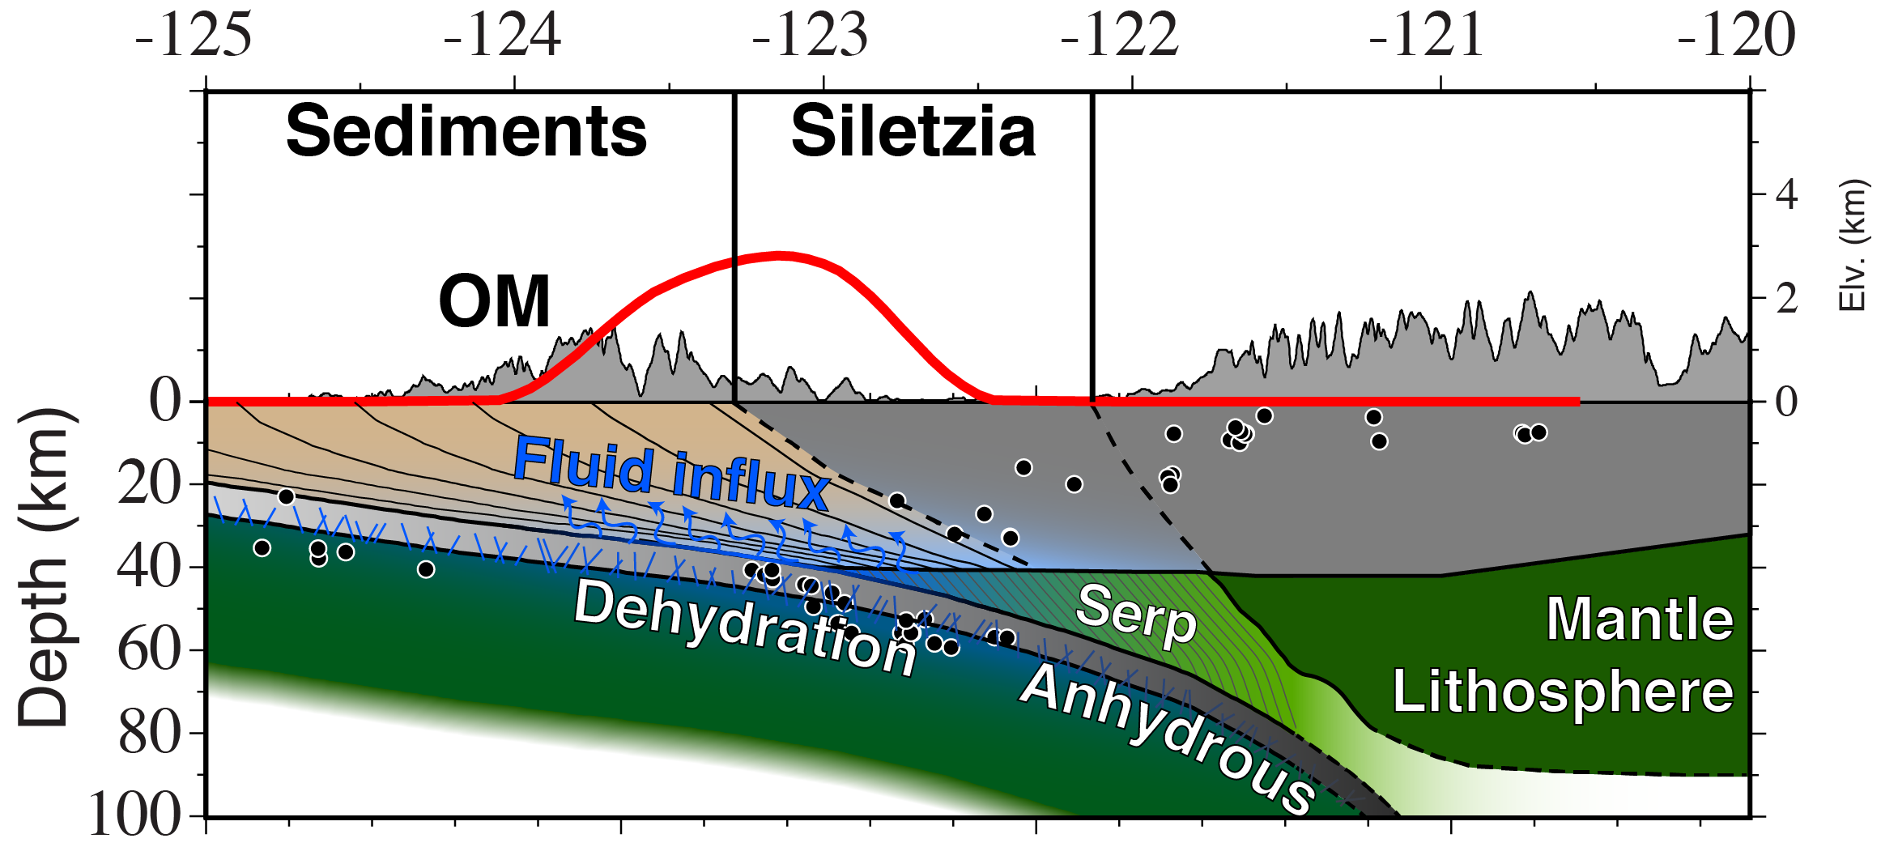
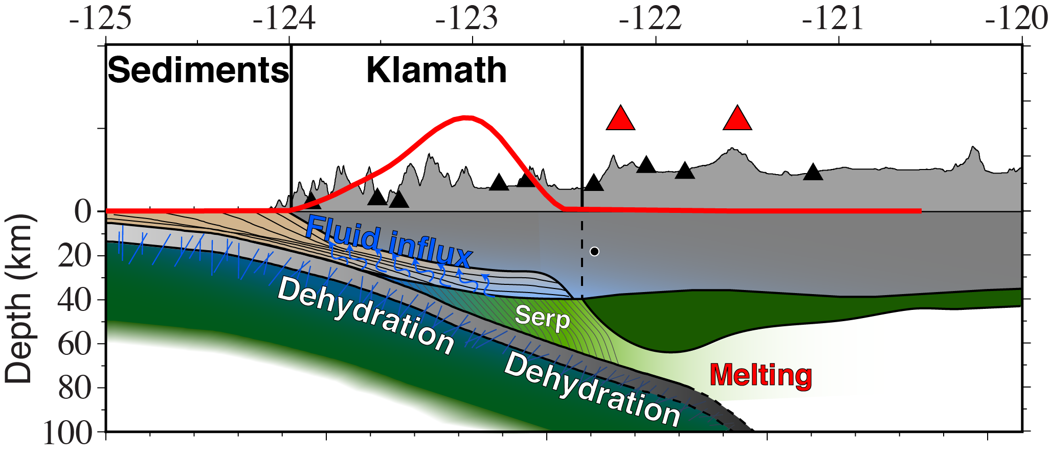
The seismic structure near NVT

Slide 5
The seismic structure near NVT
Part 1:
What controls lateral variations in NVT?
Underthrust sediments (expressed as LVZ)

Slide 6
The seismic structure near NVT
Part 1:
What controls lateral variations in NVT?
Underthrust sediments (expressed as LVZ)
Part 2:
What controls the depth extent of NVT?

Slide 7
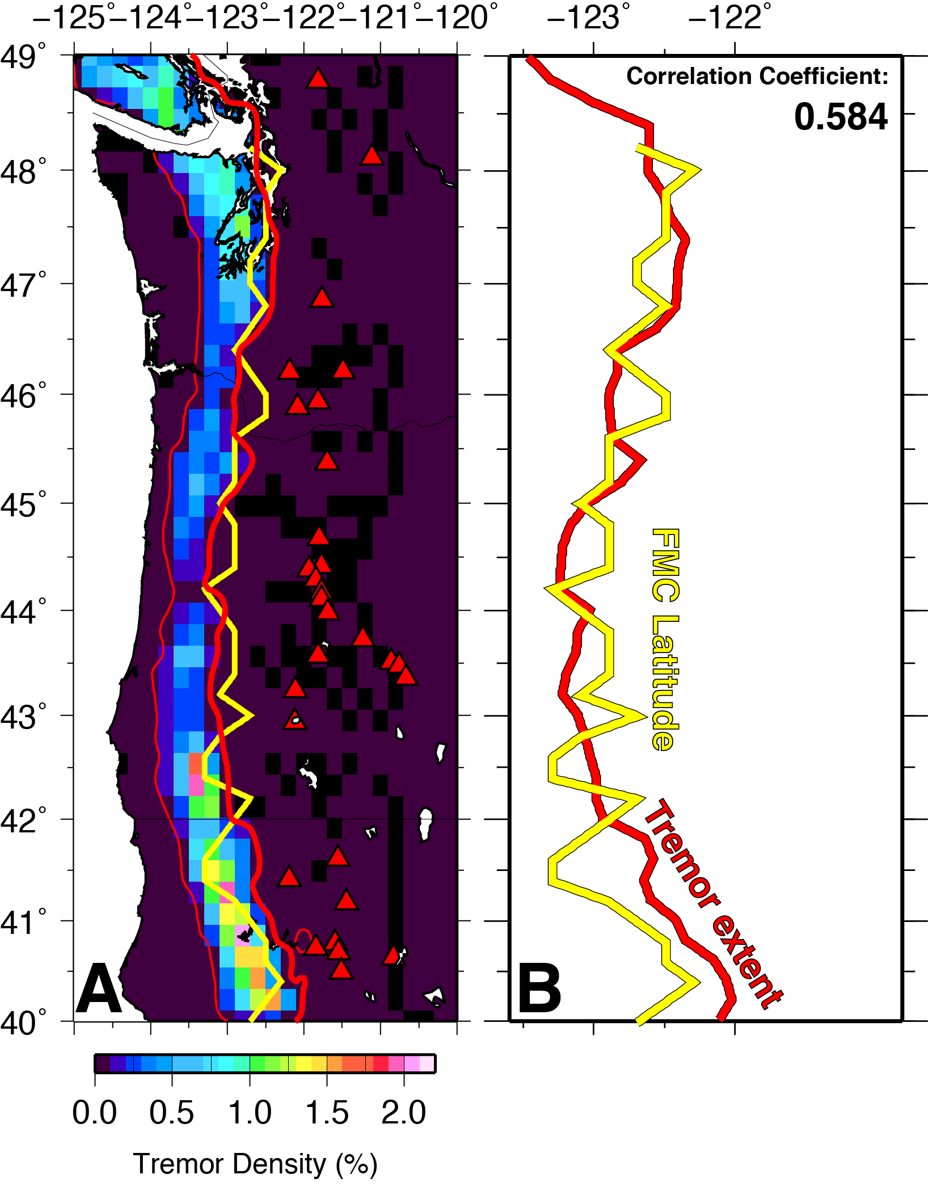
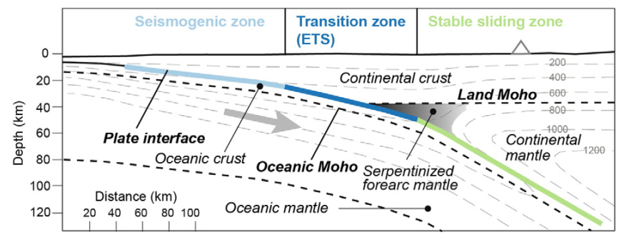
NVT and the
forearc mantle corner
FMC

Slide 8
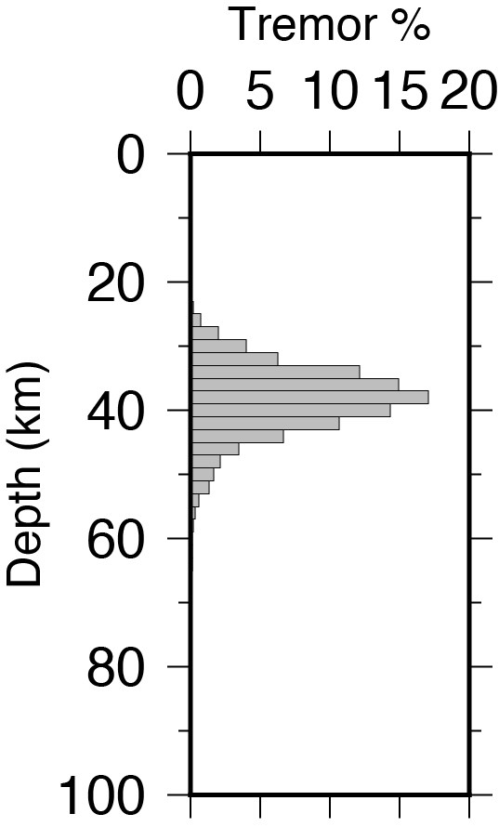
NVT and the
forearc mantle corner
FMC
The vast majority of NVT occurs updip of FMC
% Tremor updip of FMC: 83.5%

Slide 9
NVT and the
forearc mantle corner
FMC
Megathrust
NVT
Aseismic
The vast majority of NVT occurs updip of FMC
% Tremor updip of FMC: 83.5%

Slide 10
Conclusions
Part 1:
What controls lateral variations in NVT?
Underthrust sediments (expressed as LVZ)
Part 2:
What controls the depth extent of NVT?
The forearc mantle corner
Notes:
Blow up and annotate forearc mantle corner:

