Slide 1
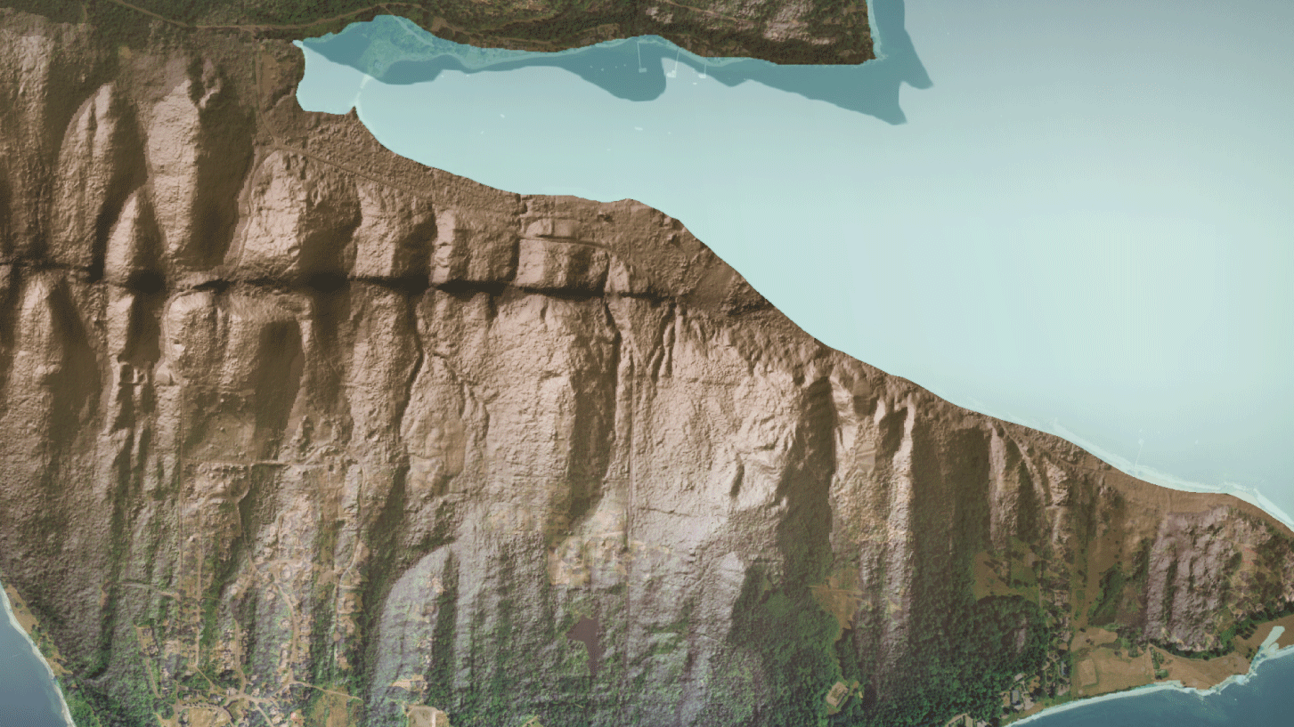
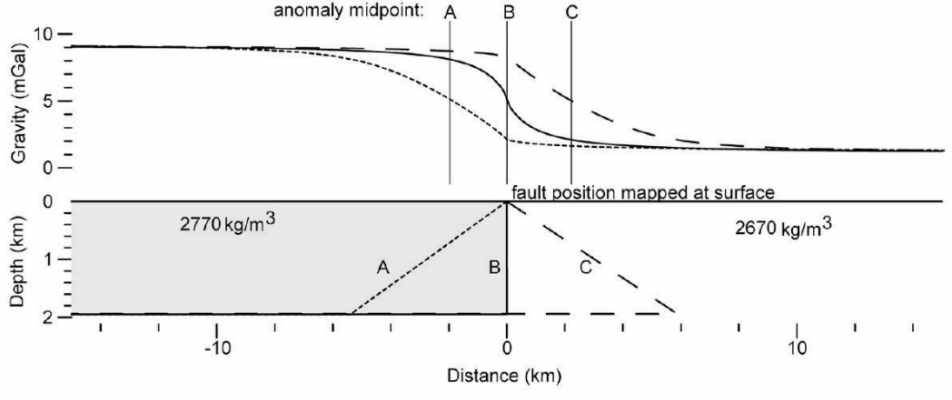
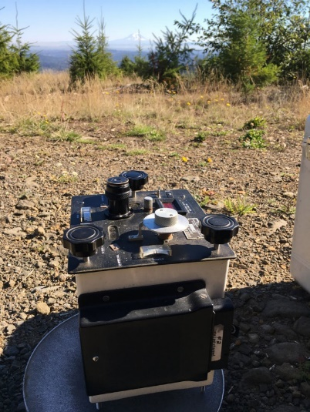
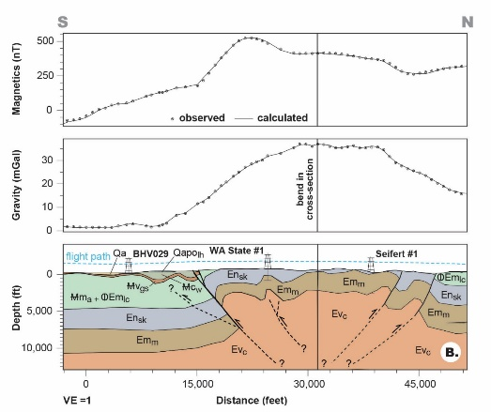
Utility of Using Gravity Data to Map Active Faults in Washington Megan Anderson, Washington Geological Survey
Gravity (and aeromagnetic) data constrains vertical or steeply-dipping fault location and geometry
Great complement to seismic studies, geomorphology
It ain’t cutting edge, but it’s darn useful!
Especially useful with strong density contrast (e.g. Siletzia mafic rocks vs. younger sediment)
Allows precise interpretation of boundary location and often dip (from anomaly shape, inflections)
Mt. Rainier
80’s era gravimeter—still produces great data
Saltus and Blakely (2011)
Doty fault—in review
Guides interpretation of fault lateral extent...

Slide 2
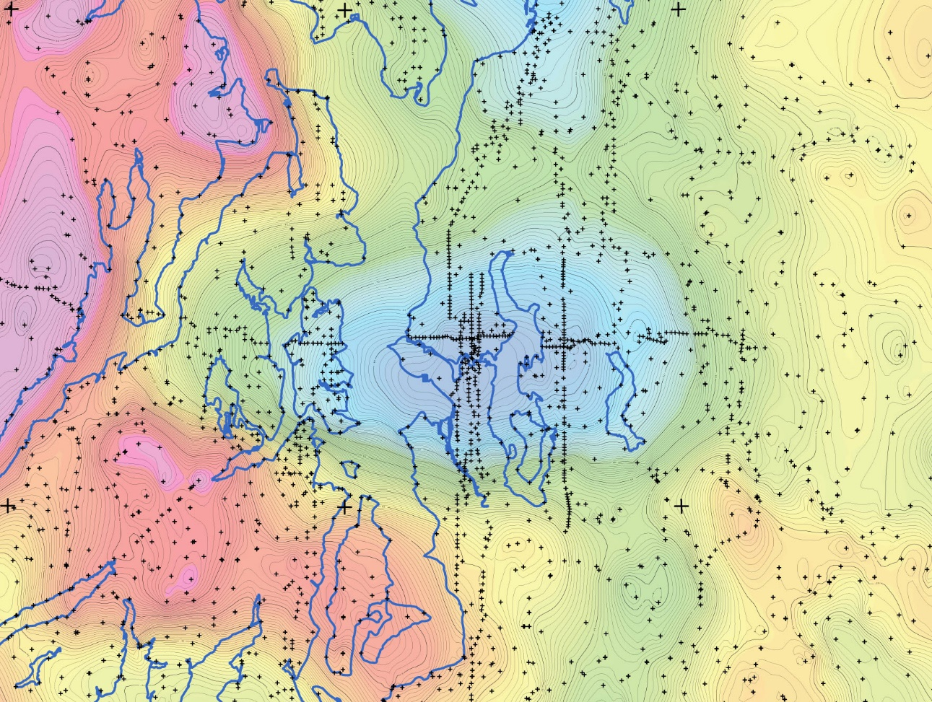
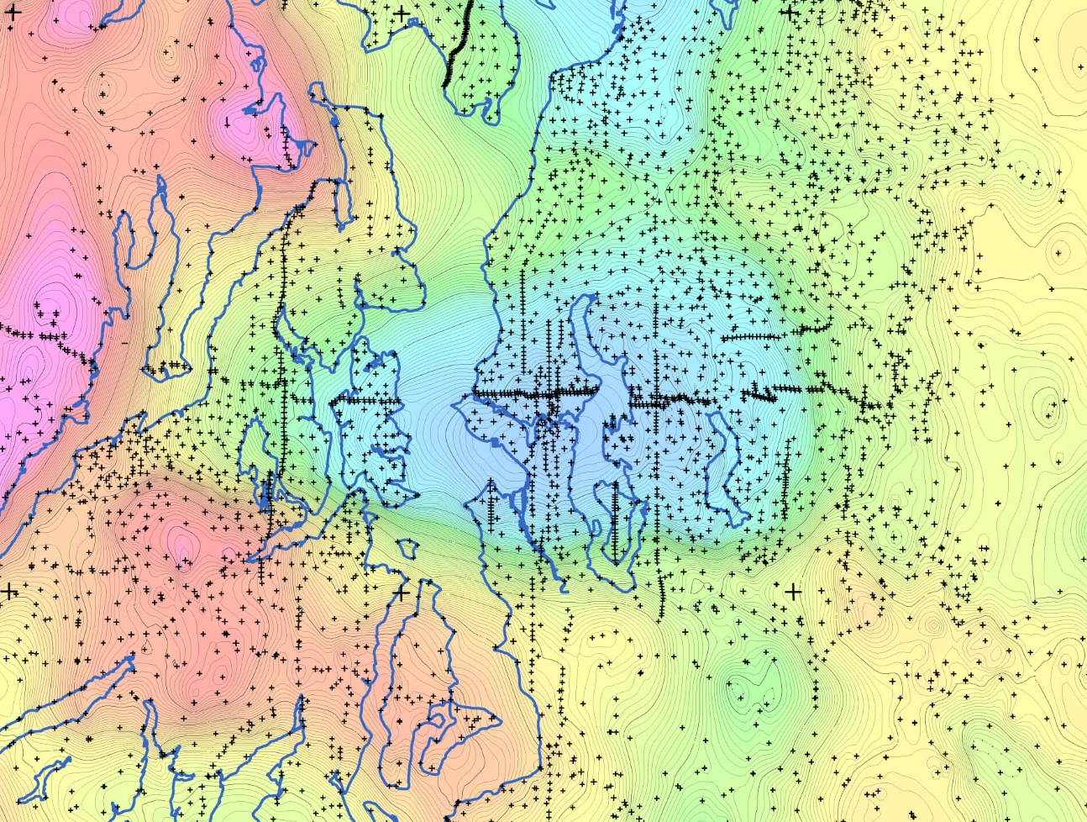
Seattle Basin and Faults With Consistent Data Spacing
Fault identification and lateral continuity
-123°
-122°30’
-122°
-123°
-122°30’
-122°
48°
47°30’
2005 Data
2017 Data
Contour interval = 1 mGal

Slide 3
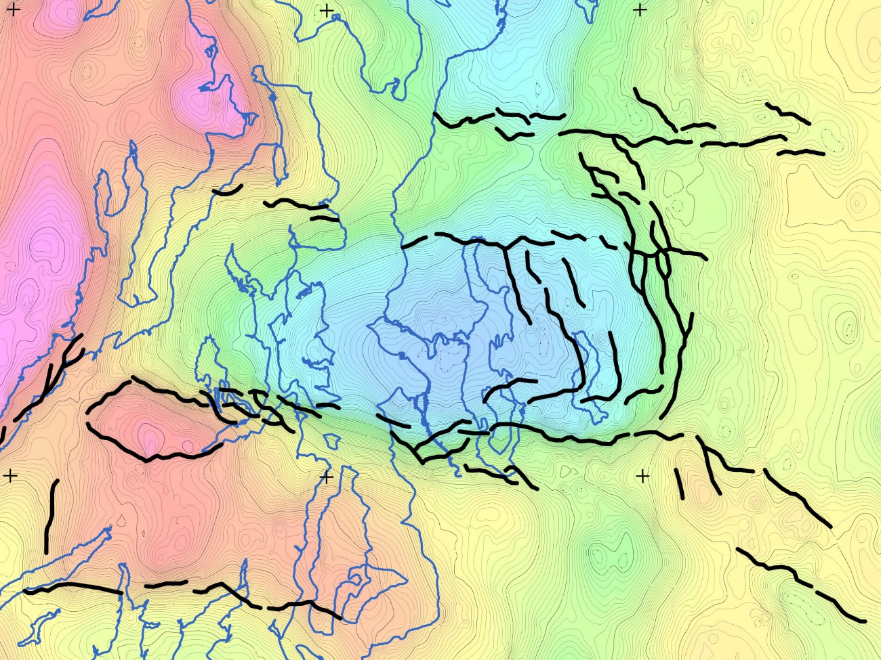
Seattle Basin and Faults With Consistent Data Spacing
Fault identification and lateral continuity
-123°
-122°30’
-122°
-123°
-122°30’
-122°
48°
Monroe FZ
Kingston Arch Structure
SWIF
SWIF
Strands?
Seattle FZ
SF Dfmn Front
Rattlesnake FZ
47°30’
Tacoma Fault
2017 Lineaments (gradient maxima)
2017 Data
Contour interval = 1 mGal
Data can also be used to detail edges for basin effects

Slide 4
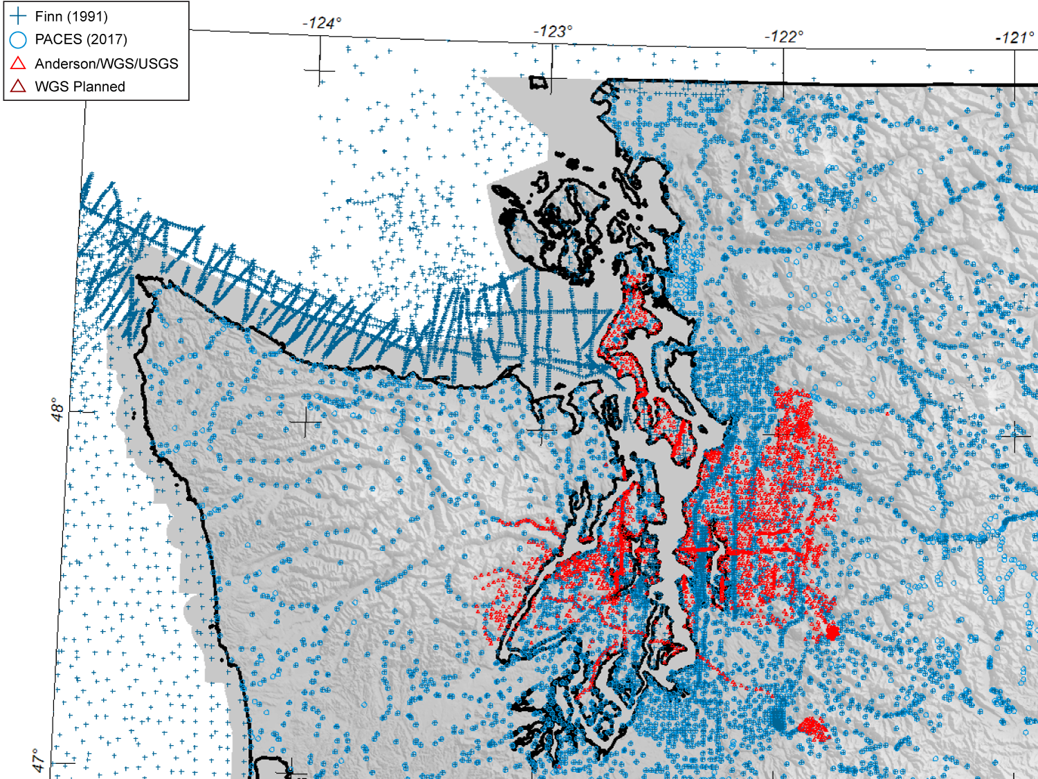
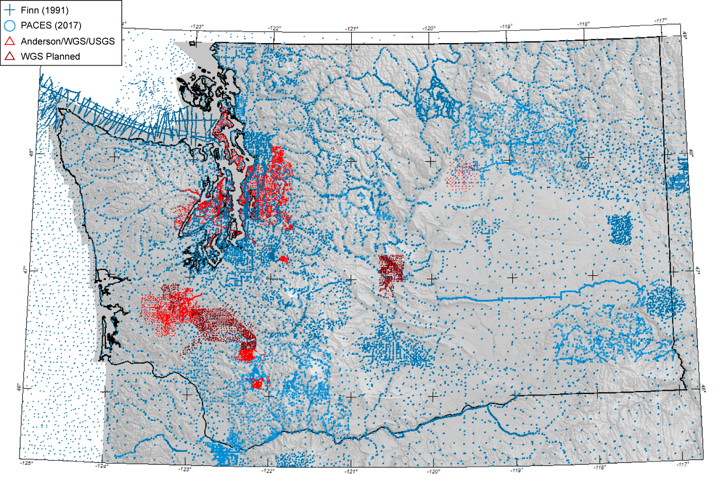
This Data Seems Pretty Useful
What do you mean its not downloadable?!
No online database currently exists (PACES is now defunct)
Clean, well documented data
has long been a problem
WGS is currently working on a curated database that solves these issues for Washington

