Slide 1
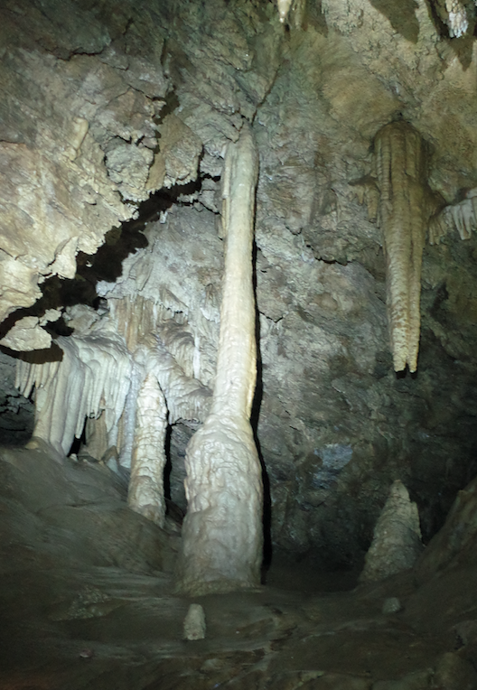
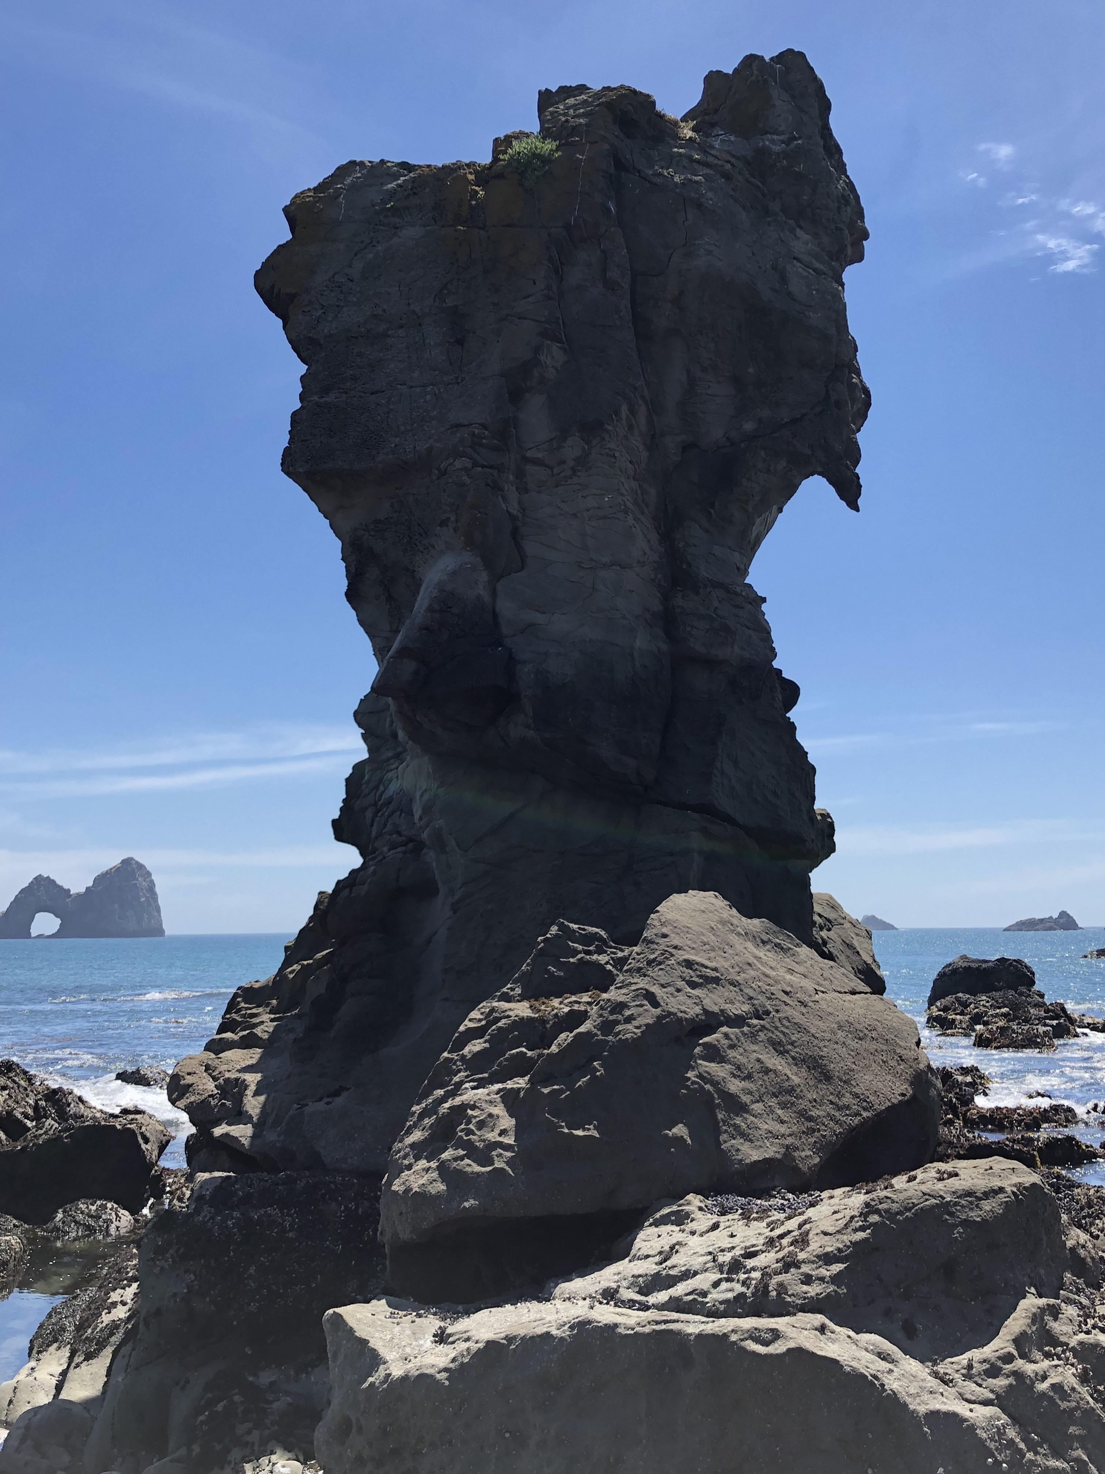
Fragile features as megathrust ground motion intensity constraints
Devin McPhillips
KM Scharer
USGS Pasadena
For PSHA, need (1) fragility and (2) age

Slide 2
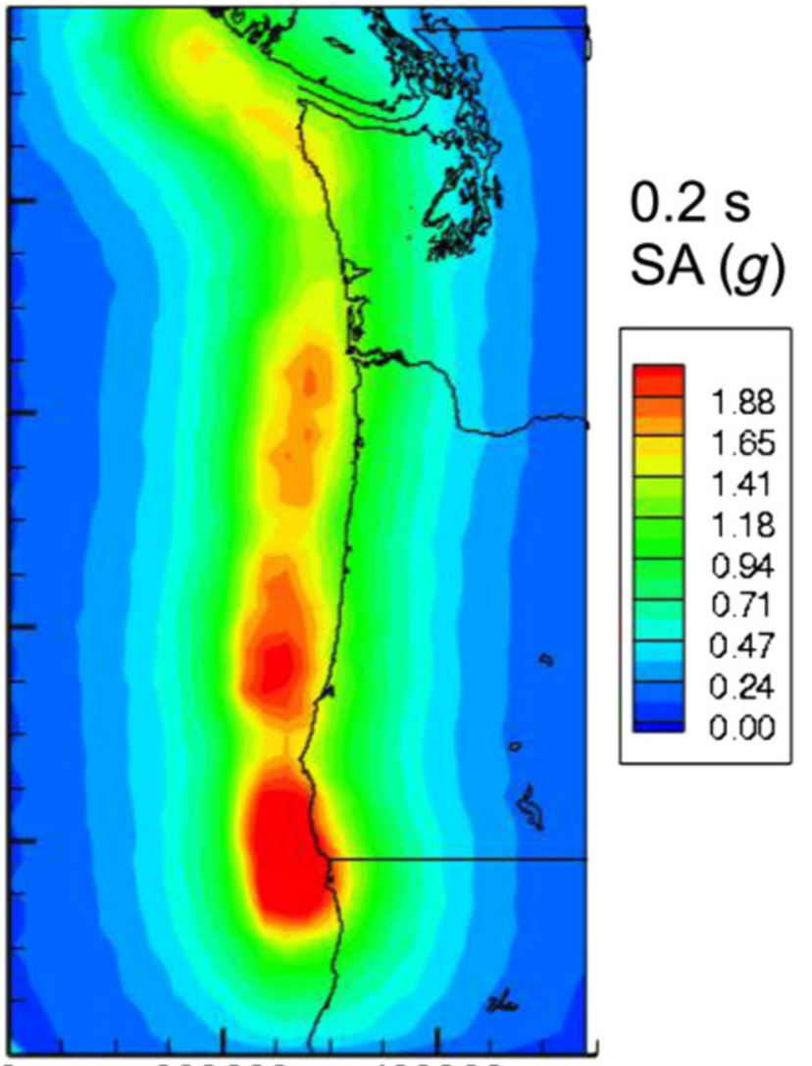
Sea stacks
PBRs
Sea stacks
Survey results from Bandon OR to Brookings OR (130 km)
Quasi-static analysis for Euler-Bernoulli beam
Frankel, Wirth, +, 2017 BSSA

Slide 3
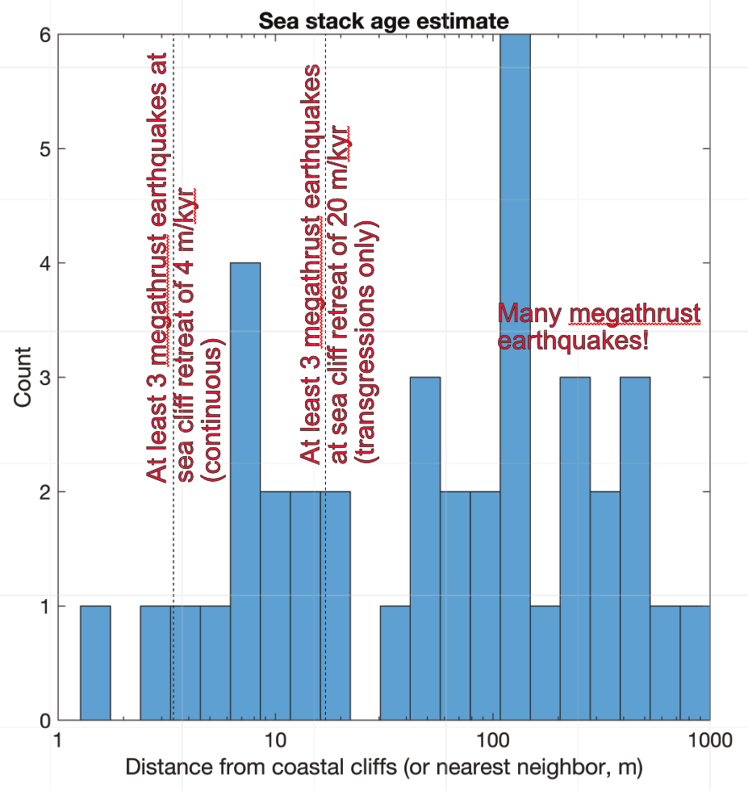
More work to do:
Structural engineering analysis (FEMs)
Trona Pinnacles case study (Ridgecrest EQ)
Cosmogenic radionuclide exposure dating
Extend survey along strike!

