Slide 1
Tectonic implications and deformation rate recorded by Pleistocene terraces above the Cascadia Subducton Zone, southwestern Washington
K. Stanton
University of Washington

Slide 2
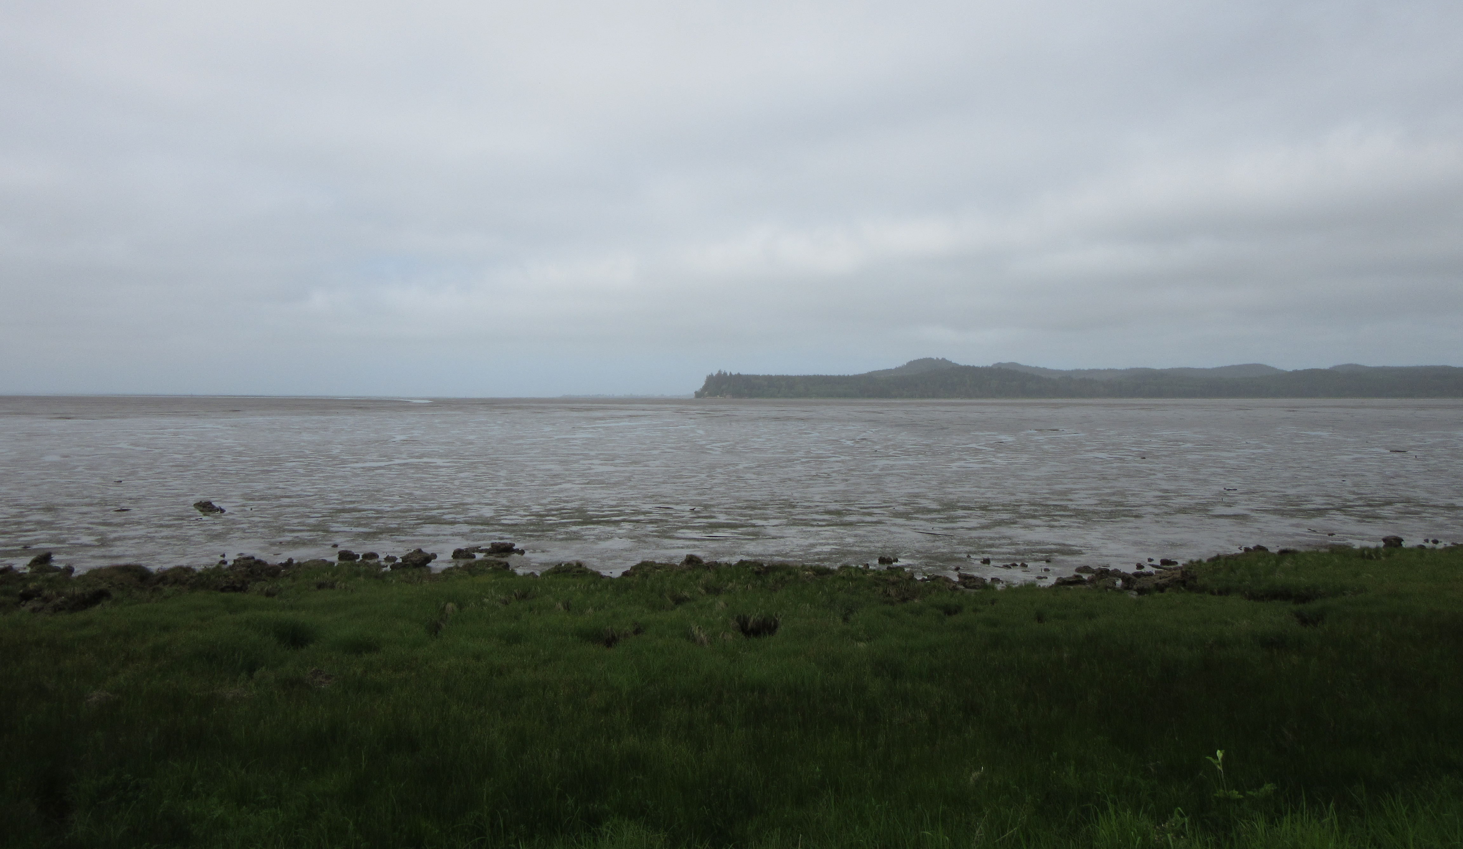
Driving Questions
What is the record of subduction-related deformation at the timescale of a million years?
Is there a geomorphic signature of this deformation along the Washington coast?
Uplifted Pleistocene marine terraces may provide insight to mechanisms and timing of deformation above the Cascadia Subduction Zone.
Notes:
This leads to my driving questions. What is the record of subduction-related deformation at the timescale of a million years? Can we see a geomorphic signature of this deformation along the Washington coast? I propose that uplifted Pleistocene marine terraces along the southwestern Washington coast may provide insight into the mechanisms and timing of deformation above the CSZ.

Slide 3
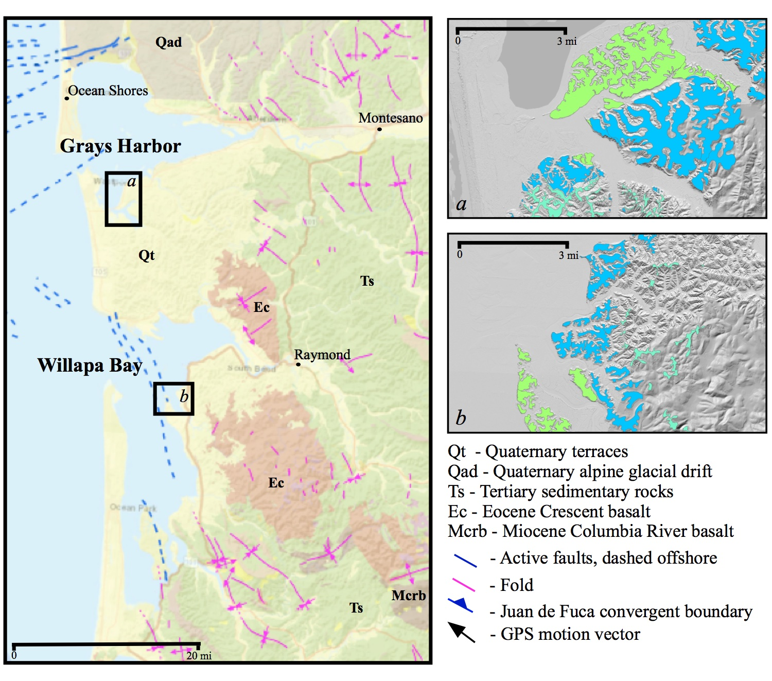
Uplifted marine Terraces In SW Washington
Previously mapped as a single unit in the 1960s.
Recent lidar shows multiple terrace sets around Grays Harbor and Willapa Bay.
Highest terraces over 120 m a.s.l.
Height cannot be explained by sea-level change or glacial-isostatic rebound.
Dating of lowest terrace by amino acid racemization shows age around 120,000.
Washington Geological Survey Information Portal 1:100,000 scale map

Slide 4
Terraces in SW Washington
Mapping during summer 2019 suggests variety of deposits, including fluvial and estuarine deposits
Estuarine deposits follow descriptions from Clifton (1983) of alternating mud flat deposits, tidal current deposits, and fluvial deposits.
Notes:
Update map and text

Slide 5
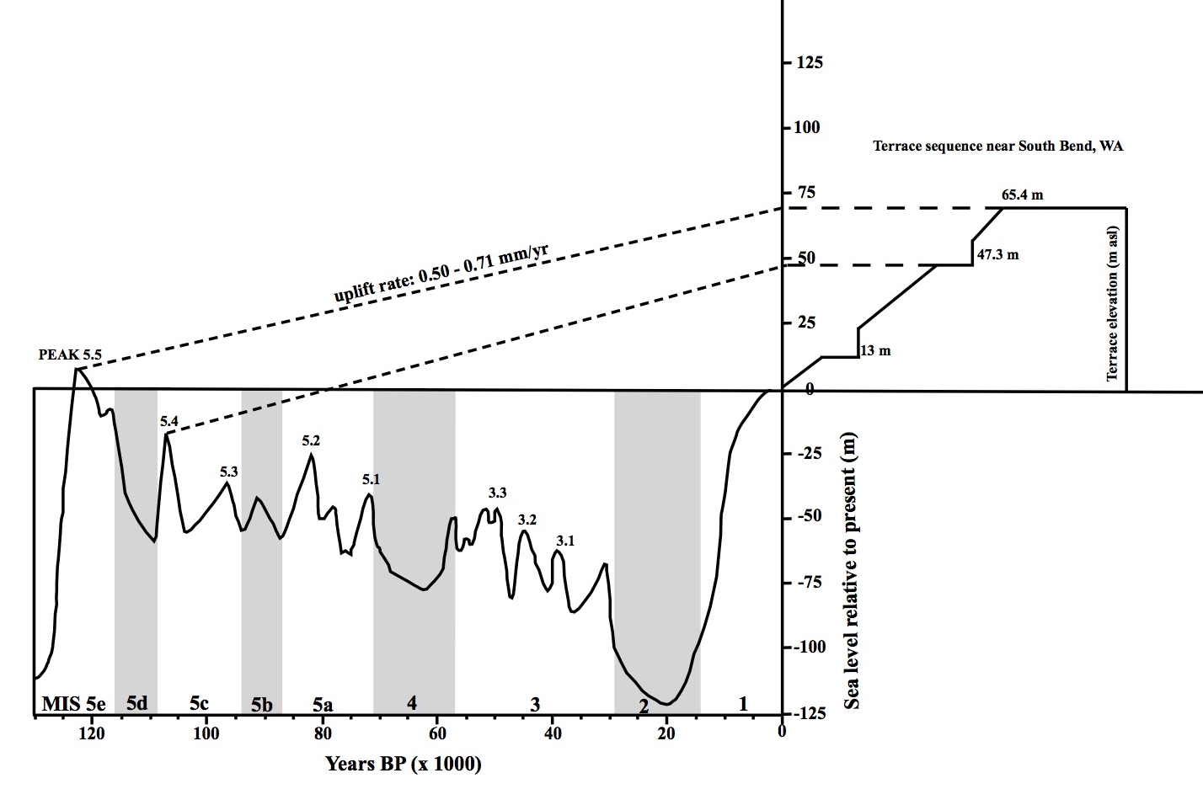
Implications from New Data
OSL dates on terraces near South Bend suggest uplift rates between 0.50-0.71 mm/yr.
Less than current geodetic uplift rates of 1.5-3 mm/yr. (Miller et al., 2018;Li et al., 2018)
Current rates include strain that will be recovered elastically during a megathrust event
Longterm average rate thus more closely represents total uplift.

Slide 6
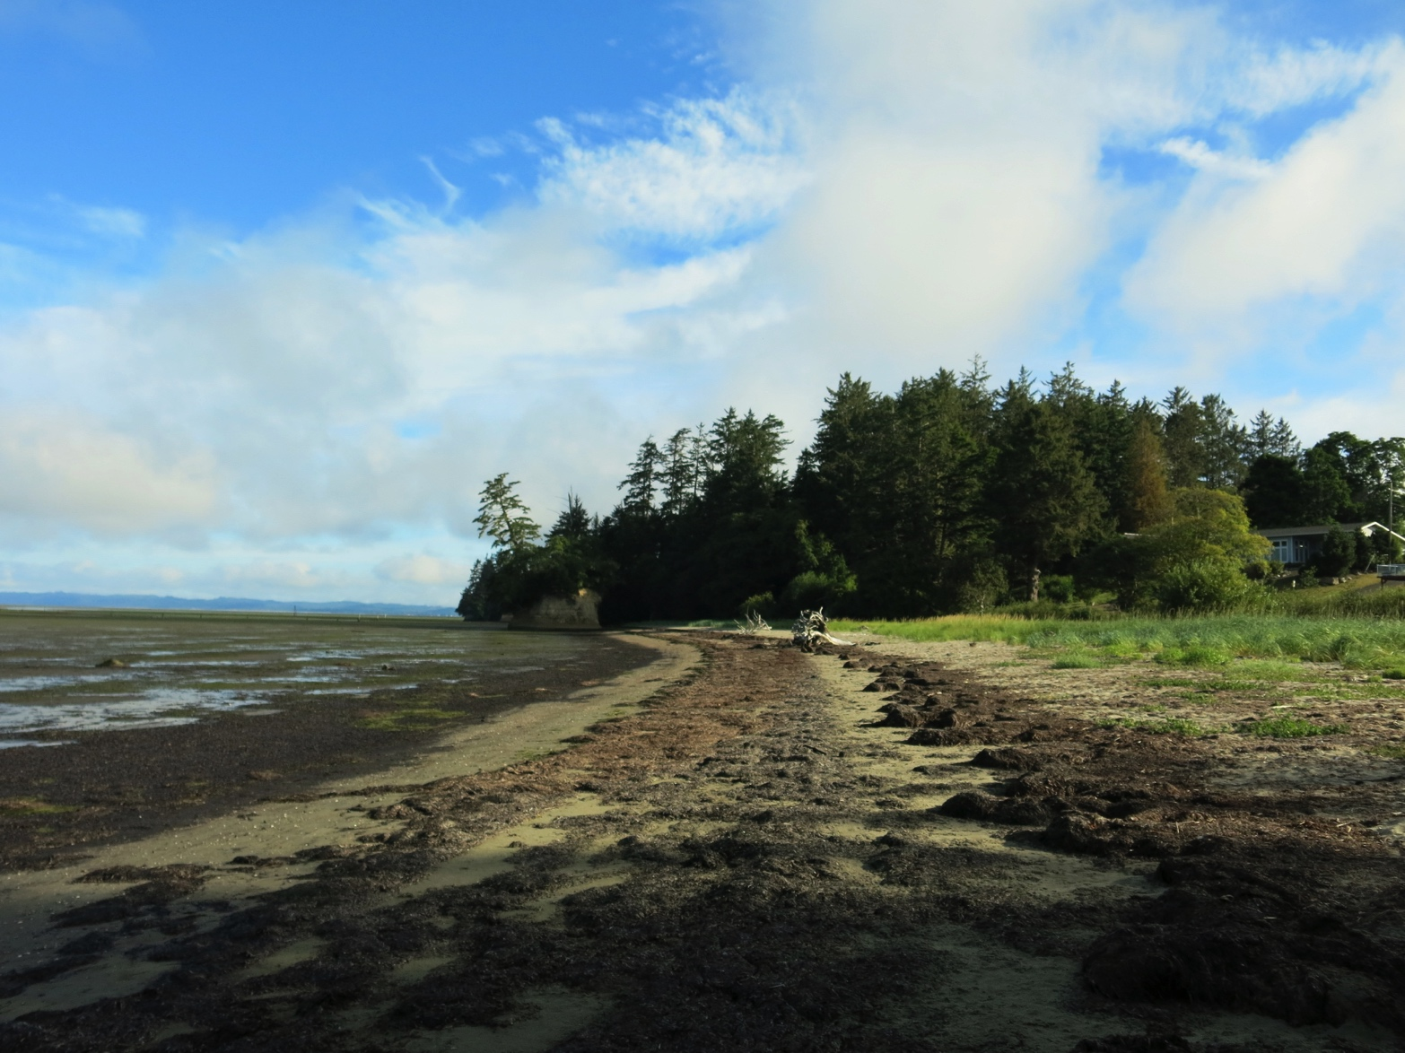
Next Steps
Cross sections using gravity modeling
Spot mapping to confirm geologic map/check cross sections
Sand Petrography
Process newest OSL samples
Photo by K. Stanton, 2019

