Slide 1


Historic Southern Cascadia Earthquakes and Sedimentological Evidence of NSAF Triggering
Goldfinger, C.
College of Earth, Ocean and Atmospheric Sciences, Oregon State University
Active Tectonics Group, Ocean Admin Bldg 104, Corvallis OR 97333
gold@coas.oregonstate.edu

Slide 2
Along strike correlation based on:
1)Chirp sub-bottom records
2) Synthetic seismogams
3) radiocarbon and age models
4) geophysical log correlation.
Goldfinger et al., 2013, Black, 2014

Slide 3
Southern Cascadia marine paleoseismic record:
The final frontier
Goldfinger et al., 2017
Marine Geology.

Slide 4
Noyo Canyon

Slide 5
Petrolia 1992
1992
(1972-2005)
CaliBomb
Several event overlie the likely AD 1700 event bed in Trinidad core M9907-36TC (and all other Soouthern Cascadia cores)
In additional cores further south, other historical beds may include the 1980 and 2005 event beds.
Likely 1906
1910
(1850-1950)
Likely 1700
1700
(1660-1750)
Oxcal Combine
M9907-36TC

Slide 6
Using OxCal, a depositional model, accounting for the sample thickness of 3 cm yields a calculated 2 sigma range of 1972-2005, median 1992.
This event is consistent with the 1992 Petrolia Mw 7.1 earthquake.
It is not consistent with the largest storm recorded within decades of this time in 1964.

Slide 7
The second event down, 1850-1950 AD, median 1910 AD.
Consistent with 1906?
This event is 110 km north of the MTJ, so perhaps at the fringe of triggering range.

Slide 8
In Noyo Canyon, there is something odd about the NSAF turbidite record
Probable
AD 1906
(1910
(1850-1950)
cal BP)
This very complex “inverted double decker” turbidite appears to be composed of two main units, the robust upper one has eroded into the lower.
And yet Noyo Canyon is a simple system, not suggestive of hydrodynamic complexity.
AD 1700
275
(170-410)
cal BP)
Unit 2
Penultimate NSAF ages
~1710 (1650-1780, Merced)
~1710 (1670-1740, Vedanta)
~1700 (1630-1780, Fort Ross
Unit 1
TN0909-14TC

Slide 9
M9907-49PC
1906
M9907-49PC ~1700 CE
TN0909-14TC ~ 1700 CE
M9907-49PC
~1700 CE
M9907-49PC
~700 BP
M9907-49TC
~ 700 BP
M9907-49PC
~ 1500 BP
TN0909-14TC
~ 2200 BP
TN0909-14TC
~ 2500 BP
M9907-49PC
~ 2500 BP
M9907-49PC
~ 2700 BP
M9907-49PC
~ 1500 BP
In the past 3000 years, 8 examples of this complex inverted doublet are present (of 12 event beds). In the prior 7000 years, only two exist (of 19 event beds, at bottom right).
TN0909-14JC ~2900 BP
TN0909-14JC
~ 3000 BP
TN0909-14TC
~ 4200 BP
TN0909-14JC
~ 8400 BP

Slide 10
The stacked turbidites are common in the late Holocene, 8 of 12 in the past 2700 years show this odd structure, but they are rare prior to that time out to ~ 12,000 BP. These events have significant radiocarbon overlap with the North Coast NSAF record at Vedanta, Lake Merced, and other land sites.
Possible explanations:
Complexity in NSAF events unrelated to Cascadia
Complex channel canyon system hydrodynamics
Mendocino or Gorda events stacked with NSAF or NSAF/Cascadia events.
Cascadia/NSAF stacking of events closely spaced in time.

Slide 11
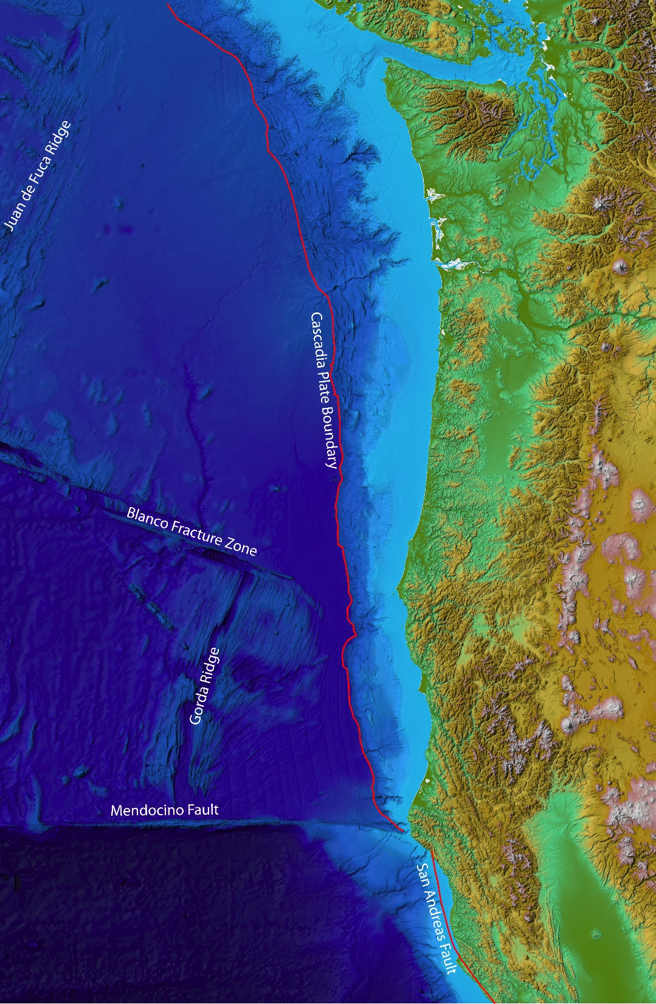
Visual Conclusions
Segmented events present from SW Washington to Cape Mendocino, the southern termination of Cascadia.
“Petrolia” 1992 like events can be recorded in this range, Segment “E”. These are not included currently in the Cascadia catalog
Northern San Andreas events likely present ~ 110 km north of the triple junction.
Southern Cascadia events likely present 110 km south of the triple junction.
Stacking of events may represent evidence for triggering and partial synchronization of the two faults post ~ 3000 BP as proposed by Goldfinger et al. (2008).

