Slide 1
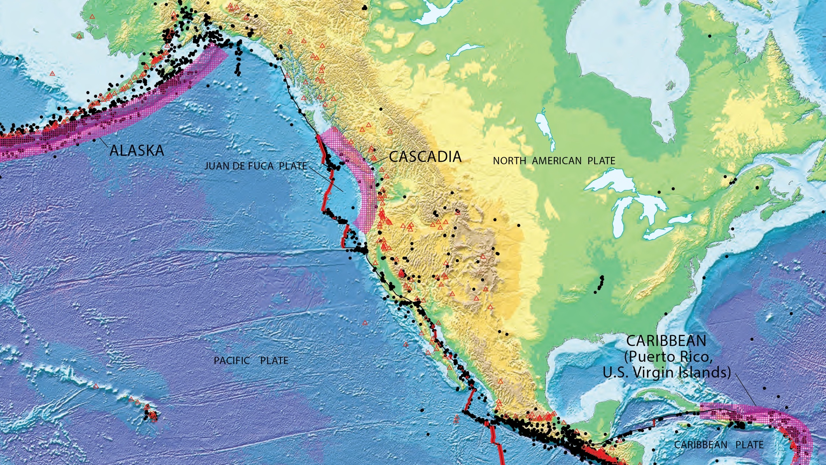
A 5-year CMHRP project focused on subduction zone marine geohazards
Pacific and Woods Hole Coastal and Marine Science Centers
Project leaders: Janet Watt and Nathan Miller
[USGS Subduction Zone Hazards Science Plan, Gomberg et al., 2017]
Notes:
Overall objective – Better understand spatial and temporal variability in upper plate morphology, structure, and Quaternary deformation history
A project of this scope relies heavily on collaborative science and leveraging resources across programs w/in the USGS and with other government agencies and with academic partners

Slide 2
A busy 2018-2019 field season!
Multibeam bathymetry, backscatter, water column, + magnetics
- near complete modern multibeam coverage of the upper slope (200 – 1600 m depth) – STILL NEED CONSISTENT MAP ALONG THE TRENCH!!
High-resolution sparker MCS & chirp sub-bottom imagery
- systematic high-resolution (vertical resolution = cm’s to m’s) imaging of entire US margin, plus detailed imagery at the head of Astoria canyon and throughout the southern Eel basin and adjacent shelf
Targeted geologic sampling (piston coring)
- stratigraphic / on-fault event chronologies, sediment properties, sediment pathways
2 new GPS-A seafloor geodetic sites to be deployed in Spring 2020
Lake Ozette / Lake Crescent marine paleoseismology
N
Astoria
Grays
Harbor
Newport
Cape
Blanco
Lake Ozette
Eureka
Eel
basin
Astoria canyon
& fan
Juan de Fuca
Plate
Gorda
Plate
Notes:
As a result – we have had an incredibly successful first 2 field seasons in Cascadia with more to come in the near future. Here I just want to run through our field accomplishments in 2018 and 2019…

Slide 3
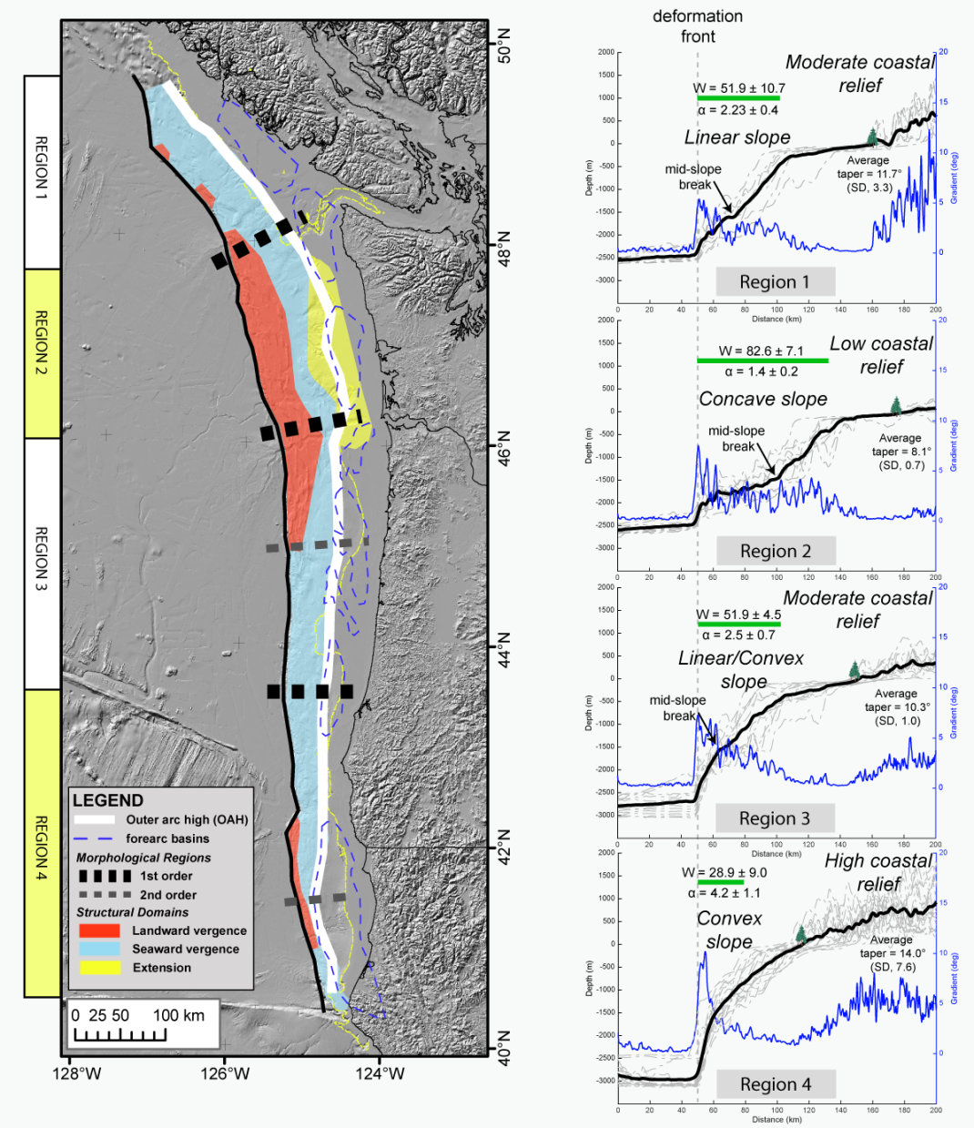
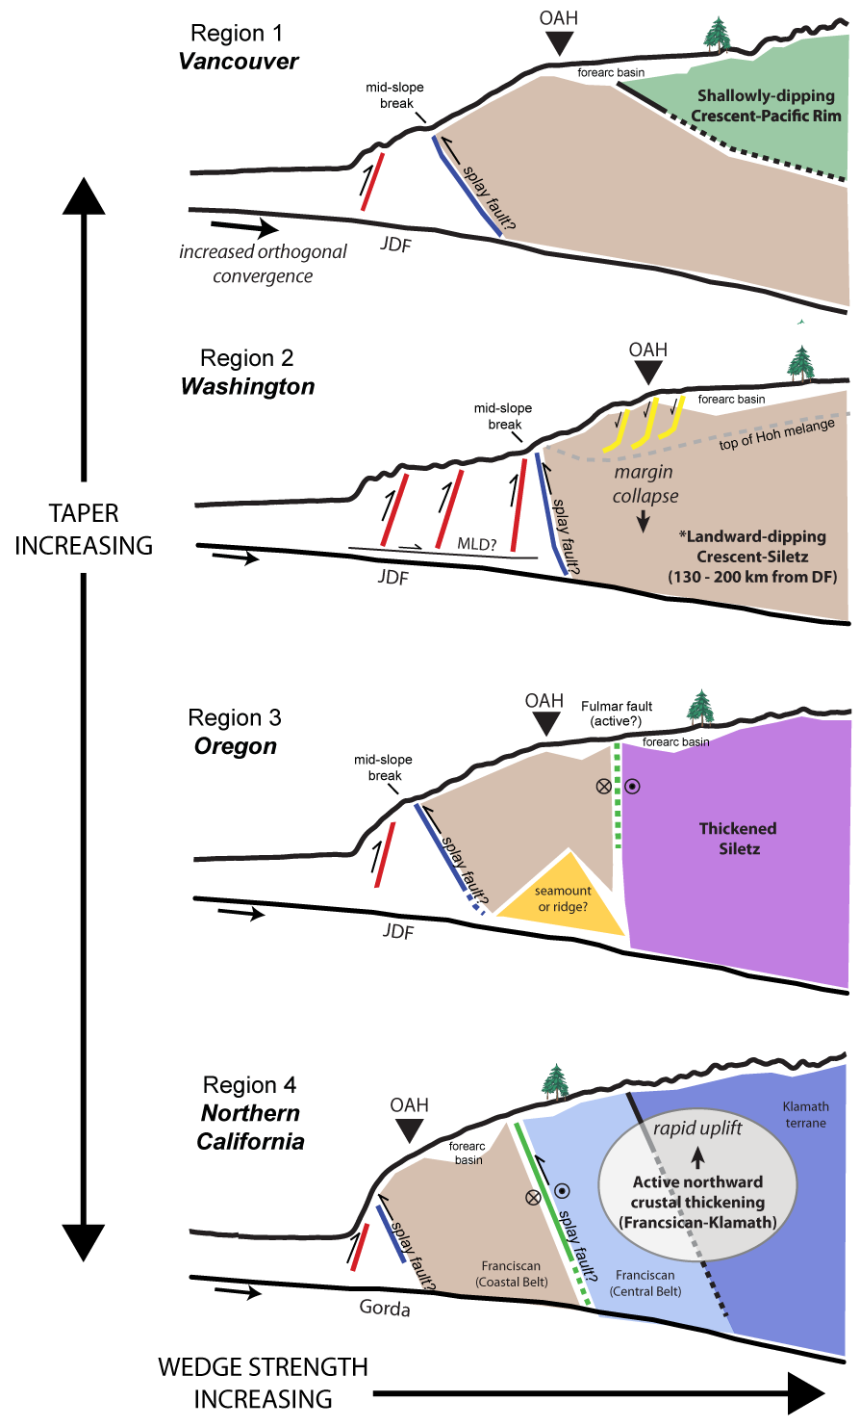
How does Cascadia’s upper plate respond to large megathrust earthquakes in space and time?
See our poster!!
(Watt & Brothers, in revision @ Geosphere)

