Slide 1
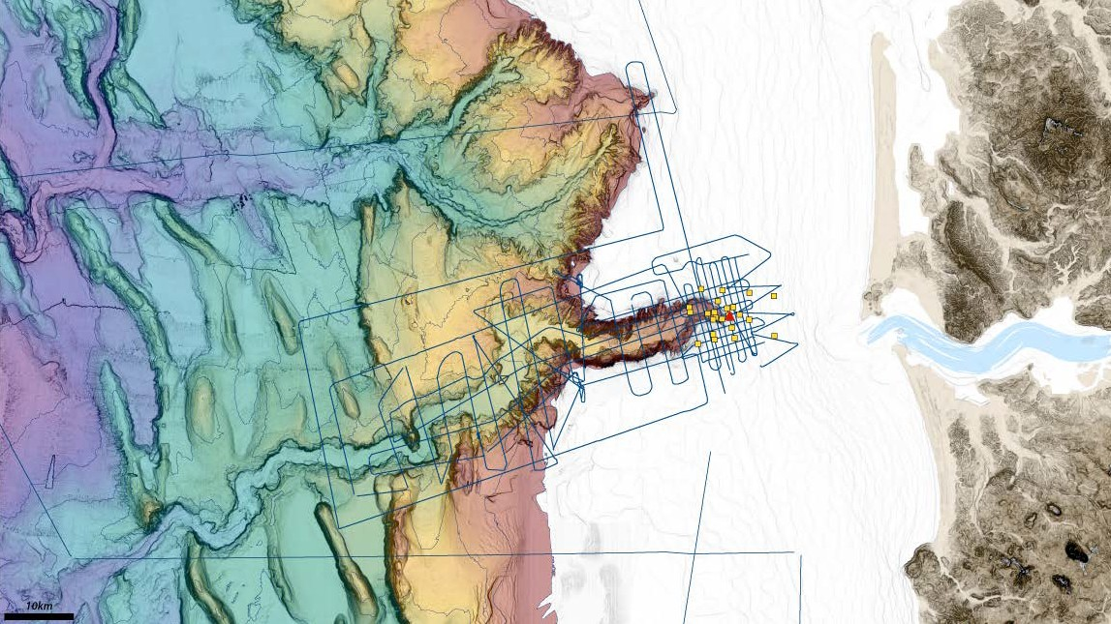



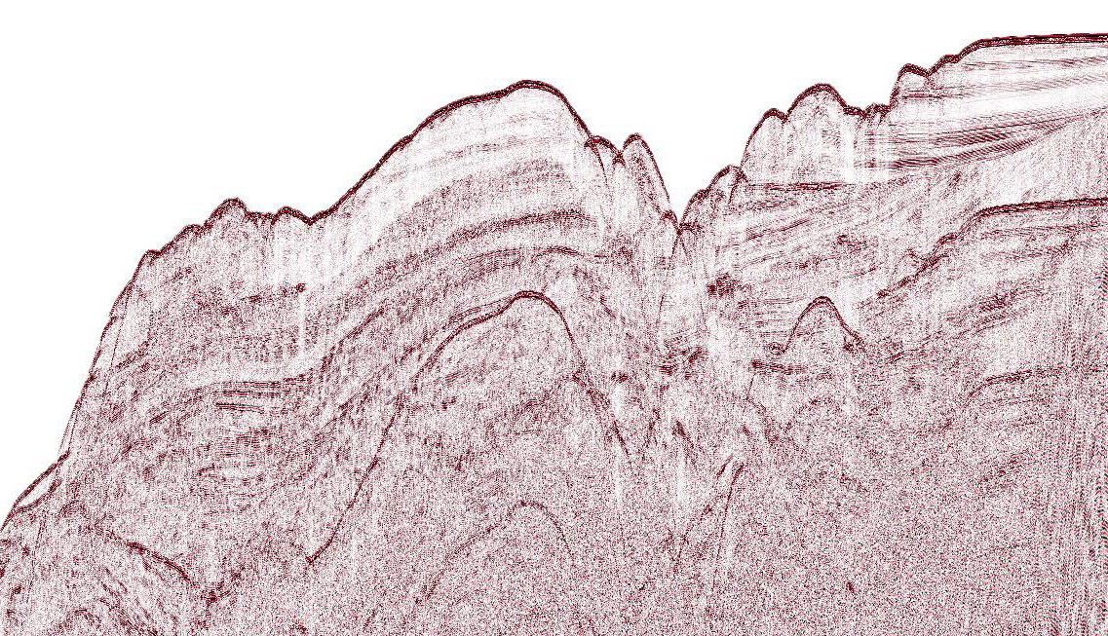
GOAL: better constrain the processes that lead to sediment gravity flows and turbidite deposits, in the context of earthquake recurrence
Sedimentary Processes of Astoria Canyon
Willapa Canyon
In-situ instrument deployment
@ the canyon head to investigate:
Mechanisms and fluxes, as well as remobilization of sediment on the upper slope
Lead PIs: Jenna Hill (USGS) & Andrea Ogston (UW)
Guide Canyon
Geophysical survey
across the outer shelf and upper slope: Examine sediment thickness, storage locations, and transport pathways
AGU 2019 Presentation: Submarine Canyons, Sediment Storage, and Mass Wasting in the Northern Cascadia Subduction Zone Friday: Marine Geohazards Session
Columbia River
Astoria Canyon
Sparker MCS

Slide 2
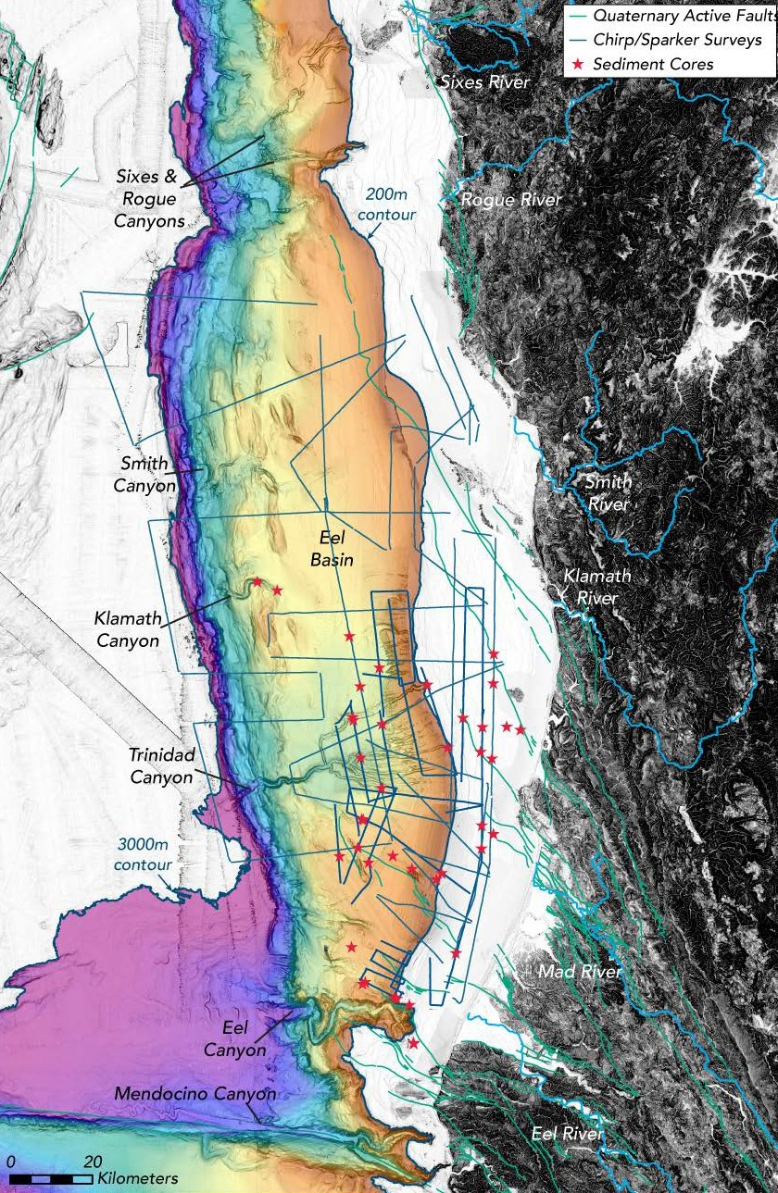
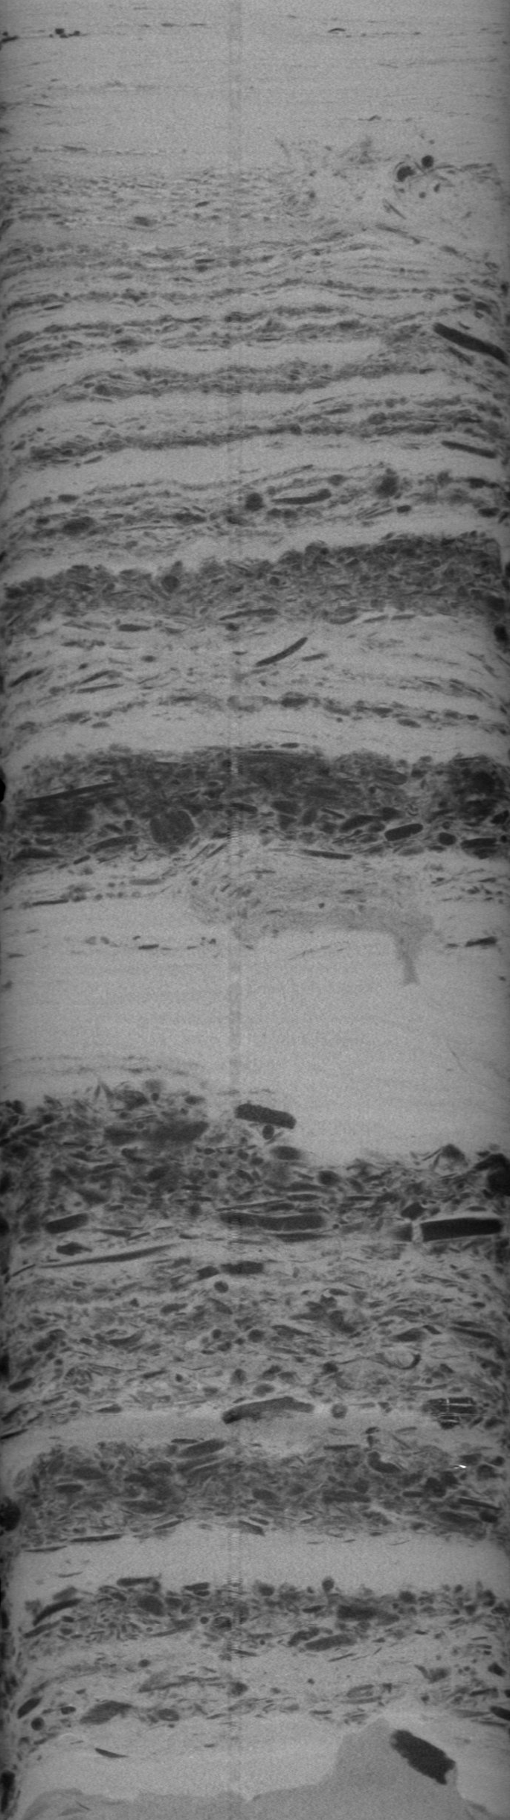

Southern Cascadia 2018 & 2019 Field Work:
﹅ >2100 km of Chirp & Sparker MCS surveys
★ ~40 Sediment cores (3-7m long)
Forthcoming GSL Special Volume Paper:
Hill et al., (2020) Submarine canyons, slope failures, and mass transport processes in southern Cascadia
KEY FINDING:
Southern Cascadia canyons (except Eel) are not delivering sediment to deep sea in the Holocene
Turbidites here are NOT sourced from canyon-confined sediment flows, instead more likely derived from disintegration of outer wedge sediment
This may explain source of mud turbidites & suggests we need to reexamination other portions of the margin (e.g., Oregon) for potential mud turbidite EQ recurrence records.

Slide 3
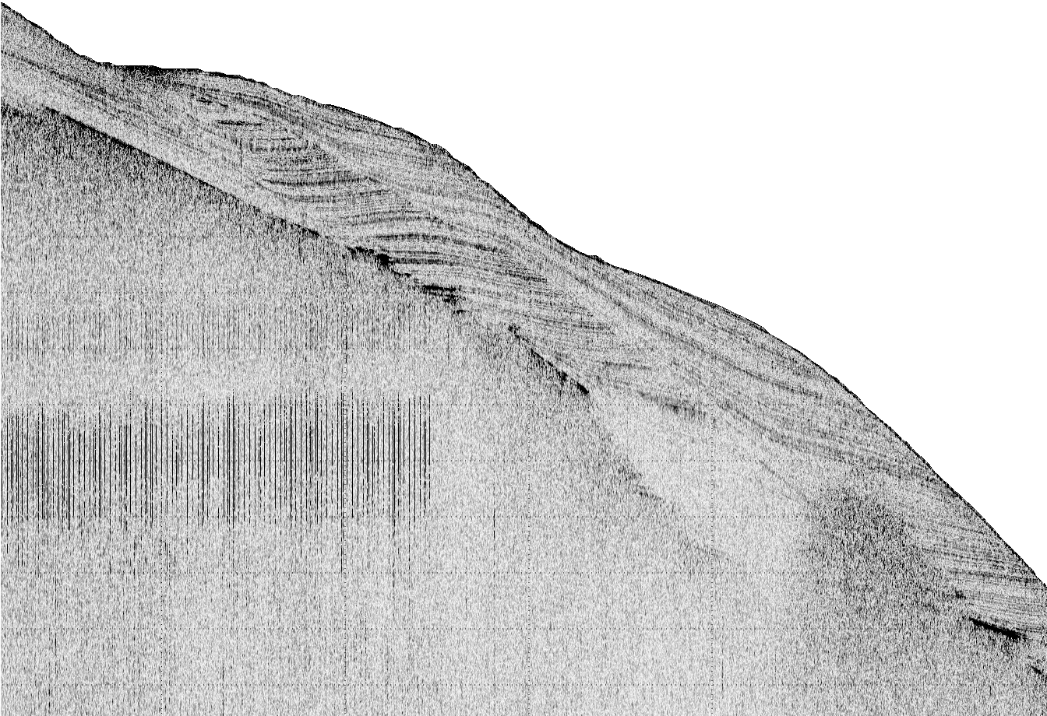

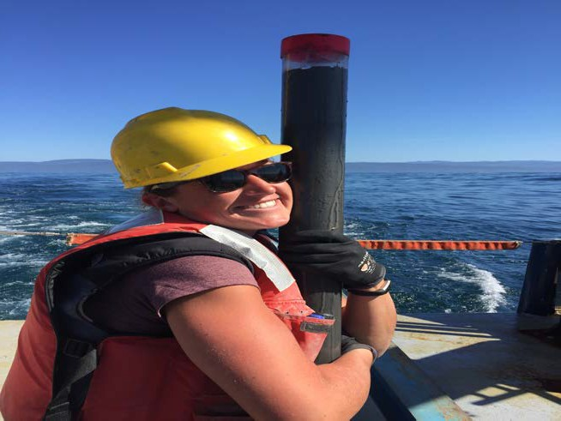
Southern Cascadia 2018 & 2019 Field Work:
﹅ >2100 km of Chirp & Sparker MCS surveys
★ ~40 Sediment cores (3-7m long)
Sediment waves in Chirp data
CT scan of a sediment core with woody debris layers
(hyperpyncal flows?) on the slope of the Eel Plateau
Welcome Nora Nieminski,
Cascadia Geohazards Mendenhall Fellow
With expertise in source to sink sedimentary geology onshore and offshore, Nora will be applying her skills to provide context for interpreting offshore earthquake recurrence record

