Slide 1
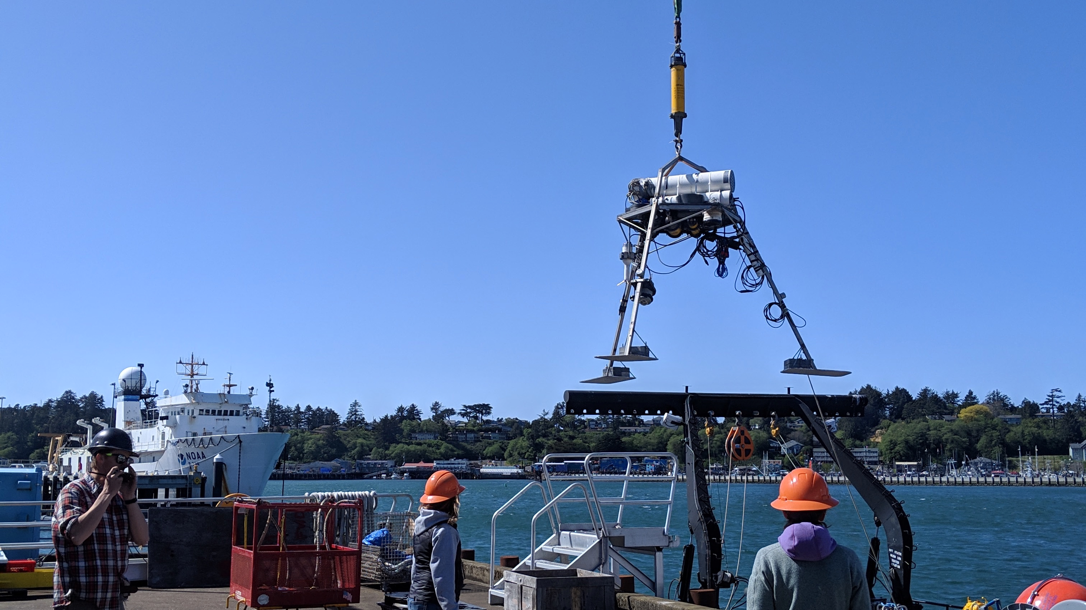
ASTORIA CANYON: MODERN SEDIMENT FLUX
Identifying drivers of Cascadia Margin sediment-gravity flows
Andrea Ogston and Evan Lahr,
UW Sediment Dynamics Group
School of Oceanography

Slide 2
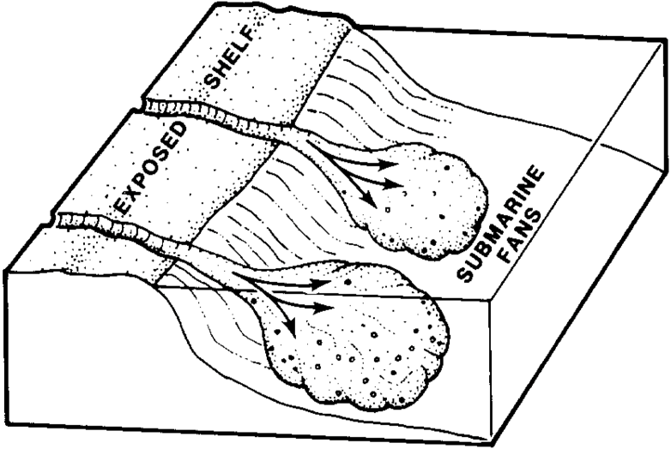
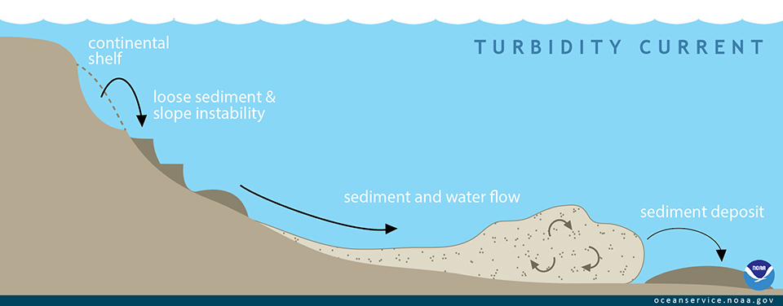
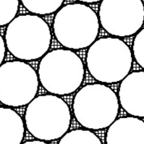
Triggers and Products of
SEDIMENT GRAVITY FLOWS
Seismicity
Pore pressure
Slope failure
Wave-orbital resuspension
River Input

Slide 3
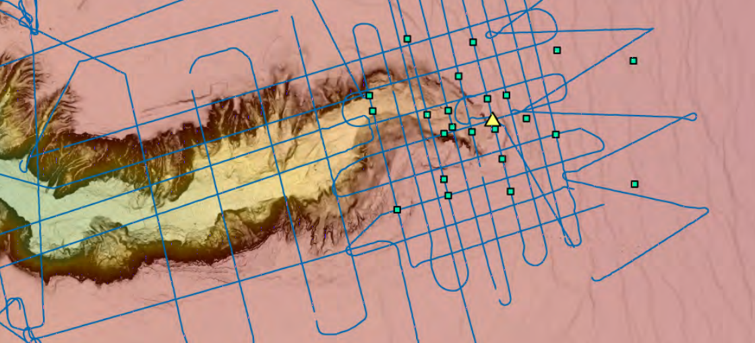
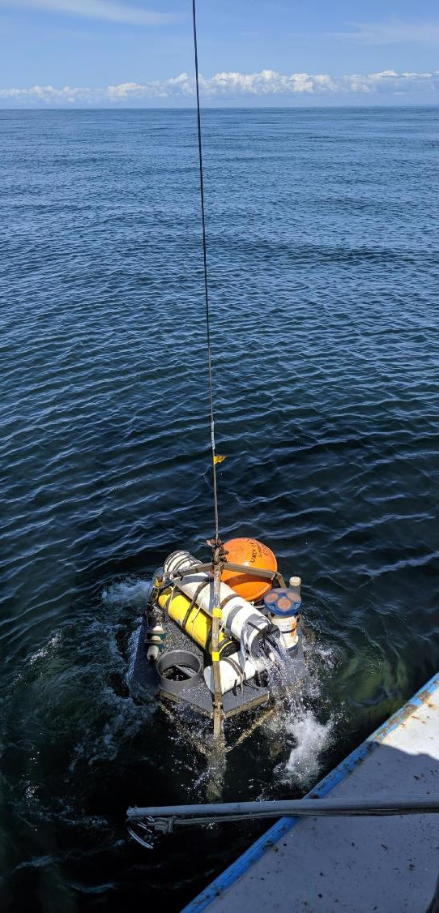
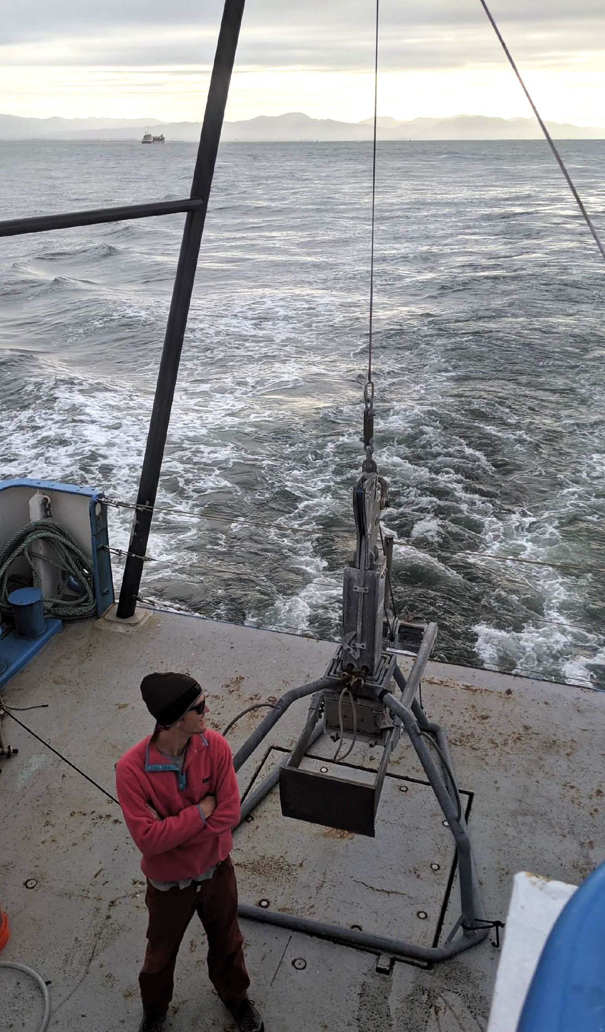
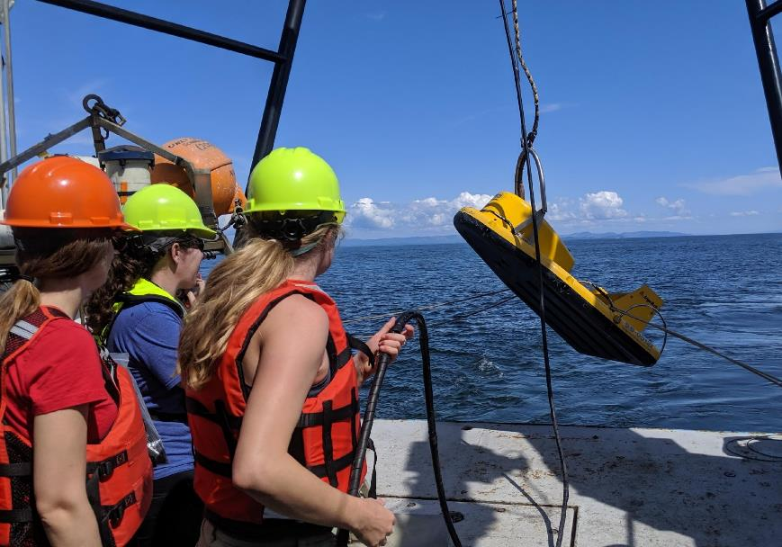
METHODS
Water column processes
Depositional history
Jenna Hill, USGS
SEDIMENT
CORES
BENTHIC TRIPOD
MONITORING
SEISMIC
PROFILING (USGS)

Slide 4
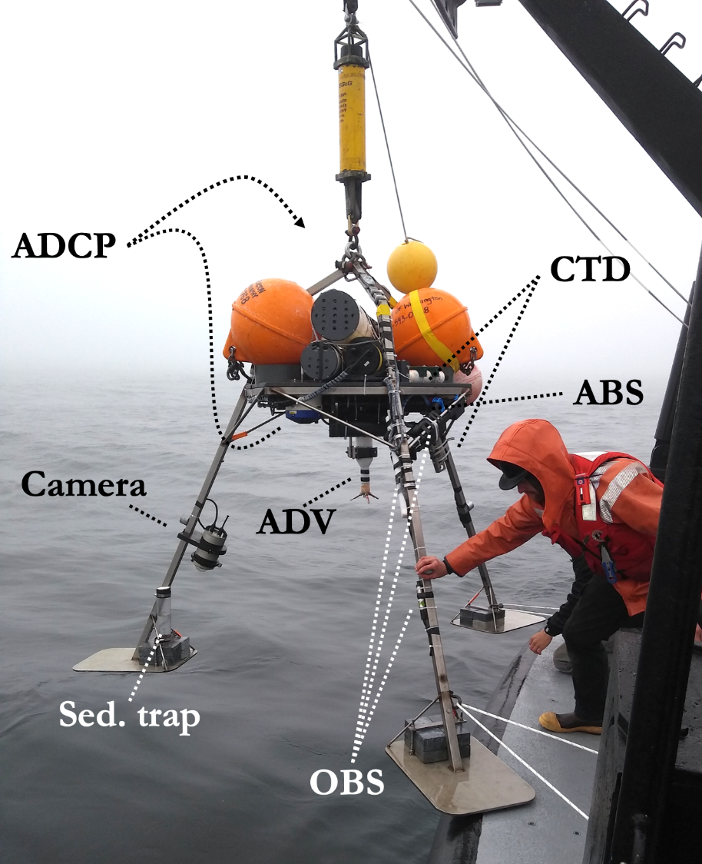
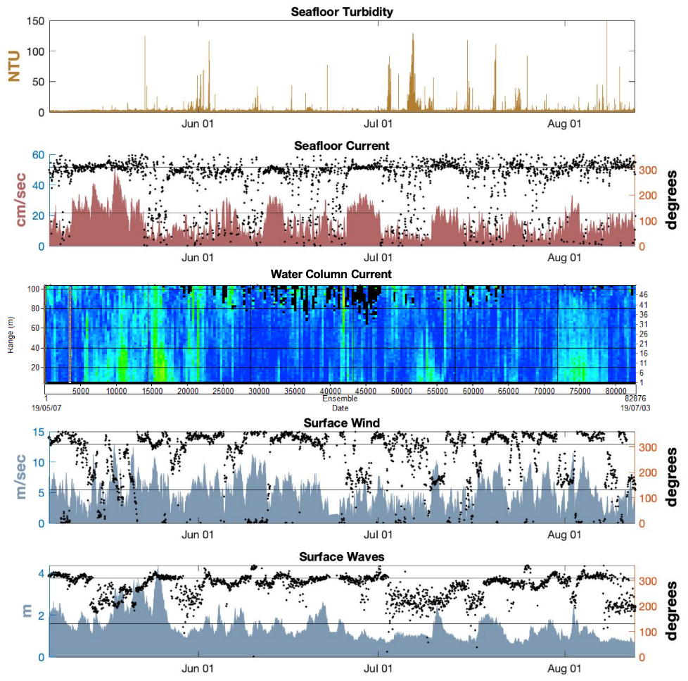
TRIPOD DATA

Slide 5
TRIPOD DATA
PRELIMINARY RESULTS
Down-canyon sediment transport events did occur in summer 2019 (generally a low-energy period).
Sands were incorporated in transport events, a key component of downcanyon turbidites.
In addition to surface gravity waves (big storms), internal bores in canyon are capable of significant resuspension.

Slide 6
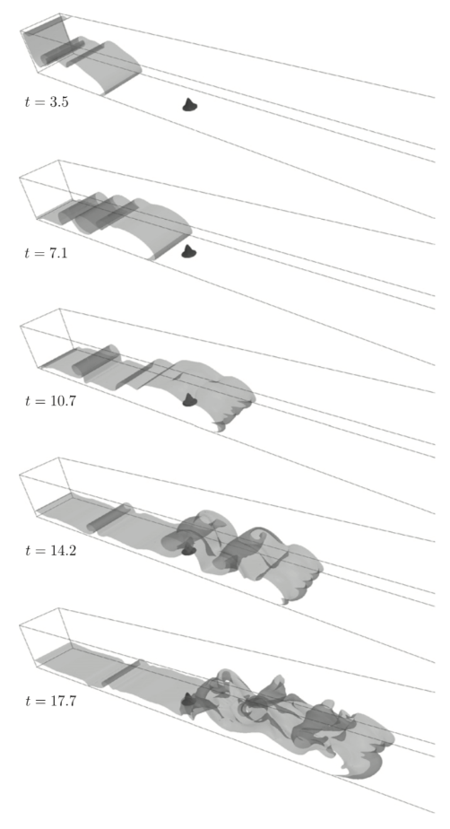
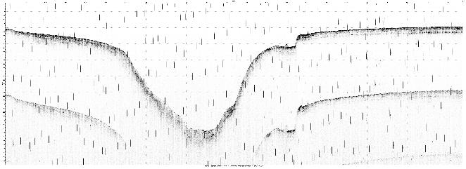
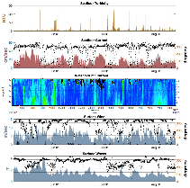
Goal: Gravity Current Modeling
to evaluate possible range of downslope flows and deposits
FIXED PARAMETERS
INITIAL
CONDITIONS
e.g., TURBINS NUMERICAL MODEL
(Nasr-Azadani, M.M., Meiburg, E., 2011)

